Slide 1
Light Transport Simulation with Vertex Connection and Merging
Iliyan Georgiev
Saarland University
Jaroslav Křivánek
Charles University in Prague
Tomáš Davidovič
Saarland University
Philipp Slusallek
Saarland University
published in ACM Transactions on Graphics, 2012

Slide 2
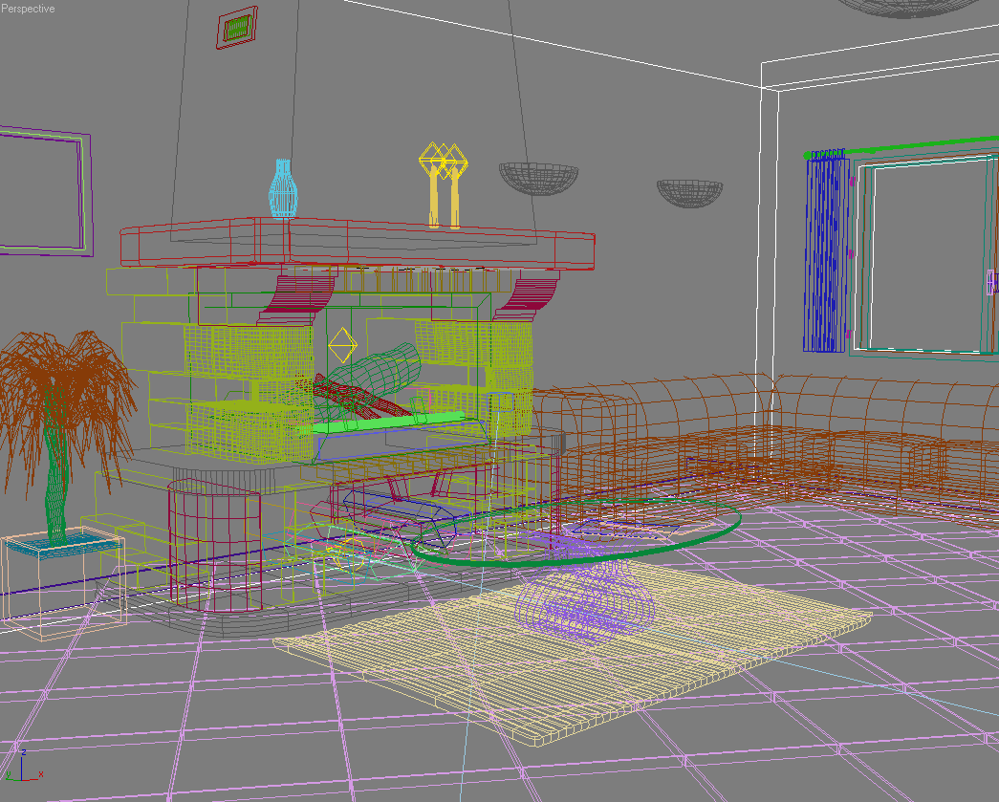
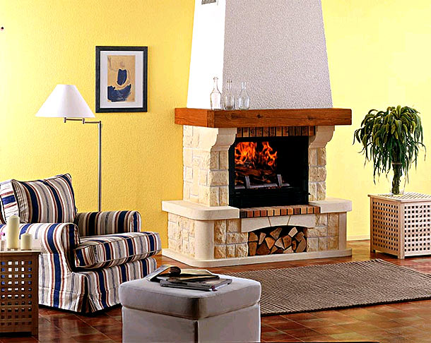
Image synthesis (Rendering)
Scene description
Image
Notes:
In this work, we’re concerned with physically-based image synthesis, or image rendering, where given a model of some environment, we want to create a “virtual snapshot” of that environment.

Slide 3
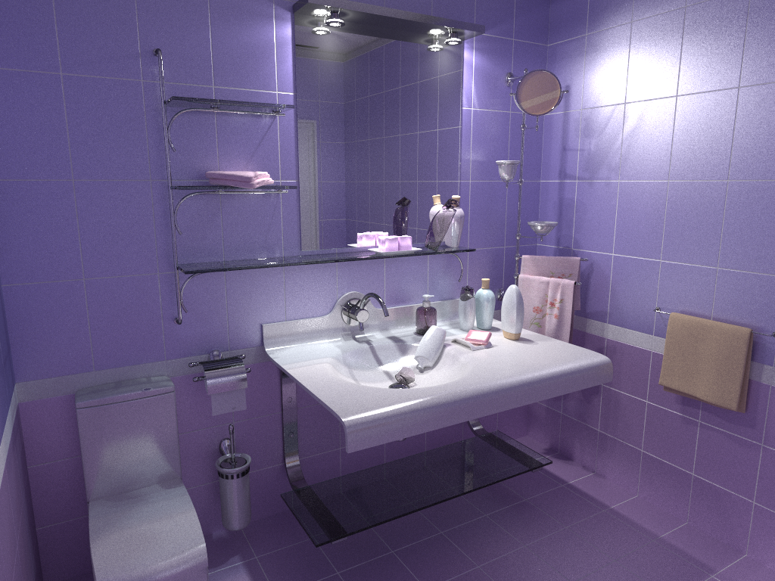
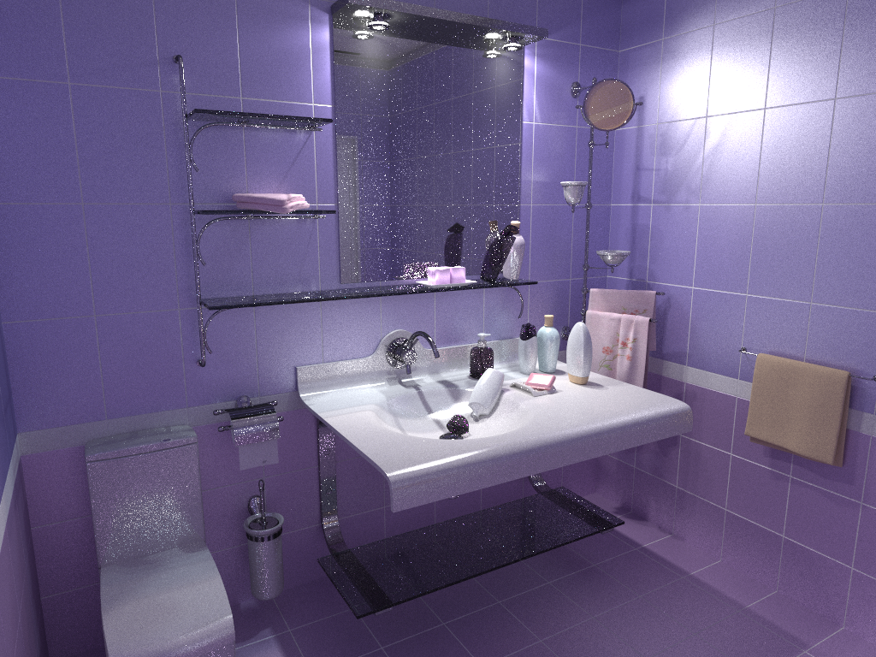
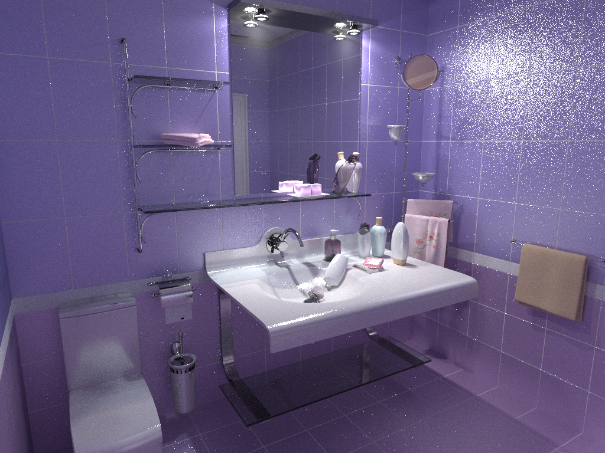
Teaser
noise (high variance)
VCM
proposed method
previous state-of-the-art
Notes:
Here’s one example of an image created by our method and by the previous state-of-the-art.
As you can see in the two images on the right, the images produces with previous methods suffer from image noise, which is a manifestation of the high variance of the estimators used to generate these images.
Our method – Vertex Connection and Merging, or VCM - is substantially more robust and yields images where the noise is greatly reduced.

Slide 4
Image Synthesis (Rendering)
Notes:
I will start with a brief intro to image synthesis.

Slide 5
Image synthesis (Rendering)
Scene description
Image
Notes:
As I said, we want to create a virtual snapshot of some environment, and we want this snapshot to be a close approximation of what the environment would look like in reality.

Slide 6
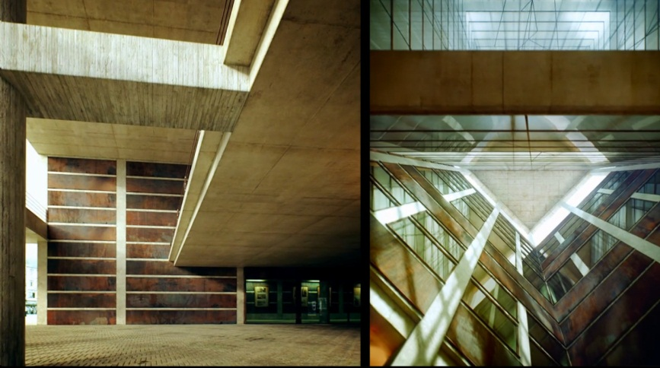
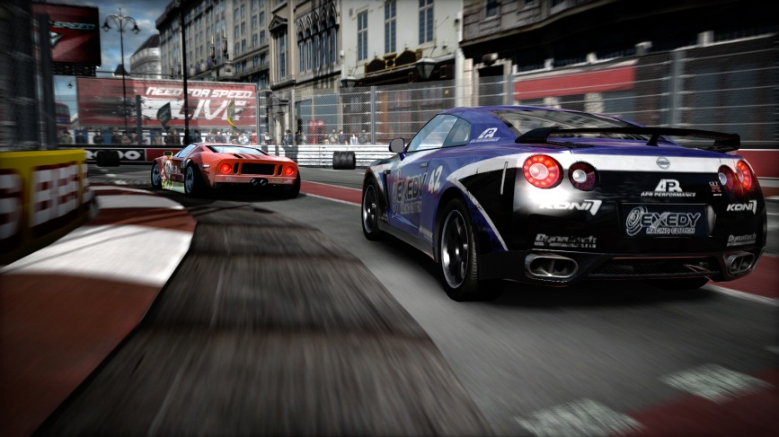
Light transport simulation
Architecture
© Alex Roman
Film / SFX
© 20th Century Fox
Games
Ad-hoc solutions
© Electronic Arts
Notes:
How we achieve this goal mainly depends on the purpose of the generated image.
In architectural visualization, product design, and recently also special effects for movies, we often employ accurate simulation of light transport.

Slide 7
Image generation
Pixel value = radiance measurement
Light transport simulation = RTE solution
Radiance L (x, ω)
7
Notes:
The problem of rendering an image is formalized as that of taking a large number of measurements of radiance, or phase space angular flux.
Each image pixel corresponds to the measurement of radiance incident at the image sensor corresponding to that pixel.
Taking this measurement involves light transport simulation – which is one instance of radiative transfer.

Slide 8
Radiative transfer flavor
One-speed, steady-state
Environment = surfaces in vacuum
Scattering and absorption only on surfaces
Boundary condition = surface reflection / transmission
=> Rendering Equation
[Kajiya 1986]
Notes:
The particular flavor of radiative transfer that we consider stems from our application: rendering of synthetic images.
We consider photon transport and assume that the energy of individual photons stays constant throughout their lifespan, so we have gray, or one-speed radiative transfer.
We assume the light propagation is instantaneous, so we want to find the steady-state, or stationary distribution of light.
Our environment consists of surfaces embedded in vacuum, so any scattering and absorption only happens on surfaces.
The boundary condition encodes the interaction of light with surfaces – reflection and transmission.
Under these assumptions, our problems is fully described by the so called Rendering equation, which is, similarly to the full RTE, a Fredholm integral equation of the second kind.

Slide 9
Rendering Equation – Kajiya 1986
L(r(x,ω_{i}), −ω_{i})
ω_{o}
ω_{i}
x
9
Notes:
The Rendering equation gives the outgoing radiance L(x, ω_{o}) from a point x in the direction ω_{o} as a sum of the source term, that is the self-emitted radiance L_{e}(x, ω_{o}), and the reflected radiance L_{e}(x, ω_{o}) given by the integral on the 2nd line of the equation.
The reflected radiance is given by the integral over the upper hemisphere of the incident radiance from each direction, weighted by the bidirectional reflectance distribution function (BRDF).
Because radiance is constant along straight lines, the radiance incident at x from some direction is equal to outgoing radiance from the point visible from x along that direction, denoted r(x,wi).
So the rendering equation has the unknown radiance L on both sides, the self-emitted radiance L_{e} plays the role of the source term, so in fact the Rendering equation has a very similar form to the general RTE.

Slide 10
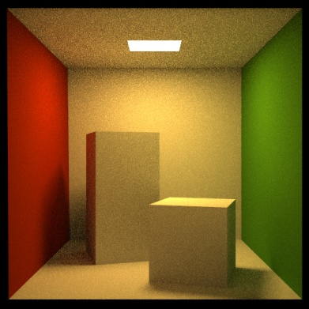
Rendering Equation – Kajiya 1986
L: Equilibrium radiance
L_{e}: Emitted radiance
T: Transport & scattering operator
Notes:
Here’s the Rendering equation in the operator form that clearly reveals that its similarity to the general radiative transfer equation in the integral form.
The equilibrium radiance function is given by the emitted radiance function plus the equilibrium radiance “bounced” in the scene.

Slide 11
Rendering Equation – Kajiya 1986
Solution: Neumann series, Monte Carlo methods
Notes:
As usual, the solution is given by the Neumann series, and is numerically evaluated by Monte Carlo methods.

Slide 12
Issue addressed by our work
Lack of robustness
None of the previous algorithms works well for all scenes
Our objective
Acceptable error in a wide range of environments
Notes:
A number of light transport algorithms have been developed in graphics to solve the rendering equation, however, the issues is - none of them really works for all practical scenes.
In other words, these solutions are not robust enough.
This is due to the extremely wide variability of the properties that we need to simulate: we shiny objects, diffuse objects, point sources, large extended source etc. This wide range of possible inputs makes light transport simulation for image synthesis a relatively hard problem, compared to other transport problems.
We address this very issue – so our goal is to develop a light transport algorithm that produces acceptable error in a wide range of environments.

Slide 13
Approach
Bidirectional path tracing
+
Photon mapping
(Density estimation)
previous state-of-the-art
- Path integral framework
- Multiple importance sampling [Veach and Guibas 1995, 1997]
Vertex Connection and Merging (VCM)
new method
Notes:
To achieve this goal, we take advantage of the complementary advantages of two existing algorithms – bidirectional path tracing and photon mapping – and combine them into a unified robust solution.
Two invaluable tools for achieving this goal – both due to Eric Veach and Leo Guibas are: the formulation of light transport as an integral over light paths, and Multiple Importance Sampling – an awesome technique for combining multiple estimators into one while minimizing variance.

Slide 14
Outline
Multiple importance sampling
Path integral formulation
Bidirectional path tracing
Photon mapping
Vertex Connection and Merging
preliminaries
our
contribution
Notes:
And because these two tools are so important, and have potential applications well outside image synthesis, I will start with them.
Then I’ll briefly describe the two algorithms that we combine, that is bidirectional path tracing and photon mapping.
And with a bit of luck, I should be able to say a couple of words about our actual contribution – the vertex connection and merging algorithm.

Slide 15
Multiple Importance Sampling

Slide 16
Multiple Importance Sampling (MIS)
[Veach & Guibas, 95]
Combined
estimator:
f(x)
p_{a}(x)
p_{b}(x)
x_{a}
Notes:
Consider a complex multimodal integrand f(x) that we want to numerically integrate using a MC method with importance sampling.
Unfortunately, we do not have a PDF that would mimic the integrand in the entire domain.
Instead, we can draw the sample from two different PDFs, p_{a} and p_{b} each of which is a good match for the integrand under different conditions – i.e. in different part of the domain.
However, the estimators corresponding to these two PDFs have extremely high variance – shown on the slide.
We can use Multiple Importance Sampling (MIS) to combine the sampling techniques corresponding to the two PDFs into a single, robust, combined technique.
The MIS procedure is extremely simple: it randomly picks one distribution to sample from (p_{a} or p_{b} , say with fifty-fifty chance) and then takes the sample from the selected distribution.
This essentially corresponds to sampling from a weighted average of the two distributions, which is reflected in the form of the estimator, shown on the slide.
This estimator is really powerful at suppressing outlier samples such as those that you would obtain by picking x_from the tail of p_{a}, where f(x) might still be large.
Without having p_{b} at our disposal, we would be dividing the large f(x) by the small p_{a} (x), producing an outlier.
However, the combined technique has a much higher chance of producing this particular x (because it can sample it also from p_{b}), so the combined estimator divides f(x) by [p_{a} (x) + p_{b}(x)] / 2, which yields a much more reasonable sample value.
I want to note that what I’m showing here is called the “balance heuristic” and is a part of a wider theory on weighted combinations of estimators proposed by Veach and Guibas.

Slide 17
MIS Results
[Veach & Guibas, 95]
High variance
1/r² singularity!
Low variance everywhere
Singularity GONE!!!
High variance
A) Random walk
B) Next-event estimation
MIS: A + B
Notes:
Here’s one example of a result achieved by Multiple importance sampling.
The scene consists of two polygons, the left one emits light and the floor receives it.
Ignoring multiple inter-reflections of light, the radiance incident at a point on the floor is given by the integral over the area source.
In the case A on the left, the samples are proposed on the light source by picking a random direction from the floor and shooting a ray. This strategy yields high variance for point far away from the source simply because the chance of hitting the light gets low.
In the case B in the middle, on the other hand, we use uniform distribution over the light source to propose the samples. This correspond to a next-event estimator in a random walk. This strategy is really great for points far away from the light source but the closer we get the higher the variance. In fact, as we approach the source, the estimator’s variance grows to infinity, because of the 1/r^2 term in the estimator – exactly the same problem as in the next-event estimator to a point detector.
In the third case, we apply MIS: we pick randomly one of the two strategies, and we divide each sample by the “average” value of the two PDFs. And magic happens: the combined solution weights up the more efficient of the two strategies, and even manages to get rid of the singularity!
This is because as we approach the light source, the strategy B is weighted down at the rate of r^2, which cancels the singularity.
This techniques can have immediate application to infinite-variance estimators encountered in neutron transport problems, such as the next-event estimators for point detector tallies, or for surface crossing tallies.

Slide 18
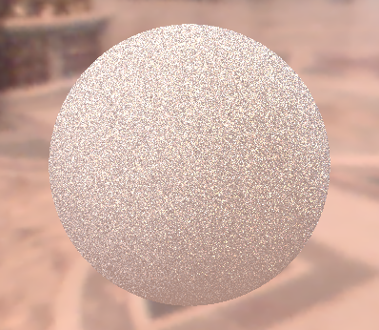
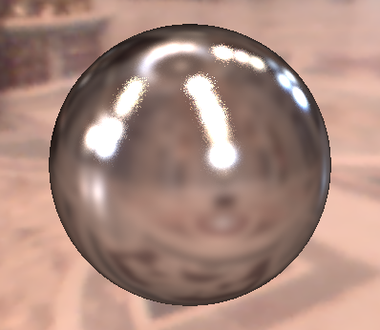
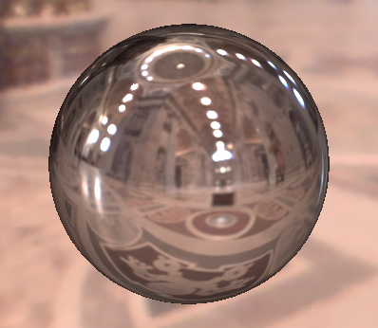
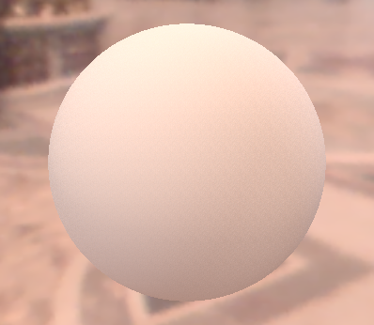
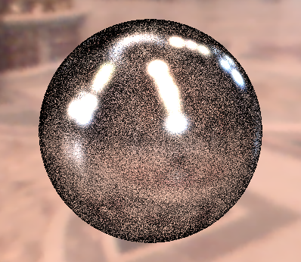
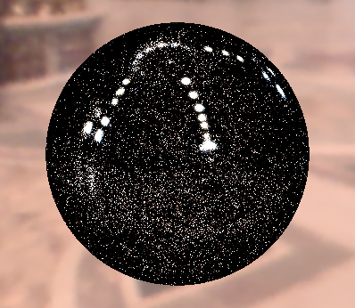
Sampling strategies
BRDF IS
600 samples
EM IS
600 samples
MIS
300 + 300 samples
surface smoothness

Slide 19
Path Integral formulation of light transport

Slide 20
Path integral formulation
all paths
measurement
(j-th pixel value)
measurement contribution function
[Veach and Guibas 1995]
[Veach 1997]
Notes:
The path integral formulation is an extremely powerful tool because it gives the measurement as simple integral – instead of a solution of an integral equation – which allows to argue about efficiency of different algorithms in terms of the probability density of sampling some types of paths, and even more importantly, it allows to combine different path sampling techniques through Multiple Importance Sampling.
The path integral formulation of light transport formalizes the idea that the response of the detector - camera in our case - is due to all the light particles – travelling over all possible paths – that hit the detector.
The detector response is written as an integral over all light transport paths of all lengths in the scene.
The integrand of this integral is the so called “measurement contribution function”.
The integral encapsulates the solution of the Rendering equation given by the Neumann series. It encapsulates a sum over all possible path lengths, and for each path length, it is an integral over all possible position of the path vertices.

Slide 21
Measurement contribution function
emitted
radiance
path
throughput
detector sensitivity (“emitted importance”)
Notes:
A light transport path is a polyline with vertices corresponding to light scattering on surfaces.
The measurement contribution function f(x) for a path x of length k is defined as the emitted radiance L_{e} at the first vertex, times the sensitivity (or “emitted importance”) W_{e} at the last vertex, times the path throughput T(x).
The throughput is defined as the product of the geometric G and scattering terms associated with the path edges and interior vertices, respectively.
The geometry term is given by the product of cosine foreshortening factors and more importantly, it contains the inverse squared falloff.

Slide 22
MC evaluation of the path integral
Path integral
MC estimator
Sample path from some distribution with PDF
Evaluate the probability density
Evaluate the integrand
?
?
✓
Notes:
Thanks to the formal simplicity of the path integral formulation, applying Monte Carlo integration is really a more-or-less mechanical process.
For each pixel, we need to repeatedly evaluate the estimator shown at the top right of the slide and average the estimates.
This involves the following three steps:
First, we need to draw (or sample, or generate – all are synonyms) a random light transport path x in the scene (connecting a light source to the camera).
Then we need to evaluate the probability density of this path, and the contribution function.
Finally, we simply evaluate the formula at the top of the slide.
Evaluating the path contribution function is simple – we have an analytic formula for this that takes a path and returns a number – the path contribution.
However, we have not discussed so far how paths can be sampled and how the PDF of the resulting path can be evaluated.

Slide 23
Path sampling
Algorithms = different path sampling techniques
Path tracing (adjoint walk)
Notes:
For example, path tracing – which is a computer graphics jargon for an adjoint random walk – samples paths by starting at the camera sensor.

Slide 24
Path sampling
Algorithms = different path sampling techniques
Light tracing (forward walk)
Notes:
Light tracing (forward walk), on the other hand, starts paths at the light sources.

Slide 25
Path sampling
Algorithms = different path sampling techniques
Bidirectional path tracing (forward + adjoint)
Notes:
Or we can combine the two ideas and generate a piece of the path starting from the camera, another piece starting from the light source, and connect the end-vertices of these sub-paths.

Slide 26
Probability density of a path
path PDF
joint PDF of path vertices
Notes:
Now that we know how to construct a path, we need to evaluate its PDF so that we can plug it into the MC estimator.
In general the PDF of a light path is simply the joint PDF of the path vertices.
That is to say, the PDF that the first vertex is where it is and the second vertex is where it is, etc.

Slide 27
Probability density of a path
path PDF
joint PDF of path vertices

Slide 28
Probability density of a path
path PDF
joint PDF of path vertices
product
of (conditional)
vertex PDFs
Path tracing example: (adjoint walk, next-event)
Notes:
The joint path PDF is given by the product of the conditional vertex PDF.
To see what this means, let us again take the example of path tracing (adjoint walk with next event estimation), where we build a path starting from the camera.
Vertex x₃ comes from an a priori distribution p(x₃) over the camera lens (usually uniform; or the delta distribution for a pinhole camera).
Vertex x₂ is sampled by generating a random direction from x₃ and shooting a ray. This induces a PDF for x₂, p(x₂ | x₃), which is in fact conditional on vertex x₃.
The same thing holds for vertex x₁, which is sampled by shooting a ray in a random direction from x₂.
Finally, vertex x₀ on the light source might be sampled from an uniform distribution over the light source area with pdf p(x₀), independently of the other path vertices.
The full joint PDF is given by the product of all these individual terms.

Slide 29
Path integral framework summary
Algorithms
different path sampling techniques
different path PDF
Notes:
From the point of view of the path integral framework, different light transport algorithms (based on Monte Carlo sampling) only differ by the path sampling techniques employed.
The different sampling techniques imply different path PDF and therefore different relative efficiency for specific lighting effects.

Slide 30
“Path integral” – A historical remark
This work [Veach and Guibas 1995], [Veach 1997]
Easily derived form the rendering equation [Veach 1997]
Feynman path integral formulation of quantum mechanics [Feynman and Hibbs 65]
Transport theory [Tessendorf 87, …]
Image synthesis [Premože et al. 03, 04]
Notes:
The term “path integral formulation” as presented here is due to Veach and Guibas, and can be derived by a fairly straightforward manipulation of the Neumann series solution of the rendering equation.
More widely known is Feynman’s path integral formulation, used to solve problems in quantum mechanics. In this formulation the transport paths are general curves, so the path space that we considered here (polylines) is just a small sub-space (of measure zero) of the path space in Feynman’s formulation.
Tessendorf used Feynman’s path integral formulation to derive the solution of light transport in strongly forward scattering media.
This solution has been used for rendering by Premože and colleagues.

Slide 31
Bidirectional Path Tracing

Slide 32
Single path – Many possible techniques
Notes:
Let us now formulate the bidirectional path tracing algorithm.
As I already said, a single light transport path can be built in many different ways. Each of these so called sampling techniques is effective for sampling different lighting effects.

Slide 33
All possible bidirectional techniques
vertex on a light sub-path
vertex on en eye subpath

Adjoint walk

Adjoint walk +
next event est.



Fwd walk +
Next event est.

Fwd walk
Notes:
This slide schematically shows all the possible bidirectional techniques that we can obtain by starting a path either on light source or on the camera and applying only the basic three operations of local path sampling for an example path of length 4.
The first case from the top corresponds to path tracing – an adjoint walk starting at the detector (camera), randomly hitting the light source.
The second case is an adjoint walk with next event estimation, connecting explicitly to the light source.
Each sampling technique importance samples a different subset of terms of the measurement contribution function.
However, in each of these techniques, there are some terms of the measurement contribution function that are not importance sampled.
The purely unidirectional techniques (top and bottom) do not importance sample the light emission and detector sensitivity, respectively. Indeed, for example the technique at the top relies on randomly hitting a light source, without incorporating any information about the location of light sources in the scene.
All the bidirectional techniques, that is, those that involve connection of two sub-paths, are unable to importance sample the terms associated with the connection edge.

Slide 34
All possible bidirectional techniques
vertex on a light sub-path
vertex on en eye subpath


no single techniques importance
samples all the terms

VPLs



Notes:
But none of the techniques shown here is able to importance sample all of the terms of the measurement contribution function.

Slide 35
Bidirectional path tracing
Use all of the above sampling techiques
Combine using Multiple Importance Sampling
Notes:
The main idea of bidirectional path tracing is to use all of the sampling techniques above and combine them using multiple importance sampling.

Slide 36
Multiple Importance Sampling (MIS)
High MIS weight
Low MIS weight
Singularity cancelled
Notes:
MIS has the great property that it will weight down the contribution of paths with short connecting edges for which the variance would otherwise be infinite (due to the singularity).

Slide 37
BPT Implementation
Notes:
In the usual implementation of bidirectional path tracing, two independent sub-paths are generated first, and each vertex from the first is connected to each vertex of the second. The contribution of each path is weighted by the MIS weight, because this algorithm can generate each path in all of the different ways shown a couple of slides back.

Slide 38
Limitations of Bidirectional Path Tracing

Slide 39
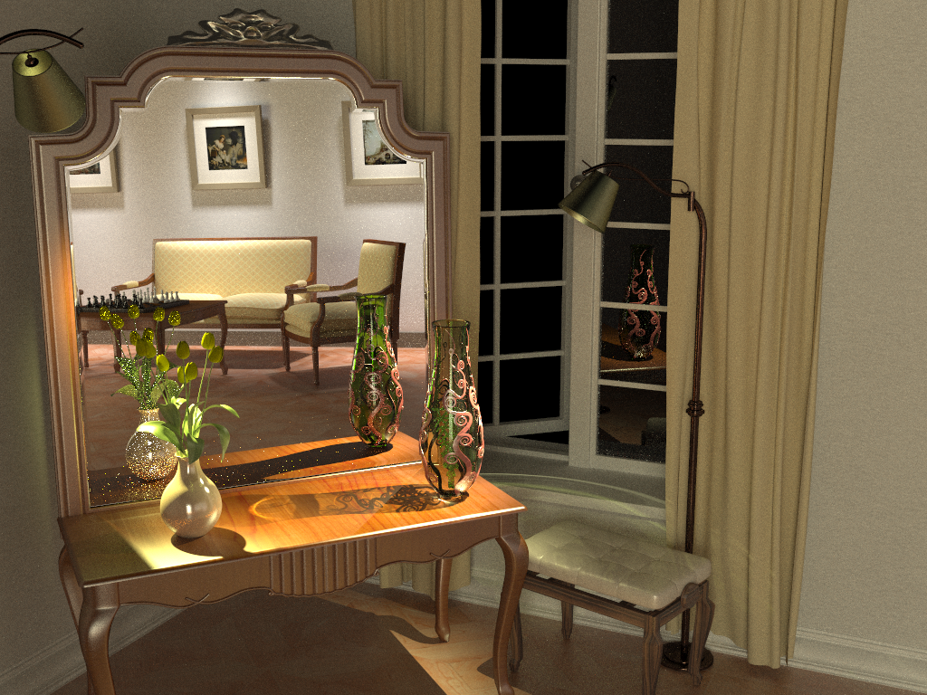
Bidirectional path tracing (30 min)
Notes:
Bidirectional path tracing is one of the most versatile light transport simulation algorithms available today. It can robustly handle a wide range of illumination and scene configurations, but is notoriously inefficient for specular-diffuse-specular light interactions, which occur e.g. when a caustic is seen through a reflection/refraction.

Slide 40
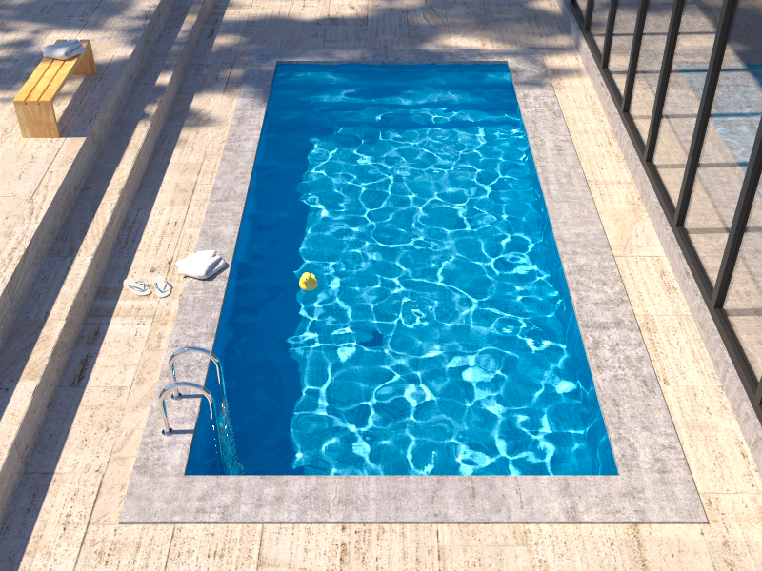
Insufficient path sampling techniques
Reference solution
Bidirectional path tracing
Notes:
The problem with SDS path is even better visible in this rendering of the pool, where BPT is unable to reproduce the caustics seen at the pool bottom.

Slide 41
Insufficient path sampling techniques
SDS paths sampled with zero (or very small) pdf
specular – S
diffuse – D
Notes:
As usual, the culprit is inappropriate path sampling. The problem is that none of the path sampling techniques used in bidirectional path tracing is efficient at sampling the SDS effects, so their combination cannot sample those effects either.
To see this, consider the example on the slide. We have a pool (diffuse – D) filled with water (specular – S), a pinhole camera, and a small light source.
No path connections are possible because of the two specular vertices. Unidirectional sampling from the light source is not possible either because of the pinhole camera.
So we are left with one single (unidirectional) path sampling technique that starts from the camera, and hope to randomly strike the light source. The smaller the source the lower the probability of hitting it and the higher the estimator variance.
In the limit, for point sources and pinhole camera, the SDS effects cannot be sampled by local path sampling at all.

Slide 42
Photon Mapping (Density estimation)

Slide 43
Photon mapping (Density estimation)
Many fwd walks + store collisions (“photon map”)
Radiance estimate: (Kernel) density estimation
Notes:
Photon mapping – a computer graphics name for a light transport technique based on non-parametric density estimation – is well known for its efficient handling of caustics and reflected caustics.
The algorithm proceeds in two stages.
In the first stage, a large number of particle histories (light paths) are traced starting from the light source. Every time the particle scatters, we store it in a data structure called the “photon map”.
In the second stage, we generate the image by tracing sub-paths starting from the camera and whenever we hit a non-specular object, we estimate the radiance by a “photon map lookup” and terminate the walk.
The photon map lookup estimates the radiance using a non-parametric density estimation technique; k-NN density estimation is most common. This involves finding the k nearest neighboring particles in the photon map and estimating the radiance as a weighted density of these particles.

Slide 44
Insufficient path sampling techniques
Notes:
This approach has absolutely no problem handling SDS paths because – unlike bidirectional path tracing – it does not rely on connecting sub-path with an edge.
Instead, the connection is made using the density estimate, which can be readily performed at the bottom of the pool.

Slide 45
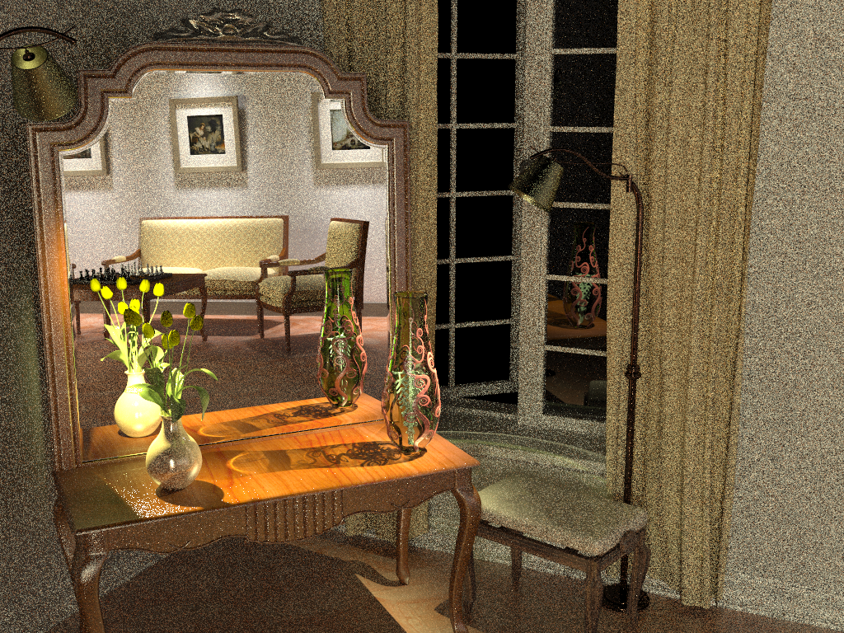
Photon mapping (Density estimation) (30 min)
Notes:
While photon mapping is efficient at handling of caustics and reflected caustics, it has hard time handling the distant indirect illumination, in this scene coming from the part of the scene behind the camera.

Slide 46
Density estimation in transport problems
Graphics – Image synthesis
[Jensen 1996], [Jensen 2001]
[Hachisuka et al. 2008 – 2010]
[Knaus and Zwicker 2011]
[Jarosz et al. 2008, 2011]
Neutron transport
[Banerjee and Martin 2009 – 2013]
[Tamamoto 2013]
[Dunn and Wilson 2013]
[Burke et al. 2013]
convergence with limited memory
“track-length” KDE

Slide 47
OuR Work: Vertex Connection and Merging

Slide 48
Bidirectional path tracing (30 min)
Notes:
In this example, we saw that bidrectional path tracing and photon mapping are pretty much complementary in terms of their strengths and weaknesses. BPT cannot do reflected caustics, but is really good at the overall diffuse illumination.

Slide 49
Photon mapping (Density estimation) (30 min)
Notes:
And vice versa for photon mapping.

Slide 50
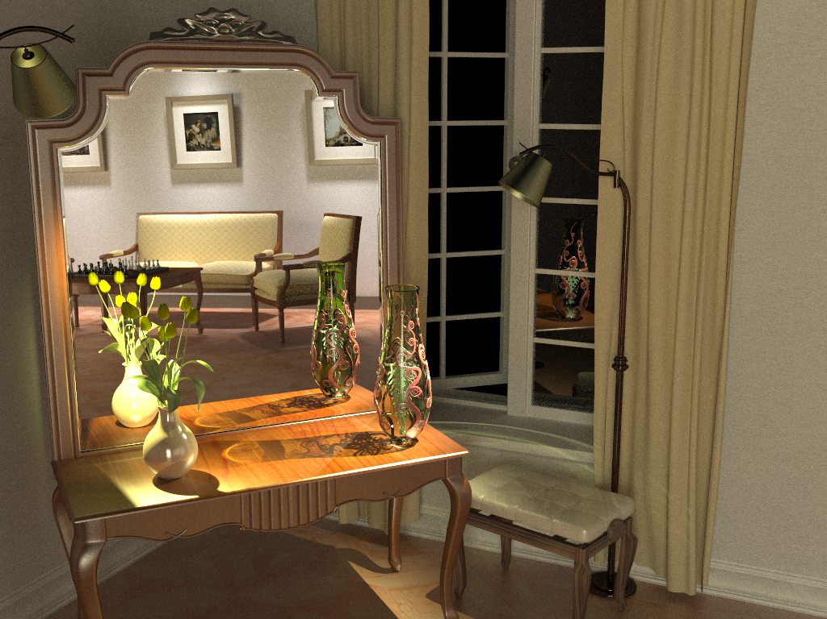
Vertex connection and merging (30 min)
Notes:
By using multiple importance sampling to combine estimators from bidirectional path tracing and photon mapping, the algorithm I will talk about today automatically finds a good mixture of techniques for each individual light transport path, and produces a clean image in the same amount of time.

Slide 51
Approach
Bidirectional path tracing
+
Photon mapping
(Density estimation)
previous state-of-the-art
- Path integral framework
- Multiple importance sampling [Veach and Guibas 1995, 1997]
Vertex Connection and Merging (VCM)
new method

Slide 52
BPT vs PM
Unidirectional sampling
Vertex connection
Density estimation
Bidirectional path tracing
Photon mapping
Notes:
Let us start by reviewing how bidirectional path tracing (BPT) and photon mapping (PM) sample light transport paths that connect the light sources to the camera:
[CLICK] The techniques BPT employs can be roughly categorized to unidirectional sampling (US) and vertex connection (VC). [CLICK] US constructs a path by starting either from a light source or the camera and tracing a random walk in the scene until termination. [CLICK] On the other hand, VC traces one subpath from a light source and another one from the camera, and then completes a full path by connects their endpoints.
[CLICK] In contrast, PM first traces a number of light subpaths and stores their vertices, a.k.a. photons. It then traces subpaths from the camera and computes the outgoing radiance at the hit points using density estimation by looking up nearby photons.

Slide 53
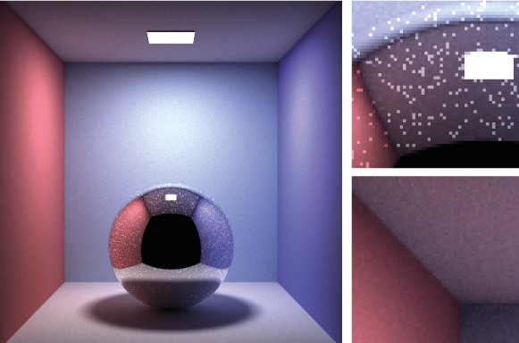
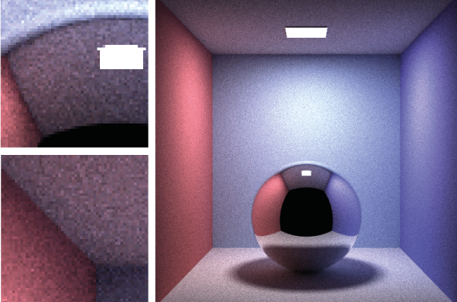
BPT
PPM
Unidirectional sampling
Vertex connection
Density estimation
Notes:
BPT can efficiently capture directly visible caustics, as it can connect light subpath vertices to the camera. However, for sampling specular-diffuse-specular paths, BPT can only rely on unidirectional sampling, as VC cannot perform connections with specular vertices. Since the probability of randomly hitting the light source is often very low, the resulting images suffer from excessive noise.
On the other hand, photon mapping handles both direct and reflected caustics pretty much the same way – by loosely connecting nearby eye and light sub-path vertices. But as can be seen in the images above, it is less efficient than BPT for diffuse illumination.

Slide 54
Overview
Problem: different mathematical frameworks
BPT: Monte Carlo estimator of a path integral
PM: Density estimation
Key contribution: Reformulate photon mapping in Veach’s path integral framework
Formalize as path sampling technique
Derive path probability density
Combination of BPT and PM into a robust algorithm
Notes:
However, even though both methods have been published more than 15 years ago, neither a rigorous analysis of their relative performance nor an efficient combination had been shown until very recently. The reason for this is that BPT and PM have originally been defined in different theoretical frameworks – BPT as a standard Monte Carlo estimator to the path integral, and PM as an outgoing radiance estimator based on photon density estimation.
The first step toward combining these two methods is to put them in the same mathematical framework. We choose Veach’s path integral formulation of light transport, as it has a number of good properties and also because BPT is already naturally defined in this framework.
We need two key ingredients: (1) express PM as a sampling technique that constructs light transport paths that connect the light sources to the camera, and (2) derive the probability densities for paths sampled with this technique. This will give us a basis for reasoning about the relative efficiency of BPT and PM. And more importantly, it will lay the ground for combining their corresponding estimators via multiple importance sampling.

Slide 55
Bidirectional MC path sampling
Notes:
Let us start by taking a simple length-3 path and see how it can be constructed bidirectionally.

Slide 56
Bidirectional MC path sampling
Light vertex
Camera vertex
Notes:
We first trace one subpath from the camera and another one from a light source.

Slide 57
Bidirectional MC path sampling
Light vertex
Camera vertex
Bidirectional path tracing
Photon mapping
Notes:
Now let’s see how we complete a full path in BPT and PM.

Slide 58
Bidirectional MC path sampling
Light vertex
Camera vertex
Vertex connection
Vertex merging
Bidirectional path tracing
Photon mapping
$$p_{VC}\left(\overline{\text{x}}\right)=p\left({\text{x}}_{0}\right)p\left({\text{x}}_{0}→{\text{x}}_{1}\right)$$
$p({\text{x}}_{3})p\left({\text{x}}_{3}→{\text{x}}_{2}\right)$
$p_{VM}\left(\overline{\text{x}}\right)=p\left({\text{x}}_{0}\right)p\left({\text{x}}_{0}→{\text{x}}_{1}\right)$ $P\left(|\left|{\text{x}}_{2}−{\text{x}}_{2}^{∗}\right||<r\right)$
$p\left({\text{x}}_{3}\right)p({\text{x}}_{3}→{\text{x}}_{2})$
$p_{VM}\left(\overline{\text{x}}\right)≈p\left({\text{x}}_{0}\right)p\left({\text{x}}_{0}→{\text{x}}_{1}\right)$ $p\left({\text{x}}_{1}→{\text{x}}_{2}^{∗}\right) πr^{2}$
$p\left({\text{x}}_{3}\right)p({\text{x}}_{3}→{\text{x}}_{2})$
$$p_{VM}\left(\overline{\text{x}}\right)=$$
Notes:
Bidirectional path tracing connects the subpath endpoints deterministically.
[CLICK] We call this technique vertex connection. The PDF of the resulting full path is well known, and is simply the product of the PDFs of two subpaths, which have been sampled independently.
[CLICK] Photon mapping, on the other hand, will extend the light subpath by sampling one more vertex from ${\text{x}}_{1}$, and will concatenate the two subpaths only if the “photon” hit-point ${\text{x}}_{2}^{∗}$ lies within a distance $r$ from ${\text{x}}_{2}$.
[CLICK] We label this technique vertex merging, as it can be intuitively thought to weld the endpoints of the two subpaths if they lie close to each other.
[CLICK] What remains is to derive the PDF of the resulting full path. To do this, we can interpret the last step as establishing a regular vertex connection between ${\text{x}}_{1}$ and ${\text{x}}_{2}$, but conditioning its acceptance on the random event that a vertex ${\text{x}}_{2}^{∗}$ sampled from ${\text{x}}_{1}$ lands within a distance $r$ to ${\text{x}}_{2}$. This probabilistic acceptance is nothing more than a Russian roulette decision. The full path PDF is then again the product of the subpath PDFs, but in addition multiplied by the probability of sampling the point ${\text{x}}_{2}^{∗}$ within a distance $r$ of ${\text{x}}_{2}$. This acceptance probability is equal to the integral of the PDF of ${\text{x}}_{2}^{∗}$ over the $r$-neighborhood of ${\text{x}}_{1}$.
[CLICK] Under the reasonable assumptions that the surface around ${\text{x}}_{1}$ is locally flat, i.e. that this neighborhood is a disk, and that the density of ${\text{x}}_{2}^{∗}$ is constant inside this disc, the integral can be well approximated by the PDF of the actual point ${\text{x}}_{2}^{∗}$ we have sampled, multiplied by the disc area $πr^{2}$.

Slide 59
Sampling techniques
Light vertex
Camera vertex
Unidirectional
2 ways
Vertex connection
4 ways
Vertex merging
5 ways
Total
11 ways
Notes:
Now that we have formulated the vertex merging path sampling technique, we can put it side by side with the already available techniques in BPT. There are two ways to sample a length-4 path unidirectionally, and four ways to sample it via vertex connection. Vertex merging adds five new ways to sample the path, corresponding to merging at the five individual path vertices. In practice, we can avoid merging at the light source and the camera, as directly evaluating emission and sensitivity is usually cheap.
But with so many ways to sample the same light transport path, a question naturally arises in the mind of the curious: which technique is the most efficient for what types of paths?

Slide 60
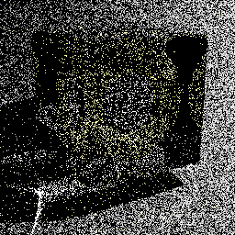
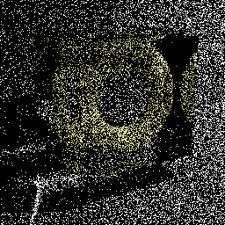
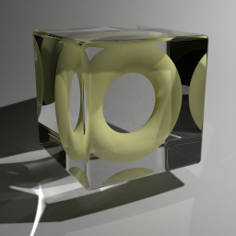
Technique comparison – SDS Paths
Diffuse light
Diffuse surface
Mirror surface
Unidirectional sampling
Vertex merging
Vertex merging (reuse)
BPT: Unidirectional sampling
PM: Vertex merging
Roughly equal path sampling probabilities
Roughly equal total number of rays per image!
10k paths/pixel
10k paths/pixel
1.2 billion paths/pixel
Notes:
To answer this question, let us first take a look at specular-diffuse-specular (SDS) paths. Here, bidirectional path tracing can only rely on unidirectional sampling: it traces a path from the camera hoping to randomly hit the light source. With vertex merging, we can trace one light and one camera subpath, and merge their endpoints on the diffuse surface.
[CLICK] It can be shown that if the light source and the merging disk have the same area $A$, then unidirectional sampling and vertex merging sample paths with roughly the same probability density. This means that we should expect the two techniques to perform similarly in terms of rendering quality.
[CLICK] We render these two images progressively, sampling one full path per pixel per iteration. For the left image we trace paths from the camera until they hit the light. For image on the right, we trace subpaths from both ends, and merge their endpoints if they lie within a distance $r=\sqrt{A/π}$ from each other. Both images look equally noisy, even after sampling 10,000 paths per pixel. This confirms that vertex merging, and thus photon mapping, is not an intrinsically more robust sampling technique for SDS paths than unidirectional sampling.
[CLICK] However, the strength of vertex merging is computational efficiency – we can very efficiently reuse the light subpaths traced for all pixels at the cost of a single range search query. This allows us to quickly construct orders of magnitude more light transport estimators from the same sampling data, with a minimal computational overhead, resulting in a substantial quality improvement.
[CLICK] For all these three images we have traced roughly the same number of rays, and the only difference between the one in the center and the one on the right is that the for right image we have enabled path reuse, by storing, and looking up, the light subpath vertices in a photon map at every rendering iteration.

Slide 61
Technique comparison – Diffuse Illum.
Diffuse light
Diffuse surface
Vertex connection (VC)
Unidirectional sampling (US)
Vertex
Merging (VM)
Notes:
Now let’s look at another extreme example – diffuse illumination. Note that vertex connection (VC) constructs the edge between ${\text{x}}_{1}$ and ${\text{x}}_{2}$ deterministically, while unidirectional sampling (US) and vertex merging (VM) both rely on random sampling.
Once again, it can be shown that if the light source and the merging disk have the same area, then US and VM sample this path with roughly the same probability density.
[CLICK] For the specific case shown on this slide, this density is about 100,000 lower than that of VC. This demonstrates that VM is not an intrinsically more robust sampling technique than VC either. This is not surprising – if we recall the expression for the VM path PDF, we see that it can only be lower than that of the corresponding VC technique, as their only difference is the probability factor in the VM PDF, which is necessarily in the range $[0;1]$. Still, by reusing paths across pixels, vertex merging, and thus photon mapping, gains a lot of efficiency over unidirectional sampling.
All these useful insights emerge from the reformulation of photon mapping as a path sampling technique.

Slide 62
VCM – Algorithm overview
Stage 1: Light sub-path sampling
a) Trace sub-paths
b) Connect to eye
c) Build search struct.
Stage 2: Eye sub-path sampling
VC
VC
VM
VM
a) Vertex connection
b) Vertex merging
c) Continue sub-path
Notes:
Even more usefully, we now have the necessary ingredients for combining photon mapping and bidirectional path tracing into one unified algorithm. The vertex merging path PDFs tell us how to weight all sampling techniques in multiple importance sampling, and the insights from the previous two slides command to strive for path reuse.
The combined algorithm, which we call vertex connection and merging (VCM), operates in two stages.
In the first stage, we
[CLICK] trace the light subpaths for all pixels,
[CLICK] connect them to the camera, and
[CLICK] store them in a range search acceleration data structure (e.g. a kd-tree or a hashed grid).
[CLICK] In the second stage, we trace a camera subpath for every pixel.
[CLICK] Each sampled vertex on this path is connected to a light source (a.k.a. next event estimation), connected to the vertices of the light subpath corresponding to that pixel, and
[CLICK] merged with the vertices of all light subpaths.
[CLICK] We then sample the next vertex and do the same.
In a progressive rendering setup, we perform these steps at each rendering iteration, progressively reducing the vertex merging radius . For details on this, please refer to the cited papers below for details.

Slide 63
Bidirectional path tracing (30 min)
Notes:
Let us now see how this combined algorithm stacks up against bidirectional path tracing and stochastic progressive photon mapping on a number of scenes with complex illumination.

Slide 64
Stochastic progressive photon mapping (30 min)

Slide 65
Vertex connection and merging (30 min)

Slide 66
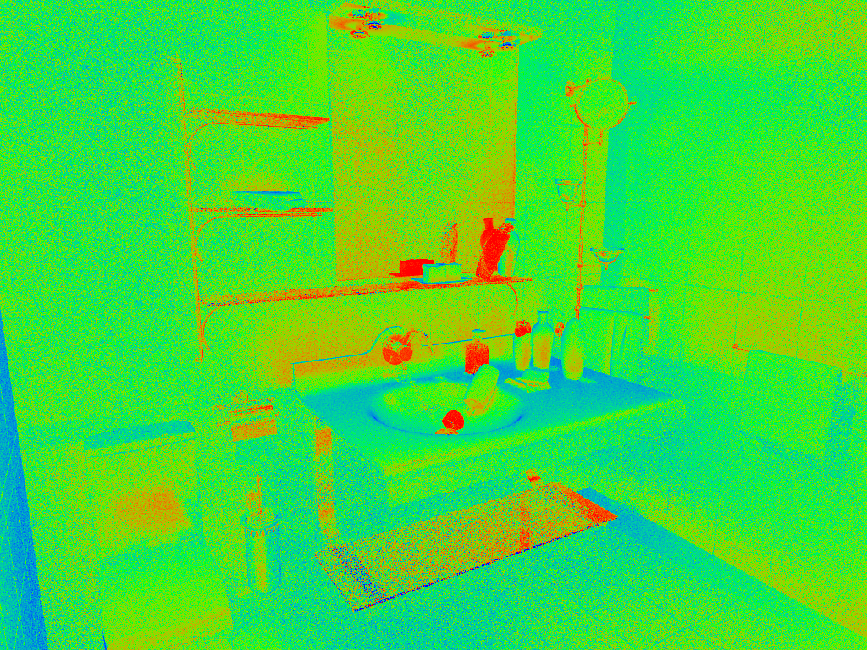
VM
Relative technique contributions
VC
Notes:
Here, we visualize the relative contributions of VM and VC techniques to the VCM image from the previous slide. This directly corresponds to the weights that VCM assigned to these techniques.

Slide 67
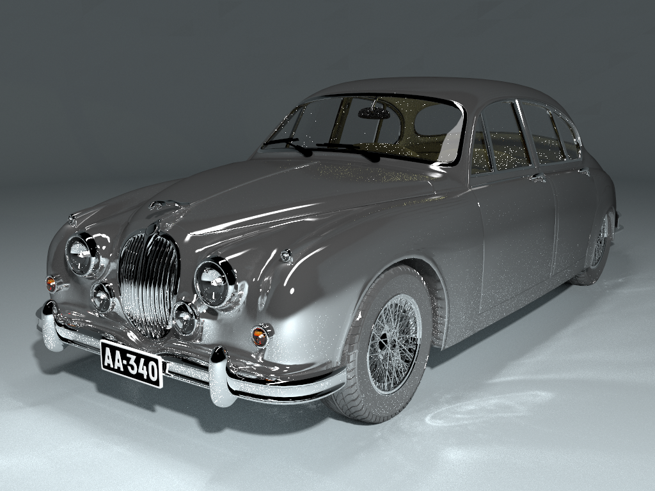
Bidirectional path tracing (30 min)

Slide 68
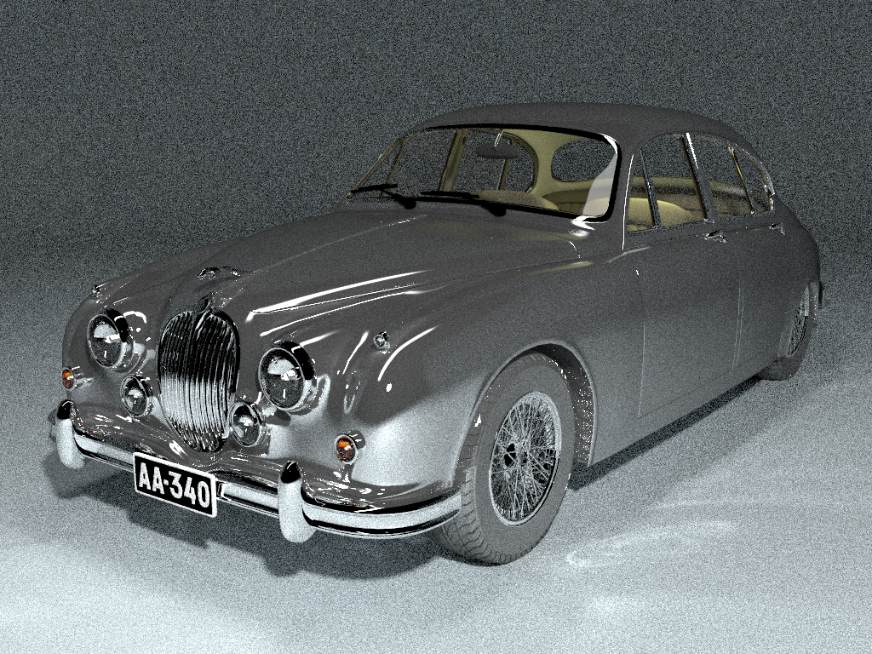
Stochastic progressive photon mapping (30 min)

Slide 69
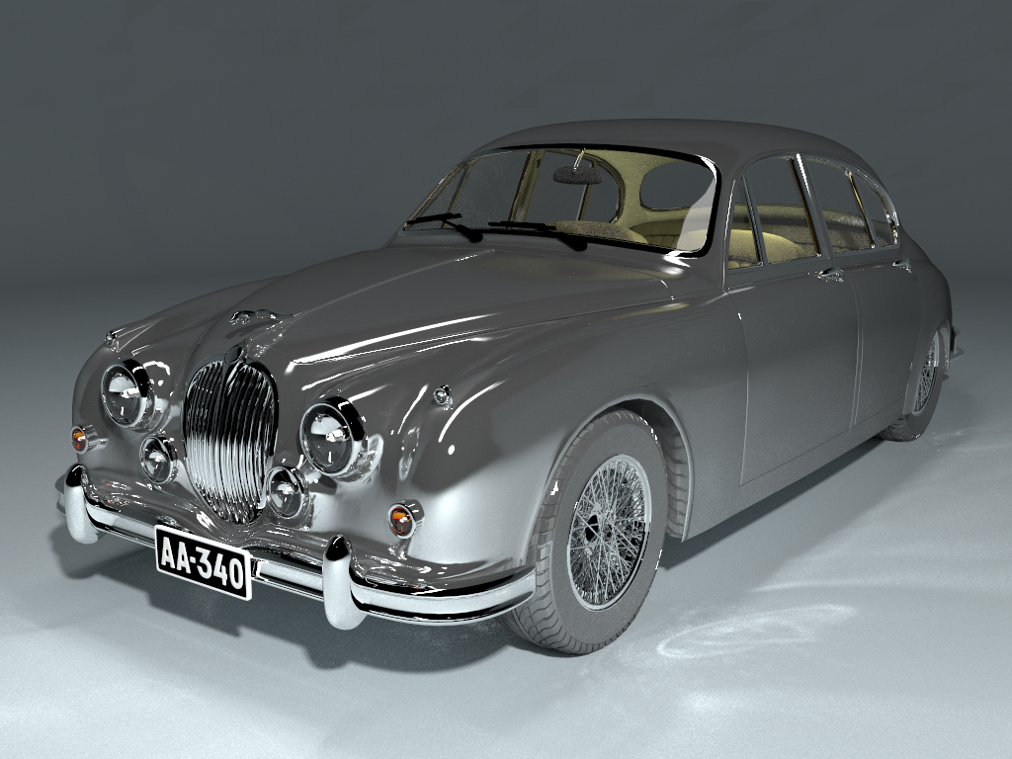
Vertex connection and merging (30 min)

Slide 70
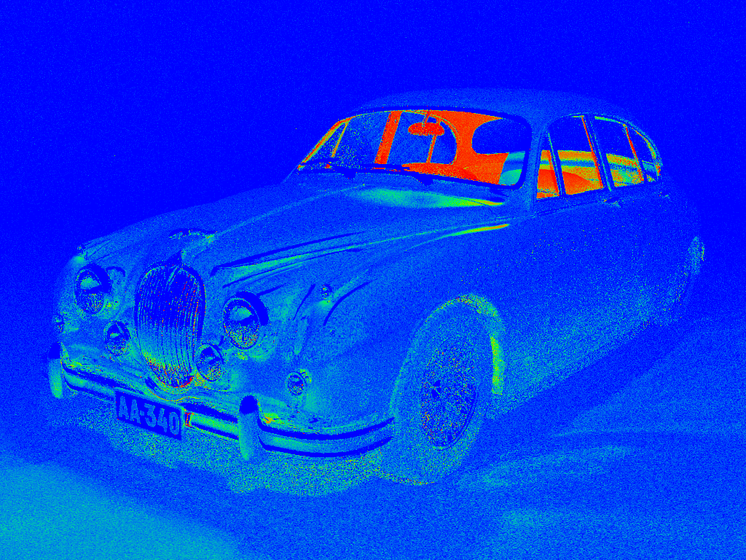
PM
Relative technique contributions
BPT

Slide 71
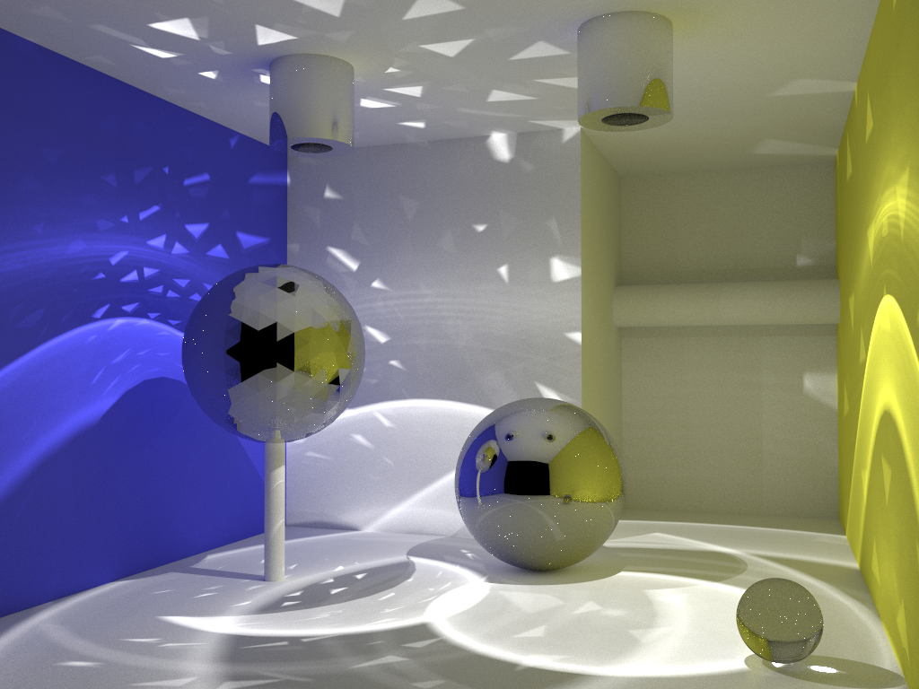
Bidirectional path tracing (30 min)

Slide 72
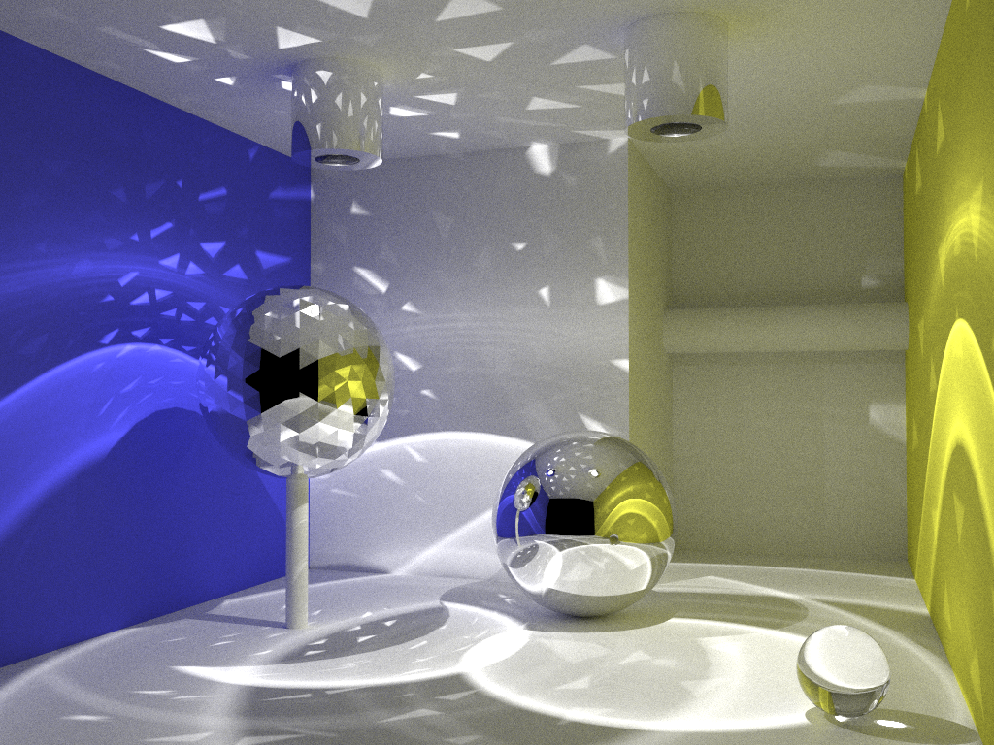
Stochastic progressive photon mapping (30 min)

Slide 73
Vertex connection and merging (30 min)

Slide 74
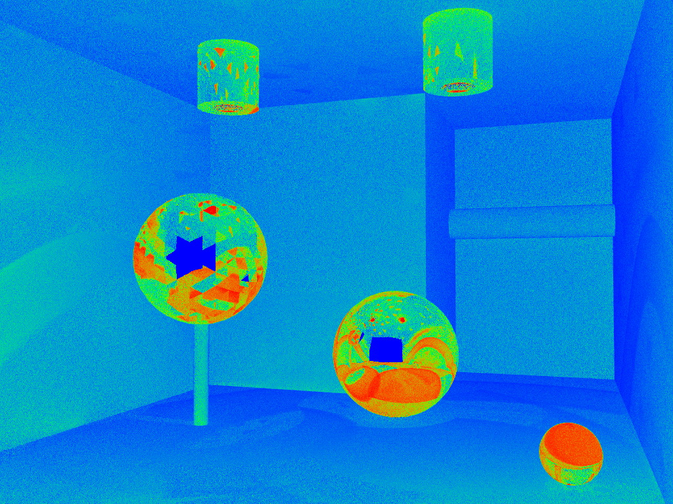
PM
Relative technique contributions
BPT

Slide 75
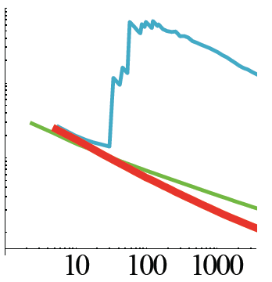
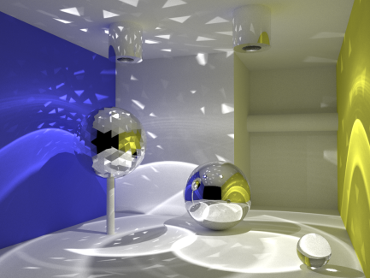
Convergence rate
RMSE convergence
BPT: O(N^{-0.5})
PPM: O(N^{-0.33})
VCM: O(N^{-0.5})
RMSE
time [s]
Notes:
In summary, vertex connection and merging tries to combine the best of bidirectional path tracing (BPT) and (progressive) photon mapping. An important property of the algorithm is that it retains the higher order of convergence of BPT, meaning that it approaches the correct solution faster than PPM as we spend more computational effort (i.e. sample more paths). The asymptotic analysis can be found in the VCM paper.

Slide 76
Summary
Image synthesis requires robust estimators
Vertex Connection and Merging
Bidirectional path tracing + Photon mapping (density est.)
Photon mapping (density est.) as a path sampling technique
Invaluable tools
Multiple importance sampling
Path integral view of light transport

Slide 77
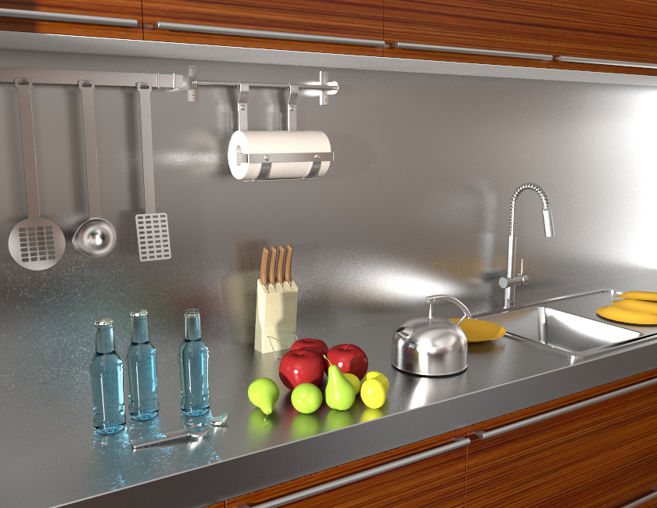
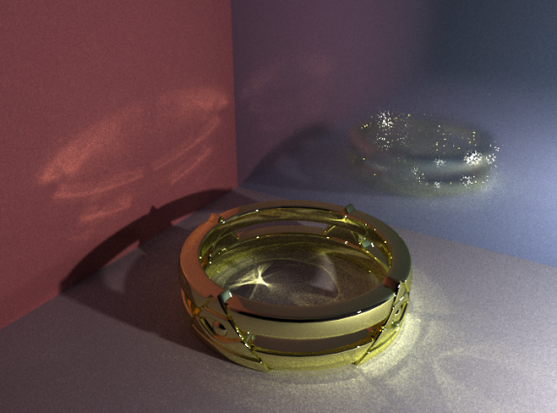
Remaining challenges
VCM
VCM
BPT
Notes:
Even though VCM is a step forward in Monte Carlo rendering and has proven very useful in practice, it doesn’t come without limitations. Specifically, it cannot handle more efficiently those types of light transport paths that are difficult for both BPT and PM to sample.
[CLICK] A prominent example are caustics falling on a glossy surface.
[CLICK] On this kitchen scene, even though VCM brings practical improvements over BPT, there is still a lot to be desired from the caustics on the glossy surface.

Slide 78
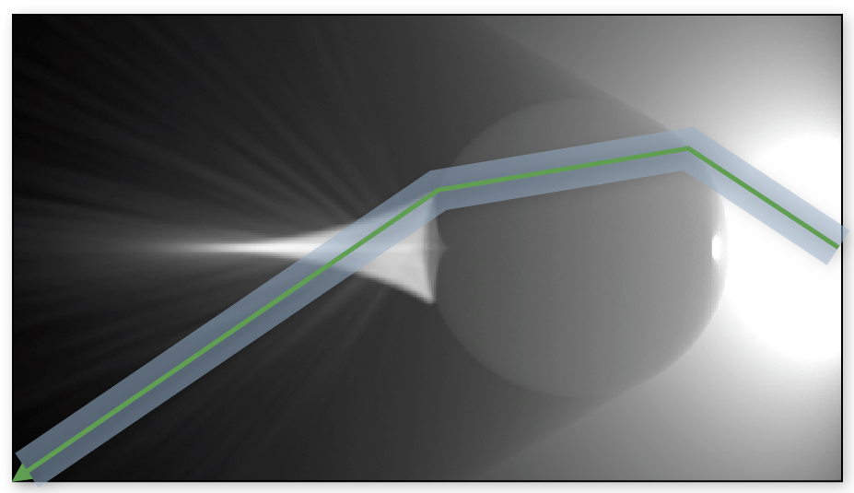
Future work
“Photon beams” [Jarosz et al. 2011]
Density estimation with cylindrical kernels

Slide 79
References
Georgiev et al., “Light Transport Simulation with Vertex Connection and Merging”
Hachisuka et al. “A Path Space Extension for Robust Light Transport Simulation”
Same algorithm, different theoretical derivations

Slide 80
Additional resources
Implementation technical report Image comparisons [iliyan.com]
SmallVCM – open-source VCM implementation [SmallVCM.com]

Slide 81
VCM in production
Developed by Ondra Karlík
http://www.corona-renderer.com
Notes:
A number of companies have announced VCM integration in the upcoming releases of their commercial renderers.
For example, VCM is coming in Pixar’s Photorealistic RenderMan v19, …

Slide 82
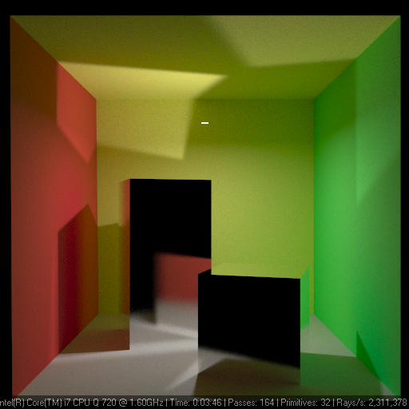
Demo
Developed by Ondra Karlík
http://www.corona-renderer.com

Slide 83
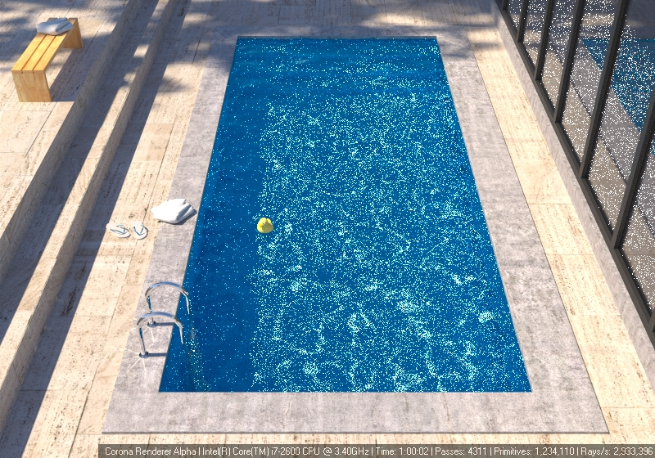
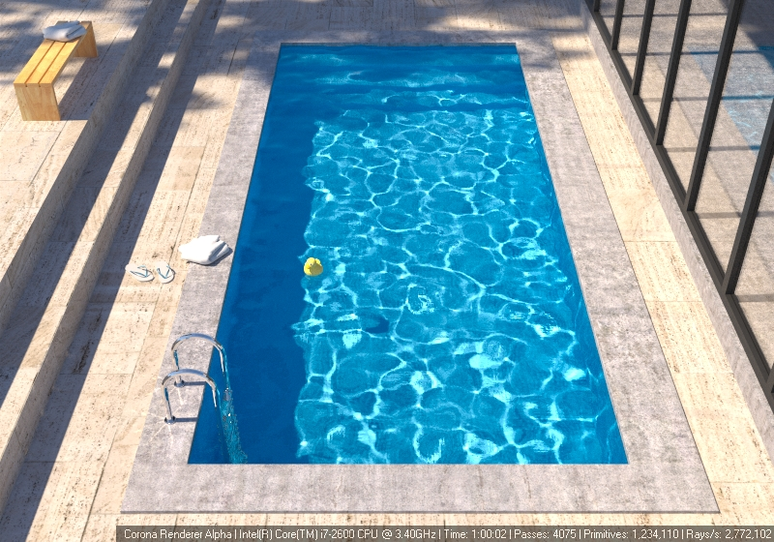
VCM in production
BPT
VCM
Developed by Ondra Karlík
http://www.corona-renderer.com
Notes:
VCM is also implemented in the public Alpha release of Corona renderer, which I encourage you to download and play around with.

Slide 84
Acknowledgements
Czech Science Foundation
grant no. P202-13-26189S
Iliyan Georgiev
Ondra Karlík
Eugene D’Eon

Slide 85
Thank you!
Questions?
Jaroslav Křivánek Light Transport Simulation with Vertex Connection and Merging
[cgg.mff.cuni.cz/~jaroslav]

