Slide 1
Realistic Rendering in Architecture and Product Visualization
INTRODUCTION
Jaroslav Křivánek Charles University | Render Legion | ChaosGroup
Notes:
Hi, my name is Jaroslav Křivánek and you are attending the course on Realistic rendering in architecture and product visualization.

Slide 2
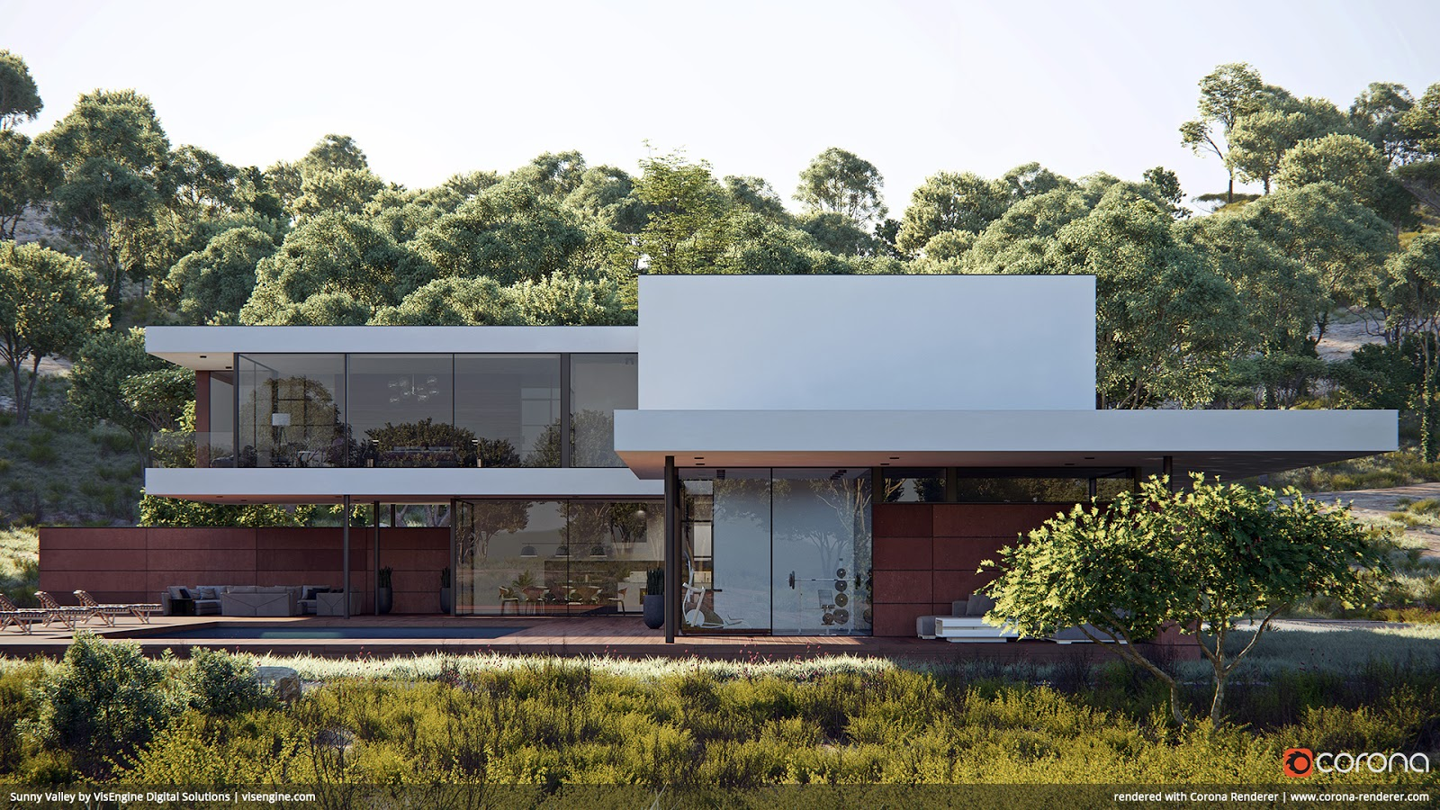
What is archviz?
Notes:
First of all, what is architectural visualization?
It’s the art and craft of creating compelling CG images of architecture – both interiors and exteriors.
It is a widespread discipline practiced by tens of thousands of architects and visualization professionals across the globe.
The main purpose of archviz is communication…

Slide 3
What is archviz?
Communication architect-client
Notes:
Communication between the architect and its client, …

Slide 4
What is archviz?
Communication architect-client
Architectural competitions
Notes:
… to convey design ideas in architectural competitions, …

Slide 5
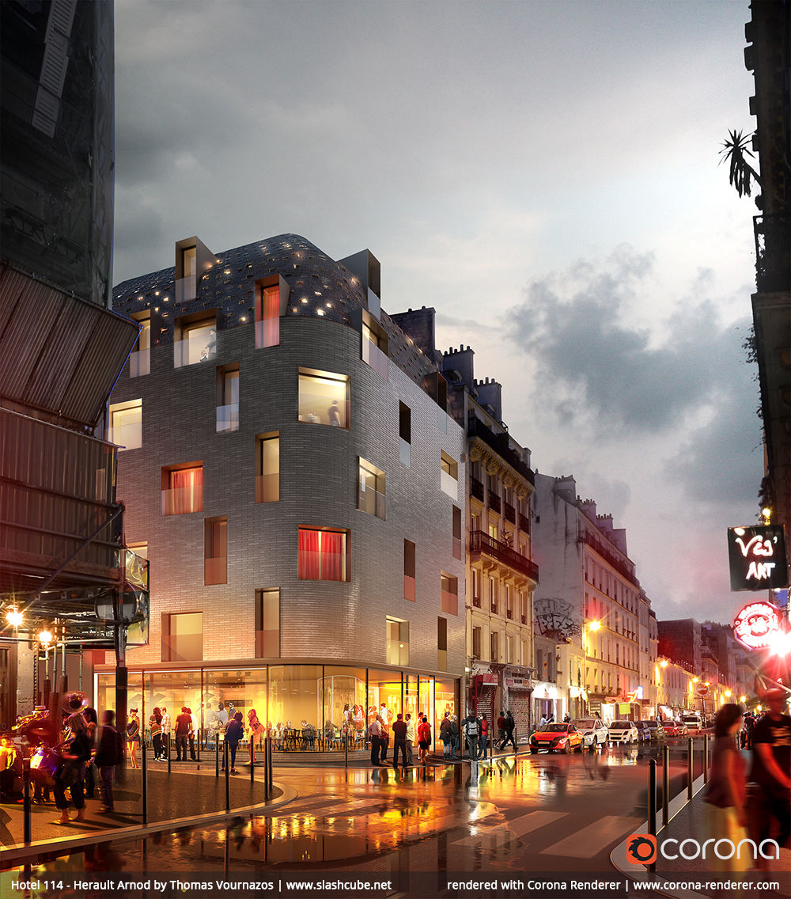
What is archviz?
Communication architect-client
Architectural competitions
Urban planning
Notes:
… in urban planning, …

Slide 6
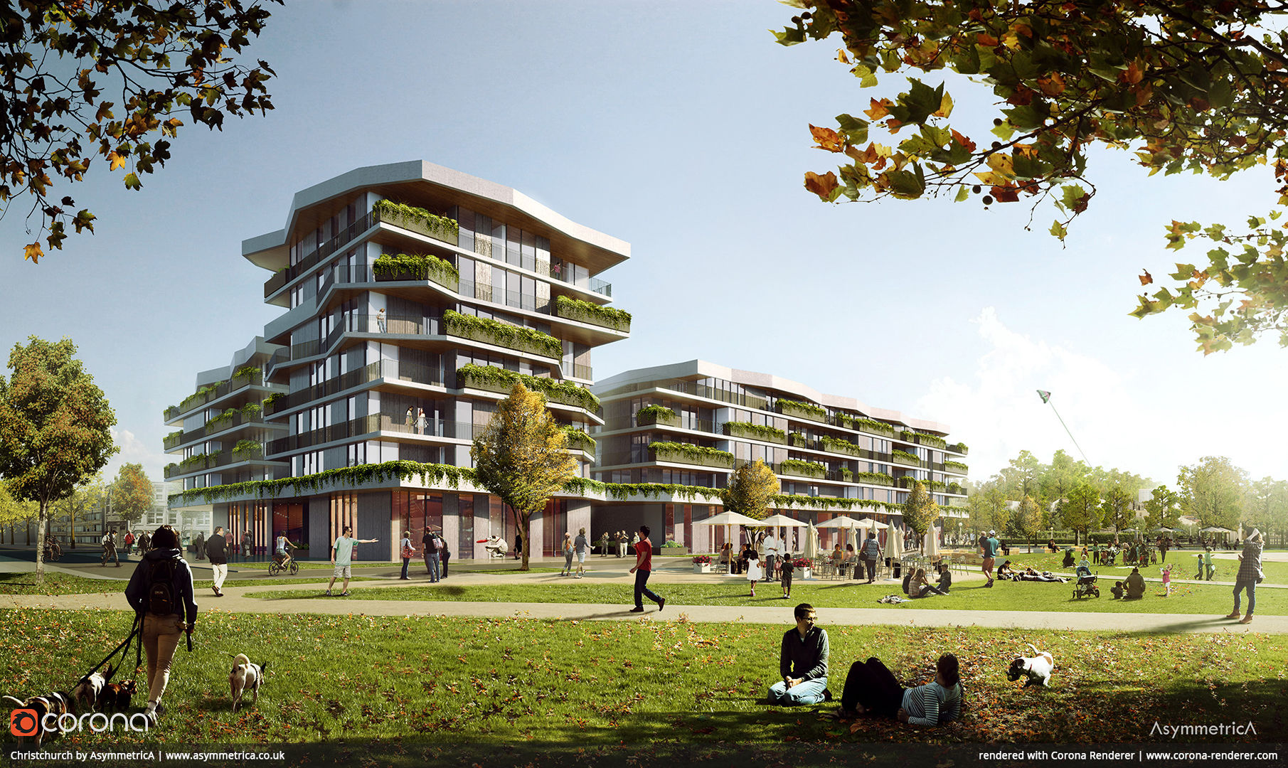
What is archviz?
Communication architect-client
Architectural competitions
Urban planning
Real-estate
Notes:
… in the real-estate market, …

Slide 7
What is archviz?
Communication architect-client
Architectural competitions
Urban planning
Real-estate
Interior-design
Notes:
… in interior design.

Slide 8
What is PRODUCT VIZ?
Design process
Notes:
Just as archviz deals with building design, product visualization deals with product/industrial design.
It can be used to support the design process itself…

Slide 9
What is PRODUCT VIZ?
Design process
Catalogues
Notes:
… create product catalogues …

Slide 10
What is PRODUCT VIZ?
Design process
Catalogues
Marketing
Notes:
… and for other marketing purposes.

Slide 11
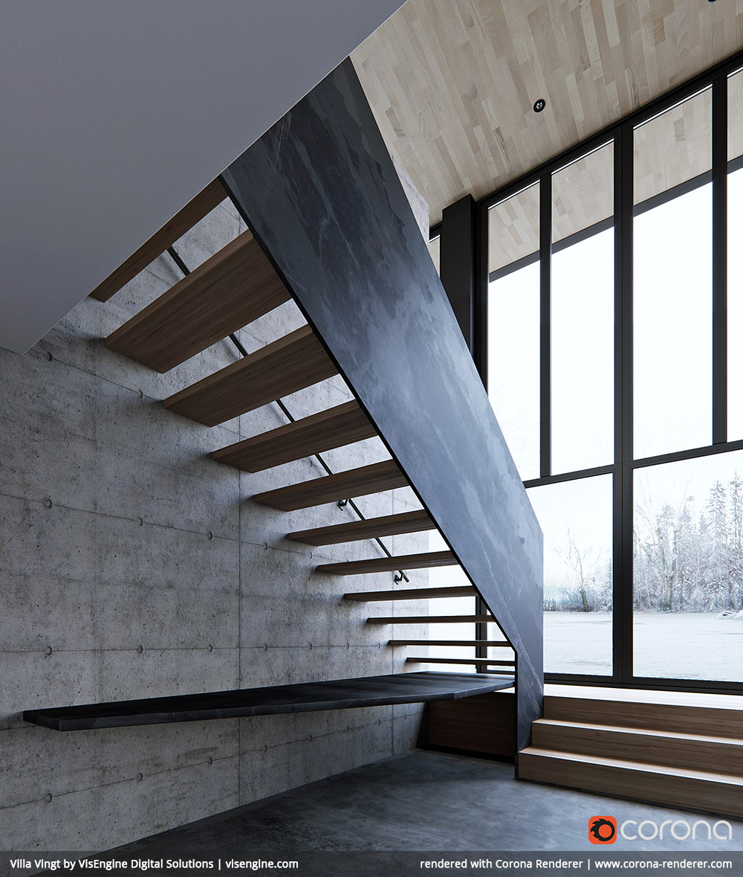
Why course on arch/prod-viz?
SIGGRAPH and ACM TOG focus mostly on CG animation/VFX
Recent SIGGRAPH courses
Path tracing in production (2017,2018)
The Path-Tracing Revolution in the Movie Industry (2015)
ACM TOG special issue on production rendering
Arnold, Hyperion, Manuka, RenderMan
Notes:
Why do we need a dedicated SIGGRAPH course on rendering in architecture and product visualization?
Simply because there is essentially no information on these fields here.
Indeed, looking at the SIGGRAPH courses from the last several years, or at the recent special issue of ACM TOG on production rendering, one find out that they all focus almost exclusively on CG animation and VFX.

Slide 12
Why course on arch/prod-viz?
Significant global market
Visualizations themselves
SW tools (renderers & their ecosystems)
Specialized needs/workflows that differ from CG animation/VFX
Broader view of rendering
Notes:
While CG animation and VFX are quite visible, thanks to the influx of Hollywood movies, architectural and product visualization are significant global markets – essentially every building project today involves some elements of it.
The market is quite extensive in terms of the visualization business itself but also in terms of the software tools, namely the renderers, used to produce the visualizations.
The workflows and tools used in architectural and product visualization differ from animation/VFX.
So our goal is to show the rendering practice form a new angle and hopefully bring a broader perspective of the rendering field to SIGGRAPH.

Slide 13
Course overview
Christophe Chevallier – Norm Li
Ondra Karlík – Render Legion
Vlado Koylazov – ChaosGroup
Notes:
For that purpose, I’ve brought together a number of speakers with different backgrounds and focus to cover different aspect of archviz and product viz.
Christophe Chevallier, the art director at Norm Li – one of the largest Canadian archviz houses – will introduce the field from the artist's perspective.
Ondra Karlík, my colleague and co-founder from Render Legion will talk about the changes in archviz rendering technology over the last fours years and illustrate them on the example of Corona Renderer.
Vlado Koylazov, co-founder and CTO of Chaos Group, will share his experience with bridging the worlds of rendering for archviz and VFX in his V-ray renderer.

Slide 14
Course overview
Henrik Wann Jensen – Luxion
Thomas Ludwig – Glare Tech.
Jarda Křivánek – Charles Uni, Render Legion
Notes:
Henrik Wann Jensen will use the story of the Keyshot renderer to take us to the worlds of rendering for CAD and industrial design.
Thomas Ludwig from Glare Technologies will talk about some specifics of Indigo Renderer, such as production-ready bidirectional path tracing on the GPU.
And finally, I will conclude by juxtaposing my experience as a rendering researcher both in the academia and in the industry, and give some directions for future rendering research.

Slide 15
Notes:
One organizational remark – we will be taking questions after the individual talks, but we’ll be also around during the break and after the course for a chat.

Slide 16
Next up
Christophe Chevallier – Norm Li
Notes:
And now, without any further ado, let me give it over to Christophe to introduce the field of archviz as such.

