Slide 1
Architectural Visualization from the artist’s perspective.
Christophe Chevallier
Norm Li Studio
Notes:
Norm Li - architectural visualization studio based in Toronto

Slide 2
Architectural Visualization
is everywhere.
Notes:
Arch Viz is everywhere if you pay attention.
Even if do pay attention sometimes difficult to know as it’s hard to tell if an image is rendering or photo.
So where can you find arch viz?

Slide 3
Notes:
Nearly 100% of Ikea kitchen catalog is 3d renderings, most of their product renders are 3d renderings and 30% of their overall image production is digitally created.
A lot of the bathroom and kitchen marketing images are now renderings because more cost effective

Slide 4
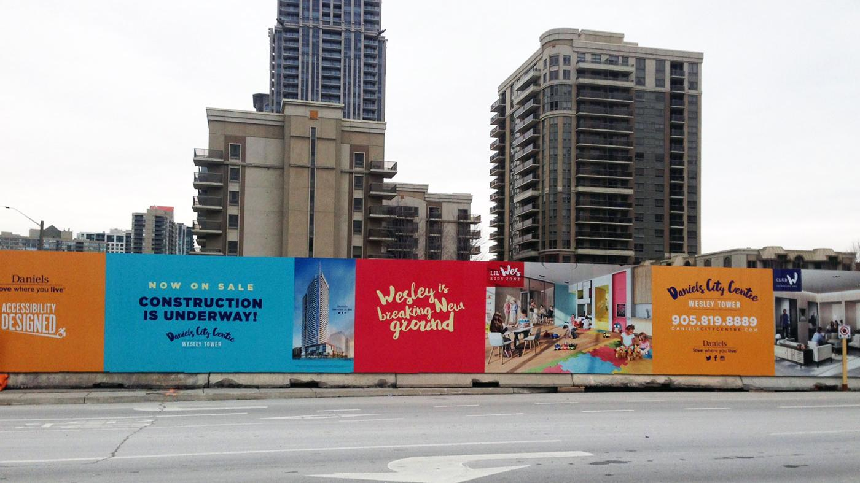
Notes:
Another spot you can find 3d renderings is in the street
Hoarding by construction sites
Showcase project
Get people excited about it

Slide 5
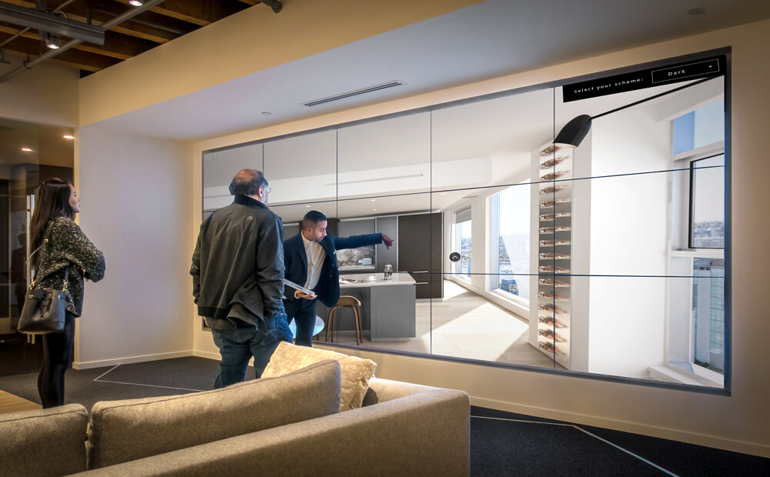
Notes:
If you like the project If lucky enough to be able to afford a condo in Vancouver, you’ll make your way to sales center
Obviously it’s going to be covered in renderings, animations and even interactive experiences.

Slide 6
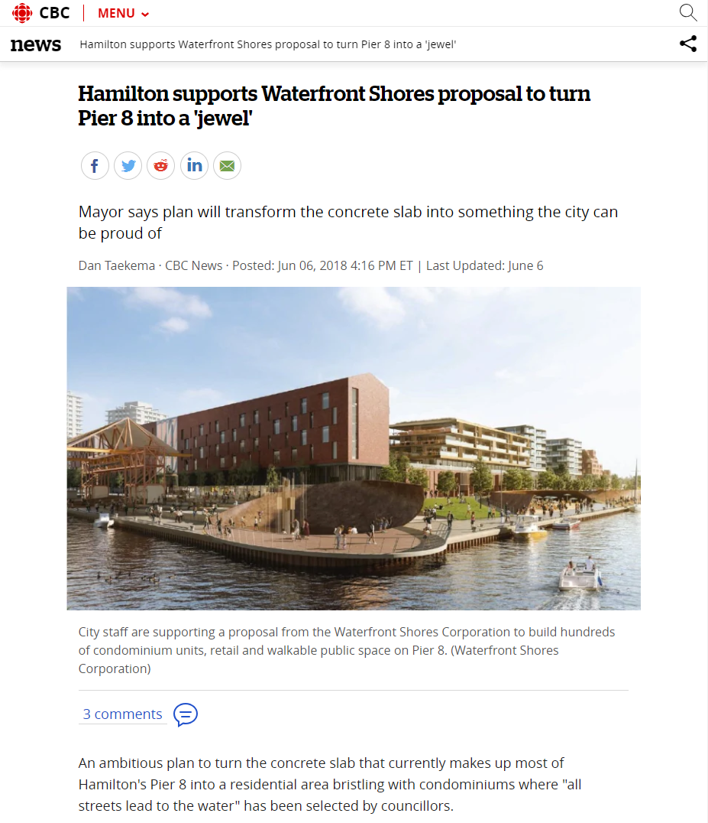
Notes:
If you just read the newspaper or just look at it on your smartphone like most people
Come across articles showcasing future project in the city
Here competition in Hamilton that we won a couple of weeks ago

Slide 7
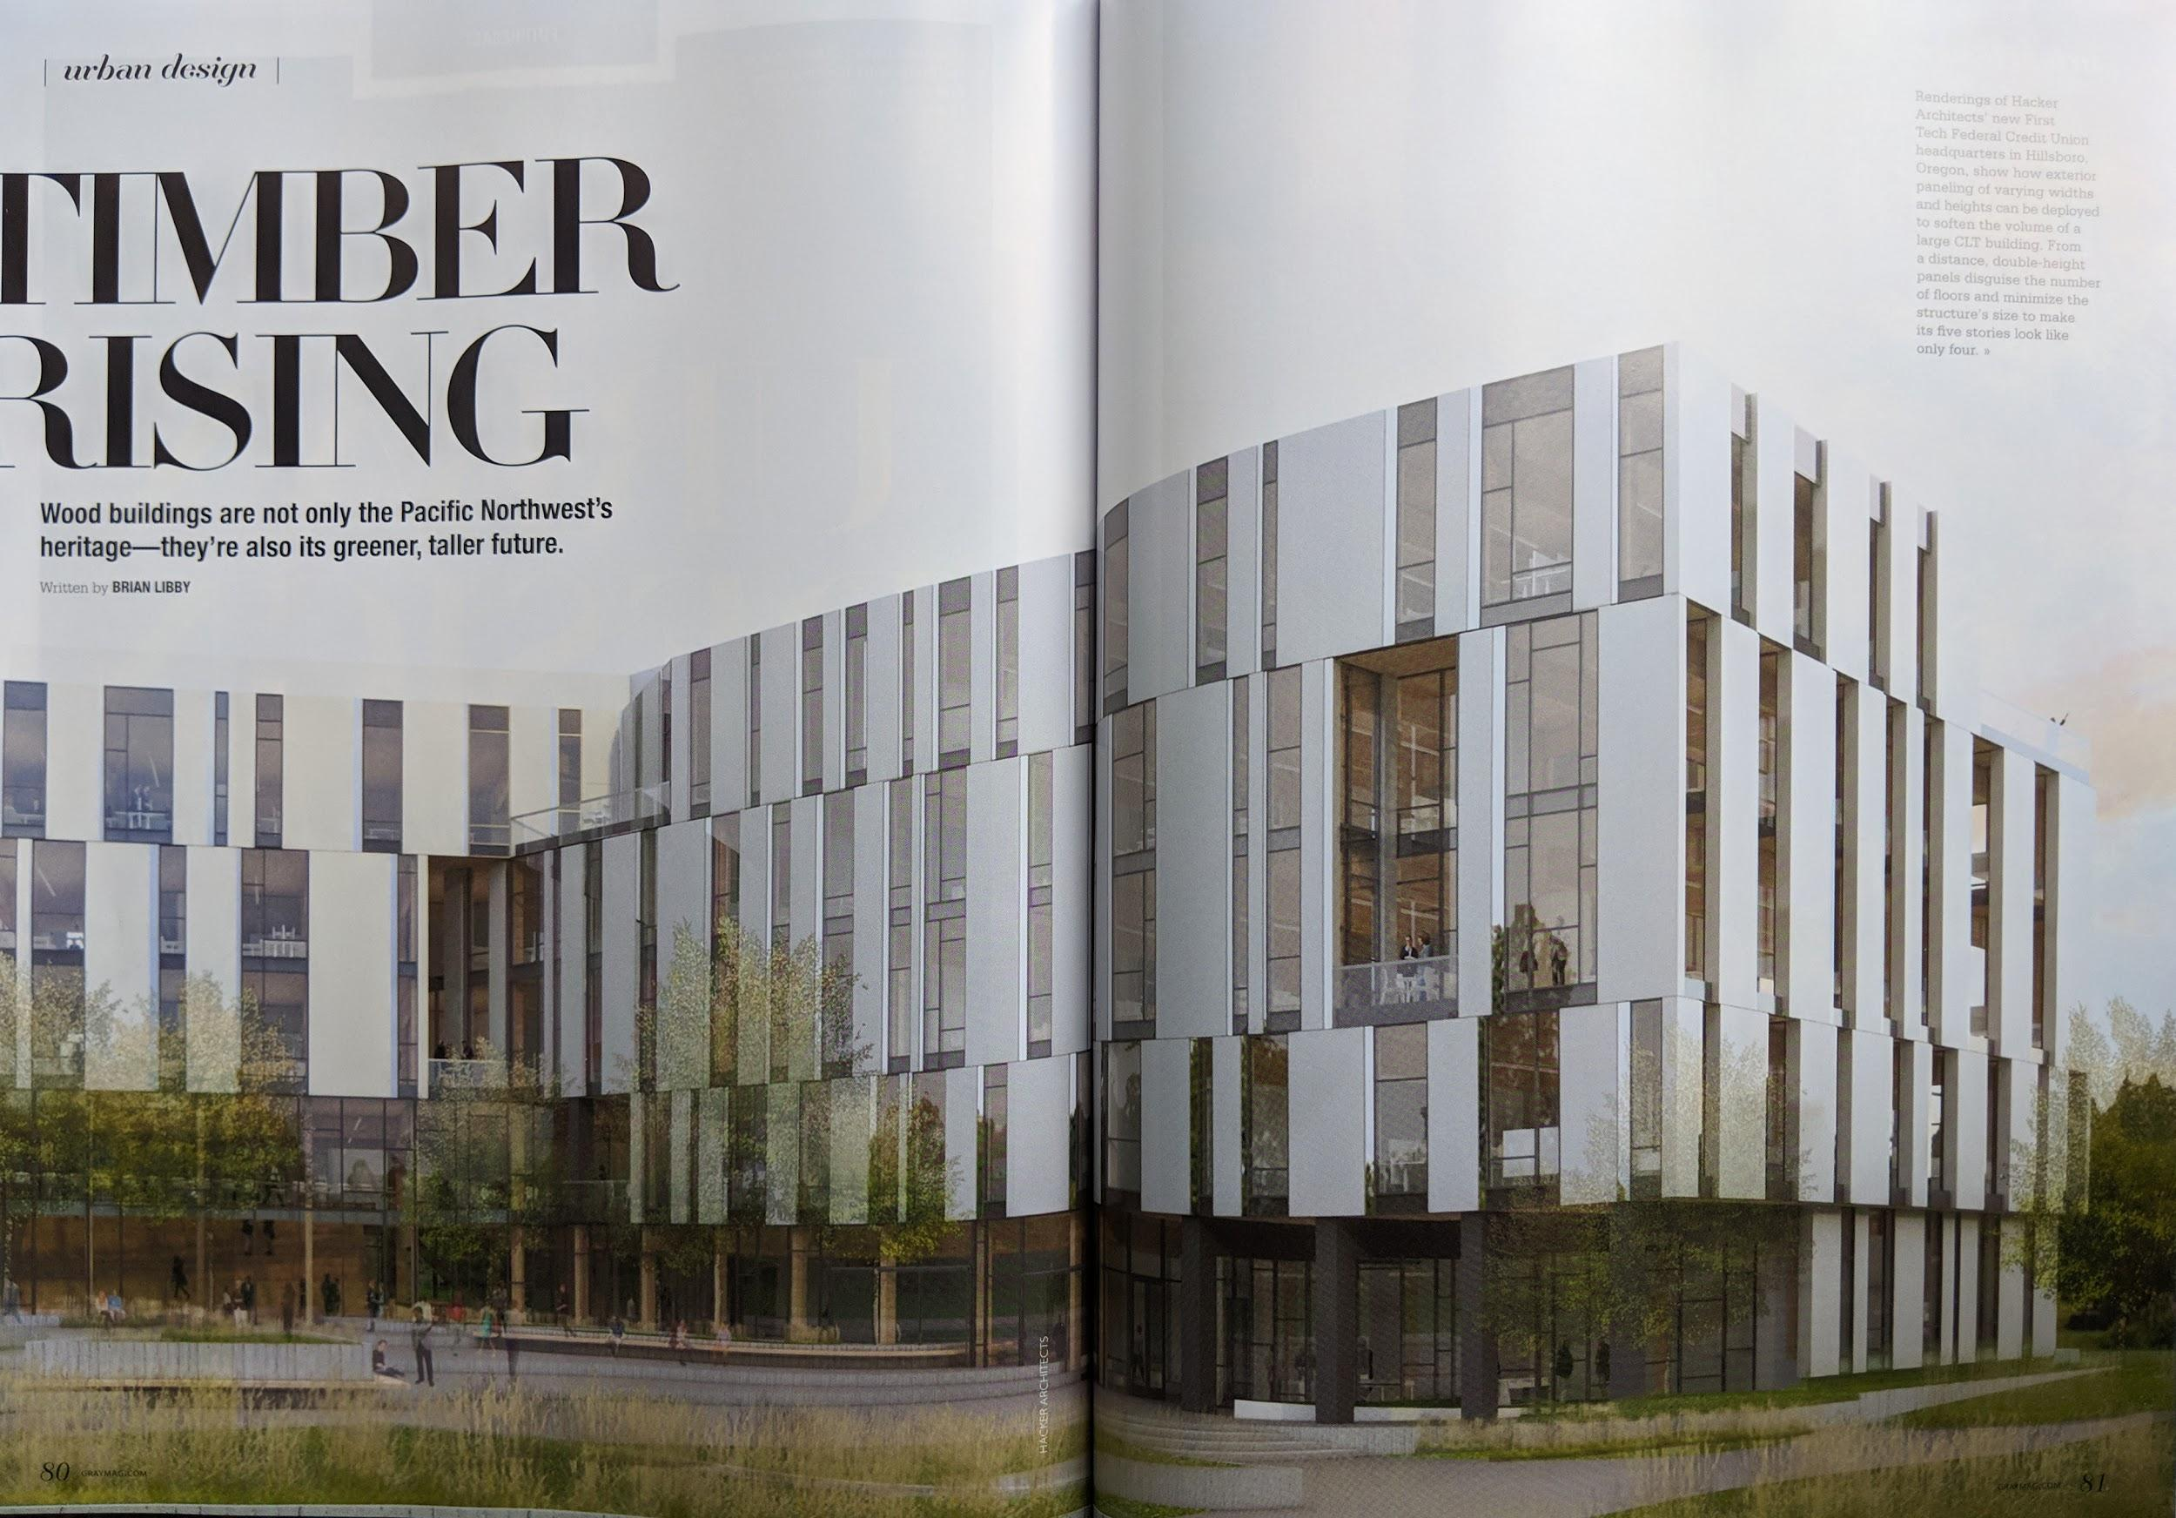
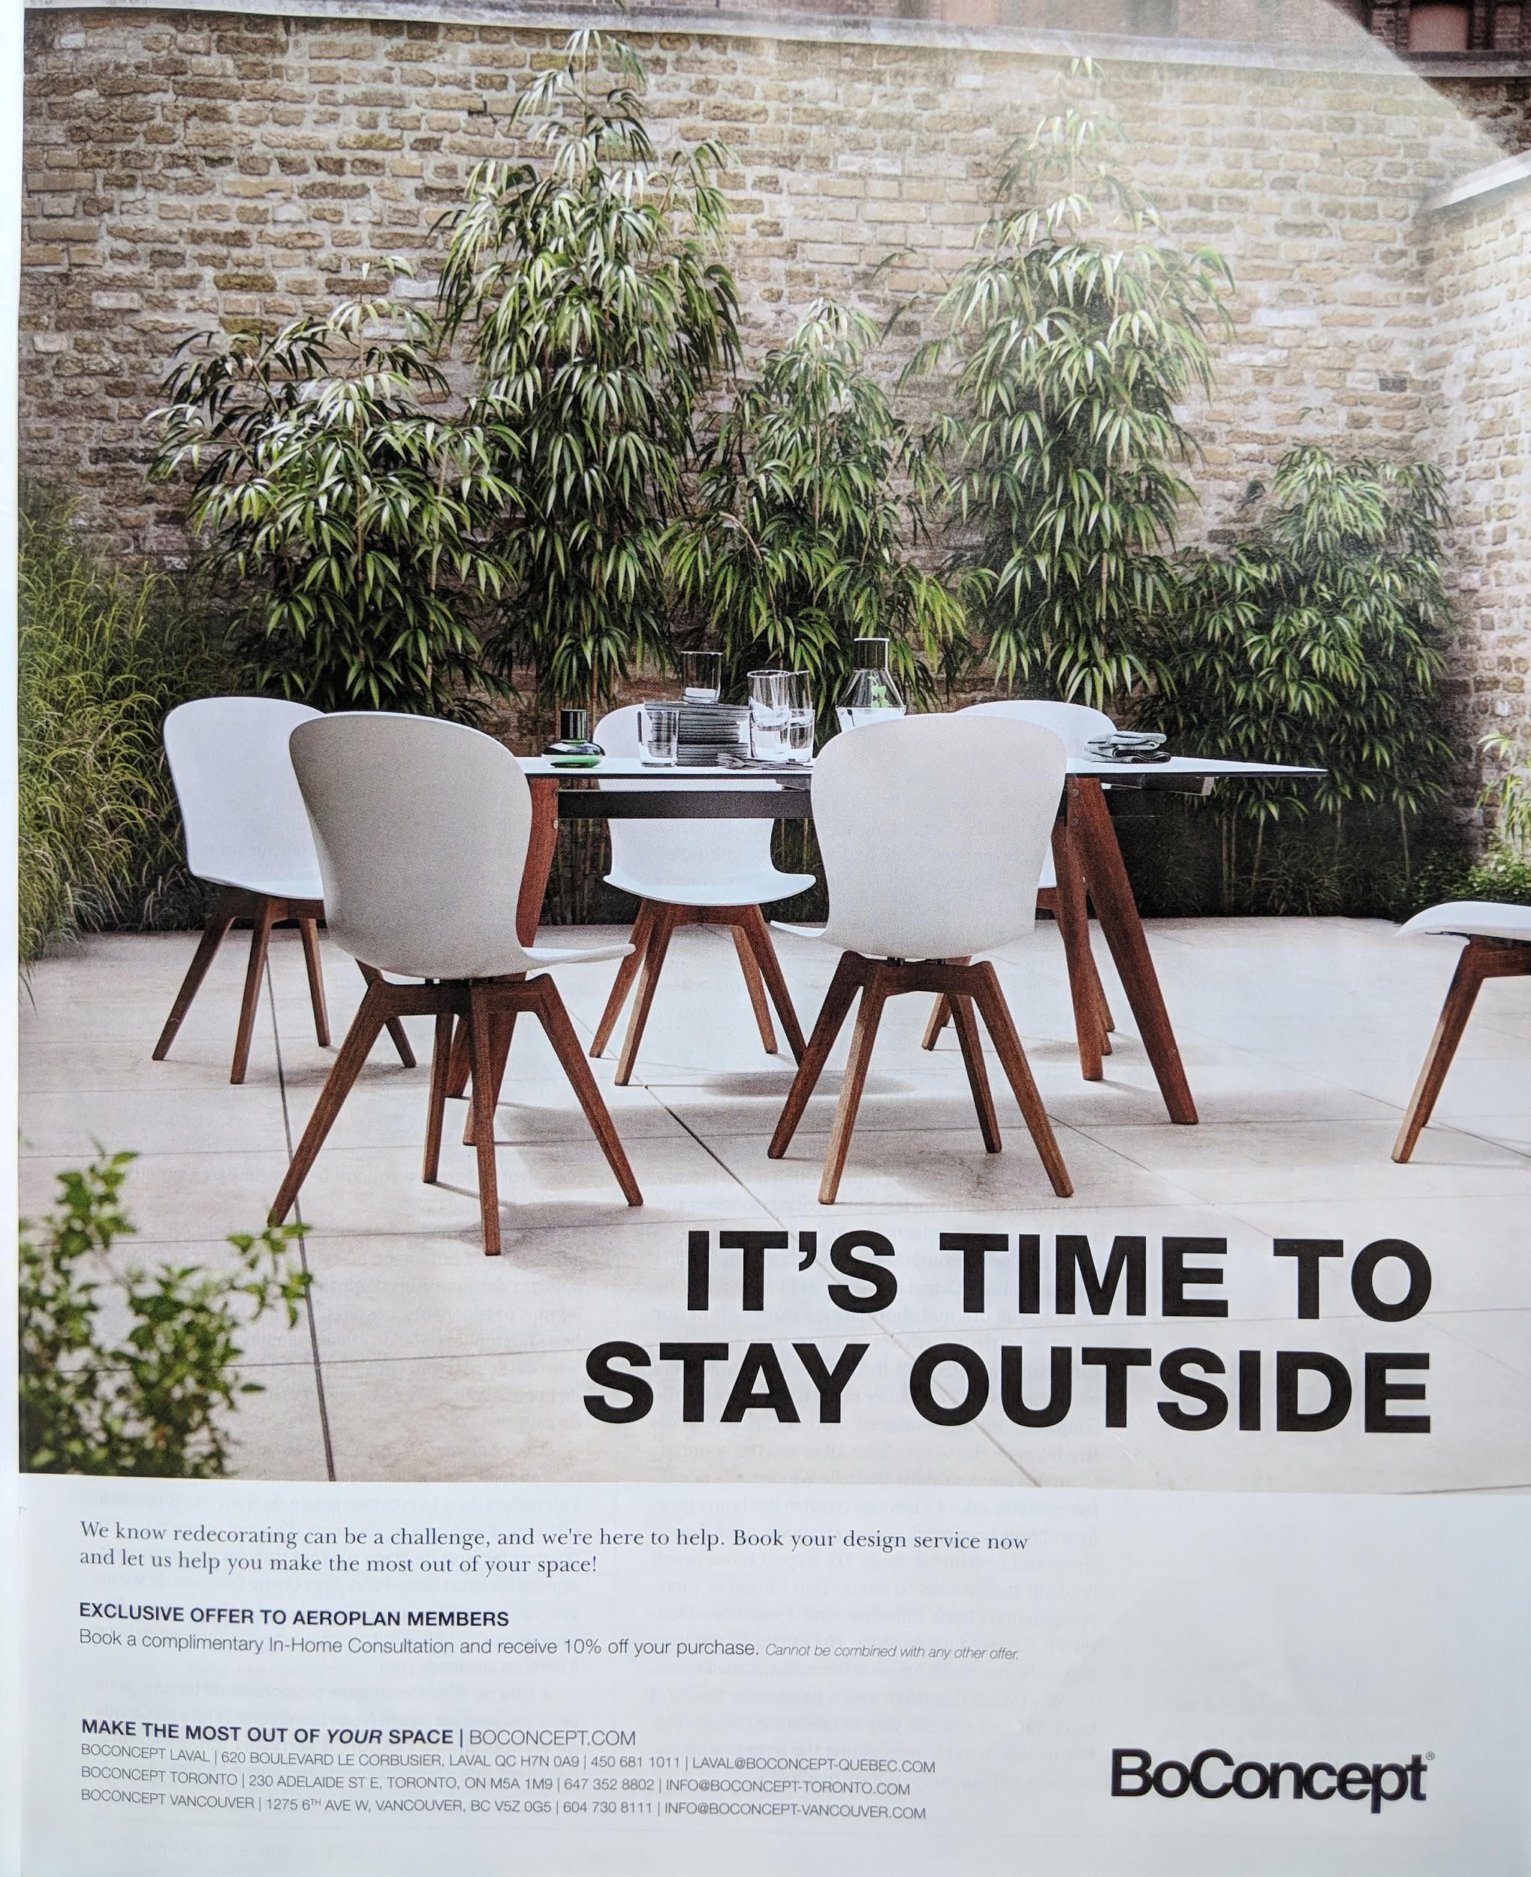
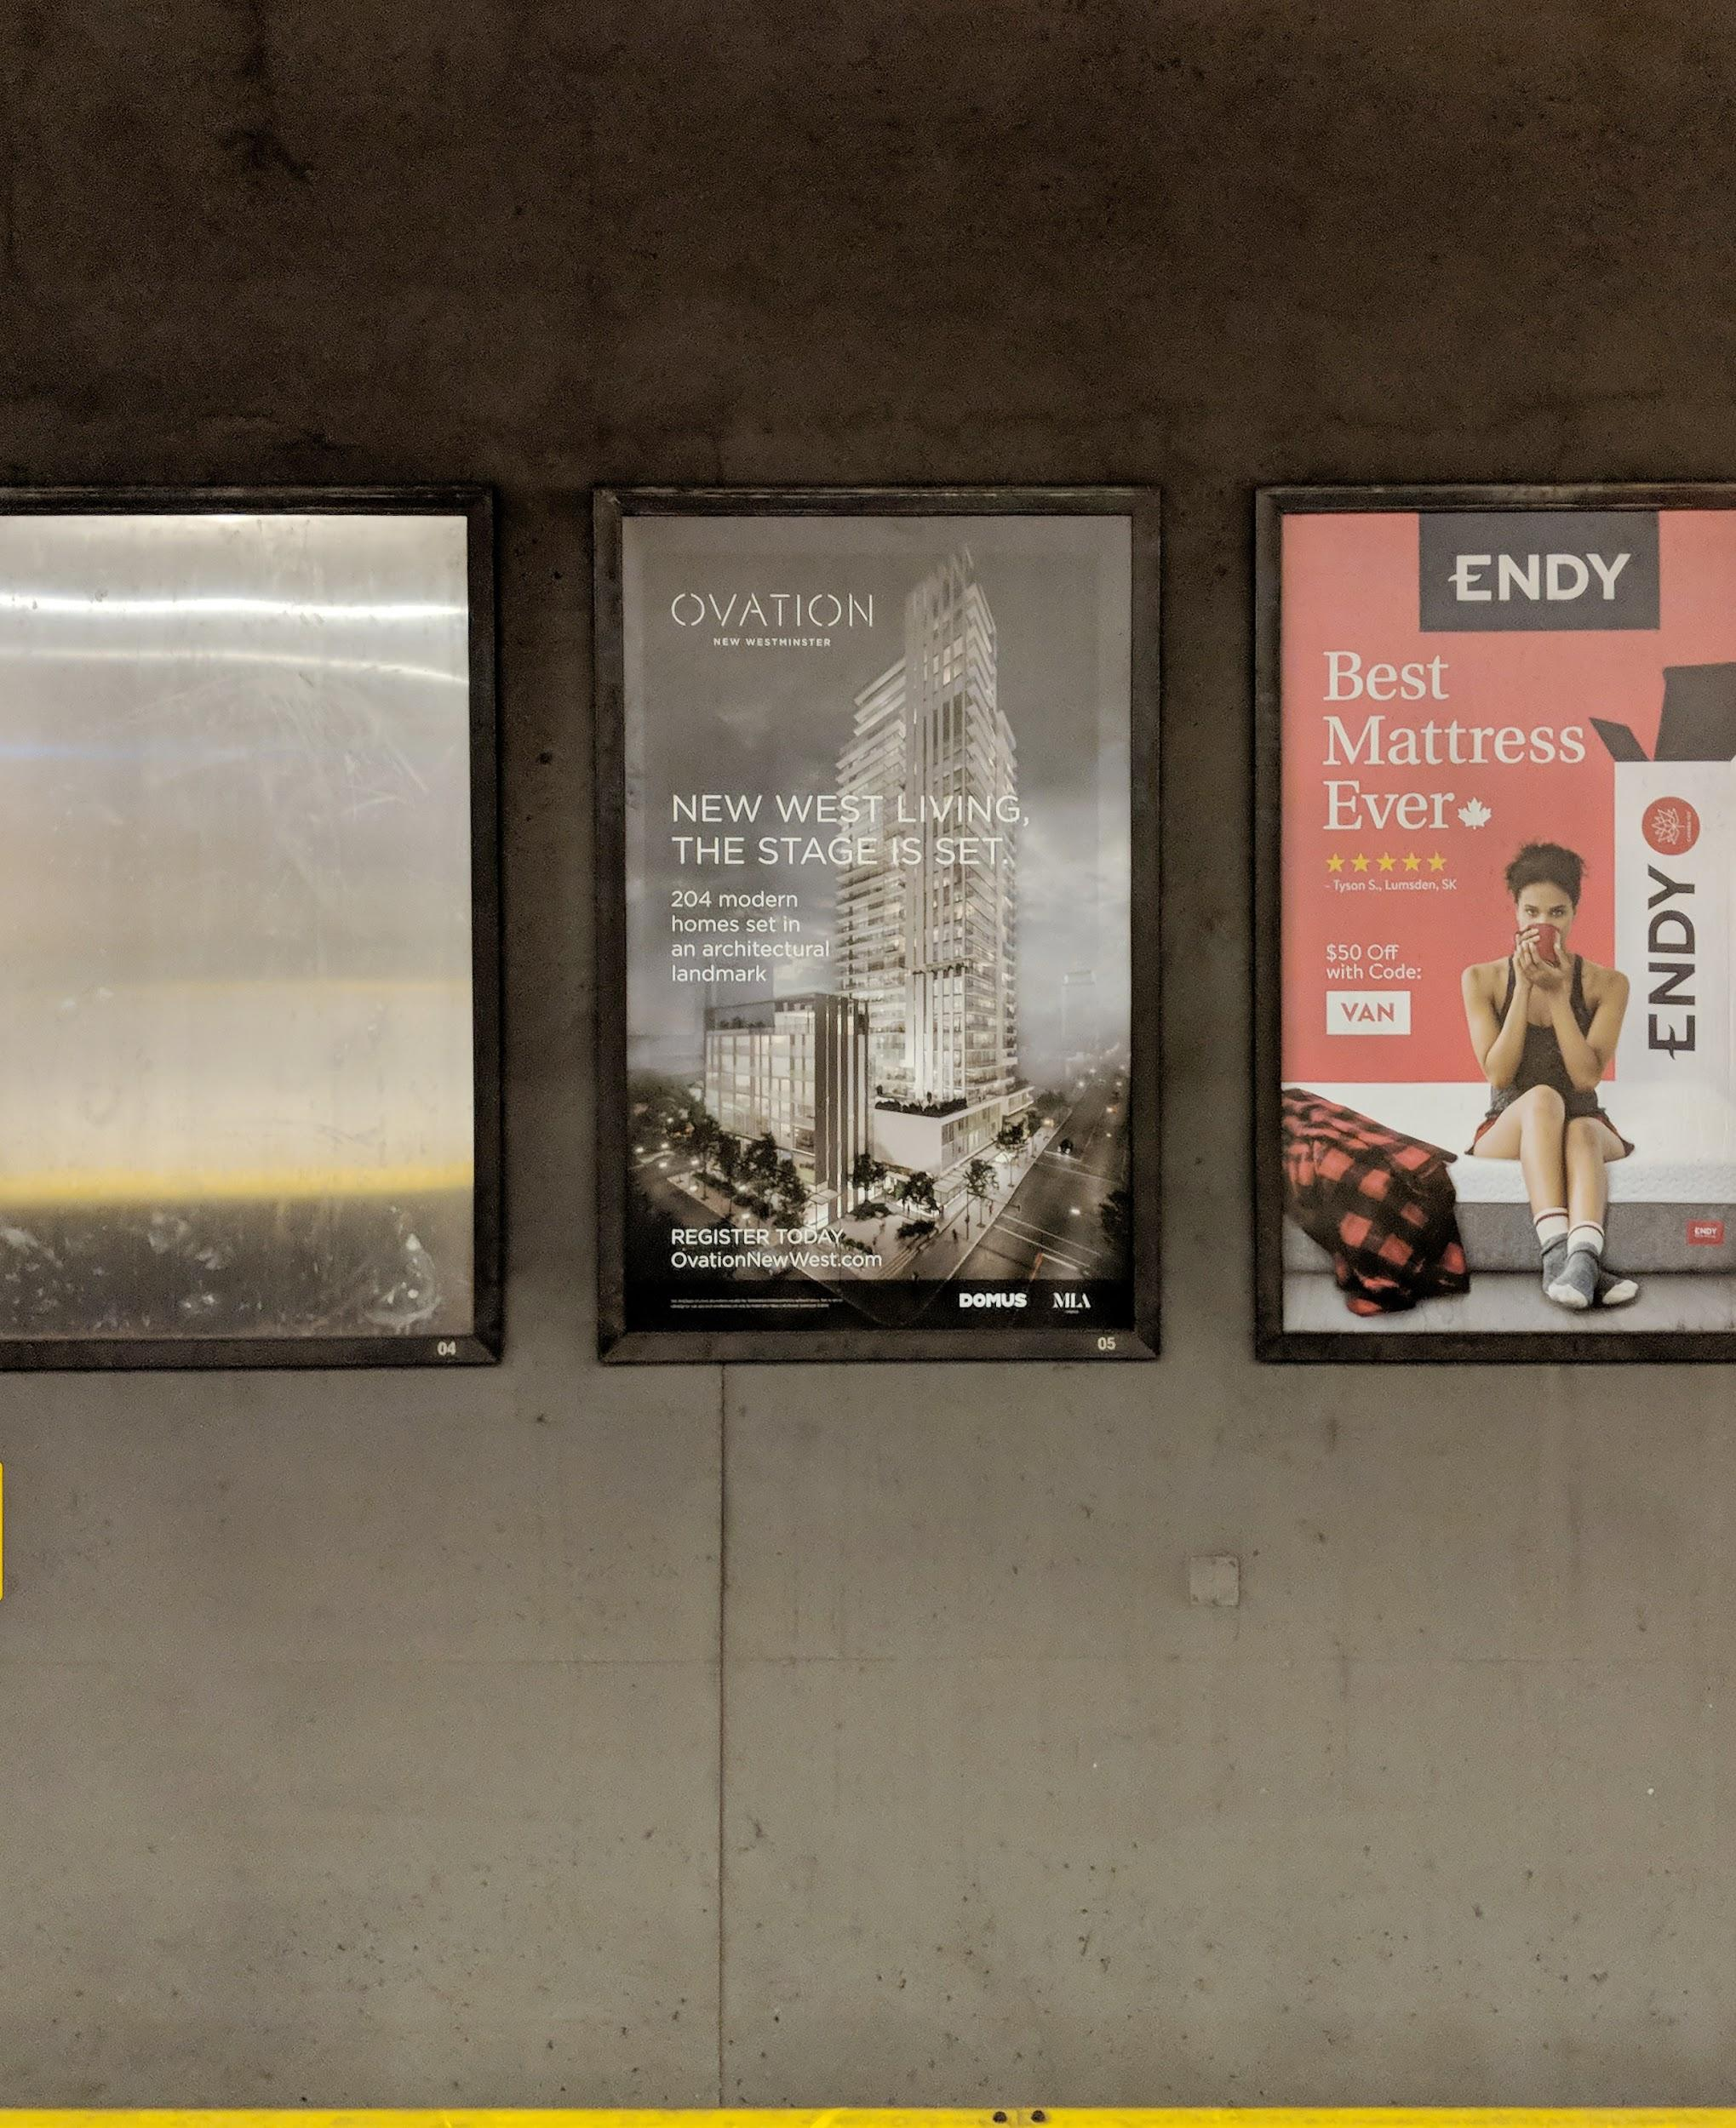
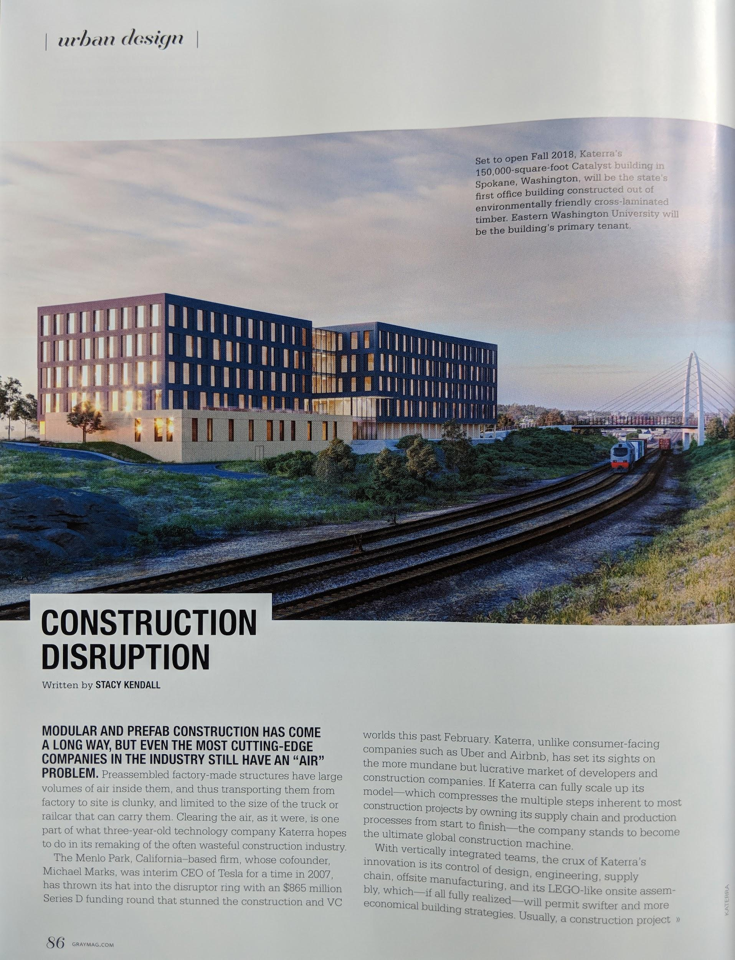
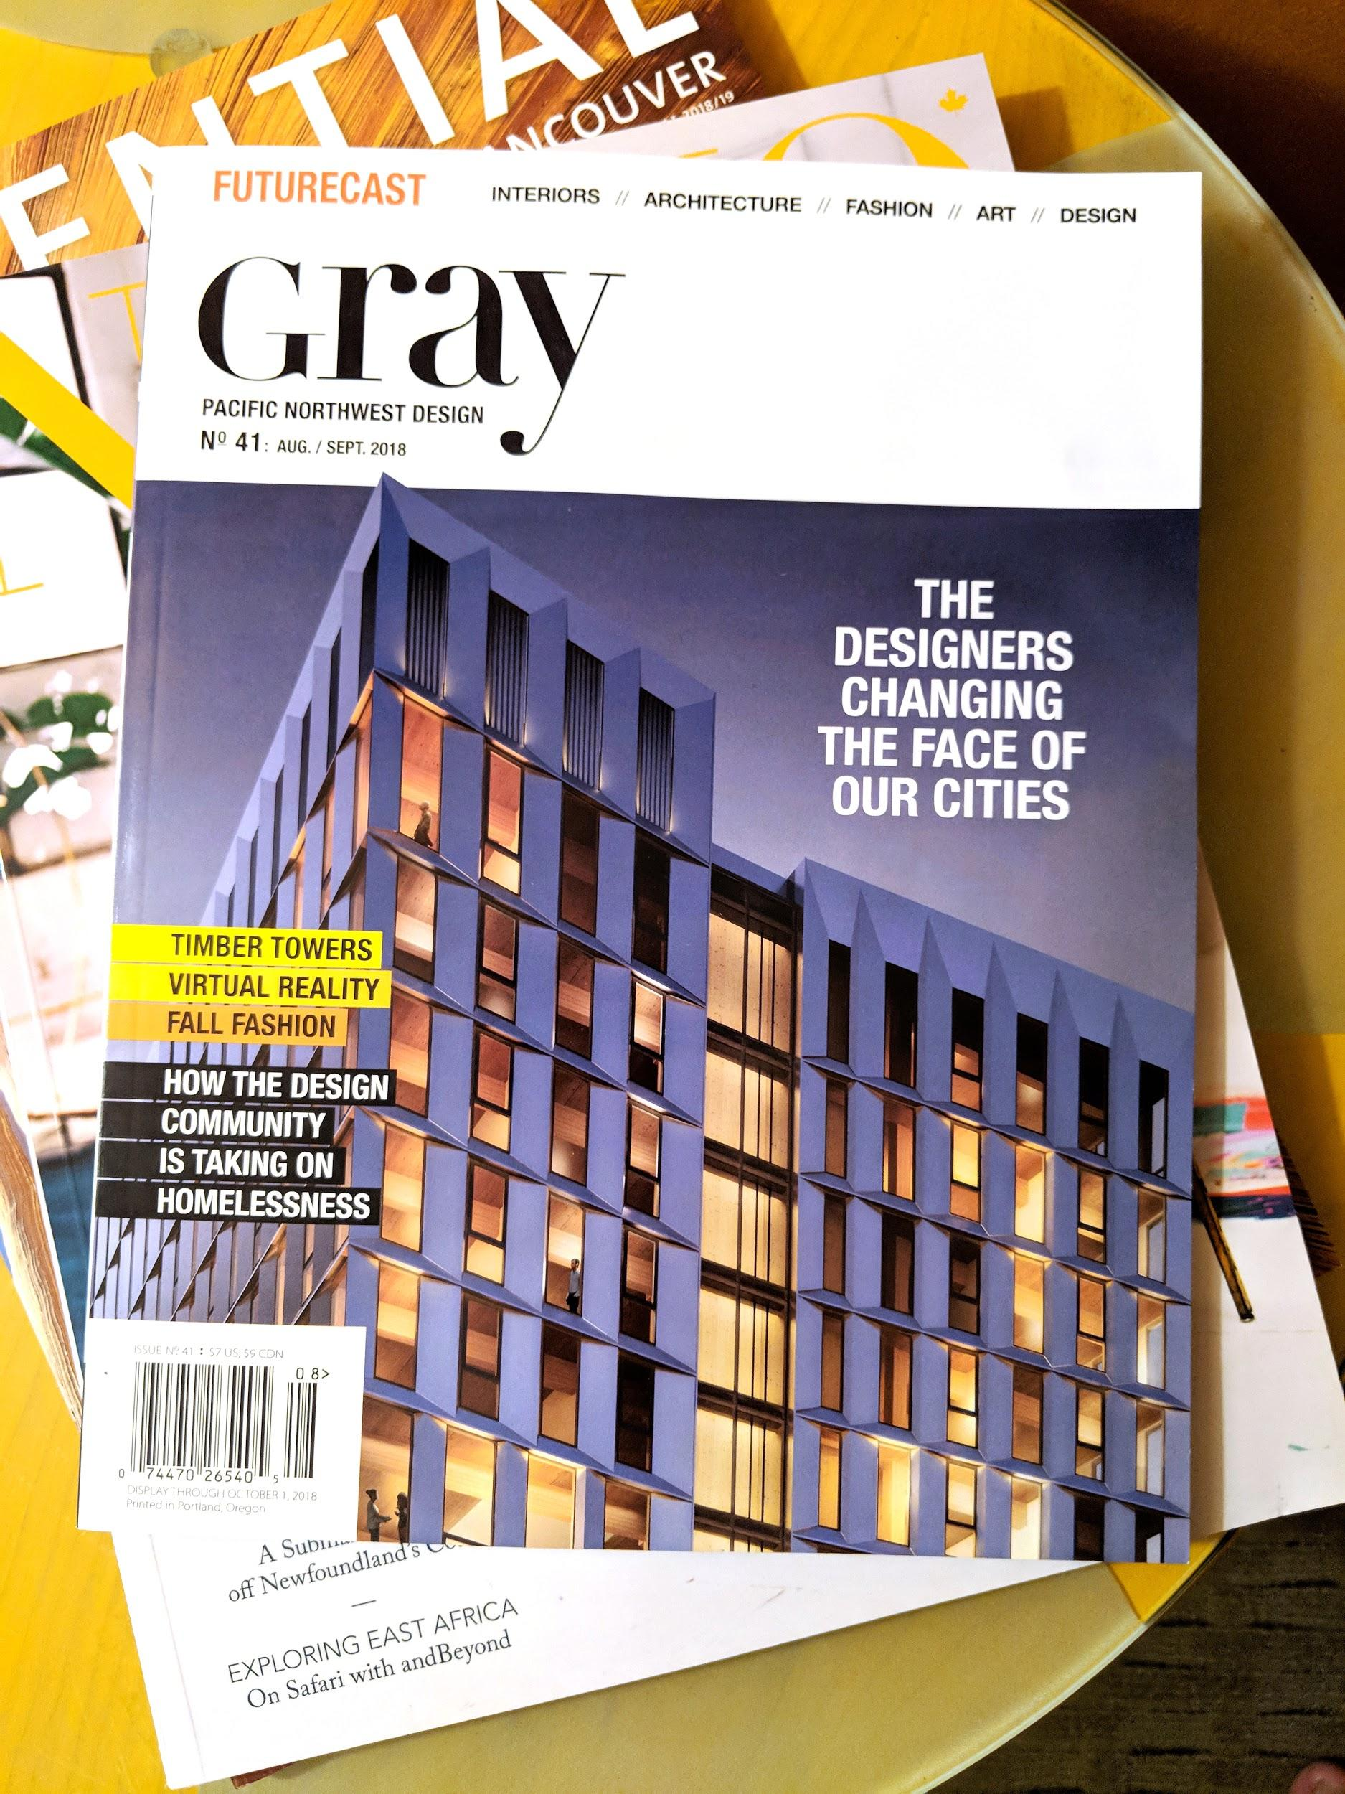
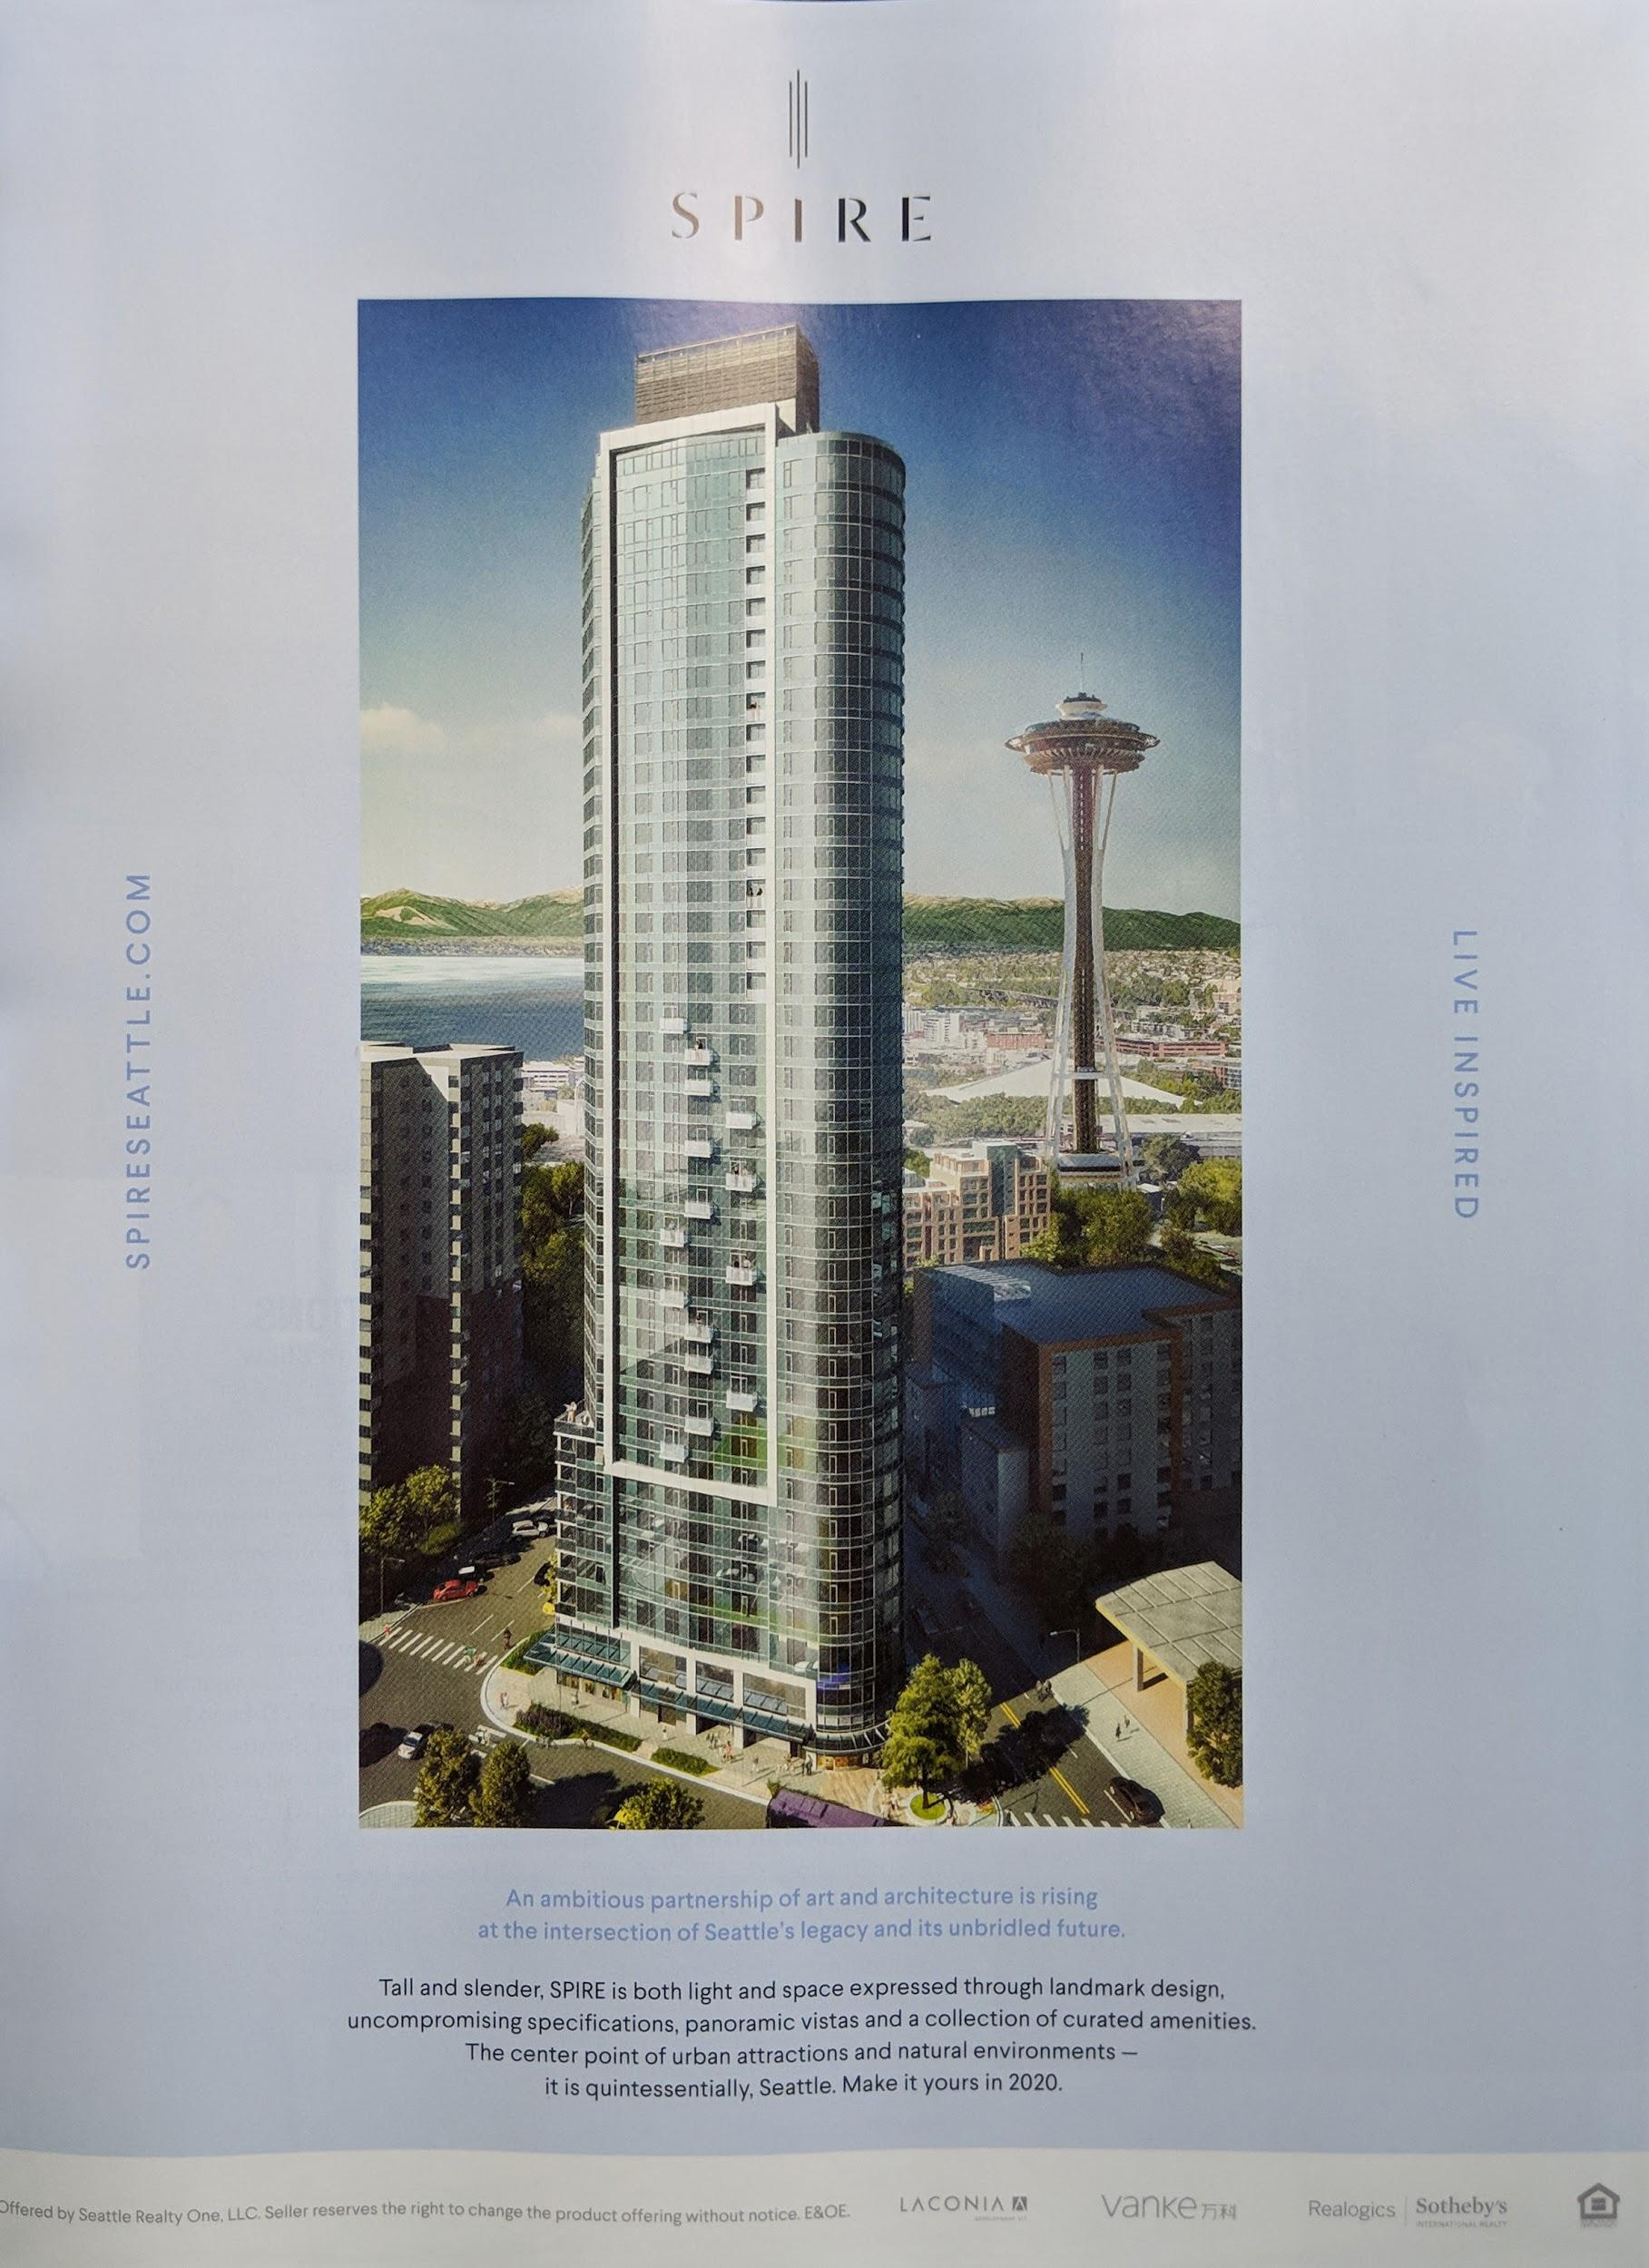
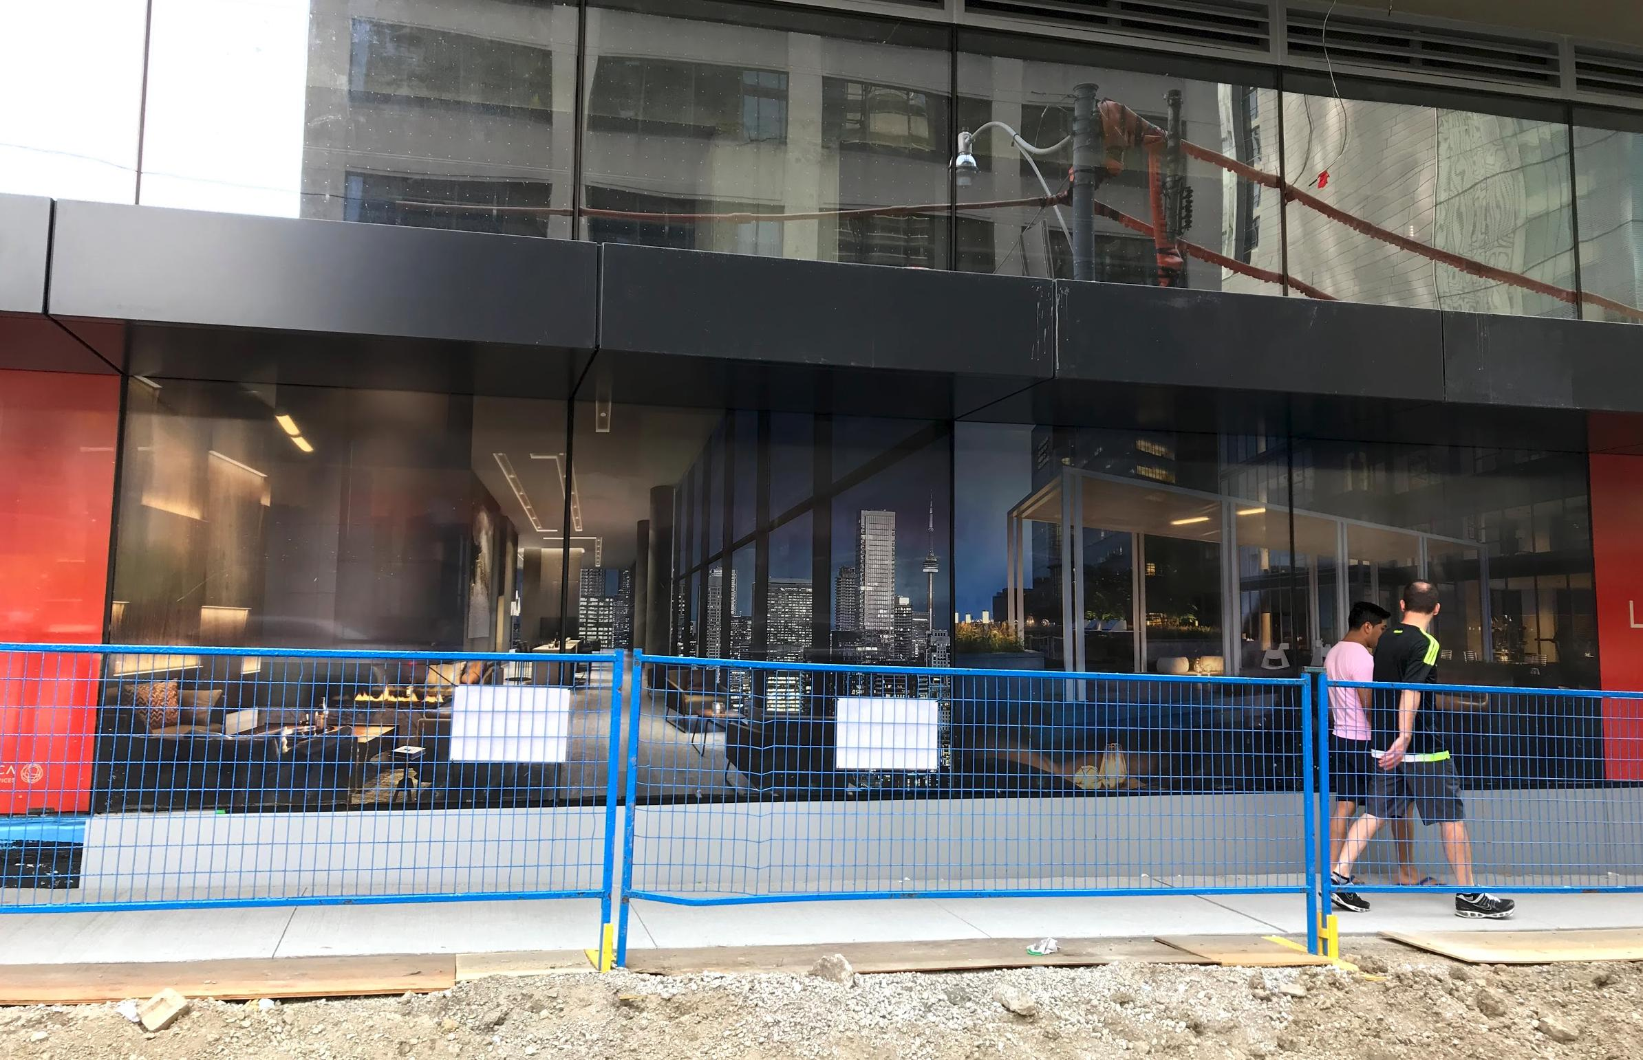
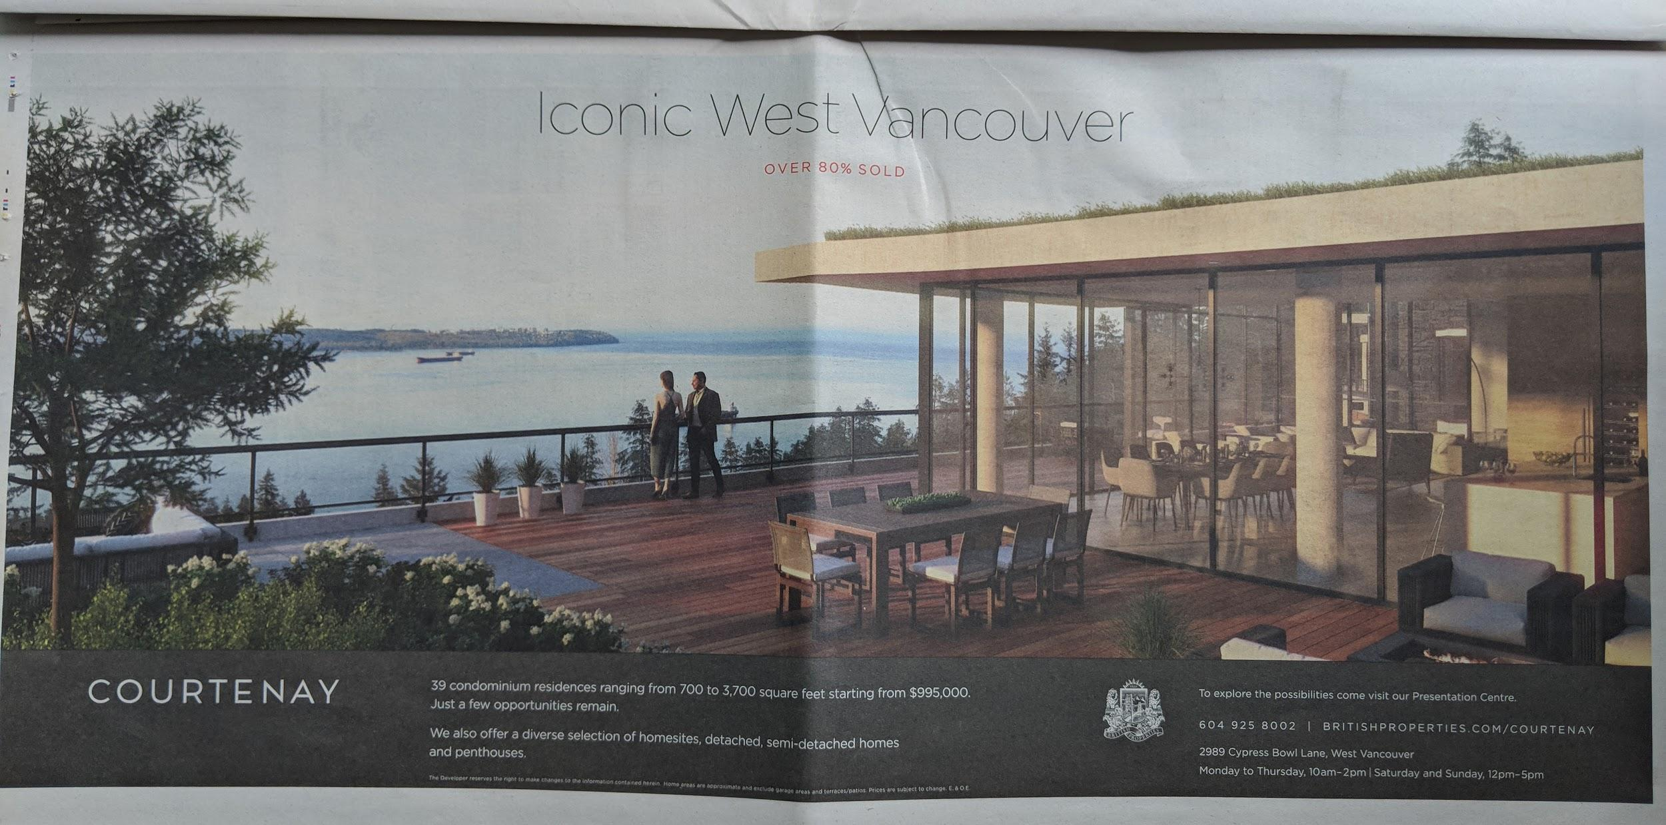
Notes:
I prepared the slides and wrote that arch viz is everywhere
Thought that maybe just because I’m obsessing?
Tried to pay attention to arch viz images on my way from Toronto to Vancouver
Arch Viz actually is everywhere

Slide 8
Why is it everywhere?
Architectural Firm
In-House Render Team
Rendering Studio
Our world is growing and changing everyday
Our cities change
Our interior design tastes change
Our daily living is always evolving
ArchViz is the medium to tell stories about
A future community
A future space to work in
A future place to live in

Slide 9
What type of application?
Who creates architectural visualizations?
What is our approach?
What is important to us?
Notes:
Describe the type of application for arch viz
Typical profile of people creating arch viz
Who we are at Norm li and what our workflow is to give you some context of where I’m coming from
What’s important to us

Slide 10
Types of Applications

Slide 11
Design Review End user: Architects, interior designers, Clients
Notes:
When architect/interior designer design something
Want to get it approved by other architect or client
Create an image so they can share it and get feedback

Slide 12
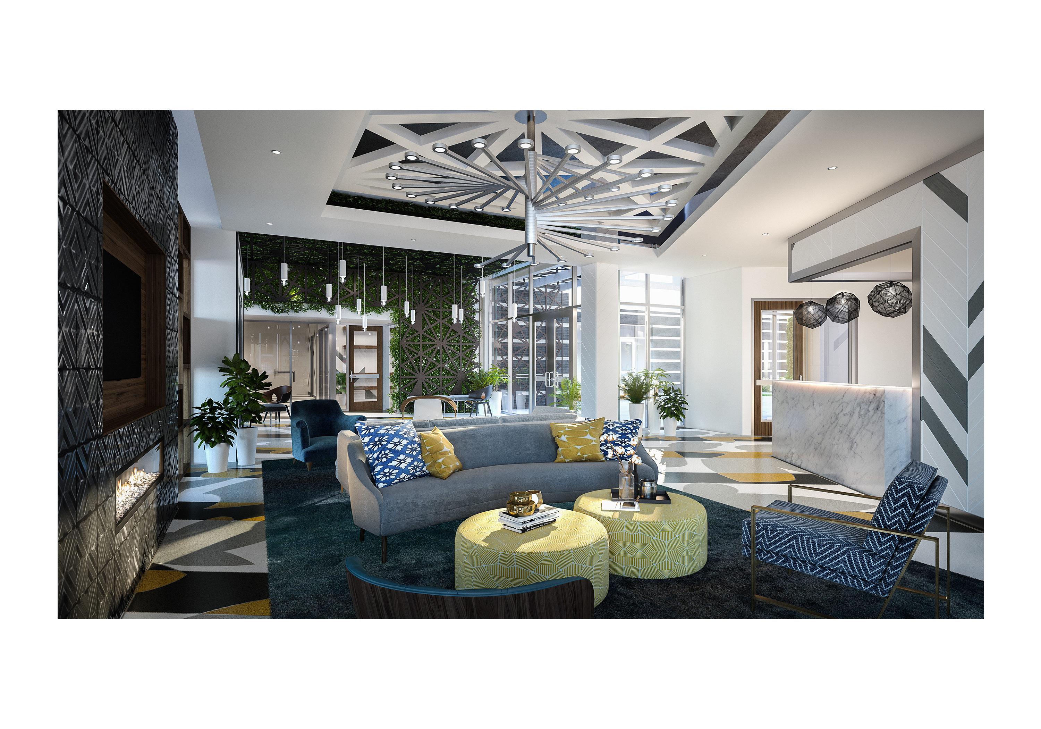
Notes:
Get it reviewed

Slide 13
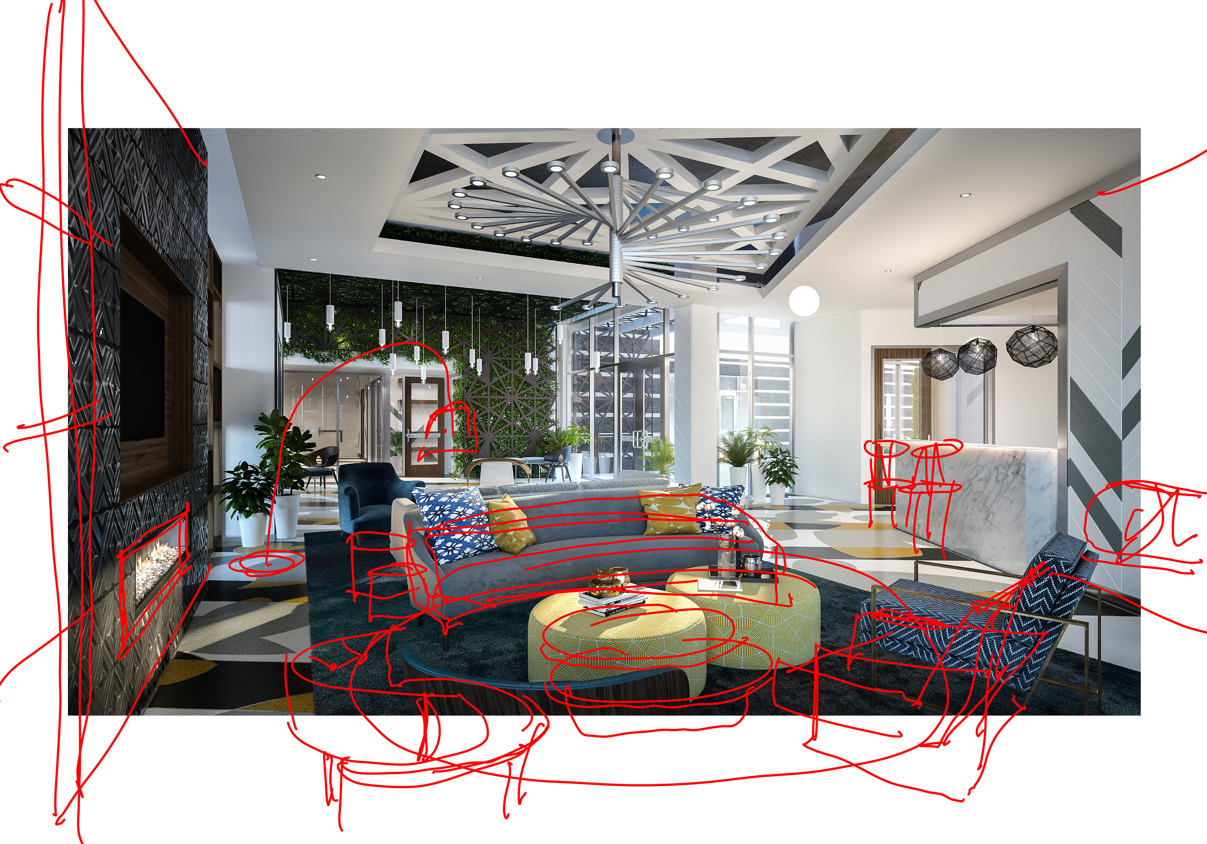
Notes:
And they do it again

Slide 14
Architectural Competitions End user: Jury, investors, public
Notes:
When city wants a new project built like library or new community
They don’t go straight to an architect but ask some selected architect to propose their best idea
Present an idea/concept to the jury/ investors and sometimes to the public

Slide 15
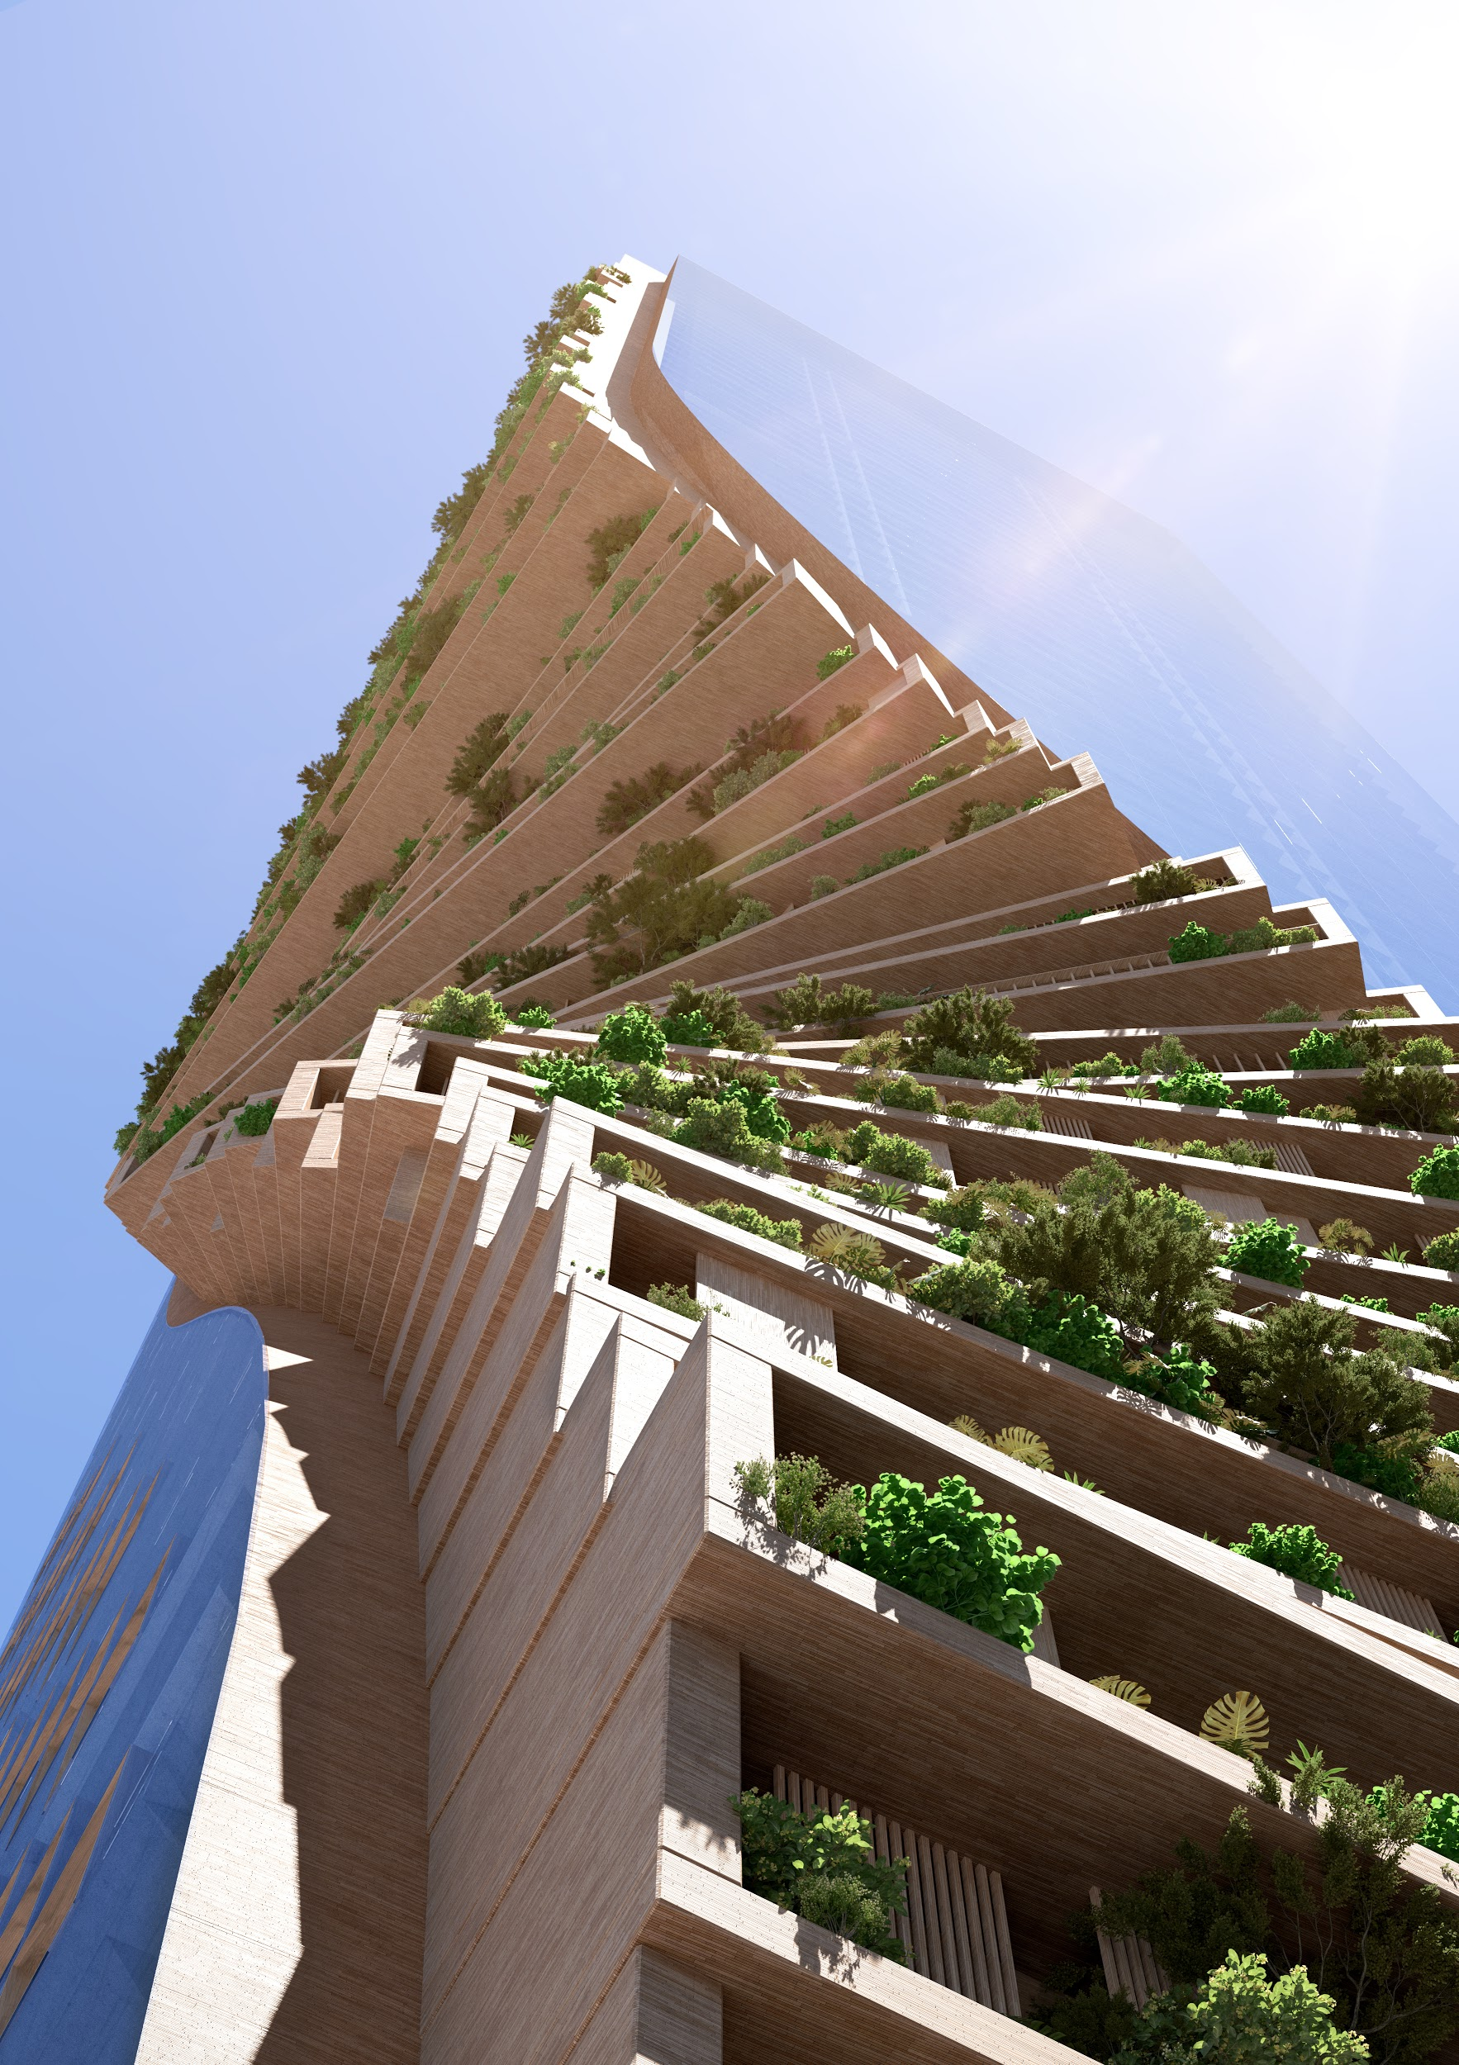
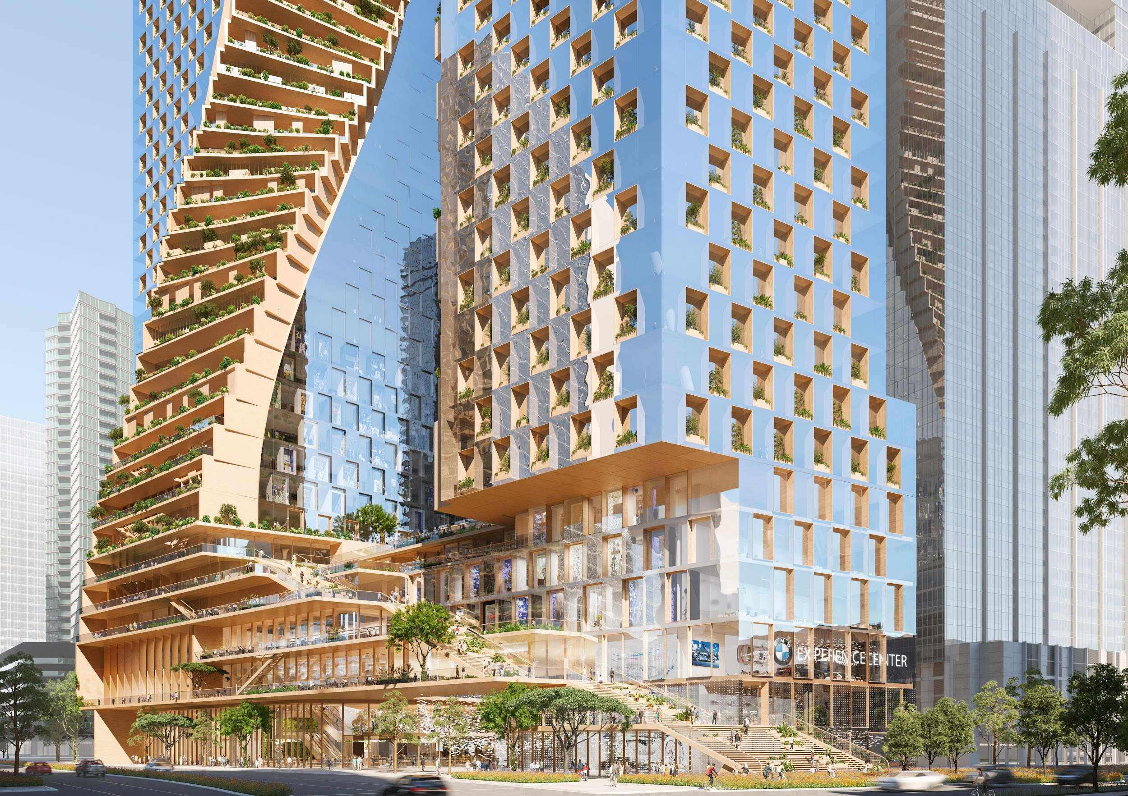
Notes:
Not representative of final design
UNStudio in Melbourne
Still being reviewed now
Once architect is picked then they actually design final tower based on concept - or not

Slide 16
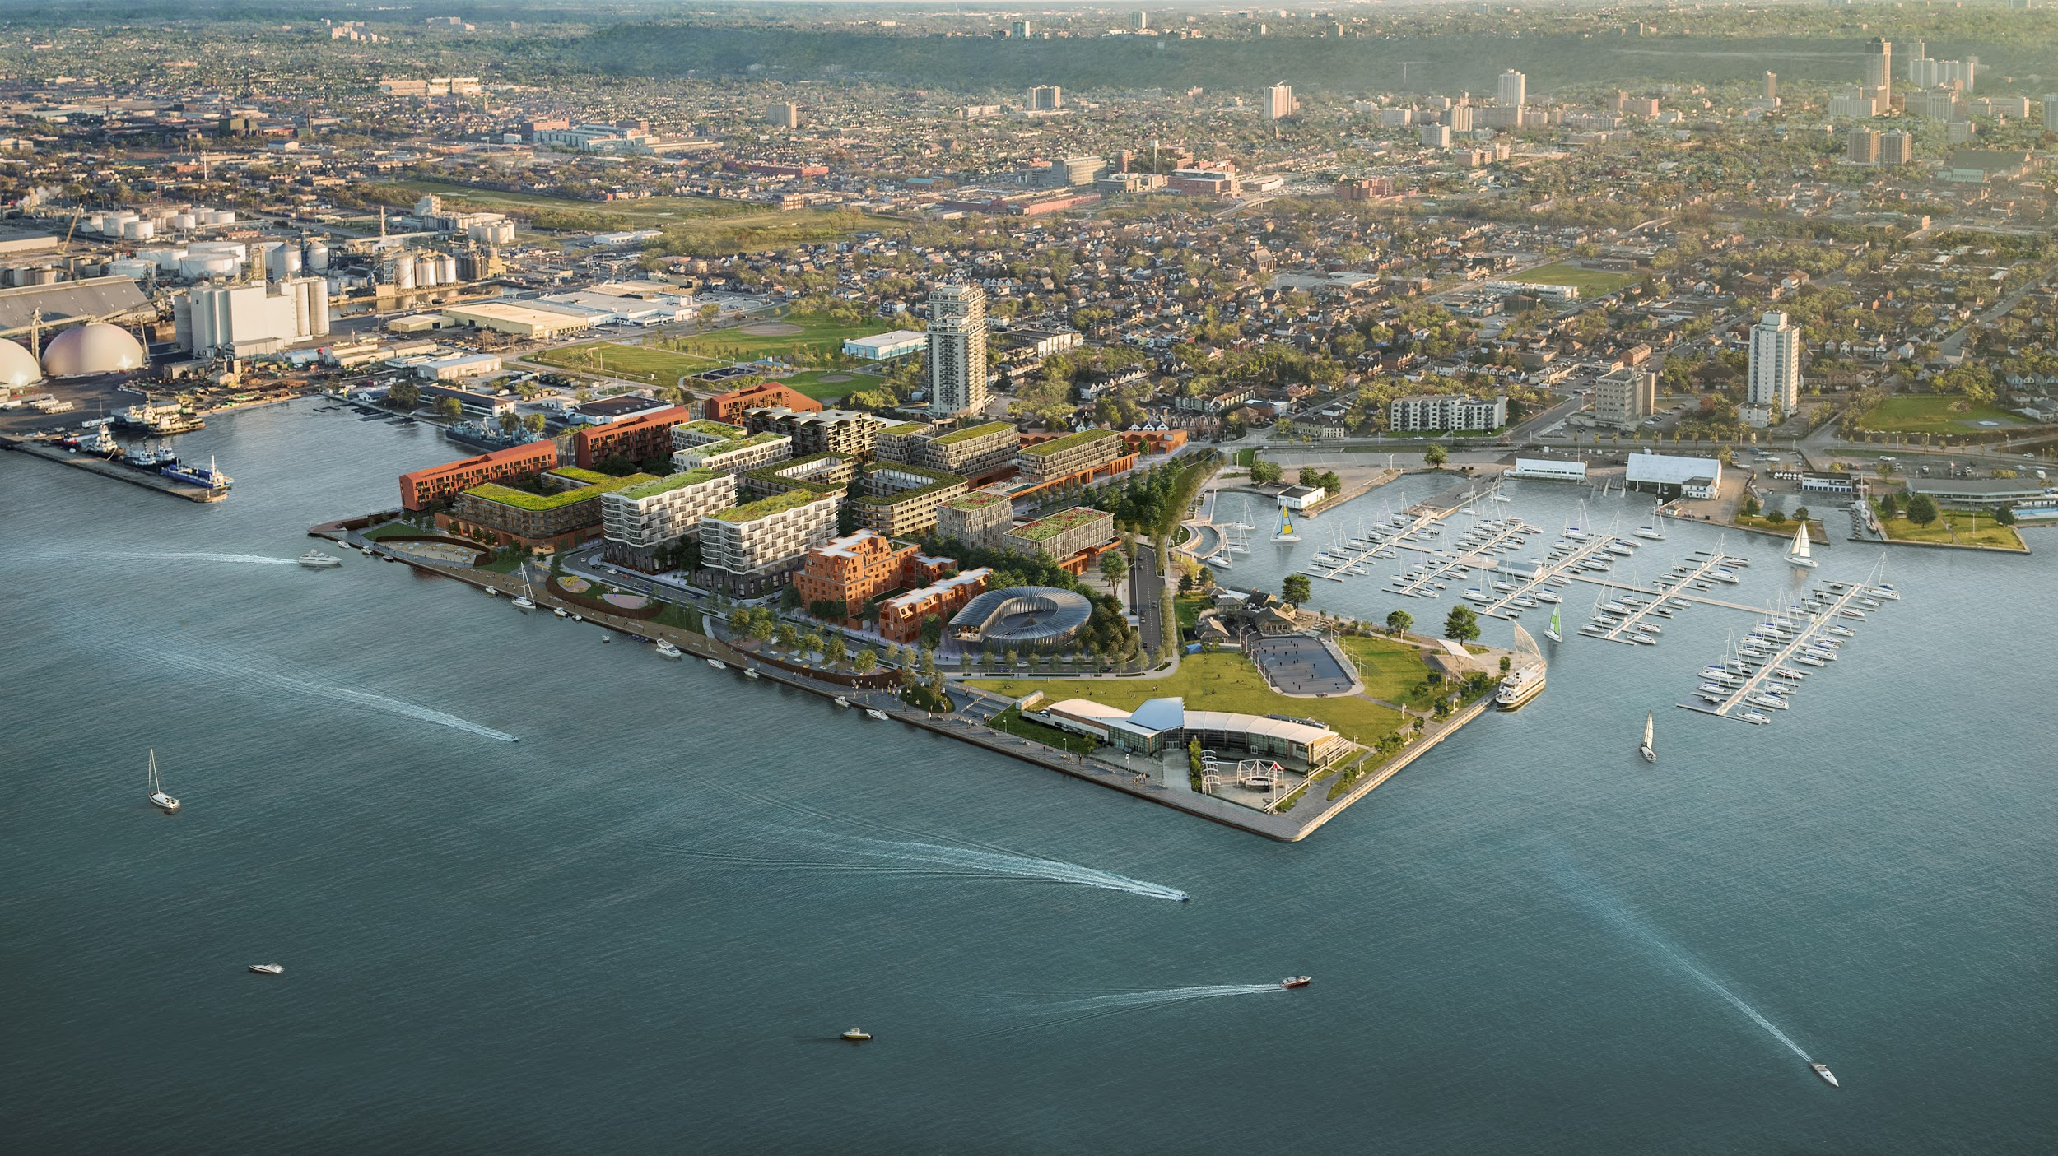
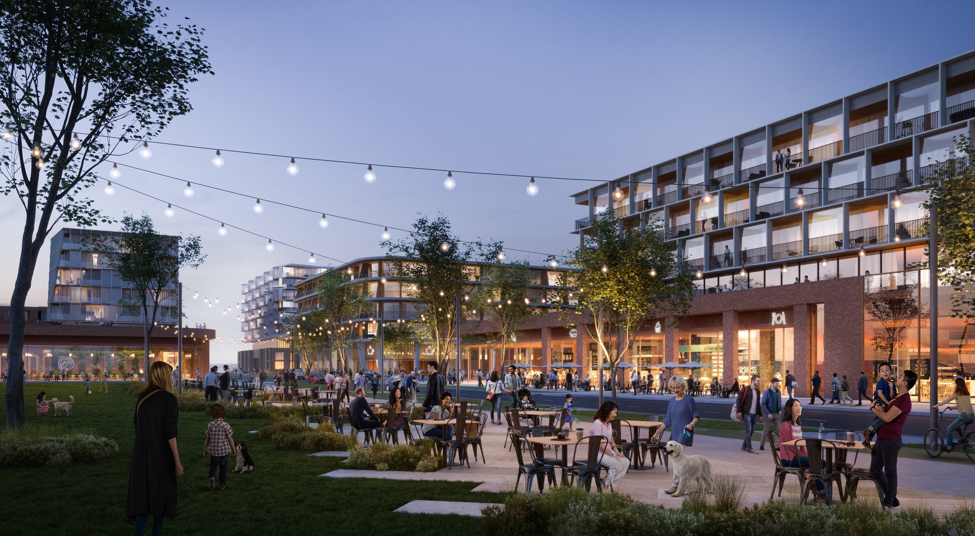
Notes:
Pier 8 in Hamilton, Won a couple of months ago

Slide 17
Urban Planning End User: City planners, Government, Public
Notes:
Once architect is picked and they work on the project
Lots of steps to get the city approved by the city

Slide 18
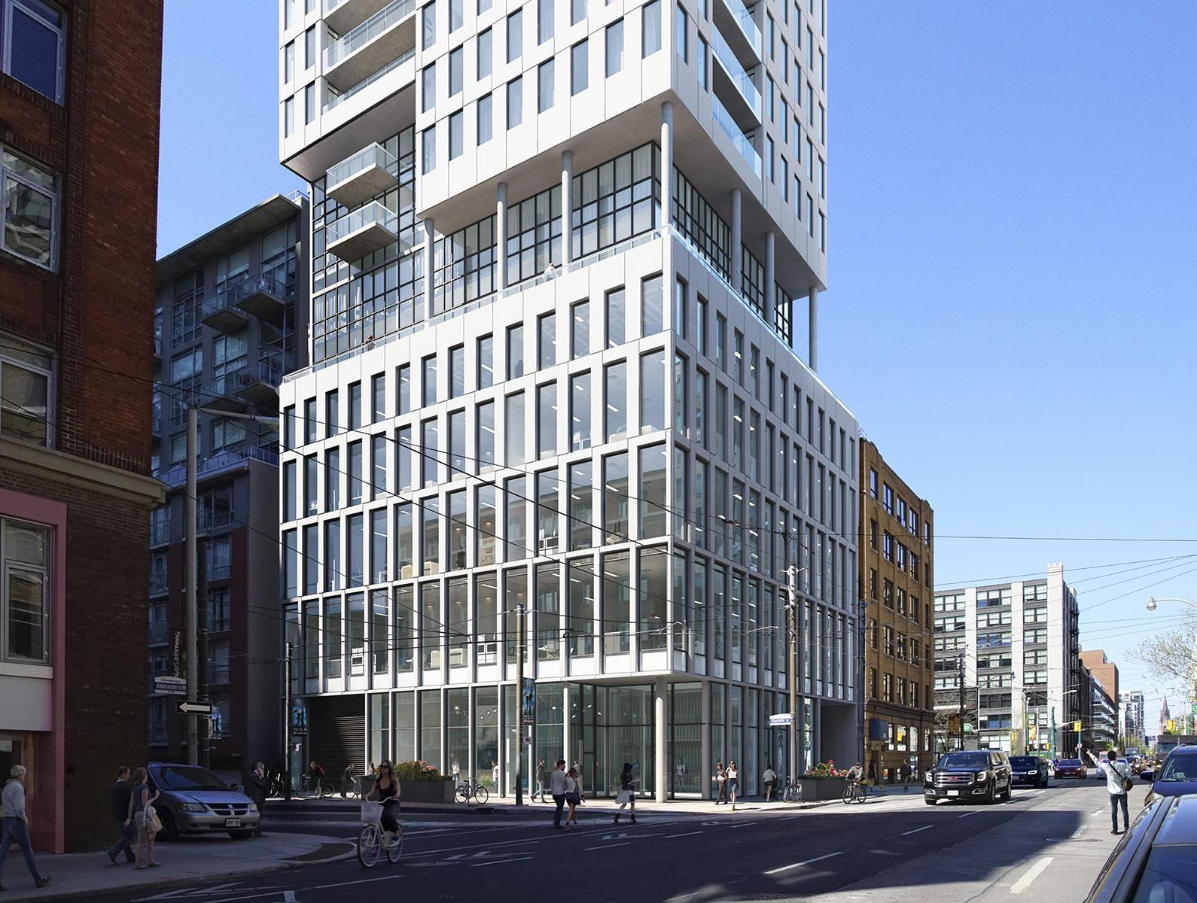
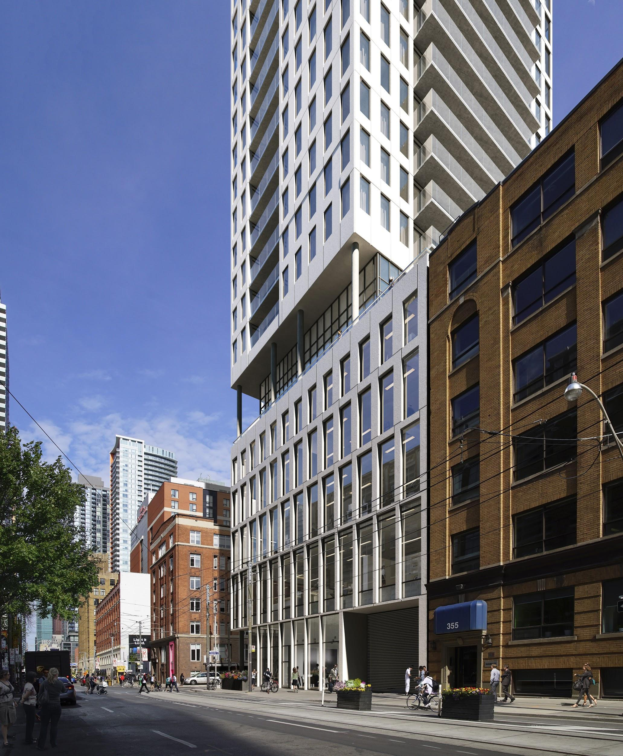
Notes:
Less flashy. Technical
Correct sun angles, can’t fake it
Building right size
No moody images with fancy light streaks
Check that building fits in neighborhood

Slide 19
Marketing End User: Public
Notes:
Most famous use of arch viz
Real estate and product design

Slide 20
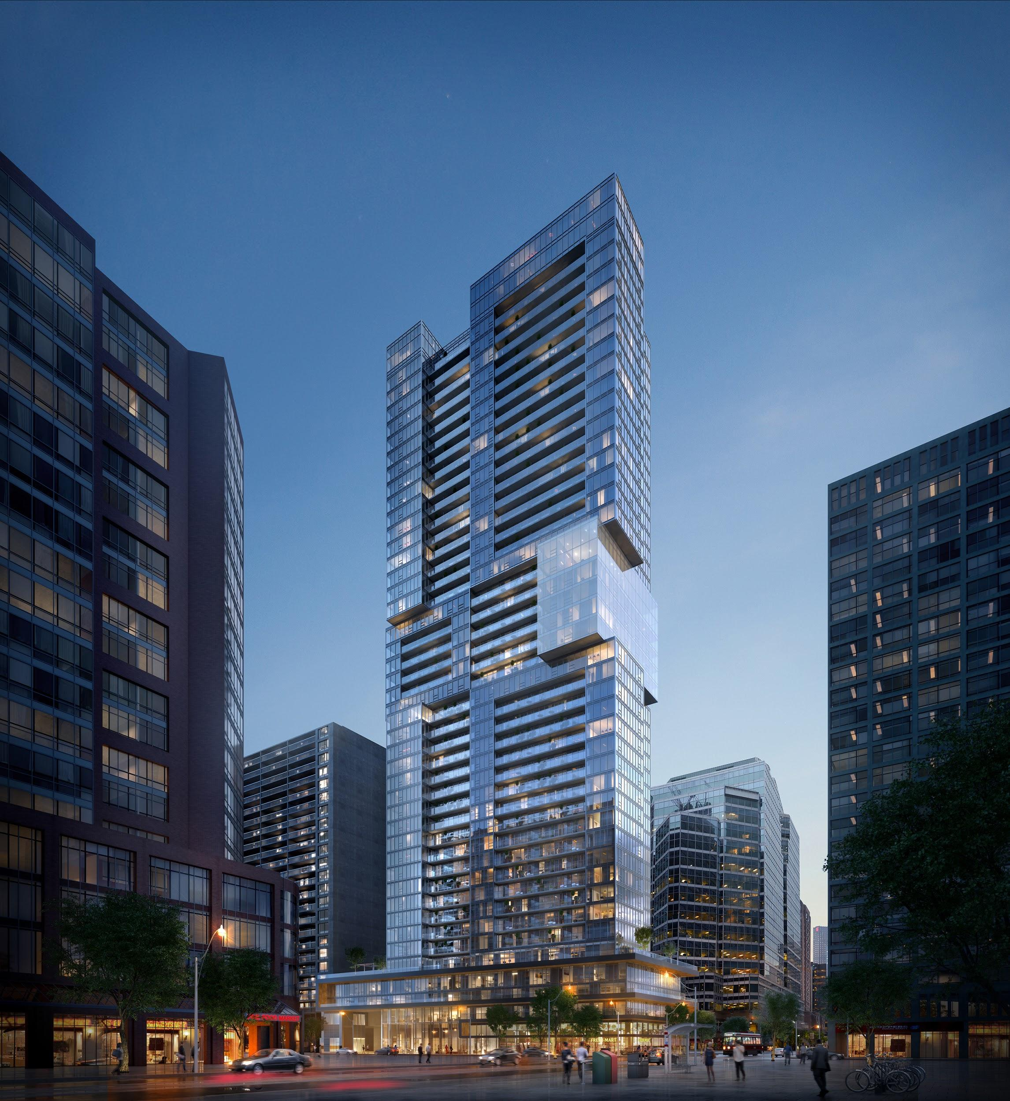
Notes:
End user is the public
Hopefully buyers
Show the project and how it fits in the neighborhood

Slide 21
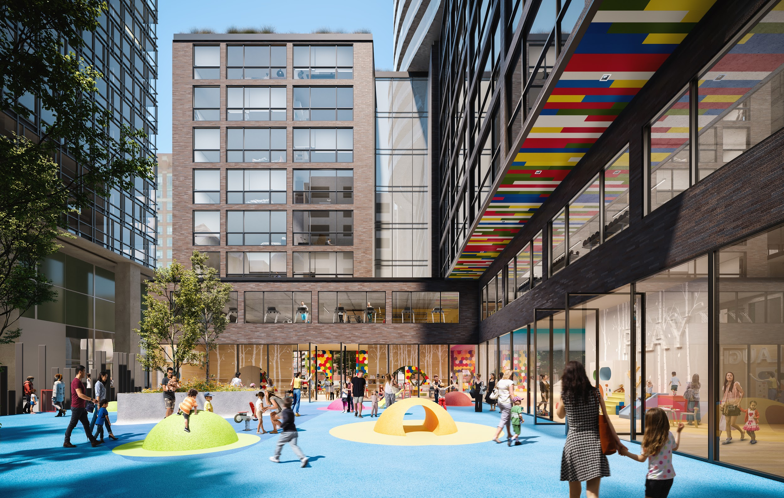
Notes:
Marketing to convey an idea.
kid friendly space
daycare and school in building

Slide 22
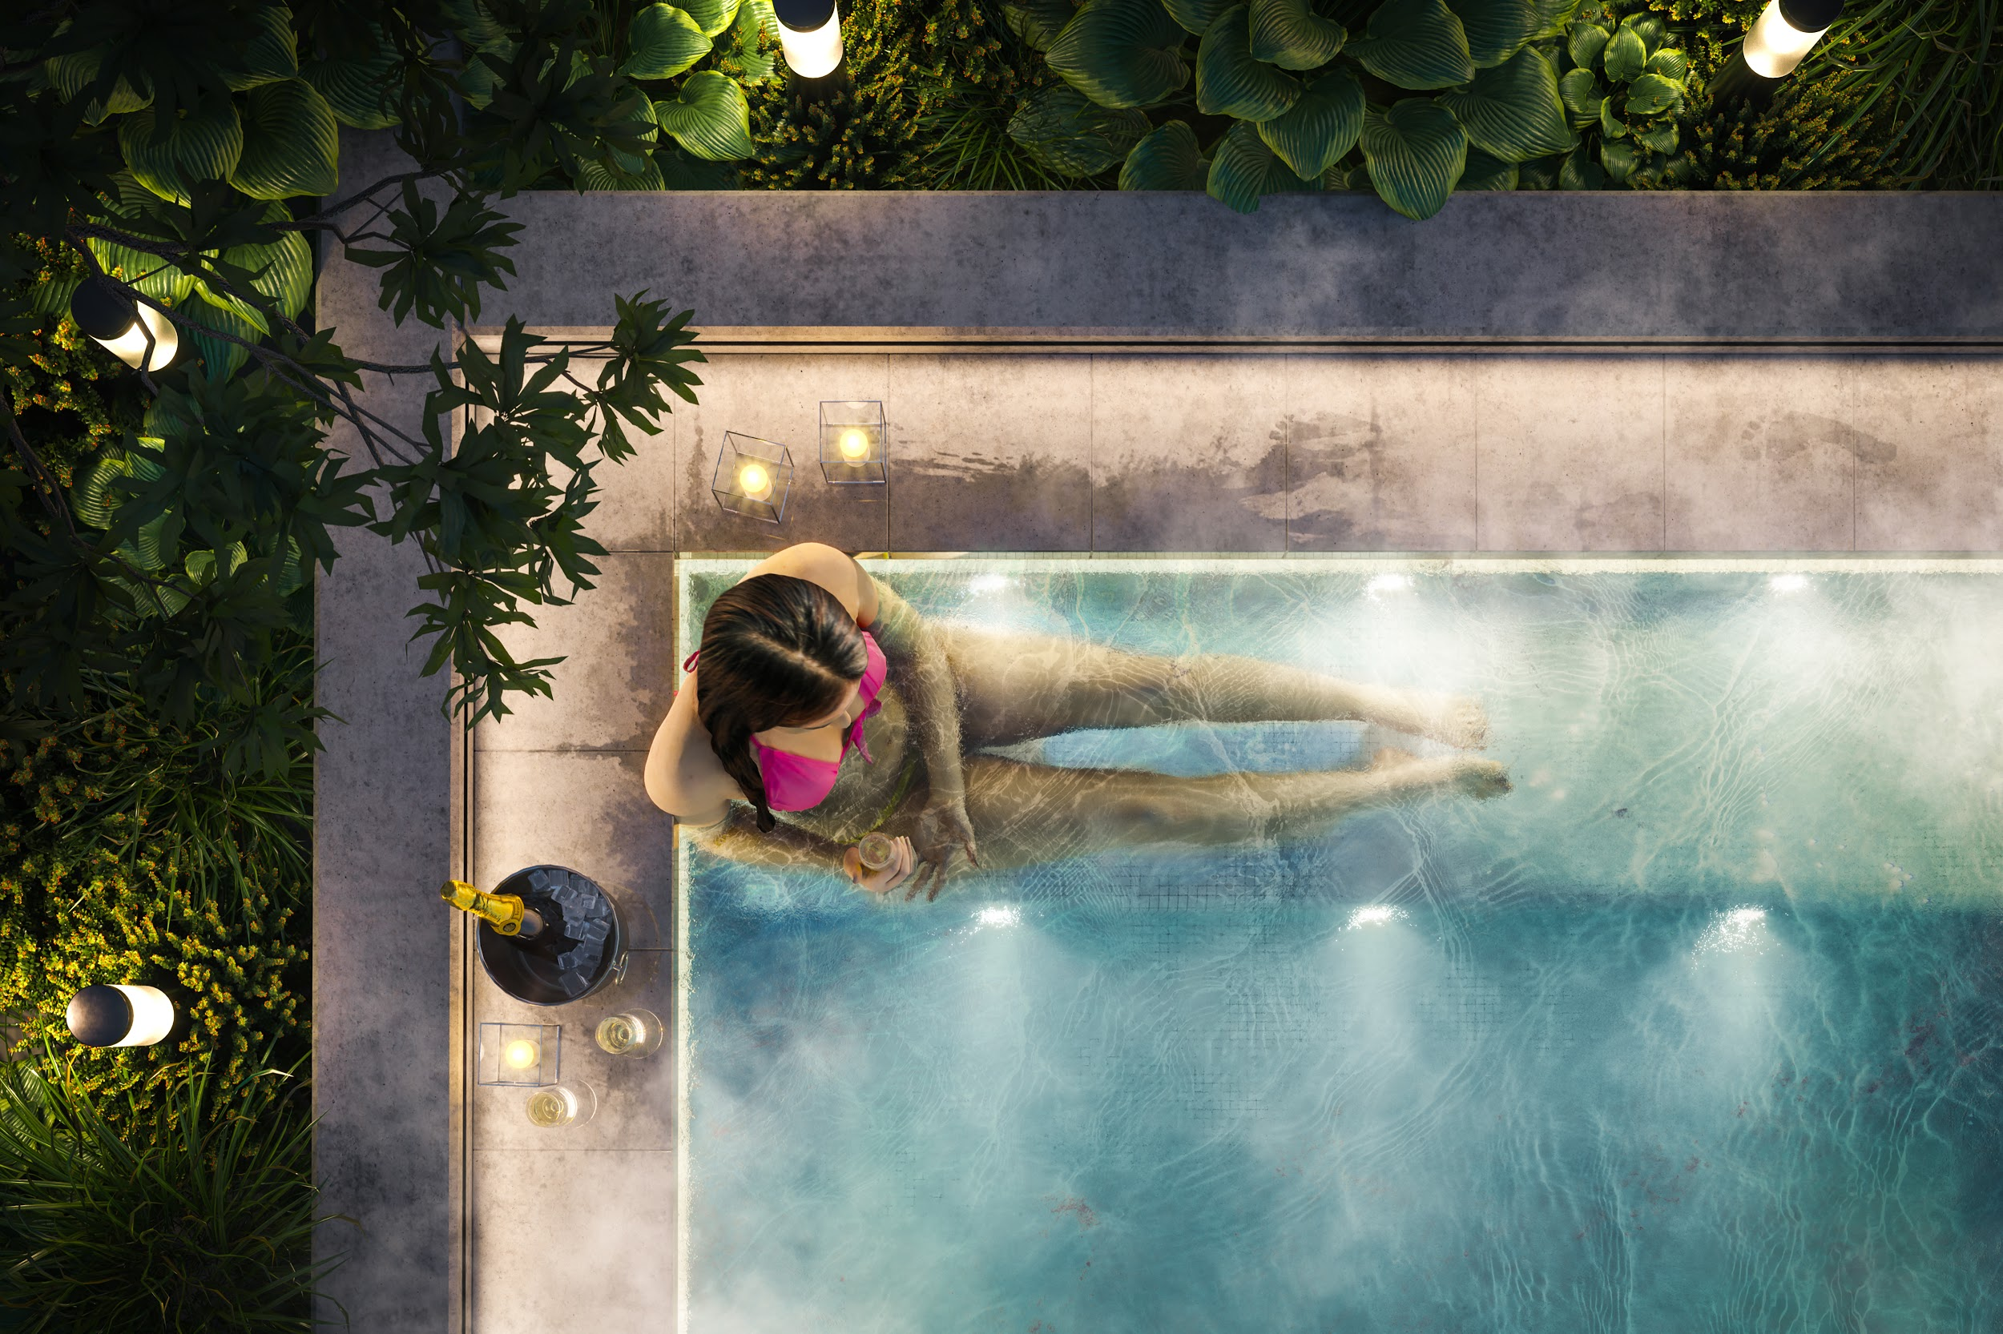
Notes:
Convey mood
Doesnt really show the design but more a lifestyle
If you buy that condo
enjoy life by just drinking champagne in your jacuzzi

Slide 23
ArchViz is more than just still images:
Animations
Interactive experiences
Virtual reality
Augmented reality
Web
Notes:
Animations. Been around for the past 10 years but easier and easier to produce so demand higher
Interactive experiences: been around for a while too but quality gets better
Virtual reality: new shiny one. Mobile oculus go. Wired rift or vive. Pick up pace once people actually have one home
Augmented reality: arkit, arcore, place furniture in your home, not there maybe see a building in the street
Web: future be able to share 3d model through browser. Then do virtual reality without headset

Slide 24
Who creates architectural visualizations?
Freelancers
Architectural Firm
In-House Render Team
Rendering Studio

Slide 25
Who creates architectural visualizations?
Students
Team Size: 1-3
Type of application:
Design review
Software: Revit, Rhino, Sketchup
Resources:
Notes:
Students:
Ressources limited:
Not a lot of software
IT department in university but can’t access always
Not a lot of assets
No render power

Slide 26
Who creates architectural visualizations?
Students
Architects
Team Size: 1-3
Team Size: 1
Type of application:
Design review
Type of application:
Design review, Client presentation, Urban planning, Marketing
Software: Revit, Rhino, Sketchup
Resources:
Software: Revit, Rhino, Sketchup
Resources:
Notes:
Architects:
Ressources limited:
More software
IT department if they don’t work by themselves
Build small asset library
Limited render power

Slide 27
Who creates architectural visualizations?
Students
Architects
Freelancers
Team Size: 1-3
Team Size: 1
Team Size: 1
Type of application:
Design review
Type of application:
Design review, Client presentation, Urban planning, Marketing
Type of application:
Client presentation, Urban planning, Marketing
Software: Revit, Rhino, Sketchup
Resources:
Software: Revit, Rhino, Sketchup
Resources:
Software: 3DS Max + Sketchup
Resources:
Notes:
Freelancers:
Ressources limited:
More software.
No IT but don’t have much hardware to debug
Asset library
Limited render power but online render farm

Slide 28
Who creates architectural visualizations?
Students
Architects
Freelancers
In house rendering team
Team Size: 1-3
Team Size: 1
Team Size: 1
Team Size: 1-10
Type of application:
Design review
Type of application:
Design review, Client presentation, Urban planning, Marketing
Type of application:
Client presentation, Urban planning, Marketing
Type of application:
Design review, Client presentation, Urban planning, Marketing, Animations
Software: Revit, Rhino, Sketchup
Resources:
Software: Revit, Rhino, Sketchup
Resources:
Software: 3DS Max + Sketchup
Resources:
Software: Sketchup, 3DS Max
Resources:
Notes:
In house rendering team:
Most architectural studios bigger than 50 people have their in house rendering team
Ressources limited:
All software need
IT department
Asset library
small render farm or at least their networked workstation

Slide 29
Who creates architectural visualizations?
Students
Architects
Freelancers
In house rendering team
VisualizationStudio
Team Size: 1-3
Team Size: 1
Team Size: 1
Team Size: 1-10
Team Size: 5-50+
Type of application:
Design review
Type of application:
Design review, Client presentation, Urban planning, Marketing
Type of application:
Client presentation, Urban planning, Marketing
Type of application:
Design review, Client presentation, Urban planning, Marketing, Animations
Type of application:
Client presentations, Urban planning, Marketing, Animations, Interactive, VR, etc.
Software: Revit, Rhino, Sketchup
Resources:
Software: Revit, Rhino, Sketchup
Resources:
Software: 3DS Max + Sketchup
Resources:
Software: Sketchup, 3DS Max
Resources:
Software: 3DS Max
Resources:
Notes:
Visualization studio:
Ressources limited:
All software need
IT department
RD department
Big Asset library
render farm + networked workstation
Online render farm
Market is really fragmented in a way that very different team size and profile work on same type of project.

Slide 30
All are different but all have things in common:
Always have tight timelines
ArchViz artists come from:
Formal education in architecture or design
Self-taught
Great artistic sense but lack formal technical training
Passion for ArchViz
Notes:
Like in evert over industry tight timeline
Arch Viz artists typically either have a formal education in architecture or design
3. No technical training other than youtube tutorials and forum
We all are passionate people and always looking to improve

Slide 31
Who are we?
Notes:
Now that you know a bit more about the industry what can be produced
Going to talk to you about our team so you know in what category we are
Talk about our process which is similar to a lot of other companies

Slide 32
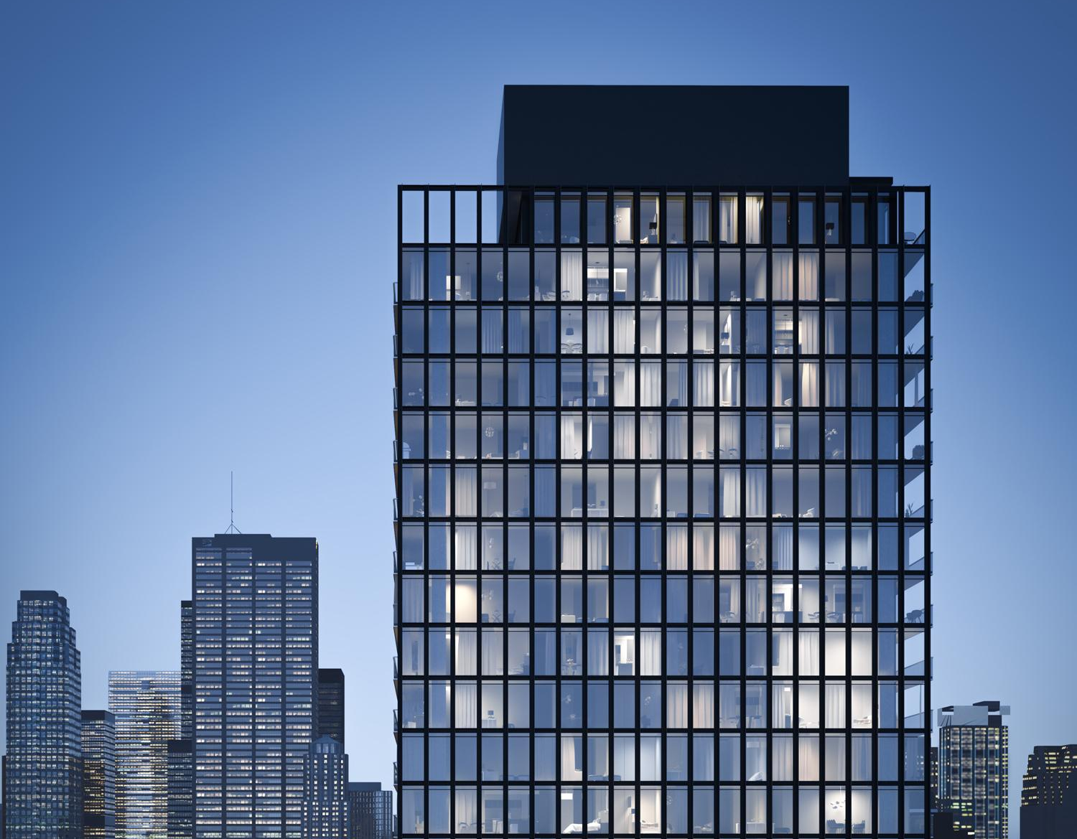
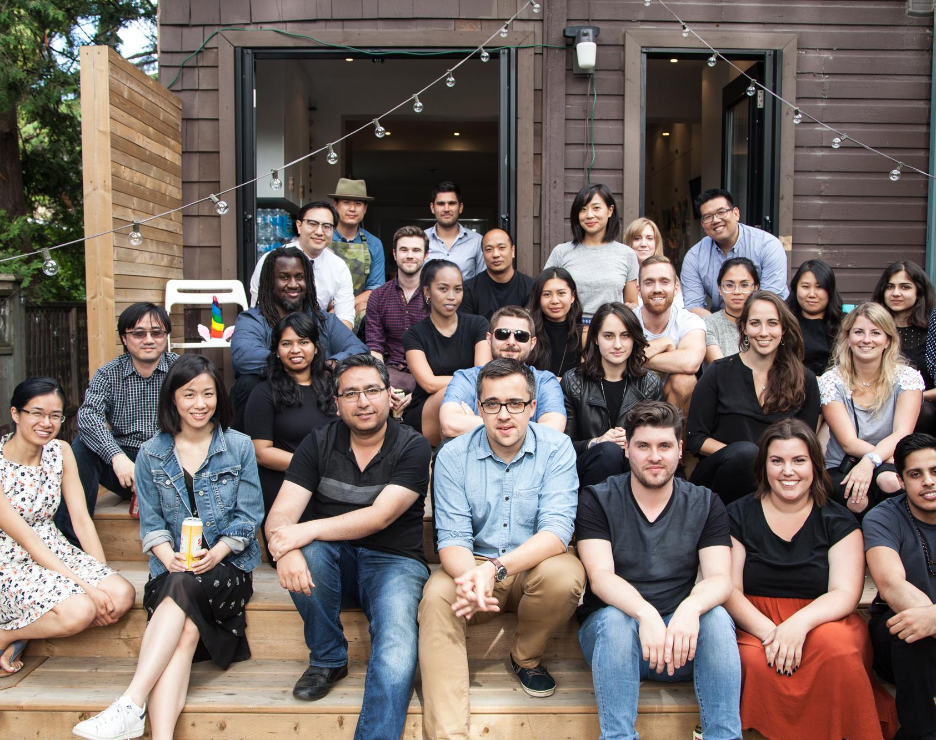
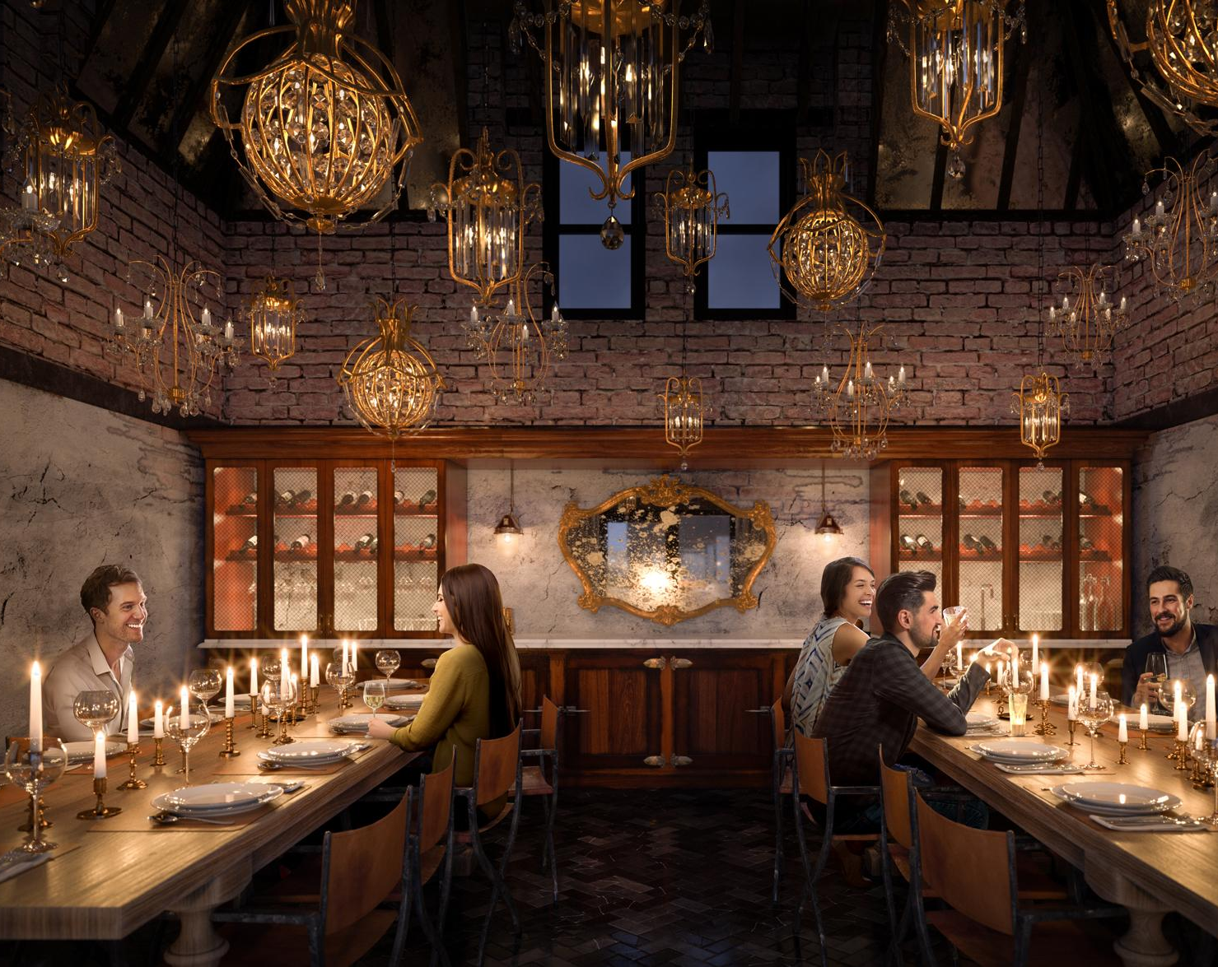
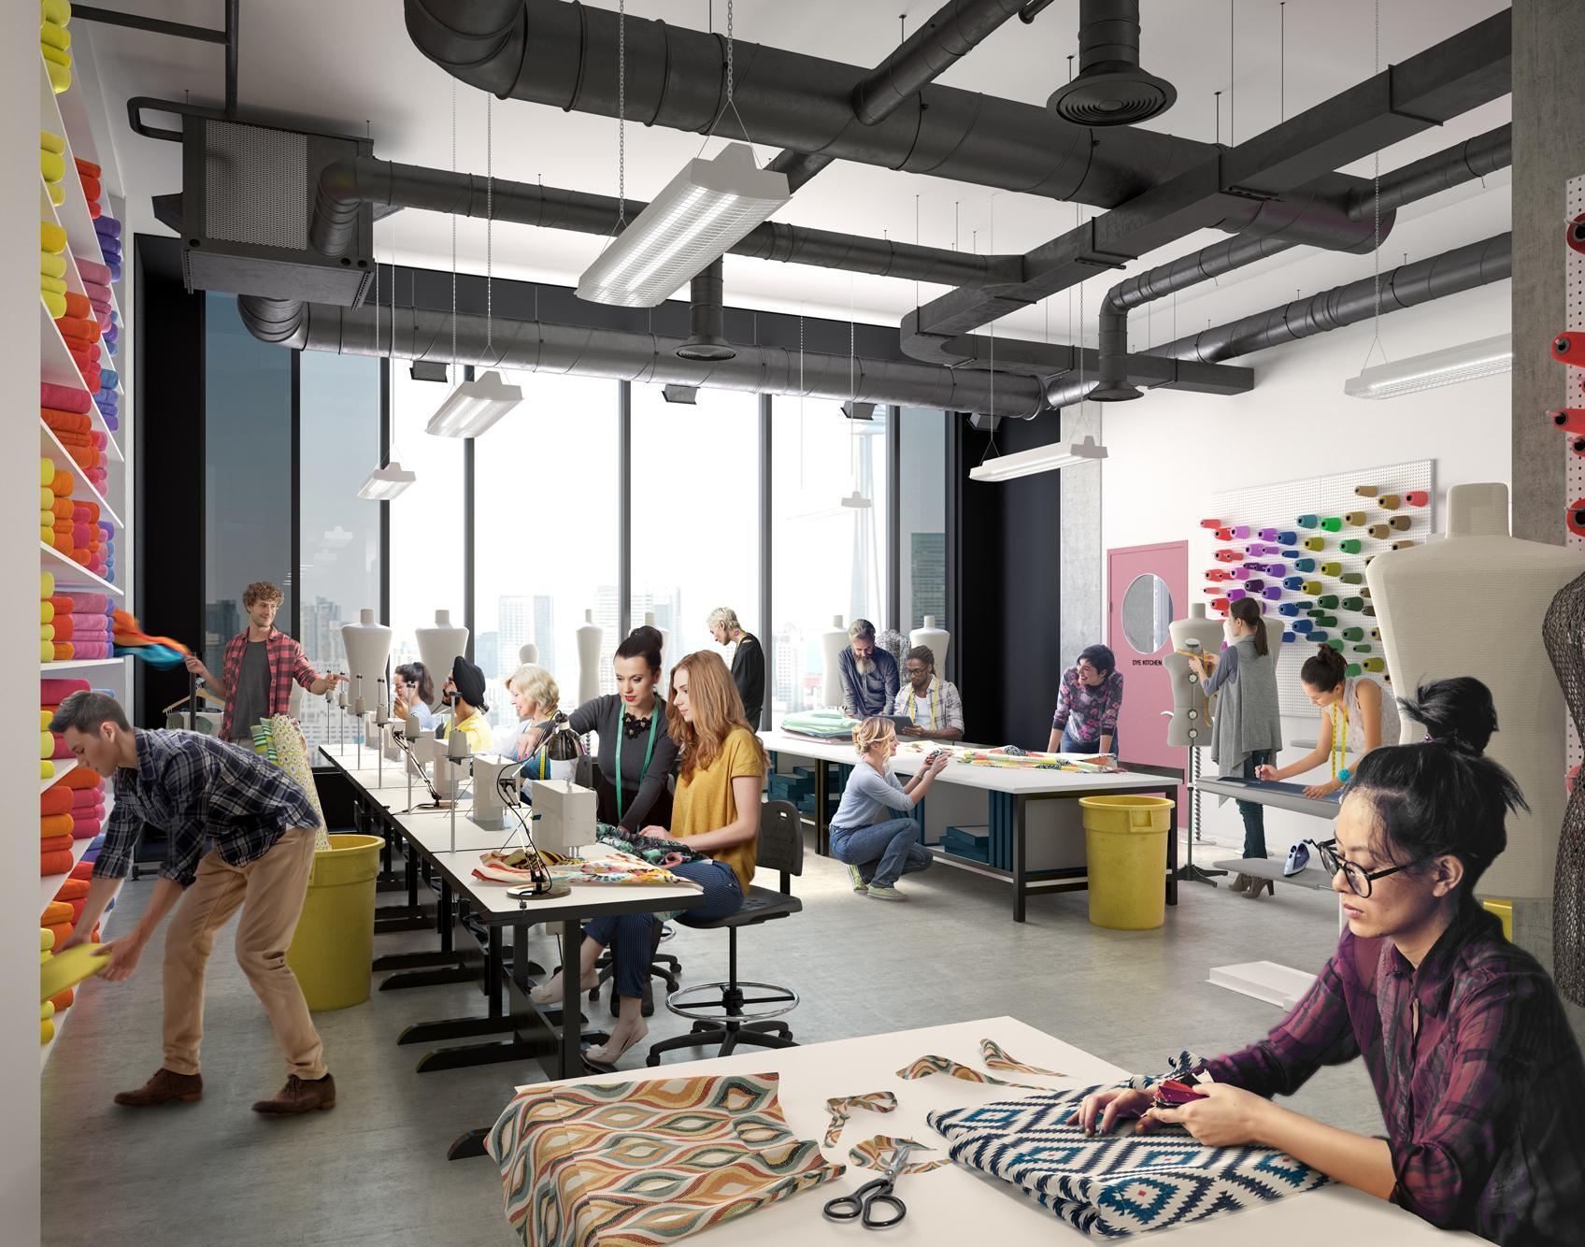
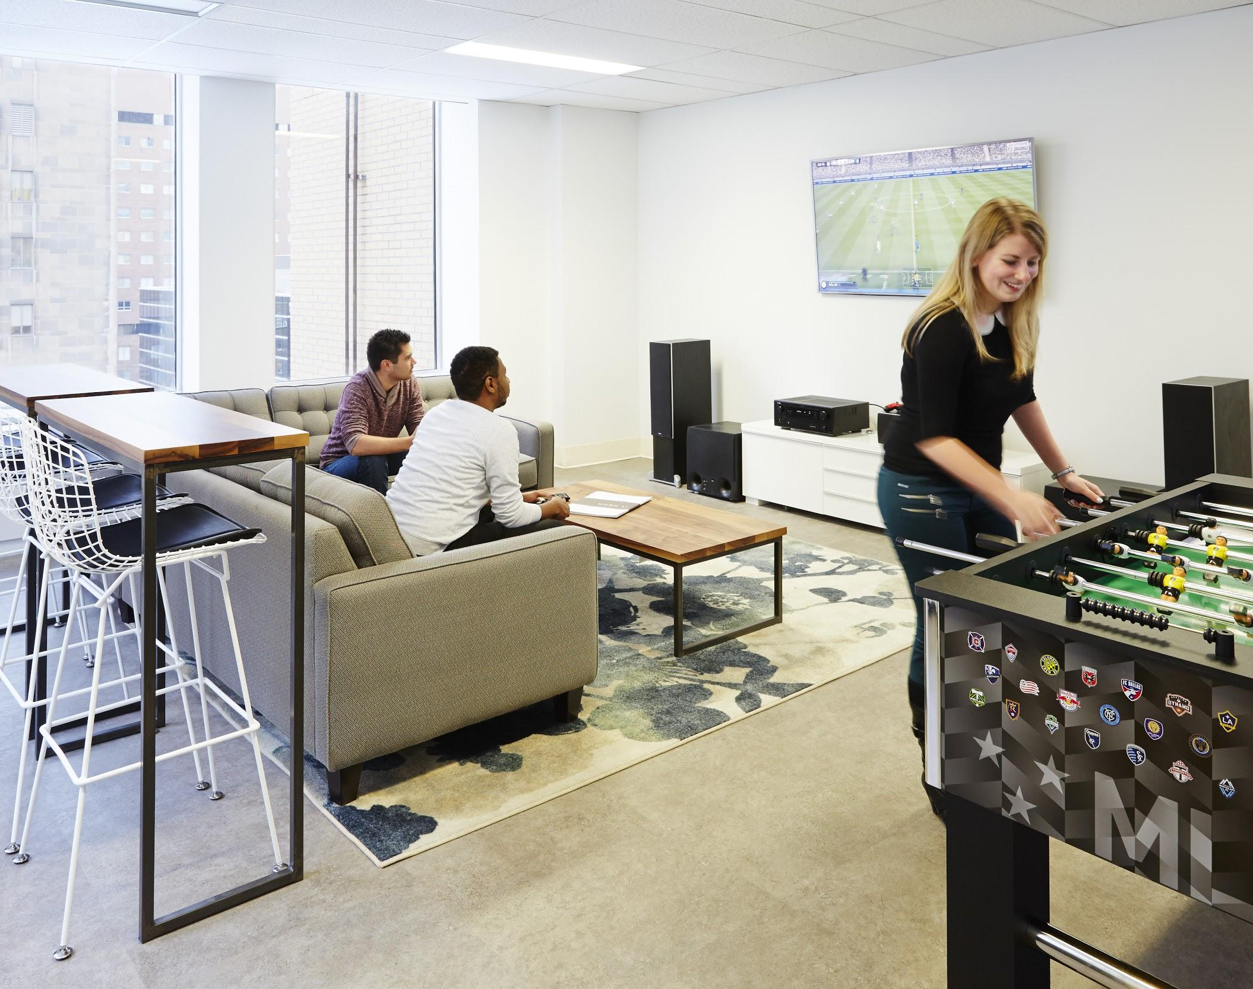
Notes:
Team composed of 47 highly talented artists and operations team
All our team members have training in architect.
Create small scale projects to large scale projects.
Emphasize storytelling. Department specialized in crafting story with people.

Slide 33
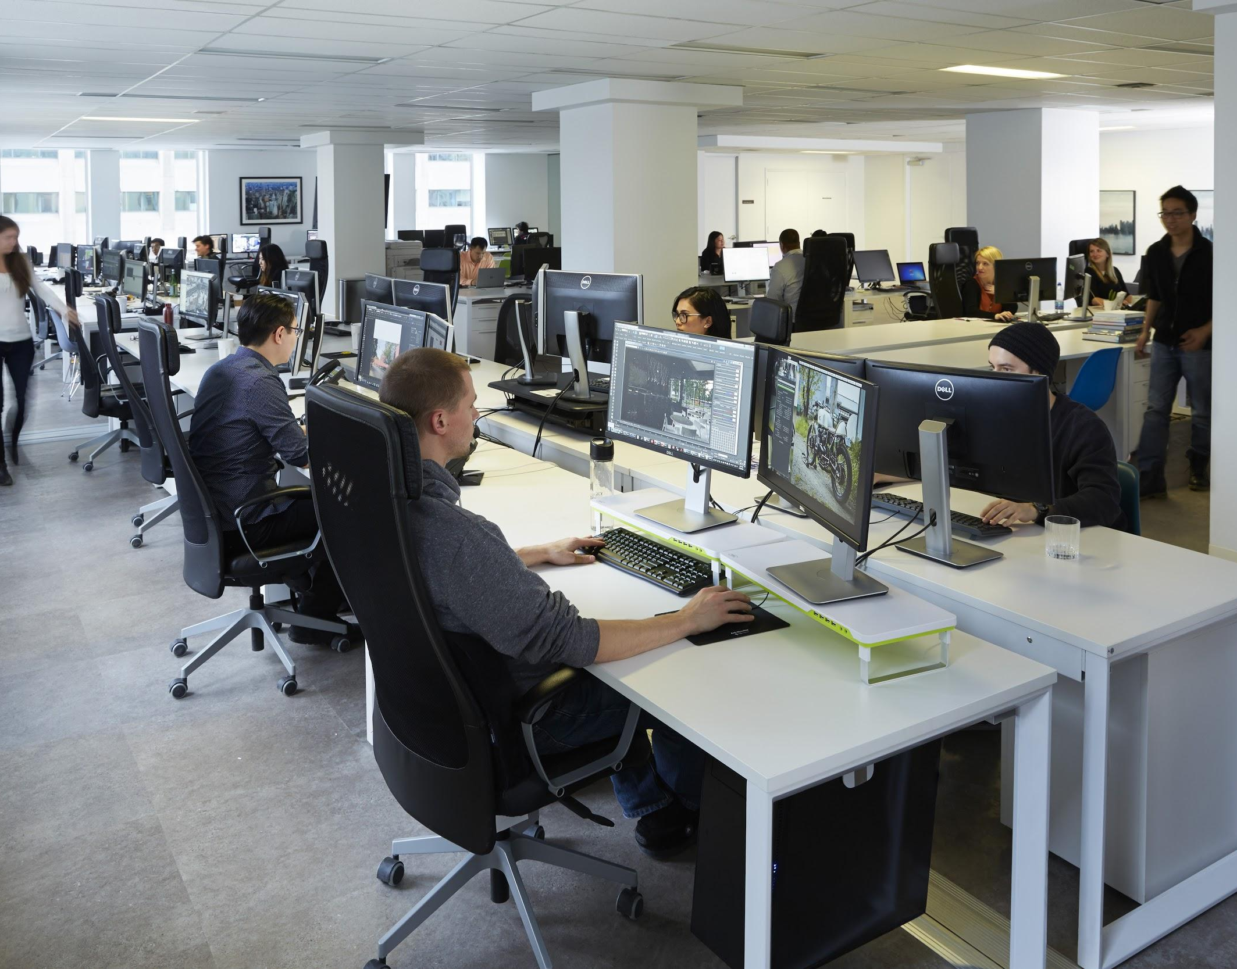
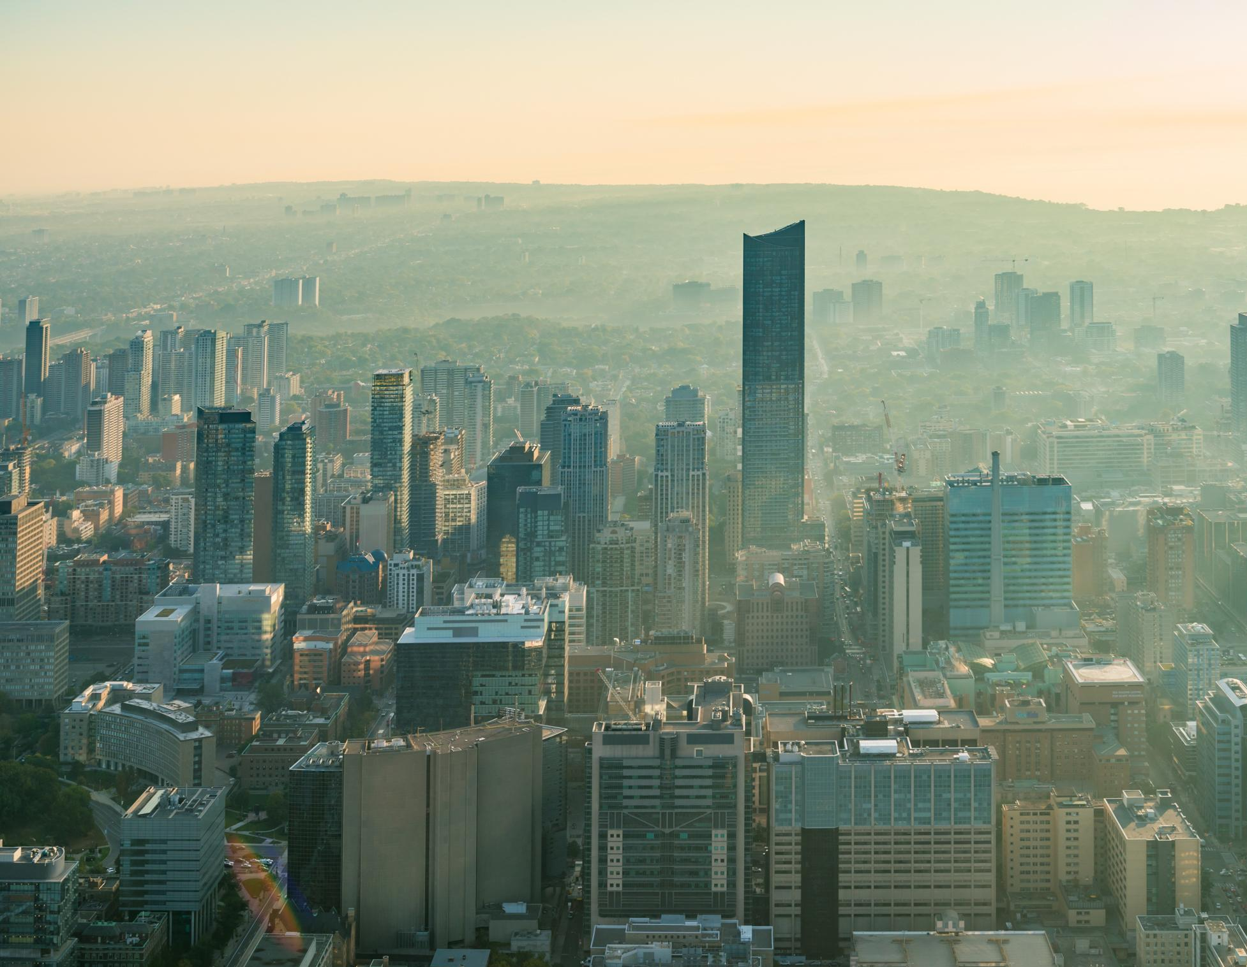
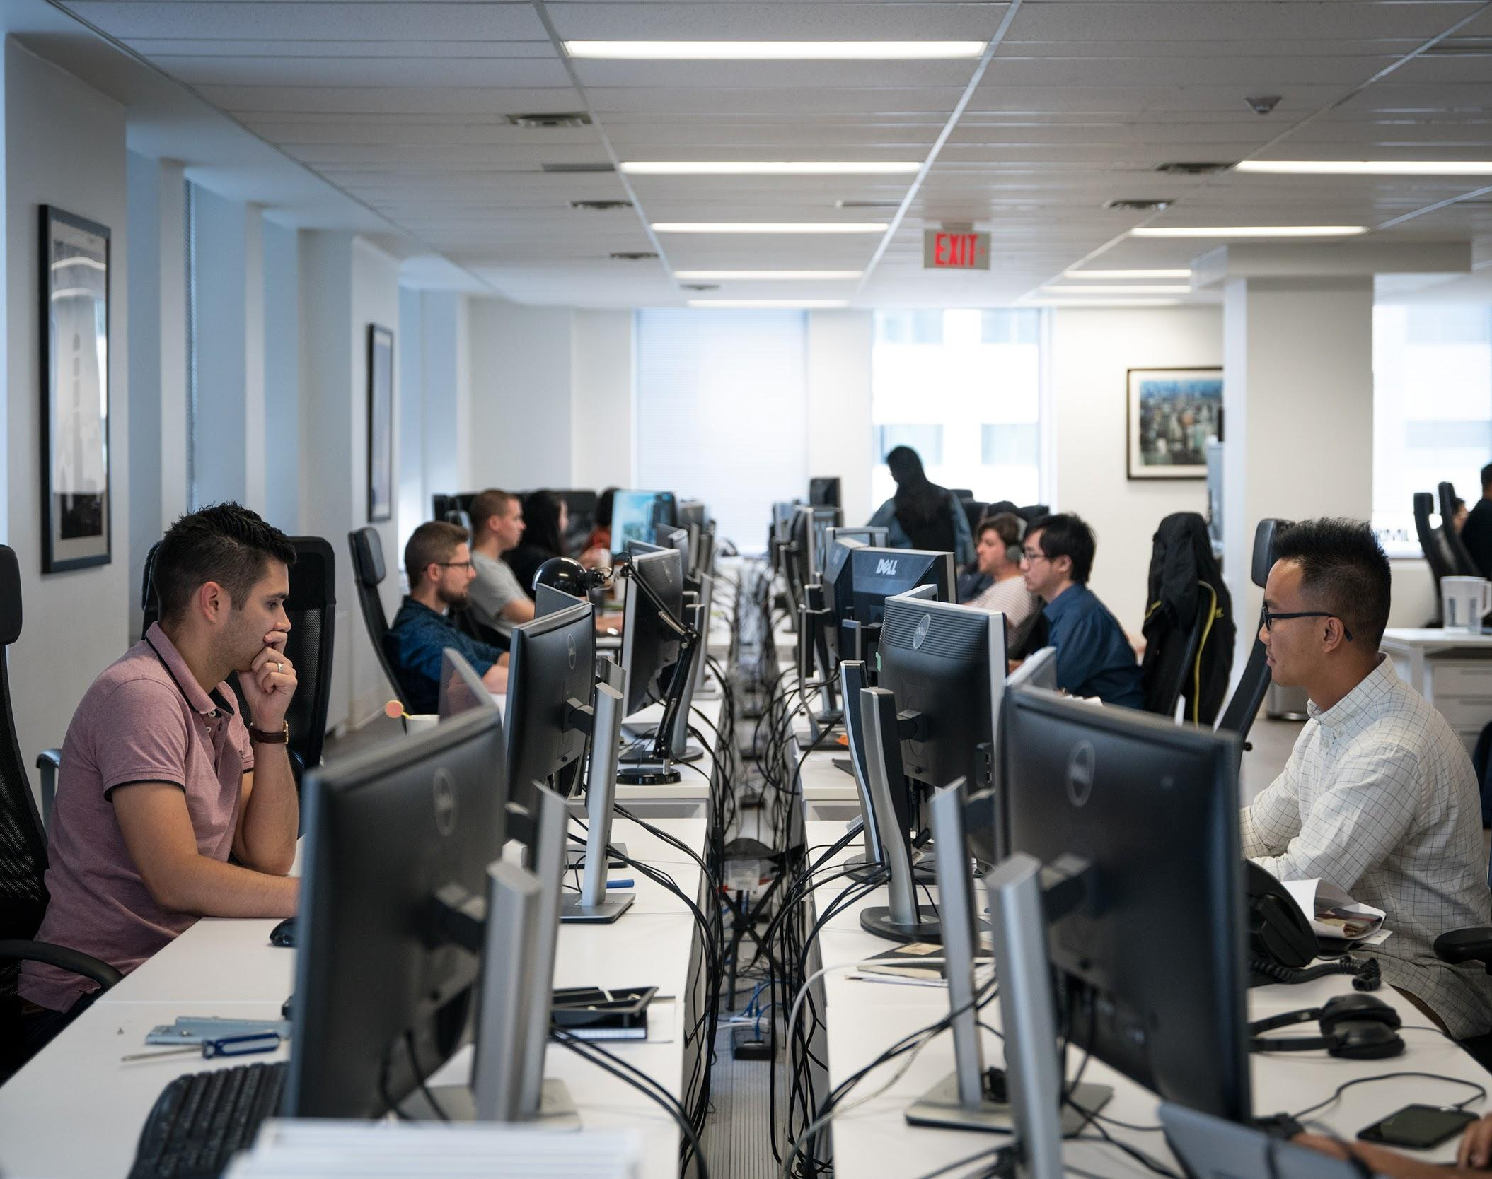
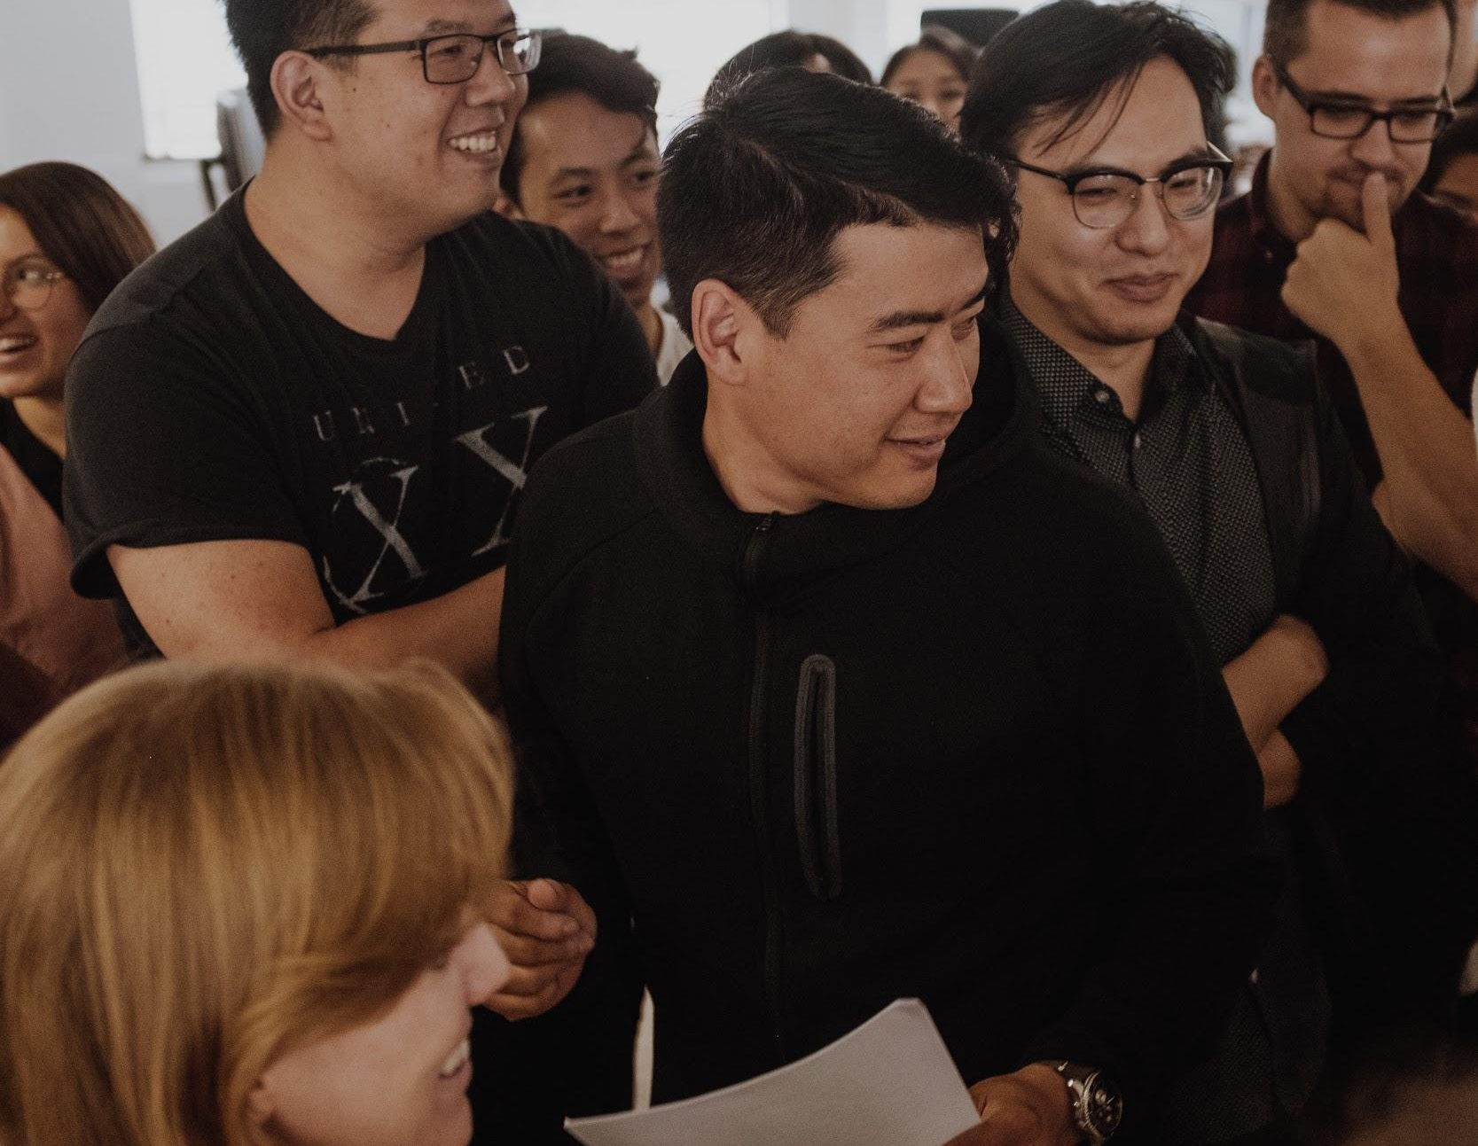
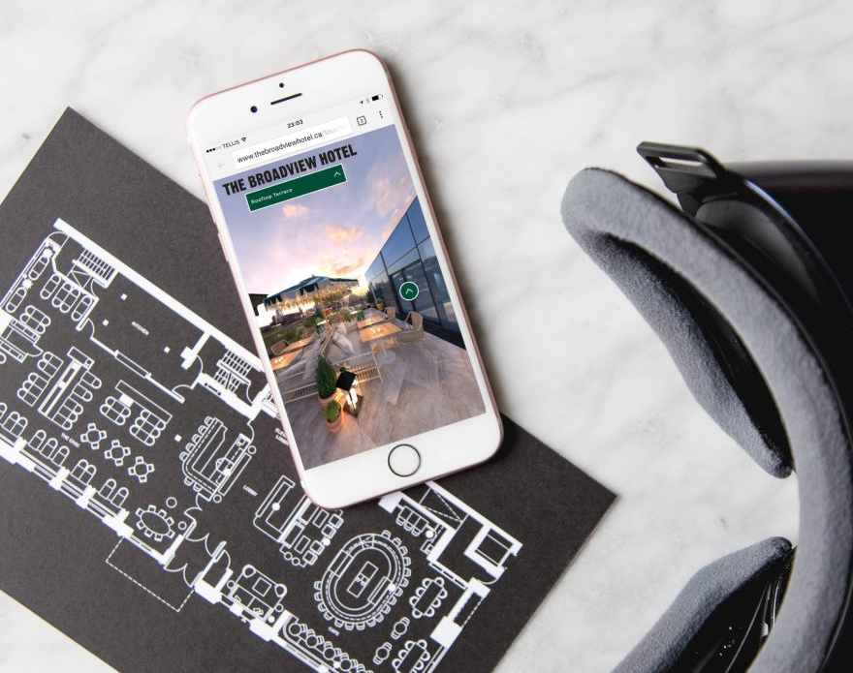
Notes:
Still rendering, animation, doing more and more VR and interactive
RD in WebGL, AR

Slide 34
Process is Key
Notes:
When we work on a project we not only get directions from our client but also from architect, landascape designer, marketing team, developers, etc.
Work with so many clients easy to go sideways
Talk bout process for still rendering
Similar for other type of content (animation, vR, etc) but timelines are slightly different
Ideal project takes 4 weeks
Kickoff meeting

Slide 35
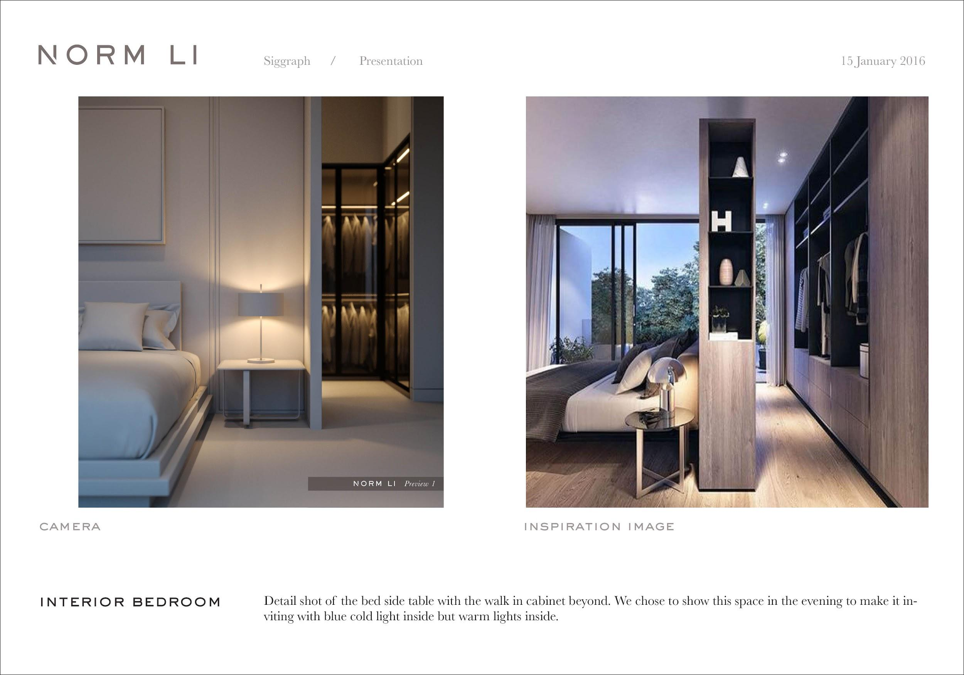
Our Typical Workflow: Week #1 — Image plan
Send to client for approval
Notes:
Import/model all new assets to 3dsmax. Receive CAD (less and less), Revit/Rhino/Sketchup/etc.
Place cameras
Find inspiration images in line with client’s request
Create lighting based on inspiration images
Basic 3d people/silhouette to emphasis storytelling
Basic Photoshop
Send for review

Slide 36
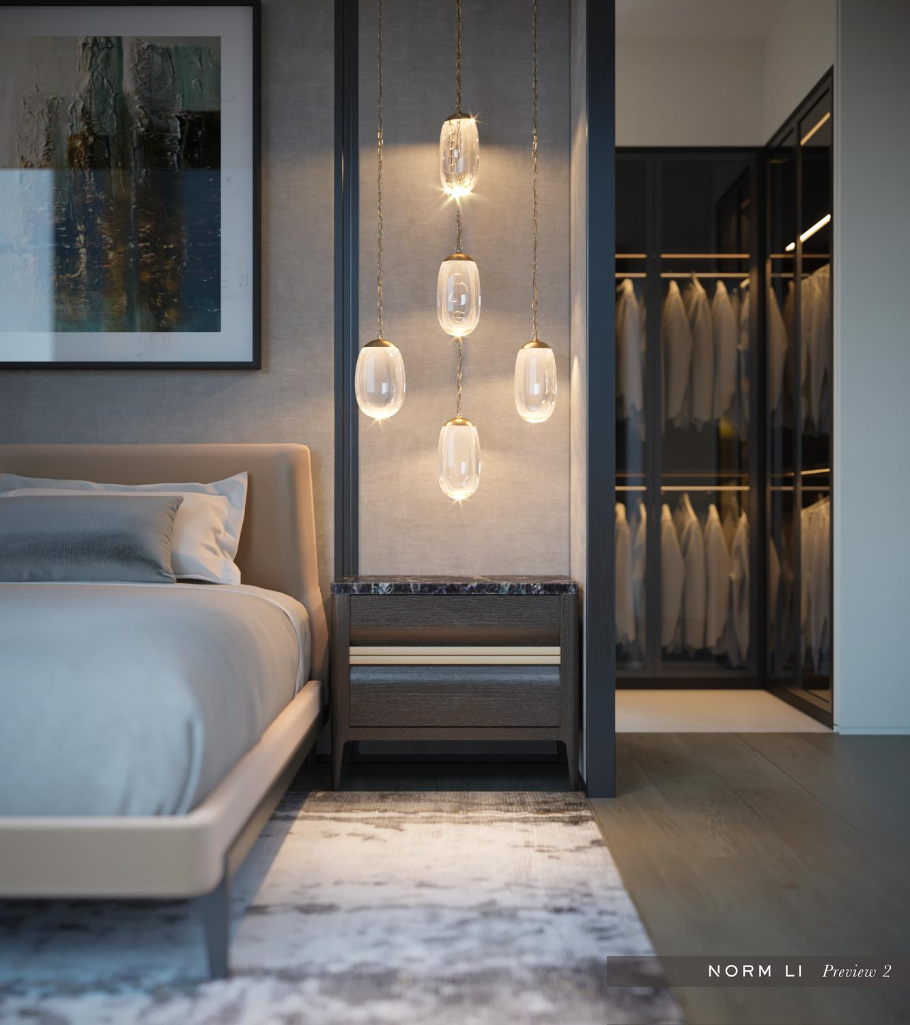
Our Typical Workflow: Week #2 — First Iteration
Client’s comments
Add materials
Add details
Refine lighting
Refine mood
Send to client for approval
Notes:
Take care of client feedback
Add materials
Add details
Refine lighting
Refine mood

Slide 37
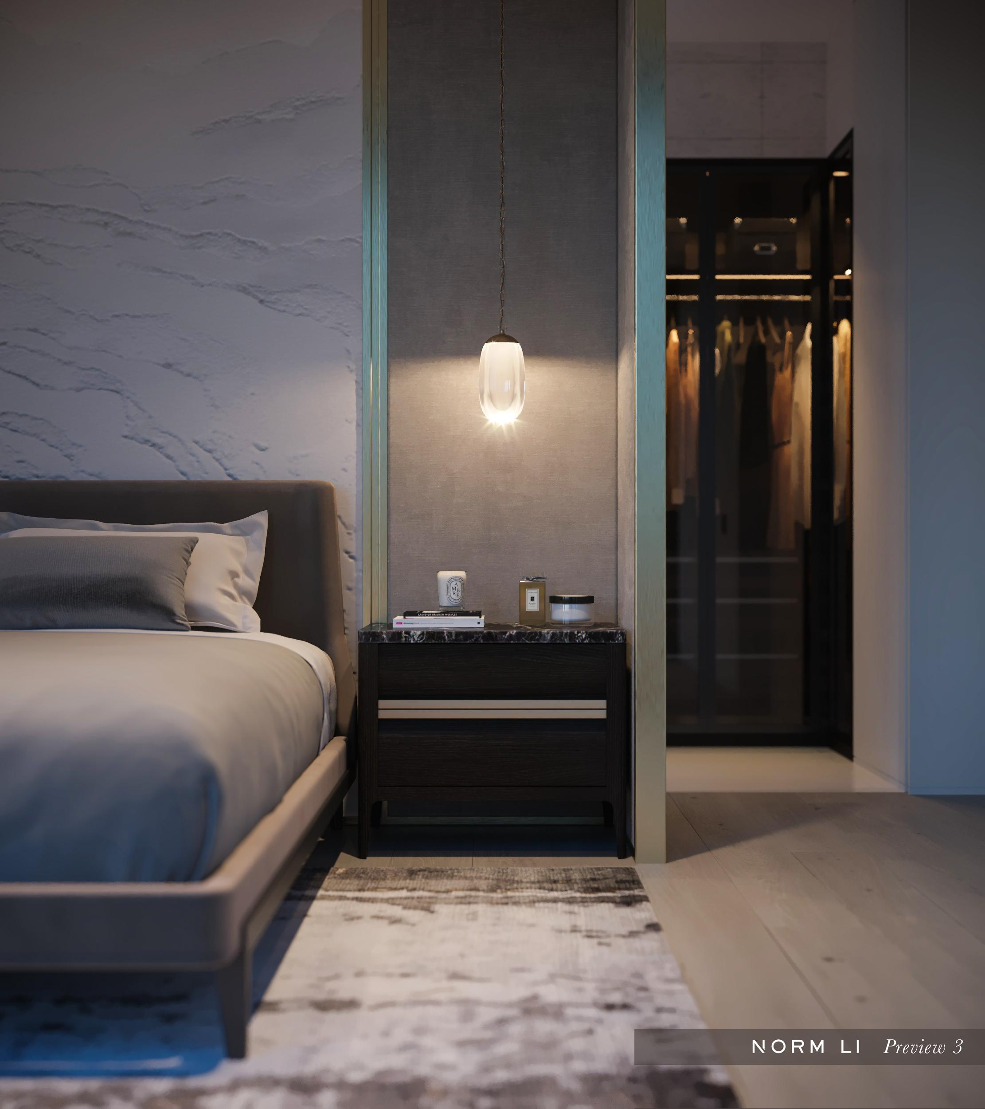
Our Typical Workflow: Week #3 — Second Iteration
Refine accessories
Refine materials
Client’s comments
Send to client for approval

Slide 38
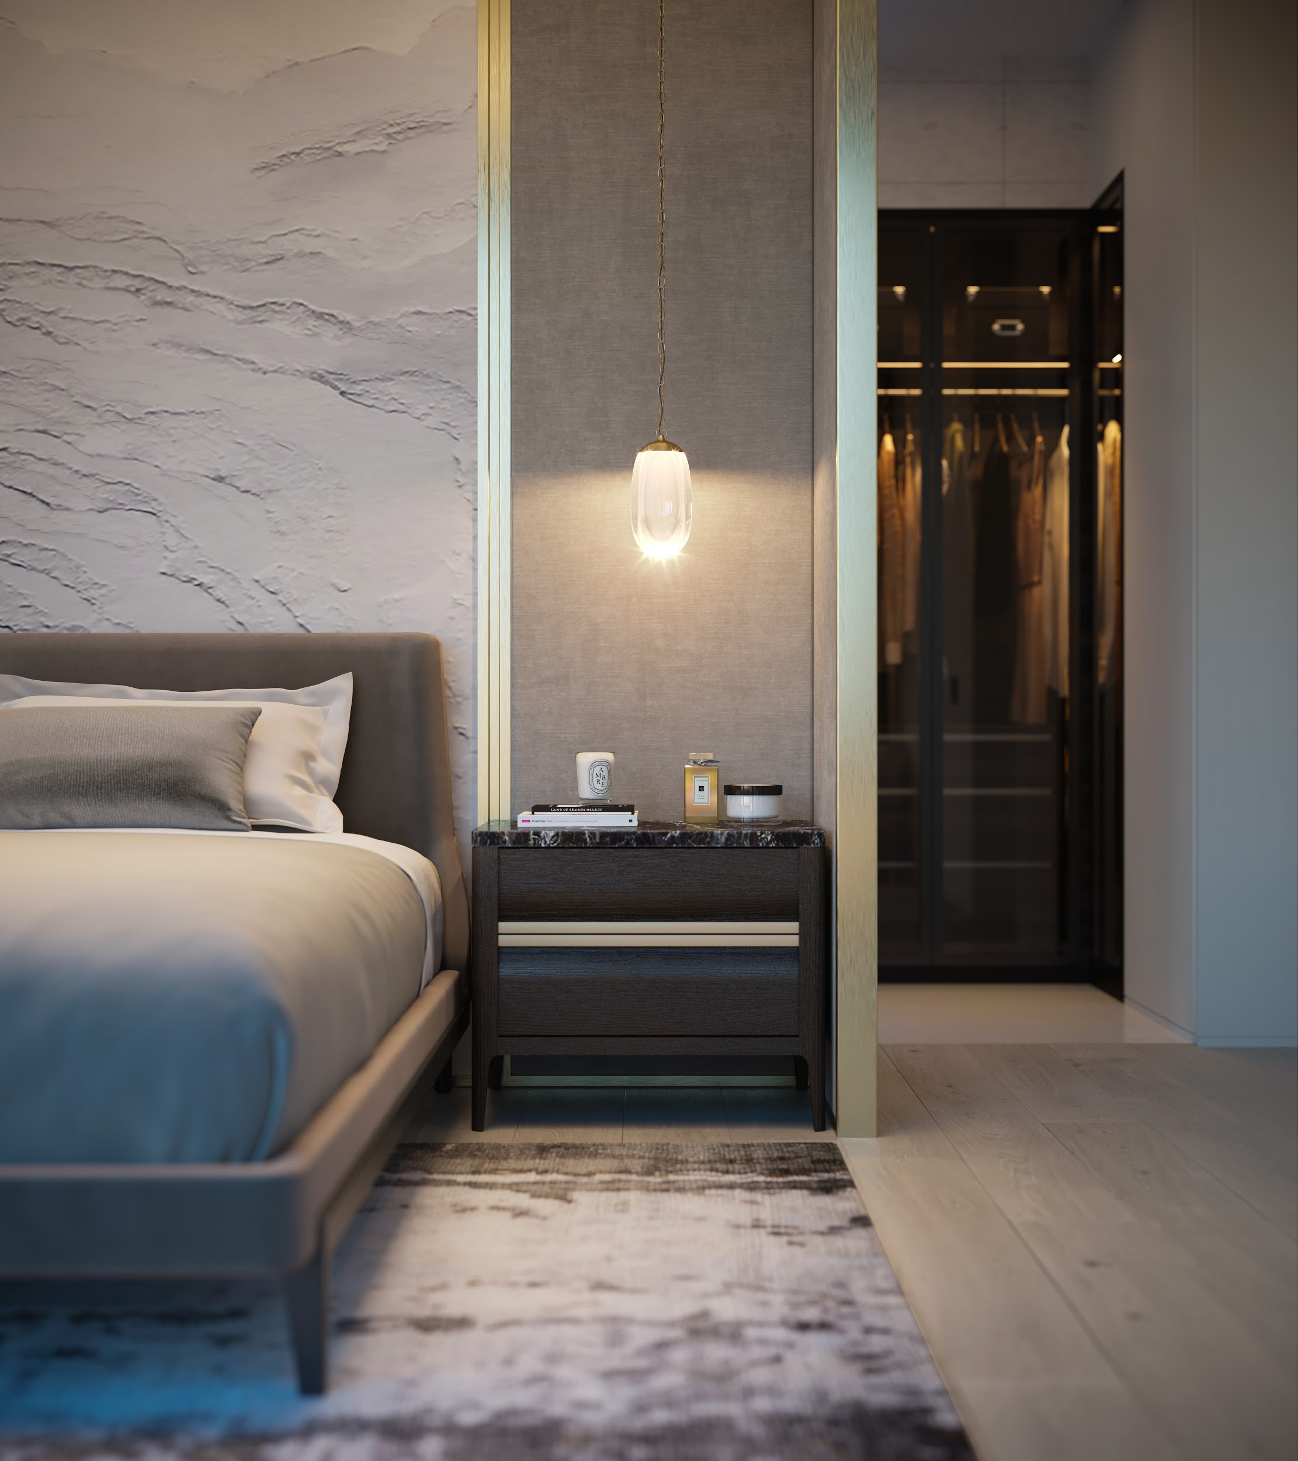
Our Typical Workflow: Week #4 — Final Image
Client’s comments
Deliver final image

Slide 39
Software
Custom Scripts

Slide 40
What’s important to us, the artists?

Slide 41
What’s important to us as arch viz users?
Robust solutions.
Notes:
Work on big and small project

Slide 42
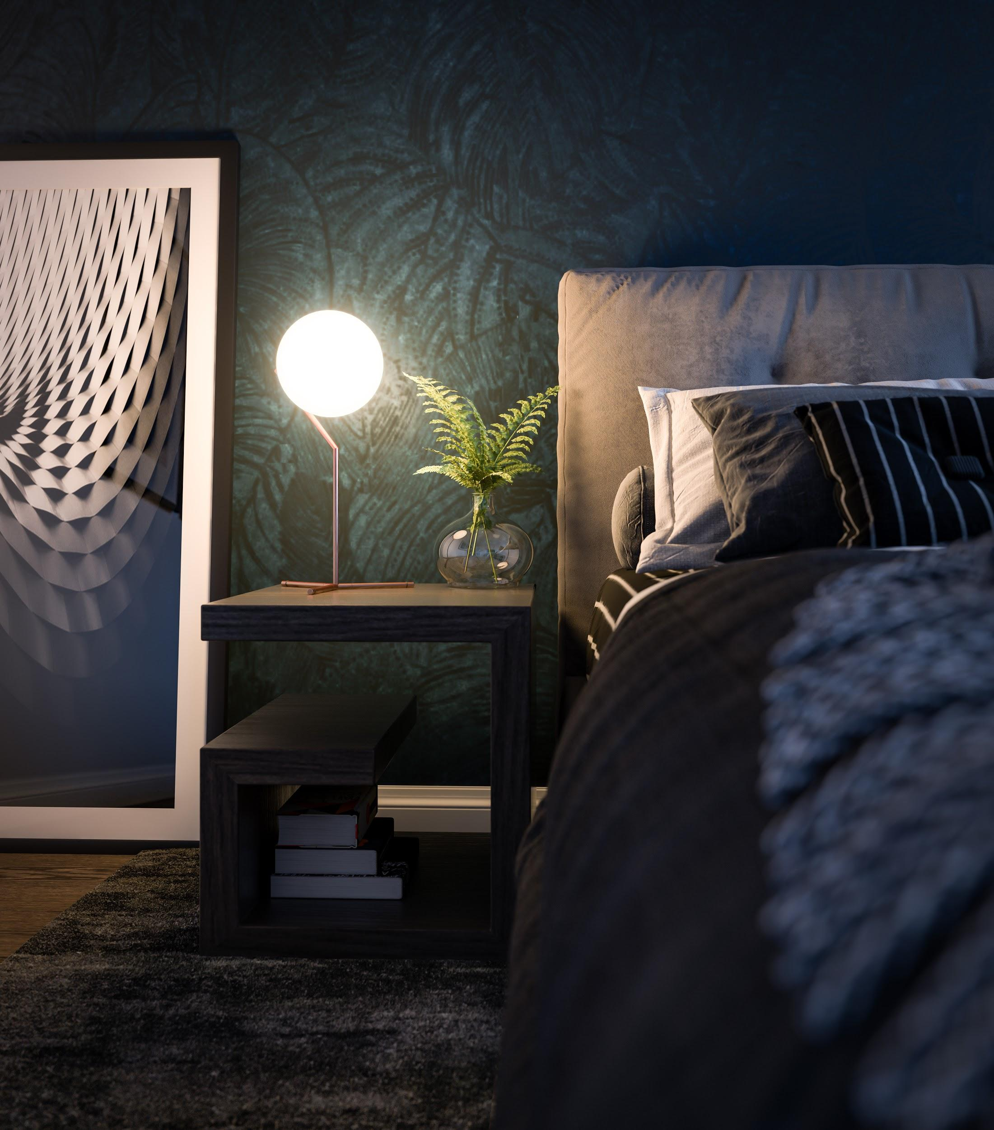
What’s important to us as arch viz users?
Robust solutions.
Notes:
We can work on detailed shots only showing a bedside table as well as working on master plan aerial views showing thousands of cars/buildings/trees/people/etc.
We want the engine to render both images locally or on a farm without problem.
Vray has made it much easier for users in the past few years and we now don’t really have to mess with settings anymore which is great. I also like how they have a beginner mode and expert mode to hide unnecessary UI.

Slide 43
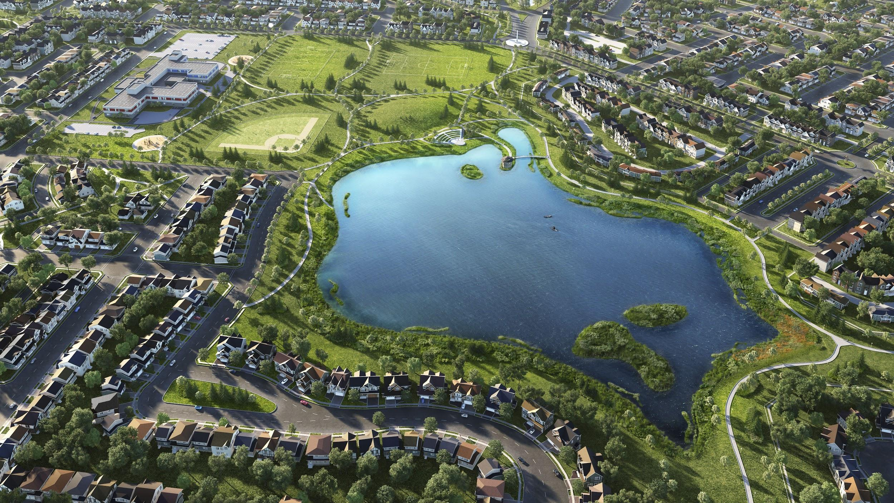
What’s important to us as arch viz users?
Robust solutions.
Notes:
Render on farm and locally without problem
Software handle any scale of project
We don’t like seeing this type of screen

Slide 44
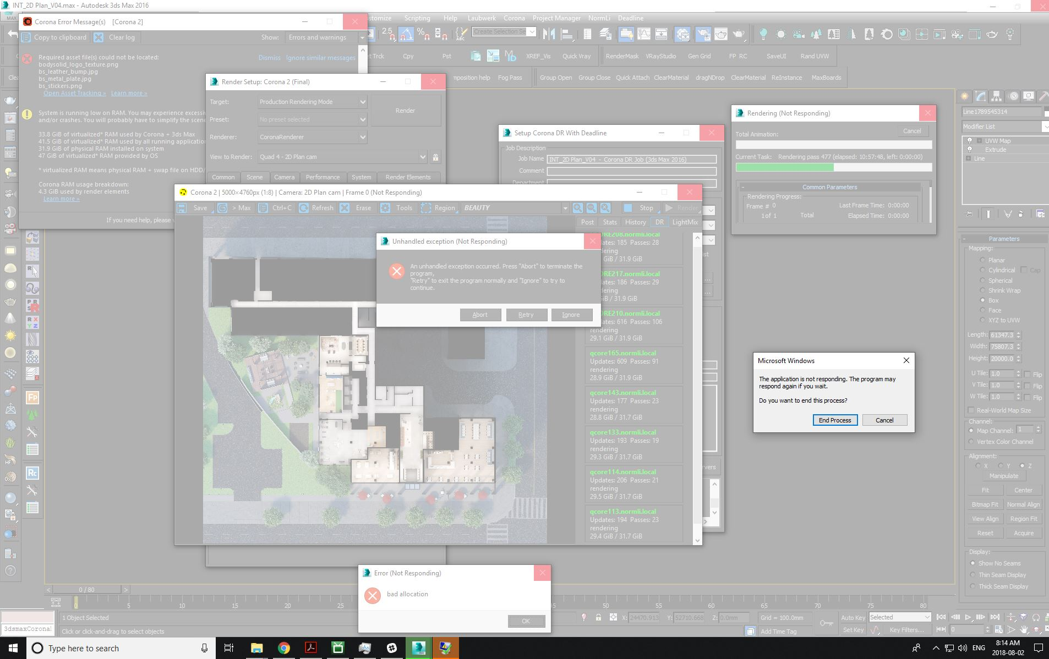
What’s important to us as arch viz users?
Robust solutions.

Slide 45
What’s important to us as arch viz users?
Render speed.

Slide 46
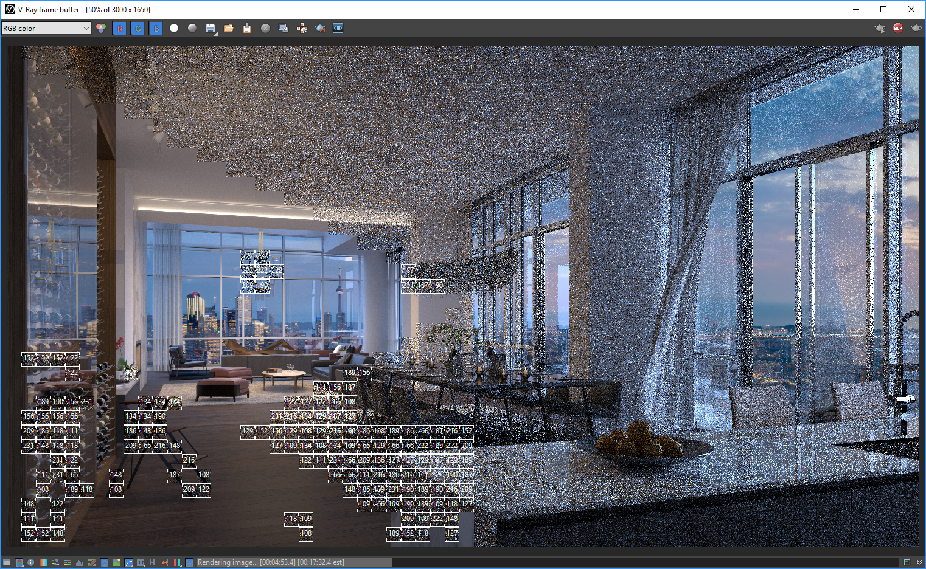
What’s important to us as arch viz users?
Render speed.
Notes:
We all hate looking at buckets moving slowly while we know that we have 5 more images to work on or a deadline coming up soon.
Weird way it’s relaxing
We want the render to be as fast as possible without compromising quality or having to tweak dozens of settings.
When creating a lighting for a scene we’d like to get instant feedback and just be able to take “photos” of the scene like you would in real life.
Need clarification

Slide 47
What’s important to us as arch viz users?
Render speed.
5k images, 10 render nodes
1-4 hours in Vray 2-6 hours in Corona
1-3 Hours per frame for HDTV animations
Notes:
We all hate looking at buckets moving slowly while we know that we have 5 more images to work on or a deadline coming up soon.
We want the render to be as fast as possible without compromising quality or having to tweak dozens of settings.
When creating a lighting for a scene we’d like to get instant feedback and just be able to take “photos” of the scene like you would in real life.
Need clarification

Slide 48
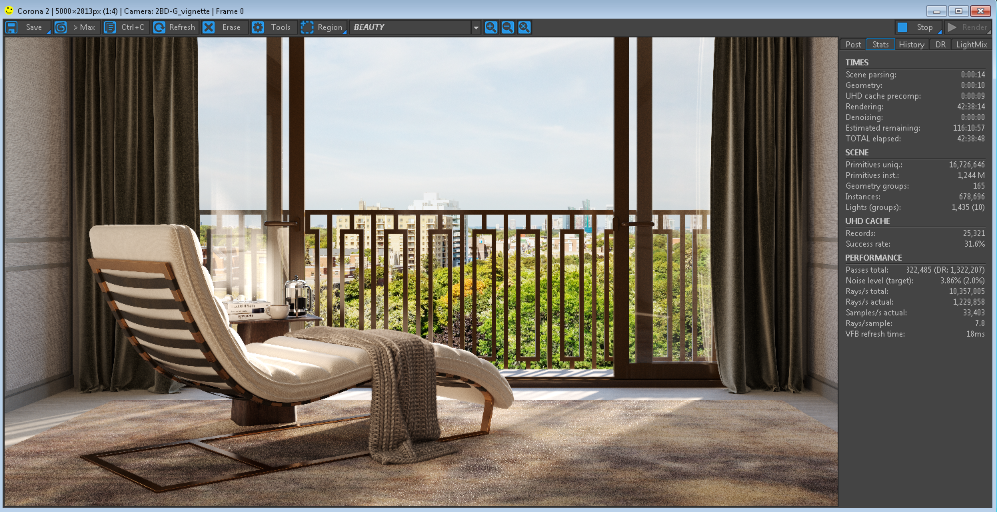
What’s important to us as arch viz users?
Render speed.
Notes:
We all hate looking at buckets moving slowly while we know that we have 5 more images to work on or a deadline coming up soon.
We want the render to be as fast as possible without compromising quality or having to tweak dozens of settings.
When creating a lighting for a scene we’d like to get instant feedback and just be able to take “photos” of the scene like you would in real life.
Need clarification

Slide 49
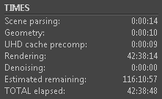
What’s important to us as arch viz users?
Render speed.
Notes:
We all hate looking at buckets moving slowly while we know that we have 5 more images to work on or a deadline coming up soon.
We want the render to be as fast as possible without compromising quality or having to tweak dozens of settings.
When creating a lighting for a scene we’d like to get instant feedback and just be able to take “photos” of the scene like you would in real life.
Need clarification

Slide 50
What’s important to us as arch viz users?
Render speed.
Notes:
We all hate looking at buckets moving slowly while we know that we have 5 more images to work on or a deadline coming up soon.
We want the render to be as fast as possible without compromising quality or having to tweak dozens of settings.
When creating a lighting for a scene we’d like to get instant feedback and just be able to take “photos” of the scene like you would in real life.

Slide 51
What’s important to us as arch viz users?
Software compatibility.
Notes:
Dont build models from sratch
We rarely have time to model/remodel everything from scratch, so it’s important to us that the engine knows how to read/translate information from other software. We get models from dozens of different software from hundreds of different companies and the quality of the model we receive greatly vary depending on who created it. We just want to be able to import them and start working on our composition/lighting.
Ex: Autodesk materials don’t get converted to vraymtl when using the converter.

Slide 52
What’s important to us as arch viz users?
Software Compatibility.
Notes:
Sometimes clients ask for us to send them something back their way
We rarely have time to model/remodel everything from scratch, so it’s important to us that the engine knows how to read/translate information from other software. We get models from dozens of different software from hundreds of different companies and the quality of the model we receive greatly vary depending on who created it. We just want to be able to import them and start working on our composition/lighting.
Ex: Autodesk materials don’t get converted to vraymtl when using the converter.

Slide 53
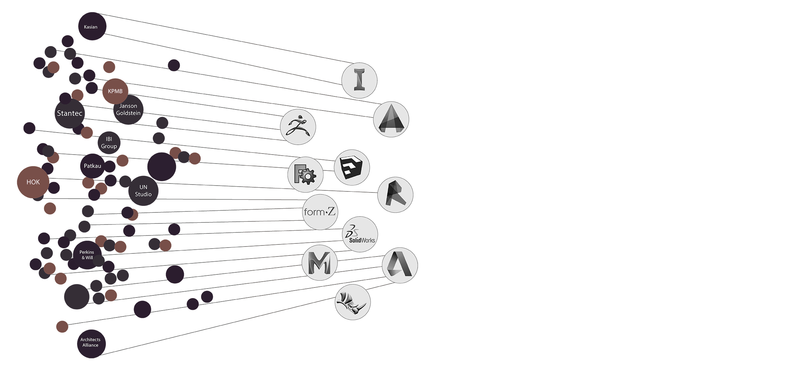
What’s important to us as arch viz users?
Software Compatibility.
Notes:
Sometimes clients ask for us to send them something back their way
We rarely have time to model/remodel everything from scratch, so it’s important to us that the engine knows how to read/translate information from other software. We get models from dozens of different software from hundreds of different companies and the quality of the model we receive greatly vary depending on who created it. We just want to be able to import them and start working on our composition/lighting.
Ex: Autodesk materials don’t get converted to vraymtl when using the converter.

Slide 54
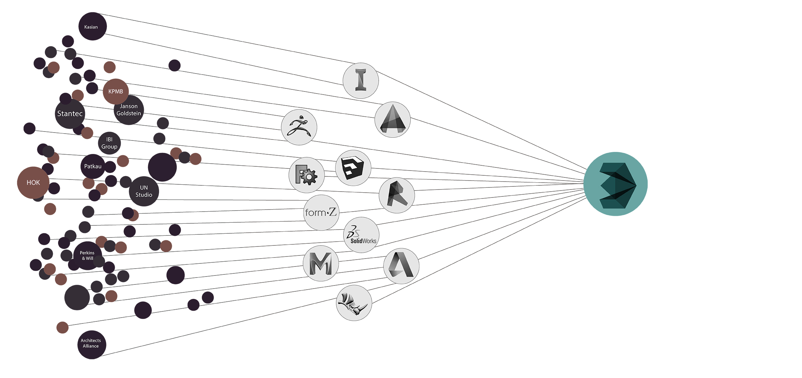
What’s important to us as arch viz users?
Software Compatibility.
Notes:
Sometimes clients ask for us to send them something back their way
We rarely have time to model/remodel everything from scratch, so it’s important to us that the engine knows how to read/translate information from other software. We get models from dozens of different software from hundreds of different companies and the quality of the model we receive greatly vary depending on who created it. We just want to be able to import them and start working on our composition/lighting.
Ex: Autodesk materials don’t get converted to vraymtl when using the converter.

Slide 55
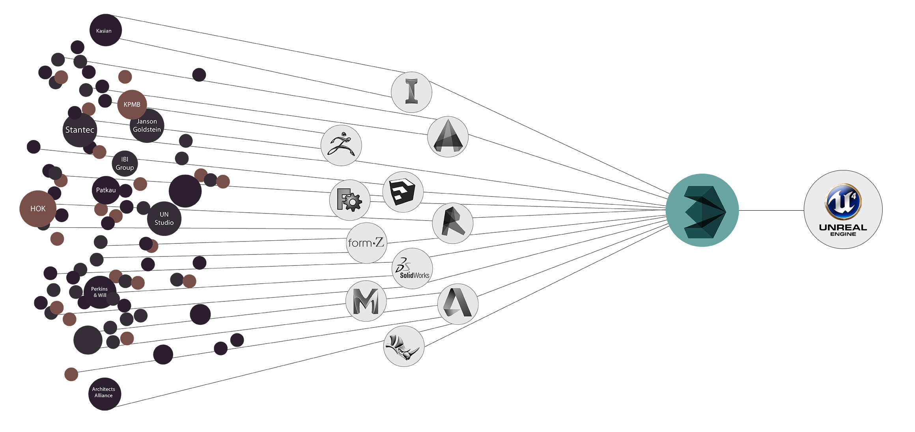
What’s important to us as arch viz users?
Software Compatibility.
Notes:
Sometimes clients ask for us to send them something back their way
We rarely have time to model/remodel everything from scratch, so it’s important to us that the engine knows how to read/translate information from other software. We get models from dozens of different software from hundreds of different companies and the quality of the model we receive greatly vary depending on who created it. We just want to be able to import them and start working on our composition/lighting.
Ex: Autodesk materials don’t get converted to vraymtl when using the converter.

Slide 56
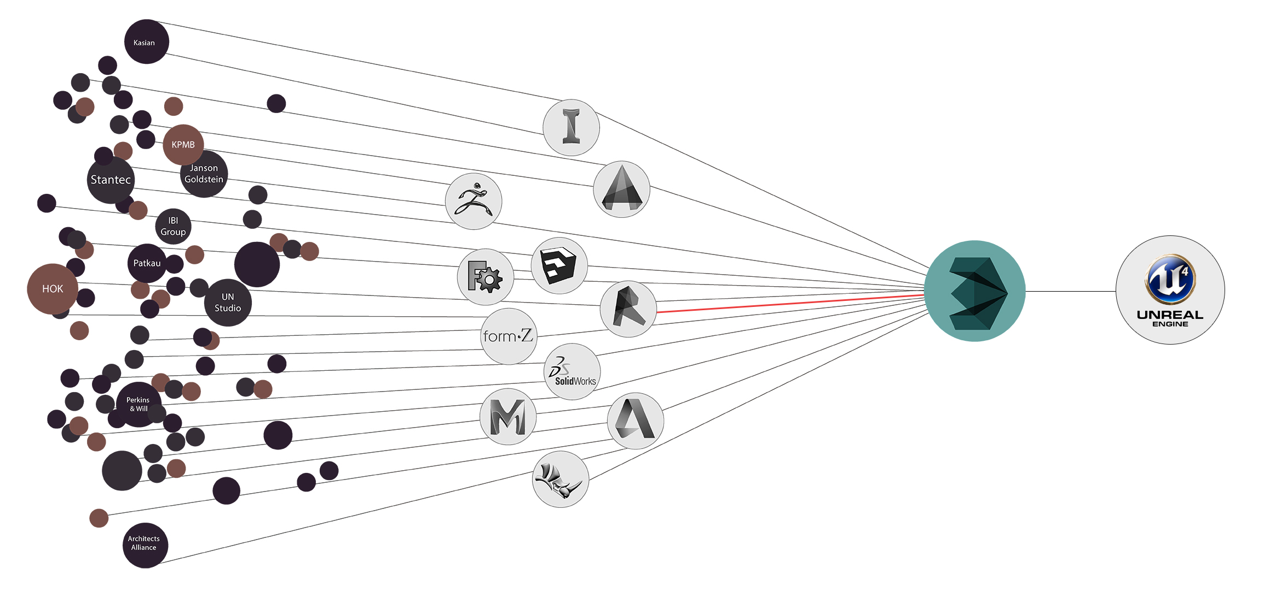
What’s important to us as arch viz users?
Software Compatibility.
Notes:
Sometimes clients ask for us to send them something back their way
We rarely have time to model/remodel everything from scratch, so it’s important to us that the engine knows how to read/translate information from other software. We get models from dozens of different software from hundreds of different companies and the quality of the model we receive greatly vary depending on who created it. We just want to be able to import them and start working on our composition/lighting.
Ex: Autodesk materials don’t get converted to vraymtl when using the converter.

Slide 57
What’s important to us as arch viz users?
Plug & Play Tools.
Notes:
Because we can’t be specialized in just all aspects of a render, we’re looking for plug and play solutions from both the engine and plugins/software to create water (phoenix), realistic vegetation (forest pack), parametric modeling(railclone), etc.
If we are creating a video and are planning to add water simulation, we can’t afford for artists to spend weeks on learning complex water simulation system. We need to get something working and looking good in a couple of days max.
Corona material library is great for beginners to learn and for more advanced users to have a go to library to start from. I wish Vray was offering something similar.

Slide 58
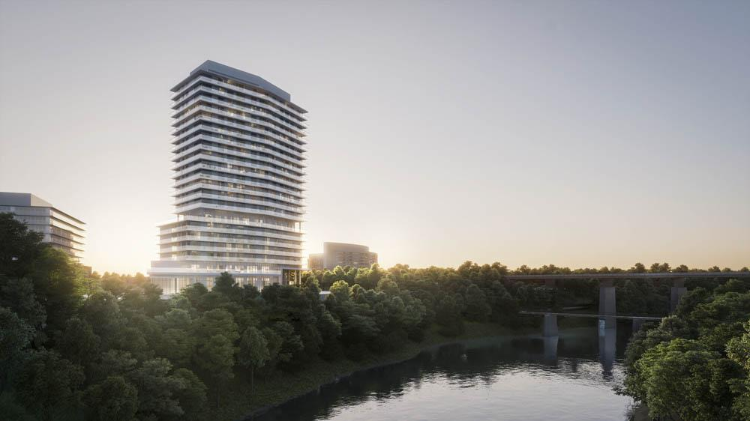
What’s important to us as arch viz users?
Plug & Play Tools.
Notes:
Because we can’t be specialized in just all aspects of a render, we’re looking for plug and play solutions from both the engine and plugins/software to create water (phoenix), realistic vegetation (forest pack), parametric modeling(railclone), etc.
If we are creating a video and are planning to add water simulation, we can’t afford for artists to spend weeks on learning complex water simulation system. We need to get something working and looking good in a couple of days max.
Corona material library is great for beginners to learn and for more advanced users to have a go to library to start from. I wish Vray was offering something similar.

Slide 59
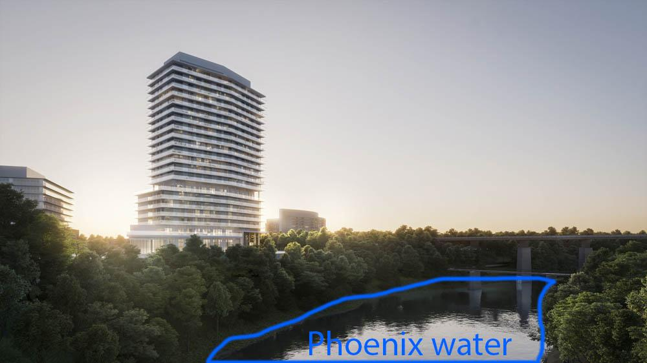
What’s important to us as arch viz users?
Plug & Play Tools.
Notes:
Because we can’t be specialized in just all aspects of a render, we’re looking for plug and play solutions from both the engine and plugins/software to create water (phoenix), realistic vegetation (forest pack), parametric modeling(railclone), etc.
If we are creating a video and are planning to add water simulation, we can’t afford for artists to spend weeks on learning complex water simulation system. We need to get something working and looking good in a couple of days max.
Corona material library is great for beginners to learn and for more advanced users to have a go to library to start from. I wish Vray was offering something similar.

Slide 60
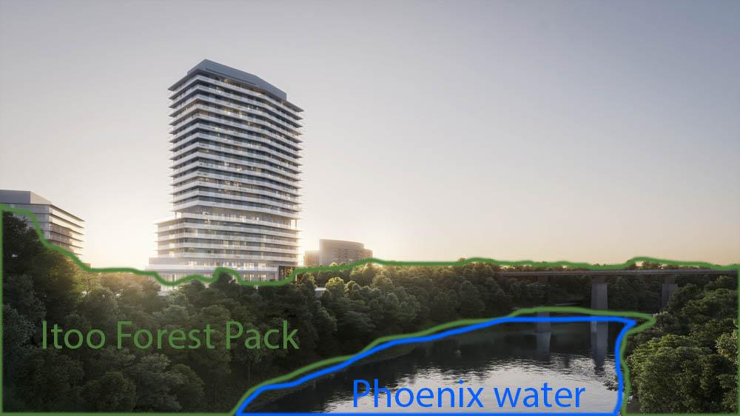
What’s important to us as arch viz users?
Plug & Play Tools.
Notes:
Because we can’t be specialized in just all aspects of a render, we’re looking for plug and play solutions from both the engine and plugins/software to create water (phoenix), realistic vegetation (forest pack), parametric modeling(railclone), etc.
If we are creating a video and are planning to add water simulation, we can’t afford for artists to spend weeks on learning complex water simulation system. We need to get something working and looking good in a couple of days max.
Corona material library is great for beginners to learn and for more advanced users to have a go to library to start from. I wish Vray was offering something similar.

Slide 61
What’s important to us as arch viz users?
Plug & Play Tools.
Notes:
Because we can’t be specialized in just all aspects of a render, we’re looking for plug and play solutions from both the engine and plugins/software to create water (phoenix), realistic vegetation (forest pack), parametric modeling(railclone), etc.
If we are creating a video and are planning to add water simulation, we can’t afford for artists to spend weeks on learning complex water simulation system. We need to get something working and looking good in a couple of days max.
Corona material library is great for beginners to learn and for more advanced users to have a go to library to start from. I wish Vray was offering something similar.

Slide 62
What’s important to us as arch viz users?
Solutions that answer our specific needs.
Notes:
We typically don’t have time to unwrap objects and paint specific maps for a model. We usually apply box mapping on everything which is a great time saver but not so great when it comes to realism and adding details.
Vraytriplanartex and corona triplanar map are really helping but it’d be great to see more built in solutions to add dirt on maps at the edges(plugin richdirt built in Vray/Corona) slide: richdirt, to randomize maps (coronaUvwRandomizer exist now but I’ve been hoping to see that node in 3dsmax/Vray for years)Slide: coronaUVWRandomizer. Solutions like built in multitexture would help a lot too. Slide: multitexture
Both Corona and Vray now offer a way to round corners of objects in a material which is great but it’s only been available for a couple of years and implemented through bump. Possible to add a round corner button in materials? Slide: rounded corner button added to vraymaterial?
Optimize map size on the fly to better deal with ram usage?
scratches

Slide 63
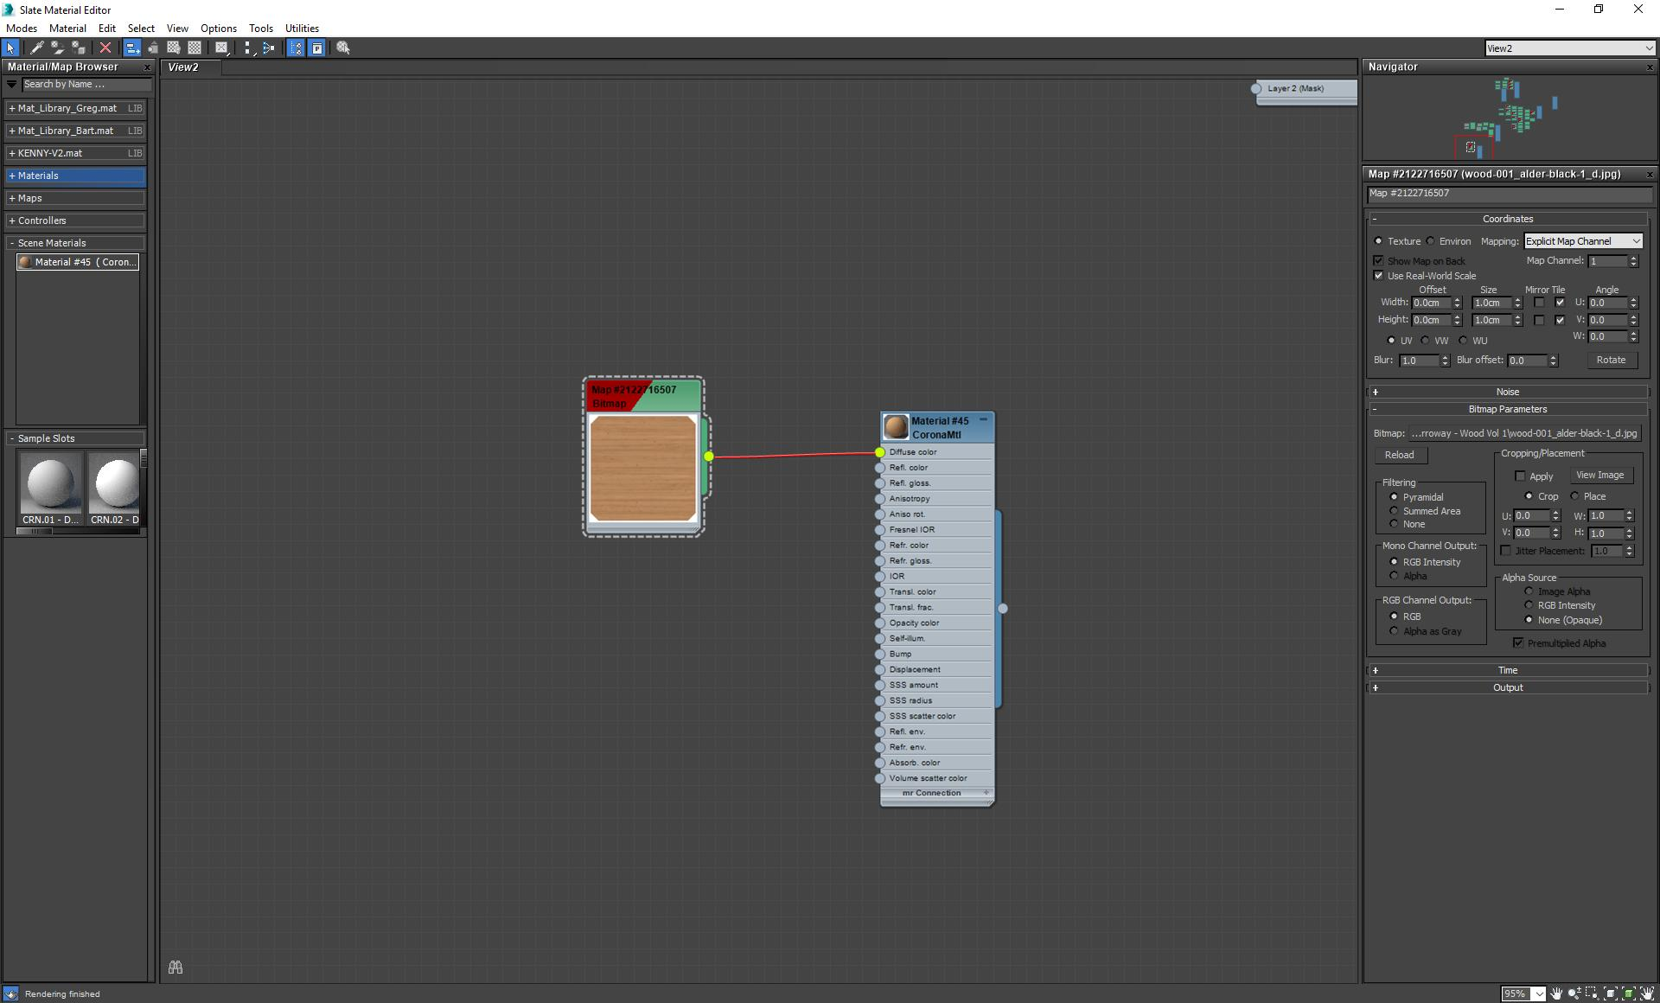
What’s important to us as arch viz users?
Solutions that answer our specific needs.
Notes:
We typically don’t have time to unwrap objects and paint specific maps for a model. We usually apply box mapping on everything which is a great time saver but not so great when it comes to realism and adding details.
Vraytriplanartex and corona triplanar map are really helping but it’d be great to see more built in solutions to add dirt on maps at the edges(plugin richdirt built in Vray/Corona) slide: richdirt, to randomize maps (coronaUvwRandomizer exist now but I’ve been hoping to see that node in 3dsmax/Vray for years)Slide: coronaUVWRandomizer. Solutions like built in multitexture would help a lot too. Slide: multitexture
Both Corona and Vray now offer a way to round corners of objects in a material which is great but it’s only been available for a couple of years and implemented through bump. Possible to add a round corner button in materials? Slide: rounded corner button added to vraymaterial?
Optimize map size on the fly to better deal with ram usage?
scratches

Slide 64
What’s important to us as arch viz users?
Solutions that answer our specific needs.
Notes:
We typically don’t have time to unwrap objects and paint specific maps for a model. We usually apply box mapping on everything which is a great time saver but not so great when it comes to realism and adding details.
Vraytriplanartex and corona triplanar map are really helping but it’d be great to see more built in solutions to add dirt on maps at the edges(plugin richdirt built in Vray/Corona) slide: richdirt, to randomize maps (coronaUvwRandomizer exist now but I’ve been hoping to see that node in 3dsmax/Vray for years)Slide: coronaUVWRandomizer. Solutions like built in multitexture would help a lot too. Slide: multitexture
Both Corona and Vray now offer a way to round corners of objects in a material which is great but it’s only been available for a couple of years and implemented through bump. Possible to add a round corner button in materials? Slide: rounded corner button added to vraymaterial?
Optimize map size on the fly to better deal with ram usage?
scratches

Slide 65
What’s important to us as arch viz users?
Solutions that answer our specific needs.
Notes:
We typically don’t have time to unwrap objects and paint specific maps for a model. We usually apply box mapping on everything which is a great time saver but not so great when it comes to realism and adding details.
Vraytriplanartex and corona triplanar map are really helping but it’d be great to see more built in solutions to add dirt on maps at the edges(plugin richdirt built in Vray/Corona) slide: richdirt, to randomize maps (coronaUvwRandomizer exist now but I’ve been hoping to see that node in 3dsmax/Vray for years)Slide: coronaUVWRandomizer. Solutions like built in multitexture would help a lot too. Slide: multitexture
Both Corona and Vray now offer a way to round corners of objects in a material which is great but it’s only been available for a couple of years and implemented through bump. Possible to add a round corner button in materials? Slide: rounded corner button added to vraymaterial?
Optimize map size on the fly to better deal with ram usage?
scratches

Slide 66
What’s important to us as arch viz users?
Solutions that answer our specific needs.
Notes:
We typically don’t have time to unwrap objects and paint specific maps for a model. We usually apply box mapping on everything which is a great time saver but not so great when it comes to realism and adding details.
Vraytriplanartex and corona triplanar map are really helping but it’d be great to see more built in solutions to add dirt on maps at the edges(plugin richdirt built in Vray/Corona) slide: richdirt, to randomize maps (coronaUvwRandomizer exist now but I’ve been hoping to see that node in 3dsmax/Vray for years)Slide: coronaUVWRandomizer. Solutions like built in multitexture would help a lot too. Slide: multitexture
Both Corona and Vray now offer a way to round corners of objects in a material which is great but it’s only been available for a couple of years and implemented through bump. Possible to add a round corner button in materials? Slide: rounded corner button added to vraymaterial?
Optimize map size on the fly to better deal with ram usage?
scratches

Slide 67
What’s important to us as arch viz users?
Solutions that answer our specific needs.
Notes:
We typically don’t have time to unwrap objects and paint specific maps for a model. We usually apply box mapping on everything which is a great time saver but not so great when it comes to realism and adding details.
Vraytriplanartex and corona triplanar map are really helping but it’d be great to see more built in solutions to add dirt on maps at the edges(plugin richdirt built in Vray/Corona) slide: richdirt, to randomize maps (coronaUvwRandomizer exist now but I’ve been hoping to see that node in 3dsmax/Vray for years)Slide: coronaUVWRandomizer. Solutions like built in multitexture would help a lot too. Slide: multitexture
Both Corona and Vray now offer a way to round corners of objects in a material which is great but it’s only been available for a couple of years and implemented through bump. Possible to add a round corner button in materials? Slide: rounded corner button added to vraymaterial?
Optimize map size on the fly to better deal with ram usage?
scratches

Slide 68
What’s important to us as arch viz users?
Solutions that answer our specific needs.
Notes:
We typically don’t have time to unwrap objects and paint specific maps for a model. We usually apply box mapping on everything which is a great time saver but not so great when it comes to realism and adding details.
Vraytriplanartex and corona triplanar map are really helping but it’d be great to see more built in solutions to add dirt on maps at the edges(plugin richdirt built in Vray/Corona) slide: richdirt, to randomize maps (coronaUvwRandomizer exist now but I’ve been hoping to see that node in 3dsmax/Vray for years)Slide: coronaUVWRandomizer. Solutions like built in multitexture would help a lot too. Slide: multitexture
Both Corona and Vray now offer a way to round corners of objects in a material which is great but it’s only been available for a couple of years and implemented through bump. Possible to add a round corner button in materials? Slide: rounded corner button added to vraymaterial?
Optimize map size on the fly to better deal with ram usage?
scratches

Slide 69
What’s important to us as arch viz users?
Solutions that answer our specific needs.
Notes:
We typically don’t have time to unwrap objects and paint specific maps for a model. We usually apply box mapping on everything which is a great time saver but not so great when it comes to realism and adding details.
Vraytriplanartex and corona triplanar map are really helping but it’d be great to see more built in solutions to add dirt on maps at the edges(plugin richdirt built in Vray/Corona) slide: richdirt, to randomize maps (coronaUvwRandomizer exist now but I’ve been hoping to see that node in 3dsmax/Vray for years)Slide: coronaUVWRandomizer. Solutions like built in multitexture would help a lot too. Slide: multitexture
Both Corona and Vray now offer a way to round corners of objects in a material which is great but it’s only been available for a couple of years and implemented through bump. Possible to add a round corner button in materials? Slide: rounded corner button added to vraymaterial?
Optimize map size on the fly to better deal with ram usage?
scratches

Slide 70
What’s important to us as arch viz users?
In-engine post production.
Notes:
This will depend on studios and look of images but we’re aiming for photorealistic look.
Most studios used to do a decent render in 3dsmax and then spice it up in photoshop. The trend these days is to get a final image in the VFB because:
Compiling in photoshop is time consuming.
If we want to move camera it has to be redone from scratch
If we want to create a new camera created from scratch
If we have to do a video lots of the tweaks done in photoshop are difficult/impossible in after effects/nuke.
VR 360 renderings

Slide 71
What’s important to us as arch viz users?
In-engine post production.
Notes:
This will depend on studios and look of images but we’re aiming for photorealistic look.
Most studios used to do a decent render in 3dsmax and then spice it up in photoshop. The trend these days is to get a final image in the VFB because:
Compiling in photoshop is time consuming.
If we want to move camera it has to be redone from scratch
If we want to create a new camera created from scratch
If we have to do a video lots of the tweaks done in photoshop are difficult/impossible in after effects/nuke.
VR 360 renderings

Slide 72
What’s important to us as arch viz users?
In-engine post production.
Notes:
This will depend on studios and look of images but we’re aiming for photorealistic look.
Most studios used to do a decent render in 3dsmax and then spice it up in photoshop. The trend these days is to get a final image in the VFB because:
Compiling in photoshop is time consuming.
If we want to move camera it has to be redone from scratch
If we want to create a new camera created from scratch
If we have to do a video lots of the tweaks done in photoshop are difficult/impossible in after effects/nuke.
VR 360 renderings

Slide 73
What’s important to us as arch viz users?
In-engine post production.
Notes:
This will depend on studios and look of images but we’re aiming for photorealistic look.
Most studios used to do a decent render in 3dsmax and then spice it up in photoshop. The trend these days is to get a final image in the VFB because:
Compiling in photoshop is time consuming.
If we want to move camera it has to be redone from scratch
If we want to create a new camera created from scratch
If we have to do a video lots of the tweaks done in photoshop are difficult/impossible in after effects/nuke.
VR 360 renderings

Slide 74
What’s important to us as arch viz users?
In-engine post production.
Notes:
This will depend on studios and look of images but we’re aiming for photorealistic look.
Most studios used to do a decent render in 3dsmax and then spice it up in photoshop. The trend these days is to get a final image in the VFB because:
Compiling in photoshop is time consuming.
If we want to move camera it has to be redone from scratch
If we want to create a new camera created from scratch
If we have to do a video lots of the tweaks done in photoshop are difficult/impossible in after effects/nuke.
VR 360 renderings

Slide 75
What’s important to us as arch viz users?
In-engine post production.
Notes:
This will depend on studios and look of images but we’re aiming for photorealistic look.
Most studios used to do a decent render in 3dsmax and then spice it up in photoshop. The trend these days is to get a final image in the VFB because:
Compiling in photoshop is time consuming.
If we want to move camera it has to be redone from scratch
If we want to create a new camera created from scratch
If we have to do a video lots of the tweaks done in photoshop are difficult/impossible in after effects/nuke.
VR 360 renderings

Slide 76
What’s important to us as arch viz users?
In-engine post production.
Notes:
This will depend on studios and look of images but we’re aiming for photorealistic look.
Most studios used to do a decent render in 3dsmax and then spice it up in photoshop. The trend these days is to get a final image in the VFB because:
Compiling in photoshop is time consuming.
If we want to move camera it has to be redone from scratch
If we want to create a new camera created from scratch
If we have to do a video lots of the tweaks done in photoshop are difficult/impossible in after effects/nuke.
VR 360 renderings

Slide 77
What’s important to us as arch viz users?
Robust solutions
Render speed
Software compatibility
Plug & play solutions
Solutions that answer our specific needs
In engine post production
Notes:
This will depend on studios and look of images but we’re aiming for photorealistic look.
Most studios used to do a decent render in 3dsmax and then spice it up in photoshop. The trend these days is to get a final image in the VFB because:
Compiling in photoshop is time consuming.
If we want to move camera it has to be redone from scratch
If we want to create a new camera created from scratch
If we have to do a video lots of the tweaks done in photoshop are difficult/impossible in after effects/nuke.
VR 360 renderings

Slide 78
What’s important to us as arch viz users?
Creatively use software
to produce captivating imagery
with narrative, mood, and purpose.

Slide 79
Conclusion
Passionate about the art form.
Nerdy about technological possibilities.
Excited to innovate on new platforms and expend ArchViz content.
Challenge to create more complex work within tight timelines.
ArchViz is everywhere.
Bright future for the industry as demand and expectations of quality continue to grow.
Looking forward to new technologies that will empower us to tell more stories about unbuilt places and spaces.
Notes:
Change all slides to bulletpoints. Text to be presented.

