Slide 1
Computer Graphics in Practice:
Beyond Games and VFX
Vladimir Koylazov
Chaos Group
SIGGRAPH 2018

Slide 2
Overview
VIZ exists
It is important
Rendering requirements for different industries
Some thoughts on the future

Slide 3
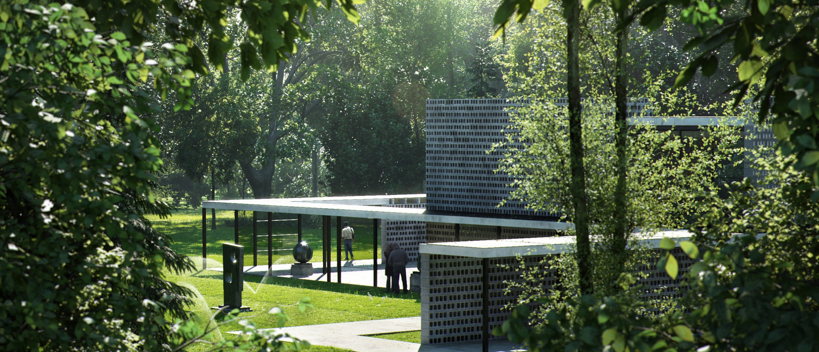
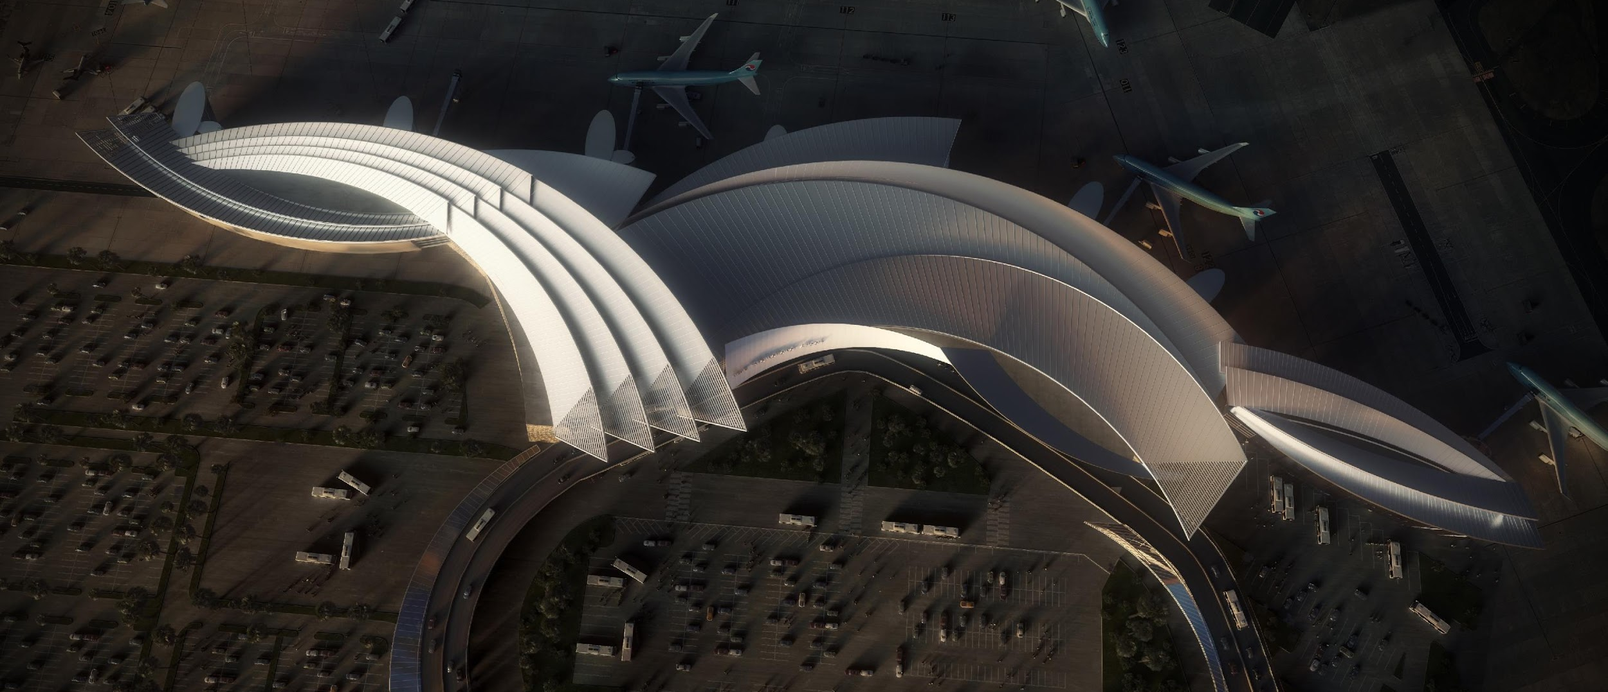
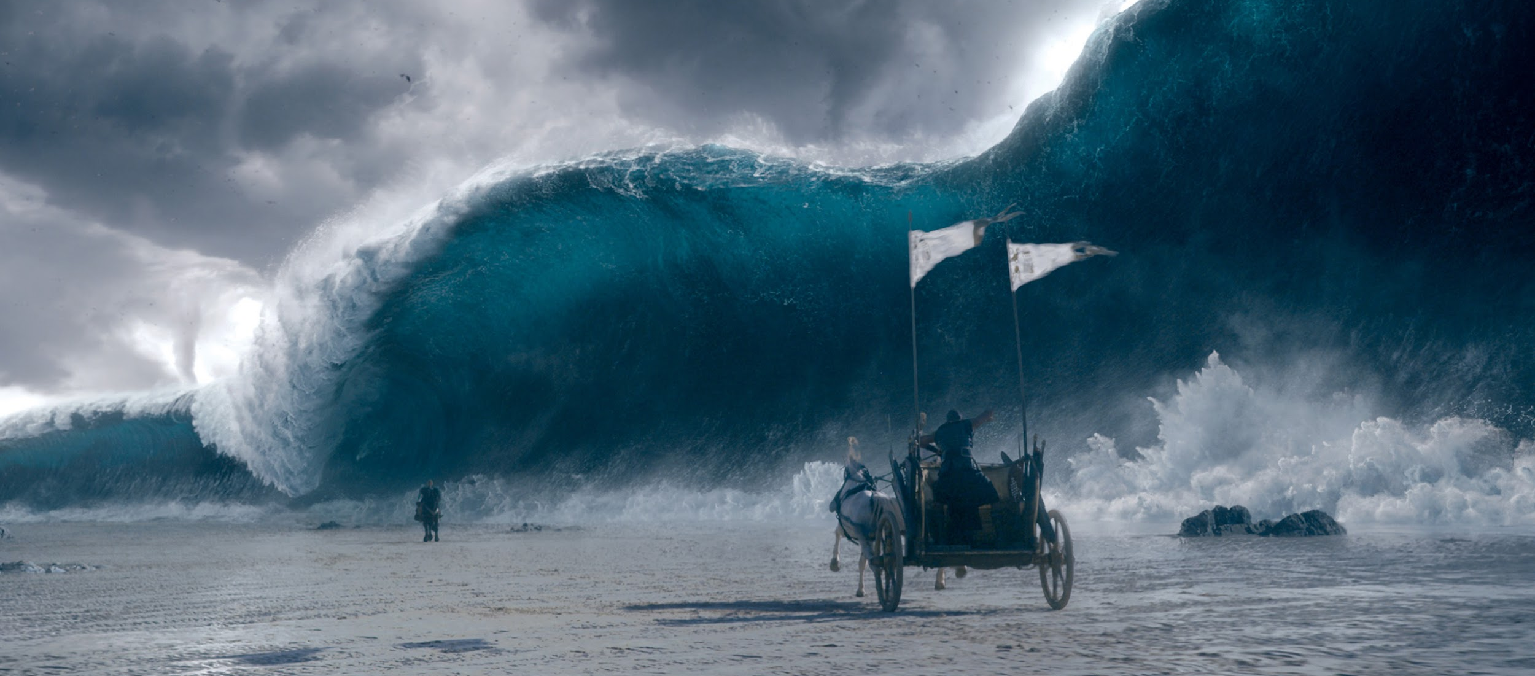
WE ARE CHAOS GROUP
We create powerful rendering and simulation technology to help you visualize anything imaginable.
Global leader in computer graphics, over 20 years experience
V-Ray is the industry standard for top design studios, architectural firms, advertising agencies, and visual effects companies
92 out of the top 100 architecture firms use V-Ray
V-Ray portfolio includes V-Ray for 3ds Max, Maya, MODO, Nuke, Katana, Rhino, SketchUp and Revit, Corona
Other products include VRscans, photoreal scanning technology and material library, Phoenix FD for fluid dynamics and PDPlayer
Our R&D division is shaping the future of creative storytelling, virtual reality and digital design
chaosgroup.com

Slide 4
Our mission
Solving hard problems so you don’t have to
Includes constantly looking into new technologies that may help our customers
Also searching for hard problems that need solutions

Slide 5
Computer graphics in practice
When I mention computer graphics, students typically imagine
  Games
  Visual effects for film and TV
These are the most famous applications of CG
  They are great!
However most of our users render visualization projects
  Interior design
  Arch Viz
  Product Viz

Slide 6
Why visualization is important?
Architecture is important
  You literally live your life in it
Product design is important
  You use those products every day

Slide 7
Computer graphics products
Many products, especially renderers, are specialized
  Realtime renderers for games
  Renderers for film VFX/TV work
  Renderers for arch viz
  Renderers for product viz
The different applications have [slightly] different requirements
  These requirements are very starting to converge somewhat

Slide 8
V-Ray is unique because it is used in all areas
V-Ray as a renderer, has been widely used in all areas of CG
  And even in newer areas like training AI
We’ve had the opportunity to observe the different requirements and attitudes of users in all CG areas
Being based exclusively on raytracing is what made it all possible
  Even for realtime - project Lavina

Slide 9
DCCs and different integrations
VFX-oriented DCCs
  Maya, Houdini, Katana, 3ds Max
ArchVIZ-oriented DCCs
  SketchUp, 3ds Max, ArchiCAD
Others
  Cinema4D, Rhino, etc

Slide 10
Rendering requirements
Different industries have slightly different rendering requirements
It is interesting to explore them in a bit more detail

Slide 11
Data size
Film renderers
  Large amounts of geometry (often subdivided/displaced)
  Large amounts of textures (usually tiled .tx files) - thousands of files
    Generating large amounts of textures is very easy these days, even if it is not strictly necessary for the project
  Data resides on a network location to be consumed by the render farm
    Could be a large bottleneck
ArchViz renderers
  Relatively less textures
  Varying file formats (JPG, PNG etc)
  Data is often local on artists’ workstation
Proxies turned out to be particularly useful for both areas
  A way for the renderer to directly load geometry bypassing the DCC

Slide 12
Scene organization
Film renderers
  Tightly controlled pipeline, mostly split into different stages
  Modeling, texturing, lighting, compositing are done by different people
  The renderer must allow data to come in and out of the renderer
    Support for common and standard file formats - Alembic, .tx, OpenEXR etc
  Object properties, overrides, shader controls based on scene data is important
    Often different versions of the same shot need to be rendered - for masks/holdouts, shadow extraction etc.
    It is useful to be able to do those overrides without changing materials - f.e. through object properties
ArchViz renderers
  Scenes can be built from publicly available models
  Varying model quality
  Varying input texture file format and shaders
    Materials specifically used to be a problem before because of material quality settings (sampling) embedded in materials instead of being handled automatically by the renderer
  Not much need to move data in and out of the renderer, in fact staying in the renderer even for post

Slide 13
Project duration
Film renderers
  Projects take a longer period of time, usually months
  There is time to research how to solve specific problems or issues (usually, less so nowadays)
ArchViz renderers
  Projects usually have a relatively quick turnaround
  There isn’t a whole lot of time to spend on rendering itself

Slide 14
Renderer output
Film renderers
  Sequences of frames (shots)
    Lots of animated stuff going on in each shot - characters, explosions, vehicles, destruction etc
  Many thousands of frames in a project
  Render elements to separate various components of the scene for adjustment/compositing in post
    World positions, extra textures etc.
  Deep output support might be needed
  Usually post-processing happens in a dedicated compositing application like Nuke or Fusion
ArchViz renderers
  Sometimes there are animations
    Usually walk-throughs or other presentation formats, not a whole lot of moving things
    Animations are increasingly moving over to realtime engines these days
  Mostly the results are still images
    Sometimes very large stills - distributed rendering is useful
  Render elements to adjust scene in post
    Usually masks
  Post-processing happens either in the frame buffer, or in PhotoShop

Slide 15
Additional tools
A renderer is sometimes expected to provide additional tools
  Scattering tools
  Variation tools (texture randomization etc)
Landscaping is a large part of ArchVIZ
  Creating the natural environment around a building
  Trees, grass, flowers

Slide 16
Lighting
Lighting in VFX
  The goal is often to match the look of a given background plate as a reference
  IBL is used all the time
  More artistic control required in order to match a given background plate or to achieve a specific look
    Separate control over diffuse and specular contributions, light linking, light filters/blockers
  Artistic light units (f-stops and exposure)
ArchVIZ requires more exact tools
  There is no reference - the renderer must say what the scene looks like, without any references
  Sun & Sky system for daylight scenes
  IES lights and area lights with prescribed intensity
  Physical light units (lumen, lux, candela etc)

Slide 17
Global illumination
GI in VFX
  Was avoided for a long time due to restrictions of the tools
  Only relatively recently VFX moved to raytracing exclusively
  Usually one or two bounces are enough when you render a character against a plate
  Tricks to suppress fireflies are allowed with less regard for physical accuracy
  Brute force strategies work well
ArchVIZ
  ArchVIZ users were pioneers here
    Starting with radiosity solutions for lighting analysis
    Moving to raytraced GI in the beginning of the 21st century
  Accurate light distribution is important - one or two bounces are not enough
  Specialized algorithms must be used to handle large number of bounces efficiently
    Light cache in V-Ray
    UHD cache in Corona

Slide 18
Materials
Materials in VFX
  Skin, hair materials are important
  Programmable shaders might be important (OSL, shading SDK)
    Could be a burden to the performance, or the development (keeping compatibility), but very helpful to customize the renderer
  Artistic control might be important
  Shading networks can be very complicated
    Lots of blend materials, masks, color correction textures etc
  Driving shaders through scene data or metadata is important
    User attributes, bitmap file name tags etc.
Materials in ArchVIZ
  Physical accuracy is important
  Materials for vegetation (foliage, grass), curtains etc
  Prebuilt material libraries might be important
  Programmable shading is not important
  Procedural shading, variations might be important

Slide 19
Some features are used differently
Hair primitives
  Used for characters in VFX - hair, facial hair, peach fuzz, animal fur
  Used for carpets, rugs, blankets, grass in ArchViz
2D displacement
  Used for skin and fine character detail in VFX
  Used for stone and brick walls, roof tiles, pavement etc
Frame buffer
  Used for previewing the output and explore render elements om VFX
  In ArchVIZ, also used as a post-processing tool, sometimes final post-processing is done there without post
  Sometimes this leads to concept clashes like LUT files

Slide 20
Renderer setup
A bit more time is available in VFX for setting up a renderer
  Different settings per shot might be required
  There are multiple iterations over a shot that allow settings to be fine-tuned
  Non-adaptive (fixed) sampling is acceptable, with manual control over every sample
    Takes a while to find the right settings, but the time is amortized over hundreds of animation frames
There is less time available in ArchVIZ
  The renderer must be able to handle many different types of projects with minimal settings
  Automatic/adaptive sampling is preferable, with only quality/max time specified as input

Slide 21
Render farm resources
In VFX, usually whole frames are distributed
  Hundreds or thousands of machines
  Render farm can spill to the cloud if needed
  Occasionally DR is used for iterations during lighting
  Software for render farm management is used
In ArchVIZ, often a single frame is distributed
  DR is often used for final results (stills)
  A few machines only available, sometimes office workstations (no dedicated render farm)
  Commercial render farm services handle the rest
  Cloud is less used because of complicated setup
    V-Ray Cloud aims to change that

Slide 22
Workflows move between industries
VFX workflows leaking into ArchVIZ
  OpenEXR
  Cryptomatte
  LUTs and post-processing
  Lots of research is done initially for VFX and then trickles down to ArchVIZ
    Accurate BRDFs (f.e. GGX)
    Volume rendering
    Hair/fur shading
    PBR-style materials
And the other way round
  Scattering tools for environments
  Global illumination
  Physical materials/lighting

Slide 23
Real time rendering
Real time rendering in VFX
  Previz, playblasts
  Occasionally for final frames or parts of final frames
    Recently entire short films/TV series are rendered in real time engines
Real time rendering in ArchVIZ
  Walk-throughs
  Space exploration/VR
  Interactive experiences
Real time engines
  Game engines repurposed for specific workflows
    Game-specific workflows might get in the way
  Specialized real time engines for arch VIZ

Slide 24
Virtual reality
Doesn’t work too well for entertainment
  Difficult to keep the attention of the viewer at the right spot
  Not very comfortable for longer viewing
Very popular for ArchVIZ
  Shows off a space much better
    Still images - stereo panoramas
    Walk-throughs
    Interactive experiences

Slide 25
Final thoughts
Can one rendering solution cover everything?
  VFX
  ArchVIZ
  Realtime

Slide 26
Questions?

