Slide 1
Design considerations for physical realism and practical use in Indigo Renderer
Thomas Ludwig
Glare Technologies Ltd.
https://www.indigorenderer.com
https://www.glaretechnologies.com
Notes:
Hi, my name is Thomas Ludwig, I’m with Glare Technologies, developers of Indigo Renderer
We’re a small company of 3 fulltime employees, plus some friends and contractors helping out.
I’ve been with Glare for 10 years now, though the history of Indigo stretches back further than that as a hobby project of Nicholas Chapman.

Slide 2
Overview
History and context
Motivation
Difficulty of caustics and indirect lighting
From a user's point of view…
From a developer's point of view…
Avoid complex algorithms
GPU rendering benefits and challenges
Conclusion
Notes:
I’ll start with a brief history of Indigo Renderer and our market context, and then go over some motivating examples for some of the design decisions.
Difficult indirect lighting, especially caustics, is not a focus of most rendering systems so I’ll go into detail about that, followed by user and developer perspectives for using bidirectional algorithms.

Slide 3
History and context
Basis is Veach's thesis [1], inspired by Maxwell Render
Need for specialised product, “max quality” implementation
Make it accessible to non-CG specialists
Notes:
Basis is of course Veach’s thesis, and Maxwell early pioneers in physically-based MC
Non-CG specialists e.g. architects, CAD designers, people with primary job in design, want good results easily
SketchUp and Revit users for archviz, C4D for productviz, Blender CAD

Slide 4
History and context
Basis is Veach's thesis [1], inspired by Maxwell Render
Need for specialised product, “max quality” implementation
Make it accessible to non-CG specialists
Indigo Renderer
Emphasis on quality and simplicity
(Volumetric) unidirectional and bidirectional path tracing
Optional Kelemen PSS-MLT [2] on top for most difficult scenes
Truly unbiased - 10k path depth, bidir on by default
Mainly archviz and productviz customers
Notes:
Indigo Renderer places great emphasis on image quality, and simplicity.

Slide 5
Motivation
Archviz / productviz has different requirements and allowances
Can assume scene fits in memory, allows bidir methods and GPU
Demand highest final quality, quick previews
Keep algorithms simple as possible
Need to exploit huge GPU resources
GPU unidir is already quite complex!
Unidir vs bidir (2.5 mins on AMD ThreadRipper), scene by Giorgio Luciano & polygonmanufaktur.de
Notes:
Biggest enabling assumption of viz: scenes can fit in memory
Relaxing this constraint allows powerful bidirectional methods
Pronounced advantage over unidir for rendering caustics
Fast early convergence big practical benefit of MLT, useful for previews

Slide 6
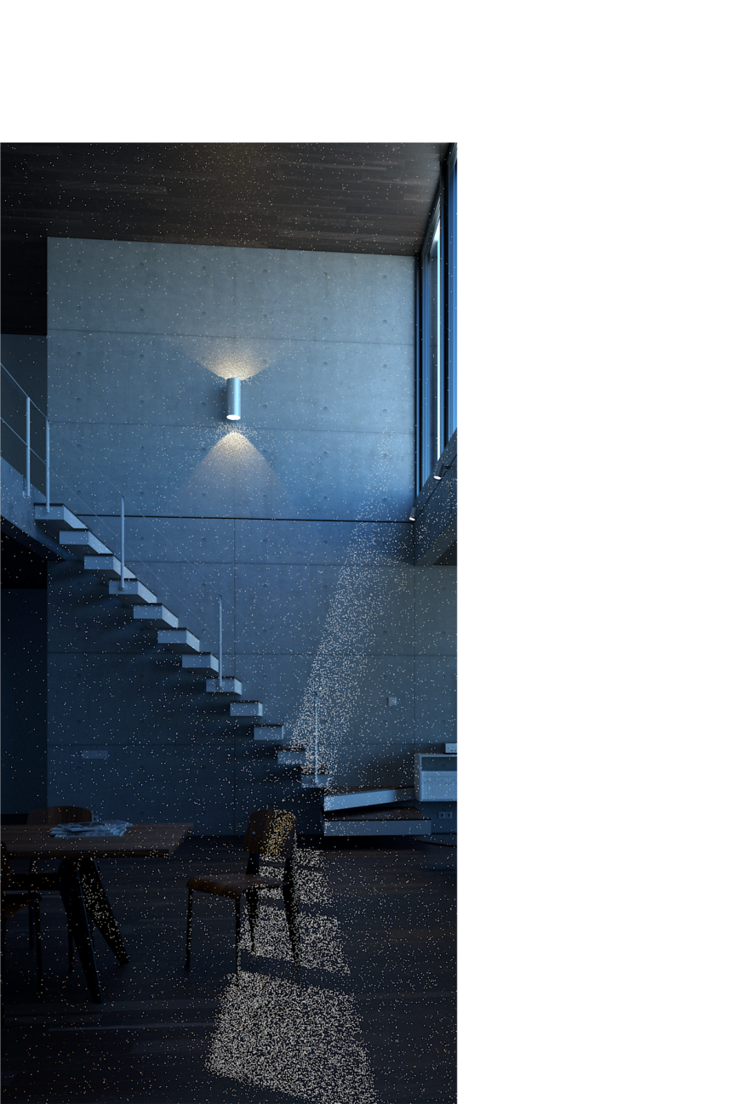
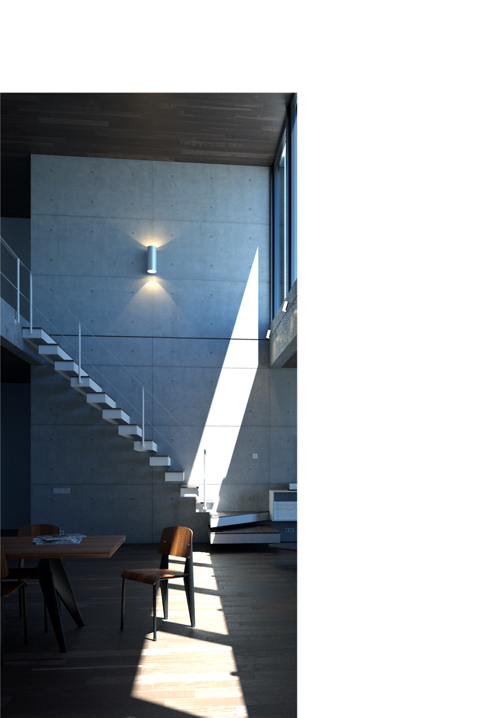
Motivation
Archviz / productviz has different requirements and allowances
Can assume scene fits in memory, allows bidir methods and GPU
Demand highest final quality, quick previews
Keep algorithms simple as possible
Need to exploit huge GPU resources
GPU unidir is already quite complex!
Interior renders much more efficient
Difficult to sample localised reflected light with eye paths
Light paths induce perfect distribution
Unidir vs bidir (8 mins on Intel i7-8700K), scene by MAD IMAGERY
Notes:
For unidir to sample localised reflections, needs path guiding methods
When there is realistically modelled glass in front of emitter, you need bidir methods

Slide 7
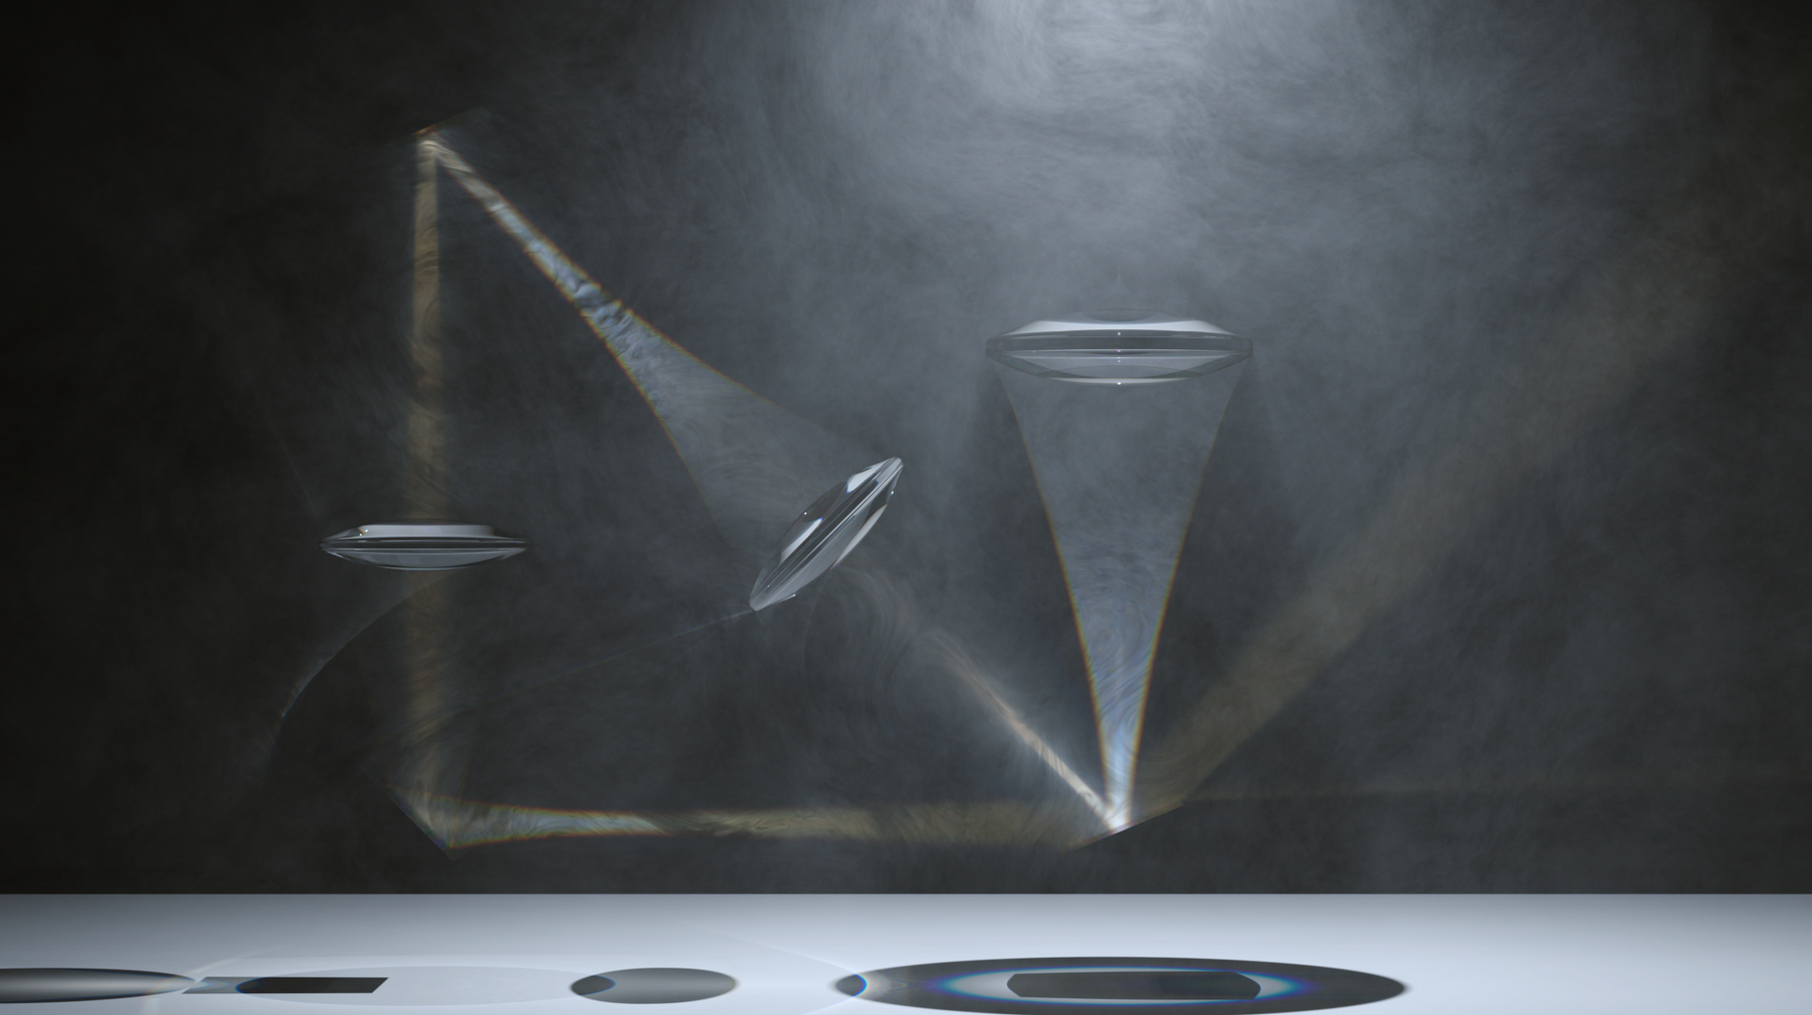
Motivation
No contest in optical simulations
Lenses Experiment by Raphael Rau / Silverwing VFX, rendered with bidir MLT @ 4K, clean image in 45 mins on 4 GHz 8-core
Notes:
Scenes as complex as this are not the norm, but same high accuracy engine rendering any archviz or productviz scene

Slide 8
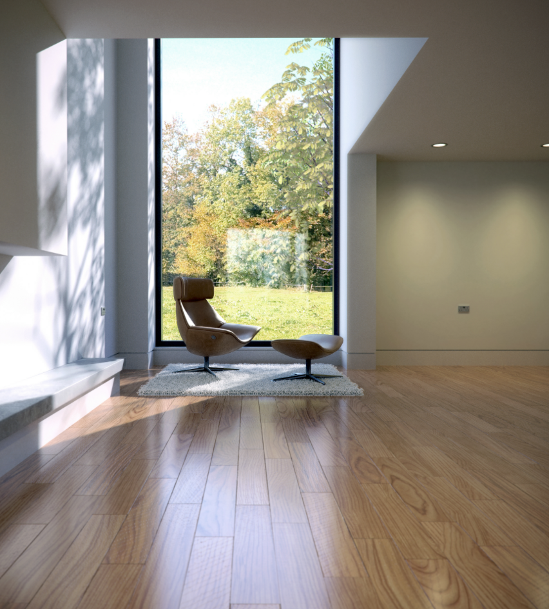
Difficulty of caustics and indirect lighting
Caustic and indirect illumination common in archviz
Glass bulbs, lampshades, mirrors and windows
Illumination from IES profiles and detailed lights
Often approximated
Biased methods, limited path depth, increasing roughness with glossy scatters
Dowling by Aaron Crozier / bubs
Notes:
Many realistic scenes almost entirely illuminated by indirect light
Narrow IES lights particularly tricky for unidir

Slide 9
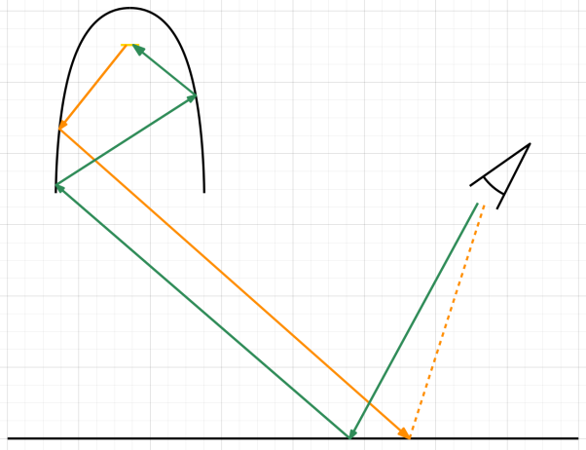
Difficulty of caustics and indirect lighting
Caustic and indirect illumination common in archviz
Glass bulbs, lampshades, mirrors and windows
Illumination from IES profiles and detailed lights
Often approximated
Biased methods, limited path depth, increasing roughness with glossy scatters
But what if it’s modelled accurately?
Difficult to sample from eye paths:
Dowling by Aaron Crozier / bubs
Notes:
Green light path starts from the camera, hits the floor or wall, fails to make a direct lighting connection and strikes light through series of low probability scatters, producing firefly
Orange light paths start from emitter, reflect inside fixture, then strike floor or wall and connect to camera → perfect importance sampling

Slide 10
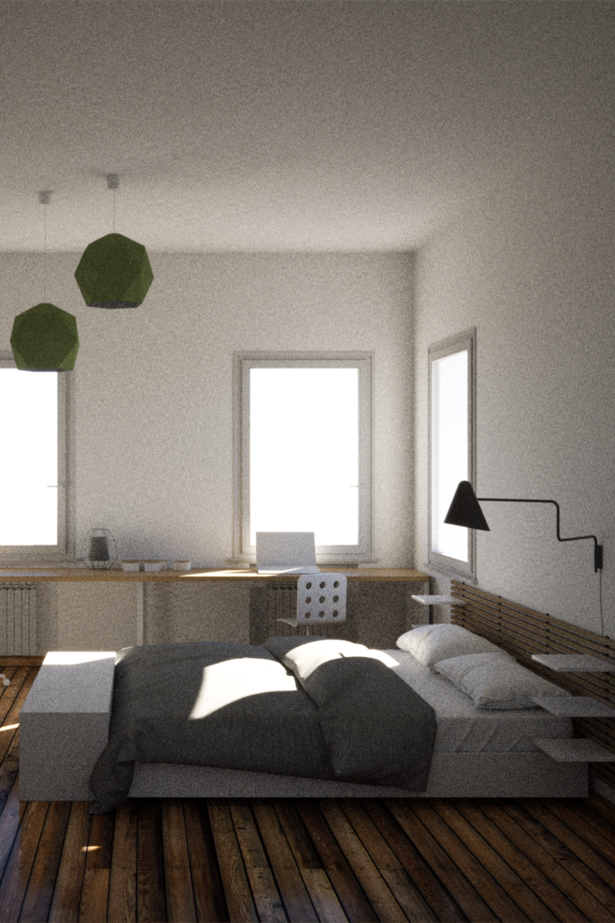
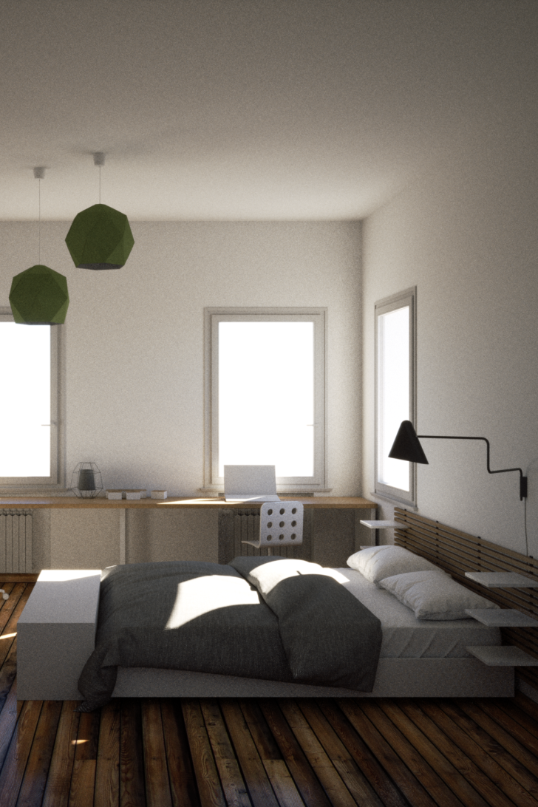
From a user's point of view...
Compute power gets cheaper over time, human time does not
Fast on modern hardware
Bidir by default means less to think about
Safest default without scene-based optimisation
Unidir vs bidir (5 mins), scene by Filippo Scarso / pibuz
Notes:
Some users willing to trade rendering speed / hw costs for simple setup, high quality final results
Nevertheless, all A/B comparisons in these slides rendered in 5 mins or less on desktop CPU
Bidir at best much more efficient, at worst not much worse (MIS), thus safest default without changing rendering modes

Slide 11
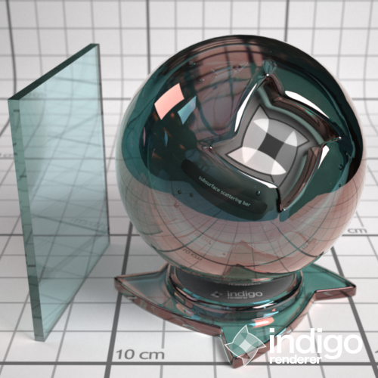
From a user's point of view...
Compute power gets cheaper over time, human time does not
Fast on modern hardware
Bidir by default means less to think about
Safest default without scene-based optimisation
Example: partnership with Saint-Gobain Glass
Verified spectral model for several glass types
Available on the online material database
Can now easily be used in high accuracy archviz, both interior and exterior shots
Saint-Gobain Glass Cool-Lite SKN 165
Notes:
Saint Gobain needed predictive accuracy, measured spectral data for various commercially offered glass types
Indigo material library allows anyone to use extremely realistic glass

Slide 12
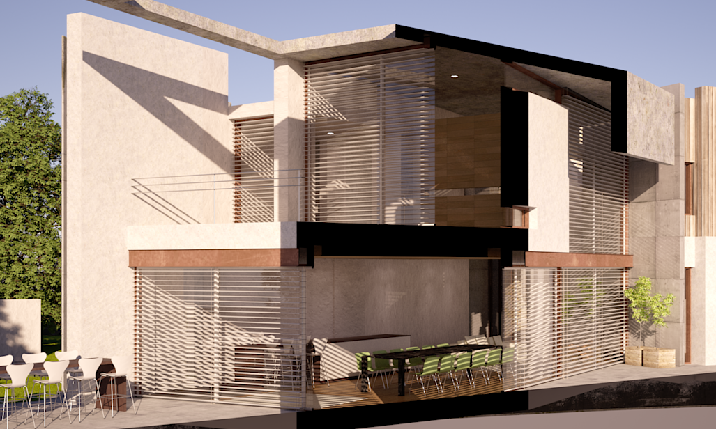
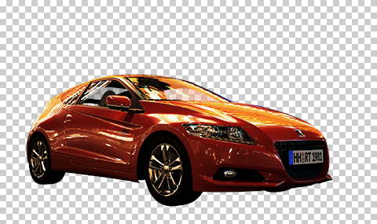
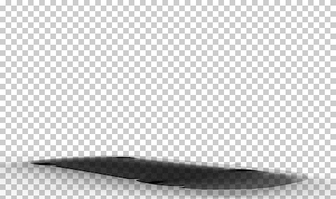
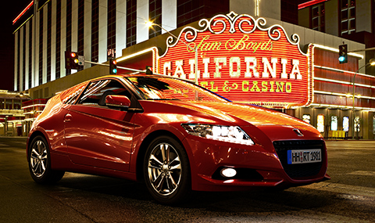
From a developer's point of view...
Bidir is more difficult to implement and maintain
Unphysical hacks trickier
Section planes
Shadow catcher
Scene by polygonmanufaktur.de
Notes:
Unphysical hacks commonly used for viz, e.g. section planes, invisible to cam objects
Section planes can’t simply clip off geometry, still need to emit from lights and reflect etc. More special cases for bidir
Shadow catcher planes are another special case, used for compositing

Slide 13
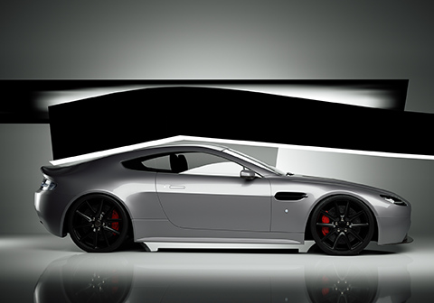
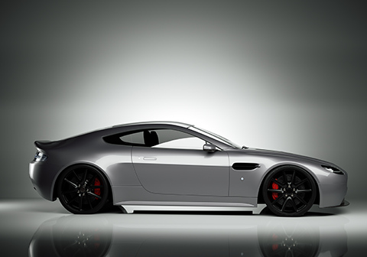
From a developer's point of view...
Bidir is more difficult to implement and maintain
Unphysical hacks trickier
Section planes
Shadow catcher
Invisible to camera
Non-symmetric scattering, normal smoothing
Naive implementation is O(N^4), can be optimised to O(N^2) [3]
Scene by Oscar Johansson
Notes:
Similarly, more special cases for invisible to cam objects when using bidir
Refraction density different for light paths, interpolated normals need Veach’s “smoothing factor”
Fast N^2 implementation complex to implement and debug

Slide 14
Avoid complex algorithms
Complex can mean:
Difficult to implement robustly, e.g. Veach-MLT vs PSS-MLT
Difficult to understand settings exposed to users, e.g. irradiance caching
Difficult to predict behaviour, e.g. flickering in animation

Slide 15
Avoid complex algorithms
Complex can mean:
Difficult to implement robustly, e.g. Veach-MLT vs PSS-MLT
Difficult to understand settings exposed to users, e.g. irradiance caching
Difficult to predict behaviour, e.g. flickering in animation
Bidir is as powerful as you can get before getting exotic
Proven highly efficient mix of direct and indirect techniques
Embarrassingly parallel, albeit with incoherent splats for light paths
Needs to work on GPU eventually too
Notes:
Vanilla bidir has overhead from many shadow rays, but there are ways to make it more efficient.
Combinatorial bidir, two-way path tracing by Simon Brown are examples

Slide 16
GPU rendering benefits and challenges
Huge performance boost for unidir PT (fully) on GPU
Tried hybrid CPU+GPU, always bottlenecked
Multi GPU performance is incredible
Nvidia announced dedicated ray tracing units in GeForce RTX, 10 gigarays / sec!
GPU bidir in future
Requires more stages in wavefront path tracing [4]
Even more memory limited
12 GB on GPU versus 128 GB on CPU practical in 2017
Out-of-core would add large amount of complexity
Still want in-memory codepath for simpler scenes
Notes:
Can’t ignore available GPU resources, factor ~10 brute force per GPU, GeForce RTX announced yesterday with dedicated RT silicon
Wavefront unidir PT already complex, bidir roughly doubles it (subpath tracing, MIS combining)
Would like to see more research on GPU out of core rendering, need practical method since complexity strictly additive

Slide 17
Thank you
References:
[1] Veach thesis “Robust Monte Carlo Methods for Light Transport Simulation”
[2] Kelemen et al. “Simple and Robust Mutation Strategy for Metropolis Light Transport Algorithm”
[3] van Antwerpen thesis “Unbiased physically based rendering on the GPU”
[4] Laine et al. “Megakernels Considered Harmful: Wavefront Path Tracing on GPUs”

