Slide 1
open research problems
Jaroslav Křivánek Charles University | Render Legion | Chaos Group
Notes:
In this concluding part of the course, I will discuss some open problems in volumetric light transport.

Slide 2
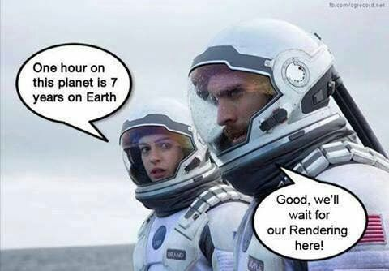
Speed in general
Heterogeneus volumes – volume lookups
Unidirectional estimators are not robust
Combined bidir estimators slow
Notes:
The first problem is of course speed: light transport is generally slow, transport in volumes even slower. Especially in large heterogeneous volumes, just looking up the volume data can easily overwhelm the entire computation budget.
Furthermore, the unidirectional estimators commonly used in practice, such as path tracing, are generally rather fragile: they do not handle well complex lighting such as caustics or strong indirect illumination. They also have trouble with light sources embedded directly into the volumes.
Bidirectional methods, such as bidirectional path tracing or UPBP [Křivánek et al. 2014], are more robust thanks to the use of combined estimators, however they tend to be generally slow, even in the simple cases that the path tracer already handles fairly well.

Slide 3
null collision algorithms and MIS
“How do I combine Woodcock tracking with equi-angular sampling?”
MIS could do that – but we need the Woodcock tracking PDF
PDF not easily available – it’s a rejection method
Can we estimate the PDF (for MIS)?
Ray marching – accurate but slow, bias does not matter (it’s just for the MIS weights)
Notes:
Some more specific problems include calculation of sampling pdfs for the null-collision tracking algorithms, such as Woodcock tracking.
Woodcock tracking is a rejection method of sorts, we know it generates samples from the appropriate distribution, but we have no way of evaluating the pdf value for a given distance.
This prevents the use of Woodcock tracking in bidirectional estimators, where the pdf value is essential for the calculation of MIS weights (e.g. the balance heuristic) [Veach and Guibas 1995].

Slide 4
leverage machine learning
Path guiding for volumes
[Herholz et al. 2019], still needs improvements
Denoising of volumes – currently does not work well
No features available
Learn a BSSRDF for dense media
Can be done for fluffy clouds, but becomes harder for more structured media
Difficult to bound error
Notes:
One interesting direction for improving the performance of volumetric light transport is the use of Machine learning.
One option, already exploited in surface rendering, is the so called path guiding. Path guiding refers to adaptive sampling in the path space, with the purpose of preferably sampling paths to scene locations where light sources can be easily reached. Machine learning can be used to learn the guiding distributions (unknown upfront) from the samples used in rendering. The upcoming work of Herholz et al. [2019] goes in this direction, but more work will be needed.
Another challenge is denoising of volumetric media, which currently does not work very well. The main reason is the lack of any reliable features (such as surface normals, depth, texture/albedo) that are readily available for surfaces. For this reason the denoiser has no way of telling noise from actual features. A ML methods trained on a sufficiently large pool of examples could help to improve this.
Another interesting direction follows from the realization that – especially in dense media – the transport has diffusive character, so the solutions are generally rather smooth and stable (in the sense that small perturbations of the volume data will not yield large perturbations of the light transport solution). These facts give some hope that it might be possible to learn – through regression – the light transport solution for canonical configurations.

Slide 5
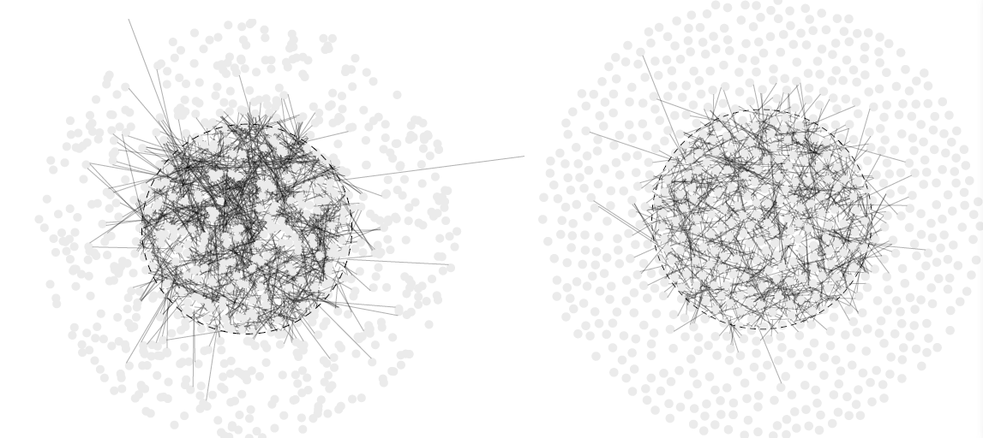
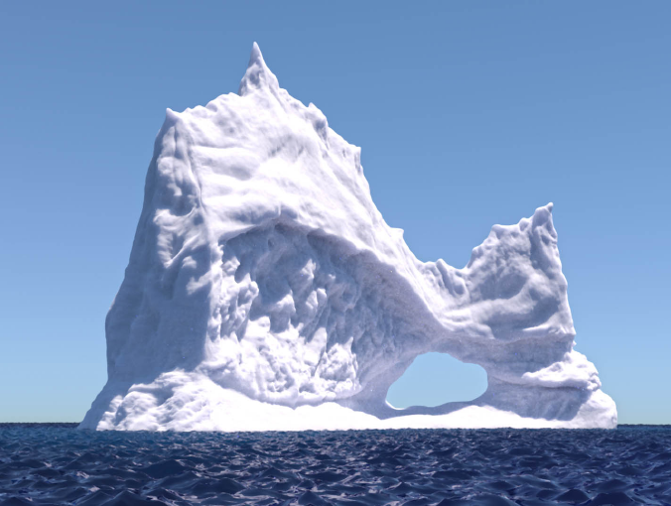
correlated scatterers
Core assumption of exponential path length – uncorrelated particles
Particles can be very correlated (biological tissue – cells, sand particles)
Some existing work [d'Eon 2018, Jarabo et al. 2018, Bitterli et al. 2018]
Notes:
Another interesting direction of future research is the co-called non-classical transport, that is, transport in media for which the Beer-Lambert law does not hold.
Such cases include all media with correlated internal structure (the exponential Beer-Lambert light falloff assumes uncorrelated particles in the volume).
Some recent work in this direction already exists, but efficient rendering methods for such media are yet to be devised.

Slide 6
surfaces & volumes
Joint handling of surfaces and volumes
Represent surfaces as volumes, too?
… and then jointly downscale for LOD
Notes:
The volumetric representation can also be though of as a natural unified representation of scenes.
Indeed, for some materials, such as fabrics, surface representation with a texture might be too limiting, while a volumetric representation easily captures all the intricacies of such materials.
A unified volumetric scene representation has the significant advantage of enabling effective level-of-detail in large scenes.

Slide 7
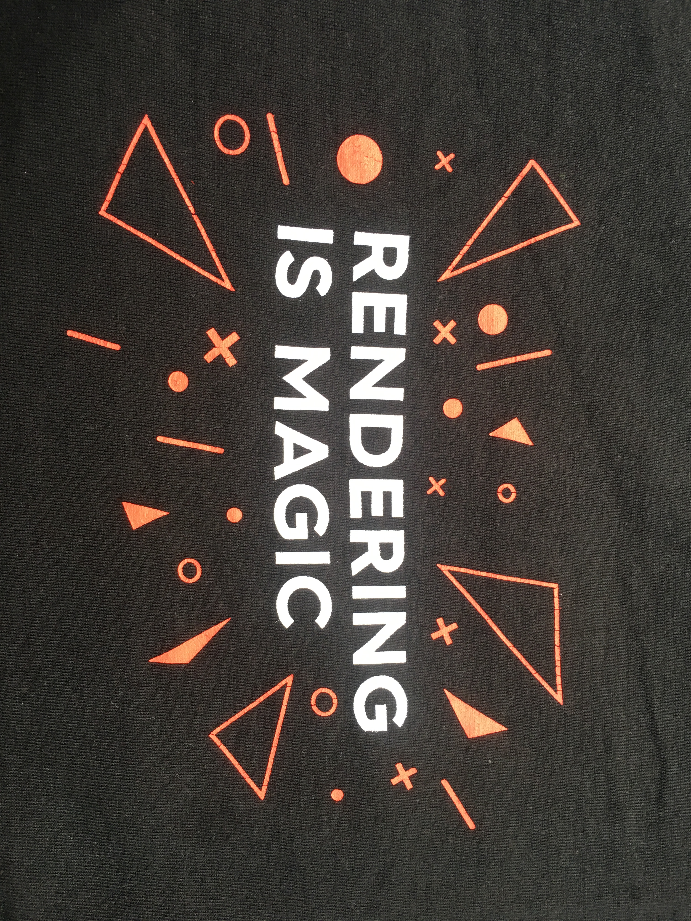
Thank you!
Acknowledgments
Funding: Czech Science Foundation (16-18964S)

