Slide 1
Me, Myself, and I
Jan Beneš
Computer Graphics Group
Faculty of Mathematics and Physics
Charles University in Prague
http://cgg.mff.cuni.cz/~benes

Slide 3
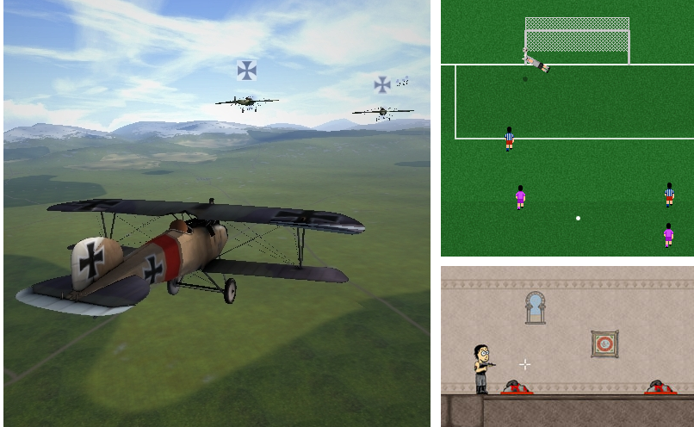

Slide 4
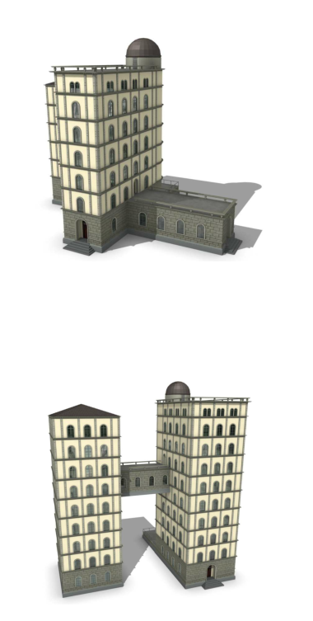
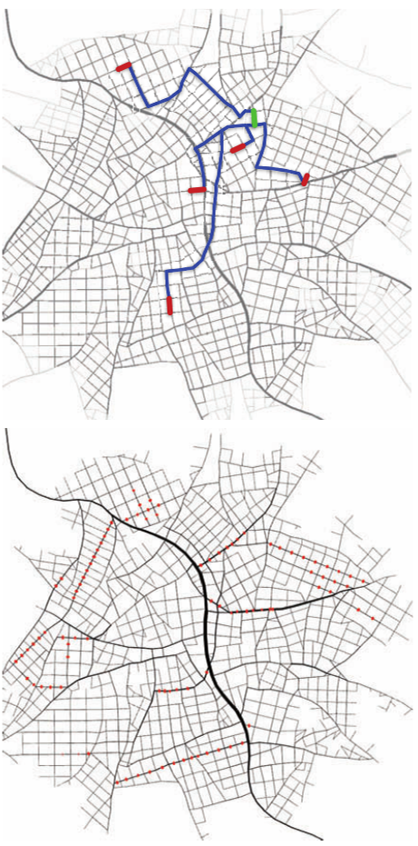
=
+

Slide 5
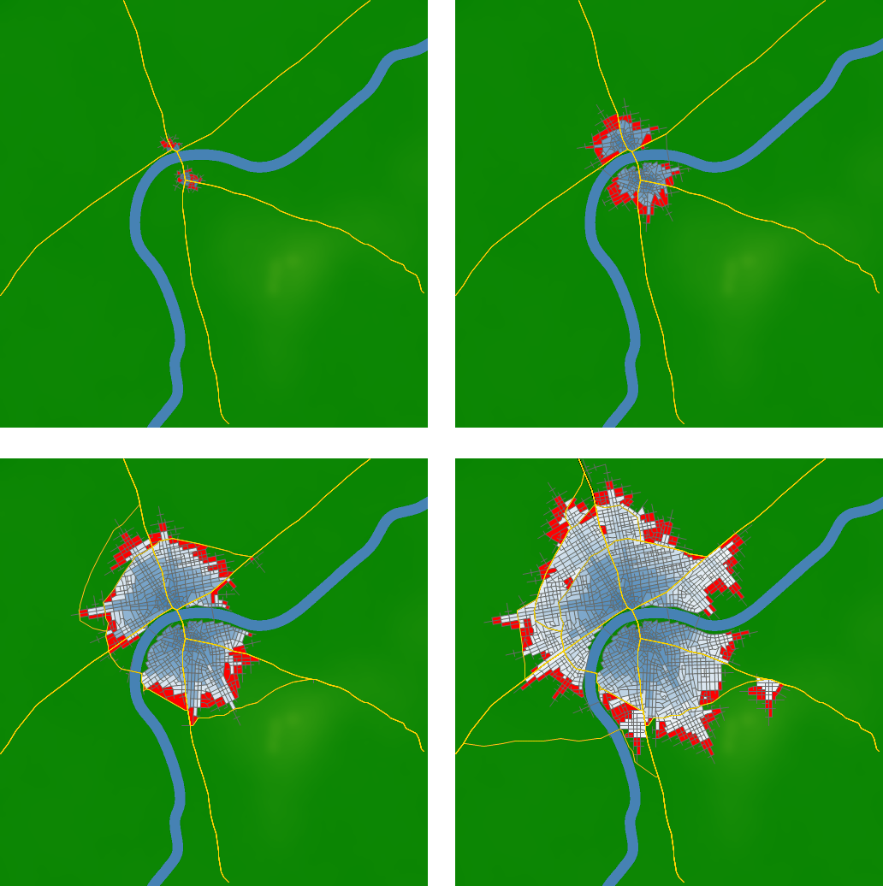

Slide 6
Thank you!

