Slide 1
Počítačová grafika III –
Irradiance Caching
Jaroslav Křivánek, MFF UK
Jaroslav.Krivanek@mff.cuni.cz

Slide 2
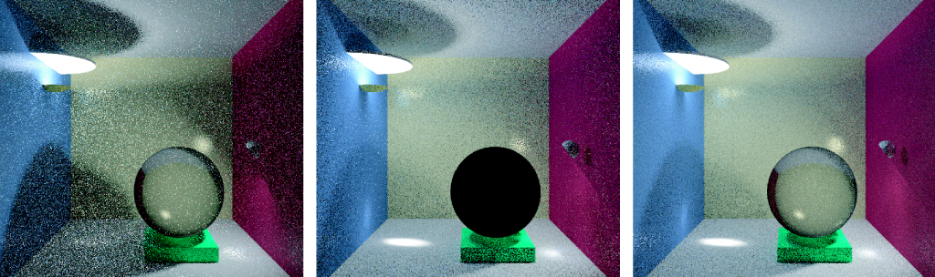
Kvíz 1
© F. Suykens
Path tracing
Light tracing
Bidirectional path tracing
Kvíz: Proč je skleněná koule černá?

Slide 3
Kvíz 2
Proč BPT neumí zobrazit kaustiku na dně bazénu (bodové světlo, pinhole kamera)?

Slide 4
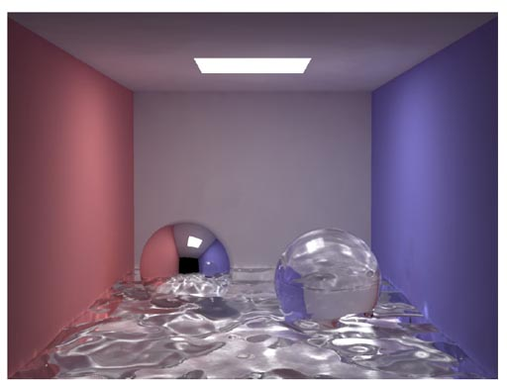
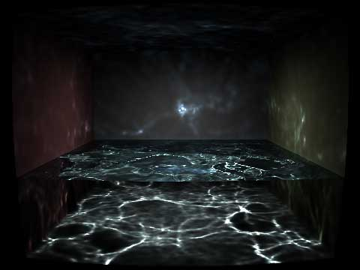
Fotonové mapy – SDS cesty
© H.W.Jensen
© Wojciech Jarosz

Slide 5
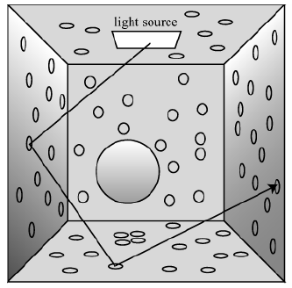
Fotonové mapy – Fáze výpočtu
Rozmístění fotonů
Rendering s využitím
fotonových map

Slide 6
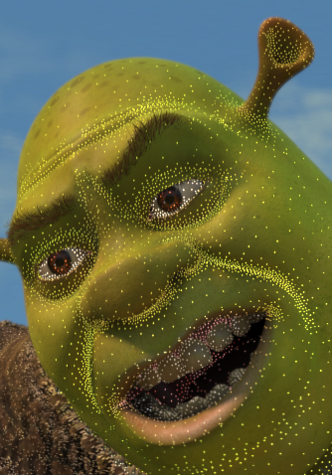
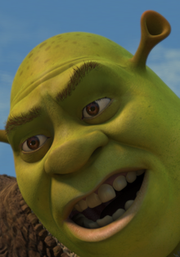
Irradiance caching
Jaroslav Křivánek
Charles University, Prague
Jaroslav.Krivanek@mff.cuni.cz

Slide 7
Motivation
Distribution path tracing (DPT)
Final gathering
  Estimate illumination integral at a point by tracing many rays (500-5000)
  Costly computation
Irradiance caching accelerates DPT for diffuse indirect illumination

Slide 8
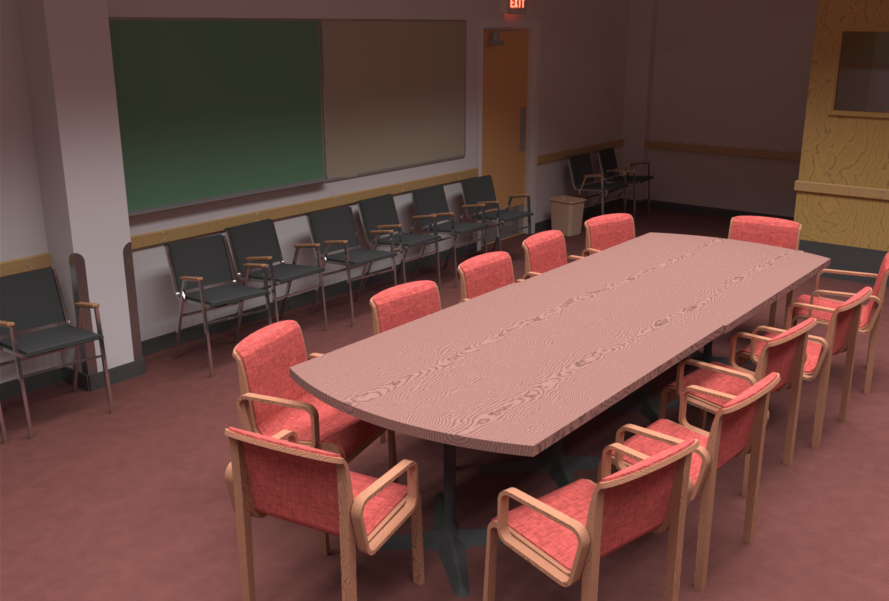
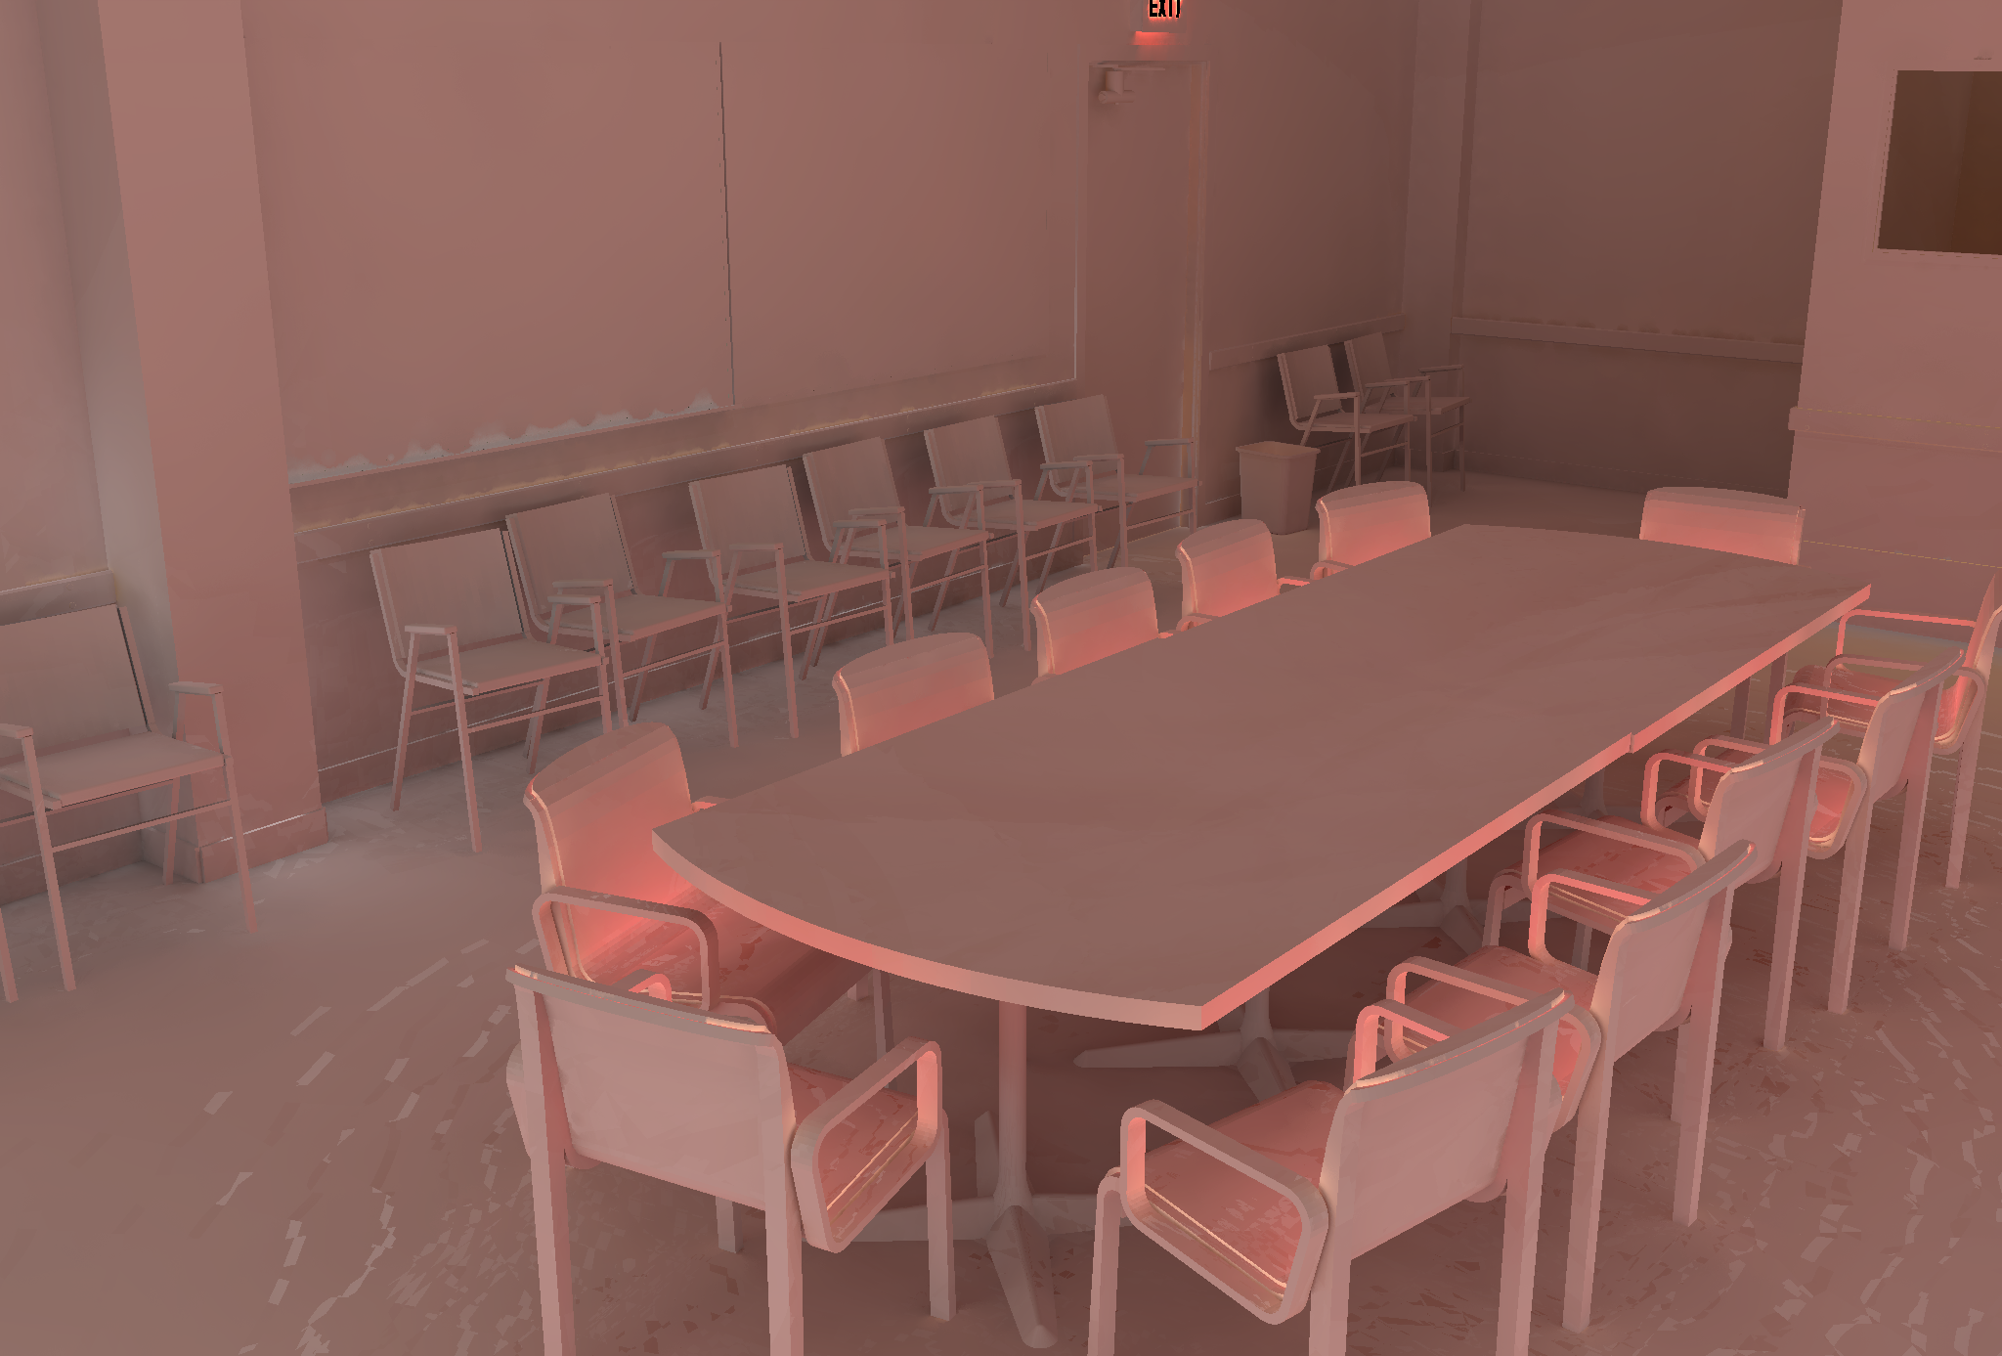
Motivation
Spatial coherence
  Diffuse indirect illumination changes slowly over surfaces
Indirect irradiance – changes slowly

Slide 9
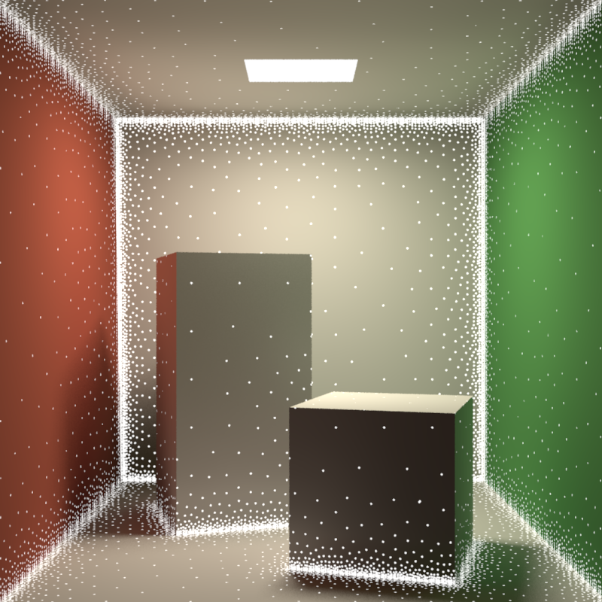
Irradiance caching
Sparse locations for full DRT computation
Resulting irradiance stored in a cache
Most pixels interpolated from cached records
Image credit: Okan Arikan

Slide 10
Irradiance caching
Faster computation of the diffuse component of indirect illumination
Diffuse reflection
  L_{o}(p) = E(p) * ρ_{d}(p) / π
View-independence
  Outgoing radiance independent of view direction
  Total irradiance is all we need => cache irradiance

Slide 11
Irradiance caching
Lazy evaluation of new irradiance values
  Only if cannot be interpolated from existing ones
Example: Values E1 and E2 already stored
  Interpolate at A (fast)
  Extrapolate at B (fast)
  Add new record at C (slow)
B
E2
A
E1
C → E3

Slide 12
Irradiance caching pseudocode
GetIrradiance(p):
  Color E = InterpolateFromCache(p);
  if( E == invalid )
    E = SampleHemisphere(p);
    InsertIntoCache(E, p);
  return E;

Slide 13
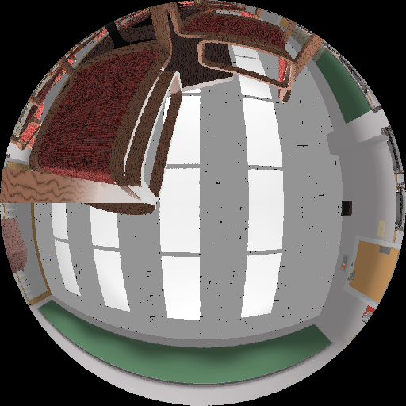
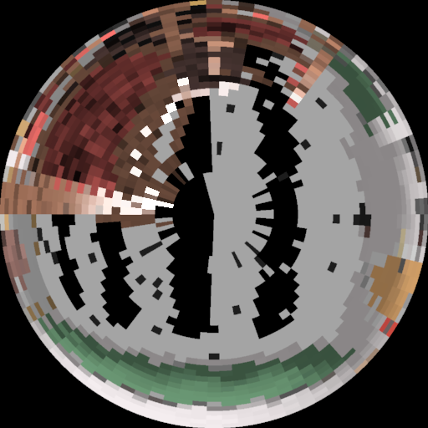
Indirect irradiance calculation
E = SampleHemisphere(p);
Cast 500-5000 secondary rays (user-specified)
Compute illumination at intersection
  Direct illumination only, or
  Path tracing, or
  Photon map radiance estimate, or
  Query in (another) irradiance cache
  No emission taken into account!

Slide 14
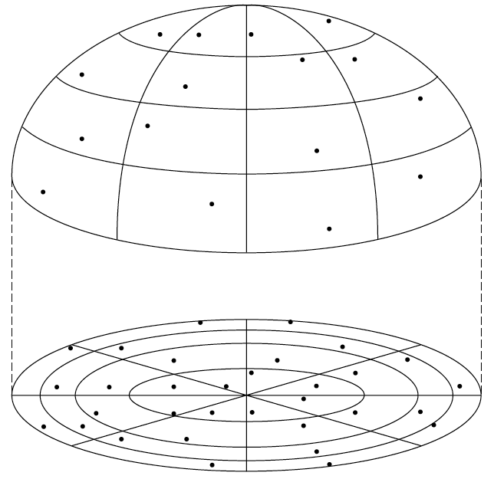
Indirect irradiance calculation
E = SampleHemisphere(p);
Stratified Monte Carlo hemisphere sampling
  Subdivide hemisphere into cells
  Choose a random direction in each cell and trace ray

Slide 15
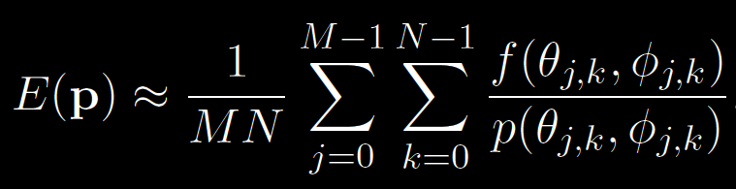
Indirect irradiance calculation
E = SampleHemisphere(p);
Estimating irradiance a p:
General form of the estimator
E(p) = ∫ L_{i}(p, ω_{i}) cosθ_{i} dω_{i}

Slide 16

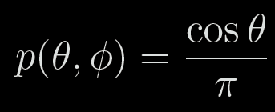
Indirect irradiance calculation
E = SampleHemisphere(p);
For irradiance calculation, the integrand is:
PDF:

Slide 17
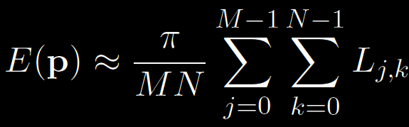
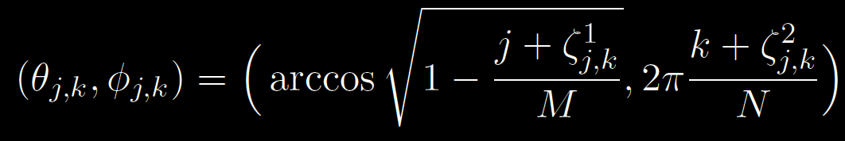

Indirect irradiance calculation
Irradiance estimator for IC:
L_{j,k} … radiance sample from direction:
M, N … number of divisions along θ and φ
… random numbers from R(0,1)

Slide 18
Irradiance caching pseudocode
GetIrradiance(p):
  Color E = InterpolateFromCache(p);
  if( E == invalid )
    E = SampleHemisphere(p);
    InsertIntoCache(E, p);
  return E;

Slide 19
Record spacing
If E(p) changes slowly => interpolate more
If E(p) changes quickly => interpolate less
What is the upper bound on rate of change (i.e. gradient) of irradiance?
Answer from the “worst case” analysis (omitted)

Slide 20
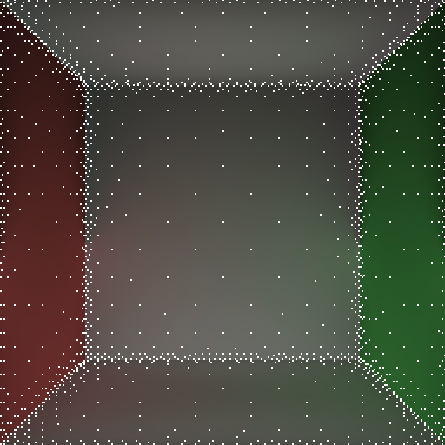
Record spacing
Near geometry
→ dense spacing
  Geometry = source of indirect
  illumination
Open spaces
→ sparse sampling

Slide 21
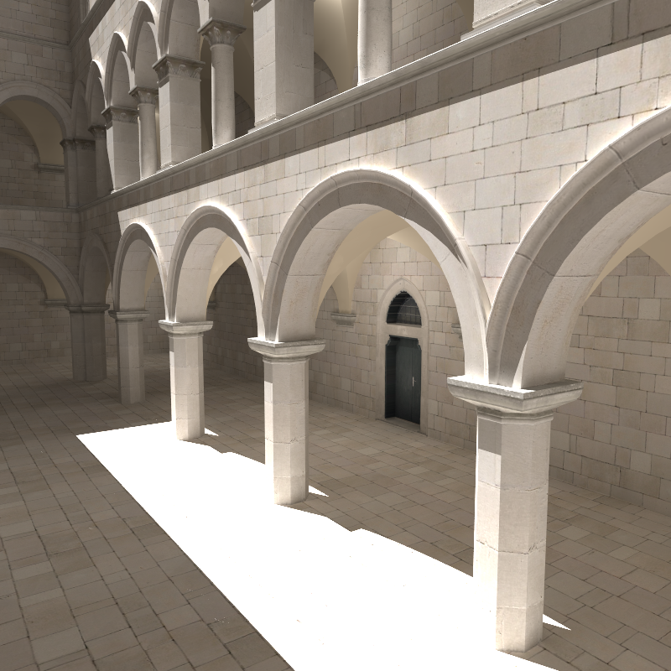
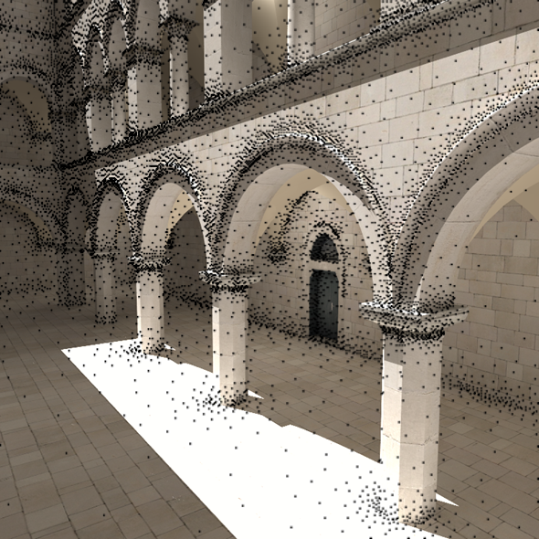
Record spacing

Slide 22
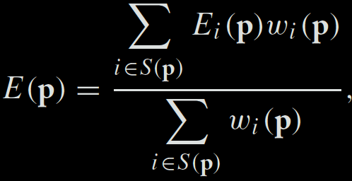

Irradiance interpolation
E = InterpolateFromCache(p)
Weighted average:
Records used for interpolation:

Slide 23
Weighting function
[Tablellion and Lamorlette 04]
p_{i}
R_{i}

Slide 24
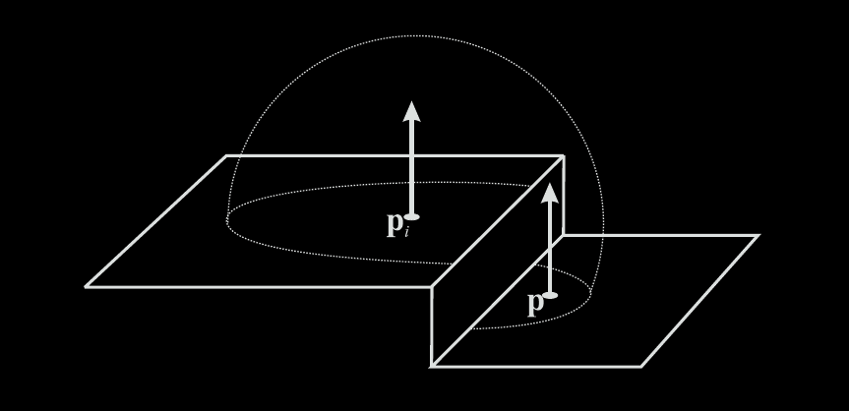
Heuristic “behind” test
Record at p_{i} rejected from interpolation at p if p is “behind” p_{i}

Slide 25
Irradiance caching pseudocode
GetIrradiance(p):
  Color E = InterpolateFromCache(p);
  if( E == invalid )
    E = SampleHemisphere(p);
    InsertIntoCache(E, p);
  return E;

Slide 26
Irradiance cache record
InsertIntoCache(E, p);
Vector3 position
Vector3 normal
float R
Color E
Color dEdP[3]
Color dEdN[3]
Position in space
Normal at `position’
Validity radius
Stored irradiance
Gradient w.r.t. translation
Gradient w.r.t. rotation

Slide 27
Irradiance cache data structure
InsertIntoCache(E, p);
Requirements
  Fast incremental updates
  (records stored on the fly)
  Fast query for all records (spheres) overlapping a given point p

Slide 28
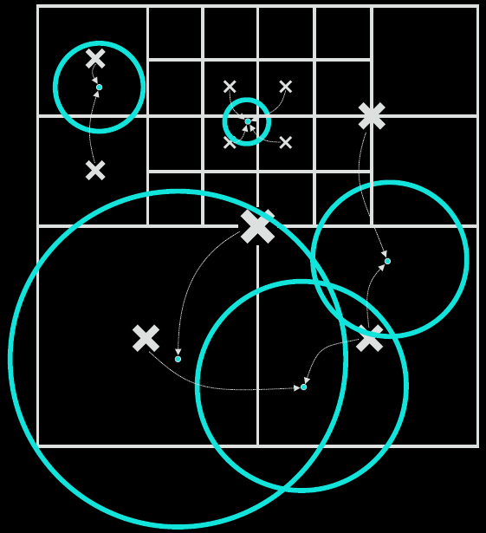
Data structure: Octree
InsertIntoCache(E, p);

Slide 29
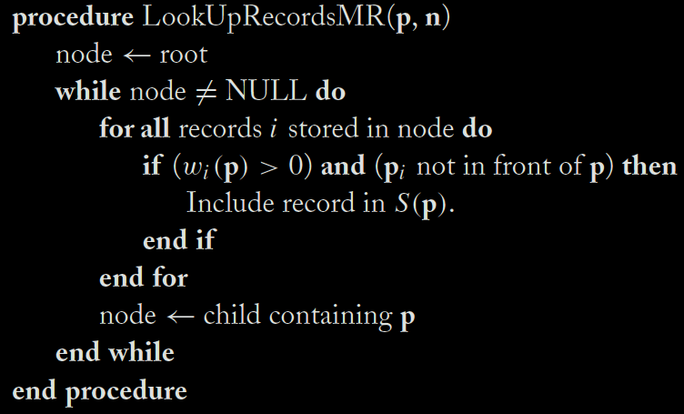
Data structure: Octree
back to … E = InterpolateFromCache(p)

Slide 30
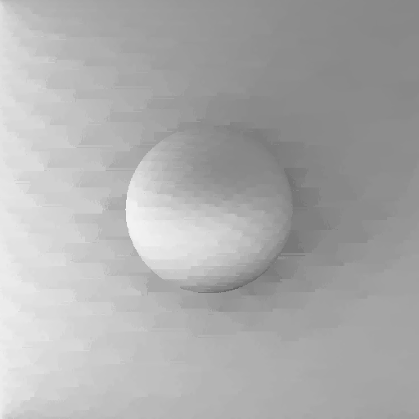
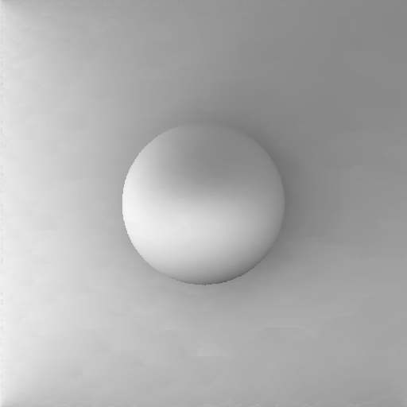
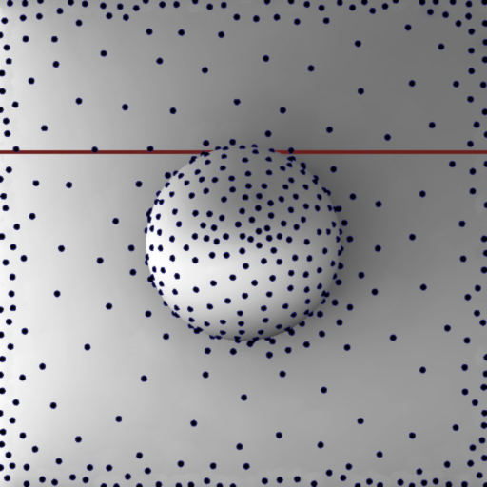
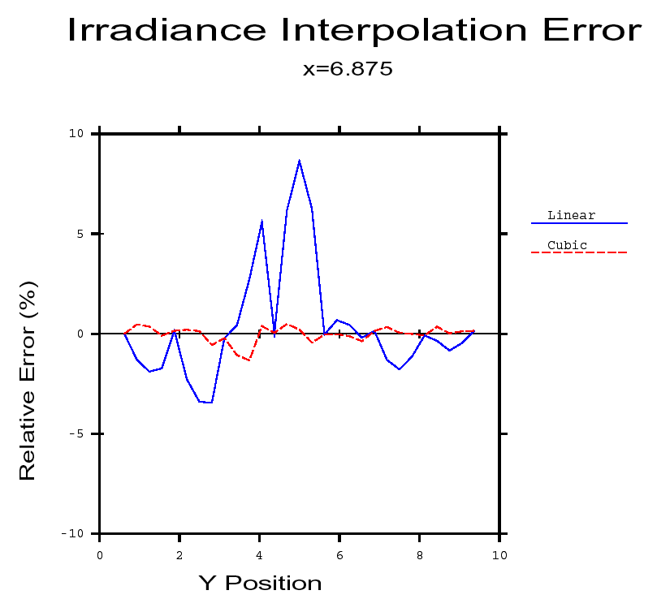
Irradiance gradients
no gradients
with gradients

Slide 31
Irradiance gradients
Essential for smooth interpolation
Calculated during hemisphere sampling
  i.e. no extra rays, little overhead
Stored as a part of the record in the cache
Used in interpolation

Slide 32
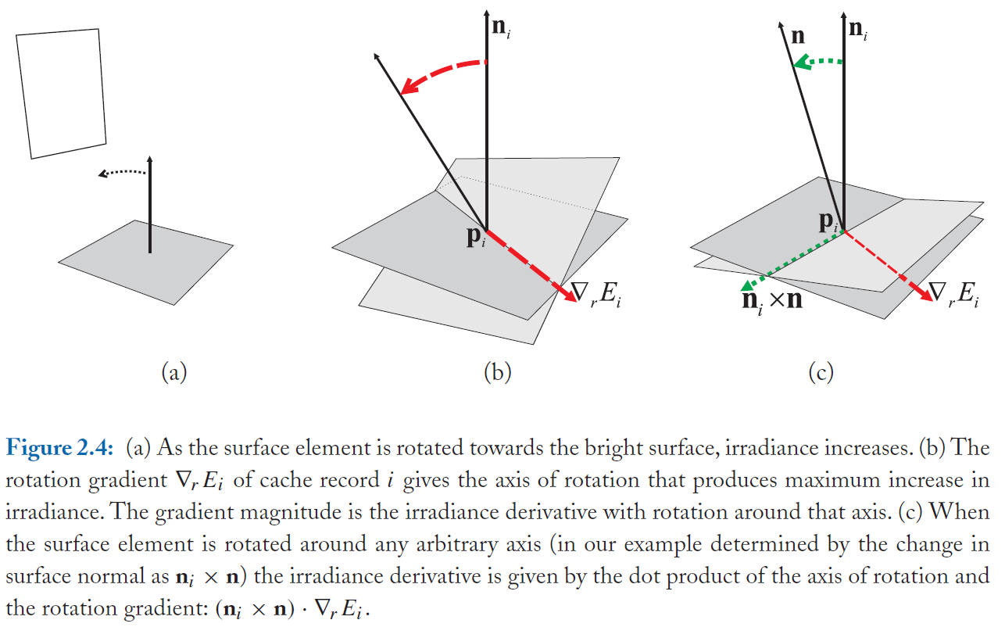
Rotation gradient

Slide 33
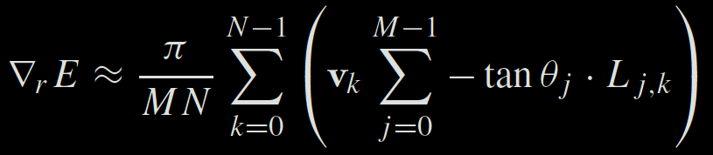
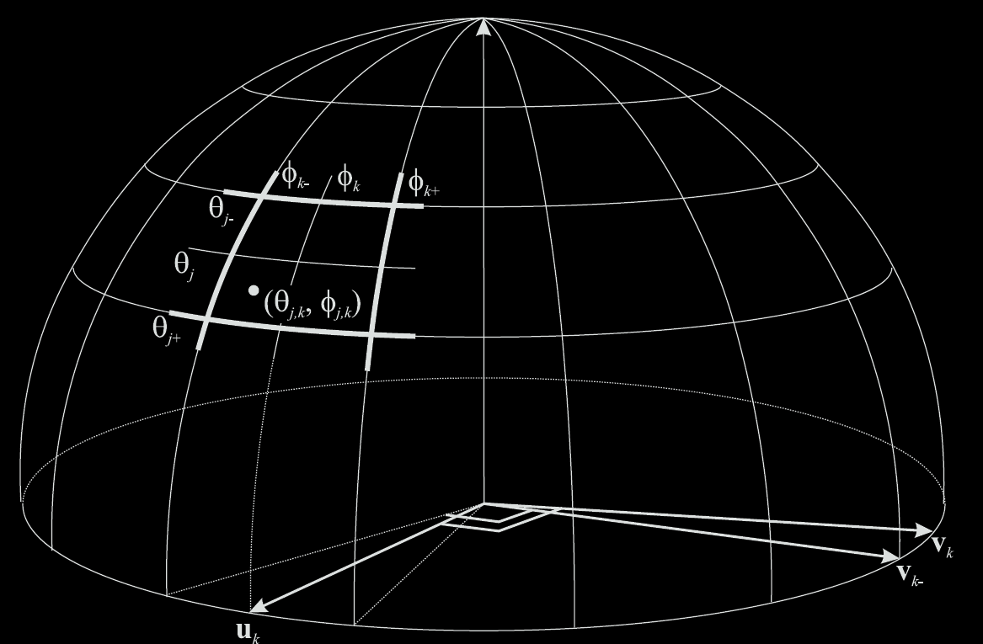
Rotation gradient formula

Slide 34
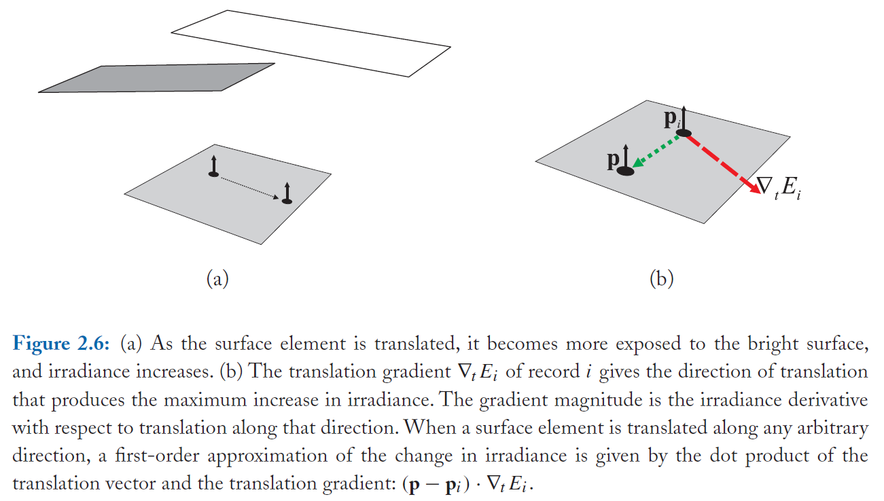
Translation gradient

Slide 35
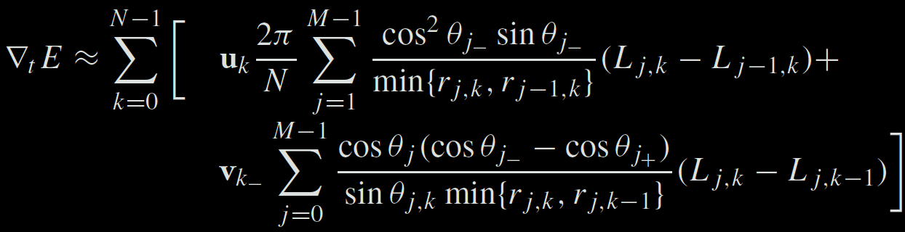
Translation gradient formula
Notes:
To evaluate the translational gradients efficiently and comfortably, it is beneficial to first shoot rays for all hemisphere cell and record the incoming radiance L_{j,k} and the hit distance r_{j,k} in a 2-D table indexed by j and k. With such a table it is then easy to evaluate the sums above.

Slide 36
Irradiance interpolation w/ grads
E = InterpolateFromCache(p)
Weighted average:

Slide 37
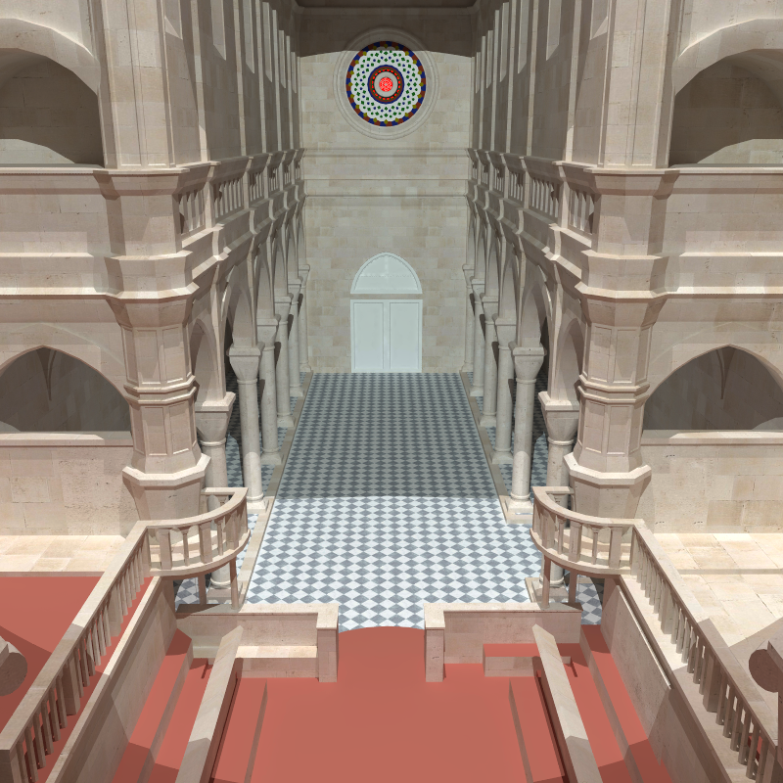
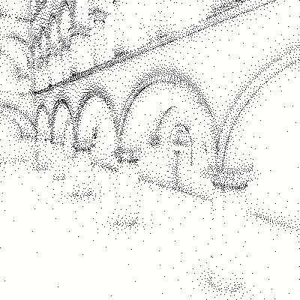
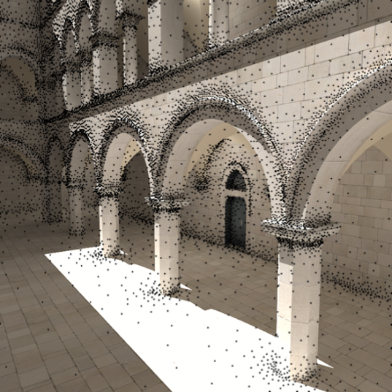
Irradiance caching examples

Slide 38
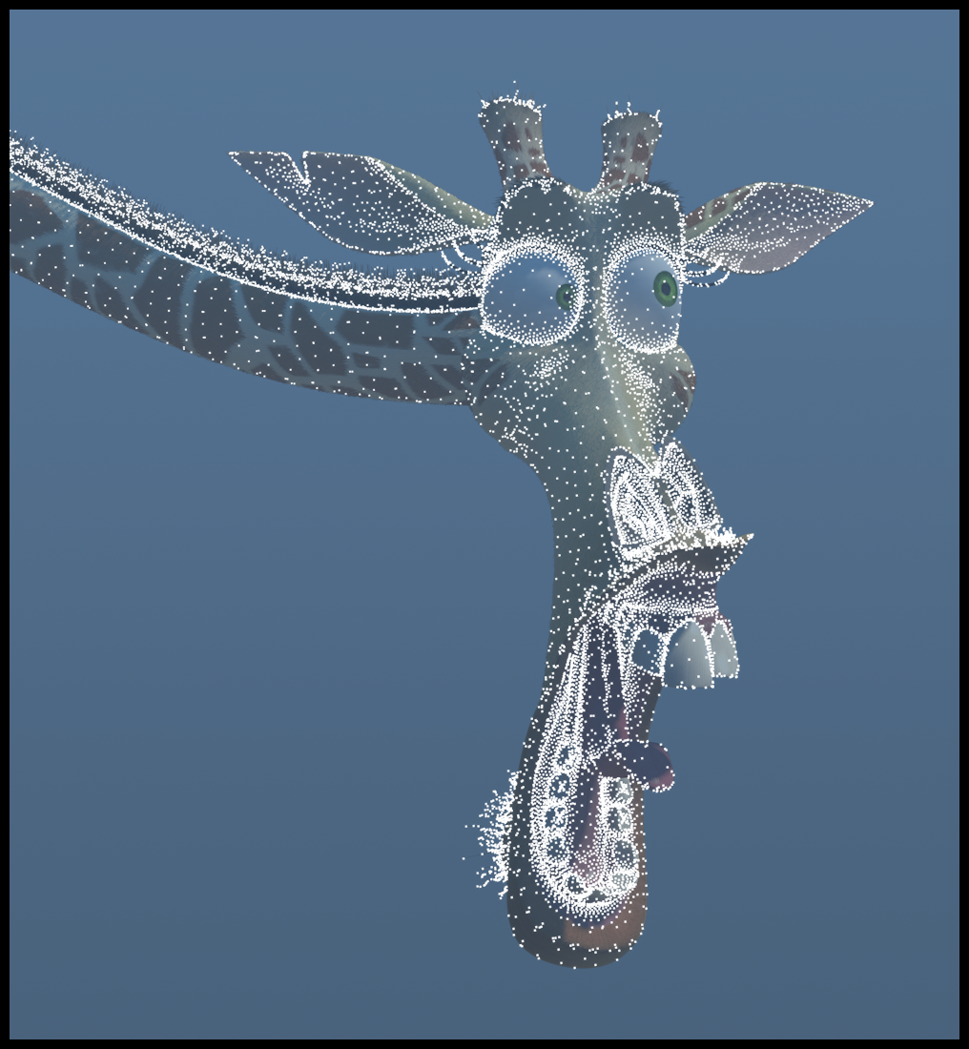
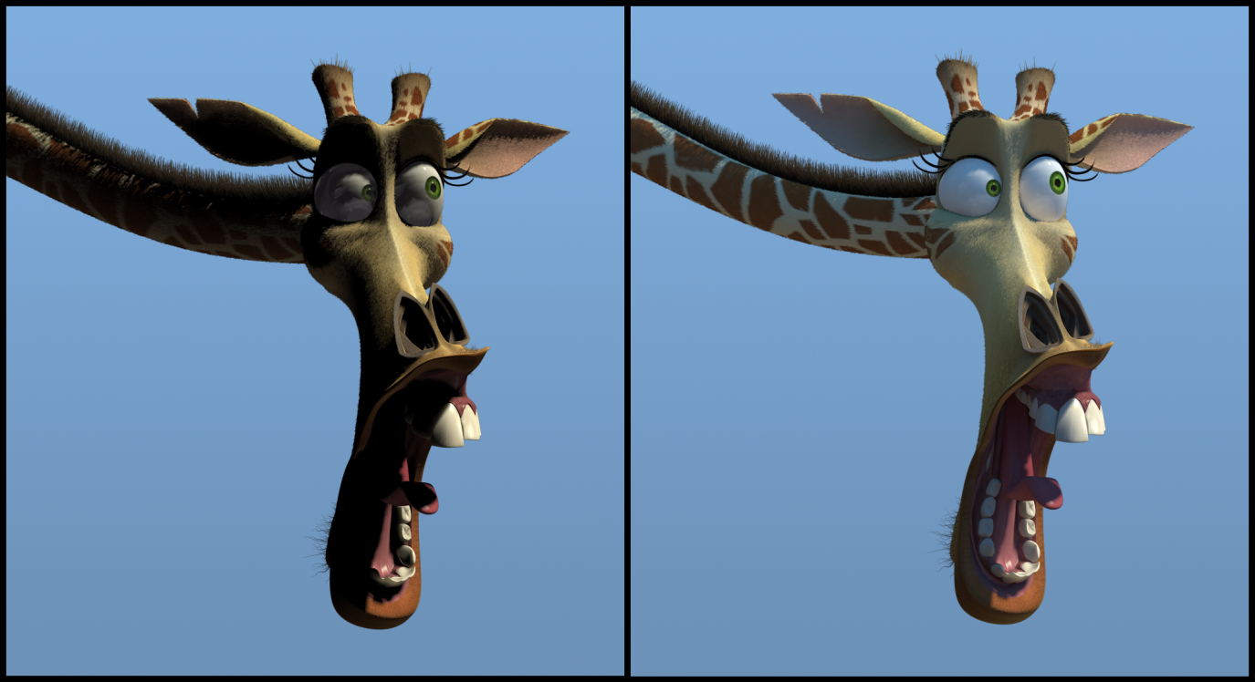
Irradiance caching examples
Image credit: Eric Tabellion, PDI DreamWorks

Slide 39
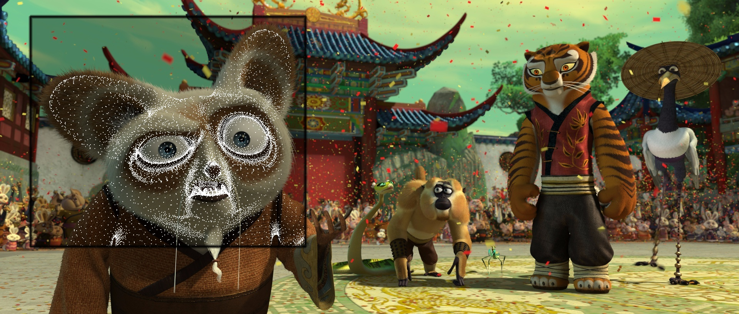
Irradiance caching examples
Image credit: Eric Tabellion, PDI DreamWorks

Slide 40
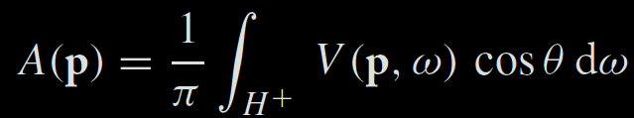
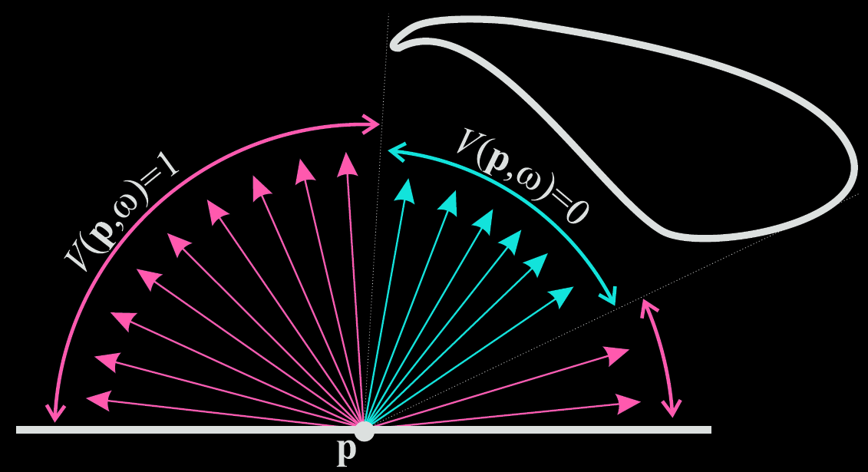
Ambient occlusion

Slide 41
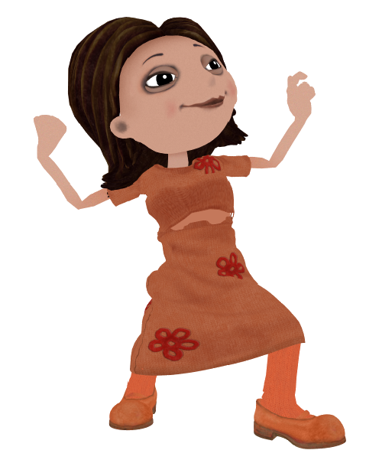
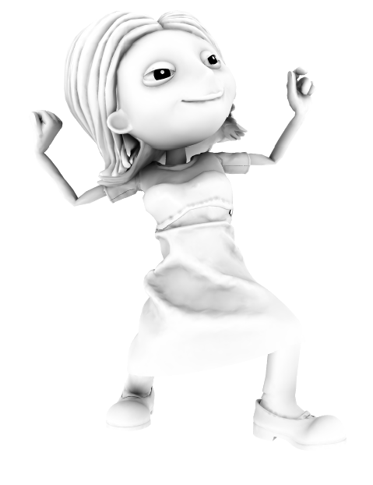
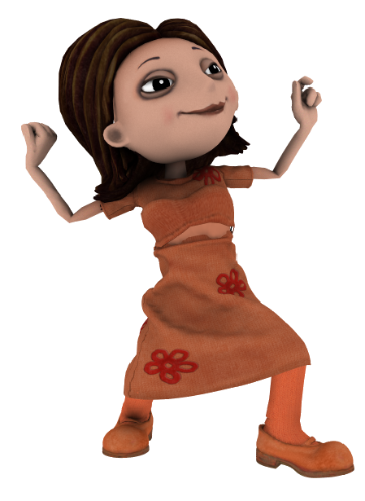
Ambient occlusion
x
=

Slide 42
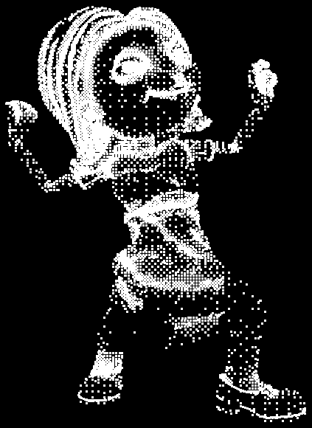
Ambient occlusion caching

Slide 43
Conclusion
Fast indirect illumination of diffuse surfaces
  Sparse sampling & fast interpolation
Biased
Not consistent
Tons of implementation details that I did not discuss here

Slide 44
Irradiance caching history
1988: Ward et al.
  Original idea
1992: Ward and Heckbert
  Irradiance Gradients
1996: Jensen
  IC part of Photon maps
2004: Tabellion and Lamorlette
  First use of GI in film (Shrek2)
2005: Krivanek et al.
  Extension to glossy surfaces
2008: Jarosz et al.
  Caching for Participating media
… lots of other work
Image credit: Eric Tabellion, PDI DreamWorks

Slide 45
Further reading
Practical Global Illumination with Irradiance Caching
  SIGGRAPH Course: 2008, Křivánek et al.
  Book, 2009, Křivánek & Gautron
  Both give references to further resources

Slide 46
Letem světem…

Slide 47
Letem světem
Teaser na předmět Vybrané metody GI
  Metropolis Light Transport
  Virtuální světla + škálovatelné metody
  Předpočítaný přenos radiance
  Opticky aktivní média + subsurface scattering
  Real-Time GI
  Zobrazování vlasů
  Modelování vzhledu

Slide 48
Metropolis Light Transport
Aplikace vzorkovací metody Metropolis-Hastings na vzorkování funkce příspěvku světelné cesty
  Mutace cest
[Veach 1997]

Slide 49
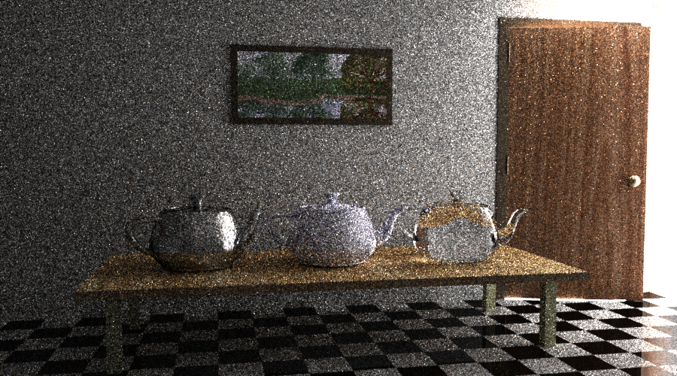
(a) Bidirectional path tracing with 40 samples per pixel.
Image credit: Eric Veach

Slide 50
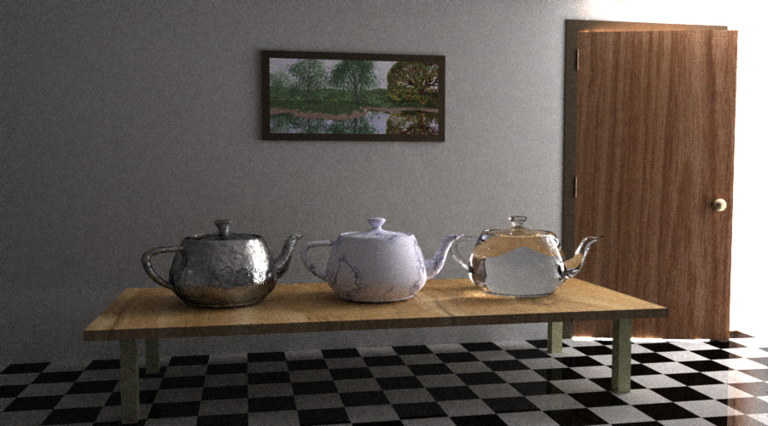
(b) Metropolis light transport with an average of 250 mutations per pixel [the same computation time as (a)].
Image credit: Eric Veach

Slide 51
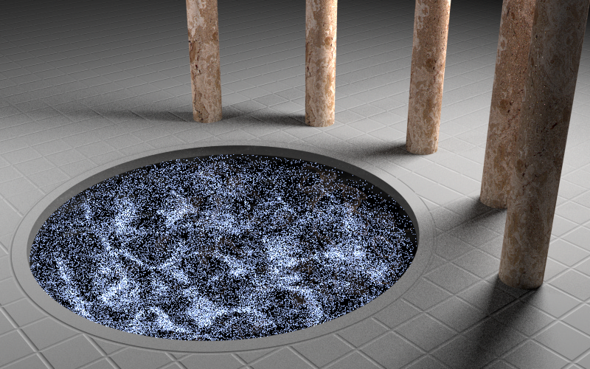
(a) Path tracing with 210 samples per pixel.
Image credit: Eric Veach

Slide 52
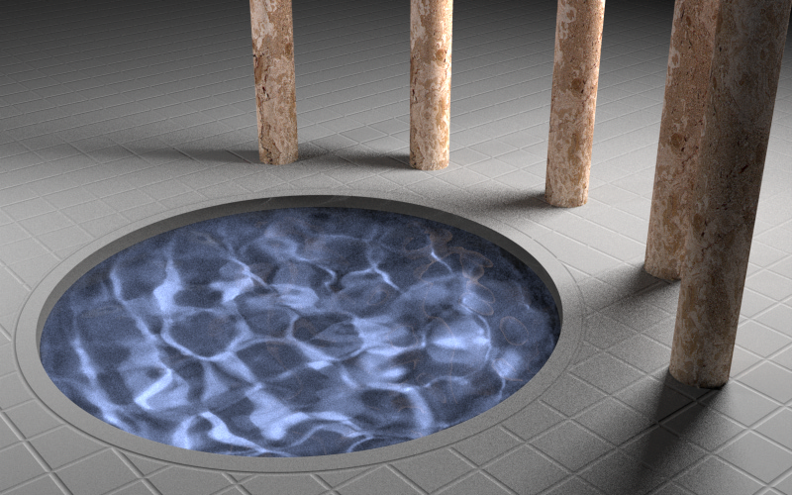
(b) Metropolis light transport with an average of 100 mutations per pixel [the same computation time as (a)].
Image credit: Eric Veach

Slide 53
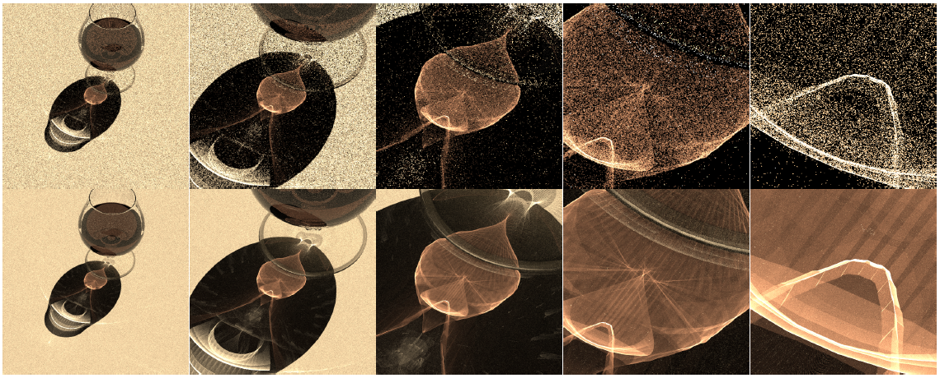
Metropolis Photon Tracing
Image credit: Toshiya Hachisuka

Slide 54
Instant radiosity (VPL rendering)
[Keller 1997]
Approximate indirect illumination by
Virtual Point Lights (VPLs)
Generate VPLs
Render with VPLs

Slide 55
Škálovatelné VPL metody
Škálovatelné VPL metody
  Lightcuts [Walter et al. 2006]
  Matrix Row-Column Sampling [Hašan et al. 2007]
  LightSlice [Ou et al. 2011]
Robustní VPL metody (naše práce)
  Virtual spherical Lights [Hašan et al. 2009]
  Local lights [Davidovič et al. 2010]

Slide 56
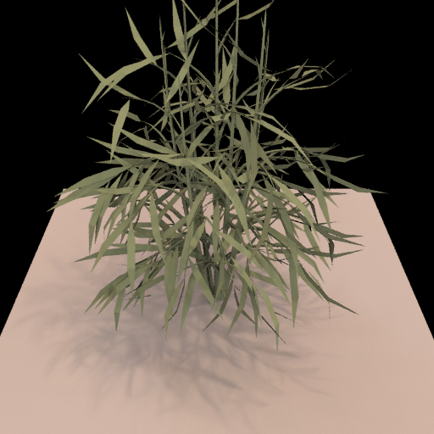

Předpočítaný přenos radiance

Slide 57

Opticky aktivní média

Slide 58






Subsurface scattering examples
Real
Simulated

Slide 59
Real-time GI
Techniky založené na VPL
Screen-space techniky
Implicitní viditelnost & anti-radiance

Slide 60

Zobrazování vlasů

Slide 61


Modelování vzhledu

Slide 62
Závěr

Slide 63

Research challenges in rendering
Existing algorithms are inherently bad
for some practical scenes
More work to do for rendering researchers
Notes:
The grand challenge #2 is rendering difficult scenes like the one shown here, where essentially all the known GI algorithms fail (or take ages to render the image). The problem is that it’s really hard to make these algorithms find some difficult light paths. Consider the light path shown in the image, where the light coming from the light source is reflected off the metal surface, refracted on the glass, scattered inside the egg white and the yolk, then focused by refractions on the glass and finally reflected off the metal countertop toward the camera. This is a nightmare for all existing GI algorithms. Yet, there’s nothing strange about the scene, so it’d be cool if we could render scenes like this easily.
In conclusion, even though great advances have been made that enable the use of GI in practice, there’s still a number of unsolved problems. Finding solutions to these challenges will open new applications for computer graphics.

Slide 64
What else in CG
Main general CG conferences
  SIGGRAPH (ACM Transactions on Graphics – TOG)
  SIGGRAPH Asia (ACM TOG)
  Eurographics (Computer Graphics Forum)
http://kesen.realtimerendering.com/

Slide 65
What else in CG
Computational photography
Appearance modeling & capture
Animation (& capture)
Dynamic simulation (hair, cloth, water, smoke, solids…)
Visual perception
Natural phenomena
Non-photorealistic rendering
Sound simulation
Display technology
Interaction technology
Geometry modeling

Slide 66
General challenges in CG
Making CG usable (!!!)
Robust and efficient lighting simulation in general scenes
Virtual human
  Hair modeling (!!!)
  Animation (!!!)
  Cloth
Managing complexity
  Natural environments etc
Virtual Worlds (shared 3D graphics)
…and more (the above is my random choice of “grand challenges”)

Slide 67
Časový harmonogram

Slide 68
Harmonogram pro zbytek semestru
3.1.2013 – Odevzdání úlohy 2
10.1.2013 – Odevzdání finálních verzí všech zápisků a článků na Wikipedii
20.1.1013 – Hodnocení zápisků a článků na Wikipedii
  (e-mailem)
22.1.2013 – Zkouška (jediný řádný termín)

