Slide 1
Quick intro to my work
Alex Zita

Slide 2
Main Focus
Digital Image Processing
Real life implications :
Medicine
Satellite imaging / remote sensing
Robotics
Industry
Many others …

Slide 3
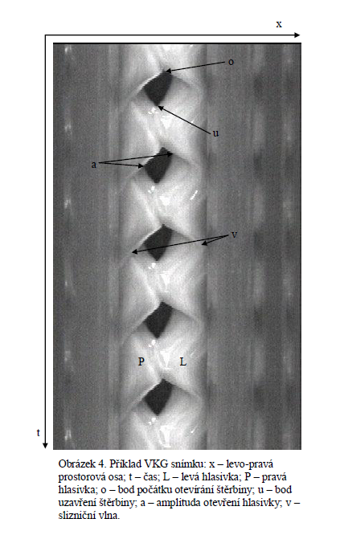
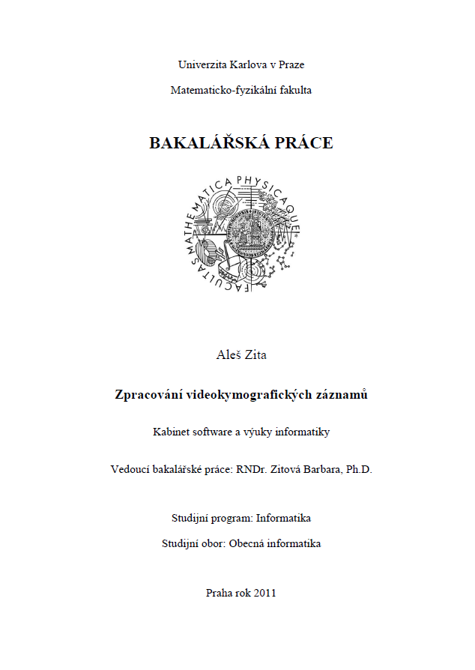
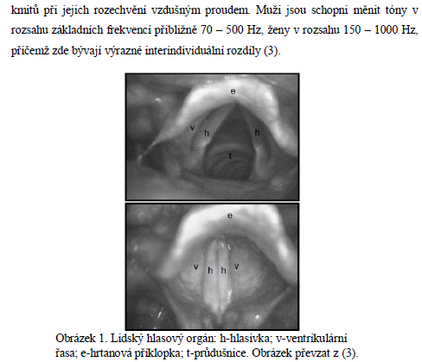
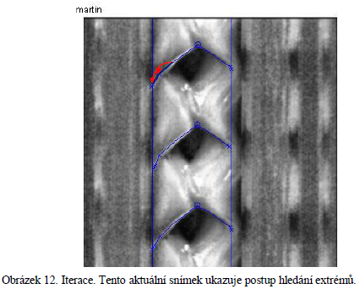
Previous work
Notes:
What, why, when, supervisor, result, publication

Slide 4
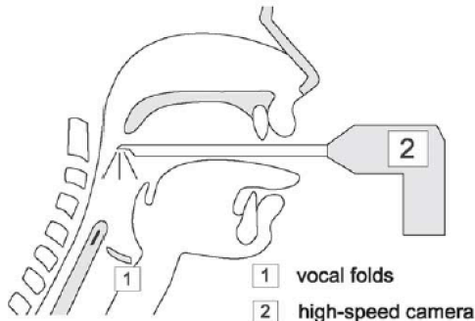
Bachelor’s thesis
http://www.youtube.com/watch?v=9kHdhbEnhoA
Notes:
Vocal chord, 80-240Hz->hifreq->image processing, 10s/10.000fps ->2:45h at 10fps

Slide 5
Bachelor’s thesis
Impact :
(Awards :)
Notes:
Publication ? Medicinal aplication-sw for phoniatres? time savings, more accurate detection...?

Slide 6
Future Work
Diploma theses.
Scientific career ahead ☺

