Slide 1
Computer graphics III – Multiple Importance Sampling
Jaroslav Křivánek, MFF UK
Jaroslav.Krivanek@mff.cuni.cz

Slide 2
Multiple Importance Sampling in a few slides

Slide 3
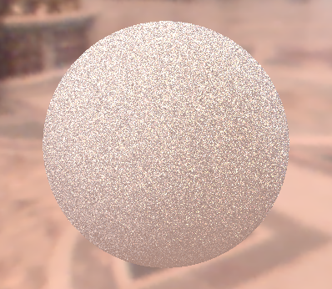
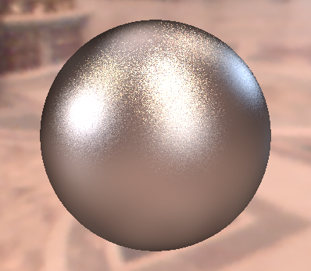
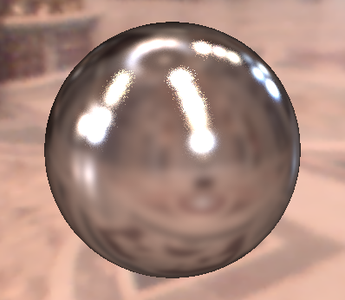
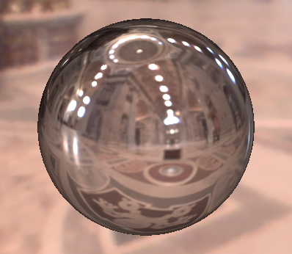
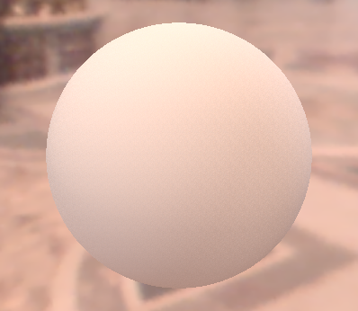
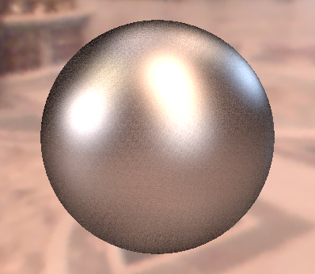
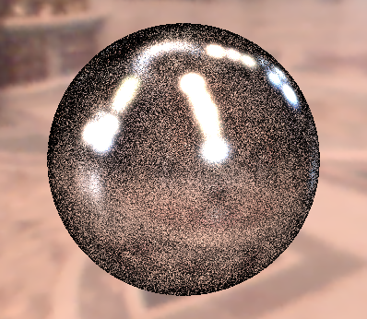
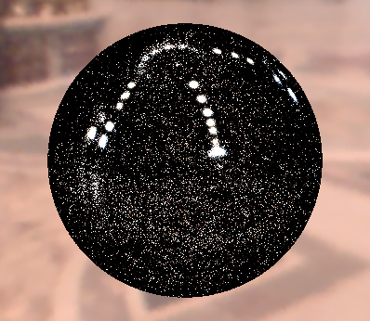
Motivation
BRDF IS
600 samples
EM IS
600 samples
MIS
300 + 300 samples
Diffuse only
Ward BRDF, α=0.2
Ward BRDF, α=0.05
Ward BRDF, α=0.01

Slide 4
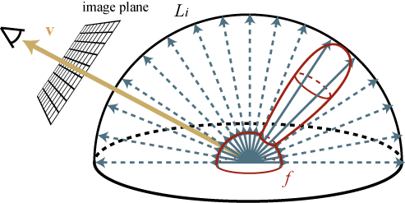
What is wrong with BRDF and light source sampling?
A: None of the two is a good match for the entire integrand under all conditions

Slide 5
Multiple Importance Sampling (MIS)
[Veach & Guibas, 95]
Combined
estimator:
f(x)
p_{a}(x)
p_{b}(x)
x_{a}
Notes:
This slide shows this situation in a simpler setting.
We have a complex multimodal integrand f(x) that we want to numerically integrate using a MC method with importance sampling.
Unfortunately, we do not have a PDF that would mimic the integrand in the entire domain.
Instead, we can draw the sample from two different PDFs, p_{a} and p_{b} each of which is a good match for the integrand under different conditions – i.e. in different part of the domain.
However, the estimators corresponding to these two PDFs have extremely high variance – shown on the slide.
We can use Multiple Importance Sampling (MIS) to combine the sampling techniques corresponding to the two PDFs into a single, robust, combined technique.
The MIS procedure is extremely simple: it randomly picks one distribution to sample from (p_{a} or p_{b} , say with fifty-fifty chance) and then takes the sample from the selected distribution.
This essentially corresponds to sampling from a weighted average of the two distributions, which is reflected in the form of the estimator, shown on the slide.
This estimator is really powerful at suppressing outlier samples such as those that you would obtain by picking x_from the tail of p_{a}, where f(x) might still be large.
Without having p_{b} at our disposal, we would be dividing the large f(x) by the small p_{a} (x), producing an outlier.
However, the combined technique has a much higher chance of producing this particular x (because it can sample it also from p_{b}), so the combined estimator divides f(x) by [p_{a} (x) + p_{b}(x)] / 2, which yields a much more reasonable sample value.
I want to note that what I’m showing here is called the “balance heuristic” and is a part of a wider theory on weighted combinations of estimators proposed by Veach and Guibas.

Slide 6
Notes on the previous slide
We have a complex multimodal integrand f(x) that we want to numerically integrate using a MC method with importance sampling.
Unfortunately, we do not have a PDF that would mimic the integrand in the entire domain.
Instead, we can draw the sample from two different PDFs, p_{a} and p_{b} each of which is a good match for the integrand under different conditions – i.e. in different part of the domain.
However, the estimators corresponding to these two PDFs have extremely high variance – shown on the slide.
We can use Multiple Importance Sampling (MIS) to combine the sampling techniques corresponding to the two PDFs into a single, robust, combined technique.
The MIS procedure is extremely simple: it randomly picks one distribution to sample from (p_{a} or p_{b} , say with fifty-fifty chance) and then takes the sample from the selected distribution.
This essentially corresponds to sampling from a weighted average of the two distributions, which is reflected in the form of the estimator, shown on the slide.
This estimator is really powerful at suppressing outlier samples such as those that you would obtain by picking x_from the tail of p_{a}, where f(x) might still be large.
Without having p_{b} at our disposal, we would be dividing the large f(x) by the small p_{a} (x), producing an outlier.
However, the combined technique has a much higher chance of producing this particular x (because it can sample it also from p_{b}), so the combined estimator divides f(x) by [p_{a} (x) + p_{b}(x)] / 2, which yields a much more reasonable sample value.
I want to note that what I’m showing here is called the “balance heuristic” and is a part of a wider theory on weighted combinations of estimators proposed by Veach and Guibas.

Slide 7
Application to direct illumination
Two sampling strategies
BRDF-proportional sampling - p_{a}
Environment map sampling - p_{b}

Slide 8
… and now the (almost) full story
First for general estimators, so please forget the direct illumination problem for a short while.

Slide 9
Multiple Importance Sampling
(Veach & Guibas, 95)
f(x)
p₁(x)
p₂(x)
0
1

Slide 10
Multiple Importance Sampling
Given n sampling techniques (i.e. pdfs) p₁(x), .. , p_{n}(x)
We take n_{i} samples X_{i,1}, .. , X_{i,ni} from each technique
Combined estimator
Combination weights (different for each sample)
samples from individual techniques
sampling techniques

Slide 11
Unbiasedness of the combined estimator
Condition on the weighting functions

Slide 12
Choice of the weighting functions
Objective: minimize the variance of the combined estimator
Arithmetic average (very bad combination)
Balance heuristic (very good combination)
….

Slide 13
Balance heuristic
Combination weights
Resulting estimator (after plugging in the weights)
i.e. the form of the contribution of a sample does not depend on the technique (pdf) from which it came

Slide 14
Balance heuristic
The balance heuristic is almost optimal
No other weighting has variance much lower than the balance heuristic
Further possible combination heuristics
Power heuristic
Maximum heuristics
See [Veach 1997]

Slide 15
One term of the combined estimator
f(x)
p₁(x)
p₂(x)
0
1

Slide 16
One term of the combined estimator: Arithmetic average
0
1

Slide 17
One term of the combined estimator: Balance heuristic
0
1

Slide 18
Direct illumination calculation using MIS
We now focus on area lights instead of the motivating example that used environment maps. But the idea is the same.

Slide 19
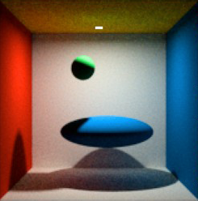
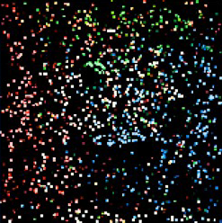
Problem: Is random BRDF sampling going to find the light source?
Images: Alexander Wilkie
reference
simple path tracer (150 paths per pixel)

Slide 20
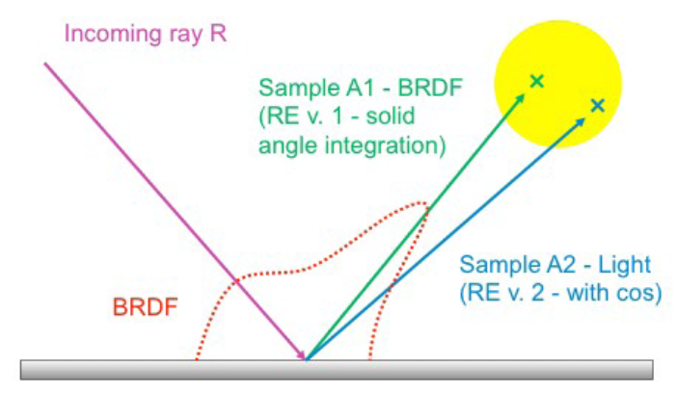
Direct illumination: Two strategies
We are calculating direct illumination due to a given light source.
i.e. radiance reflected from a point x on a surface exclusively due to the light coming directly from the considered source
Two sampling strategies
BRDF-proportional sampling
Light source area sampling
Image: Alexander Wilkie

Slide 21
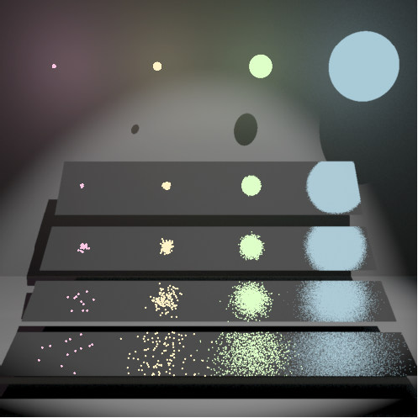
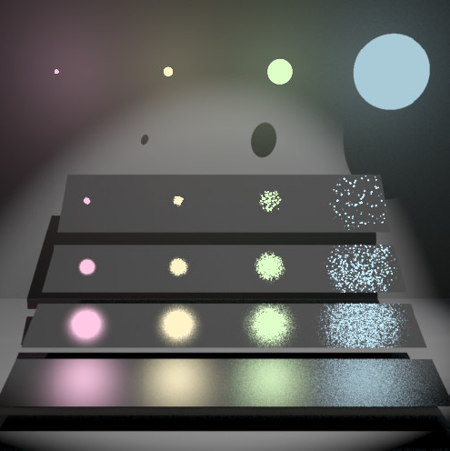
Direct illumination: Two strategies
Images: Eric Veach
BRDF proportional sampling
Light source area sampling

Slide 22
Direct illumination: BRDF sampling (rehash)
Integral (integration over the hemisphere above x)
MC estimator
Generate random direction ω_{i,k} from the pdf p
Cast a ray from the surface point x in the direction ω_{i,k}
If it hits a light source, add L_{e}(.) f_{r}(.) cos/pdf

Slide 23
Direct illumination: Light source area sampling (rehash)
Integral (integration over the light source area)
MC estimator
Generate a random position y_{k} on the source
Test the visibility V(x, y) between x and y
If V(x, y) = 1, add |A| L_{e}(y) f_{r}(.) cos/pdf

Slide 24
Direct illumination: Two strategies
BRDF proportional sampling
Better for large light sources and/or highly glossy BRDFs
The probability of hitting a small light source is small -> high variance, noise
Light source area sampling
Better for smaller light sources
It is the only possible strategy for point sources
For large sources, many samples are generated outside the BRDF lobe -> high variance, noise

Slide 25
Direct illumination: Two strategies
Which strategy should we choose?
Both!
Both strategies estimate the same quantity L_{r}(x, ω_{o})
A mere sum would estimate 2 x L_{r}(x, ω_{o}) , which is wrong
We need a weighted average of the techniques, but how to choose the weights? => MIS

Slide 26
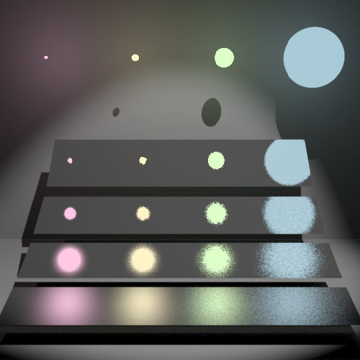
How to choose the weights?
Multiple importance sampling (Veach & Guibas, 95)
Weights are functions of the pdf values
Almost minimizes variance of the combined estimator
Almost optimal solution
Image: Eric Veach

Slide 27
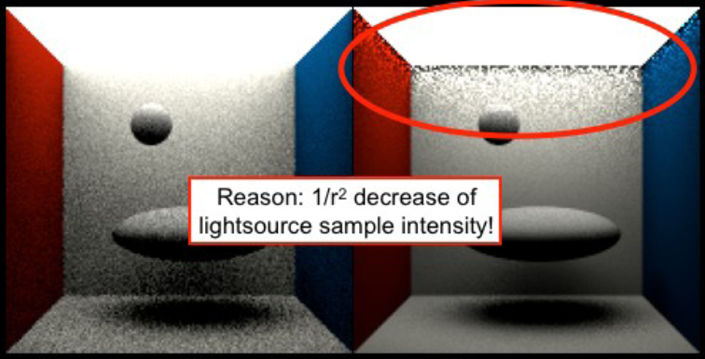
Direct illumination calculation using MIS
Image: Alexander Wilkie
Sampling technique (pdf) p₁: BRDF sampling
Sampling technique (pdf) p₂: Light source area sampling

Slide 28
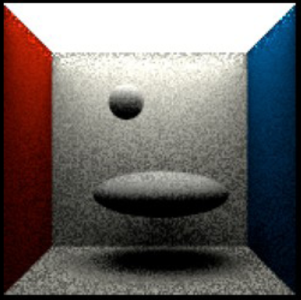
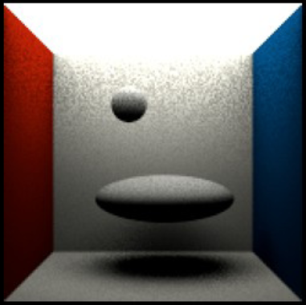
Combination
Image: Alexander Wilkie
Arithmetic average Preserves bad properties of both techniques
Balance heuristic Bingo!!!

Slide 29
MIS weight calculation
Sample weight for BRDF sampling
PDF for BRDF sampling
PDF with which the direction ω_{j} would have been generated, if we used light source area sampling

Slide 30
PDFs
BRDF sampling: p₁(ω)
Depends on the BRDF, e.g. for a Lambertian BRDF:
Light source area sampling: p₂(ω)
Conversion of the uniform pdf 1/|A| from the area measure (dA) to the solid angle measure (dω)

Slide 31
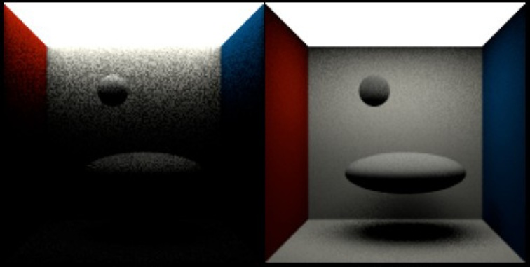
Contributions of the sampling techniques
Image: Alexander Wilkie
w1 * BRDF sampling
w2 * light source area sampling

Slide 32
Other examples of MIS applications
In the following we apply MIS to combine full path sampling techniques for calculating light transport in participating media.

Slide 33
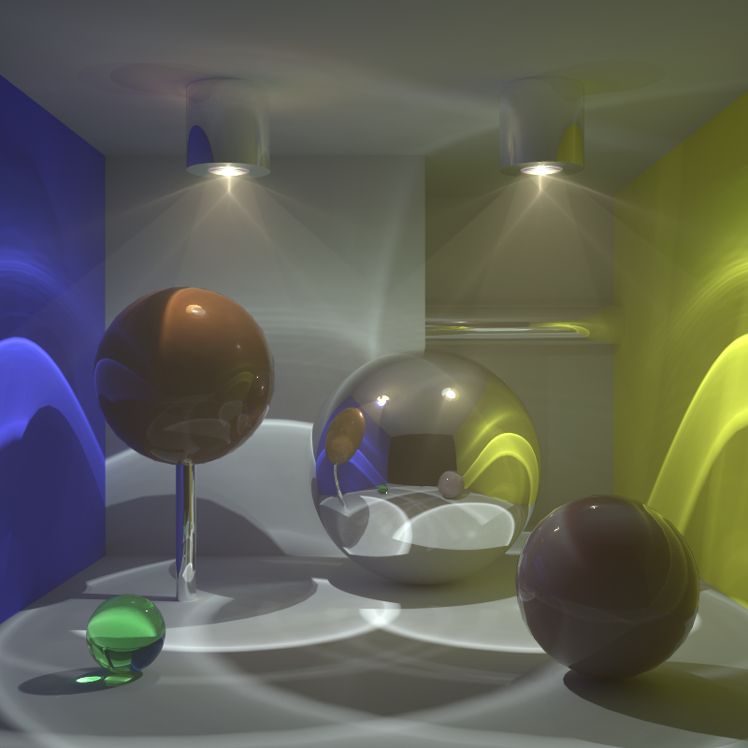
Full transport
rare, fwd-scattering fog
back-scattering
high albedo
back-scattering
Notes:
We have set up this test scene which is filled with rare, forward scattering fog.
There are two spheres filled with a dense back-scattering medium.
And the scene is illuminated almost entirely by caustic lighting.

Slide 34
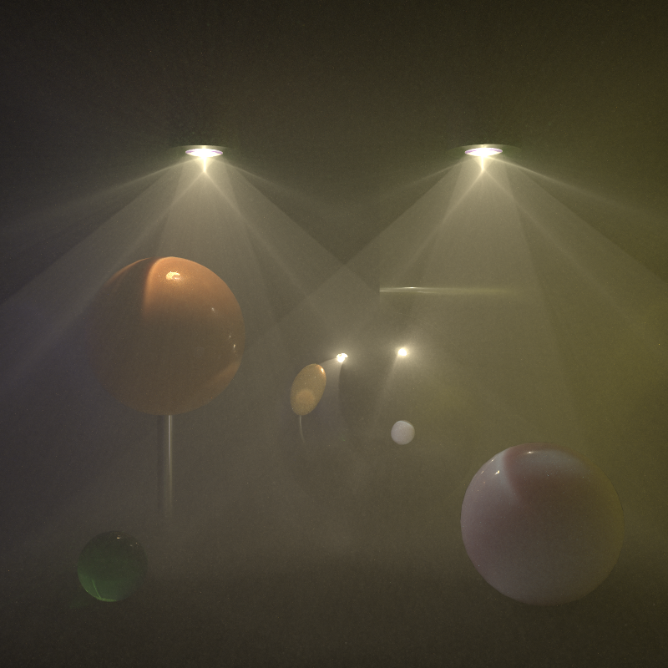
Medium transport only
Notes:
For the algorithm comparison, we again consider only transport in media.

Slide 35
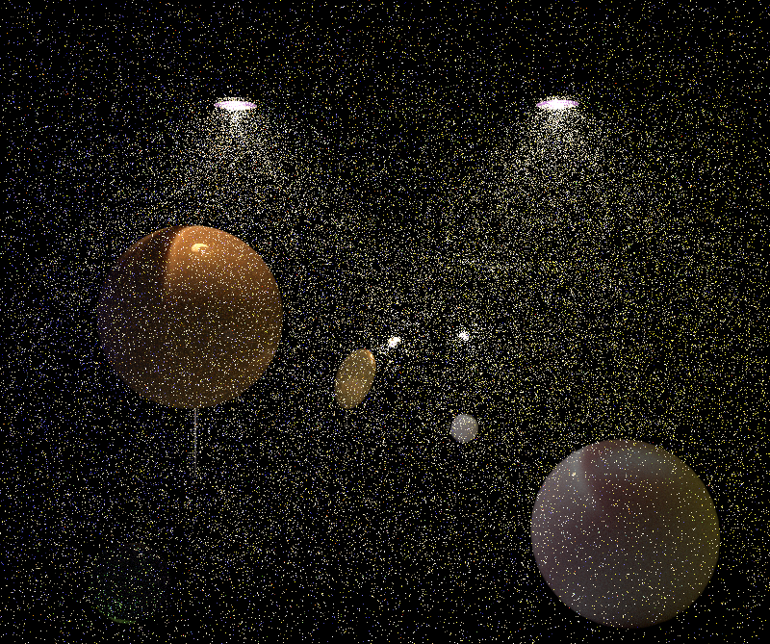
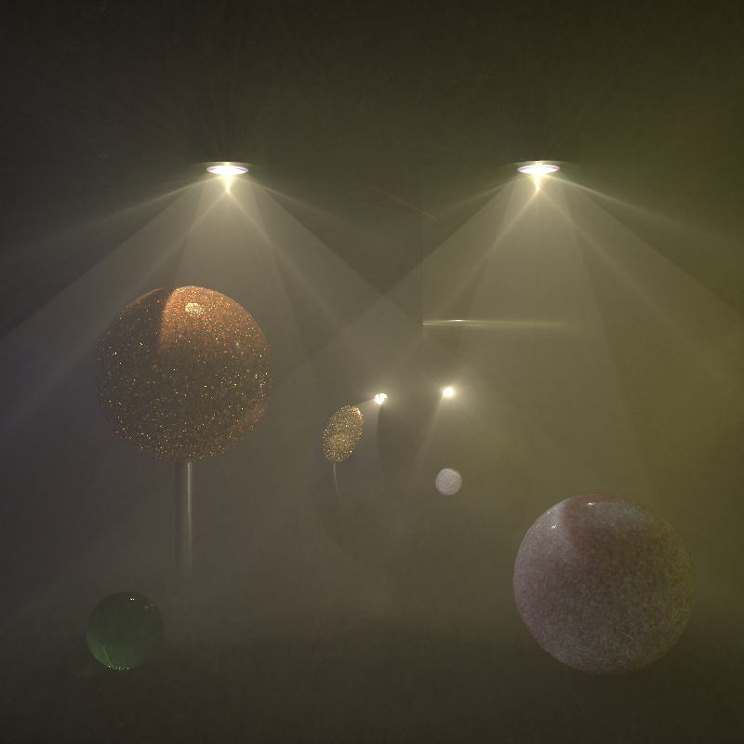
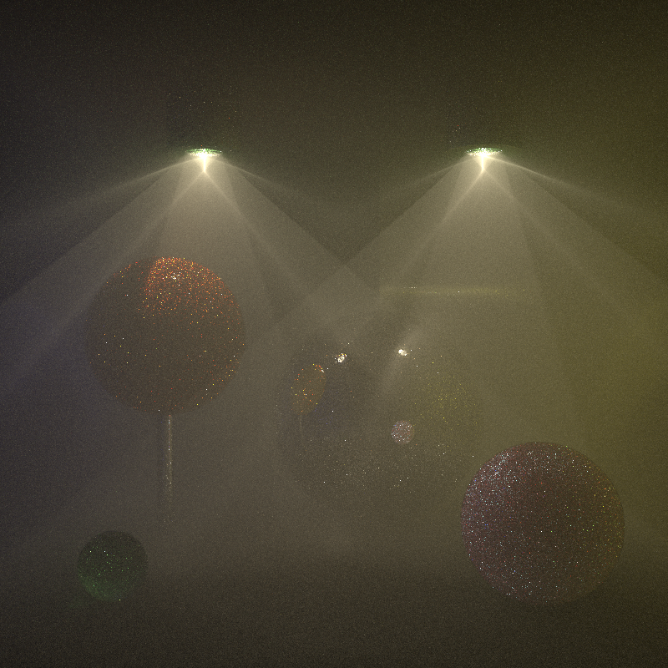
Previous work comparison, 1 hr
Point-Point 3D (≈vol. ph. map.)
Point-Beam 2D (=BRE)
Beam-Beam 1D (=photon beams)
Bidirectional PT
Notes:
And here’s how the previous work does.
The point-point estimator, which is equivalent to volumetric photon mapping without ray marching, does a pretty good job at rendering the dense spheres but cannot handle the sparser fog.
The point-beam estimator, or the beam radiance estimate, does a much better job at rendering the fog, though it still fairly noisy as you can see in the inset.
The beam-beam estimator, or photon beams, provides excellent results for the fog, bug the spheres suffer from some nasty noisy artifacts.
Bidir handles the fog quite well, though not as well as the photon beams. It produces bad artifacts in the dense spheres because much of the illumination there is essentially a reflected caustic.

Slide 36
UPBP (our algorithm) 1 hour
Notes:
Our algorithm is able to take the best from the individual techniques to produce a much cleaner image.

Slide 37
Previous work comparison, 1 hr
Point-Point 3D
Point-Beam 2D
Beam-Beam 1D
Bidirectional PT
Notes:
Let’s go back to the results of the previous work and ….

Slide 38
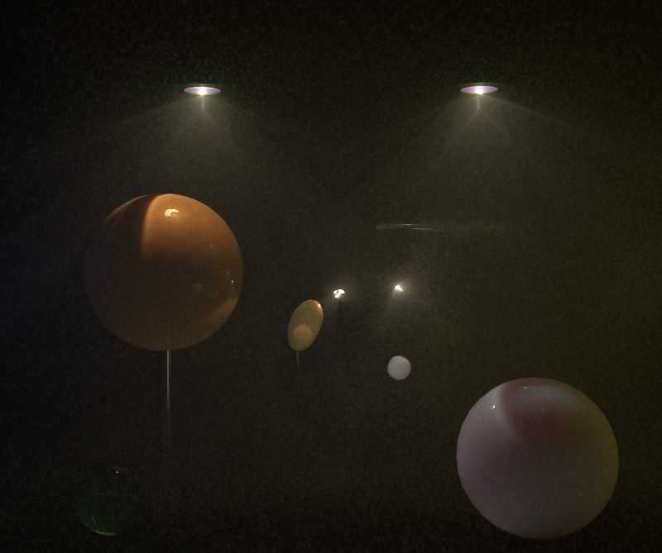
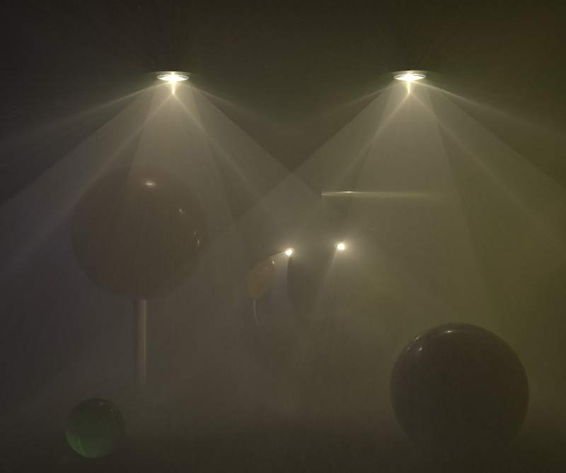
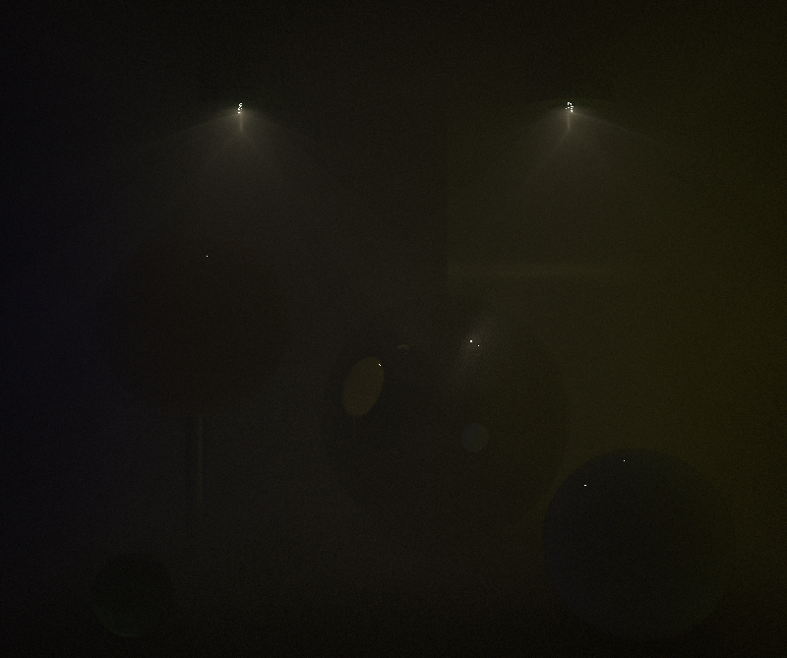
Point-Point 3D
Point-Beam 2D
Weighted contributions
Beam-Beam 1D
Bidirectional PT
Notes:
… and let’s start replacing it by the weighted contribution of the individual estimators to our combined result.
PP, PB, BB, BPT.
We see that most of the image is made up from the contributions from the point-beam and beam-beam estimators, where the point-beam takes care of rendering the dense, back-scattering spheres, and the beam-beam estimator renders the rarer fog.
Bidirectional path tracing contributes mostly the surface-to-medium transport, which is visible as the blue tint of the right sphere.

