Slide 2
Real-time Diffuse Global Illumination in CryENGINE 3
Anton Kaplanyan
antonk@crytek.de
Notes:
This chapter of the course is devoted to the real-time solution to a diffuse indirect lighting that is used in the large-scale cross-platform commercial game engine CryENGINE 3™.
My name is Anton Kaplanyan and I’m a researcher in Crytek GmbH.

Slide 3
Crytek GmbH
10 years in game development
~650 employees in 5 offices across Europe
Multicultural company with 30+ languages
Shipped:
FarCry on CryENGINE 1 in 2001 (PC only)
Crysis and Crysis Warhead on CryENGINE 2 in 2007-8 (PC only)
Multi-platform consoles-ready CryENGINE 3
Currently working hard on Crysis 2…
Q4 2010
Notes:
Crytek is an interactive entertainment development company founded in 1997 - formally turned into a company in 1999. The main office is located in Frankfurt am Main.
Crytek is dedicated to the creation of high-quality video games for PC and next generation consoles and real-time 3D-Technologies such as the CryENGINE®, one of the world’s most advanced and award winning 3d engines.
In addition to the in-house development of video-games, Crytek also licenses the CryEngine technology to other developers to create games, movies and serious games.
Crytek's development teams and studios are comprised of game professionals from 36+ different nations. Crytek's world-wide official language is English.
We are best known for developing the game Far Cry and the CryEngine that the game uses, and more recently Crysis and CryEngine 2.
We are currently working on the upcoming blockbuster Crysis 2 based on the CryEngine 3.

Slide 4
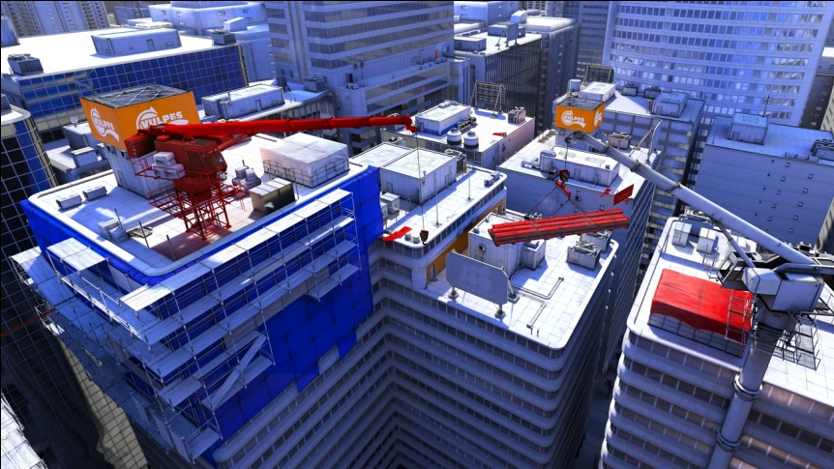
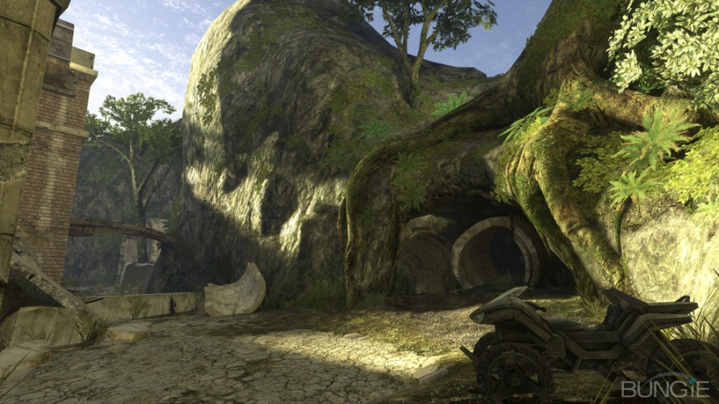
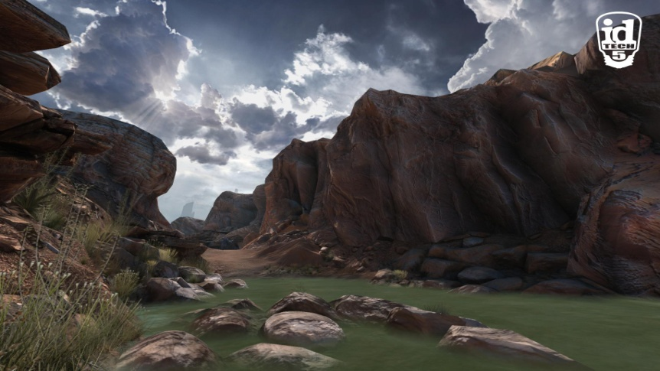
Global Illumination in games
Mirror’s Edge
Halo 3
RAGE
Danger Planet
Notes:
Global Illumination is an integral part of the most of the state-of-the-art games and engines.
It obviously enriches the picture and adds to the image quality and its perception.
Inherently, it is very important to provide a plausible picture to a gamer to deliver a better gaming experience.

Slide 5
Why dynamic Global Illumination?
Most games use precomputed indirect lighting (Lightmaps, PRT etc.)
Means static scene/lighting
CryENGINE 3® includes following features:
Dynamic deferred lighting
Objects’ breakability as a part of game-play
That cancels out all precomputed GI methods
We’ve tried out most of it (including Lightmaps, PRT, RAM etc)
But we came up with a solution….
Notes:
The majority of current games and game engines use approaches with precomputed global illumination. That imposes some inherent limitations, like static lighting conditions and/or static objects. Due to this fact the game development process becomes more complicated and consequently lowers the gaming experience.
We always position our engine as an precomputations-free game engine. We provide physically based phenomenon like dynamic time of day changes and objects’ breakability to enrich gaming experience and simplify game production process.
That forced us to drop many precomputation-based global illumination approaches, such as Lightmaps and Precomputed Radiance Transfer.
However we came up with a brand-new technique that suits our purposes and has very good characteristics for real-time gaming graphics.

Slide 6
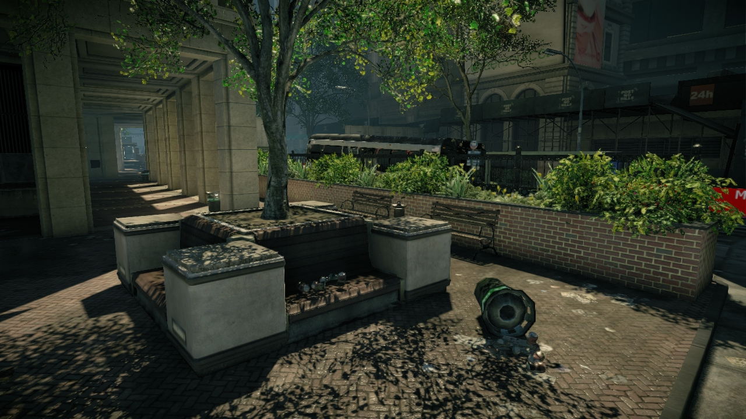
Diffuse Global Illumination in Crysis 2™
Notes:
Here is a screenshots from the upcoming blockbuster Crysis 2. Notice the indirect illumination on columns and flowerbeds.

Slide 7
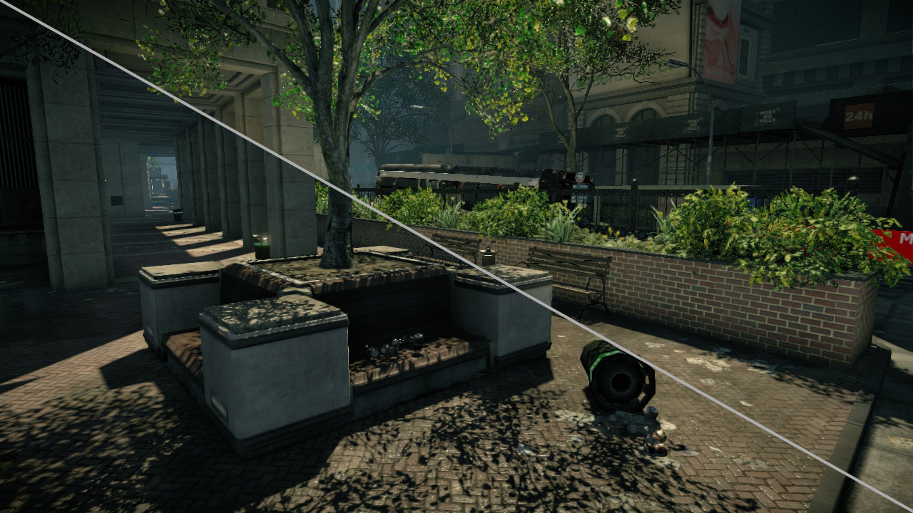
Diffuse Global Illumination in Crysis 2™
Notes:
The left bottom part demonstrates the same scene with constant ambient term to emphasize the difference.

Slide 8
Cascaded Light Propagation Volumes

Slide 9
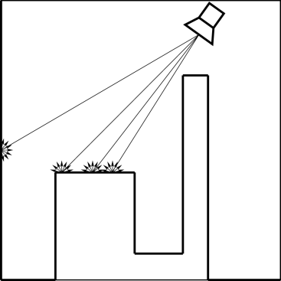
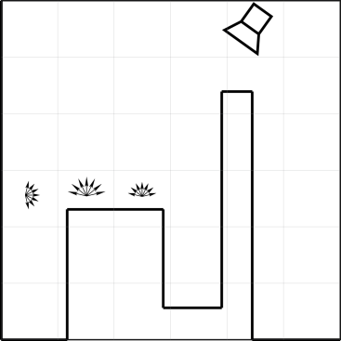
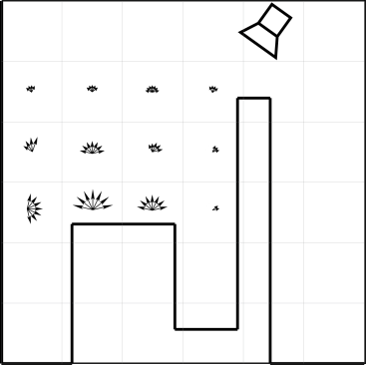
Core Idea
Sample lit surfaces
Treat them as secondary light sources
Cluster samples into a uniform coarse 3D grid
Sum up and average radiance in each cell
Iteratively propagate radiance to adjacent cells, works only for diffuse
Lit the scene with the resulting grid
Notes:
Consider the primary light source emanating light rays.
Assuming the whole scene consists of only diffuse surfaces.
Each ray excites a secondary emission of bounced radiance along a visible hemisphere of surface element.
We introduce a regular 3D grid.
Approximate the bounced radiance by this grid.
Accumulate all the bounced results inside of each cell into that cell.
Thus we have an initial accumulated indirect radiance distribution.
After we’ve got the initial reflected light distribution in the grid, we propagate the radiance iteratively around the 3D grid until the light passes the entire grid.
Several highlights of the idea:
We use a many-lights approach for approximation of reflected light
Also we use a regular 3D grid to approximate lighting in 3D world space and use sampled lit surfaces to initialize the 3D grid with the initial lighting distribution.
- We use a few bands of SH basis to approximate lighting in angular space
- The iterative light propagation approach lowers down the rendering complexity of many secondary lights.

Slide 10
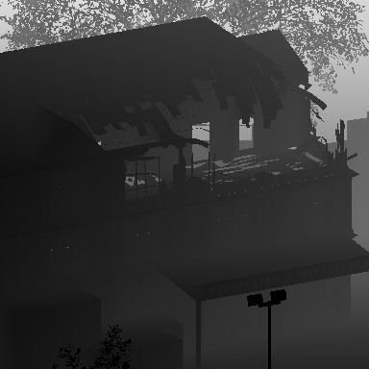
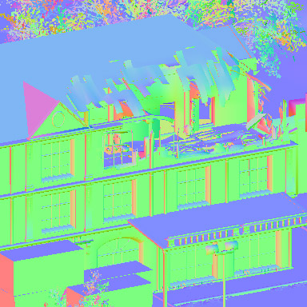
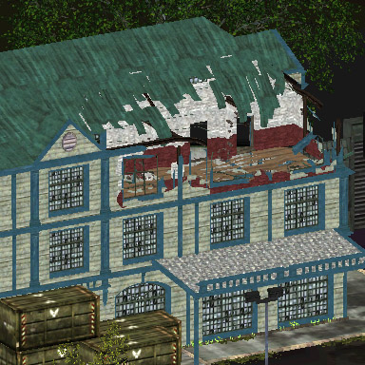
Sampling the scene for GI
Depth
Depth
We use surfels (aka “points”, “disks”)
Surfel == surface element
All lit surfels can be flattened into 2D map in light’s space
Reflective Shadow Maps [DS05]
Fastest way to sample lit surfels on GPU
Even excessively
Normals
Albedo
Notes:
Point cloud produced by direct illumination of a single light source could be flattened into 2D map in light’s space. We use Reflective Shadow Maps to sample lit surfaces.
Reflective Shadow Maps are an extension of shadow maps and store not only depth, but also normal and reflected flux of the surface seen from the light source.
This is essentially a very fast method to sample lit surfaces of the scene on GPU.
All pixels of such a shadow map can bee seen as indirect light sources that generate the one-bounce indirect illumination in a scene, similarly to Instant Radiosity approach.

Slide 11
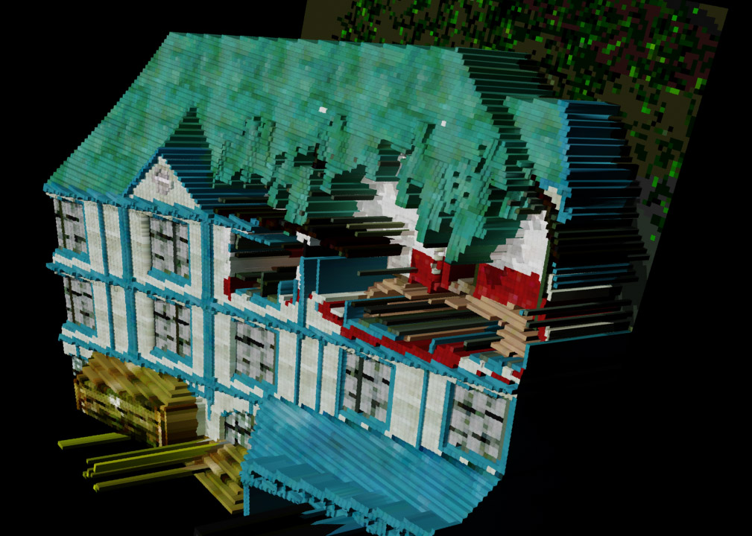
Sampling the scene for GI
Depth
Normals
Albedo
Notes:
The example of scene sampled with Reflective Shadow Map. Note that all the lit surfels are efficiently represented by a layered 2D texture.

Slide 12
Clustering Surfels
Lit surfels represented as Virtual Point Lights
Comes from Instant Radiosity approach [Keller97]
Distribute each surfel into the closest grid cell
Similar to PBGI, light-cuts and radiosity clustering
Convert all VPLs into outgoing radiance distribution
Represent in Spherical Harmonics with lower bands
Sum it up in the center of owner grid cell
Done completely on GPU using rasterization
Notes:
The Reflective Shadow Map is an input data for this stage. We treat it as a set of virtual point lights (VPLs).
We use point rendering to distribute each VPL of the RSM into the 3D grid efficiently on GPU.
We create a radiant intensity distribution out of orientation and colored intensity of each texel of RSM.
We use additive blending to efficiently accumulate contribution of all VLPs from RSM in parallel.
Thus we’ve got a 3D grid initialized by the initial distribution of reflected light in the end of this process.

Slide 13
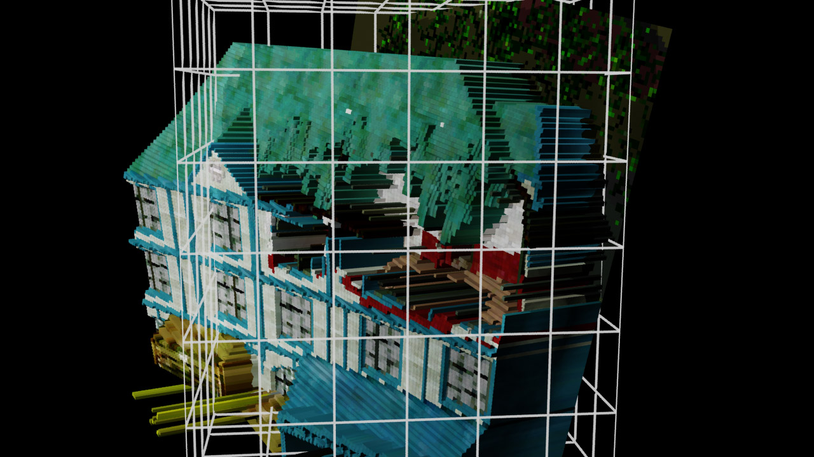
Clustering Surfels
Notes:
Light Propagation Volume is created as a bounding volume for the sampled scene’s surfels.

Slide 14
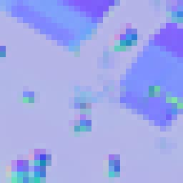
Propagation
Reflective shadow maps
Radiance volume gathering
Iterative propagation
VPL
VPL
VPL
A set of regularly sampled VPLs of the scene from light position
Discretize initial VPL distribution by the regular grid and SH
Propagate light iteratively going from one cell to another
Notes:
After we‘ve got an approximation of outgoing indirect lighting in each cell of our 3D grid, we can apply an iterative process of energy propagation across the grid.

Slide 15
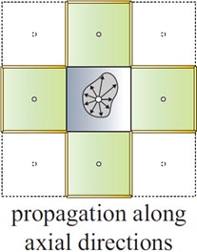
Propagation, cont’d
Local cell-to-cell propagation across the 3D grid
Similar to SH Discrete Ordinate Method for participating media illumination [GRWS04]
6 axial directions with contour faces as a propagation wave front
Accumulate the resulting SH coefficients into the destination cell for next iteration
Notes:
We do several iterations (a precise number is determined by the brightest intensity of initial distribution, see paper for more details) to bring the system to the energy equilibrium.
Many variations of this method are widely used in computations of the scattering process in participating media.
For each iteration of the propagation we consider 6 axial directions (depicted with 4 on the top right figure in 2D).
We use contour faces as a propagation wave front (the contour depicted in yellow on the top right figure).

Slide 16
Final scene rendering with LPV
Look-up resulting grid 3D texture at certain position with h/w trilinear interpolation
Convolve the irradiance with cosine lobe of surface’s normal being illuminated
Apply dampening factor to avoid self-bleeding
Compute directional derivative towards normal
Dampen based on gradient deviation from the intensity distribution direction
Notes:
During a usual scene rendering (either forward or deferred) we look up the radiance distribution from this grid using world space position. Then we integrate this distribution with weighting by a clamped cosine lobe induced by surface’s normal.
To avoid improper trilinear interpolation we check if the radiance gradient direction along surface’s normal matches the radiance flow itself. See [KD10] for more details.

Slide 17
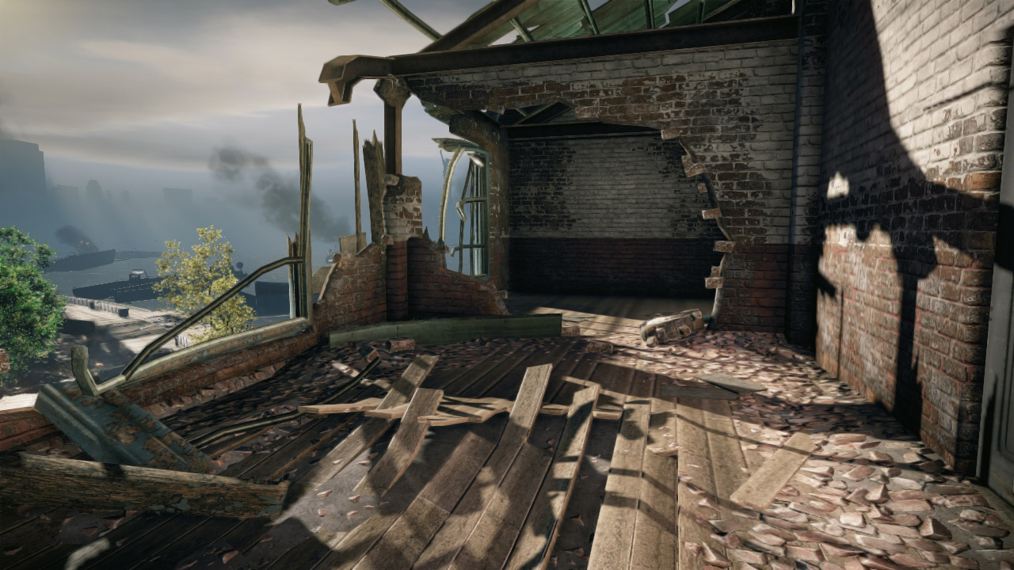
Results
Depth
Normals
Albedo
Notes:
This is a screenshot of indoor scene using Light Propagation Volumes

Slide 18
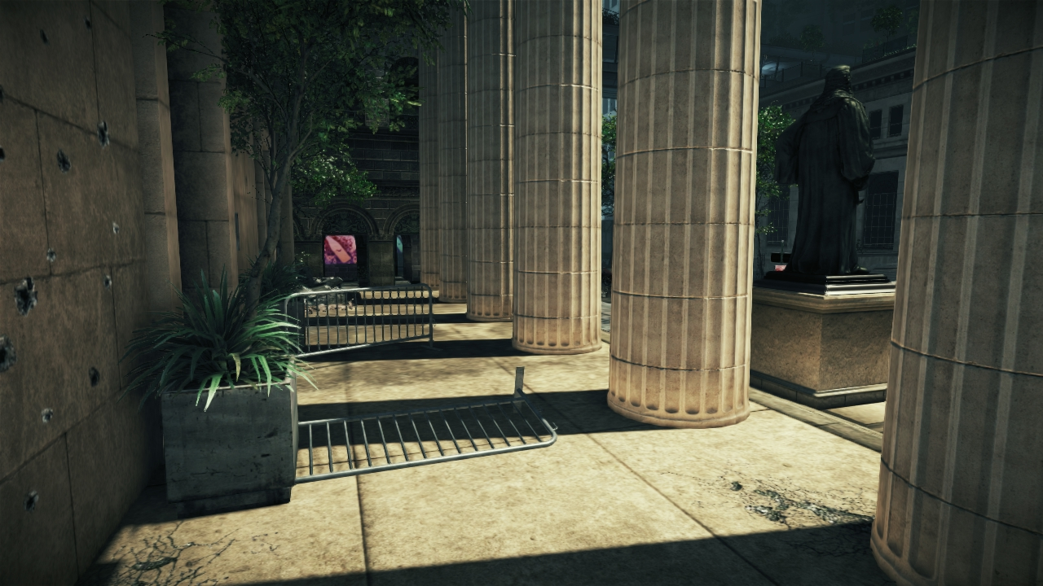
Results
Notes:
This is a screenshot of indoor scene using Light Propagation Volumes

Slide 19
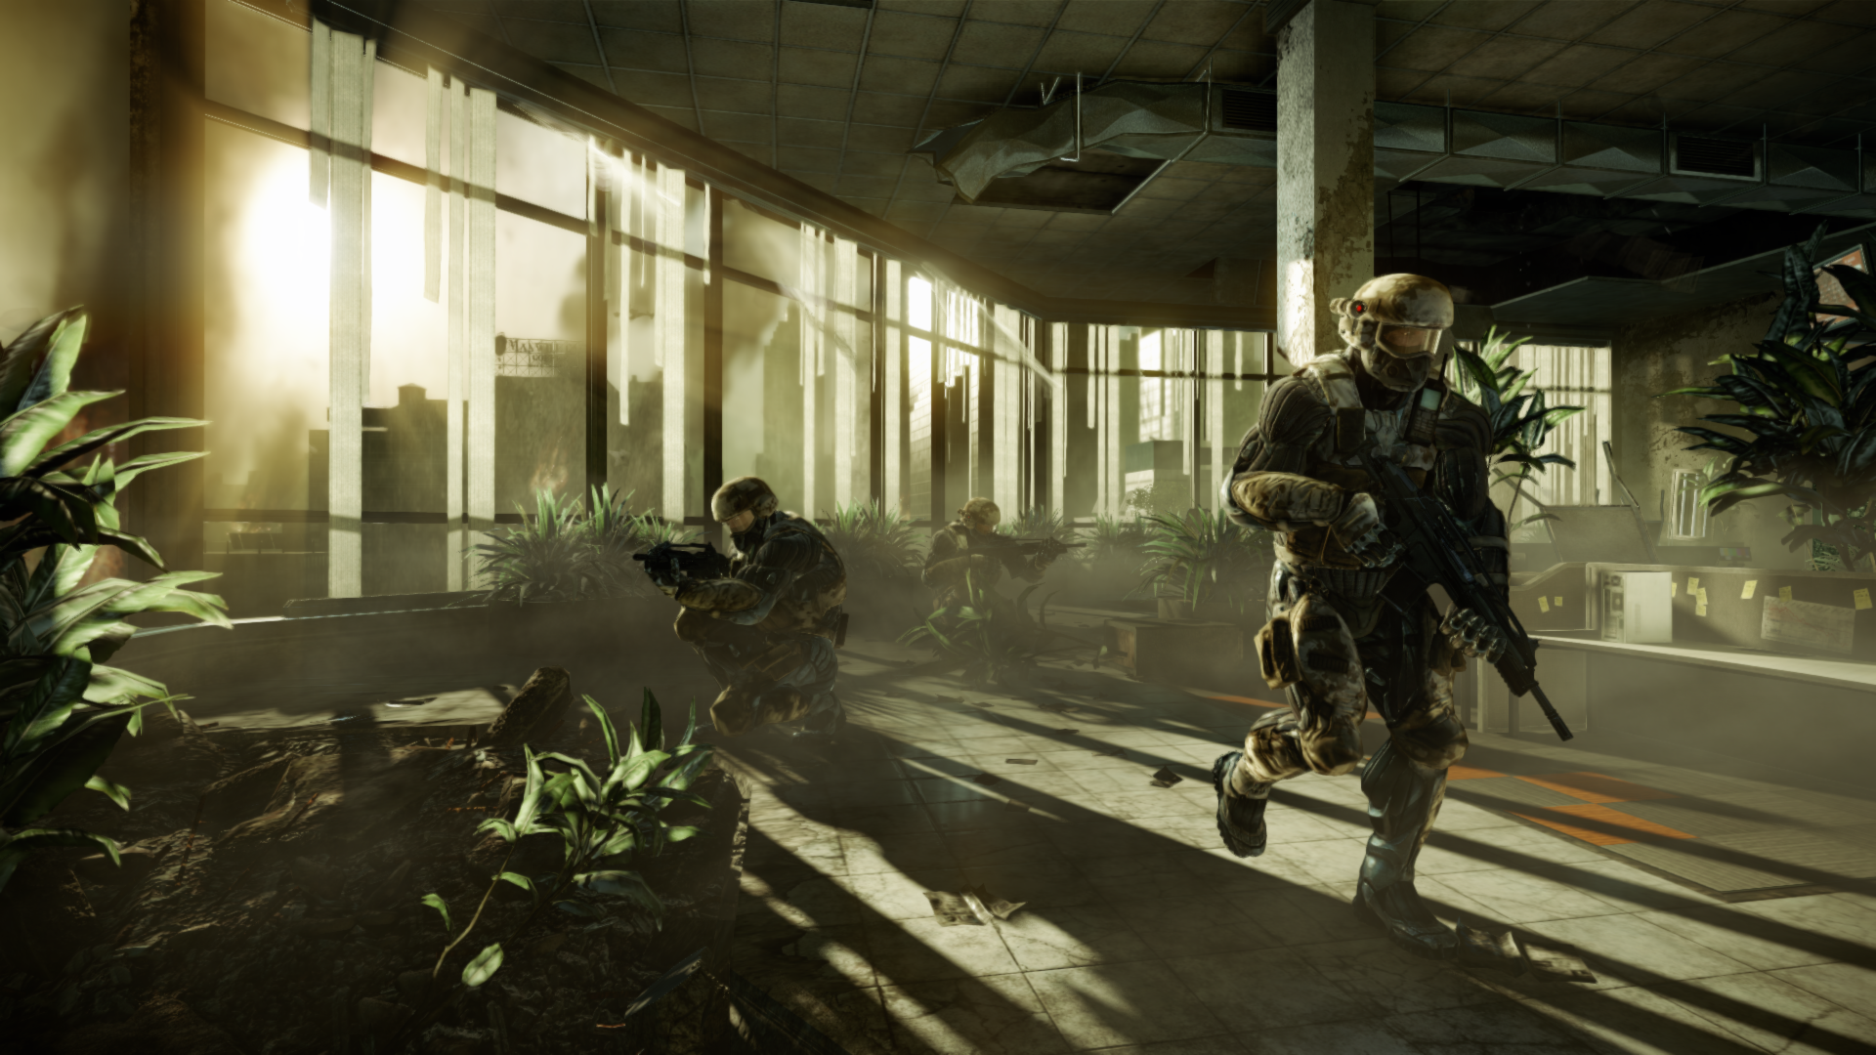
Results
Notes:
This is a screenshot of indoor scene using Light Propagation Volumes

Slide 20
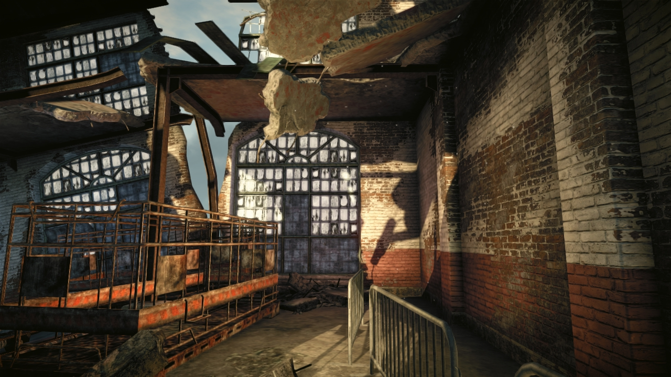
Results
Notes:
This is a screenshot of indoor scene using Light Propagation Volumes

Slide 21
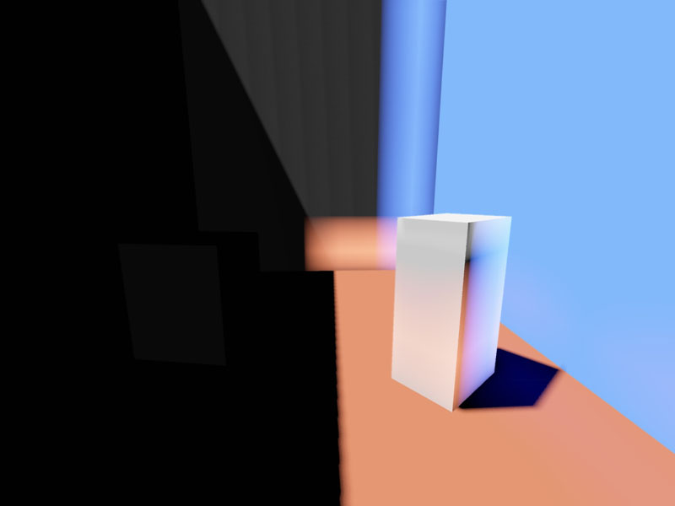
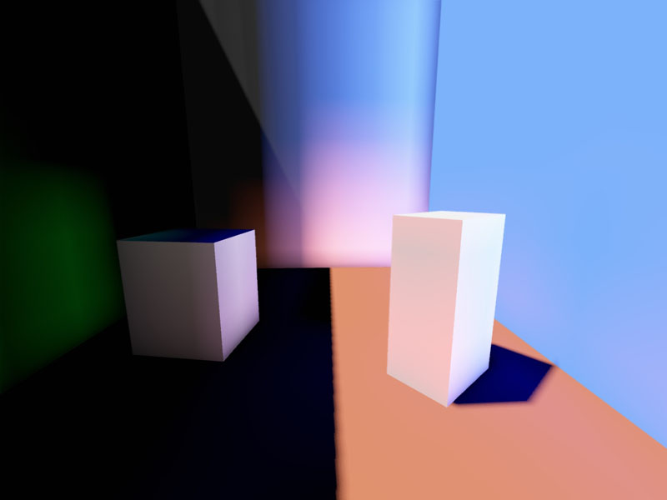
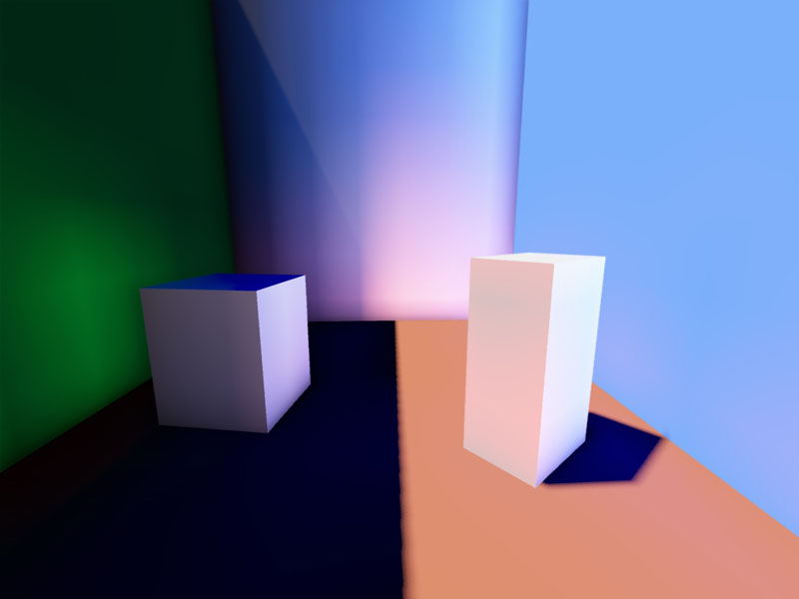
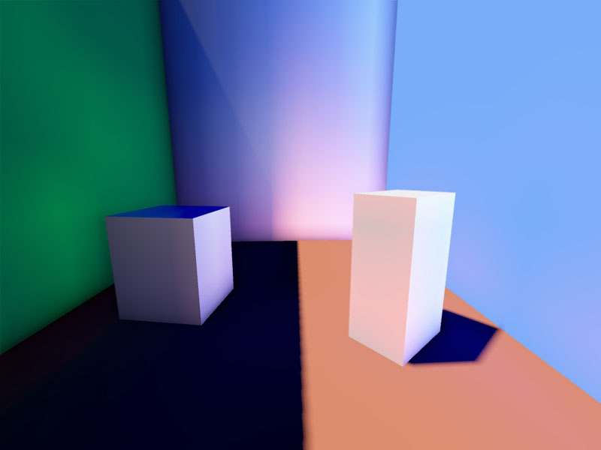
Propagation example
0 iterations, only injection
4 iterations after injection
6 iterations after injection
8 iterations after injection
Notes:
Here is a sequence demonstrating the propagation results for different number of iterations for light propagation stage.
It’s a Cornell-box-like room with the blue right wall, red floor, green left wall (which is in shadow) and grey back wall.
The grid is very coarse to emphasize the contribution of each subsequent iteration.

Slide 22
Stabilizing solution
Spatial stabilization
Snap RSM by one pixel for conservative rasterization
Snap LPV by one grid cell for stable injection
Self-illumination
Half-cell VPL shifting to normal direction during RSM injection
Temporal coherence and reprojection
Temporal SSAA with reprojection for RSM injection
Notes:
Stability is an important issue of this technique.
Spatio-temporal stability of both LPV and RSM during movements is required.
Temporal antialiasing (jittering) can be employed to achieve better scene sampling with RSM across several frames.
All the issues mentioned on the previous slide could be avoided within these steps (details in the I3D paper).

Slide 23
Limitations of the method
Only diffuse inter-reflections
Sparse spatial and low-frequency angular approximations
Light diffusion: light transport smears in all directions
Spatial discretization: visible for occlusion and very coarse grids
Incomplete information for secondary occlusion
Notes:
This method has several obvious limitations.
1. It takes only diffuse inter-reflections into account.
2. Also the spatial and angular approximations are the sources of error:
- The light smearing happen during the light propagation process because of low-frequency angular approximation in each cell of the LPV.
- Another error comes from spatial discretization and mostly noticeable with sparse grids as shown on the right bottom picture.
3. And the information about the indirect occluders is incomplete in our approach as we use only two views to sample all the potential occluders, which might be not sufficient for some cases.

Slide 24
Multi-resolution approach
Render several nested RSMs at different resolutions
Inspired by cascaded shadow maps technique
Simulates uneven multi-resolution rendering on GPU
Distribute objects into different RSMs based on their size
Inject RSMs into corresponding LPVs
Create nested LPV grids that bound RSM frustums
Do propagation and rendering independently
Propagate from inner LPV to outer one
Notes:
Using a single LPV to compute the light propagation in an entire scene (with acceptable resolution) would require a very large grid.
Instead we use a set of nested grids moving with the viewer similar to cascaded shadow maps but in 3D.
The nested grid approach allows us to use grids of smaller size (typically 32^3 cells) and thus reduce the number of required propagation iterations.
The important property of the cascaded approach we use is the orthogonality. That allows us to have different scales of indirect radiance distribution at different cascades. Also that means that we can simply add up the contribution of all cascades together without caring about overlapping indirect illumination.

Slide 25
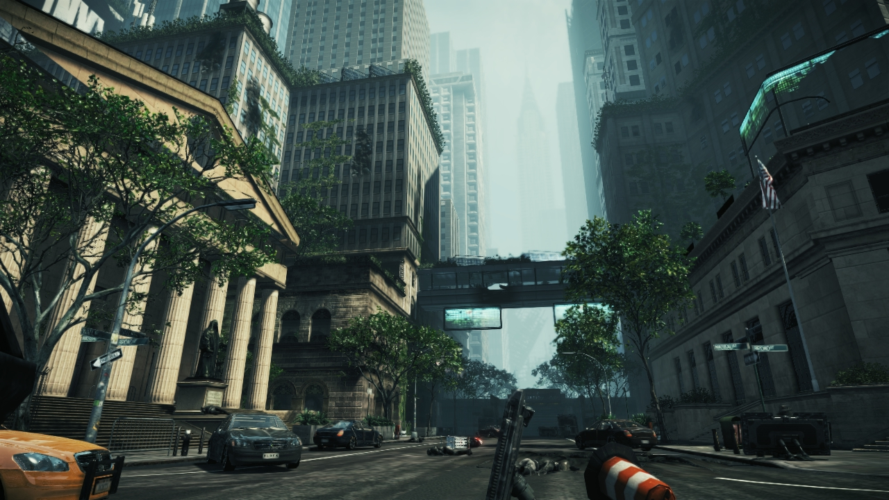
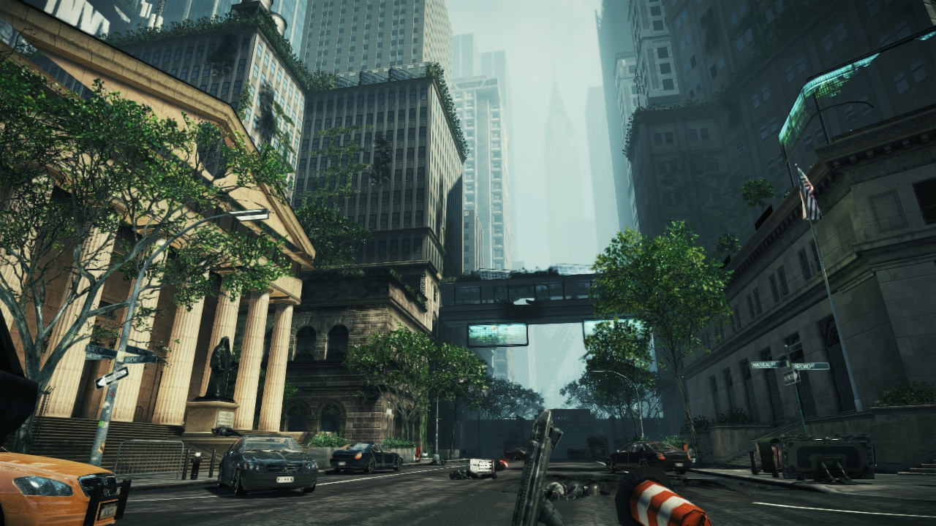
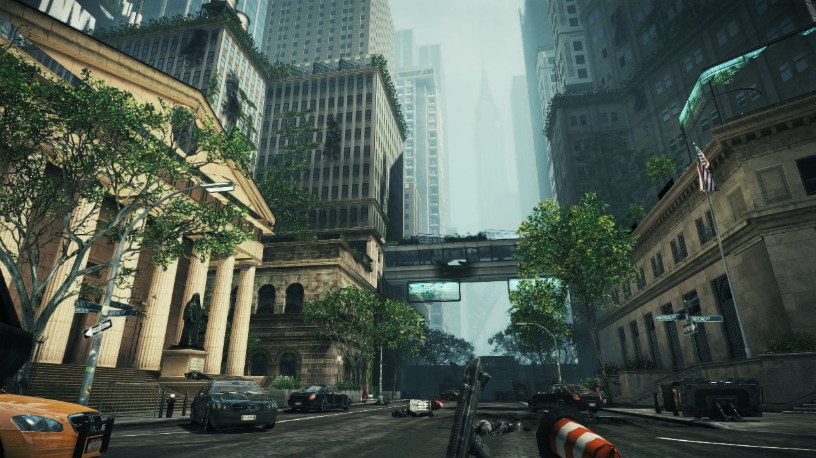
Cascaded Light Propagation Volumes
Global Illumination with 3 Light Propagation Volumes
Global Illumination with 1 Light Propagation Volume
Global Illumination off
Notes:
Examples of cascaded approach in a huge outdoor scene.

Slide 26
Extensions
Transparent objects
Lighting caching for massive lighting approximation
Inject analytical radiance into grid cells covered by light
Secondary occlusion with additional occlusion grid
Multiple bounces possible using the same trick
Glossy reflections by partial matching in LPV
Participating media illumination
Comes inherently from the propagation process’ nature
Notes:
Light Propagation Volumes has a lot of natural extensions as it is essentially a coarse volumetric representation of radiance distribution.
Some of these extensions are mentioned here. For the full list of extensions and examples please refer to I3D 2010 paper “Cascaded Light Propagation Volumes” [KD10]

Slide 27
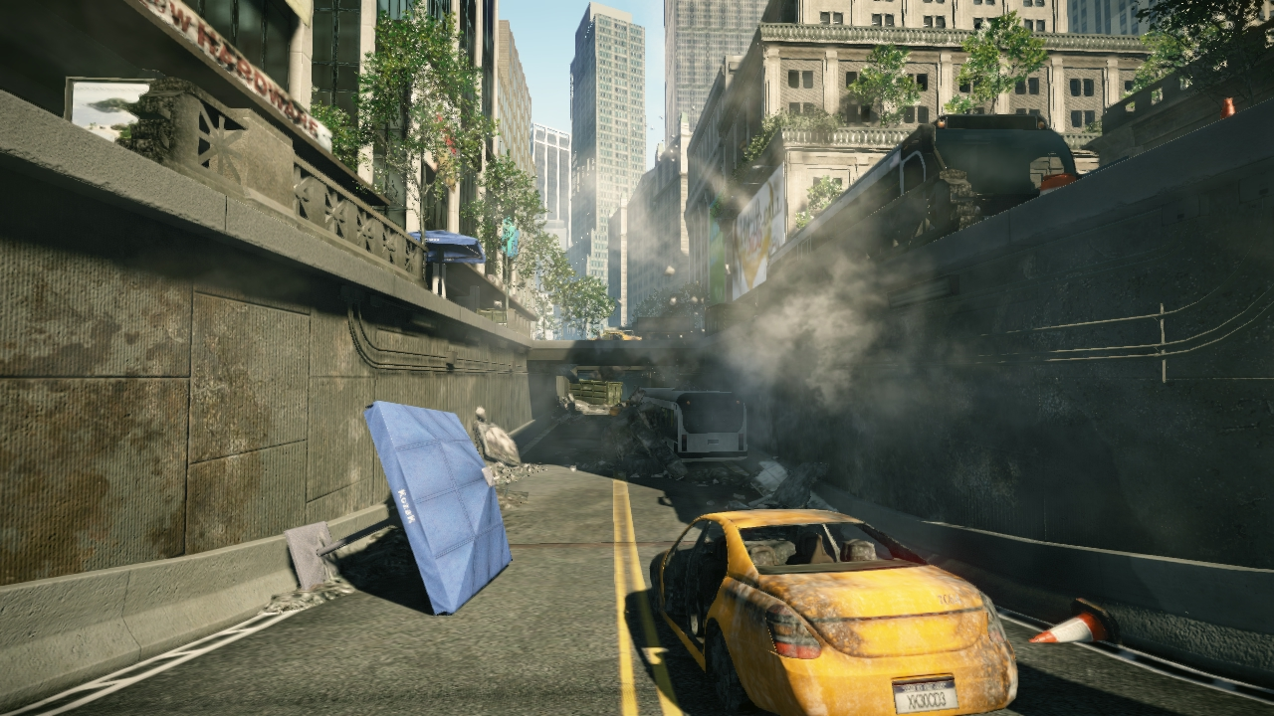
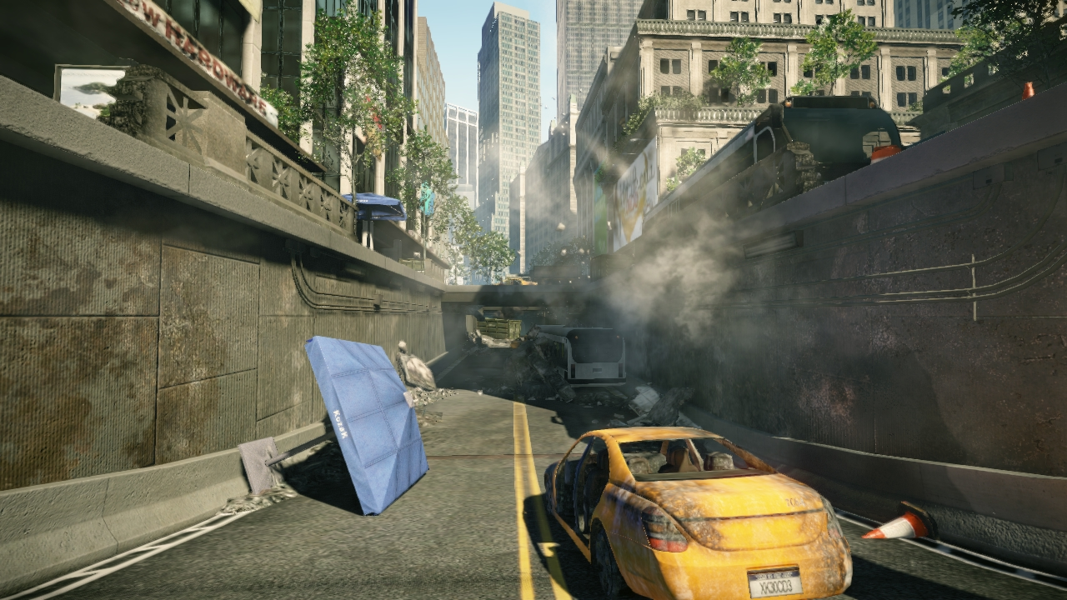
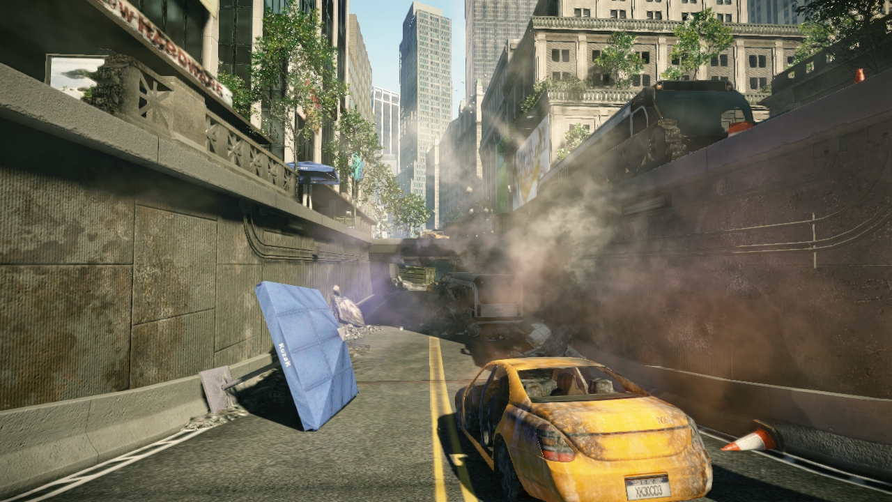
Global Illumination on particles
Global Illumination on particles
Global Illumination on
Global Illumination off
Notes:
Here is an example of global illumination applied to particle effects.

Slide 28
Why does it work so good?
Human perception of Indirect Lighting
Very sensitive for contact lighting (corners, edges etc.)
Indirect lighting is mostly in low frequency
Even for indirect shadows
Smooth gradients instead of flat ambient in shadow
Approximated as diffusion process in participating media
Cascades: importance-based clustering
Emitters are distributed across cascades based on its size

Slide 29
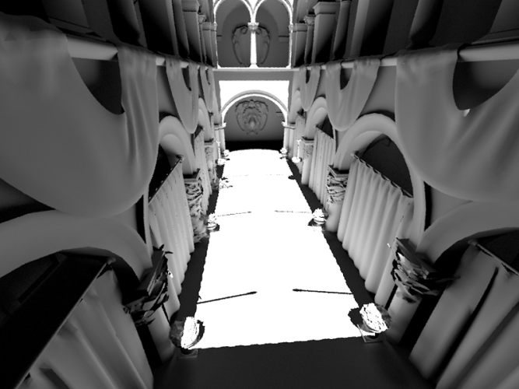
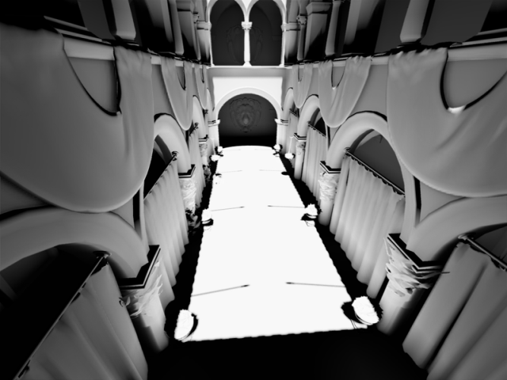
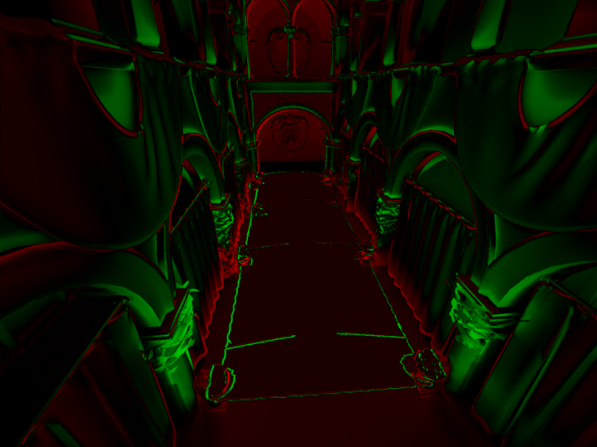
How far are we from ground truth?
PBRT
LPV
Difference
Notes:
Here is the comparison to the “ground truth” off-line rendering.
Reference solution is on the left and rendered with PBRT.
The result of our method with 3 cascades is in the middle.
You can see the difference on the right colored as a red/green heatmap.
The most of the error comes from a lack of fine-grained indirect occlusion on this image.
However that found to be not an issue in the production.

Slide 30
Comparison
 | Lightmaps | Precomputed Radiance Transfer | Light Propagation Volumes
Image quality | Very good | Good | Good
Memory budget | Medium | Medium | Low and fixed
Dynamic lighting | - | + | +
Dynamic objects | - | - | +
Secondary Occlusion | + | + | + (via extensions)
Multiple bounces | + | + | - (unstable solution)
Area covered | Whole scene | Whole scene | Limited (w/o cascades)
Auxiliary data | Moderate | Huge | None
Affecting production | Strong | Strong | Low
Notes:
Here is a comparison table provided for our method versus the most commonly used real-time methods in games.
The area covered by the technique becomes an important property for our technique. The area covered by one cascade is small, however the area covered by three cascades becomes sufficient for majority of game scenes.

Slide 31
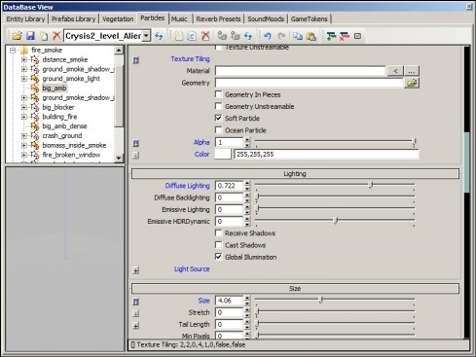
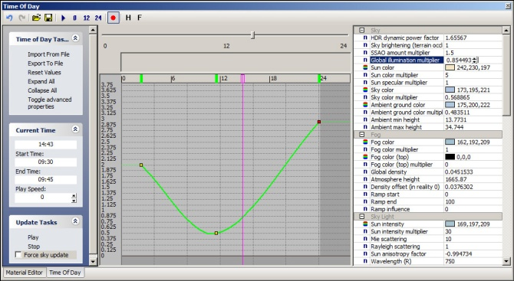
Tools for game production
GI editing tools for artists:
GI intensity for each direct light contributing into GI
Mark objects as non-casters and/or non-receivers
Notes:
We provide a rich set of tools to control Global Illumination.
We have global and time-varying intensity multiplier for indirect lighting.
Also we have some additional tools.
We provide per-object artistic control over global illumination receivers for both solid and transparent objects including particle effects.

Slide 32
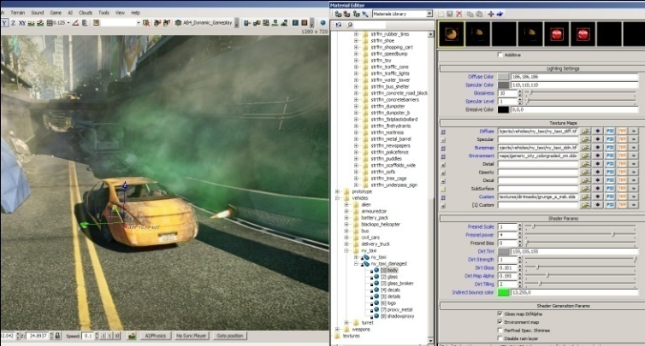
Tools for game production
GI tools for artists:
Per material indirect color and intensity
Optionally apply on any transparent objects and particles
Clip areas: provides control over indoors
Transition areas: provides smooth GI changes across level areas / game events
Notes:
We provide a per-object control over the bleeding intensity and color. That means that an artist can change the indirect color of an object without touching any other material parameters in real-time. You can see the example in the middle figure. The bounced color of the yellow taxi is set to green. You can see the Global Illumination effect from the taxi on the surrounding particles.
….
This set of tool is provided to be sufficient and very convenient for real-time tweaking of Global Illumination effect by artists.

Slide 33
Combination with other techniques
Multiply with SSAO to add micro-occlusion details
Deferred environment probes
Combined to augment for distant GI
Fill lights and deferred lights
Simulating GI with fill lights at some places
Important for artists for GI stylization
Notes:
We use Screen-Space Ambient Occlusion as a multiplicative factor to add more high frequency occlusion details.
Also we provide our artists with fill lights, negative lights and simple deferred point lights to give them freedom in achieving the effects they want to. This becomes especially important in places or cut-scenes where an dramatic view is much more important rather than physically-correct Global Illumination effect.
In addition, we augment our technique with preconvolved diffuse environment probes to approximate distant indirect lighting in outdoors. This term usually comes from huge global contributors like sky, terrain, ocean etc.

Slide 34
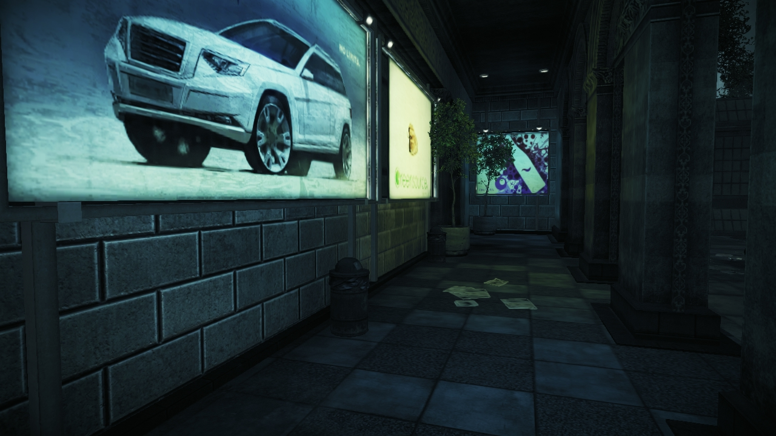
Global Illumination simulated with Deferred Lights
Notes:
This is an example of the simulated Global Illumination manually created by artists. In this particular case the sampling of the scene by several area light sources would take a lot of time. Moreover as light sources are very coarse spatially, it is possible to easily emulate the Illumination with several deferred point light sources with almost no performance impact.

Slide 35
Console optimizations
For both consoles
Store everything in signed QUVW8 format, [-1;1] with scaling factor
Use h/w 3D textures and trilinear filtering
Xbox 360
Unwrap RT vertically to avoid bank conflicts during injection (next slide)
Use API bug work-around to resolve into a 3D slice
PlayStation 3
Use memory aliasing for render into 3D texture
Use 2x MSAA aliasing to reduce pixel work twice

Slide 36
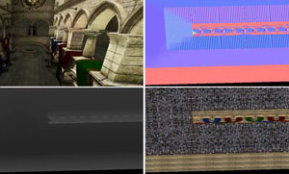
Console optimizations , cont’d
Render Reflective Shadow Map
Usually 128 x 128 is ok
Inject each pixel into unwrapped LPV with a swarm of points
16384 points in one DIP
Use vertex texture fetch on X360
Use R2VB on PlayStation 3
Multi-layered unwrapping to avoid bank conflicts during RSM injection
Combine LPV rendering pass with SSAO to amortize the cost

Slide 37
Performance
Stage | GTX 285, ms | Xbox 360, ms | PS 3, ms
RSM Rendering | 0.16 (256^2) | 0.5 (128^2) | 0.8 (128^2)
VPL Injection | 0.05 | 0.2 | 0.4
Occlusion Injection | 0.02 | 0.15 | 0.15
Propagation | 0.5/0.8/1.1 | 0.5/0.8/1.2 | 0.5/0.8/1.2
LPV look-up | 1.4 | 0.9 | 0.9
Total | 2.1/2.4/2.7 | 2.1/2.4/2.8 | 2.6/3.0/3.4
Refresh once per 5 frames
Reprojection for camera movement
Depends on scene complexity
32^3 grid size
8 iterations
Depends on image size (1280x720)
Notes:
Performance of our method is provided in this table. Note that different stages of the algorithm depend on different data, like scene complexity and screen resolution.
This is a very important advantage for real-time technique, because it decomposes the complexity of the algorithm, providing more predictable performance.
Notice that we can reuse the results of propagation across multiple frames.

Slide 38
Performance, cont’d
Stage | GTX 285, ms | Xbox 360, ms | PS 3, ms
RSM Rendering | 0.16 (256^2) | 0.5 (128^2) | 0.8 (128^2)
VPL Injection | 0.05 | 0.2 | 0.4
Occlusion Injection | 0.02 | 0.15 | 0.15
Propagation | 0.5/0.8/1.1 | 0.5/0.8/1.2 | 0.5/0.8/1.2
LPV look-up | 1.4 | 0.9 | 0.9
Total (per frame) | 1.5/1.6/1.7 | 1.1/1.1/1.3 | 1.2/1.3/1.4
Once per 5 frames
Once per frame
Notes:
We regenerate GI data once per 5 frames (which is proved to be enough) and fade in new results smoothly.
Also we do a reprojection from the old LPV to the new LPV in case of intensive camera movements.

Slide 39
Conclusion
Full-dynamic approach, changing scene/view/lighting
GPU- and consoles- friendly
Extremely fast (takes ~1 ms/frame on PlayStation 3)
Production-eligible (rich toolset for real-time tweaking)
Highly scalable, proportionally to quality
Stable, flicker-free
Supports complex geometry (e.g. foliage)
Notes:
We presented an efficient method for the rendering of plausible indirect lighting in fully dynamic, complex scenes in real-time that uses volumetric representations of the light and geometry in a scene.
We demonstrated our method in various real game scenes in combination with wide-spread real-time rendering techniques.

Slide 40
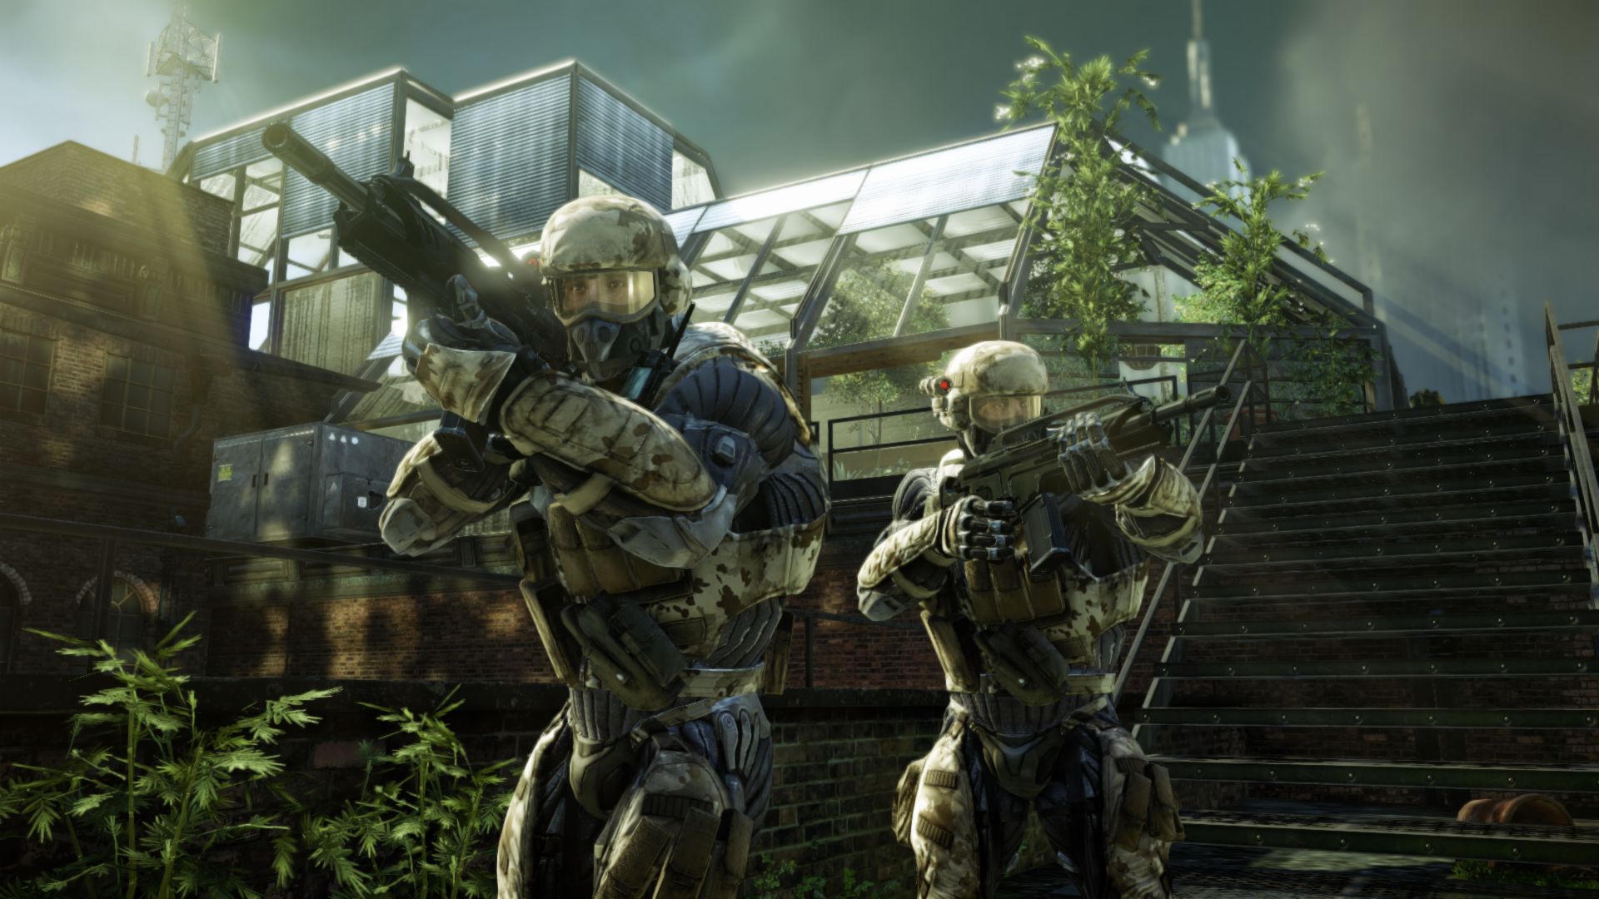
Q&A
Anton Kaplanyan
antonk@crytek.de
Find the last version of course notes at: http://www.crytek.com/technology/presentations/
Notes:
I’d like to acknowledge the whole Crytek team for their support and especially Tiago Sousa and Pierre-Yves Donzallaz for their help.

Slide 41
References
[Bunnel05] Bunnel, M. 2005 “Dynamic ambient occlusion and indirect lighting”, GPU Gems 2
[Christensen07] Christensen, P. 2007. “Point-based approximated color bleeding,” Tech Memo, Pixar.
[DS05] Dachsbacher, C., and Stamminger, M. 2005. Reflective shadow maps. In Proc. of the Symposium on Interactive 3D Graphics and Games
[GRWS04] Geist, R., Rasche, K., Westall, J., and Schalkoff, R. J. 2004. Lattice-boltzmann lighting. In Rendering Techniques 2004 (Proc. of the Eurographics Symposium on Rendering
[KD10] Kaplanyan A., Dachsbacher C. 2010. Cascaded Light Propagation Volumes, In Proc. of the ACM SIGGraph Symposium on Interactive 3D Graphics and Games
[KELLER97] Keller, A. 1997. Instant radiosity. In SIGGRAPH ’97: Proceedings of the 24th annual conference on Computer graphics and interactive techniques

