Slide 1
Conclusions
Global Illumination Across Industries
Jaroslav Křivánek
Cornell University &
Charles University, Prague

Slide 2
Film vs. game rendering
Film
Fixed quality requirements
Performance negotiable
Games
Fixed performance requirements
Quality negotiable
(after Larry Gritz @ HPG 2009)
Notes:
We’ve been focusing on two application areas: film rendering and video games. The main difference between rendering for film and games is that in film, there are fixed quality requirements but performance is negotiable. In games, on the on the other hand, we have fixed performance requirements and we’re trying to get the best possible quality out of it.

Slide 3
Research challenges
How about
Fixed quality requirements &
Fixed performance requirements ?
What for?
Product customization in ecommerce
Interactive interior design
Notes:
But what if the quality requirements and performance requirements are both fixed at the same time? Imagine you’re customizing a product that you want to buy on-line, or you want to design the interior of your apartment on your computer. These examples show that having photorealistic rendering at interactive rates would open up new applications for computer graphics rendering.
But that’s not so easy to do with today’s software and hardware technology. So the grand challenge #1 is interactive photorealism.

Slide 4
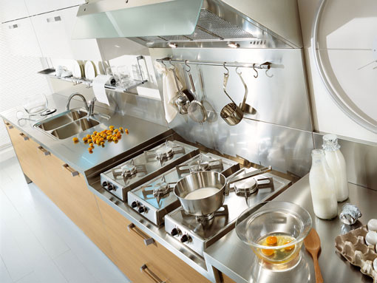
Research challenges
Existing algorithms are inherently bad for some practical scenes
More work to do for rendering researchers
Notes:
The grand challenge #2 is rendering difficult scenes like the one shown here, where essentially all the known GI algorithms fail (or take ages to render the image). The problem is that it’s really hard to make these algorithms find some difficult light paths. Consider the light path shown in the image, where the light coming from the light source is reflected off the metal surface, refracted on the glass, scattered inside the egg white and the yolk, then focused by refractions on the glass and finally reflected off the metal countertop toward the camera. This is a nightmare for all existing GI algorithms. Yet, there’s nothing strange about the scene, so it’d be cool if we could render scenes like this easily.
In conclusion, even though great advances have been made that enable the use of GI in practice, there’s still a number of unsolved problems. Finding solutions to these challenges will open new applications for computer graphics.

Slide 5
Acknowledgements
Funding (Jaroslav)
Marie Curie Fellowship PIOF-GA-2008-221716
Speakers
Marcos, Per, Eric, Michael, David, Anton

Slide 6
Thank you!
Global Illumination
Across Industries
http://www.graphics.cornell.edu/~jaroslav/gicourse2010

