Slide 1
Spatial Directional Radiance Caching
Václav Gassenbauer
Czech Technical University in Prague
Jaroslav Křivánek
Cornell University
Kadi Bouatouch
IRISA / INRIA Rennes
Notes:
Good morning ladies and gentlemen my name is VG and I would like to present you our paper Spatial Directional Radiance Caching.

Slide 2
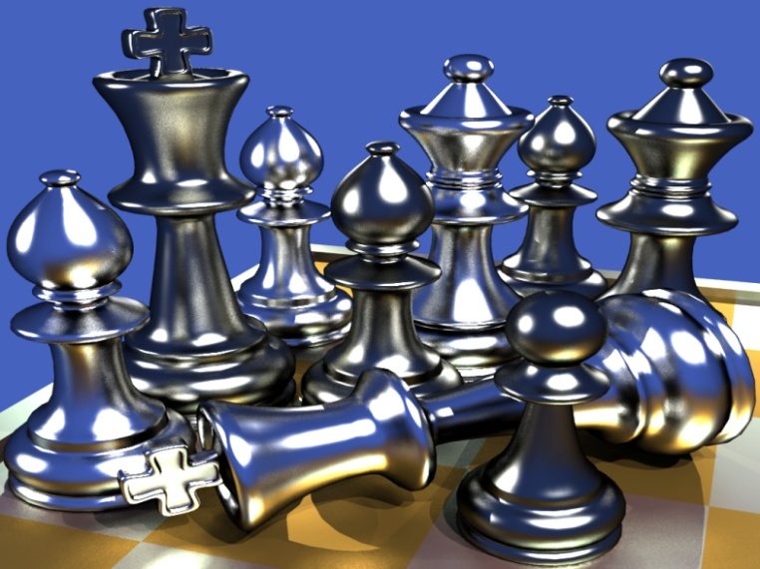
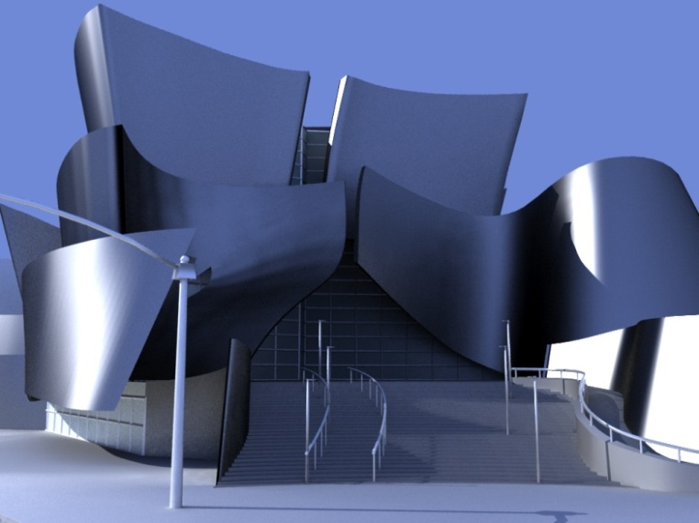
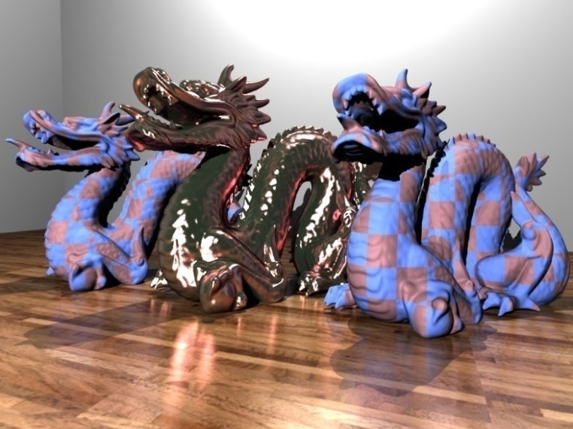
Goal
Acceleration of Global Illumination Computation on Glossy Surfaces
Adapt glossiness of surfaces
Notes:
We propose a new approach for accelerated global illumination computation in the scenes with glossy surfaces. Some examples of such scenes are in the following figures. There are scenes with glossy chess pieces, glossy flamingos, a simple model of the Walt Disney Hall and the scene with dragons on the glossy varnished floor. Note the glossy reflection of small pieces on each other. Similarly you can see reflection of flamingos and so on. It is crucial to compute indirect illumination on glossy surfaces to capture these effects. It is the only way for obtaining realistic looking images.

Slide 3
Previous Work
Irradiance caching (IC)
[Ward et al. 88], [Ward and Heckbert 92]
Indirect illumination changes slowly → interpolate
Variants of IC
[Tabellion and Lamorlette 04], [Brouillat et al. 08], [Arikan et al. 05], …
Radiance caching (SHRC)
[Křivánek et al. 05]
Other techniques
[Hinkenjann and Roth 07, …]
Notes:
Our algorithm is a variant of illumination caching techniques. The seminal work in this area is irradiance caching proposed by Ward et al. It is based on the idea that the slowly varying indirect illumination term can be computed only at several locations in the scene, stored in the cache, and later used for fast interpolation. Some extensions of irradiance caching are work of Tabellion and Lamorlette, Brouillat et al., Arikan et al. 05 and etc. They modify the original algorithm in order to obtain faster and or more accurate estimation of indirect illumination. However, they work for diffuse illumination only. Křivánek et al. modify the original algorithm to include the support for caching on low-glossy surfaces. Our objective is account higher-frequency surfaces too.

Slide 4
Motivation
Radiance caching limitation
Uniform sampling of full hemisphere
Low glossy surfaces
Conversion of the scene BRDFs into the frequency domain in preprocess
Notes:
The major limitation of radiance caching consists of the uniform sampling of full hemisphere used to estimate incoming radiance. Sampling the rays outside the lobe of a glossy BRDF, however, produce wasted effort. Other limitation is that the algorithm can be applied on low frequency surfaces. Moreover it needs to maintain the precomputed representations of the scene BRDFs in spherical harmonics. We would like to avoid these limitations as we will explain in the following slides.

Slide 5
SDRC – Overview
Caching scheme
Cache structure
New record computation
Spatial / Directional Interpolation
Outgoing radiance computation
Notes:
Let’s see an overview of our method. First we describe a caching scheme and caches structure. Then we describe each individual steps (New record computation, Spatial / Directional Interpolation, Outgoing radiance computation) more precisely. Finally we present results and summarize our contribution.

Slide 6
Spatial Directional Caching Scheme
Spatial
Cache
Spatial
Cache
Lookup
Spatial
Cache
Lookup
Spatial
Cache
Miss!
Store in
cache
Spatial
Cache
Hit!
Directional
Cache
Update
Directional Cache
Project Sample onto Unit Square
Directional
Cache HIT!
Directional
Cache
MISS!
BRDF
Importance
Sampling
p₁
p₂
Notes:
Let me show you briefly how the algorithm works. Suppose we would like to compute outgoing radiance at point p1. We query the spatial cache to see if there are some nearby records available for interpolation. The cache is empty so we must evaluate a new cache record. We generate random directions using BRDF importance sampling. We compute incoming radiance for each direction by ray casting. We use a photon map to estimate the incoming radiance. We project these directions to a normalize phi-theta space. We store the directions in a hierarchical data structure. Note that each direction in the data structure is assigned a radiance value. The data structure is then store into the spatial cache as a single record. Finally we evaluate the outgoing radiance using a Monte Carlo estimator.
Now we would like to compute an outgoing radiance at point p2. We query the spatial cache if there are some nearby records available. The query is succeeds for now and we obtain the record. We generate random directions using BRDF importance sampling as before. But instead of computing the incoming radiance for these directions by ray casting, we try to find close radiance sample stored in the data structure and possibly reuse it. If no suitable radiance sample is available for a given direction, we shoot a ray to obtain a new radiance sample and update the L-tree. Finally we evaluate the outgoing radiance using interpolation.

Slide 7
Structure of the Two Caches
Spatial
Cache
Octree (spatial cache)
kD-tree
(directional cache)
Notes:
Since we use non-uniform sampling to create cache records, we need a representation for the incoming radiance that offers directional localization. This is why spherical harmonics are not an option. Wavelets do offer such directional localization. But the rotation matrices require a lot of memory for a reasonable directional resolution. Our choice is, therefore, to retain the individual radiance samples in spatial domain and organize them in a kdtree.
There is a spatial cache contacting three records in the figure. Each record represents incoming radiances in phi-theta space using a kd-tree. All the records are organized in an octree similar to the original irradiance caching. The sphere around the records represents the zone of influence of the records.

Slide 8
New Record Computation
Generate N samples using BRDF importance sampling
Compute incoming radiance using ray casting and photon map
p
Transform samples onto 2D domain
Build a k-D tree upon the samples
L-tree
Notes:
To create a new spatial record, we first generate N random directions using BRDF importance sampling. We compute incoming radiance for each direction by ray casting. We then map these samples from the sphere to a phi/theta space. We use a paraboloid mapping which has a low distortion and fast analytical transform. We construct a kd-tree, or L-tree, over the radiance samples. The record computation is completed by inserting the whole L-tree into the spatial cache.

Slide 9
Spatial Interpolation
Collect L-trees that can be used for interpolation at p (borrowed from RC)
Spatial
Cache
Lookup
Spatial
Cache
p₂
p₂
p
p
Spatial
Cache
Hit!
p₁
L-tree(p₂)
p₁
L-tree(p₁)
For all L-trees found compute the spatial weight
Notes:
How to interpolate the incoming radiance? Suppose that we would like to compute outgoing radiance at point p. We start by query the spatial cache if there are some nearby records available for interpolation. We assume that we get the two records for our illustration. The definition of the set of the records used for interpolation is borrowed from the original radiance caching algorithm. Similarly we compute spatial weights for the records. Next we continue by a directional interpolation.

Slide 10
Directional Interpolation
Generate M(M<<N) samples using BRDF importance sampling
p₂
p
Transform samples onto unit domain
L-tree(p₂)
For all the samples try find nearby radiance samples in L-tree(p₂) in S(p)
L-tree(p₂)
Radiance sample found
Radiance not sample found
→ ray tracing
Update L-tree(p₂) if necessary
Notes:
We generate M random directions using BRDF importance sampling at point p. We map these directions to the phi/theta space and for each direction generated we collect nearby radiance samples stored in all the contributing records’ L-trees. If, otherwise, no radiance sample was found in any of the L-trees, we compute a new radiance sample by a ray casting. We place the ray origin of the radiance sample to the location of one of the contributing Ltree. Finally we insert the computed radiance sample into the Ltree for later reuse.

Slide 11
Which Radiance Samples Are Nearby?
Compute search radius for each radiance sample
Collect nearby radiance samples
Compute directional weights
i-th L-tree
Notes:
How to find nearby radiance samples? Given a direction w_{j}^{in}, generated during BRDF importance sampling, and an L-tree, we use a range query to collect nearby radiance samples stored in the L-tree. The query radius r_{d} is designed to adapt both to the number of rays M used for rendering and to the reflectance properties at p. In particular, the radius will be smaller around the peak of a glossy BRDF lobe and vice versa. Then we compute the directional weight for each radiance sample found.

Slide 12
Incoming Radiance Interpolation
Interpolate all collected radiance sample
Sums run over all radiance samples from all contributing L-trees.
Product of spatial and directional weights
k-th radiance sample stored in the i-th L-tree
Interpolated incoming radiance
Notes:
The radiance samples collected in the previous step participate in the directional interpolation. We use the following weighted sums. Outer sum run over all the contributing L-trees. Inner sum runs over all radiance samples found in i-th L-tree. We use a product of the spatial and directional weights in the sums. That is different from the irradiance caching that take only the spatial weight. The weight value is the k-th radiance sample stored in i-th spatial L-tree.

Slide 13
Outgoing Radiance Computation
Evaluate Monte Carlo Estimator
# render samples
interpolated incoming radiance
Estimated outgoing radiance
Sampling probability of
Notes:
The interpolated incoming radiance Lin-tilde is computed for each direction generated during BRDF importance sampling. The outgoing radiance at a point p is estimated using biased Monte Carlo estimator. All the terms of the estimator were computed in the previous steps. For the sake of completeness we repeat that BRDF is the reflectance function and pdf is probability density function of the BRDF importance sampling.

Slide 14
Results
SHRC vs. SDRC
SHRC = Spherical harmonics caching
SDRC = new Spatial-Directional caching
MC vs. SHRC vs. SDRC vs. REF
MC = Monte Carlo importance sampling
REF = reference solution
SDRC scalability
Animation
Notes:
In this section we show results of our algorithm. We compare our algorithm “Spatial Directional Radiance Caching, or SDRC” with the original radiance caching based on spherical harmonics, or SHRC, and with the Monte Carlo importance sampling. Finally we show an animation that reduces flickering artifacts.

Slide 15
SHRC vs. SDRC
SDRC adapts to the BRDF lobe exponent automatically
Notes:
The following figures show the RMS error produced by the SHRC and SDRC as a function of the surface finish. Columns of the table list a lobe exponent of modified Phong’s model, while the rows list the rendering method. There are the SHRC, SDRC and the reference images in the individual rows. We can see that the SHRC works well for a low lobe exponent. Importance sampling has no advantage compared with sampling the whole hemisphere. However, for higher exponents the SHRC blurs out the reflection or produces ringing artifacts. For higher quality images, it is necessary to take a higher number of SH coefficients and, also, a higher number of rays have to be casted. For the lobe exponents greater than 16 our algorithm performs better for equal time.

Slide 16
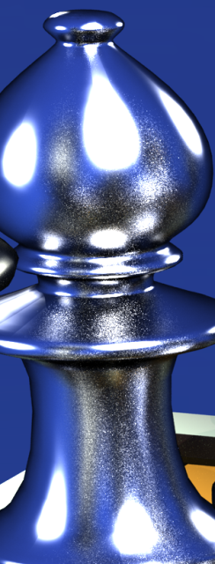
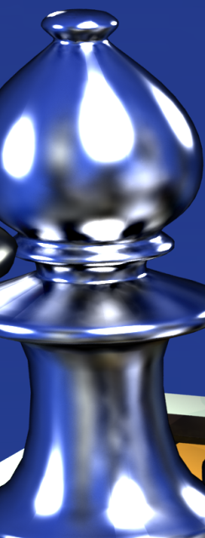
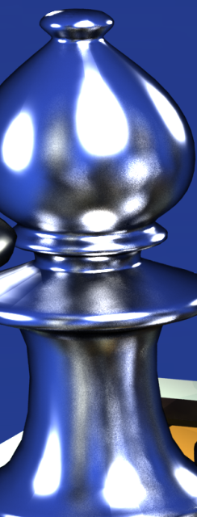
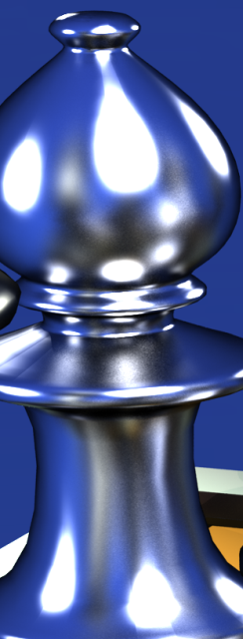
MC vs. SHRC vs. SDRC vs. REF
MC
SHRC
SDRC
(new)
REF
SDRC produce less noise than MC
SDRC produce no ringing artifacts as SHRC.
Notes:
In this slide our objective is compare the MC, SHRC and SDRC algorithms with reference image. All images were rendered with the global illumination effects up to the fourth bounce of indirect lighting. The first bounce was computed using the compared algorithms while photon map was used for the higher recursion level. MC importance sampling provides very noisy image. On the other hand SHRC suffers from ringing artifacts. They are visible in areas with high change of indirect lighting. The third image was rendered using our algorithm. It is more accurate then than the other ones.

Slide 17
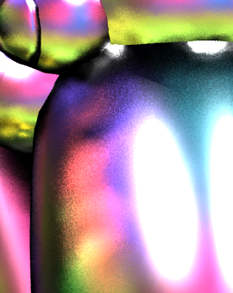
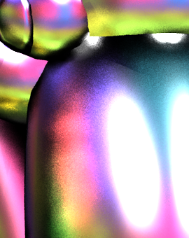
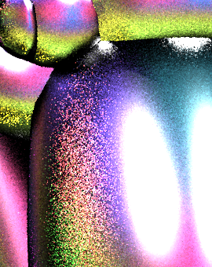
SDRC scalability
indirect lighting compu-tation time of the detail
N=64 / t≈6.2s
N=128 / t≈13.0s
N=256 / t≈23.6s
SDRC
MC
Rendering time is O(N).
Notes:
The following figures show the scalability of the rendering time to the number of directional rays N used. We use a scene with anisotropic glossy flamingos. The top images show the details of flamingo rendered using our algorithm. We can see that the rendering time spent for indirect lighting computation on glossy surfaces is directly proportional to N. Indirect lighting computation of the details took 6, 13 and 24 seconds respectively. In bottom images we show corresponding images rendered using the MC importance sampling in appropriately the same time.

Slide 18
Animation
Without reusing cache record
With reusing cache record
- Flickering reduced
Side-by-side comparison
Notes:
We show an animation of the chess scene now. We render all frames independently of each other in the animation on the right. Note the flickering artifacts in places with highlights. We reuse the cache record computed in the previous frames for the animation on the left. Note the lower level of noise in this animation. Last animation shows side-by-side comparison with and without reusing of the cache records.

Slide 19
Discussion
Interpolation
MC performs better than SDRC for highly glossy materials
Supported materials
Spatially varying ones without sudden changes
Availability of sampling procedure
Memory consumption
≈ higher memory requirements than SHRC (N = 512 and SH order of 10)
Notes:
We discuss the use of the interpolation on glossy surfaces, supported materials and memory requirements of our algorithm. The idea of sparse illumination computation and interpolation elsewhere is based on the assumption that indirect illumination changes slowly on surfaces. However, for highly glossy surfaces the assumption is not the true. Therefore MC importance sampling can performs better than our algorithm for such reflection.
From the second point, our algorithm supports spatially varying materials. However, a lot of sudden changes in material properties decrease efficiency of the algorithm due to continually update. Furthermore, spatial directional caching relies on the availability of sampling procedure for the BRDFs.
Lastly, our algorithm requires about 2 times more memory than the SHRC. The memory requirements hold for the following settings which we used in our comparisons for equal time.

Slide 20
Conclusion
Indirect lighting computation on glossy surfaces
PROS:
Exploits spatial / directional coherence
No blurry / banding artifacts
Adapts automatically to the glossiness
Less noisy than MC
CONS
Higher memory requirements
Potentially difficult parallelization
Notes:
We propose a new algorithm for indirect lighting computation on glossy surfaces. Our new caching algorithm outperforms the original radiance caching for scenes with shiny surfaces, where radiance caching produces blurring or banding artifacts. Furthermore our algorithm adapts automatically to the glossiness of surfaces. Compared to Monte Carlo importance sampling, our algorithm produces less noisy images in the same time. The main disadvantages of our algorithm are higher memory demands and potentially difficult parallelization due to the continual updates of cache records

Slide 21
Future Work
Precise formalization of illumination coherence
Decrease flickering in animation
Notes:
In future work, we want to investigate the formalization of illumination coherence in the spatial and directional domains. In addition we would like to improve quality of animation.

Slide 22
Acknowledgements
Chess pieces courtesy of T. Hachisuka
Ray tracing system - PBRT
Thank you for your attention
Notes:
SDRC was implemented as a single plug-in into the physically based ray tracing system PBRT. Thanks for your attention.

Slide 23
Cache Record Density Control

