Slide 1
Effects of Global Illumination Approximations on Material Appearance
Jaroslav Křivánek
James Ferwerda
Kavita Bala
Cornell University &
Charles University, Prague
Rochester Institute of Technology
Cornell University
Notes:
In this work we investigate how some approximations to GI affect image fidelity and material appearance.

Slide 2
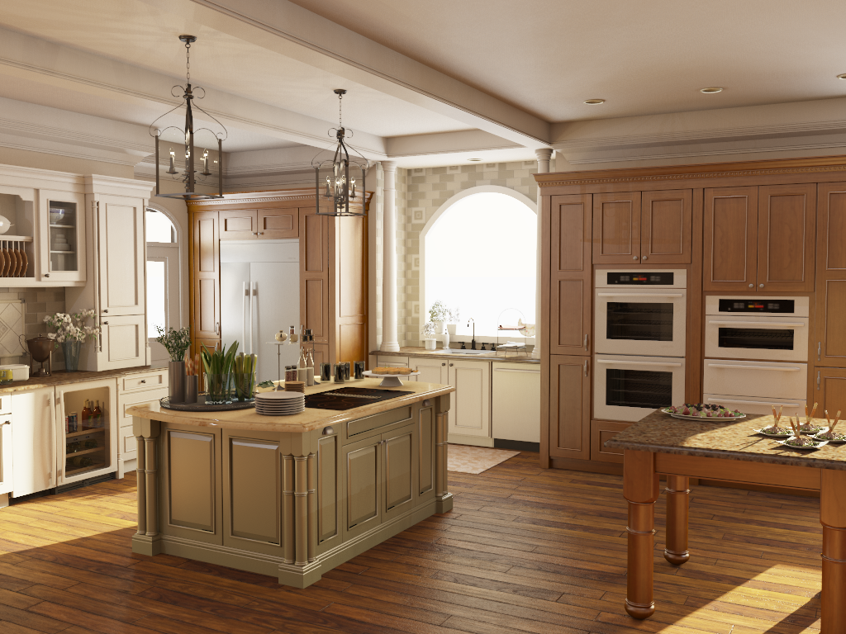
Global illumination rendering
Required for accurate appearance, but slow
scene: Autodesk | rendering: Edgar Velázquez-Armendáriz
Notes:
GI is necessary for accurate appearance rendering , but it’s slow.

Slide 3
Global illumination rendering
Fast GI algorithms are inaccurate
scene: Autodesk | rendering: Edgar Velázquez-Armendáriz
Notes:
Fast GI algorithms, on the other hand, are inaccurate.
The goal of this work is to study some of these inaccuracies perceptually.

Slide 4
Overview
VPL rendering (Instant Radiosity [Keller 1997])
Fast & popular
Image artifacts & energy losses
Impact of VPL rendering on visual fidelity
Systematic perceptual study
Notes:
Specifically, we’re focusing on what we call VPL rendering, which is a class of GI algorithms derived form Instant radiosity.
These algorithms have recently gotten a lot of attention in rendering research for their efficiency and they’re still gaining more popularity.
But sometimes, they introduce image artifacts or energy losses.
For that reason, we investigate the impact of the VPL methods on visual fidelity by means of a systematic perceptual study.

Slide 5
Related work
Perceptually-based rendering
Visible Difference Predictor [Mitchell 87, Bolin and Meyer 95/98, Myszkowski 02, …]
Illumination components [Stokes et al. 04; Debattista et al 05]
Higher-level processing [Yee et al. 01, O’Sullivan et al. 04]
Material appearance [Pellacini et al. 00; Westlund and Meyer 01; Fleming et al. 03; Khan et al. 06; Vangorp et al. 07/08]
Visual Equivalence [Ramanarayanan et al. 2007] …
Notes:
There is a lot of related work on Perceptually-based rendering, where the idea is to take advantage of the properties of human visual system to produce images more efficiently or effectively.
Due to time limitations I won’t be able to go into the detail, and I’ll only discuss the most closely related work, which is the works of Ramanarayanan and colleagues on visual equivalence.

Slide 6
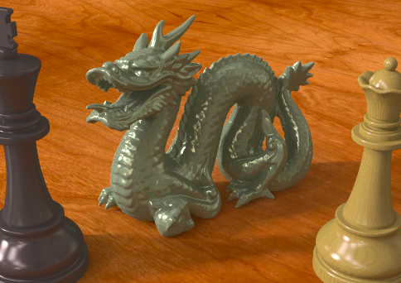
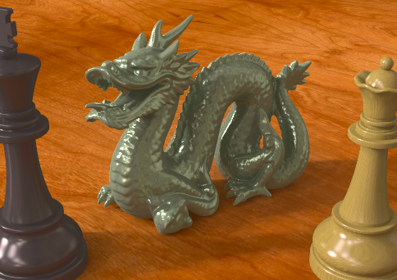
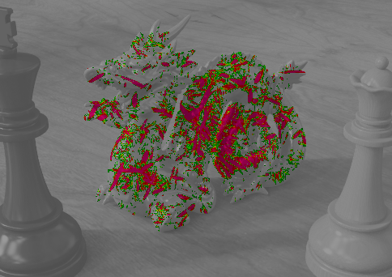
Related work – Visual equivalence
Visually equivalent =
Same scene appearance
Visibly different
Foundation of our work
Apply visual equivalence to VPL rendering
reference
warped illumination
visible differences
Notes:
In this work, they define two images to be visually equivalent if they convey the same scene appearance, in spite of having visible differences.
We use the concept of visual equivalence as the foundation of our work, and we apply it to the specific problem of studying visual fidelity in VPL rendering.

Slide 7
Related work – VPL rendering
Based on Instant Radiosity [Keller 1997]
Approximate indirect illumination by
Virtual Point Lights (VPLs)
Generate VPLs
Render with VPLs
Notes:
The VPL rendering, as I said, is derived from the instant radiosity algorithm proposed by Keller.
The idea here is to approximate indirect illumination by a number so called Virtual Point Lights, or VPLs.
In the first step, the VPLs are created on scene surfaces and in the second step, the image is rendered by summing contributions from all the VPLs.

Slide 8
Related work – VPL rendering
Interactive GI (≈ 1,000 VPLs) [Wald et al. 02; Segovia et al. 07; Laine et al. 07; Ritschel et al. 08; Dong et al. 09; Yu et al. 09 ; …]
Preview-quality (≈ 100,000 VPLs) [Hašan et al. 07/09]
High-quality ( > 1,000,000 VPLs) [Walter et al. 05/06]
Notes:
We can categorize the previous work on VPL rendering by the number of VPLs used.
Most of the previous work falls into the category Interactive GI, where a limited number of VPLs is used to achieve efficiency.
But VPL methods aiming at higher image quality have also been proposed. The challenge here is to make the algorithms scalable with the higher number of VPLs necessary to achieve the image quality goals.

Slide 9
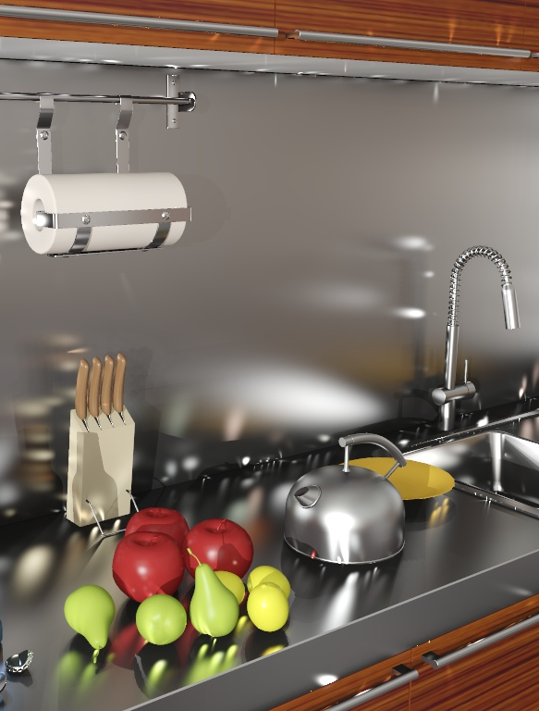
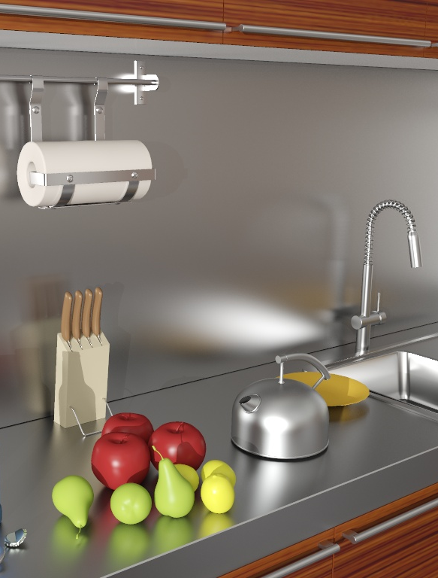
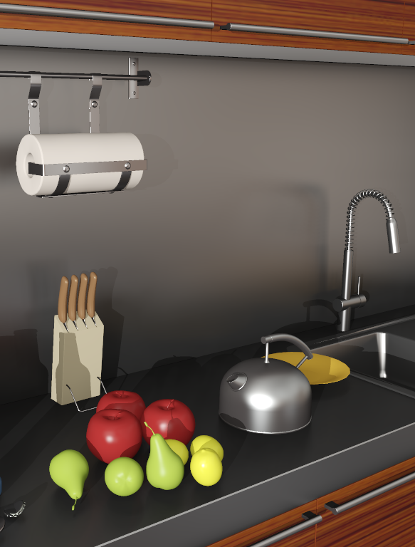
VPL rendering is fast, but…
VPL
GI reference
VPLs w/ clamping
artifacts
material change
Notes:
Alright, so VPL rendering is fast, so what is the problem?
The problem is that the VPL methods can produce disturbing artifact in the form of light splotches, especially on glossy surfaces.
The usual way of dealing with the artifacts is so called clamping, where we clamp away the offending energy. But this selective energy removal can severely change material appearance, as you can seen in the image on the right, where the counter-top looks dark and diffuse, instead of having the shiny metallic appearance seen in the reference rendering.

Slide 10
VPLs for high-fidelity rendering
Q: When do VPL methods produce high-fidelity renderings?
A: Systematic perceptual study
trade-offs : VPL parameters vs. visual fidelity
Notes:
So the question that we’re asking is “When do VPL methods produce hi-fi renderings?”
To answer this question, ran a systematic perceptual study where we investigate the trade offs between VPL parameters and visual fidelity.

Slide 11
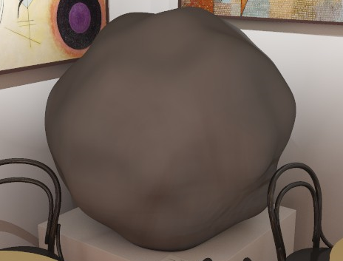
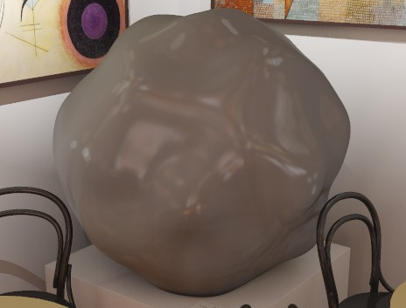
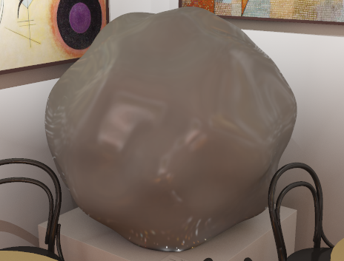
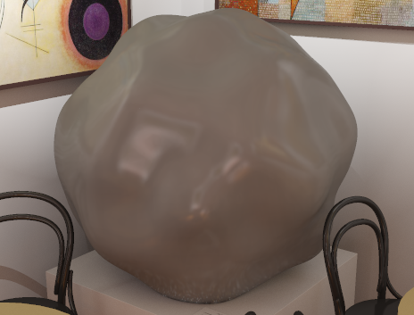
VPL Rendering Parameters
VPL rendering parameters
VPL count
clamping level
visible artifacts
material change
clamping level
visible artifacts
VPL count
slow rendering
Notes:
Let’s now have a closer look at the VPL rendering parameters.
The first important parameter is the VPL count, that gives us a trade-off between image quality and rendering efficiency: with low VPL count, rendering is fast but we can see artifacts, and as we increase the VPL count, the artifacts go away, but the rendering is slower.
There’s another way of dealing with the artifacts---it’s the clamping that I mentioned earlier. The clamping level provides us with a trade-off between visible artifacts and material appearance accuracy. That is to say, with low clamping level, there will be artifacts. As the clamping level increases, which means that we remove more and more light energy, the artifacts go away, but we are losing glossy reflections, therefore the material appearance changes.

Slide 12
VPL Rendering Parameters
material change
VPL rendering parameters
VPL count
clamping level
clamping level
visible artifacts
visible artifacts
VPL count
slow rendering

Slide 13
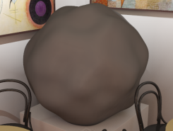
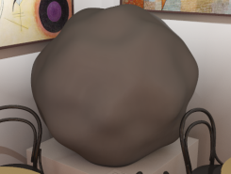
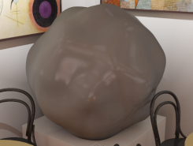
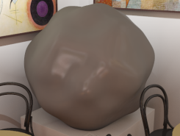
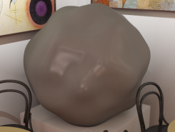
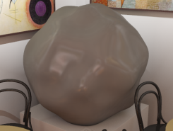
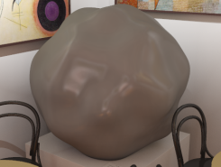
Space of rendering parameters
Material change
Material change thr.
clamping level
…
…
…
…
VISUALLY
EQUIVALENT
Artifacts
Artifact visibility thr.
VPL count
Notes:
So we’ve go a space of VPL rendering parameters, where each point corresponds to a different VPL rendering of a given scene. Let’s get oriented in this space.
For any given VPL count, if there’s not enough clamping, there will be visible artifacts. It turns out that as the VPL count increases, the clamping level necessary to get rid of the artifacts goes down. So we can draw a curve, the artifact visibility threshold, that divides the space into two halves, one where the images have artifacts and the other where the images are artifact free.
Similarly, when the clamping level is too high, the material appearance changes. So we can draw a second curve, the material change threshold, that separates the images with and without material change.
Between these two thresholds is the area, shown in green, of images that are artifact-free and where the material looks the same as in the reference. This is the area of visual equivalence where the VPL technique can be used for high fidelity rendering. We believe that this is a meaningful definition of visual fidelity in application such as virtual prototyping, where accurate material appearance is critical.

Slide 14
Psychophysical experiments
How are the thresholds affected by
shape complexity?
material?
illumination?
Outline
Experiment design
Results & validation
Applications
clamping level
VPL count
Notes:
The goal of our psychophysical experiments is to investigate how the thresholds, and consequently visual equivalence, are affected by shape complexity, material, and illumination.
In the rest of the talk, I will first describe our experimental design, then I’ll discuss the experiment results and their validation, and show some applications.

Slide 15
Test objects – Shape complexity
Same as [Ramanarayanan et al. 07]
G0 ... sphere
G1-G3 ... bumpy spherical objects
Notes:
Let’s start the experiment design with the description of our test objects.
To investigate trends of visual equivalence with shape complexity, we use four shapes: G0 is a sphere; and G1-G3 are spherical objects of increasing bumpiness.

Slide 16
Test objects – Materials
Metal
Smooth
Metal
Rough
Dielectric
Black
Smooth
Dielectric
Black
Rough
Dielectric
Gray
Smooth
Ward-Dür BRDF:
ρ_{s}
α
ρ_{d}
Notes:
We included five different materials represented by the Ward-Duer BRDF model.

Slide 17
Test objects – Materials
Metal
Smooth
Metal
Rough
Dielectric
Black
Smooth
Dielectric
Black
Rough
Dielectric
Gray
Smooth
ρ_{s}
0.22
0.033
Ward-Dür BRDF:
specular reflectivity
ρ_{s}
α
ρ_{d}
17
Notes:
We have two metals with high specular reflectivity, and three dielectrics with low specular reflectivity.

Slide 18
Test objects – Materials
Metal
Smooth
Metal
Rough
Dielectric
Black
Smooth
Dielectric
Black
Rough
Dielectric
Gray
Smooth
α
0.05
0.15
ρ_{s}
0.22
0.033
Ward-Dür BRDF:
surface roughness
ρ_{s}
α
ρ_{d}
Notes:
Within each of these categories, we have two different values of surface roughness, corresponding to smooth and rough materials.

Slide 19
Test objects – Materials
Metal
Smooth
Metal
Rough
Dielectric
Black
Smooth
Dielectric
Black
Rough
Dielectric
Gray
Smooth
ρ_{d}
0.03
0.19
α
0.05
0.05
0.15
0.15
ρ_{s}
0.22
0.033
Ward-Dür BRDF:
diffuse reflectivity
ρ_{s}
α
ρ_{d}
Notes:
We also included two different values of diffuse reflectivity for the dielectrics, corresponding to black and gray colors.

Slide 20
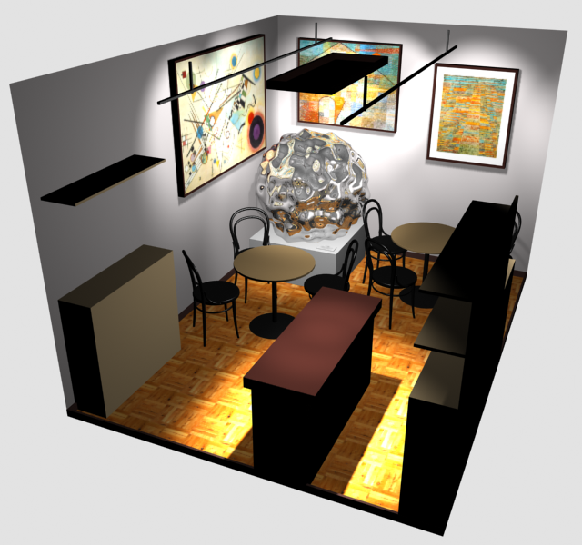
Scene
Art gallery café
Studied object on a pedestal
Notes:
For rendering, we included the test objects in a simple scene of an art-gallery café, shown here.

Slide 21
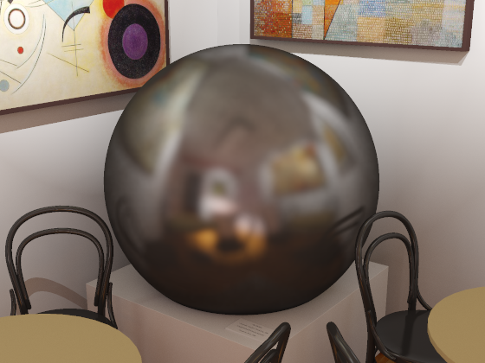
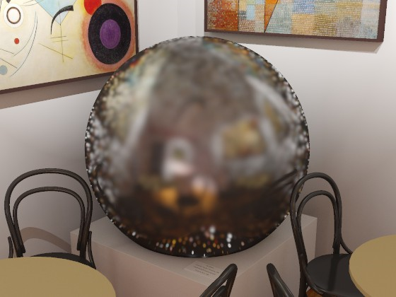
Stimulus images
Different VPL rendering parameters
3 VPL counts
11 clamping levels
clamping level
VPL count
Notes:
To render the stimulus images, we discretize the space of VPL rendering parameters. Each point in this discrete space corresponds to one stimulus image.

Slide 22
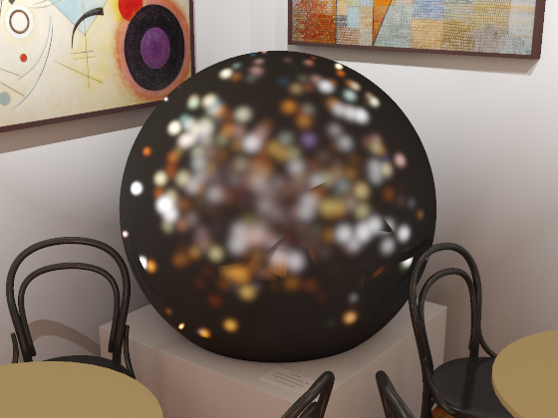
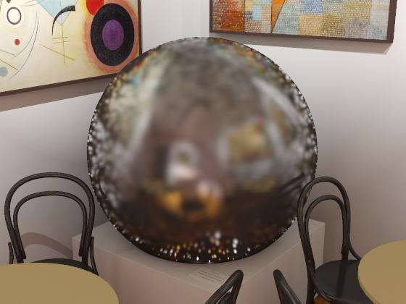
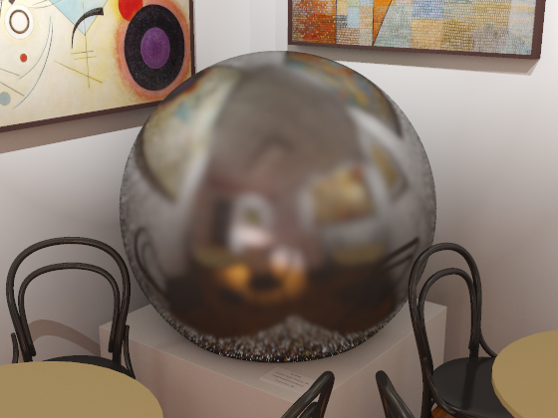
Stimulus images –VPL count
1,000 (1k)
100,000 (100k)
5,000,000 (5M)
Interactive rendering
Preview-quality
rendering
High-quality rendering
Notes:
We use three different VPL counts, 1,000 VPL corresponding to interactive rendering, 100,000 VPL corresponding to preview quality rendering, and finally, 5 million VPLs for high-quality rendering.

Slide 23
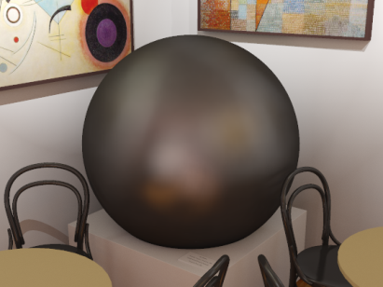
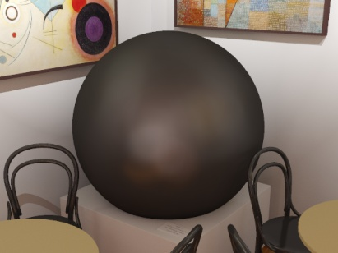
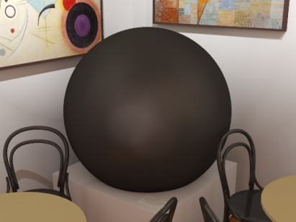
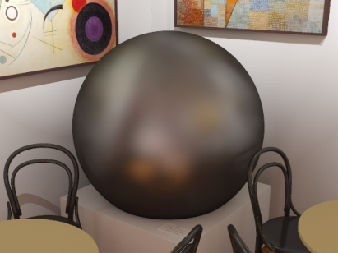
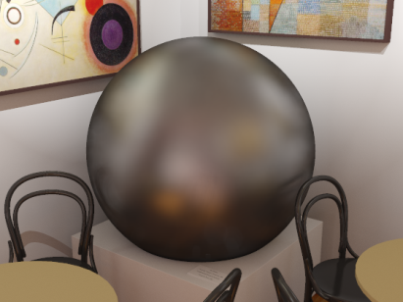
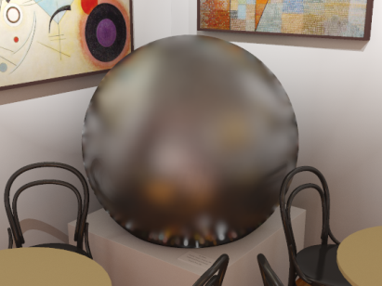
Stimulus images – Clamping level
C8
C9
C10
C7
C6
C5
11 levels from none to severe (C0 – C10)
C4
C3
C2
C1
C0
Notes:
We use fine sampling along the clamping level axis, from C0 corresponding to no clamping, to C10, corresponding to severe clamping.

Slide 24
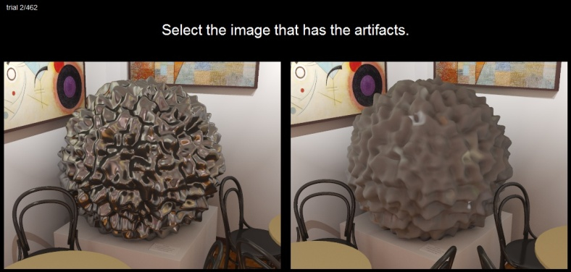
Experiment 1: Artifact visibility
Select the image that
has the artifacts.
Standard two-alternative forced choice method
480 trials, 12 participants
Artifact visibility
clamping level
VPL count
Notes:
So now we’ve defined the stimulus images. The next step are the perceptual experiments themselves.
In the first experiment, the goal is to identify the parameter combinations that produce visible artifacts.
For each trial, we display two images: One is a path traced reference (with no artifacts) and the other VPL rendering (possibly with artifacts).
The subjects are asked to select the image that has the artifacts.

Slide 25
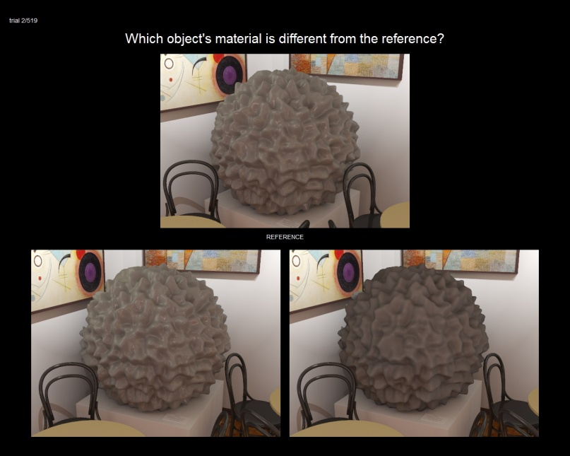
Experiment 2: Material change
Which object’s material is different from the reference?
Standard two-alternative forced choice method
520 trials, 14 participants
Material change
Reference
clamping level
VPL count
Notes:
Similarly in the Material change experiment, the goal is to identify the parameter combination that produce material changes.
In each trial, we show the “reference” on the top. At the bottom, there is a pair of images, one of them path traced and the second rendered with VPLs. We ask the subjects to select which of the two objects at the bottom has different material from the reference on the top.

Slide 26
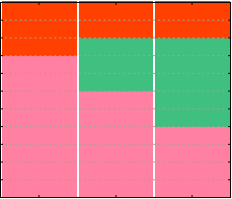
Data analysis
Extract thresholds from subjects’ answers
Standard 75% 2 AFC threshold criterion
Material change
C10
C9
C8
C7
C6
VISUALLY EQUIVALENT
clamping level
C5
C4
C3
C2
C1
C0
Visible artifacts
1k
100k
5M
VPL count
26
Notes:
After the experiments, we use the 75% threshold criterion to aggregate the subjects’ answers.
We organize the results in a graph similar to the one shown here, that shows which images have visible artifacts, which have material changes and which are visually equivalent to reference renderings, that is to say, they are artifact-free and the material looks the same as in the reference.
We have one such graph for each test object.

Slide 27
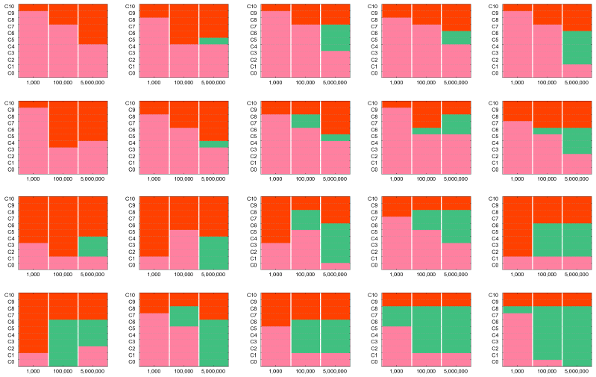
Experiment results
C10
C10
C10
C10
C10
C9
C9
C9
C9
C9
C8
C8
C8
C8
C8
C7
C7
C7
C7
C7
C6
C6
C6
C6
C6
C5
C5
C5
C5
C5
C4
C4
C4
C4
C4
C3
C3
C3
C3
C3
C2
C2
C2
C2
C2
C1
C1
C1
C1
C1
C0
1k
100k
5M
C0
1k
100k
5M
C0
1k
100k
5M
C0
1k
100k
5M
C0
1k
100k
5M
C10
C10
C10
C10
C10
C9
C9
C9
C9
C9
C8
C8
C8
C8
C8
C7
C7
C7
C7
C7
C6
C6
C6
C6
C6
C5
C5
C5
C5
C5
C4
C4
C4
C4
C4
C3
C3
C3
C3
C3
C2
C2
C2
C2
C2
C1
C1
C1
C1
C1
C0
1k
100k
5M
C0
1k
100k
5M
C0
1k
100k
5M
C0
1k
100k
5M
C0
1k
100k
5M
C10
C10
C10
C10
C10
C9
C9
C9
C9
C9
C8
C8
C8
C8
C8
C7
C7
C7
C7
C7
C6
C6
C6
C6
C6
C5
C5
C5
C5
C5
C4
C4
C4
C4
C4
C3
C3
C3
C3
C3
C2
C2
C2
C2
C2
C1
C1
C1
C1
C1
C0
1k
100k
5M
C0
1k
100k
5M
C0
1k
100k
5M
C0
1k
100k
5M
C0
1k
100k
5M
C10
C10
C10
C10
C10
C9
C9
C9
C9
C9
C8
C8
C8
C8
C8
C7
C7
C7
C7
C7
C6
C6
C6
C6
C6
C5
C5
C5
C5
C5
C4
C4
C4
C4
C4
C3
C3
C3
C3
C3
C2
C2
C2
C2
C2
C1
C1
C1
C1
C1
C0
1k
100k
5M
C0
1k
100k
5M
C0
1k
100k
5M
C0
1k
100k
5M
C0
1k
100k
5M
Notes:
To investigate the trends in the data, we organize the individual graphs in a larger matrix, where material changes along the horizontal axis and the shape changes along the vertical.

Slide 28
Trends – VPL count
C10
C10
C10
C10
C10
C9
C9
C9
C9
C9
C8
C8
C8
C8
C8
C7
C7
C7
C7
C7
C6
C6
C6
C6
C6
C5
C5
C5
C5
C5
C4
C4
C4
C4
C4
C3
C3
C3
C3
C3
C2
C2
C2
C2
C2
C1
C1
C1
C1
C1
C0
1k
100k
5M
C0
1k
100k
5M
C0
1k
100k
5M
C0
1k
100k
5M
C0
1k
100k
5M
C10
C10
C10
C10
C10
C9
C9
C9
C9
C9
C8
C8
C8
C8
C8
C7
C7
C7
C7
C7
C6
C6
C6
C6
C6
C5
C5
C5
C5
C5
C4
C4
C4
C4
C4
C3
C3
C3
C3
C3
C2
C2
C2
C2
C2
C1
C1
C1
C1
C1
C0
1k
100k
5M
C0
1k
100k
5M
C0
1k
100k
5M
C0
1k
100k
5M
C0
1k
100k
5M
C10
C10
C10
C10
C10
C9
C9
C9
C9
C9
C8
C8
C8
C8
C8
C7
C7
C7
C7
C7
C6
C6
C6
C6
C6
C5
C5
C5
C5
C5
C4
C4
C4
C4
C4
C3
C3
C3
C3
C3
C2
C2
C2
C2
C2
C1
C1
C1
C1
C1
C0
1k
100k
5M
C0
1k
100k
5M
C0
1k
100k
5M
C0
1k
100k
5M
C0
1k
100k
5M
C10
C10
C10
C10
C10
C9
C9
C9
C9
C9
C8
C8
C8
C8
C8
C7
C7
C7
C7
C7
C6
C6
C6
C6
C6
C5
C5
C5
C5
C5
C4
C4
C4
C4
C4
C3
C3
C3
C3
C3
C2
C2
C2
C2
C2
C1
C1
C1
C1
C1
C0
1k
100k
5M
C0
1k
100k
5M
C0
1k
100k
5M
C0
1k
100k
5M
C0
1k
100k
5M
Notes:
First, we investigate the trend of equivalence with the number of VPLs.
To do that, we look at each of the graphs independently and we observe what’s going on with the green area as we move from left to right.
And we can see that there’s a trend of increasing equivalence with increasing number of VPLs.
This is not surprising, it’s just a verification of common knowledge.

Slide 29
Trends – VPL count
1k VPLs
C10
C10
C10
C10
C10
C9
C9
C9
C9
C9
C8
C8
C8
C8
C8
C7
C7
C7
C7
C7
C6
C6
C6
C6
C6
C5
C5
C5
C5
C5
C4
C4
C4
C4
C4
C3
C3
C3
C3
C3
C2
C2
C2
C2
C2
C1
C1
C1
C1
C1
C0
1k
100k
5M
C0
1k
100k
5M
C0
1k
100k
5M
C0
1k
100k
5M
C0
1k
100k
5M
C10
C10
C10
C10
C10
C9
C9
C9
C9
C9
C8
C8
C8
C8
C8
C7
C7
C7
C7
C7
C6
C6
C6
C6
C6
C5
C5
C5
C5
C5
C4
C4
C4
C4
C4
C3
C3
C3
C3
C3
C2
C2
C2
C2
C2
C1
C1
C1
C1
C1
C0
1k
100k
5M
C0
1k
100k
5M
C0
1k
100k
5M
C0
1k
100k
5M
C0
1k
100k
5M
C10
C10
C10
C10
C10
C9
C9
C9
C9
C9
C8
C8
C8
C8
C8
C7
C7
C7
C7
C7
C6
C6
C6
C6
C6
C5
C5
C5
C5
C5
C4
C4
C4
C4
C4
C3
C3
C3
C3
C3
C2
C2
C2
C2
C2
C1
C1
C1
C1
C1
C0
1k
100k
5M
C0
1k
100k
5M
C0
1k
100k
5M
C0
1k
100k
5M
C0
1k
100k
5M
C10
C10
C10
C10
C10
C9
C9
C9
C9
C9
C8
C8
C8
C8
C8
C7
C7
C7
C7
C7
C6
C6
C6
C6
C6
C5
C5
C5
C5
C5
C4
C4
C4
C4
C4
C3
C3
C3
C3
C3
C2
C2
C2
C2
C2
C1
C1
C1
C1
C1
C0
1k
100k
5M
C0
1k
100k
5M
C0
1k
100k
5M
C0
1k
100k
5M
C0
1k
100k
5M
Notes:
But what’s more interesting is to look at the existence of equivalence for the individual VPL counts that we studied.

Slide 30
Trends – VPL count
1k
VPLs
… mostly insufficient
C10
C10
C10
C10
C10
C9
C9
C9
C9
C9
C8
C8
C8
C8
C8
C7
C7
C7
C7
C7
C6
C6
C6
C6
C6
C5
C5
C5
C5
C5
C4
C4
C4
C4
C4
C3
C3
C3
C3
C3
C2
C2
C2
C2
C2
C1
C1
C1
C1
C1
C0
1k
100k
5M
C0
1k
100k
5M
C0
1k
100k
5M
C0
1k
100k
5M
C0
1k
100k
5M
C10
C10
C10
C10
C10
C9
C9
C9
C9
C9
C8
C8
C8
C8
C8
C7
C7
C7
C7
C7
C6
C6
C6
C6
C6
C5
C5
C5
C5
C5
C4
C4
C4
C4
C4
C3
C3
C3
C3
C3
C2
C2
C2
C2
C2
C1
C1
C1
C1
C1
C0
1k
100k
5M
C0
1k
100k
5M
C0
1k
100k
5M
C0
1k
100k
5M
C0
1k
100k
5M
C10
C10
C10
C10
C10
C9
C9
C9
C9
C9
C8
C8
C8
C8
C8
C7
C7
C7
C7
C7
C6
C6
C6
C6
C6
C5
C5
C5
C5
C5
C4
C4
C4
C4
C4
C3
C3
C3
C3
C3
C2
C2
C2
C2
C2
C1
C1
C1
C1
C1
C0
1k
100k
5M
C0
1k
100k
5M
C0
1k
100k
5M
C0
1k
100k
5M
C0
1k
100k
5M
C10
C10
C10
C10
C10
C9
C9
C9
C9
C9
C8
C8
C8
C8
C8
C7
C7
C7
C7
C7
C6
C6
C6
C6
C6
C5
C5
C5
C5
C5
C4
C4
C4
C4
C4
C3
C3
C3
C3
C3
C2
C2
C2
C2
C2
C1
C1
C1
C1
C1
C0
1k
100k
5M
C0
1k
100k
5M
C0
1k
100k
5M
C0
1k
100k
5M
C0
1k
100k
5M
Notes:
We can see that one thousand VPLs, which is roughly the number used in VPL-based interactive algorithms, was insufficient to yield equivalence in most of the cases that we studied.

Slide 31
Trends – VPL count
100k
VPLs
C10
C10
C10
C10
C10
C9
C9
C9
C9
C9
C8
C8
C8
C8
C8
C7
C7
C7
C7
C7
C6
C6
C6
C6
C6
C5
C5
C5
C5
C5
C4
C4
C4
C4
C4
C3
C3
C3
C3
C3
C2
C2
C2
C2
C2
C1
C1
C1
C1
C1
C0
1k
100k
5M
C0
1k
100k
5M
C0
1k
100k
5M
C0
1k
100k
5M
C0
1k
100k
5M
C10
C10
C10
C10
C10
C9
C9
C9
C9
C9
C8
C8
C8
C8
C8
C7
C7
C7
C7
C7
C6
C6
C6
C6
C6
C5
C5
C5
C5
C5
C4
C4
C4
C4
C4
C3
C3
C3
C3
C3
C2
C2
C2
C2
C2
C1
C1
C1
C1
C1
C0
1k
100k
5M
C0
1k
100k
5M
C0
1k
100k
5M
C0
1k
100k
5M
C0
1k
100k
5M
C10
C10
C10
C10
C10
C9
C9
C9
C9
C9
C8
C8
C8
C8
C8
C7
C7
C7
C7
C7
C6
C6
C6
C6
C6
C5
C5
C5
C5
C5
C4
C4
C4
C4
C4
C3
C3
C3
C3
C3
C2
C2
C2
C2
C2
C1
C1
C1
C1
C1
C0
1k
100k
5M
C0
1k
100k
5M
C0
1k
100k
5M
C0
1k
100k
5M
C0
1k
100k
5M
C10
C10
C10
C10
C10
C9
C9
C9
C9
C9
C8
C8
C8
C8
C8
C7
C7
C7
C7
C7
C6
C6
C6
C6
C6
C5
C5
C5
C5
C5
C4
C4
C4
C4
C4
C3
C3
C3
C3
C3
C2
C2
C2
C2
C2
C1
C1
C1
C1
C1
C0
1k
100k
5M
C0
1k
100k
5M
C0
1k
100k
5M
C0
1k
100k
5M
C0
1k
100k
5M
Notes:
As we increase the number of VPLs, more equivalence exists.

Slide 32
Trends – VPL count
5M
VPLs
C10
C10
C10
C10
C10
C9
C9
C9
C9
C9
C8
C8
C8
C8
C8
C7
C7
C7
C7
C7
C6
C6
C6
C6
C6
C5
C5
C5
C5
C5
C4
C4
C4
C4
C4
C3
C3
C3
C3
C3
C2
C2
C2
C2
C2
C1
C1
C1
C1
C1
C0
1k
100k
5M
C0
1k
100k
5M
C0
1k
100k
5M
C0
1k
100k
5M
C0
1k
100k
5M
C10
C10
C10
C10
C10
C9
C9
C9
C9
C9
C8
C8
C8
C8
C8
C7
C7
C7
C7
C7
C6
C6
C6
C6
C6
C5
C5
C5
C5
C5
C4
C4
C4
C4
C4
C3
C3
C3
C3
C3
C2
C2
C2
C2
C2
C1
C1
C1
C1
C1
C0
1k
100k
5M
C0
1k
100k
5M
C0
1k
100k
5M
C0
1k
100k
5M
C0
1k
100k
5M
C10
C10
C10
C10
C10
C9
C9
C9
C9
C9
C8
C8
C8
C8
C8
C7
C7
C7
C7
C7
C6
C6
C6
C6
C6
C5
C5
C5
C5
C5
C4
C4
C4
C4
C4
C3
C3
C3
C3
C3
C2
C2
C2
C2
C2
C1
C1
C1
C1
C1
C0
1k
100k
5M
C0
1k
100k
5M
C0
1k
100k
5M
C0
1k
100k
5M
C0
1k
100k
5M
C10
C10
C10
C10
C10
C9
C9
C9
C9
C9
C8
C8
C8
C8
C8
C7
C7
C7
C7
C7
C6
C6
C6
C6
C6
C5
C5
C5
C5
C5
C4
C4
C4
C4
C4
C3
C3
C3
C3
C3
C2
C2
C2
C2
C2
C1
C1
C1
C1
C1
C0
1k
100k
5M
C0
1k
100k
5M
C0
1k
100k
5M
C0
1k
100k
5M
C0
1k
100k
5M
Notes:
And by the time we get to 5M VPLs, equivalence can be found for most of the cases that we studied.
So we can conclude that VPL rendering is able to produce images that are visually equivalent to reference renderings for a wide range of scene settings … but only with a very large # of VPLs.
It is also important to point out that even with this extremely large VPL count, we are not able to achieve equivalence for the case of smooth metal object of low shape complexity, which are quite common in industrial design.

Slide 33
Trends – Material contrast gloss
ρ_{s}
∫
ρ_{d}
contrast gloss:
⟩
C10
C10
C10
C10
C10
C9
C9
C9
C9
C9
C8
C8
C8
C8
C8
C7
C7
C7
C7
C7
C6
C6
C6
C6
C6
C5
C5
C5
C5
C5
C4
C4
C4
C4
C4
C3
C3
C3
C3
C3
C2
C2
C2
C2
C2
C1
C1
C1
C1
C1
C0
1k
100k
5M
C0
1k
100k
5M
C0
1k
100k
5M
C0
1k
100k
5M
C0
1k
100k
5M
C10
C10
C10
C10
C10
C9
C9
C9
C9
C9
C8
C8
C8
C8
C8
C7
C7
C7
C7
C7
C6
C6
C6
C6
C6
C5
C5
C5
C5
C5
C4
C4
C4
C4
C4
C3
C3
C3
C3
C3
C2
C2
C2
C2
C2
C1
C1
C1
C1
C1
C0
1k
100k
5M
C0
1k
100k
5M
C0
1k
100k
5M
C0
1k
100k
5M
C0
1k
100k
5M
C10
C10
C10
C10
C10
C9
C9
C9
C9
C9
C8
C8
C8
C8
C8
C7
C7
C7
C7
C7
C6
C6
C6
C6
C6
C5
C5
C5
C5
C5
C4
C4
C4
C4
C4
C3
C3
C3
C3
C3
C2
C2
C2
C2
C2
C1
C1
C1
C1
C1
C0
1k
100k
5M
C0
1k
100k
5M
C0
1k
100k
5M
C0
1k
100k
5M
C0
1k
100k
5M
C10
C10
C10
C10
C10
C9
C9
C9
C9
C9
C8
C8
C8
C8
C8
C7
C7
C7
C7
C7
C6
C6
C6
C6
C6
C5
C5
C5
C5
C5
C4
C4
C4
C4
C4
C3
C3
C3
C3
C3
C2
C2
C2
C2
C2
C1
C1
C1
C1
C1
C0
1k
100k
5M
C0
1k
100k
5M
C0
1k
100k
5M
C0
1k
100k
5M
C0
1k
100k
5M
lower contrast gloss → greater equivalence
Notes:
Next, we investigate the trend of equivalence along the contrast gloss axis.
Contrast gloss is just a fancy name for the contrast of the image reflected on an object’s surface. This perceptual material attribute decreases with decreasing specular reflectivity, rho_s, or with increasing diffuse reflectivity, rho_d.
As you can see in the data, there’s a trend of increasing equivalence with decreasing contrast gloss.

Slide 34
Trends – Shape complexity
complex shape → greater equivalence
C10
C10
C10
C10
C10
C9
C9
C9
C9
C9
C8
C8
C8
C8
C8
C7
C7
C7
C7
C7
C6
C6
C6
C6
C6
C5
C5
C5
C5
C5
C4
C4
C4
C4
C4
C3
C3
C3
C3
C3
C2
C2
C2
C2
C2
C1
C1
C1
C1
C1
C0
1k
100k
5M
C0
1k
100k
5M
C0
1k
100k
5M
C0
1k
100k
5M
C0
1k
100k
5M
C10
C10
C10
C10
C10
C9
C9
C9
C9
C9
C8
C8
C8
C8
C8
C7
C7
C7
C7
C7
C6
C6
C6
C6
C6
C5
C5
C5
C5
C5
C4
C4
C4
C4
C4
C3
C3
C3
C3
C3
C2
C2
C2
C2
C2
C1
C1
C1
C1
C1
C0
1k
100k
5M
C0
1k
100k
5M
C0
1k
100k
5M
C0
1k
100k
5M
C0
1k
100k
5M
C10
C10
C10
C10
C10
C9
C9
C9
C9
C9
C8
C8
C8
C8
C8
C7
C7
C7
C7
C7
C6
C6
C6
C6
C6
C5
C5
C5
C5
C5
C4
C4
C4
C4
C4
C3
C3
C3
C3
C3
C2
C2
C2
C2
C2
C1
C1
C1
C1
C1
C0
1k
100k
5M
C0
1k
100k
5M
C0
1k
100k
5M
C0
1k
100k
5M
C0
1k
100k
5M
C10
C10
C10
C10
C10
C9
C9
C9
C9
C9
C8
C8
C8
C8
C8
C7
C7
C7
C7
C7
C6
C6
C6
C6
C6
C5
C5
C5
C5
C5
C4
C4
C4
C4
C4
C3
C3
C3
C3
C3
C2
C2
C2
C2
C2
C1
C1
C1
C1
C1
C0
1k
100k
5M
C0
1k
100k
5M
C0
1k
100k
5M
C0
1k
100k
5M
C0
1k
100k
5M
Notes:
Next, we investigate the trend of equivalence along the shape complexity axis.
You can see in the two example columns highlighted here, that there is a trend of increasing equivalence with increasing shape complexity.

Slide 35
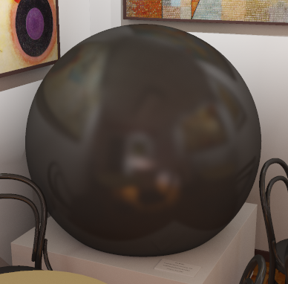
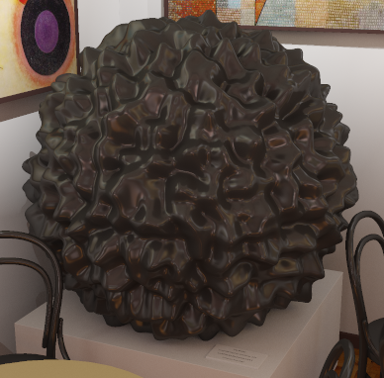
Trends – Shape complexity
artifacts
≡
C10
C10
C10
C10
C10
C9
C9
C9
C9
C9
C8
C8
C8
C8
C8
C7
C7
C7
C7
C7
C6
C6
C6
C6
C6
C5
C5
C5
C5
C5
C4
C4
C4
C4
C4
C3
C3
C3
C3
C3
C2
C2
C2
C2
C2
C1
C1
C1
C1
C1
C0
1k
100k
5M
C0
1k
100k
5M
C0
1k
100k
5M
C0
1k
100k
5M
C0
1k
100k
5M
reference
C10
VPLs
C10
C10
C10
C10
C9
C9
C9
C9
C9
C8
C8
C8
C8
C8
C7
C7
C7
artifacts
C6
C6
C6
C7
C7
C5
C5
C5
C6
C6
C4
C4
C4
C5
C5
C3
C3
C3
C4
C4
C2
C2
C2
C3
C3
C1
C1
C1
C2
C2
C0
C0
C0
C1
C1
1k
100k
5M
1k
100k
5M
1k
100k
5M
C0
1k
100k
5M
C0
1k
100k
5M
C10
C10
C10
C10
C10
C9
C9
C9
C9
C9
C8
C8
C8
C8
C8
C7
C7
C7
C7
C7
≡
C6
C6
C6
C6
C6
C5
C5
C5
C5
C5
C4
C4
C4
C4
C4
C3
C3
C3
C3
C3
C2
C2
C2
C2
C2
C1
C1
C1
C1
C1
C0
1k
100k
5M
C0
1k
100k
5M
C0
1k
100k
5M
C0
1k
100k
5M
C0
1k
100k
5M
C10
C10
C10
C10
C10
C9
C9
C9
C9
C9
C8
C8
C8
C8
C8
C7
C7
C7
C7
C7
C6
C6
C6
C6
C6
C5
C5
C5
C5
C5
C4
C4
C4
C4
C4
C3
C3
C3
C3
C3
C2
C2
C2
C2
C2
C1
C1
C1
C1
C1
reference
C0
1k
100k
5M
C0
1k
100k
5M
C0
1k
100k
5M
C0
1k
100k
5M
C0
1k
100k
5M
VPLs
Notes:
This is indeed a very strong trend as you can see in the example shown here, where the VPL rendering of the smooth sphere is full of visible artifacts, whereas the VPL rendering of the more complex object looks just fine, even though it’s rendered with exactly the same settings.

Slide 36
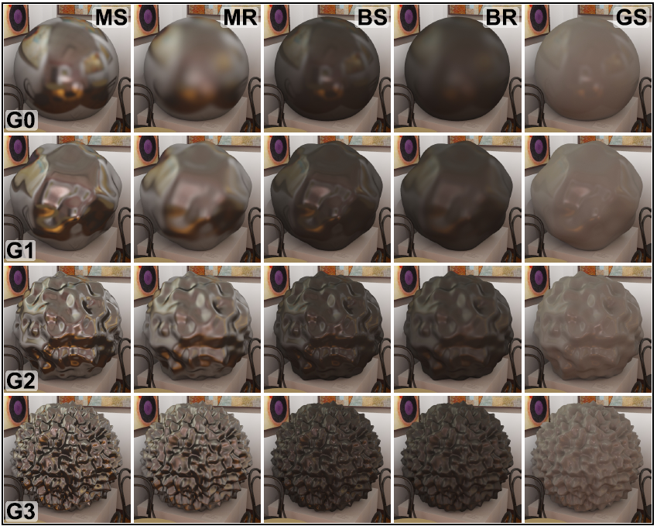
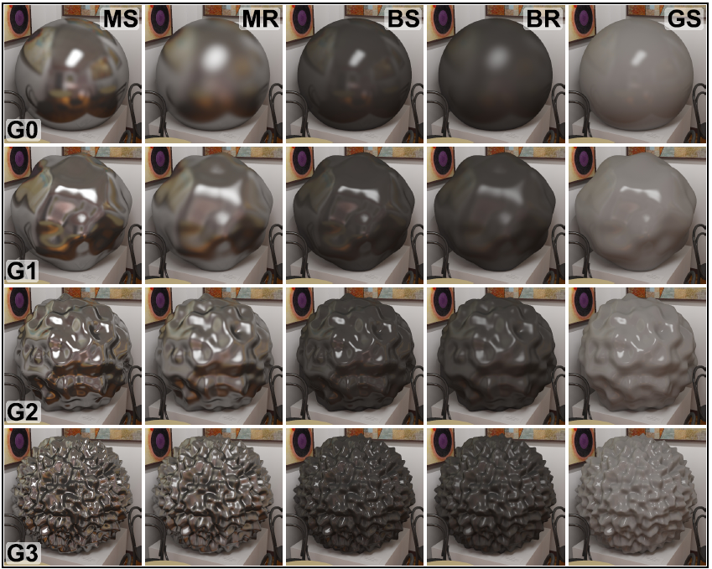
Trends – Illumination
Does accurate direct illumination help preserve material appearance?
No significant improvement measured
Further investigation needed
indirect-only
direct-and-indirect
Notes:
So far I’ve been showing the results for images where the test objects received only indirect illumination.
But we included in our experiments a full data set with direct illumination, which is computed accurately and does not suffer from the shortcoming of VPL rendering. The idea was that accurate highlights produced by direct illumination would serve as an additional material cue and therefore would help preserve the material appearance.
Quite interestingly, this didn’t seem to be the case in our results. This is a surprising finding that deserves further investigation.

Slide 37
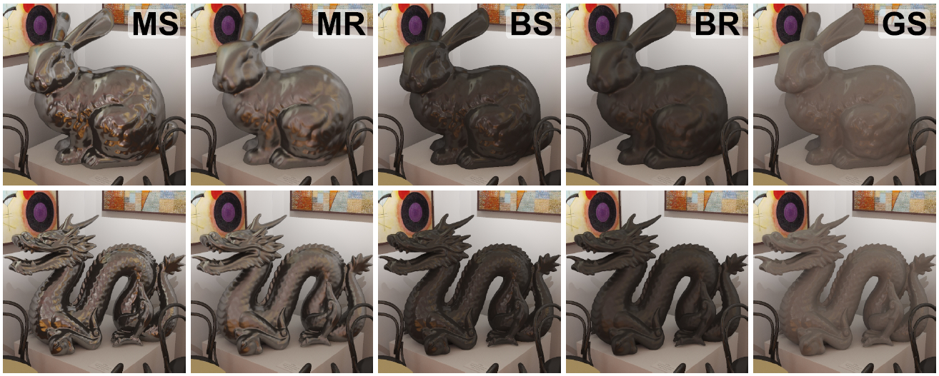
Validation
Real-world geometry
Trends confirmed
New material (diffuse)
Most forgiving material
Need more than 1k VPL to achieve equivalence
Notes:
Since we ran all our experiments with rather abstract shapes, we wanted to make sure the results generalize to real-word geometry.
We ran a validation study with the bunny and dragon geometries, and we were able to validate the trends of equivalence that we saw in the main experiment.
We also wanted to verify that our findings extrapolate beyond the materials used in the main experiment, so we included object with purely diffuse materials.
We validated that this was indeed the “most forgiving” material for VPL rendering.
But the interesting this here is that 1k VPLs still did not offer equivalence in most cases even with this simple material.

Slide 38
Applications
Per-object clamping
Luminance normalization
Notes:
We show two applications in the paper, but due to time limitations, I will only show one, where …

Slide 39
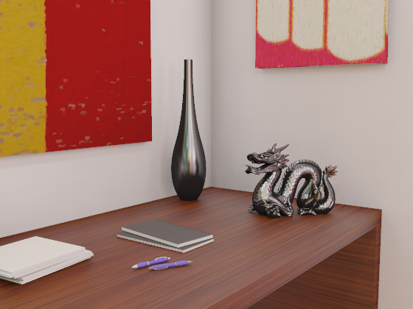
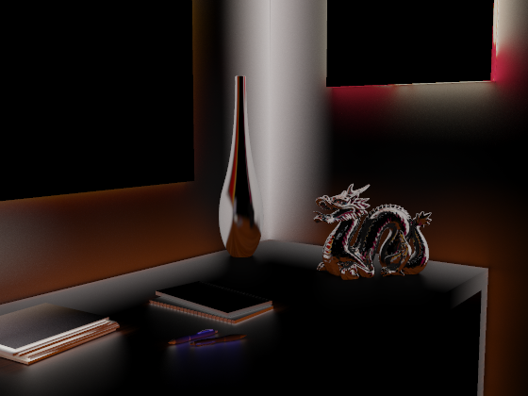
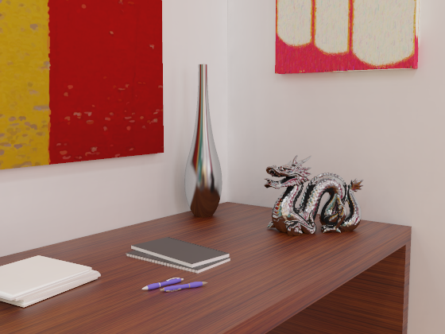
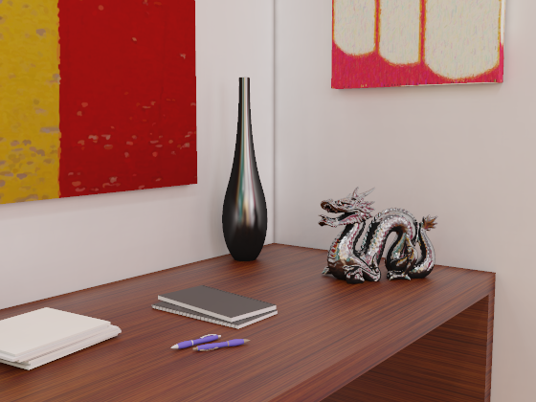
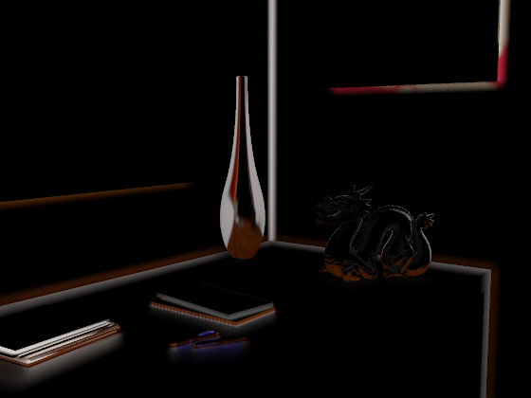
Application – Per-object clamping
Energy compensation [Kollig & Keller 04]
+
=
≡
clamping (VPL)
compensation (PT)
+
=
Less clamping for
diffuse & complex objects
→
Less work, 2x speedup
Notes:
…we use per-object clamping to accelerate the energy compensation algorithm of Kollig and Keller.
In this algorithm, they use selective path tracing to compensate for the energy loss in VPL rendering. But this compensation step is often a bottleneck of the entire approach.
But we can take advantage of our findings, that show that less clamping is possible for more diffuse or complex objects.
We change the algorithm to use minimum possible clamping for such objects, which decreases the amount of energy removed from the VPL rendering, and there’s less work left for the path traced compensation. We achieve 2x speedup while computing equivalent images.

Slide 40
Summary of results
Visual equivalence in space of VPL parameters
Trends in equivalence
VPL count
Shape complexity
Contrast gloss decrease
clamping level
VPL count
VPL count
Notes:
To summarize, in our experiments, we verified the expected location of equivalence in the space of VPL rendering parameters.
We identified and validated trends of increasing equivalence with VPL count, increasing shape complexity and with decreasing contrast gloss.

Slide 41
Conclusions
Adequacy of VPL methods for high fidelity rendering
Take-home messages
VPL methods produce equivalent renderings for a wide range of scene settings
1k VPLs used in interactive apps → no equivalence
Smooth metal & simple shape → no equivalence
Solid perceptual foundation for VPL methods
Notes:
The motivation for our study was to investigate the adequacy of VPL methods for high fidelity rendering. This is important because as the VPL methods are gaining more and more popularity, it is important to know which application they can be applied to.
There’s a number practical take-home messages:
First, the VPL methods can produce equivalent images for a wide range of scene settings, but only with a relatively large number of virtual lights.
Second, commonly used VPL settings are often insufficient to produce equivalent renderings.
And third, even with a very high number of VPLs, there is no equivalence for smooth metal objects of low shape complexity.
In conclusion, we believe that our work lays a solid perceptual foundation for the use of VPL methods in application where accurate material appearance is important.

Slide 42
Future work
Model for visual equivalence in VPL rendering
Effects of accurate direct illumination
Ambiguity between artifacts and highlights
Scalable & equivalent VPL methods
Notes:
In the future work, we would like to build a predictive model for visual equivalence in VPL rendering.
It would also be interesting to study the effects of accurate direct illumination on equivalence, particularly the ambiguity between artifacts and highlight that we could observe in some of the images.
And we’re continuing our effort on building scalable VPL methods that produce equivalent images.

Slide 43
Acknowledgements
Marie Curie Fellowship PIOF-GA-2008-221716
NSF CAREER 0644175
NSF CPA 0811680
Intel
Microsoft
Experiment participants

Slide 44
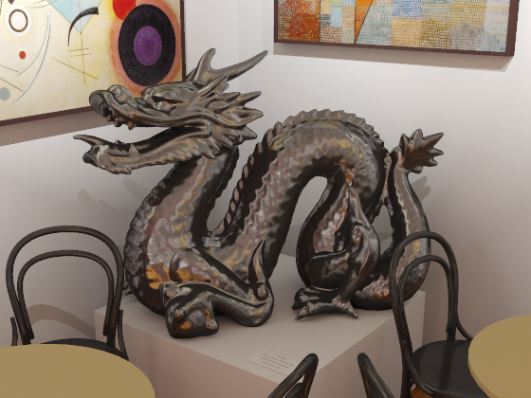
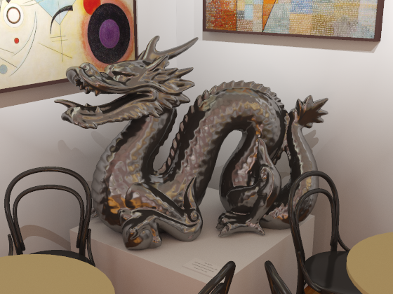
Thank you
≡

Slide 45
Additional Slides
Notes:
In this work we investigate through perceptual experiments how some approximations to GI affect image fidelity.

Slide 46
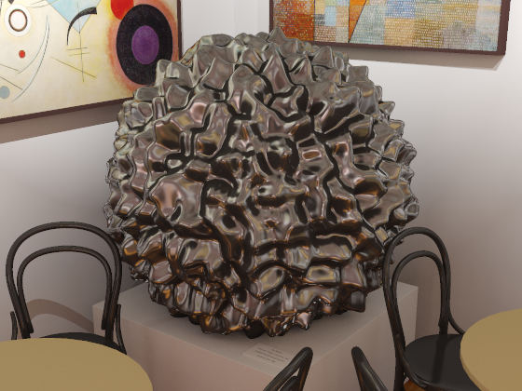
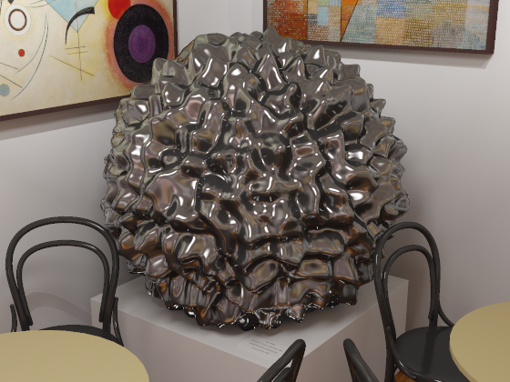
Ambiguity: highlights vs. artifacts
highlights or artifacts?
indirect-only
direct-and-indirect

Slide 47
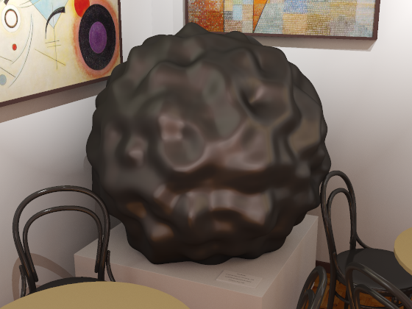
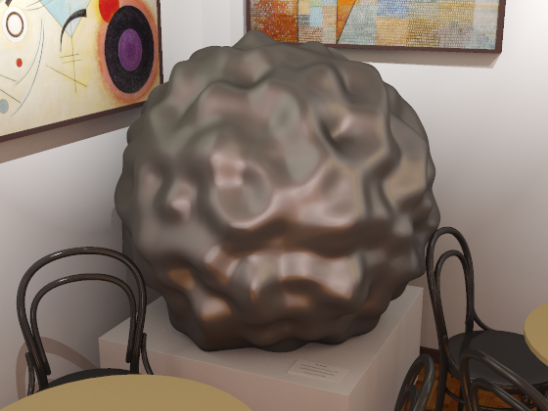
Apps: Luminance normalization
Re-introduce energy removed by clamping
clamped
normalized
match avg.
luminance
unclamped
Validation
Can increase equivalence

Slide 48
Apps: Luminance normalization
original
normalized
reference

Slide 49
Trends – Material roughness
rougher → greater equivalence

