Slide 1
Improving Performance and Accuracy of Local PCA
V. Gassenbauer, J. Křivánek, K. Bouatouch,
C. Bouville, M. Ribardière
University of Rennes 1, France, and
Charles University, Czech Republic
Notes:
Hi, good afternoon everyone.
My name is VG and I would like to present you our paper “Improving Performance and Accuracy of Local PCA”.

Slide 2
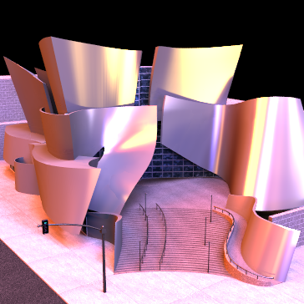
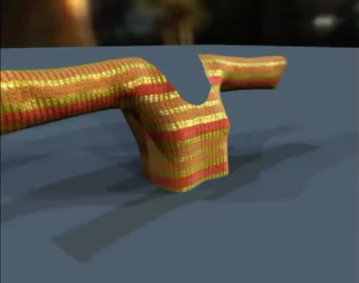
Objective
Precomputed Radiance Transfer (PRT)
Bidirectional Texture Function (BTF) compression
Image courtesy of Hongzhi Wu
Need to compress large data set
Notes:
In computer graphic we often encounter large data sets.
For example in the precomputed radiance transfer they are radiance transfer matrices.
Another example is when describing a spatially varying materials described using large image database of the materials.
Common to these approaches is that they need to compress large data sets.

Slide 3
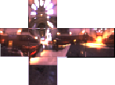
Precomputed Radiance Transfer
Relighting as a matrix-vector multiply
Matrix T(x,ω_{i}) - Billions of elements
Infeasible multiplication
Compression (wavelet, Local PCA)
Notes:
Let me briefly introduce PRT methods.
PRT refers to a group of methods used for interactive relighting of a scene allowing some changes in the scene.
For example having a dynamically changing environment map we could recompute lighting including GI effects on-the-fly.
In run-time such the algorithm take a vector of cubemap pixels L.
It multiplies it with a radiance transfer matrix T resulting in a vector of image pixels P.
This matrix is precomputed offline and describes the light propagation in the scene.
But the transfer matrix is generally very huge.
So to be able to work with we must compress the transfer matrix first.

Slide 4
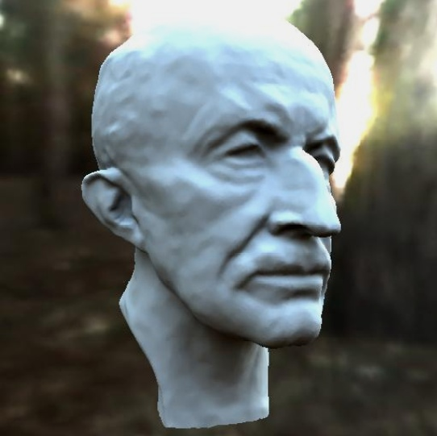
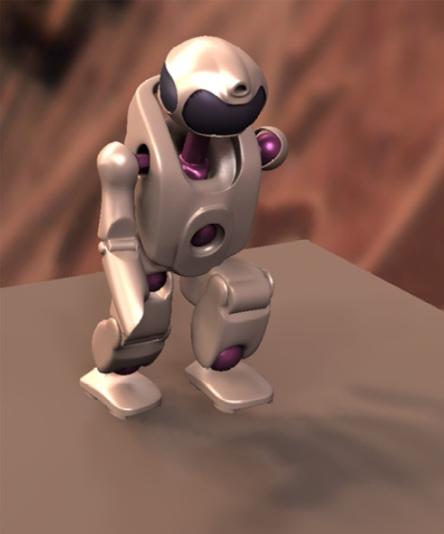
Related Work
Precomputation-based rendering
[Sloan et al. 02,03]
Low-freq shadows, inter-reflections
[Liu et al. 04],
[Huang et al. 10]
High-freq shadows, inter-reflections
[Xu et al. 08]
Dynamic scene, BRDF editing
Still use slow and inaccurate LPCA !
Notes:
One of the compression technique is Local Principal Component Analysis.
Sloan et al. were the first who use the LPCA algorithm for compression of low-frequency light transfer.
Later Liu et al. and Huang at el. also for all-frequency light transfer.
and Xu et al. use the LPCA for compression of visibility field.
Their application support even dynamic scenes and on-the-fly BRDF editing.
Well, PRT techniques have been progressively developed adding new features.
But they still use slow and inaccurate LPCA algorithm which is a bottleneck in practical applications.

Slide 5
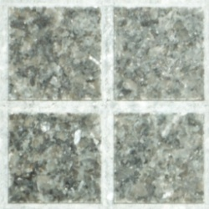
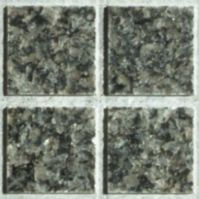
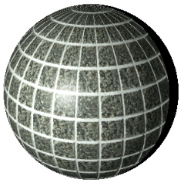
Related Work
BTF compression
[Müller et al. 03], [Filip et al. 09]
Simpler LPCA: k-means problem
Better performance
[Phillips 02], [Elkan 03], [Hamerly10]
Better accuracy
[Arthur et al. 07], [Kanugo et al. 02]
Notes:
LPCA is also commonly used for compression of Bidirectional Texture Function.
Aside from these applications of the LPCA in computer graphic, there are a lot of work dealing with k-means which is a simple variant of the LPCA.
A lot of papers have been devoted to accelerating the k-means clustering.
Also there are couple of papers dealing with improving accuracy of it.
We build on these works, especially on the work of Phillips and Arthur et al.,
and generalize them to be used even for the LPCA algorithm.

Slide 6
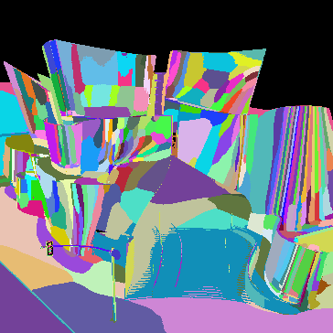
Compression Problem
Input
High-dimensional points (rows of T)
Number of clusters k
Output
Find k clusters – i.e.
low-dimensional subspaces
x₁₃
x₁₄
x₁₀₄
x₉₆₀
Notes:
Let me define the compression problem.
So we have a set of high-dimensional data points (or vectors).
And also we have a number of cluster k to which we want to classify our data.
The goal of the LPCA is to find k clusters represented by low-dimensional subspaces minimizing some error measure.
Intuitively, the LPCA finds rows with similar elements and approximate these rows in low-dimensional subspaces.

Slide 7
LPCA – The Algorithm
Guess k clusters (i.e. subs.)
Initialize by randomly selected centers
Generate seeds
Until converge
Repeat until convergence
Classification
Assign each point to the nearest cluster
Update PCA in the cluster
Update
Notes:
The original LPCA algorithm is very simple.
It starts by generating k clusters.
Then each point is assigned to the nearest cluster.
And after it update all the clusters fitting assigned data.
The last two steps are repeatedly performed until the desired number of iteration is reached
or until the point-cluster assignment changes.

Slide 8
Motivation
Inefficient
Generate seeds
For each point compute distance to all clusters a_{i}
Until converge
x
Classification
a_{k}
a₁
a₂
Update
Inaccurate
Prone to get stuck in a local optimum
Notes:
But there are serious bottlenecks with this simple LPCA algorithm.
First it is inefficient.
When classifying a data point x to the nearest cluster, distances to all clusters are computed.
Data point x is then assigned to such the cluster for which the distance is minimal.
Second problem is the accuracy.
And it is well known that LPCA is prone to stuck in a local optimum.

Slide 9
Our Contribution
Inefficient
Generate seeds
For each point compute distance to all clusters a_{i}
SortCluster LPCA (SC-LPCA)
Until converge
x
Classification
a_{k}
a₁
a₂
Update
Inaccurate
Prone to get stuck in a local optimum
SortMeans++
Notes:
To address the efficiency we propose a simple heuristic which allows us to eliminate some distance computations.
To address the inaccuracy we propose an algorithm that better initialize the LPCA algorithm.

Slide 10
Outline
Improving Performance
SortCluster-LPCA (SC-LPCA)
Improving Accuracy
SortMeans++
Results
Notes:
Now I describe, how do we improve performance of the Local PCA algorithm.

Slide 11
Accelerated k-means
∆-inequality [Phillips 02]
x
If d(c_{a},c_{b}) ≥ 2d(x,c_{a})
d(x,c_{a})
→ d(x,c_{b}) ≥ d(x,c_{a})
d(x,c_{b})
→ d(x,c_{b}) not necessary to compute !
c_{a}
d(c_{a},c_{b})
c_{b}
Notes:
Let’s start with a simpler k-means which is the LPCA with subspaces having dimension of zero.
Phillips proposes to use the triangle inequality to eliminate some distance calculations.
Let’s say we would like to decide if x is closer to a cluster ca or cb.
And also let’s say we already know the green distance and the blue distance which is the distance between the cluster centers.
Then according the ∆-inequality if the blue distance will be smaller than two times of the green distance,
then the red distance must be greater then the green one.
So then the computation of red distance could be avoided knowing that x is closer to ca.

Slide 12
How does it work ?
We know: potentially nearest cluster to x
We know: Distances of other cluster w.r.t. c_{a}
x
c_{a}
c_{b}
c_{c}
Compute d(x,c_{b})
Check d(c_{a},c_{b}) ≥ 2d(x,c_{a})
Compute d(x,c_{a})
c_{b} becomes a new nearest cluster
Check d(c_{a},c_{c}) ≥ d(x,c_{a})+d(x,c_{b})
Notes:
And here is how does it work in the whole algorithm.
The algorithm exploits the information gathered from the previous pass.
Well, we know the cluster to which the point x was assigned to – let’s say ca,
and we could precompute distances between ca and all the other clusters and keep them sorted w.r.t. ca.
When classifying the point x,
we first compute the green distance.
Then we check if x can be closer to cb using the ∆-inequality.
Yes – it can. So we compute the red distance.
But the red distance is lower than the green one so cb becomes the new nearest cluster.
Then again check if x can be closer to cc using the ∆-inequality.
No – it cannot. So we have already found the nearest cluster.
It is the cluster cb and stop the classification.

Slide 13
Our Contribution: From k-means to LPCA
k-means
LPCA
Piecewise
reconstruction
Piecewise reconstruction in
low-dimensional subspaces
d(x,a_{b})
x
x
d(x,c_{b})
d(x,a_{b})
d(x,c_{b})
a_{a}
dir(a_{b})
c_{a}
dir(a_{a})
a_{b}
d(c_{a},c_{b})
c_{b}
d(a_{a},a_{b})
Notes:
In the k-means algorithm all the clusters are represented by just their centroids,
while in the LPCA they are low-dimensional subspaces having origin and basis vectors.
More concretely in the k-means we measure distances between x and cluster centers,
while in the LPCA we measure the projected distances of x to subspaces.
Similarly we measure distances between cluster centers in k-means,
While in the LPCA they are distances between low-dimensional subspaces.
Let’s focus on such the distances.

Slide 14
∆-inequality for LPCA
Distance between subspaces
d(a_{a},a_{b}) = inf{║p - q║; p in a_{a}, q in a_{b} }
∆-inequality for subspaces
If d(a_{a},a_{b}) ≥ 2d(x,a_{b})
→ d(x,a_{b}) ≥ d(x,a_{b})
→ d(x,a_{b}) not necessary to compute !
x
d(x,a_{b})
d(x,a_{b})
dir(a_{b})
a_{a}
a_{b}
d(a_{a},a_{b})
Notes:
We use the following definition of the distance between subspaces.
It is the minimum distance between all the points where the first point lies in the cluster aa and the second point lies in the cluster ab. The details about fast evaluation of such the distance are in the paper.
Using such the distance we can obtain ∆-inequality and use it in similar way as in the k-means.
Well, if the blue distance will be smaller than two times of the green distance,
then the red distance must be greater then the green one,
So the computation of the red distance could be avoided knowing that x is closer to aa.

Slide 15
Our SortCluster-LPCA
Generate seeds
When assigning x
Start from a_{j}
Proceed a_{i} in increasing order of distances w.r.t. a_{j}
Check ∆-inequality
Until converge
Classification
using ∆-ineq.
For all a_{i} precompute
Distances to each others
Ordering
Update
Precompute distances
Notes:
Wrapped into the whole algorithm,
we use the ∆-inequality to eliminate unnecessary distance calculation.
As an overhead we need to precompute distances between all pairs of the subspaces.
But as we see such the overhead will be negligible,
since the number of data point to be classified is much higher than the number of clusters.

Slide 16
Outline
Improving Performance
SortCluster-LPCA (SC-LPCA)
Improving Accuracy
SortMeans++
Results
Notes:
Now I describe, how do we improve accuracy of the Local PCA algorithm.

Slide 17
LPCA Accuracy
LPCA prone to stuck in local optimum
Observation
Error comes from poor selections of cluster centers
Notes:
LPCA is prone to stuck in a local optimum.
A high error often comes from the poor selection of cluster centers.
Assume we have a distribution of data points like in the Figure.
There are 3 well separated clusters.
But when we select cluster centers badly – and it is very easy, because we select them uniformly at random from the data points –
we stuck in a local optimum obtaining very huge cluster on the right.

Slide 18
Generation of Seeds
Some heuristic
Farthest first [Hochbaum et al. 85]
Sum based [Hašan et al. 06]
k-means++ [Arthur and Vassil. 07]
…
Our approach: SortMeans++
Based on k-means++
Faster
Generate seeds
Until converge
Classification
using ∆-ineq.
Update
Precompute distances
Notes:
To address this problem several heuristics have been proposed.
Experimentally we found, that the k-means++ produced the best results,
though with high computational cost.
We propose a new algorithm called the SortMeans++.
It is based on the k-means++ but is faster.

Slide 19
Our SortMeans++
Select initial seeds
Select 1st seed at random
Take 2nd seed with probability equal distances
Recluster using ∆-inequality
Take 3rd seed with probability equal distances
Recluster …
Notes:
Let’s have a look how our SortMeans++ works.
First centroid we select at random.
Then we compute the distances to all the data-points.
We use these distances as weights for sampling the 2nd centroid.
Let’s say we choose this center.
Then we need to reclassify all the data-points wrt to both the cluster centers.
We use the ∆-inequality to avoid some distance calculations.
After reclassification process we obtain two clusters.
For sampling 3rd cluster center we use the same procedure as before.
We use distances to all the data points as weights for sampling 3rd center.
We select center and reclassify.

Slide 20
Outline
Improving Performance
SortCluster-LPCA (SC-LPCA)
Improving Accuracy
SortMeans++
Results
Notes:
Hereafter I show some our results.

Slide 21
Results
Evaluate method with different parameters
Scalability with the subspace dimension
More than 5x speed-up
Notes:
We tested our algorithm SC-LPCA for compression of light transfer matrices used in PRT.
In this plot we show the scalability of our algorithm with the subspace dimension.
As an input we use the light transfer matrix precomputed for a model of Walt Disney Concert Hall depicted on the right.
The red line in the plot show the computation time spent by the original LPCA algorithm.
The green line show the computation time of our algorithm.
As we can see, we achieved more than 5 times speed-up compared to the original method.
Also note that our algorithm scales linearly with subspace dimension.

Slide 22
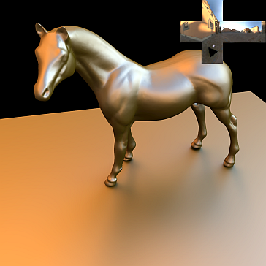
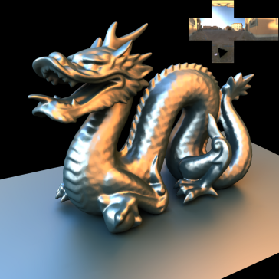
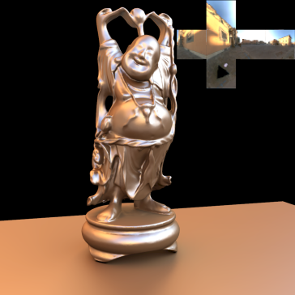
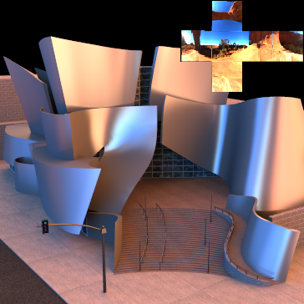
Overall Performance
Did several iterations of (SC)LPCA up to 24 basis
Model | Vertices [#] | LPCA | SC-LPCA | Speed Up | PRT
Horse | 67.6k | 3h 48m | 11m | 20.3x | 22.5 s
Dragon | 57.5k | 3h 1m | 28m | 6.4x | 25.5 s
Buddha | 85.2k | 4h 38m | 50m | 5.6x | 31.6 s
Disney | 106.3k | 5h 50m | 1h 8m | 5.1x | 46.5 s
Notes:
Now let’s see for the overall performance.
We perform several iterations of our and the original LPCA algorithm up to 24 dimensions.
The original LPCA spent from 3 to 6 hours to compress the PRT matrices.
Our SC-LPCA require from 15 minutes to one hour, achieving speed-up of 20 for a simple scene with horse model and speed-up of 5 for a complex model of the Walt Disney Concert Hall.
The last column show the time spent for the computation of light transfer matrices which we did on the GPU.
Note that this time is negligible compared to the compression time.

Slide 23
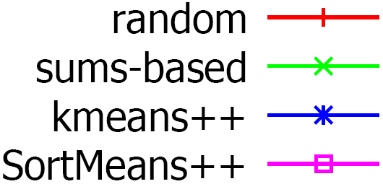
Improving Accuracy
Latency and accuracy of seeding algs:
Our SortMeans++
Generally lowest error & fast
Improve performance of SC-LPCA !
Notes:
Let’s have a look for an accuracy.
We run our SC-LPCA after initialization of it using different seeding algorithms.
The red line stands for the case when we choose the cluster centers uniformly at random.
The start-up latency is high and the resulting accuracy is poor.
The blue line show the result for the kmeans++.
It provides a much lower approximation error, though at the highest latency.
On the other hand our SortMeans++ decreases the start-up latency of the kmeans++ about 6x,
while maintaining it approximation accuracy.

Slide 24
Conclusion
SC-LPCA (accelerated LPCA)
Avoid unnecessary distance comp.
Speed-up of 5 to 20 on our PRT data
Without changing output !
Generate seeds
SortMeans++
Until converge
Improve accuracy (SortMeans++)
More accurate data approximation
Classification
using ∆-ineq.
Update
Future work
Test on other CG data
GPU acceleration
Precompute distances
Notes:
To conclude our work. - We propose an accelerated and more accurate local PCA algorithm.
We eliminate some point-cluster distance calculations.
We achieve a speed-up of 5 to 20 on our PRT dataset.
Statistically we improve accuracy of the Local PCA algorithm through better initialization of it.
In future work, we would like to investigate the efficiency of the proposed approach on another data sets, like local lights transfer matrices.
Also it would be nice to port our algorithm to GPU.

Slide 25
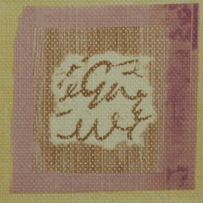
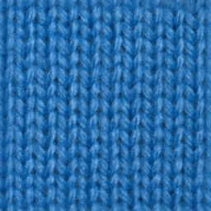
BTF Compression
Try several data sets
SC-LPCA speed-up of about only 1.5x
Reason: Small number of subspaces
Notes:
We also try our SortCluster-LPCA for compressing BTF data sets available on-line.
It is often used a small number of subspaces to achieve a high compression ratio.
Consequently, there is a less chance to use the ∆-inequality and so our SC-LPCA show a small speed-up about 1.5.

Slide 26
The End
Acknowledgement
European Community
Marie Curie Fellowship PIOF-GA-2008-221716
Ministry of Education, Czech Republic
Research program LC-06008.
Anonymous reviewers
Thank You for your attention
Notes:
Thank You for your attention.
(priprav si slajdy s dalsimi vysledky – chyba oproti nezakompresene matici, video atp. Mohlo bvy se to hodit pro zodpovezeni nejake otazky)

