Slide 1
Jiří Vorba¹ Ondřej Karlík¹ Martin Šik¹ Tobias Ritschel² Jaroslav Křivánek¹
¹Charles University in Prague ²MPI Informatik Saarbrücken
On-line Learning of Parametric Mixture Models
for Light Transport Simulation
Notes:
Good morning. Thank you for the introduction.
I am going to present a new method …

Slide 2
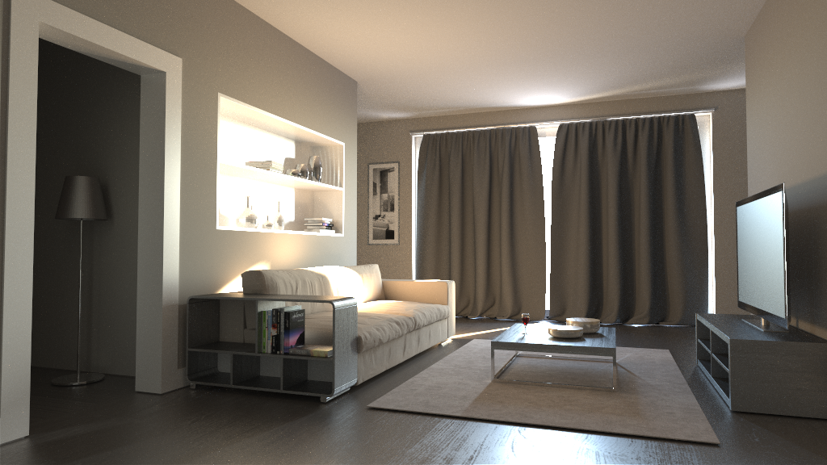
Difficult visibility
Notes:
… that aims at rendering scenes with difficult visibility.
Such scenes comprise complex geometry and light reaches the camera only after several interactions with surfaces.
In this example, the sunlight reaches the interior through a window and the small gap between the curtains and undergoes many interactions before it enters the dim room on the left.
Now I will demonstrate, that rendering of such scenes remains an open problem.

Slide 3
Motivation
Metropolis light transport (1h) [Veach and Guibas 1997], [Jakob and Marschner 2012]
Reference
Notes:
It is generally considered that Metropolis light transport algorithm is a remedy for this problem.
However, as you can see in the image, the result after 1h is very far from the reference.

Slide 4
Motivation
Vertex Connection and Merging (1h)
[Georgiev et al. 2012]
Reference
Notes:
Recently, Vertex Connection and Merging algorithm was introduced.
This algorithm can efficiently handle high variety of lighting conditions thanks to connecting and merging of many light paths.
However, as you can see, the difficult visibility remains a problem.
There are simply too few light paths that could be connected or merged. The result is a noisy image.
We aim to solve this problem by guiding of the path-sampling process.
Now, I will show you the result of our guiding applied to VCM.

Slide 5
Our method
Our guided Vertex Connection and Merging
(1h)
Reference
Notes:
As you can see, guiding of path-sampling process substantially reduced the noise.

Slide 6
Poor importance sampling
Notes:
To understand why such scenes are so difficult for rendering, we need to look at the rendering equation.
The product of incoming radiance L_in and BRDF (which is highlighted in green) is integrated over the hemisphere of directions.
State-of-the-art MC-based algorithms strive for importance sampling of the BRDF only and they often ignore the incoming radiance term.

Slide 7
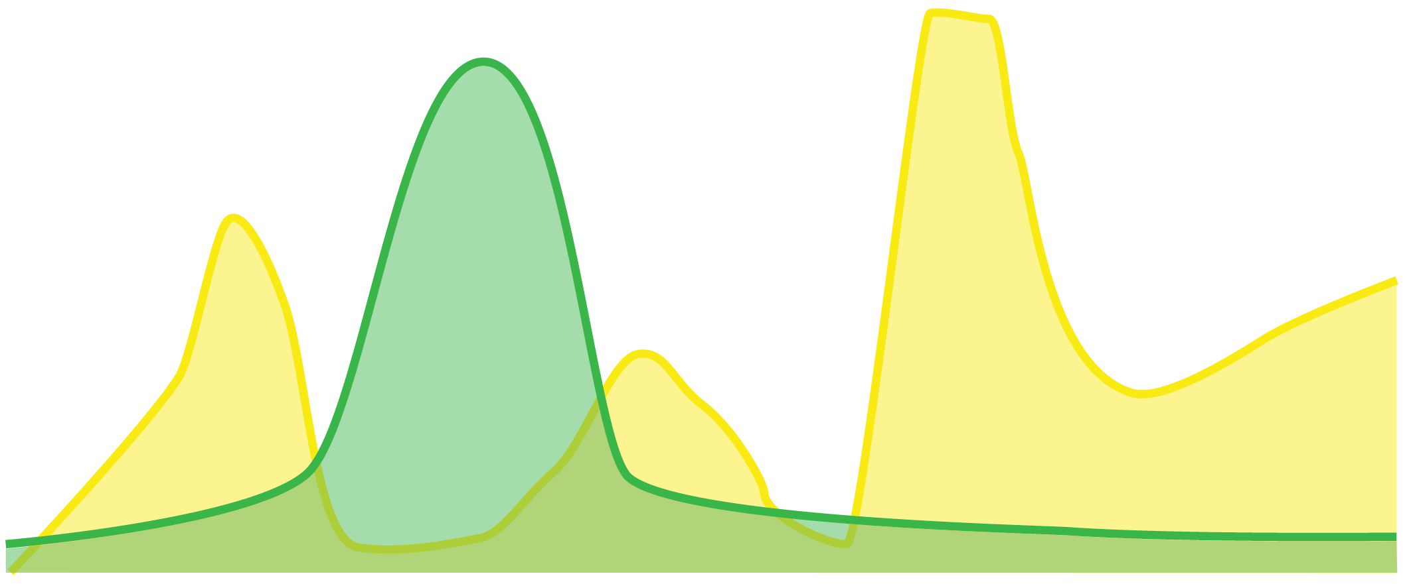
Poor importance sampling
0
Notes:
But this term can be the source of high variance due to possible caustic lighting and highlights in the scene.
And it also includes the visibility. So we could say that ignoring the radiance term makes the sampling blind to the rendered scene and results in waste of samples.

Slide 8
Previous work
Notes:
People tried to address this inefficient sampling in the past.

Slide 9
Previous work
photon tracing
Jensen [1995]
Notes:
Jensen [1995], in his previous work, uses light particles – that is photons – to reconstruct the distribution of incoming radiance (Li).

Slide 10
Previous work
photon tracing
Jensen [1995]
Notes:
They trace the photons in a preprocessing phase…

Slide 11
Previous work
photon tracing
Jensen [1995]
Notes:
They trace the photons in a preprocessing phase…

Slide 12
Previous work
photon tracing
Jensen [1995]
Notes:
and store them on surfaces for later use in path-tracing.

Slide 13
Previous work
photon tracing
path tracing
Jensen [1995]
Notes:
During the path-tracing, …

Slide 14
Previous work
photon tracing
path tracing
Jensen [1995]
Notes:
…, they reconstruct the directional distributions of radiance from nearest photons…

Slide 15
Previous work
photon tracing
path tracing
Jensen [1995]
Notes:
and use the distributions for sampling of reflected directions. Note that contrary to photon mapping, the method produces an unbiased image.

Slide 16
Previous work
Jensen [1995]
Notes:
and use the distributions for sampling of reflected directions. Note that contrary to photon mapping, the method produces an unbiased image.

Slide 17
Previous work
Jensen [1995]
Notes:
and use the distributions for sampling of reflected directions. Note that contrary to photon mapping, the method produces an unbiased image.

Slide 18
Previous work
Jensen [1995]: reconstruction
Notes:
The reconstruction of a distribution starts with a search for nearest photons from the surface intersection.

Slide 19
Previous work
Jensen [1995]: reconstruction
k-NN
Notes:
They are interested in a directional distribution so they make the assumption that all particles hit the surface at one point.

Slide 20
Previous work
Jensen [1995]: reconstruction
Notes:
To reconstruct the directional probability distribution …

Slide 21
Previous work
Jensen [1995]: reconstruction
Notes:
they discretize the hemisphere into equal-sized bins and count the number of particle directions falling into each bin.

Slide 22
Previous work
Jensen [1995]: reconstruction
Notes:
The result is a histogram over hemisphere.
However, histogram density estimate is known to be a poor estimation method prone to over and under estimation.

Slide 23
Previous work
Hey & Purgathofer [2002]
Notes:
Hey & Purgathofer [2002] alleviate the problem by using a different model to reconstruct and represent the directional distributions.

Slide 24
Previous work
Hey & Purgathofer [2002]
Equivalent to kernel density estimate
Notes:
They represent the directional pdf by overlapping cones with adaptive width.
The cones are centered around incoming photon directions
and the size of the cones is inversely proportional to directional density of photons.
[CLICK]
This corresponds to a kernel density estimate with adaptive kernel size so the method allows to have more refined pdf than Jensen’s histograms.

Slide 25
Previous work
Transport theory and radiative transfer
Spanier [1999]
Booth [2000]
Franke et al. [2009]
Notes:
The light transport can be considered a subfield to radiative transfer and transport theory of neutral particles.
I will point out works of Spanier [1999], Booth [2000] and Franke et al. [2009].

Slide 26
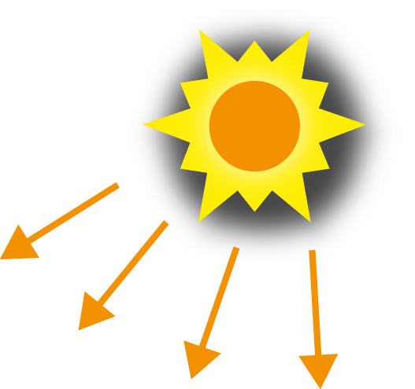
Previous work
Transport theory and radiative transfer
Spanier [1999]
Booth [2000]
Franke et al. [2009]
transport simulation
≈
rendering
Notes:
Similarly to their work, we also interleave photon and particle tracing steps to refine our distributions.

Slide 27
Limitations of previous work
Notes:
Now I will explain the main issue connected with previous methods.

Slide 28
Limitations of previous work
Bad approximation of in complex scenes
Notes:
Although they approximate the radiance term for importance sampling, they struggle in a wide range of scenes.

Slide 29
Limitations of previous work
Bad approximation of in complex scenes
Notes:
Let’s consider an interior scene where the camera is in a dim room and light is entering from the outside.

Slide 30
Limitations of previous work
Notes:
As the particles are scattered through BRDF at the beginning, it is not possible to obtain a sufficient number of particles everywhere for good reconstruction.

Slide 31
Limitations of previous work
Notes:
Note that, in the illustration, we have only one photon in front of the camera.

Slide 32
Limitations of previous work
PT
Notes:
Using such a poor reconstruction in path-tracing would even increase the noise level in the rendered image.
What we need is to get many more particles into the dim room, …

Slide 33
Limitations of previous work
Not enough memory!
Notes:
... but the problem is that we are limited by memory where all the particles need to be stored (including the particles outside of the room, where we do not need them at all).

Slide 34
Our solution
Notes:
Now I will present our solution to this problem that forms the cornerstone of our method.

Slide 35
Our solution
The Gaussian mixture model (GMM)
GMM
Notes:
We follow the same line of work. But instead of histogram or cones, we use a Gaussian mixture model to represent directional distributions.

Slide 36
Our solution
The Gaussian mixture model (GMM)
on-line learning
⇒
GMM
Notes:
This model can be progressively trained from a potentially infinite stream of particles. The important thing is that the particles do not need to be stored in memory.

Slide 37
Our solution
The Gaussian mixture model (GMM)
on-line learning
constant memory
⇒
⇒
GMM
Notes:
So in this way our on-line learning allows to overcome the memory constraint.

Slide 38
Overcoming the memory constraint
Notes:
This is how it works.

Slide 39
Overcoming the memory constraint
1st pass
Notes:
We trace particles in batches that can fit into memory. So we trace a first batch of photons, …

Slide 40
Overcoming the memory constraint
1st pass
GMM
Notes:
… we create a distribution on a scene surface…

Slide 41
Overcoming the memory constraint
1st pass
k-NN
Notes:
and we use the nearest photons for its initial training.

Slide 42
Overcoming the memory constraint
1st pass
GMM

Slide 43
Overcoming the memory constraint
1st pass
GMM
Notes:
Now the particles can be removed …

Slide 44
Overcoming the memory constraint
1st pass
GMM
Notes:
… because the information is absorbed in the distribution.

Slide 45
Overcoming the memory constraint
1st pass
2nd pass
GMM
Notes:
Then we trace another batch of particles,

Slide 46
Overcoming the memory constraint
1st pass
2nd pass
GMM
Notes:
… and we use the nearest ones to progressively update the distribution.

Slide 47
Overcoming the memory constraint
1st pass
2nd pass
3rd pass
…
GMM
Notes:
We can repeat this process until the distribution is fully trained.

Slide 48
Overcoming the memory constraint
1st pass
2nd pass
3rd pass
…
GMM

Slide 49
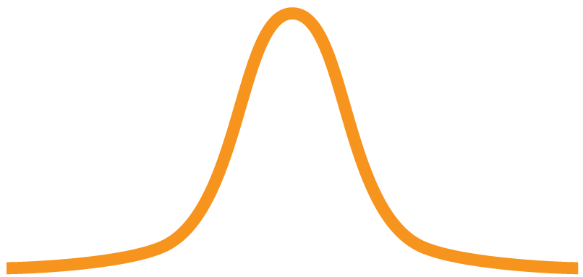
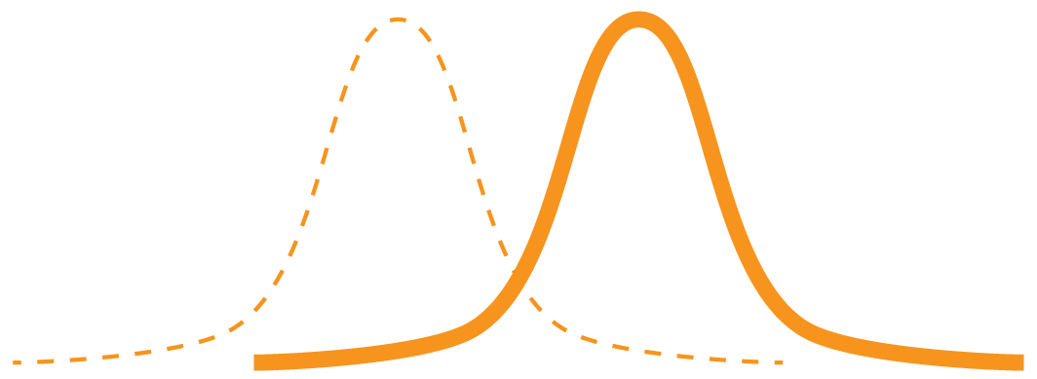
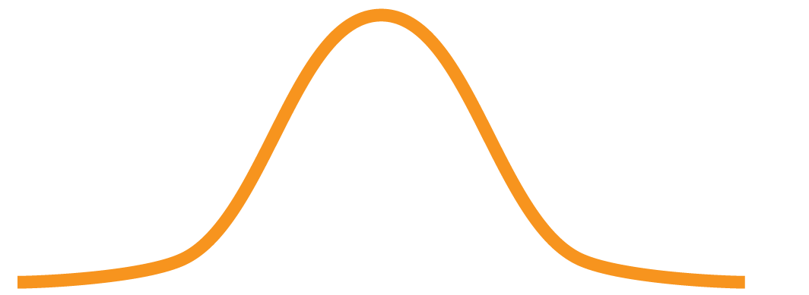
Gaussian mixture
Notes:
Lets see what the Gaussian mixture actually is.
It is a convex combination of Gaussian distributions that is fully described by [CLICK] a set of parameters theta.
Each Gaussian is defined by its [CLICK] mixture weight, [CLICK] its mean and [CLICK] its covariance matrix.

Slide 50
Gaussian mixture
Shirley and Chiu [1997]
Notes:
The Gaussians are defined in plane, [CLICK] however, to obtain a distribution over the hemisphere, [CLICK] we simply use [CLICK] the mapping of Shirley and Chiu [1997].

Slide 51
GMM: superior estimate
Reference
Superior estimate of an unknown distribution
Given the same number of particles
No on-line learning
Notes:
I would like to stress that on-line learning is not the only advantage of Gaussian mixture models over the previous directional distribution representations.
[CLICK]
It is also better at estimating of unknown distributions.
Let me demonstrate on an example.
[CLICK]
We rendered a complex scene where we have traced as many photons in one single batch as we could.
[CLICK]
There is no on-line learning involved – that means that all models were given the same number of particles.

Slide 52
GM: superior estimate (1h)
Jensen (histogram)
Hey and Purgathofer (kernel density)
Gaussian mixtures
(parametric model)
Notes:
Then we used path-tracing guided by Jensen’s histograms, …
[CLICK]
… Hey and Purgathofer’s cones …
[CLICK]
… and our Gaussian mixtures.
The amount of noise after 1h of rendering suggests that the Gaussian mixture model is clearly superior to the previous models.

Slide 53
GMM: learning
Notes:
For learning of Gaussian mixtures …

Slide 54
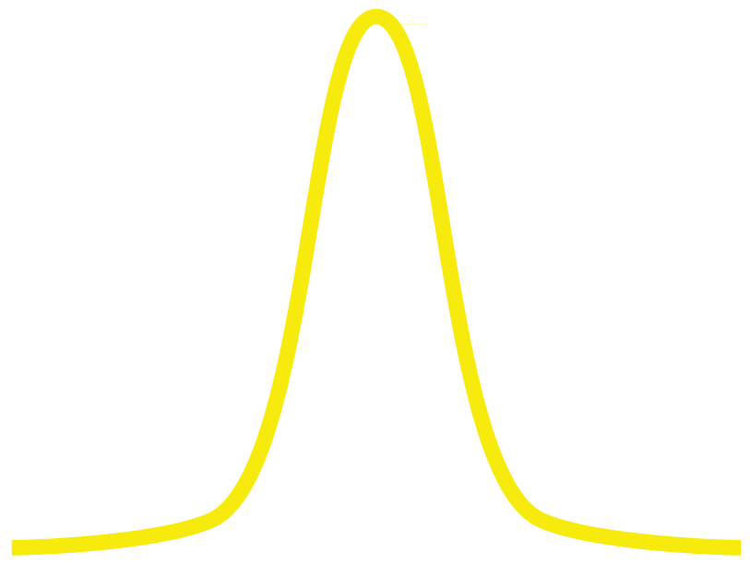
Stepwise Expectation-Maximization
[Liang&Klein 2009]
0
Input: a batch of particles
Notes:
… we use the stepwise Expectation-Maximization.
This is different from the usual EM algorithm previously used in graphics in that the E and M steps are performed immediately after observing each particle.
[CLICK] In this 1D scheme we have a hemisphere
[CLICK] that is mapped to a plane.
The example mixture has only two Gaussians [CLICK]
and the input of the algorithm is [CLICK] a batch of particles.

Slide 55
Stepwise Expectation-Maximization
[Liang&Klein 2009]
E-step
0
Input: a batch of particles
Notes:
The algorithm takes the particles one-by-one [CLICK] and every particle is processed in two steps. First, in the E-step, [CLICK] it determines its “soft” assignment to all Gaussians in the mixture [CLICK].
Then follows the M-step,

Slide 56
Stepwise Expectation-Maximization
[Liang&Klein 2009]
E-step
M-step
0
Input: a batch of particles
Notes:
in which the parameters of all Gaussians are updated.

Slide 57
Stepwise Expectation-Maximization
[Liang&Klein 2009]
E-step
M-step
0
Input: a batch of particles
Notes:
The update is based on the assignment from the E-step.

Slide 58
Stepwise Expectation-Maximization
[Liang&Klein 2009]
E-step
M-step
0
Input: a batch of particles
Notes:
The algorithm proceeds to another particle, it goes through the E-step [CLICK] and updates parameters in the M-step. [CLICK]

Slide 59
Stepwise Expectation-Maximization
[Liang&Klein 2009]
E-step
M-step
0
Input: a batch of particles
Notes:
The algorithm proceeds to another particle, it goes through the E-step [CLICK] and updates parameters in the M-step. [CLICK]

Slide 60
Stepwise Expectation-Maximization
[Liang&Klein 2009]
E-step
M-step
0
Input: a batch of particles
Notes:
The algorithm proceeds to another particle, it goes through the E-step [CLICK] and updates parameters in the M-step. [CLICK]

Slide 61
Stepwise Expectation-Maximization
[Liang&Klein 2009]
E-step
M-step
0
Input: a batch of particles
Notes:
These steps are repeated for all particles in the batch…

Slide 62
Stepwise Expectation-Maximization
[Liang&Klein 2009]
E-step
M-step
0
Input: a batch of particles
Notes:
These steps are repeated for all particles in the batch…

Slide 63
Stepwise Expectation-Maximization
[Liang&Klein 2009]
E-step
M-step
0
Input: a batch of particles
Notes:
These steps are repeated for all particles in the batch…

Slide 64
Stepwise Expectation-Maximization
[Liang&Klein 2009]
E-step
M-step
0
Input: a batch of particles
Notes:
… and when the last particle from the input batch is finally processed …

Slide 65
Stepwise Expectation-Maximization
[Liang&Klein 2009]
E-step
M-step
0
Input: a batch of particles
Notes:
the algorithm returns to the first particle again.
This process continues until convergence.

Slide 66
Stepwise Expectation-Maximization
[Liang&Klein 2009]
Input: a batch of particles

Slide 67
On-line stepwise Expectation-Maximization
[Cappé & Moulines 2009]
Input: a batch of particles
Notes:
Thanks to the stepwise formulation, making the algorithm on-line is very simple.

Slide 68
On-line stepwise Expectation-Maximization
[Cappé & Moulines 2009]
Input: an infinite stream of particles
…
Notes:
All we need to do is to read particles from potentially infinite stream and never return to previously used particles.
Note that this would not be possible with the usual E-M algorithm previously used in graphics.

Slide 69
Method’s outline
Notes:
Now I will finally outline the complete picture of our method.

Slide 70
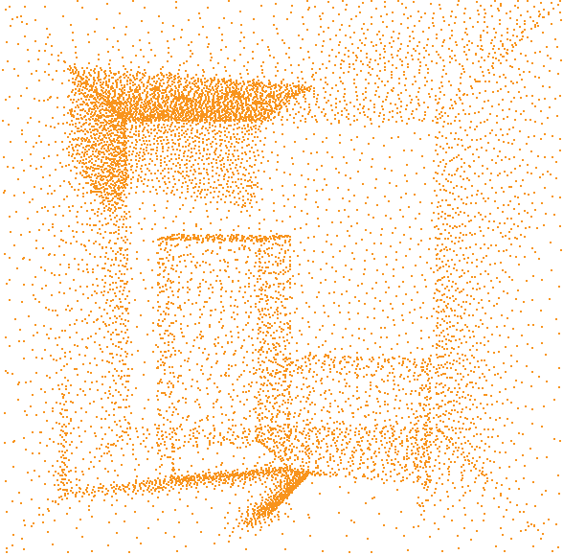
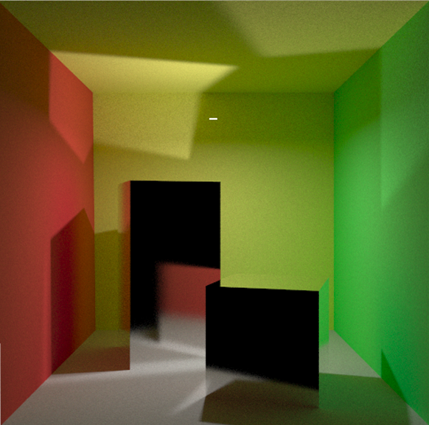
Training phase
training
rendering
Notes:
Before rendering, we train our Gaussian mixtures in a training phase.
The result of this phase are two spatial caches of distributions.
[CLICK]
One of them is trained from photons and thus contains directional distributions of radiance
[CLICK]
while the other is trained from camera particles and contains distributions of visual importance.
These distributions are used to guide path-sampling during the rendering phase.

Slide 71
Guided path sampling
Notes:
I will explain the guided path-sampling on the illustration.
[CLICK]
Here, we trace a path from the camera and we use the nearest radiance distributions for its guiding towards the light sources.

Slide 72
Guided path sampling
Notes:
I will explain the guided path-sampling on the illustration.
[CLICK]
Here, we trace a path from the camera and we use the nearest radiance distributions for its guiding towards the light sources.

Slide 73
Guided path sampling
Notes:
I will explain the guided path-sampling on the illustration.
[CLICK]
Here, we trace a path from the camera and we use the nearest radiance distributions for its guiding towards the light sources.

Slide 74
Guided path sampling
Notes:
I will explain the guided path-sampling on the illustration.
[CLICK]
Here, we trace a path from the camera and we use the nearest radiance distributions for its guiding towards the light sources.

Slide 75
Guided path sampling
Notes:
I will explain the guided path-sampling on the illustration.
[CLICK]
Here, we trace a path from the camera and we use the nearest radiance distributions for its guiding towards the light sources.

Slide 76
Guided path sampling
Notes:
I will explain the guided path-sampling on the illustration.
[CLICK]
Here, we trace a path from the camera and we use the nearest radiance distributions for its guiding towards the light sources.

Slide 77
Guiding and BRDF
or
Notes:
In our method we also sample the BRDF.
To sample a new direction we randomly use [CLICK] either our guiding distribution [CLICK] or the BRDF.
Both sampling strategies, are combined via multiple importance sampling.

Slide 78
Guided path sampling
Notes:
During the guided path-sampling, we also create new distributions on-the-fly as needed.

Slide 79
Guided path sampling
Notes:
During the guided path-sampling, we also create new distributions on-the-fly as needed.

Slide 80
New distribution
Notes:
Similarly to irradiance caching, if there is no distribution that could be reused at the intersection point …

Slide 81
New distribution
new GMM
Notes:
… a new distribution is trained and placed into the spatial cache.

Slide 82
Guided path sampling
Notes:
Now that I’ve finished the description of the guided path-sampling, …

Slide 83
Training phase
training
rendering
Notes:
we can look in detail at the training phase.

Slide 84
Training phase
training
Notes:
we can look in detail at the training phase.

Slide 85
Training phase
…
Notes:
We interleave the particle tracing steps which is possible thanks to on-line learning.

Slide 86
Interleaved particle tracing
…
Notes:
We start the training phase by blindly tracing importons using only importance sampling according to the BRDF.

Slide 87
Interleaved particle tracing
…
Notes:
Then, we trace photons, guiding them towards visually important places.

Slide 88
Interleaved particle tracing
…
Notes:
Then, we trace importons again and we guide them towards light sources.

Slide 89
Interleaved particle tracing
…
Notes:
This is repeated several times …

Slide 90
Interleaved particle tracing
…
Notes:
… until the training phase is concluded by photon tracing.

Slide 91
Update of distributions
…
radiance update
importance update
radiance update
Notes:
Between the particle tracing steps we use gathered particles to update the cached distributions.
So the distributions are getting more refined and in turn provide better importance sampling for the subsequent tracing.

Slide 92
Results
Notes:
For details about the presented algorithms, please, refer to the paper.
Now I will present our results.

Slide 93
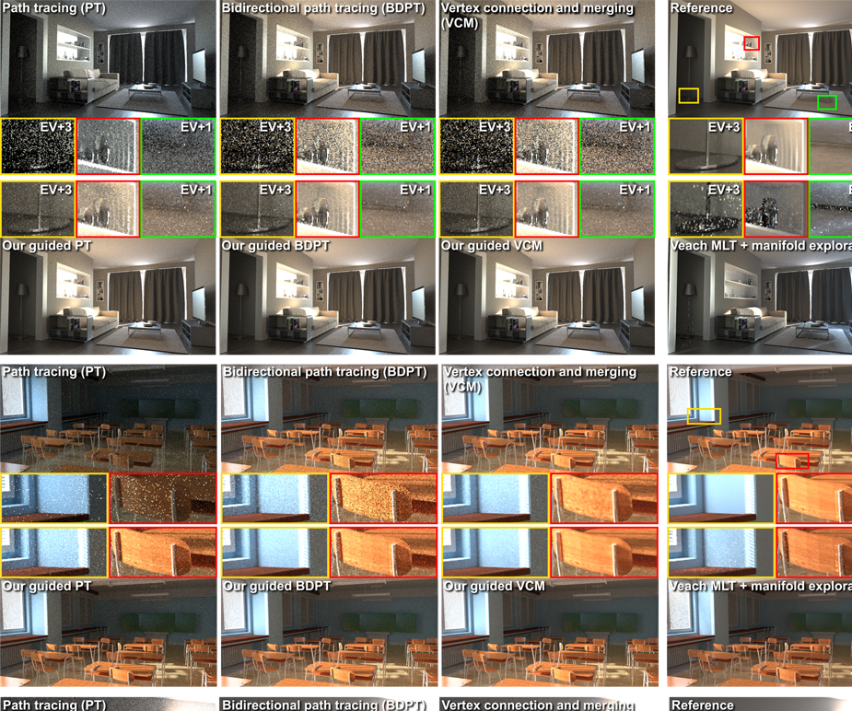
Results
Application to
PT
BDPT
PPM [Hachisuka 2008]
VCM [Georgiev et al. 2012]
Three scenes
Comparison to
MLT + Manifold Exploration [Veach and Guibas 1997], [Jakob and Marschner 2012]
Notes:
We have applied our method to [CLICK] PT, BDPT, PPM and VCM and we provide extensive comparison [CLICK] conducted on three different scenes.
[CLICK]
We compare the results also to Veach-style MLT with Manifold exploration.

Slide 94
Results
Same-time (1h) comparisons
Preprocessing time included
Took 4 to 10 minutes
Notes:
However, I will show you only fraction of the results.
All the images were rendered for 1h including the preprocessing time.

Slide 95
Reference (60 days)
Notes:
This slide shows the Living room scene that I have presented at the very beginning.
[CLICK]
I will draw your attention to a small region that is especially difficult to render.
Note that this reference image was rendered by plain BDPT for 60 days. And you might still notice some noise.

Slide 96
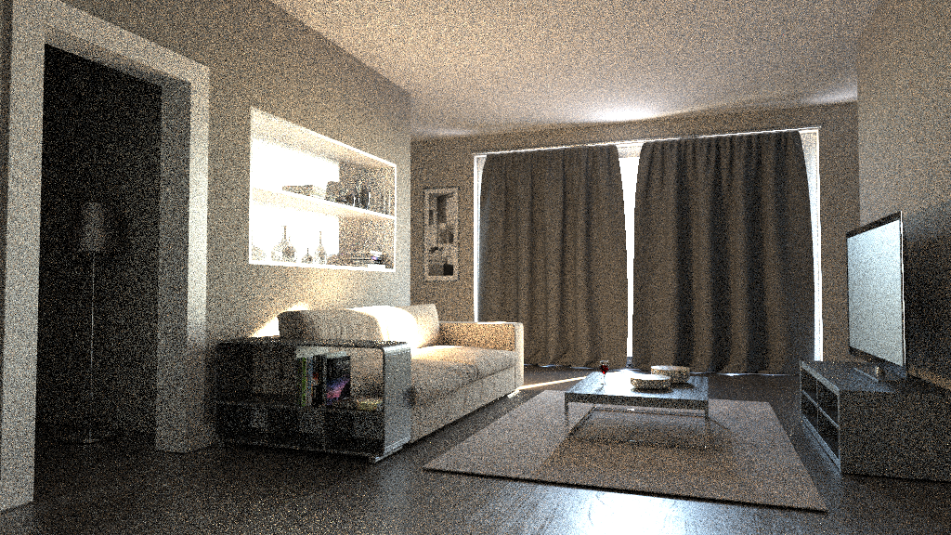
Bidirectional path tracing
(1h)
Notes:
This very noisy result was achieved with bidirectional path tracing after one hour.
Now I will show you the result after application of our guiding method.

Slide 97
Our guided bidirectional path tracing
(1h)
Notes:
As you can see, the noise was substantially reduced.
However, you may also notice some residual high-frequency noise visible especially around the picture on the wall. We would like to address this in our future work by learning of distributions also during the rendering phase.

Slide 98
Progressive training
BDPT
1 training pass (TP)
+ 2 TP
+ 5 TP
+ 30 TP
Notes:
On another detail of the same scene I will demonstrate that the time spent on training is amortized by faster convergence of rendering.
[CLICK]
We use different number of training passes in the preprocessing.
[CLICK]
1 training pass corresponds to tracing importons followed by tracing photons.
You can see that more passes produced better result even when we account for the preprocessing time.

Slide 99
Progressive training
BDPT
+ 2 TP
+ 5 TP
+ 30 TP
Notes:
The improvement is visible in the insets …

Slide 100
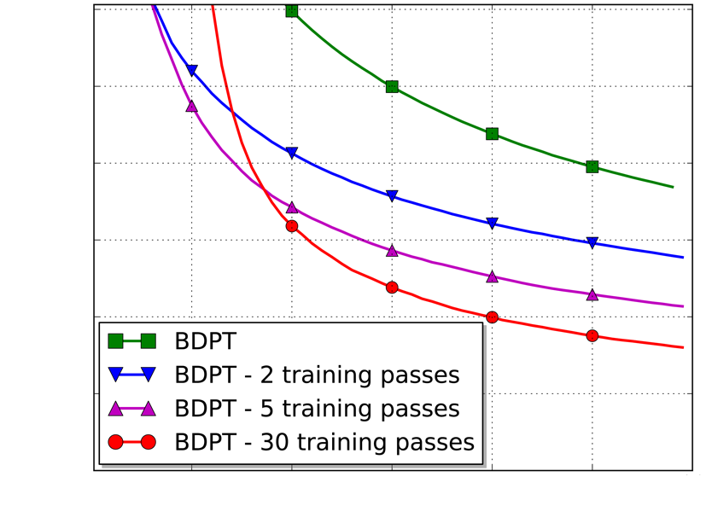
Notes:
… and is also underlined by L1 error plots.

Slide 101
Unidirectional vs. bidirectional algorithms
⇒
Guiding redundant sampling strategies
Notes:
Based on our results, we suspect that guiding might render some path sampling techniques in bidirectional algorithms less important.
[CLICK]
The L1 error plots correspond to the living room scenes rendered with three different algorithms. (Path tracing, Bidirectional path tracing and VCM). Green color is used for unguided methods while red depicts the guided algorithm.
[CLICK]
Clearly the highest relative improvement is always achieved for path tracing and …
[CLICK]
… guided bidirectional algorithms are only slightly superior to guided path tracing.

Slide 102
Reference
Notes:
On another scene I will show the improvement achieved for simple path-tracing.
The sunlight reaches the scene after passing through windows with jalousies and undergoes complex interactions in the classroom.

Slide 103
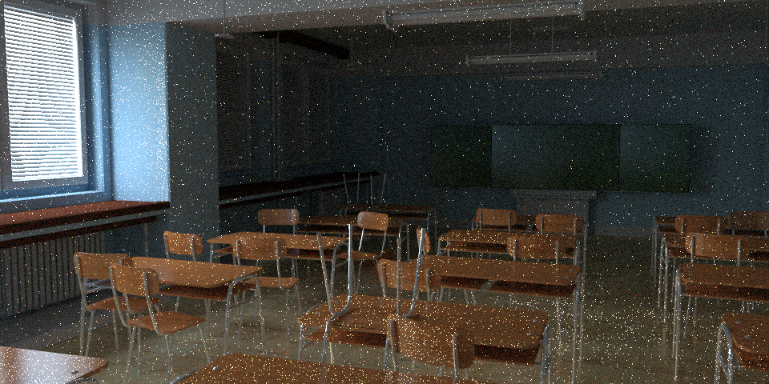
Path tracing (1h)
Notes:
The simple path tracing fails to render the scene. In fact, all the sunlight is almost completely missing.
Now I am going to show you the result after the application of our guiding method.

Slide 104
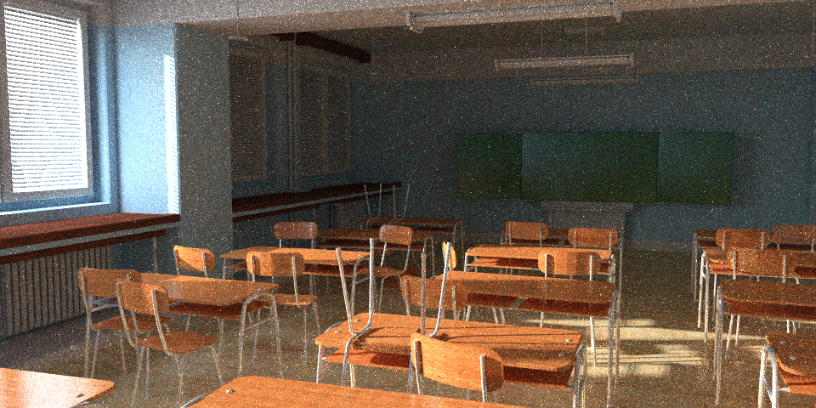
Our guided path tracing (1h)
Notes:
Again, the noise reduction is substantial and even higher then in the case of bidirectional path tracing.

Slide 105
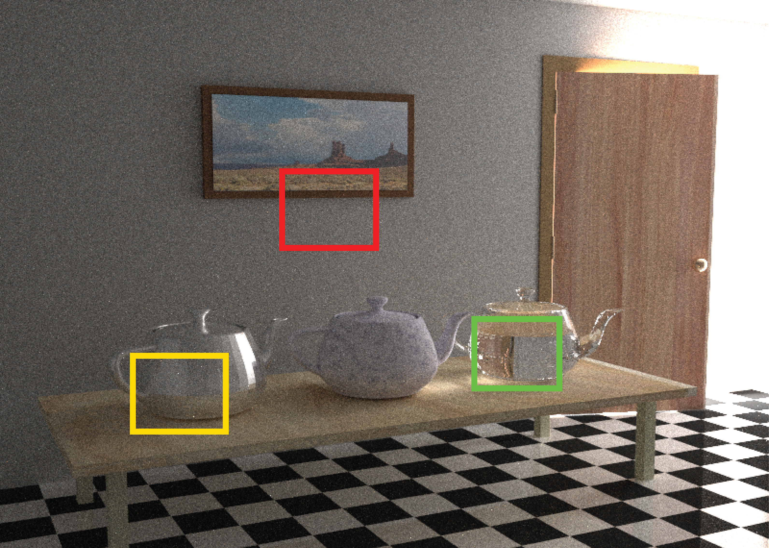
Bidirectional path tracing (BDPT)
Notes:
On this famous scene I show the result using bidirectional path tracing.
The light is coming from the other room through a small door slit.
This is our guided version and finally the reference.

Slide 106
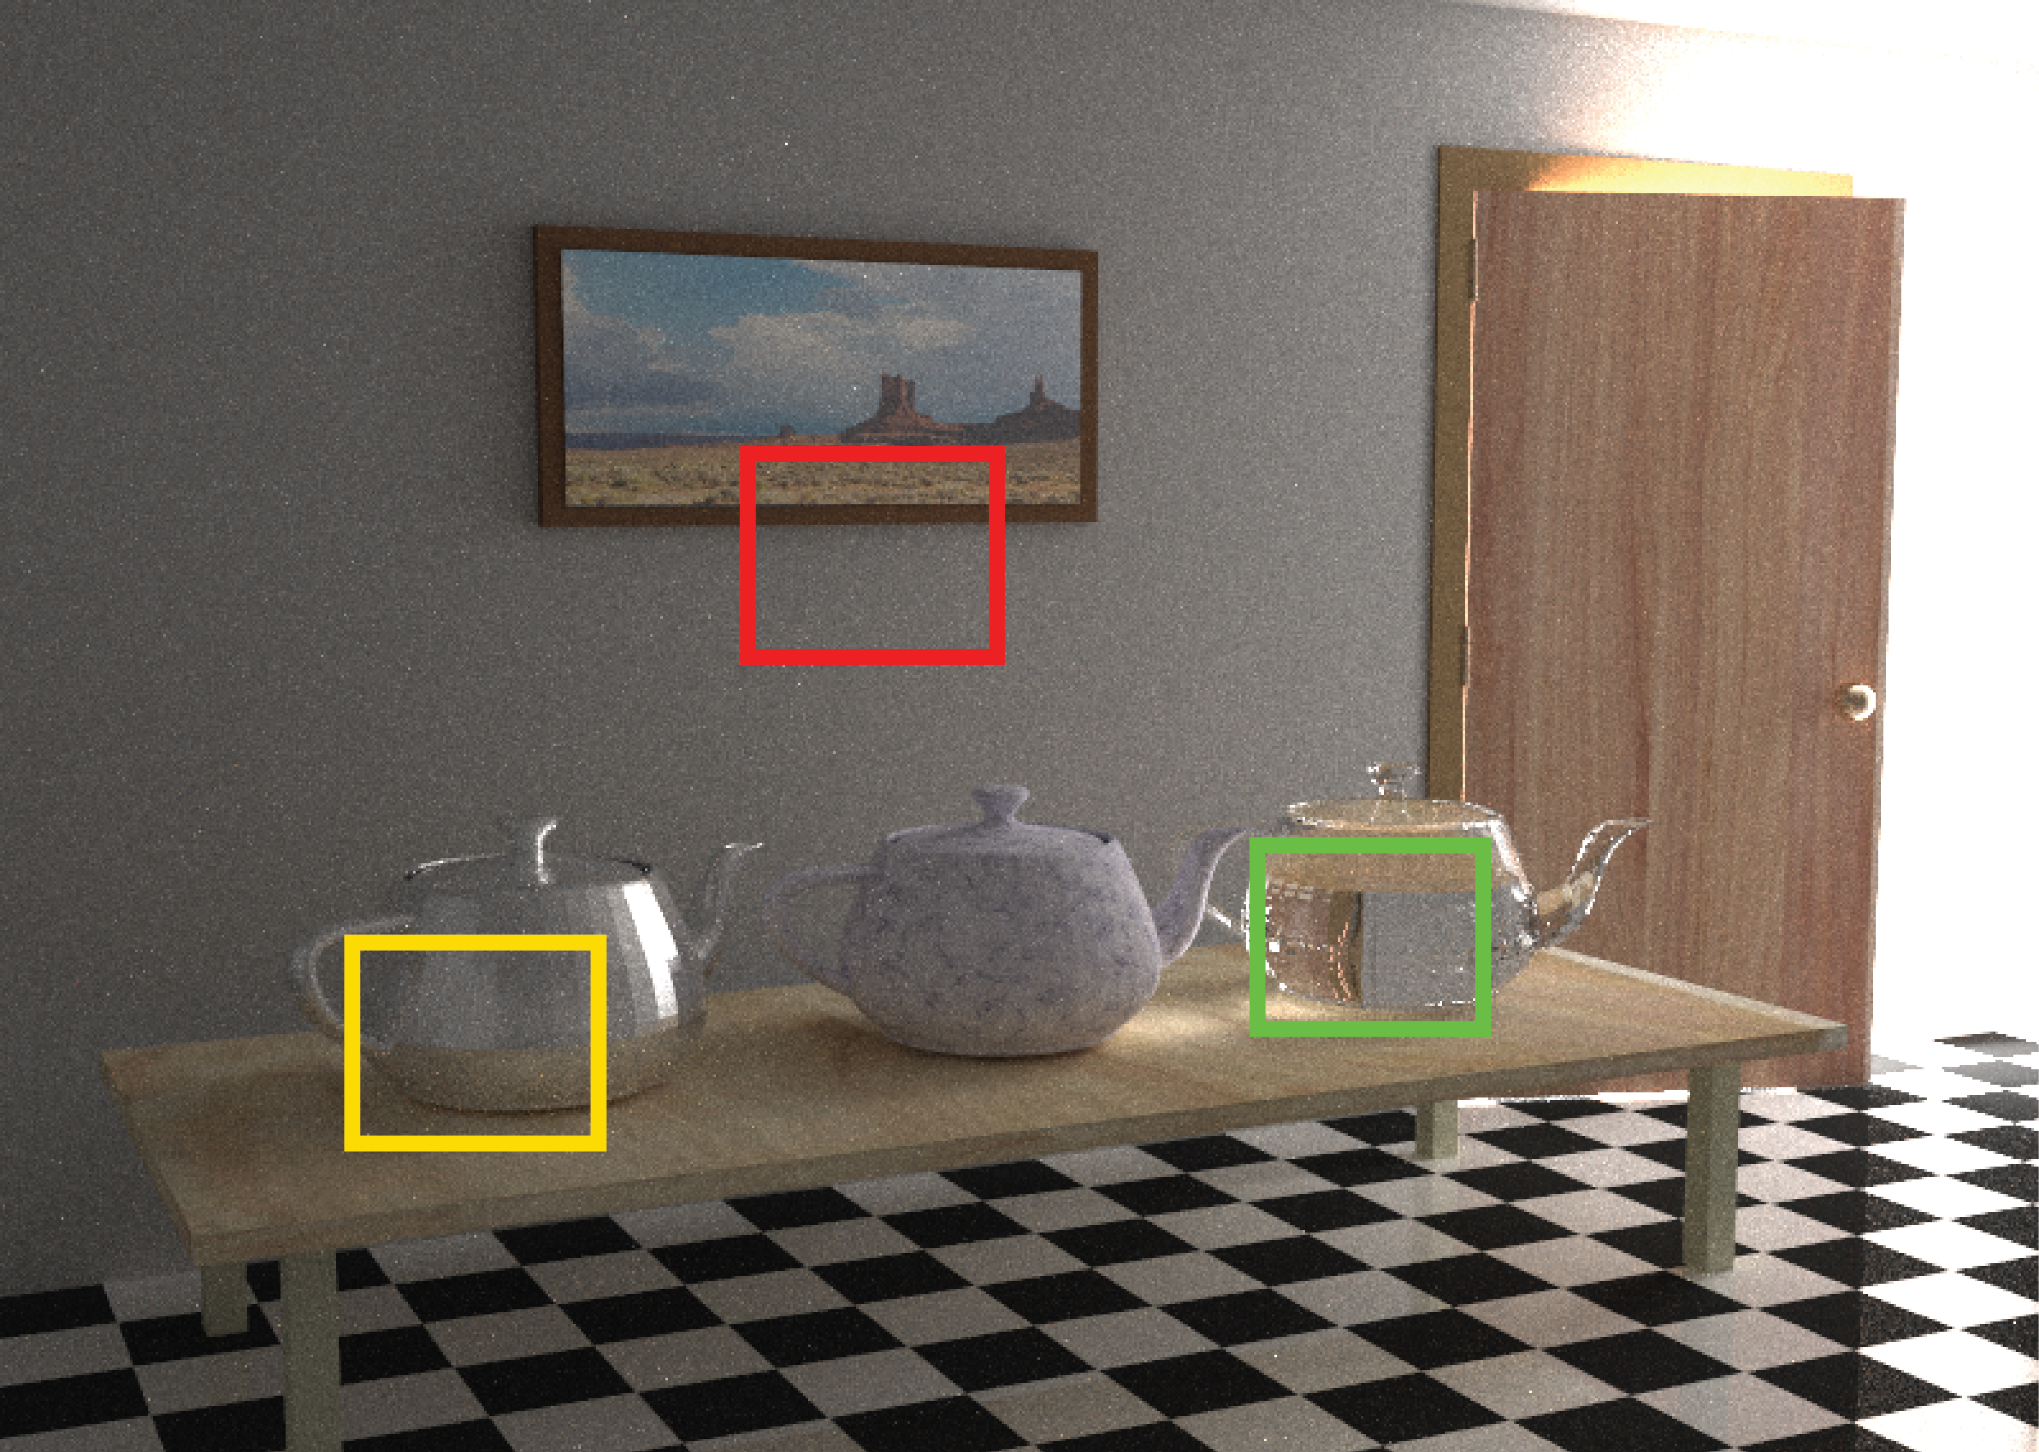
Our guided BDPT
Notes:
On this famous scene I show the result using bidirectional path tracing.
The light is coming from the other room through a small door slit.
This is our guided version and finally the reference.

Slide 107
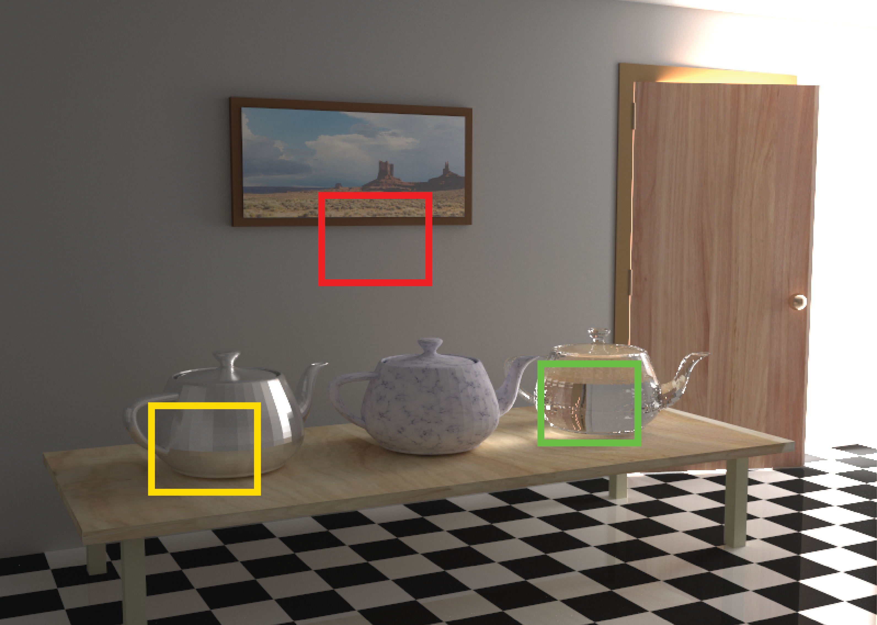
Reference
Notes:
On this famous scene I show the result using bidirectional path tracing.
The light is coming from the other room through a small door slit.
This is our guided version and finally the reference.

Slide 108
Conclusion
Parametric mixtures
Importance sampling
On-line training
Scenes with difficult visibility
Notes:
To sum up, we propose the use of a parametric mixture model to represent directional distributions.
These distributions are trained in the preprocessing phase and used for importance sampling in the rendering.
The proposed model allows on-line training from an infinite stream of particles which in turn enables rendering scenes with difficult visibility.

Slide 109
Limitations and future work
Limitations
Overhead (from caching)
Future Work
Adaptive refinement in rendering
Combination with Metropolis Ligth Transport
Notes:
However, the overhead of our method, that comes from querying the distribution cache, may offset its advantages in simple scenes.
[CLICK]
In the future, we would like to refine the distributions adaptively also during the rendering phase.
We also plan to combine our method with MLT.
We think that these two approaches could complement each other to achieve further benefits.

Slide 110
Source code
guiding library
Demo in
any C++ renderer
http://cgg.mff.cuni.cz/~jirka/papers/2014/olpm/index.htm
Notes:
The source code of our method is publicly available at the project home page.
[CLICK]
The method is implemented as a library and its sample usage for path tracing is available in the Mitsuba renderer.

Slide 111
Acknowledgements
Funding institutions
Charles University in Prague
Czech Science Foundation
Scenes
Ludvík Koutný
Jaakko Lehtinen et al.
Notes:
We would like to thank the following people and institutions for their help and funding
(We also thank to anonymous reviewers for their thoughtful comments.)

Slide 112
Thank you!
http://cgg.mff.cuni.cz/~jirka/papers/2014/olpm/index.htm
Notes:
Thank you for your attention.

Slide 113
Additional Slides

Slide 114
Guiding emission
Environment light source
One progressive framework:
Scattering and emission
Notes:
We use our method also for guiding of emission sampling from environment light source.
In other words, we drive the emission by visual importance.
Both guiding of scattering and the emission fit nicely into the same framework.

Slide 115
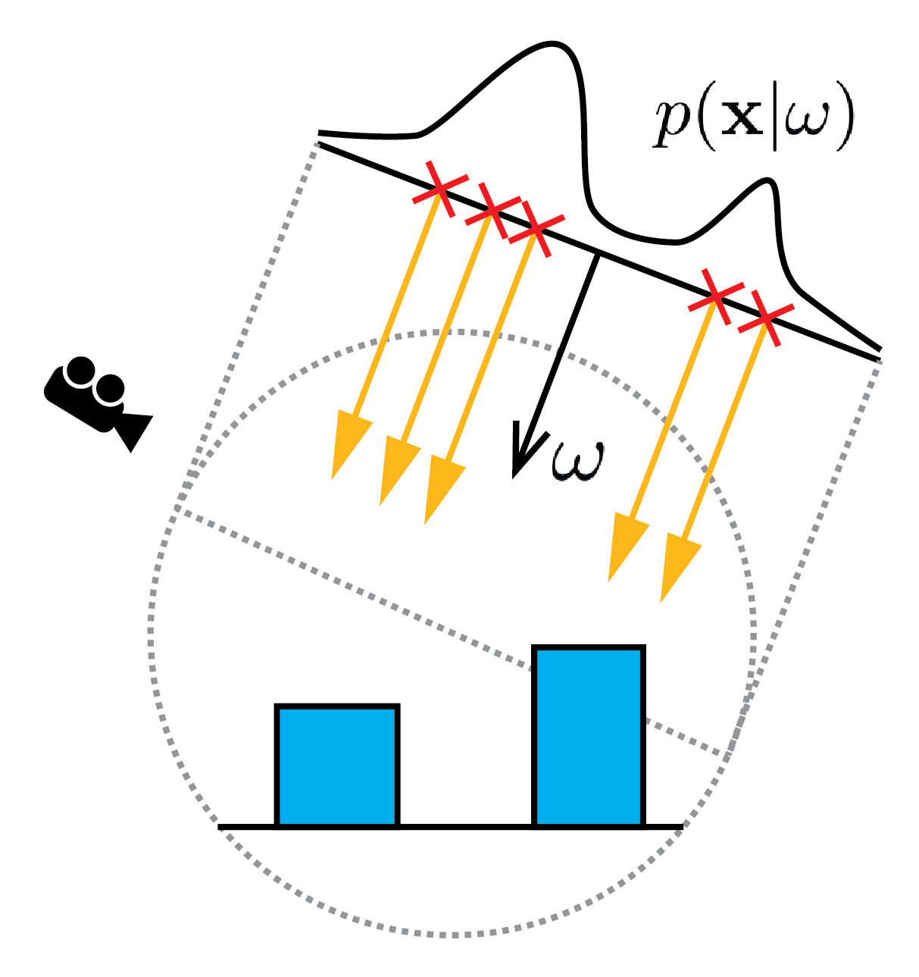
Guiding emission
Notes:
Our Gaussian mixtures for sampling starting position are conditioned by a direction omega and are defined on a disk perpendicular to omega.

Slide 116
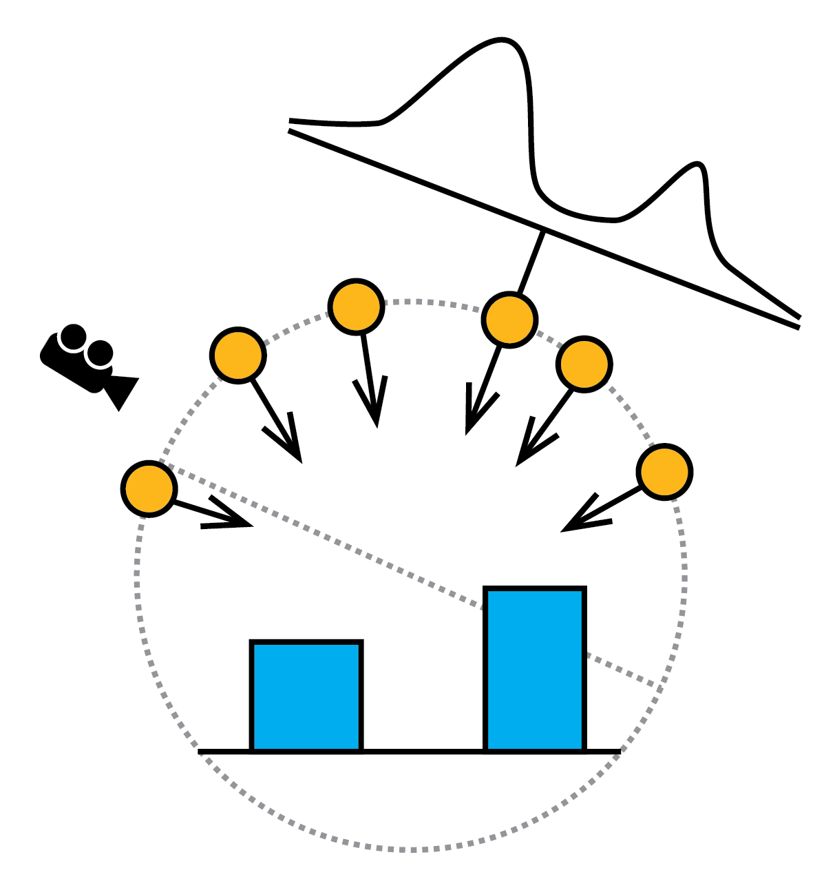
Guiding emission
Notes:
To allow progressive training, we store the distributions in a directional cache.

Slide 117
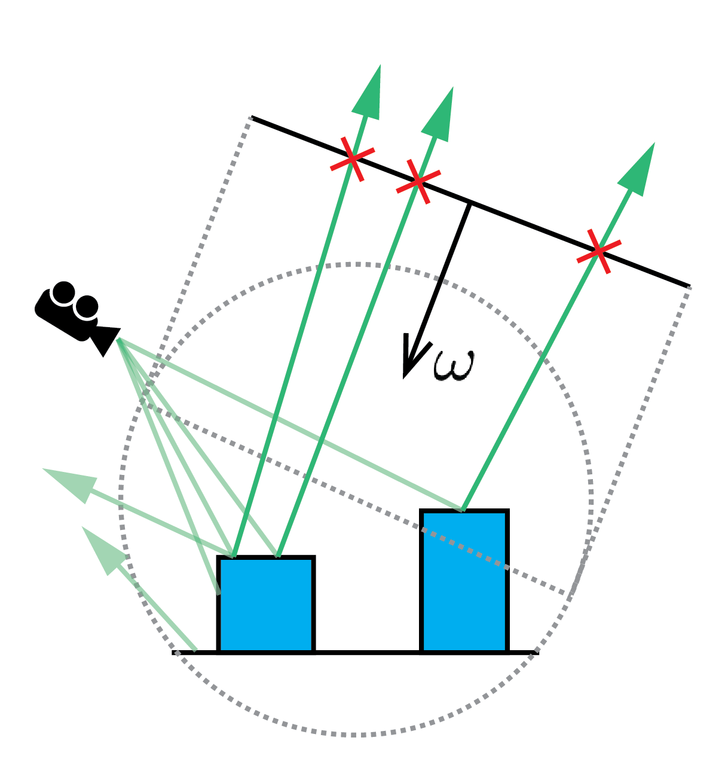
Guiding emission
Notes:
After every particle tracing step, distributions are trained from importons that left the scene.

Slide 118
Previous work
Peter and Pietrek [1998]
photon tracing
path
tracing
Notes:
The work of Peter and Pietrek [1998] extended Jensen’s idea …

Slide 119
Previous work
Peter and Pietrek [1998]
importon tracing
photon tracing
path
tracing
Notes:
… by using camera particles – importons – to guide photons to visually important places.

Slide 120
Previous work
Peter and Pietrek [1998]
PT
Notes:
The algorithm starts by tracing particles from the camera – called importons.

Slide 121
Previous work
Peter and Pietrek [1998]
PT

Slide 122
Previous work
Peter and Pietrek [1998]
PT
Notes:
Then the photon tracing pass uses the importons …

Slide 123
Previous work
Peter and Pietrek [1998]
PT
Notes:
Then the photon tracing pass uses the importons …

Slide 124
Previous work
Peter and Pietrek [1998]
PT
Notes:
… to reconstruct the visual importance distributions for scattering.

Slide 125
Previous work
Peter and Pietrek [1998]
PT
Notes:
Thus the photons are guided towards the camera and during the path-tracing phase allow …

Slide 126
Previous work
Peter and Pietrek [1998]
PT
Notes:
for better reconstruction of radiance in visually important places.

