Slide 1
Adjoint-Driven Russian Roulette and Splitting in Light Transport Simulation
Jiří Vorba^{1,2}
Jaroslav Křivánek¹
¹⁾ Charles University in Prague
²⁾ Weta Digital, Wellington
Notes:
… I’m going to present Adjoint-Driven Russian Roulette and Splitting for efficient light transport simulation.

Slide 2
Motivation
Notes:
The simulation becomes expensive especially in the presence of indirect illumination.

Slide 3
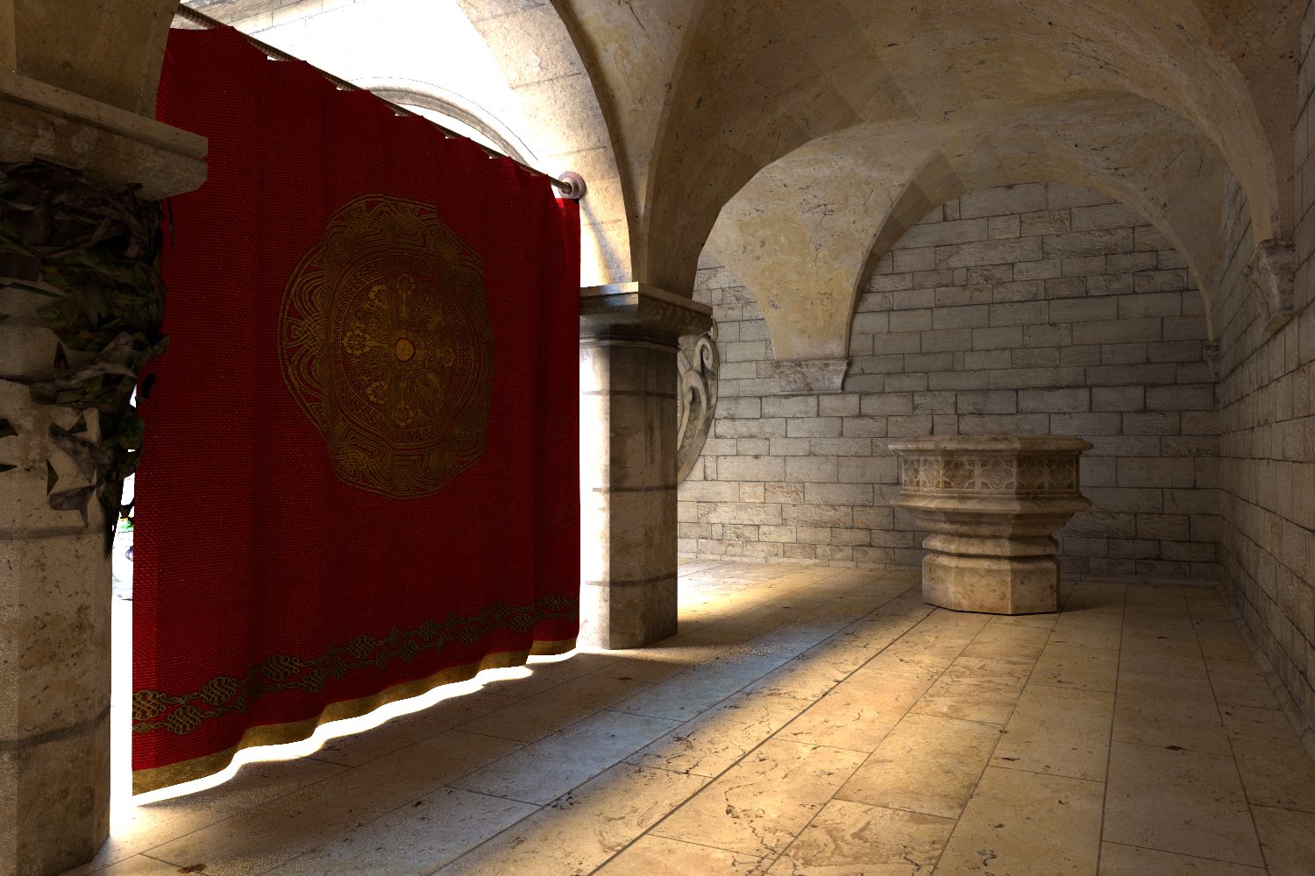
Notes:
In this Crytek recreation of the famous Sponza scene, the sun shines into atrium behind the curtain and the shot is lit mostly indirectly.

Slide 4
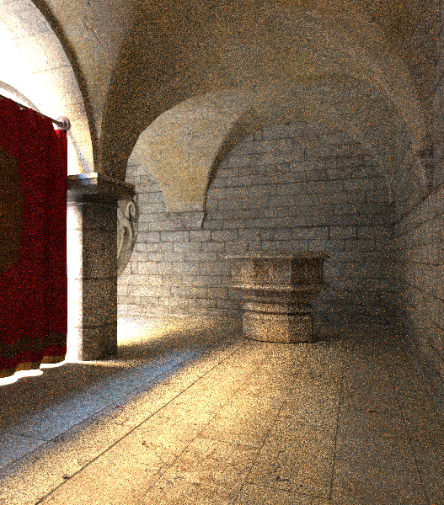
Path tracing (1h)
Notes:
When we render the scene with path tracing that utilizes classic albedo-driven Russian roulette,
we can notice that the image is especially noisy in areas, …

Slide 5
Path tracing (1h)
Notes:
When we render the scene with path tracing utilizing classic albedo-driven Russian roulette,
we can notice that the image is especially noisy in areas, where light is transported over long paths.

Slide 6
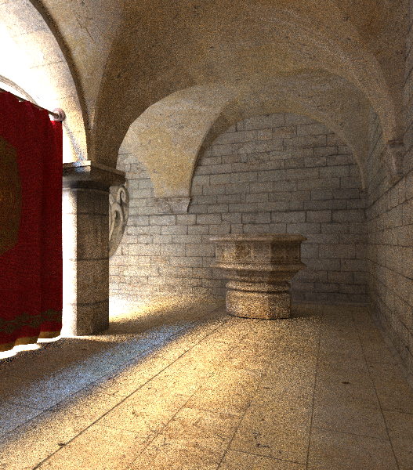
Path tracing (1h)
Our ADRRS in path tracing (1h)
Notes:
We show that our Adjoint-Driven Russian roulette and Splitting achieves better importance
sampling and results in more efficient simulations.

Slide 7
Path tracing (1h)
Our ADRRS in path tracing (1h)

Slide 8
Path tracing (1h)
Our ADRRS in path tracing (1h)
Notes:
Our method is based on knowledge of an initial estimate of the light field in the scene.
We precompute this estimate prior to rendering and the time for precomputation is included in the total rendering time.

Slide 9
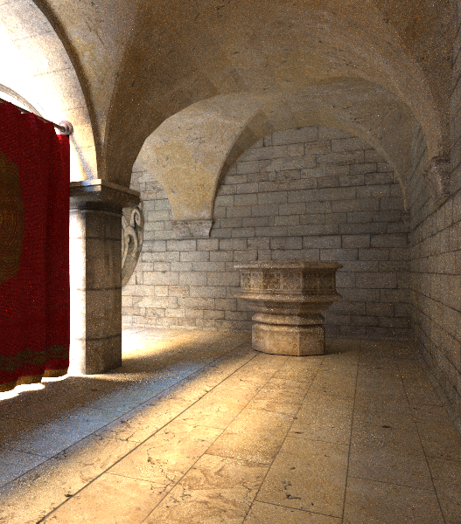
Path tracing + path guiding (1h)
[Vorba et al. 14]
Notes:
Recently, we introduced a path guiding method for efficient sampling of indirect illumination.

Slide 10
Path tracing + path guiding (1h)
[Vorba et al. 14]
Our ADRRS + path guiding (1h)
in path tracing
Notes:
However, we show that our new ADRRS method further improves the efficiency of path guiding …

Slide 11
Path tracing + path guiding (1h)
[Vorba et al. 14]
Our ADRRS + path guiding (1h)
in path tracing
Notes:
and that these two different importance sampling schemes complement each other.

Slide 12
Previous work
Notes:
I will go through previous work.

Slide 13
Previous work
Russian roulette [Arvo & Kirk 1990]
Splitting [Cook et al. 1984]
Notes:
Arvo & Kirk adopted Russian roulette from neutron transport simulations and introduced it to computer graphics some 25 years ago.

Slide 14
Russian roulette
Notes:
Under Russian roulette at each vertex the path survives with some probability q …

Slide 15
Russian roulette
Notes:
… and is terminated with probability 1-q.
If path is terminated, it does not contribute to estimated pixel value.

Slide 16
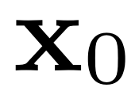
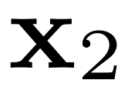
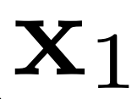
Russian roulette
Notes:
If the path survives its throughput is devided by the surviving probability to compensate for terminated paths.

Slide 17
Russian roulette
Notes:
The throughput also known as path weight, is a product of emission, bsdf and geometric terms,
and these terms are also divided by the direction sampling probabilities p and surviving probabilities q at each vertex.

Slide 18
Russian roulette
[Arvo & Kirk 1990]
Notes:
Arvo & Kirk suggest to set the surviving probability to a ratio of the current path weight and a user defined threshold.
This allows unbiased rendering without spending too much time on tracing long paths with a small throughput.

Slide 19
Russian roulette
[Jensen 2001]
Notes:
Another commonly used approach is to use local reflectance of the material as a surviving probability.
(This corresponds to an analog simulation where particles (or paths) are absorbed by the material.)

Slide 20
Previous work
Russian roulette [Arvo & Kirk 1990]
Splitting [Cook et al. 1984]
Notes:
Splitting, which is a technique used in neutron transport as well, is known in computer graphics as distributed ray tracing and was introduced by Cook et al.

Slide 21
Splitting
Notes:
It works by partitioning a path into several diverging trajectories that are tracked independently.

Slide 22
Splitting
Notes:
Similarly to Russian roulette we need to correct the path weight after each split by the number of spawned paths.
The main problem is to determine this splitting factor q.

Slide 23
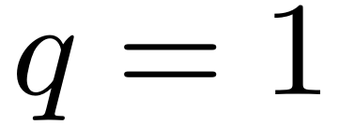
Splitting
Notes:
If we set q to 1 we end up with path tracing.

Slide 24
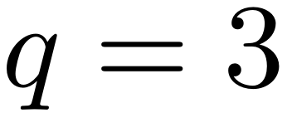
Splitting
Notes:
If we use a fixed rate higher than 1 we get bushy trees due to exponential branching.

Slide 25
Splitting
[Szirmay-Kalos and Antal 2001]
Notes:
Instead of fixed rates, Szirmay-Kalos and Antal suggest to use a heuristic based on material properties like albedo and roughness.

Slide 26
Russian Roulette and Splitting
RR:
Split:
[Szirmay-Kalos and Antal 2001]
Notes:
Obviously, both Russian roulette and splitting can be naturally combined together through the factor q.
If q is less than one roulette is played if q is greater than one the path is split.

Slide 27
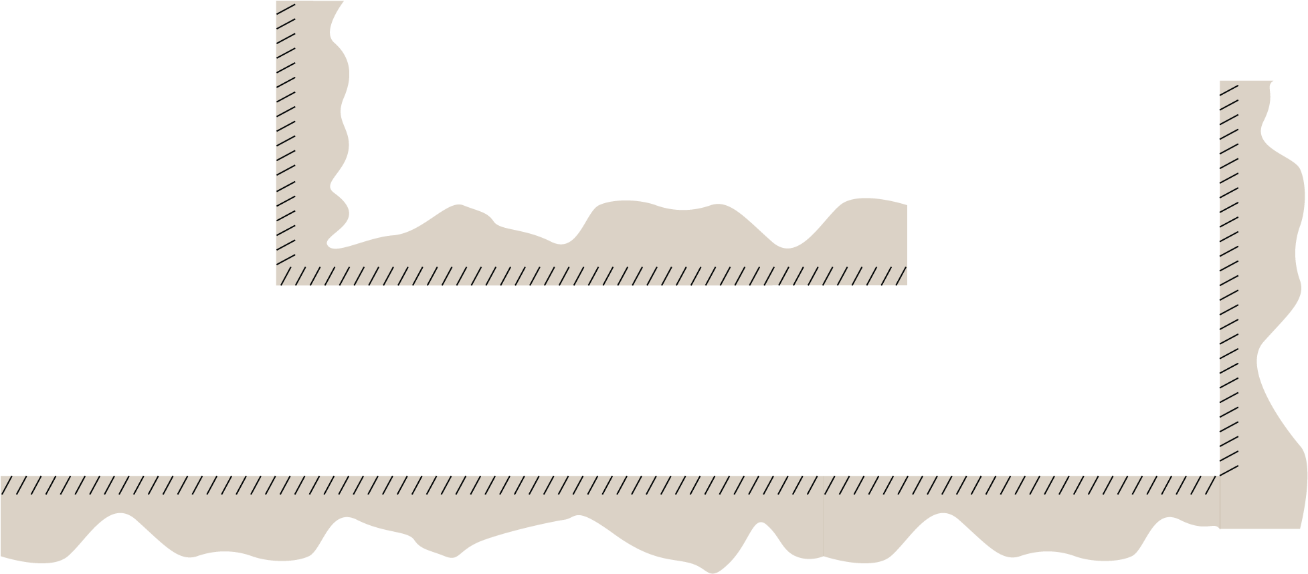
Issues
Notes:
The main downside of the current approaches is the termination/splitting factor based on local reflectance properties.

Slide 28
Issues
Notes:
While RR saves time by terminating paths with small throughput it may tremendously increase variance per path…

Slide 29
Issues
Notes:
… if only a fraction of them will make it to important regions.
This is particularly pressing in scenes with strong indirect illumination that is reflected several times of materials with rather low albedo.

Slide 30
Issues
Notes:
Splitting on the other hand decreases variance per primary ray cast from the camera but at the cost of tracing more rays in total.

Slide 31
Issues
Notes:
Unfortunately, the cost becomes too high when we base splitting on the local material properties and split also in regions where the total path contribution will be small.

Slide 32
Our method
Notes:
What we achieve is a combination of Russian roulette and splitting that terminates paths which have a little chance to make a significant contribution,

Slide 33
Our method
Notes:
allows to survive long paths heading for a significant contribution,

Slide 34
Our method
Notes:
and splits the path when its expected contribution is high.

Slide 35
Our adjoint-driven method
Notes:
I’m going to talk about our adjoint-driven Russian roulette and splitting in more detail.

Slide 36
Our ADRRS
ADRRS
Notes:
To compute the termination/splitting factor q at a point y for a path that came from a direction omega_i,
we compute an expected contribution of the path.

Slide 37
Our ADRRS
ADRRS
Notes:
This expected contribution is a product of the current path weight and reflected adjoint solution.
In this path tracing example the adjoint is simply the reflected radiance from y into the direction omega_i.
The splitting factor q is then a ratio of this expected contribution…

Slide 38
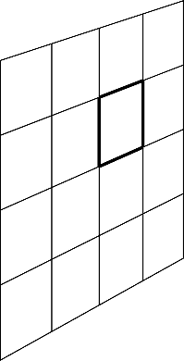
Path weight under ADRRS
ADRRS
Notes:
and value of the computed pixel estimate I.
Of course we do not know precisely the value of I nor L.
These are the quantities that we want to compute in the first place.
We use only their precomputed approximations and I will get back to them later.

Slide 39
Path weight under ADRRS
ADRRS
Notes:
Now I want to show what happens with the path weight under application of our ADRRS.

Slide 40
Path weight under ADRRS
ADRRS
Notes:
Recall that when a path survives or is split we need to divide the current path weight by the factor q.

Slide 41
Path weight under ADRRS
ADRRS
Notes:
This simply results into the ratio of the pixel value I and the reflected radiance.
So clearly under our approach the weight of each path that has landed in y from a direction omega_i looks like this ratio.

Slide 42
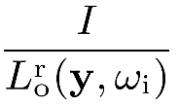
Path weight under ADRRS
Notes:
We can depict the situation on this simple weight chart.

Slide 43
Path weight under ADRRS
Notes:
When the incoming weight is higher than this ratio…

Slide 44
Path weight under ADRRS
split
Notes:
… we split the path and each resulting path will have the weight equal to this ratio.

Slide 45
Path weight under ADRRS
split
Notes:
Similarly, when the weight is lower that the demanded ratio…

Slide 46
Path weight under ADRRS
split
roulette
Notes:
… we play Russian roulette.

Slide 47
Weight window
Notes:
However, in our implementation we allow some leeway and we force the path weight to lie in an interval centered at the demanded weight ratio.

Slide 48
Weight window
split
roulette
Notes:
so in fact we play roulette so that surviving paths have weight at the lower boundary delta minus while we split path so that the resulting path weights are at the top boundary delta plus.

Slide 49
Weight window
split
pass through
roulette
Notes:
If the path weight lies within the interval we let the path survive without playing roulette or splitting.
This technique is called weight-window and we adopt it from neutron transport simulations.
The weight window makes our algorithm more robust to the inaccuracies of our measurement and radiance estimates.

Slide 50
Weight window
split
pass through
roulette
Notes:
We set the weight-window size so that the upper boundary is five times the lower boundary.
We experimented with different window sizes and it turned out that the method is not particularly sensitive to that parameter.

Slide 51
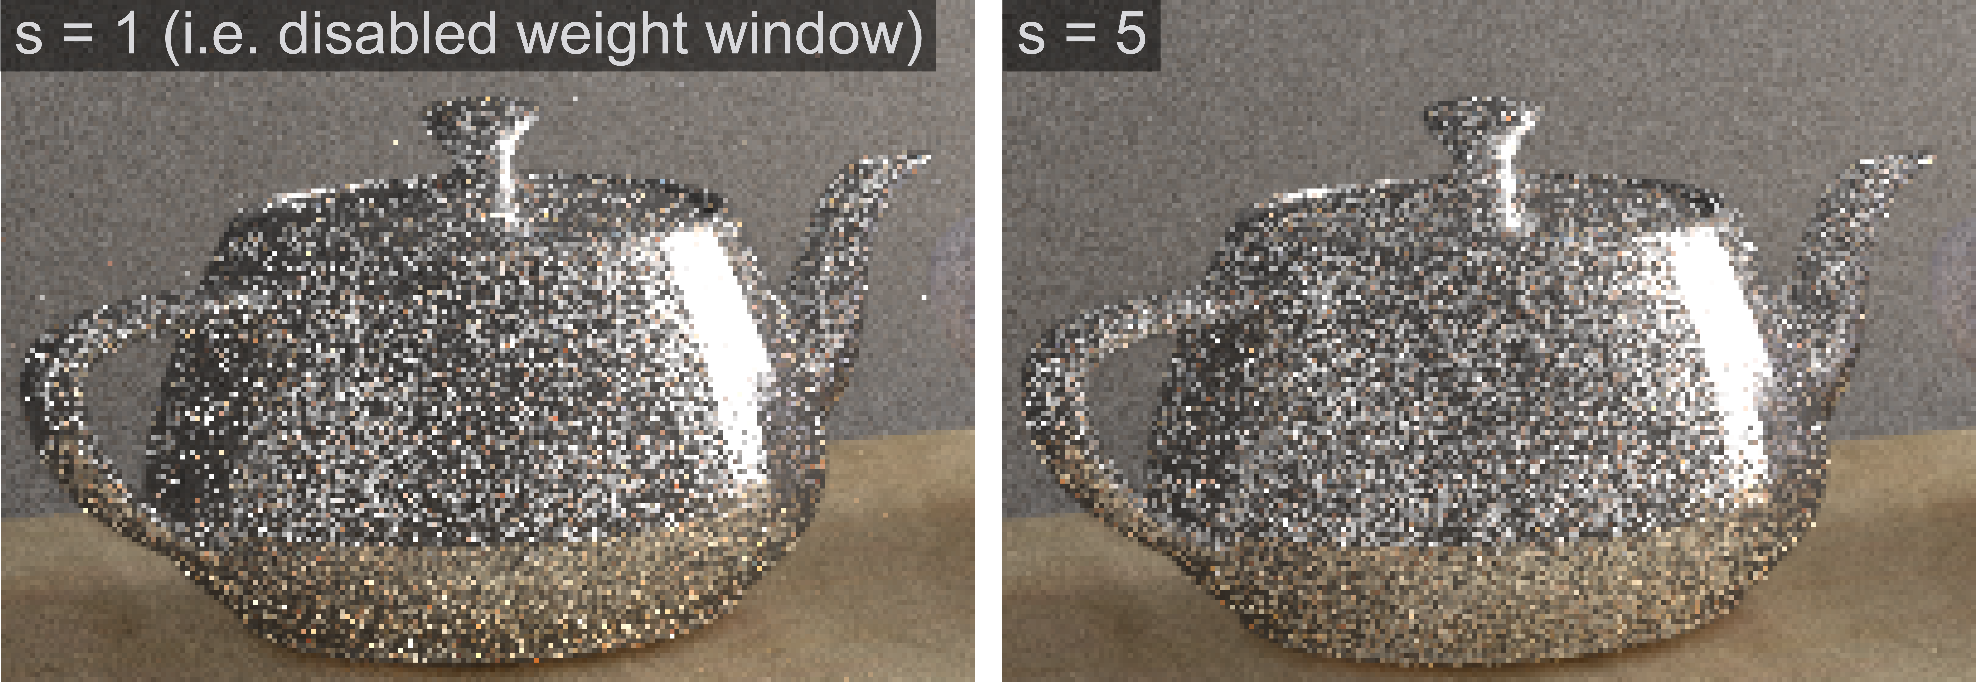
Weight window
Notes:
There is a comparison of not using a weight window on the left image to weight window of size 5.
We can see that the weight window prevented some high frequency noise around the tea pot and that for example the reflection of the table in the teapot is less noisy as well.

Slide 52
Computing estimates
Notes:
Now I am going to say more about how we compute the estimates necessary for setting-up a weight window.

Slide 53
Computing estimates
ADRRS
Notes:
I will recall that to set up the weight window at the position y we need to estimate the pixel value I and the radiance reflected towards our path.

Slide 54
Computing estimates
Options
Irradiance cache [Ward et al. 1998]
Radiance cache [Křivánek et al. 2005]
Our approach
Path guiding [Vorba et al. 2014]
Notes:
To get the approximation of the radiance field we could for example precompute irradiance or radiance cache.
However, instead of implementing the cache according to works of Ward or Krivanek, we base our solution on our previous path guiding method.

Slide 55
Path guiding
Notes:
This method precomputes directional distributions in the scene and store them in a spatial cache.
Each yellow dot corresponds to such a distribution.
Each distribution is fitted so that it is roughly proportional to incident radiance.
As we can see in the illustration the method uses the distributions for sampling scattering directions in order to guide sampled paths towards the light sources.

Slide 56
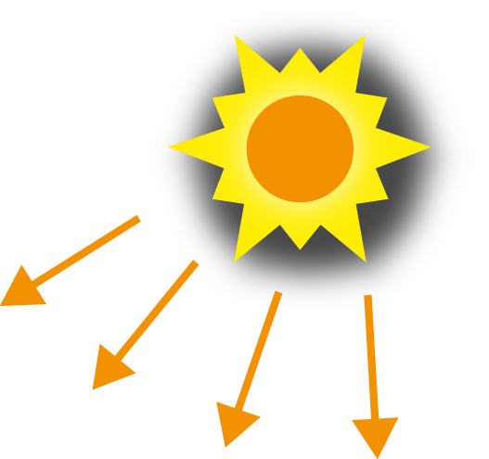
Path guiding: pre-computation
…
Notes:
In our ADRRS implementation we use the same precomputation step as the path guiding method.
It means that we run several interleaved steps in which we trace particles from the camera and photons from light sources.
During these steps the directional distributions are trained.
For ADRRS purposes, we additionally use the particles to estimate incident flux and we store this value with each distribution.

Slide 57
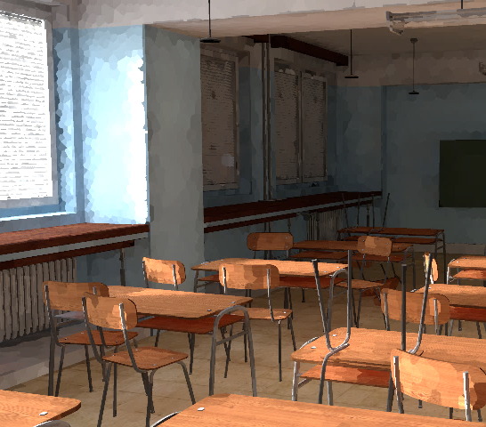
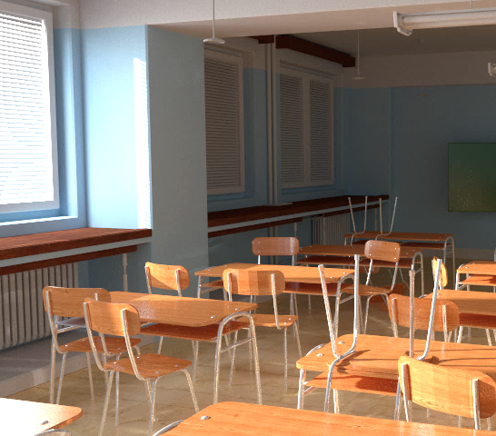
Pixel value estimates
Notes:
Here is a visualization of the approximation of reflected radiance that we achieve when we pretend that all materials are diffuse and we multiply the stored irradiance by albedo of used materials.
This is exactly what we use for the pixel value estimates I in our ADRRS.

Slide 58
Reflected radiance estimate
ADRRS
Notes:
To approximate the reflected radiance from y on secondary hits we use the same approach.
We use the irradiance and albedo at y.
However, such approximation underestimates glossy materials.

Slide 59
Reflected radiance estimate
ADRRS
Notes:
To achieve better approximation we also use directional distribution and stored irradiance at x.

Slide 60
Reflected radiance estimate
ADRRS
Notes:
This gives us an estimate of incident radiance at x and if y is not a light source and there is not a medium in the scene these two are equal.
We always take the maximum of these two estimates.
This is a conservative decision because higher value means smaller probability that the path gets terminated (if it is a bad decision then the path is likely to be terminated at next vertex).

Slide 61
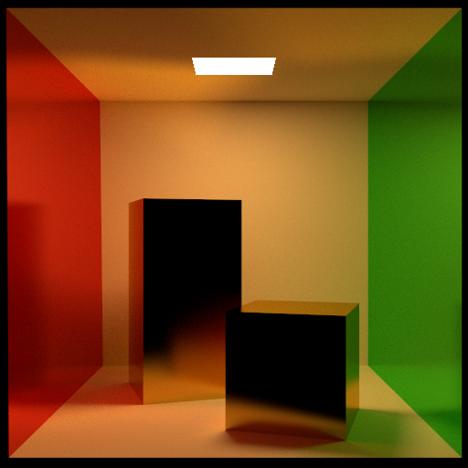
ADRRS on glossy surfaces
Irradiance only
Directional estimate
Notes:
Here on the right inset we can see the effect of better estimate of reflected radiance when we use also the directional information.
The left inset uses only irradiance multiplied by albedo.
(This leads to higher termination rates and thus to increased noise.)

Slide 62
Path guiding
Notes:
To this end I was talking about path guiding only as a convenient method that we exploited instead of implementing radiance or irradiance caches.
Now I would like to stress out that our ADRRS and path guiding pursue the same goal: better importance sampling of indirect illumination.

Slide 63
Path guiding vs ADRRS
Path guiding
Notes:
However, each through different means.
While guiding methods change the directional sampling distributions in order to sample proportionally to the incident illumination, …

Slide 64
Path guiding vs ADRRS
ADRRS
Path guiding
Notes:
our method adjusts only path sampling weights through termination and splitting.
It turns out that using both methods in one simulation is actually beneficial.

Slide 65
Path guiding and classic RR
Notes:
In fact, if we use classic local based approach to RR together with path guiding we will kill paths before they can yield any significant contribution.

Slide 66
Importance sampling
Notes:
Now I would like to present our theoretical contribution that shed light on importance sampling properties of ADRRS.

Slide 67
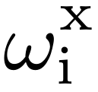
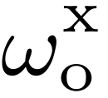
Importance sampling
ADRRS
Notes:
We show that the termination/splitting factor at vertex y is actually given by the ratio of ideal zero-variance sampling distribution at the previous vertex x and actually used sampling distribution at x.
The actual distribution p can be proportional to BSDF or guiding distribution as I mentioned before.

Slide 68
Importance sampling
ADRRS
Notes:
The ideal zero-variance distribution is proportional to the product of incident radiance, bsdf and cosine term at x.

Slide 69
Importance sampling
ADRRS
Notes:
This form of the termination/splitting factor also reveals very nice property of our method:
splitting and termination at y only depends on event at x. Whatever happened before doesn’t matter. We always start with a clean slate.

Slide 70
Importance sampling
split
Notes:
We can see that whenever we undersample the ideal distribution in some direction we will split the path immediately at the next vertex to compensate this undersampling.

Slide 71
Importance sampling
split
roulette
Notes:
Similarly, if we cast way too many rays in some direction, Russian roulette will act as a rejection sampling to adjust the sample density.
(So we can see that our method steps in immediately when it detects that sampling didn’t go as it ideally should have. Then it tries to amend the wrong decision through termination and splitting. )

Slide 72
Photon tracing
Notes:
Before I show you our results, I should briefly say what needs to be done for algorithms based on tracing photons from light sources.

Slide 73
Path tracing
ADRRS
Notes:
To this end I was explaining our ADRRS on a path tracing example and we needed to know pixel estimates I and radiance estimates L.
For light tracing or photon mapping, we only need to change these two estimates.

Slide 74
Photon tracing
ADRRS
Notes:
So our paths now starts at lightsources.
First, because we do not know a priory what pixel the emitted path will contribute to…

Slide 75
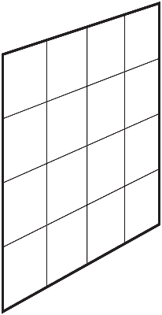
Photon tracing
ADRRS
Notes:
… we take an average over all pixels to get the pixel estimate I.

Slide 76
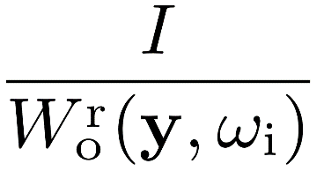
Photon tracing
ADRRS
Notes:
We also need to change the adjoint quantity that we use for setting up our weight window.
Now, instead of radiance, we need to use visual importance W emitted from camera.

Slide 77
Results
Notes:
Now I will present some of our results.

Slide 78
Reference
Notes:
We rendered all our results for one hour on Intel i7 with eight logical cores.
The preprocessing time is included in this one hour.

Slide 79
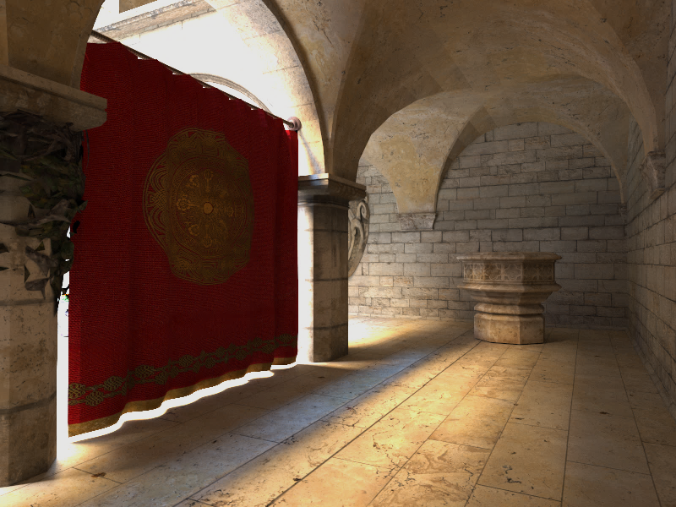
Path tracing
Plain
Notes:
We can see that path tracing with RR roulette is very inefficient on the indirect illumination.

Slide 80
Path tracing
Plain
+ our ADRRS
Notes:
Our ADRRS improves mainly indirect illumination transported over long paths.
We can see that it didn’t improve much the noise at the bottom part of the well.
This illumination comes only from one indirect bounce.

Slide 81
Reference
Notes:
In this scene, the living room is illuminated by sun and sky.
Light comes only through glass window and a small gap between the curtains.

Slide 82
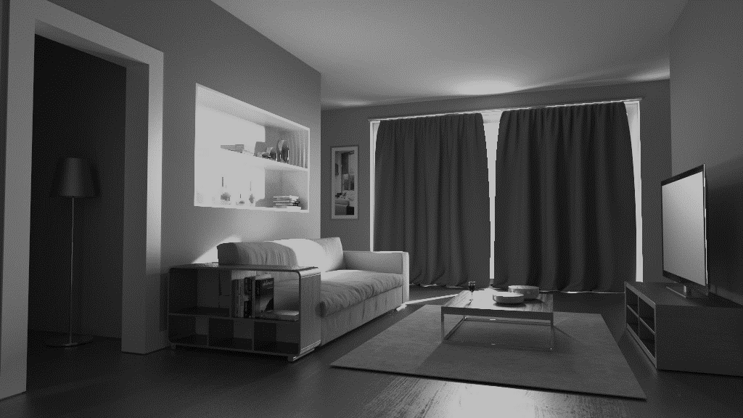
Path tracing
Plain
Notes:
These difficult conditions are showstopper for plain path tracing.

Slide 83
Path tracing
Plain
+ our ADRRS
Notes:
Our ADRRS doesn’t make any striking difference.
The main problem is that light can reach the light source only through very narrow set of directions.
Our ADRRS detects that we highly undersample these directions in the moment when path hits the window.
It is too late for splitting because all rays would be refracted in the same direction and end in the Sun.

Slide 84
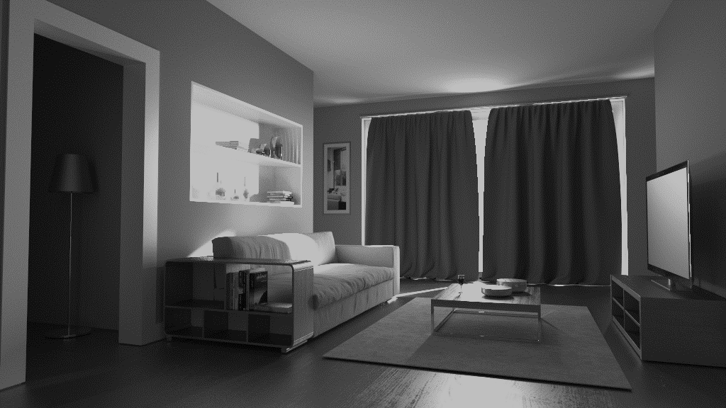
Path tracing
Plain
+ our ADRRS
Path guiding
Notes:
This is the scenario where path guiding achieves better results.

Slide 85
Path tracing
Plain
+ our ADRRS
Path guiding
+ our ADRRS
Notes:
However, we can see that path guiding clearly benefits from our ADRRS and together achieves better results.

Slide 86
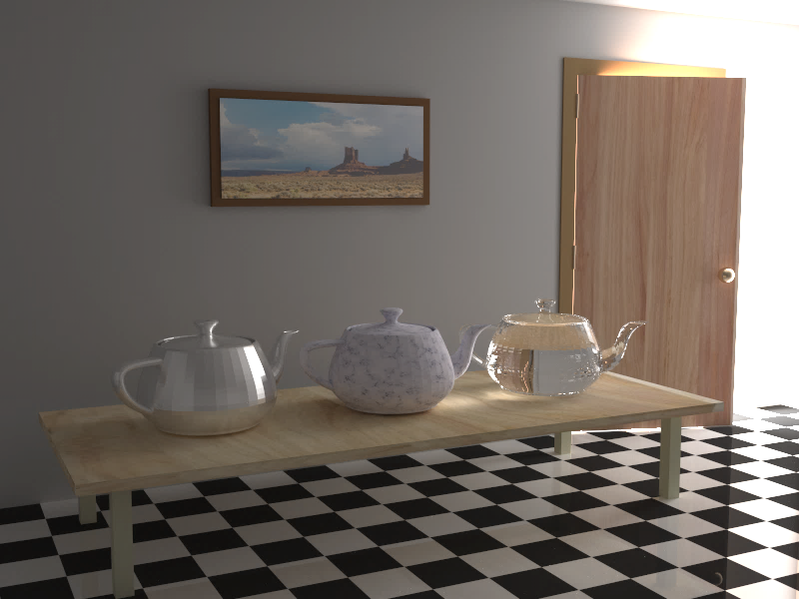
Reference
Notes:
I will present a result of our ADRRS in photon mapping on this famous scene with teapots and light source behind the doors.

Slide 87
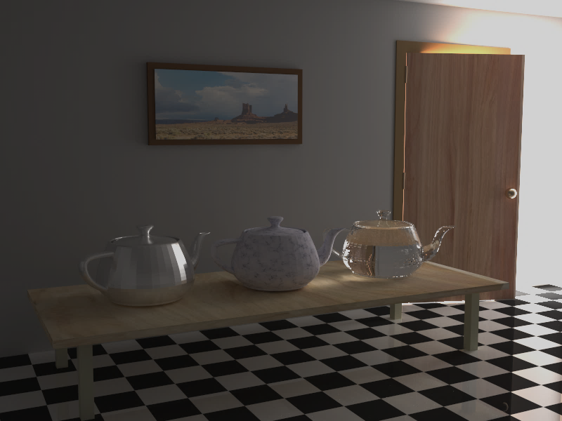
Plain
+ our ADRRS
Photon mapping
Notes:
It turns out that ADRRS performs especially well with photon based approaches.
The upper left inset shows plain progressive photon mapping.
( – note that we gather photons directly everywhere without any sort of final gathering except for glass.)

Slide 88
Plain
+ our ADRRS
Photon mapping
Path guiding
Notes:
In this scene our ADRRS actually outperforms even the path guiding method.

Slide 89
Plain
+ our ADRRS
Photon mapping
Path guiding
+ our ADRRS
Notes:
Together they achieve slightly better result only on the shiny teapot.

Slide 90
Limitations and future work

Slide 91
Limitations and future work
split
Limitations
Splitting on the next vertex
Inaccurate estimates (can increase variance)
Future Work
Participating media
Efficiency-driven RR and splitting
Notes:
As a major limitation, we consider the fact that the splitting does not take place on the same vertex where the sub-optimal directional sampling introduce the variance.
However, this is nicely complemented by path guiding methods that improve the directional sampling.

Slide 92
Limitations and future work
split
Limitations
Splitting on the next vertex
Inaccurate estimates (can increase variance)
Future Work
Participating media
Efficiency-driven RR and splitting
Pixel estimates
Notes:
Highly inaccurate adjoint or pixel measurement estimates can increase variance.
Because in our implementation we based our pre-computation on the same principles as photon mapping we can get highly inaccurate estimates due to light leaks.

Slide 93
Limitations and future work
split
Limitations
Splitting on the next vertex
Inaccurate estimates (can increase variance)
Future Work
Participating media
Efficiency-driven RR and splitting
Notes:
Because particles typically undergo many more events in media than on surfaces, we think that extension of our method to participating media would result in a substantially greater increase in efficiency than on surfaces.

Slide 94
Limitations and future work
split
Limitations
Splitting on the next vertex
Inaccurate estimates (can increase variance)
Future Work
Participating media
Efficiency-driven RR and splitting
Notes:
We based our termination/splitting rate on ideal importance sampling schemes.
However, an interesting avenue of future work is definitely exploring efficiency driven approach that would take into account also cost of sampled rays.

Slide 95
Conclusion
Termination/splitting factor based on expected path contribution
Practical implementation
Glossy, specular materials
Works well also with path guiding
Theoretical justification
Notes:
We suggest termination/splitting factor based on approximation of adjoint solution and current path weight as opposed to local reflectance properties in the state-of-the-art methods.

Slide 96
Conclusion
Termination/splitting factor based on expected path contribution
Practical implementation
Glossy, specular materials
Works well also with path guiding
Theoretical justification
Notes:
We achieved practical implementation of the suggested approach that is robust even in the presence of glossy and specular materials in the scene.

Slide 97
Conclusion
Termination/splitting factor based on expected path contribution
Practical implementation
Glossy, specular materials
Works well also with path guiding
Theoretical justification
Notes:
We showed that it works in synergy with path guiding methods.

Slide 98
Conclusion
Termination/splitting factor based on expected path contribution
Practical implementation
Glossy, specular materials
Works well also with path guiding
Theoretical justification
Notes:
And we provided theoretical justification of importance sampling properties of our approach which also explains its limitations.

Slide 99
Acknowledgements
Funding institutions
Charles University in Prague
Czech Science Foundation
Scenes
Ludvík Koutný
Jaakko Lehtinen et al.
Frank Meinl
Toshiya Hachisuka
Notes:
We would like to thank the following people and institutions for their help and funding
(We also thank to anonymous reviewers for their thoughtful comments.)

Slide 100
Source code
Demo in
(Coming soon)
http://cgg.mff.cuni.cz/~jirka/papers/2016/adrrs/index.htm
Notes:
We based our implementation on Mitsuba renderer and we will publish the source code very soon.

Slide 101
Thank you!
Demo in
(Coming soon)
http://cgg.mff.cuni.cz/~jirka/papers/2016/adrrs/index.htm
Notes:
Thank you.

Slide 102
Additional slides

Slide 103
Non-integer splitting
Notes:
To cope with the non-integer values in the splitting factor q,
we probabilistically split into ...

Slide 104
Non-integer splitting
Notes:
… either closest smaller integer n with the probability n + 1 – q …

Slide 105
Non-integer splitting
Notes:
… or into n + 1 paths with probability q – n.

Slide 106
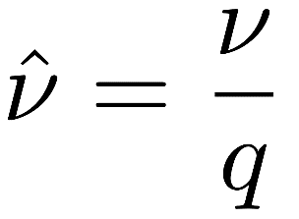
Non-integer splitting
Notes:
The weight of each new path is computed using the real split factor q and is the same regardless of whether we happen to split into n or n+1 paths.
This approach is unbiased in the expected value sense.

Slide 107
Next-event estimation
Notes:
In our implementation when path is split into n rays in a vertex y we use exactly the same number of next-event estimation samples in that vertex.
Reasoning behind this decision is motivated by the fact that splitting happens when we enter more important regions where expected contribution is high.
So the splitting is also very likely to happen when path enters a directly lit region.

Slide 108
Reference

Slide 109
Path tracing - baseline

Slide 110
Path tracing - ADRRS

Slide 111
Path tracing – path guiding

Slide 112
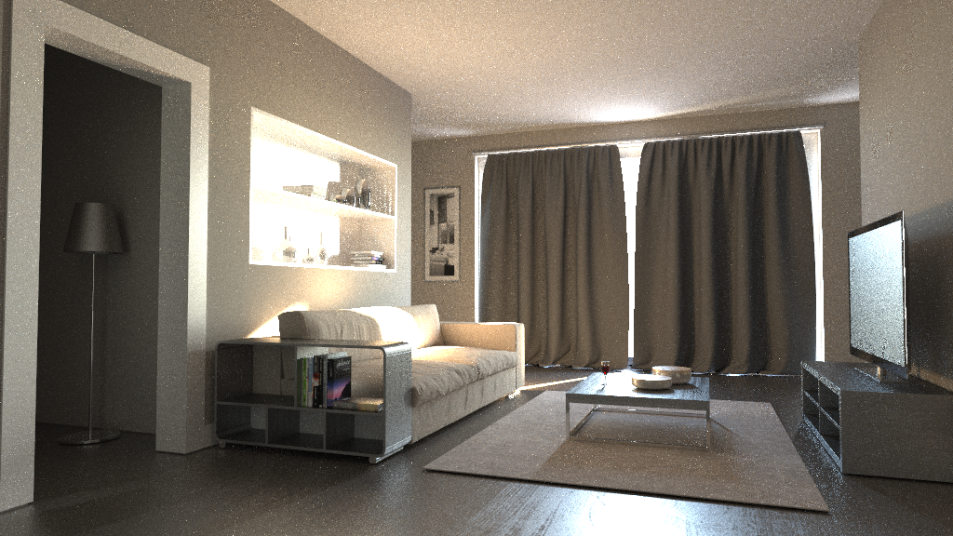
Path tracing – ADRRS + path guiding

