Slide 1
Product Importance Sampling for Light Transport Path Guiding
Sebastian Herholz¹ Oskar Elek² Jiří Vorba^{2,3}
Hendrik Lensch¹ Jaroslav Křivánek²
¹University Tübingen ²Charles University Prague ³Weta Digital

Slide 2
Motivation
Motivation | Product Importance Sampling | BRDF Fitting | Component Reduction | Results | Future Work

Slide 3
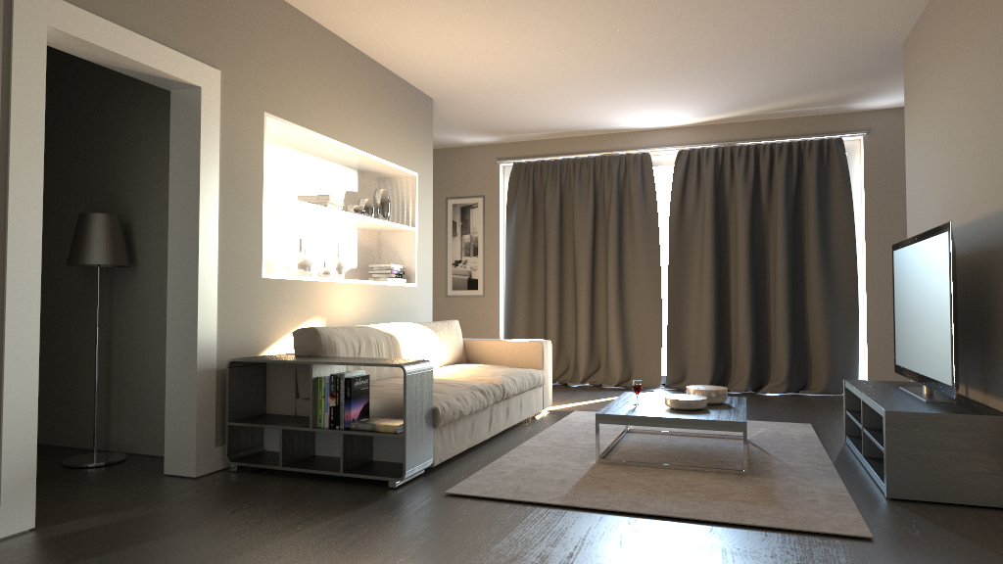
Reference
VCM (3 weeks)
Reference
(4 weeks)

Slide 4
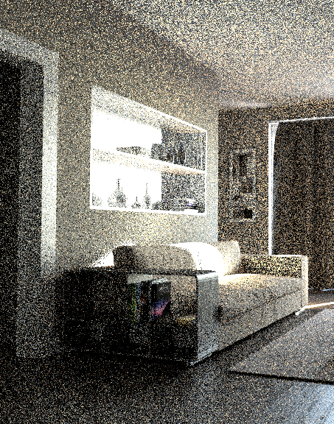
BDPT
(1hr)

Slide 5

BDPT
(1hr)
Reference
VCM (3 weeks)
Vorba2014
(1hr)

Slide 6

Our
(1hr)
Reference
VCM (3 weeks)
Vorba2014
(1hr)

Slide 7
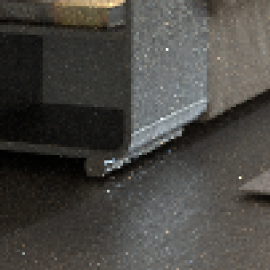
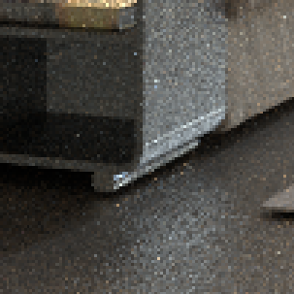
Our
(1hr)
Reference
VCM (3 weeks)
Vorba2014
(1hr)

Slide 8
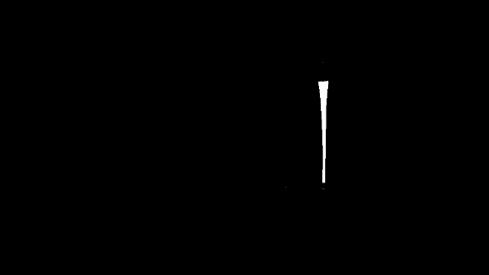
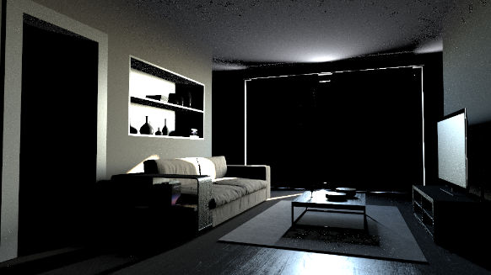
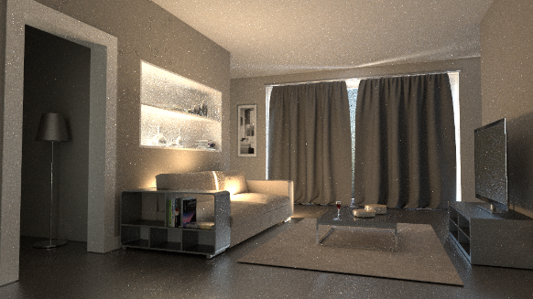



Light Transport: Rendering Equation
$$L_{o}=L_{e}+\int_{Ω}{f_{r}⋅L_{i}⋅cosθ⋅d{\vec{ω}}_{i}}$$
$$L_{R}$$
emission
direct
indirect
combined
Notes:
Explain Rendering equation:
Le and direct illumination is relativly easy to approximate.
Indirect component of Lr can be tricky, dependending on
Scene cpmplexity and materials
Build up the emission, direct and indirect Compentents in an animation.
Highlight exht part of the RE while the components appear

Slide 9
Light Transport: Rendering Equation
$$L_{o}=L_{e}+\int_{Ω}{f_{r}⋅L_{i}⋅cosθ⋅d{\vec{ω}}_{i}}$$
$$L_{R}$$
emission
direct
indirect
combined
Notes:
Explain Rendering equation:
Le and direct illumination is relativly easy to approximate.
Indirect component of Lr can be tricky, dependending on
Scene cpmplexity and materials
Build up the emission, direct and indirect Compentents in an animation.
Highlight exht part of the RE while the components appear

Slide 10


Bidirectional Reflectance Distribution Function (BRDF)
$$L_{R}=\int_{Ω}{f_{r}⋅L_{i}⋅cosθ⋅d{\vec{ω}}_{i}}$$
Notes:
Tell how an optimal sampling would look like
Explain that this kind of sampling would need to know the light transport
Upfront.
If the pdf differs from the integrant variance can increase

Slide 11
Incomming Illumination
$$L_{R}=\int_{Ω}{f_{r}⋅L_{i}⋅cosθ⋅d{\vec{ω}}_{i}}$$
Notes:
Tell how an optimal sampling would look like
Explain that this kind of sampling would need to know the light transport
Upfront.
If the pdf differs from the integrant variance can increase

Slide 12

Reflectance Integral
$$L_{R}=\int_{Ω}{f_{r}⋅L_{i}⋅cosθ⋅d{\vec{ω}}_{i}}$$
Notes:
Tell how an optimal sampling would look like
Explain that this kind of sampling would need to know the light transport
Upfront.
If the pdf differs from the integrant variance can increase

Slide 13
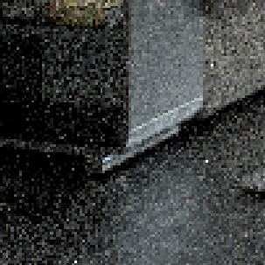

BRDF-based Sampling
$$p_{f_{r}}\left(ω_{i} | ω_{o},x\right)∝f_{r}\left(x,{\vec{ω}}_{o},{\vec{ω}}_{i}\right)$$
Notes:
Explain the current sampling/path generation is based on BSDF sampling
Next event estimation can be used to additionally sample direct illumination at each intersection point
(show graphic)

Slide 14

Guided Illumination Sampling
$$p_{L}\left(ω_{i} | ω_{o},x\right)∝L_{i}\left(x, {\vec{ω}}_{i}\right)⋅cosθ$$
[Vorba: Participating Media Illumination Using Light Propagation Maps, ACM ToG, 2009]
Notes:
Vorba et all. Presented a method to increase indirect illumination sampling by
Sampling an approximation of the indirect illumination

Slide 15
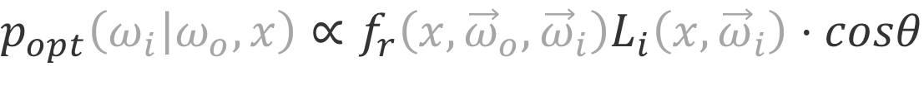
Optimal (Product) Sampling
$$p_{opt}\left(ω_{i} | ω_{o},x\right)∝f_{r}\left(x,{\vec{ω}}_{o},{\vec{ω}}_{i}\right)L_{i}\left(x,{\vec{ω}}_{i}\right)⋅cosθ$$
Notes:
Tell how an optimal sampling would look like
Explain that this kind of sampling would need to know the light transport
Upfront.
If the pdf differs from the integrant variance can increase
Algorithms for optimal sampling only exists for direct illumination when an envmap or distance pointlights are used

Slide 16
Related Work
[CAM08]: Practical product importance
sampling for direct illumination
[TCE05]: Importance resampling for global illumination
[CJAMJ05]: Wavelet importance sampling: efficiently evaluating products of complex functions
[JCJ09]: Importance sampling spherical harmonics

Slide 17
Product Importance Sampling
Motivation | Product Importance Sampling | BRDF Fitting | Component Reduction | Results | Future Work

Slide 18
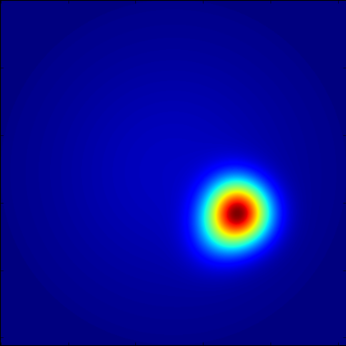

BRDF GMM Representation
$$p_{f_{r}}\left(ω_{i} | ω_{o},x\right)≈G_{f_{r}}(y,Θ)$$
Notes:
Show that the BRDF lobe can be represented by a GMM
Maybe different incident angles?

Slide 19
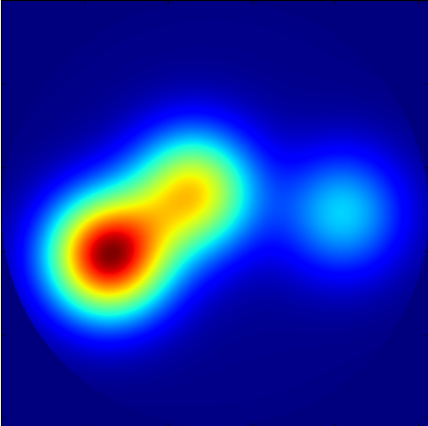

Illumination GMM Representation
$$p_{L}\left(ω_{i} | ω_{o},x\right)≈G_{L}(y,Θ)$$
Notes:
Show how the illumination times cosine can be represented by a GMM

Slide 20

Gaussian Mixture Model (GMM)
$$−∞ ∞$$
$$G_{ }\left(y,Θ\right)=\sum^{K}{ π_{i}N(y,μ_{i},Σ_{i}) }$$
$$Θ=\{π_{0}…,μ_{0}…,Σ_{0}…\}$$

Slide 21
Gaussian Mixture Model (GMM)
$$−∞ ∞$$
$$G_{ }\left(y,Θ\right)=\sum^{K}{ π_{i}N(y,μ_{i},Σ_{i}) }$$
$$Θ=\{π_{0}…,μ_{0}…,Σ_{0}…\}$$

Slide 22
Gaussian Mixture Model (GMM)
$$−∞ ∞$$
$$G_{ }\left(y,Θ\right)=\sum^{K}{ π_{i}N(y,μ_{i},Σ_{i}) }$$
$$Θ=\{π_{0}…,μ_{0}…,Σ_{0}…\}$$

Slide 23
Gaussian Mixture Model (GMM)
$$−∞ ∞$$
$$G_{ }\left(y,Θ\right)=\sum^{K}{ π_{i}N(y,μ_{i},Σ_{i}) }$$
$$Θ=\{π_{0}…,μ_{0}…,Σ_{0}…\}$$

Slide 24
Product of two Gaussians is a Gaussian
$$−∞ ∞$$
$π_{i}N\left(y,μ_{i},Σ_{i}\right)⋅π_{j}N\left(y,μ_{j},Σ_{j}\right)=π_{ij}N(y,μ_{ij},Σ_{ij})$
$$μ_{ij}=Σ_{i}{\left(Σ_{i}+Σ_{j}\right)}^{−1}{μ_{j}+Σ}_{j}{\left(Σ_{i}+Σ_{j}\right)}^{−1}μ_{i}$$
$$Σ_{ij}=Σ_{i}{\left(Σ_{i}+Σ_{j}\right)}^{−1}Σ_{j}$$
$w_{ij}=w_{i}w_{j}N(μ_{i},μ_{j},Σ_{i}+Σ_{j})$

Slide 25
Product of two Gaussians is a Gaussian
$$−∞ ∞$$
$π_{i}N\left(y,μ_{i},Σ_{i}\right)⋅π_{j}N\left(y,μ_{j},Σ_{j}\right)=π_{ij}N(y,μ_{ij},Σ_{ij})$
$$μ_{ij}=Σ_{i}{\left(Σ_{i}+Σ_{j}\right)}^{−1}{μ_{j}+Σ}_{j}{\left(Σ_{i}+Σ_{j}\right)}^{−1}μ_{i}$$
$$Σ_{ij}=Σ_{i}{\left(Σ_{i}+Σ_{j}\right)}^{−1}Σ_{j}$$
$w_{ij}=w_{i}w_{j}N(μ_{i},μ_{j},Σ_{i}+Σ_{j})$

Slide 26
Product of two Gaussians is a Gaussian
$$−∞ ∞$$
$π_{i}N\left(y,μ_{i},Σ_{i}\right)⋅π_{j}N\left(y,μ_{j},Σ_{j}\right)=π_{ij}N(y,μ_{ij},Σ_{ij})$
$$μ_{ij}=Σ_{i}{\left(Σ_{i}+Σ_{j}\right)}^{−1}{μ_{j}+Σ}_{j}{\left(Σ_{i}+Σ_{j}\right)}^{−1}μ_{i}$$
$$Σ_{ij}=Σ_{i}{\left(Σ_{i}+Σ_{j}\right)}^{−1}Σ_{j}$$
$w_{ij}=w_{i}w_{j}N(μ_{i},μ_{j},Σ_{i}+Σ_{j})$

Slide 27
Product of two Gaussians is a Gaussian
$$−∞ ∞$$
$π_{i}N\left(y,μ_{i},Σ_{i}\right)⋅π_{j}N\left(y,μ_{j},Σ_{j}\right)=π_{ij}N(y,μ_{ij},Σ_{ij})$
Full GMM product contains $K^{2}$ components
$$μ_{ij}=Σ_{i}{\left(Σ_{i}+Σ_{j}\right)}^{−1}{μ_{j}+Σ}_{j}{\left(Σ_{i}+Σ_{j}\right)}^{−1}μ_{i}$$
$$Σ_{ij}=Σ_{i}{\left(Σ_{i}+Σ_{j}\right)}^{−1}Σ_{j}$$
$w_{ij}=w_{i}w_{j}N(μ_{i},μ_{j},Σ_{i}+Σ_{j})$

Slide 28
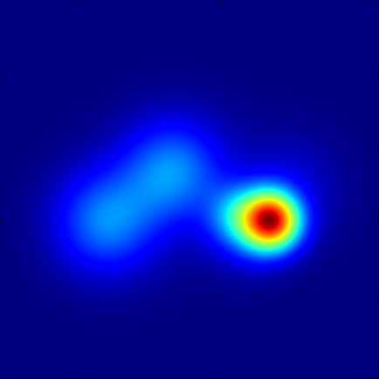
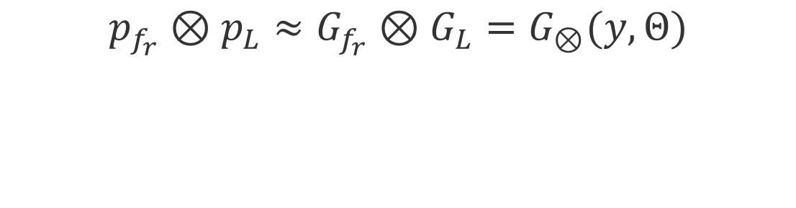
Product GMM Representation
$$p_{f_{r}}⊗p_{L}≈G_{f_{r}}⊗G_{L}=G_{⊗}(y,Θ)$$
Notes:
Show that the product of two GMMs is again a GMM

Slide 29
Product GMM Representation
Notes:
Show that the product of two GMMs is again a GMM

Slide 30

Pipeline
Pre-Processing
Rendering
Path Tracer
GuidedProductBRDF
Illum. Fit
Weight Window RR
BRDF Fit
Notes:
Right after Product

Slide 31
Pipeline
Pre-Processing
Rendering
Path Tracer
GuidedProductBRDF
Illum. Fit
Weight Window RR
BRDF Fit
Notes:
Right after Product

Slide 32
Pipeline
Pre-Processing
Rendering
Path Tracer
GuidedProductBRDF
Illum. Fit
Weight Window RR
BRDF Fit
Notes:
Right after Product

Slide 33
Pipeline
Pre-Processing
Rendering
Path Tracer
GuidedProductBRDF
Illum. Fit
Weight Window RR
BRDF Fit
Notes:
Right after Product

Slide 34
Pipeline
Pre-Processing
Rendering
Path Tracer
GuidedProductBRDF
Illum. Fit
Weight Window RR
BRDF Fit
Notes:
Right after Product

Slide 35
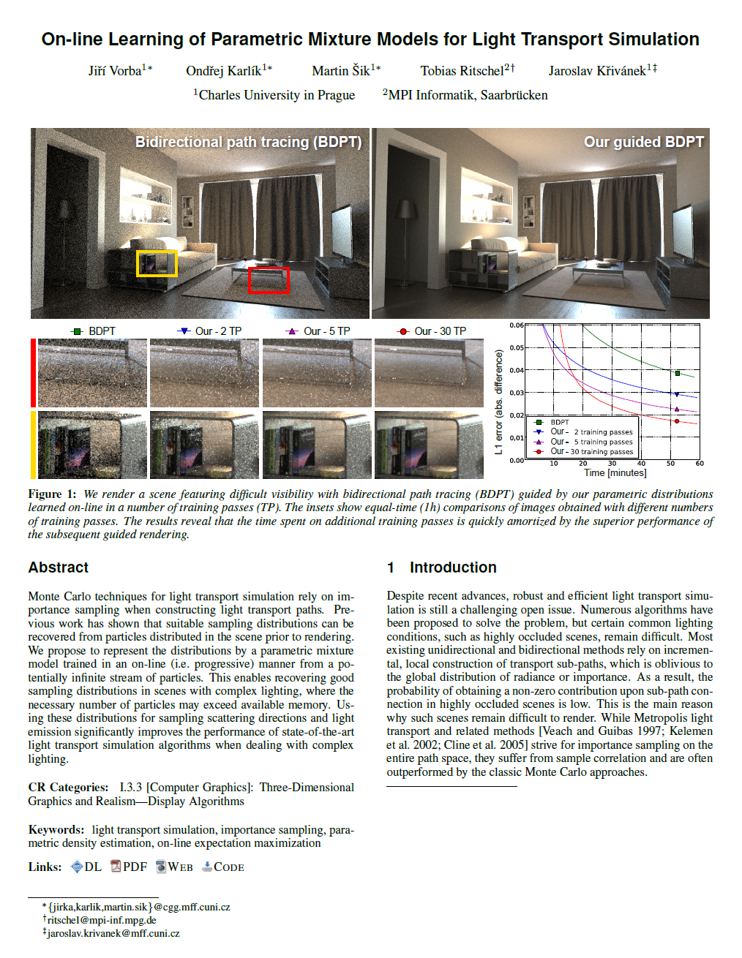




Illumination Fit: [Vorba2014]
GMM Illumination caches
[Vorba2014]

Slide 36
BRDF Fitting and Caching
Motivation | Product Importance Sampling | BRDF Fitting | Component Reduction | Results | Future Work

Slide 37
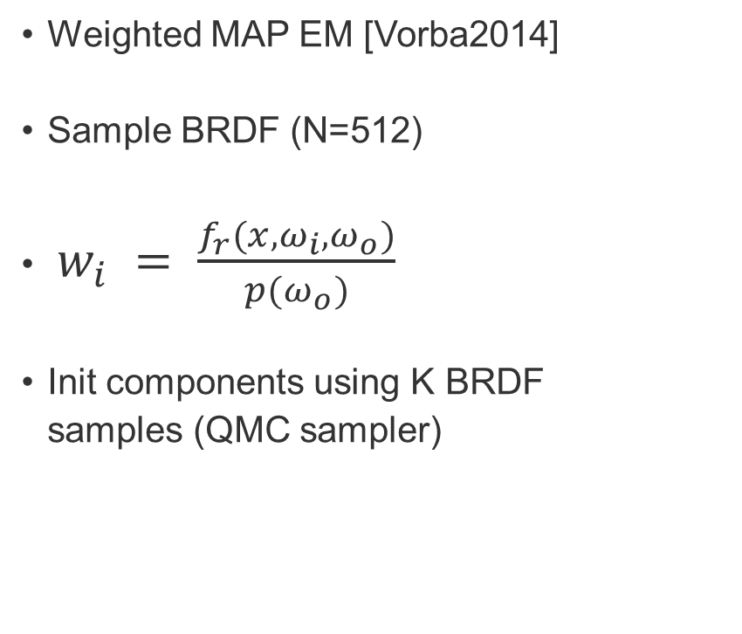

Fitting BRDF GMM
Weighted EM
CERES
Weighted MAP EM [Vorba2014]
Sample BRDF (N=512)
$w_{i} = \frac{f_{r}(x,ω_{i},ω_{o})}{p(ω_{o})}$
Init components using K BRDF
samples (QMC sampler)
Non-linear optimization
Init with weighted EM
Objective function:
$$\sum_{i}^{N}{{\left[1−\frac{\hat{f_{r}}\left(ω_{i}\right)}{G\left(y | Θ\right)}\right]}^{2}}$$
Notes:
Explain the two fitting strategies:
wEM
How the samples are drawn.
Expalin the weight
Explain the initialzation
Ceres:
Explain the objective function
Explain the init using wEM.

Slide 38
Fitting BRDF GMM
Weighted EM
CERES
Weighted MAP EM [Vorba2014]
Sample BRDF (N=512)
$w_{i} = \frac{f_{r}(x,ω_{i},ω_{o})}{p(ω_{o})}$
Init components using K BRDF
samples (QMC sampler)
Non-linear optimization
Init with weighted EM
Objective function:
$$\sum_{i}^{N}{{\left[1−\frac{\hat{f_{r}}\left(ω_{i}\right)}{G\left(y | Θ\right)}\right]}^{2}}$$
Notes:
Explain the two fitting strategies:
wEM
How the samples are drawn.
Expalin the weight
Explain the initialzation
Ceres:
Explain the objective function
Explain the init using wEM.

Slide 39
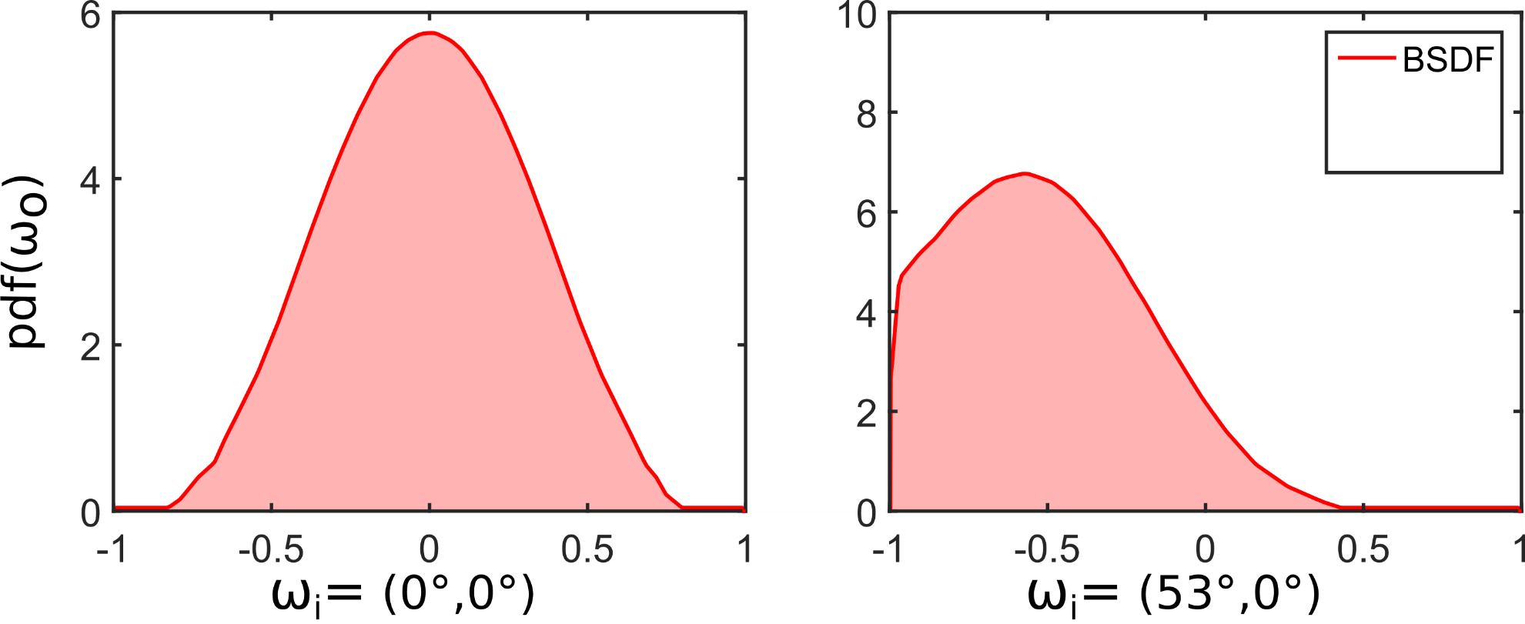
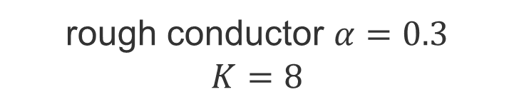
wEM vs CERES
rough conductor $α=0.3$
$$K=8$$
Notes:
Show here that wEM does a good job when the roughness decreases.

Slide 40
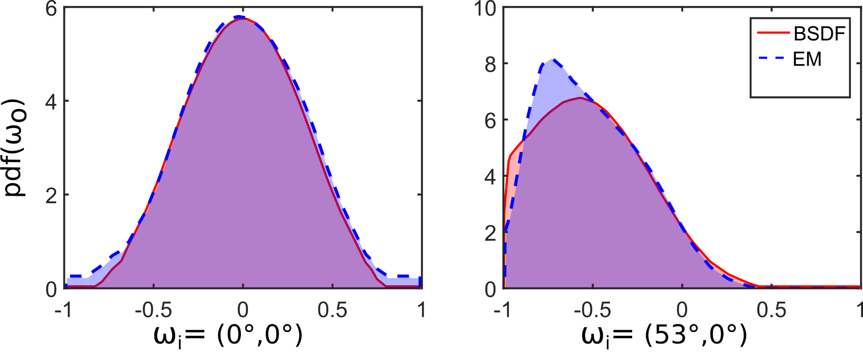
wEM vs CERES
rough conductor $α=0.3$
$$K=8$$
Notes:
Show here that wEM does a good job when the roughness decreases.

Slide 41
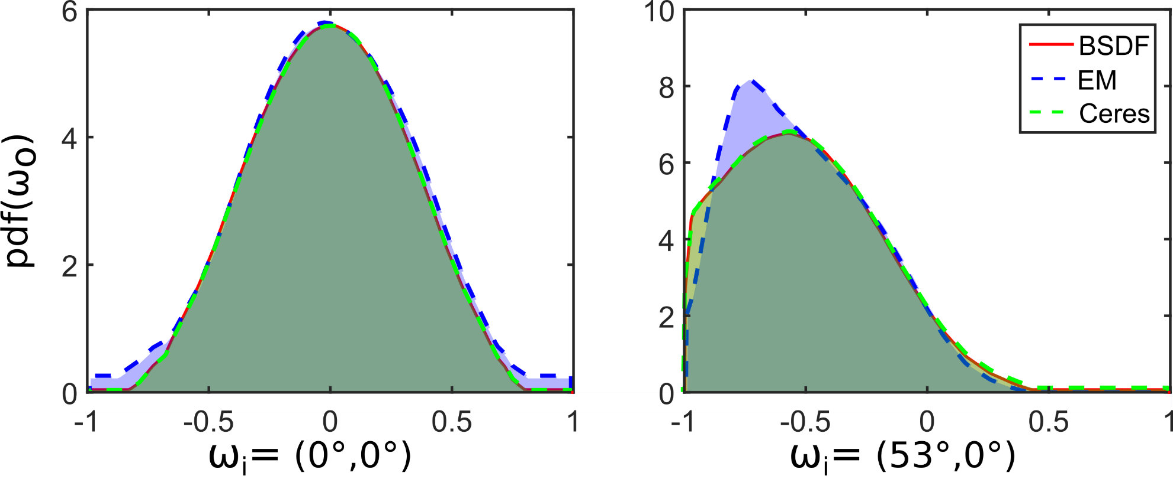
wEM vs CERES
rough conductor $α=0.3$
$$K=8$$
Notes:
Show here that wEM does a good job when the roughness decreases.
While Ceres is good it is expensive ....

Slide 42
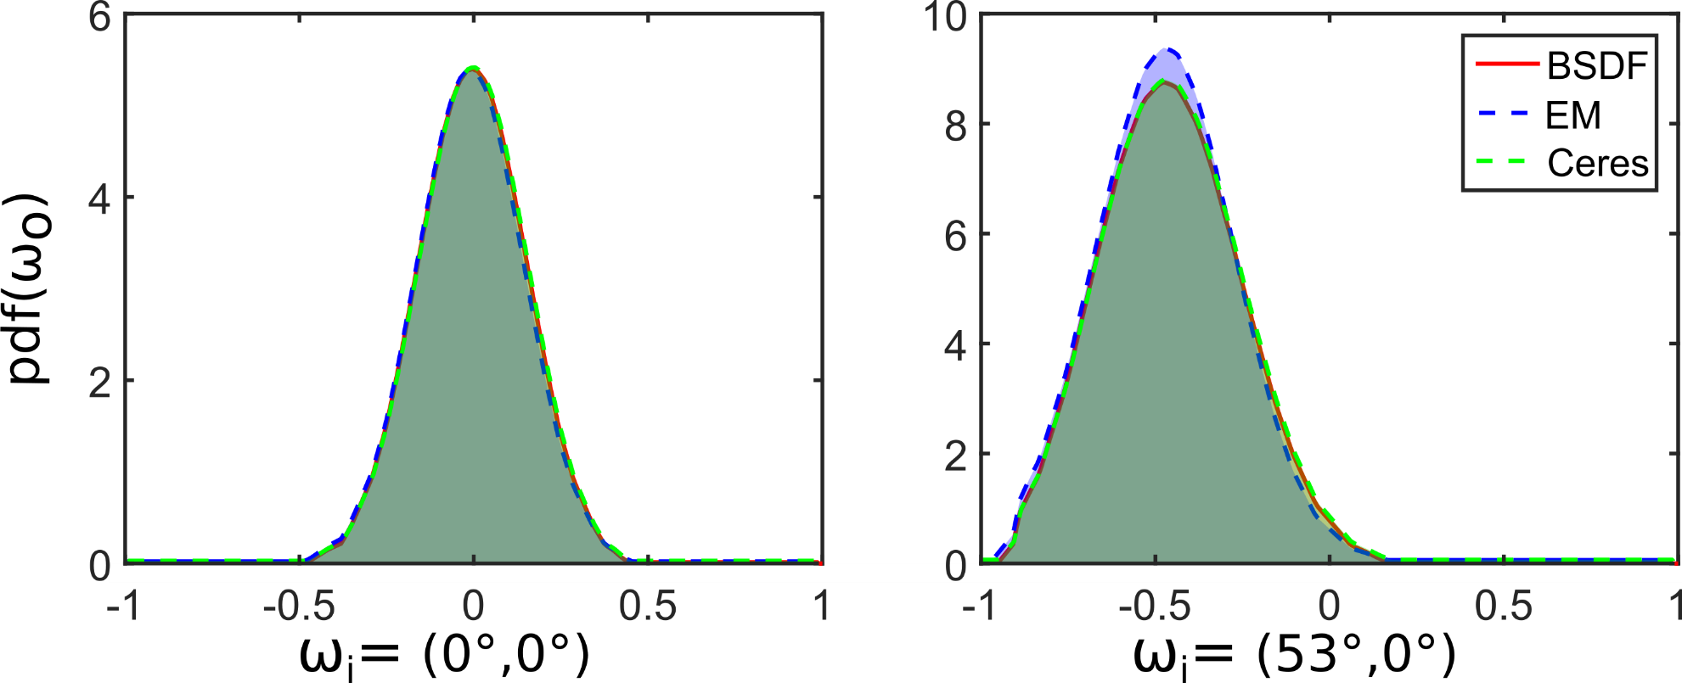
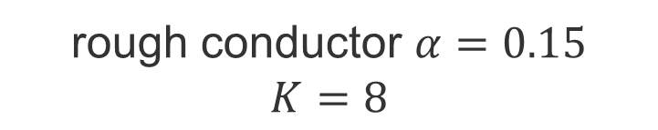
wEM vs CERES
rough conductor $α=0.15$
$$K=8$$
Notes:
Show here that wEM does a good job when the roughness decreases.

Slide 43
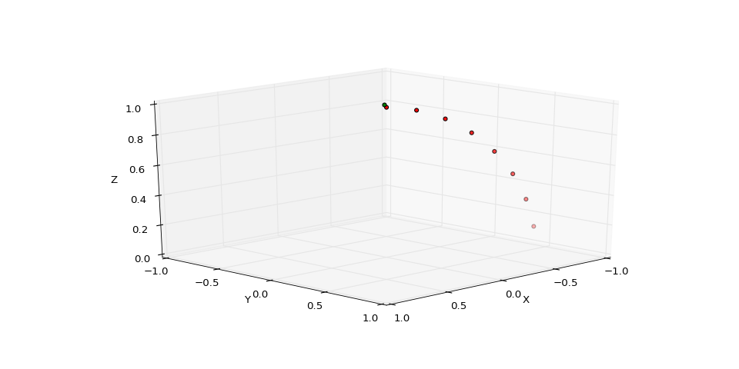
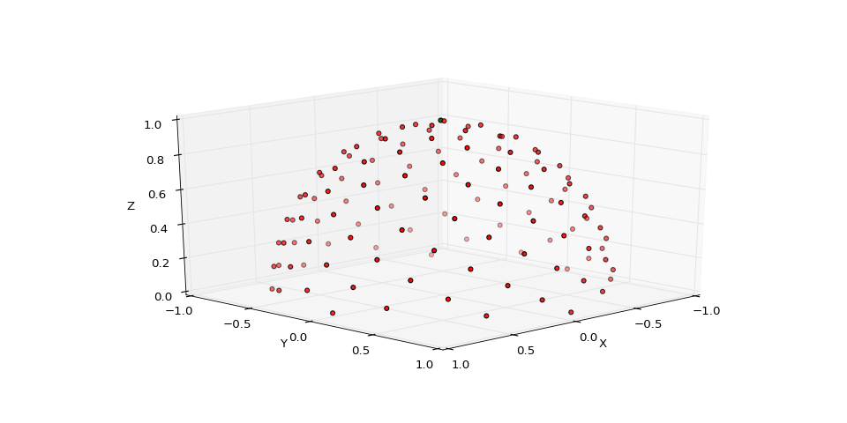
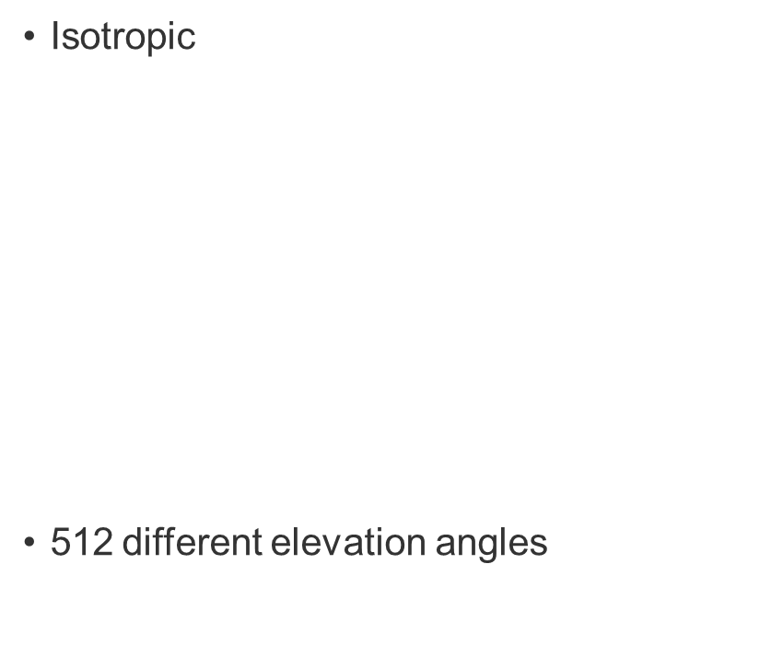
Caching
Isotropic
512 different elevation angles
Anisotropic
4096 spherical Fibonacci points [KISS15]
Notes:
Expalin that online fitting during rendering is to expensive.
Therefore, we decided to cache the GMM representations for the BRDF lobes.
The caches are calcualted in a pre-processing step for each material of the scene.
During rendering the GMM representation of the querried incident direction is fetched for mthe cache and used
to approximate the product.
Diffuse BRDFs are constant for every incident direction, therefore only one GMM is needed.
There are two different types of cahces one for isotropic BRDFs, which are rotationally independent and
anisotropic BRDFs, where the BRDF lobe is rotationally dependent.

Slide 44
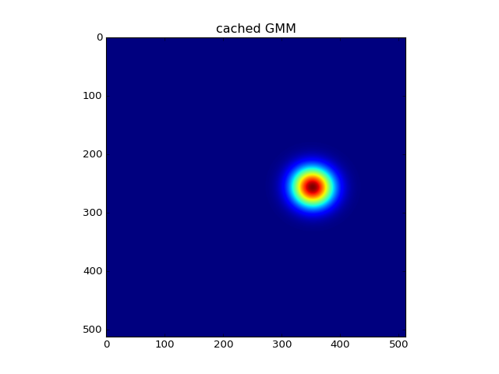
Caching
Isotropic
Notes:
Expalin that online fitting during rendering is to expensive.
Therefore, we decided to cache the GMM representations for the BRDF lobes.
The caches are calcualted in a pre-processing step for each material of the scene.
During rendering the GMM representation of the querried incident direction is fetched for mthe cache and used
to approximate the product.
Diffuse BRDFs are constant for every incident direction, therefore only one GMM is needed.
There are two different types of cahces one for isotropic BRDFs, which are rotationally independent and
anisotropic BRDFs, where the BRDF lobe is rotationally dependent.

Slide 45
Caching
Isotropic
Notes:
Expalin that online fitting during rendering is to expensive.
Therefore, we decided to cache the GMM representations for the BRDF lobes.
The caches are calcualted in a pre-processing step for each material of the scene.
During rendering the GMM representation of the querried incident direction is fetched for mthe cache and used
to approximate the product.
Diffuse BRDFs are constant for every incident direction, therefore only one GMM is needed.
There are two different types of cahces one for isotropic BRDFs, which are rotationally independent and
anisotropic BRDFs, where the BRDF lobe is rotationally dependent.

Slide 46
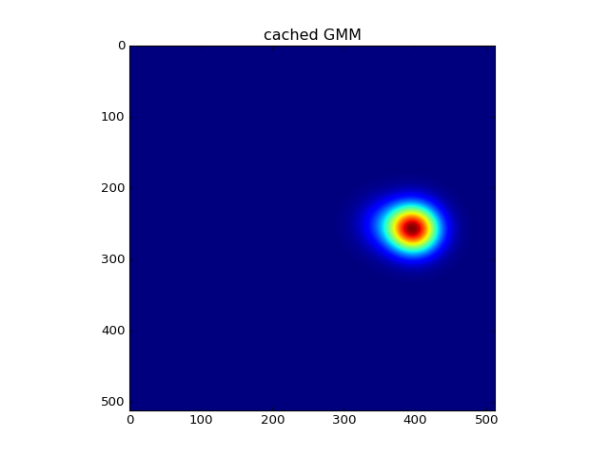
Caching
Isotropic
Notes:
Expalin that online fitting during rendering is to expensive.
Therefore, we decided to cache the GMM representations for the BRDF lobes.
The caches are calcualted in a pre-processing step for each material of the scene.
During rendering the GMM representation of the querried incident direction is fetched for mthe cache and used
to approximate the product.
Diffuse BRDFs are constant for every incident direction, therefore only one GMM is needed.
There are two different types of cahces one for isotropic BRDFs, which are rotationally independent and
anisotropic BRDFs, where the BRDF lobe is rotationally dependent.

Slide 47
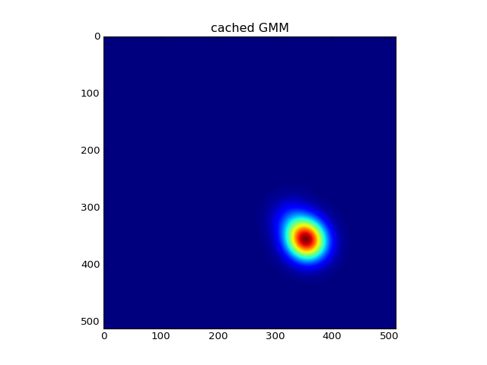
Caching
Isotropic
Notes:
Expalin that online fitting during rendering is to expensive.
Therefore, we decided to cache the GMM representations for the BRDF lobes.
The caches are calcualted in a pre-processing step for each material of the scene.
During rendering the GMM representation of the querried incident direction is fetched for mthe cache and used
to approximate the product.
Diffuse BRDFs are constant for every incident direction, therefore only one GMM is needed.
There are two different types of cahces one for isotropic BRDFs, which are rotationally independent and
anisotropic BRDFs, where the BRDF lobe is rotationally dependent.

Slide 48
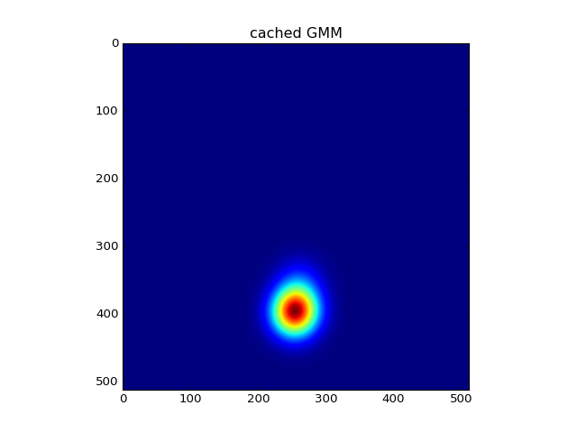
Caching
Isotropic
Notes:
Expalin that online fitting during rendering is to expensive.
Therefore, we decided to cache the GMM representations for the BRDF lobes.
The caches are calcualted in a pre-processing step for each material of the scene.
During rendering the GMM representation of the querried incident direction is fetched for mthe cache and used
to approximate the product.
Diffuse BRDFs are constant for every incident direction, therefore only one GMM is needed.
There are two different types of cahces one for isotropic BRDFs, which are rotationally independent and
anisotropic BRDFs, where the BRDF lobe is rotationally dependent.

Slide 49
GMM Component Reduction
Motivation | Product Importance Sampling | BRDF Fitting | Component Reduction | Results | Future Work

Slide 50
Component Reduction
$$−∞ ∞$$
$$c_{i,j}=d_{KL}(\{(π_{i},μ_{i},Σ_{i}),(π_{j},μ_{j},Σ_{j})\},{(π}_{ij},μ_{ij},Σ_{ij}))$$

Slide 51
Component Reduction
$$−∞ ∞$$
$$c_{i,j}=d_{KL}(\{(π_{i},μ_{i},Σ_{i}),(π_{j},μ_{j},Σ_{j})\},{(π}_{ij},μ_{ij},Σ_{ij}))$$

Slide 52
Component Reduction
$$−∞ ∞$$
$$c_{i,j}=d_{KL}(\{(π_{i},μ_{i},Σ_{i}),(π_{j},μ_{j},Σ_{j})\},{(π}_{ij},μ_{ij},Σ_{ij}))$$

Slide 53
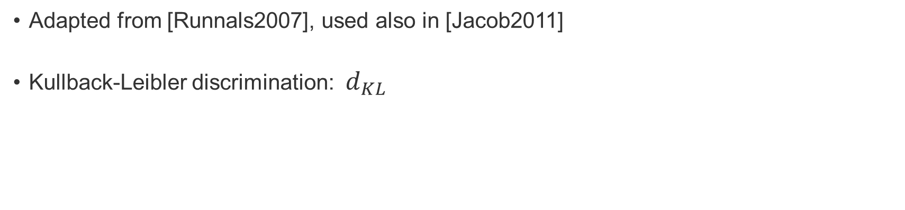
Component Reduction
$$−∞ ∞$$
$$c_{i,j}=d_{KL}(\{(π_{i},μ_{i},Σ_{i}),(π_{j},μ_{j},Σ_{j})\},{(π}_{ij},μ_{ij},Σ_{ij}))$$
Adapted from [Runnals2007], used also in [Jacob2011]
Kullback-Leibler discrimination: $d_{KL}$

Slide 54

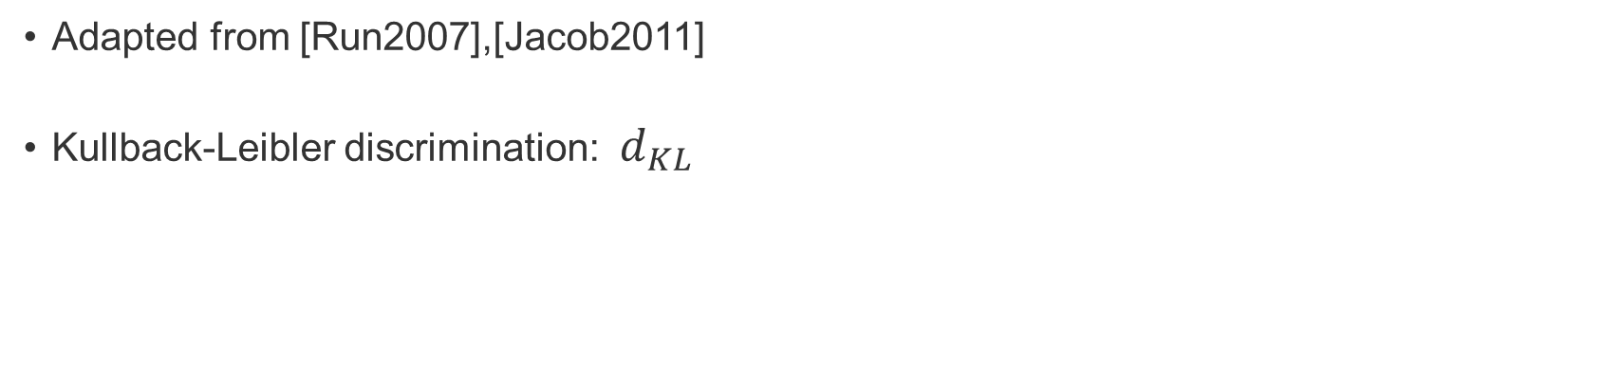
Component Reduction
$$−∞ ∞$$
$$c_{i,j}=d_{KL}(\{(π_{i},μ_{i},Σ_{i}),(π_{j},μ_{j},Σ_{j})\},{(π}_{ij},μ_{ij},Σ_{ij}))$$
Adapted from [Run2007],[Jacob2011]
Kullback-Leibler discrimination: $d_{KL}$
$$C_{K´}=\sum_{s=K}^{K´}{\min_{i,j}{c_{i,j}^{s}}}$$

Slide 55
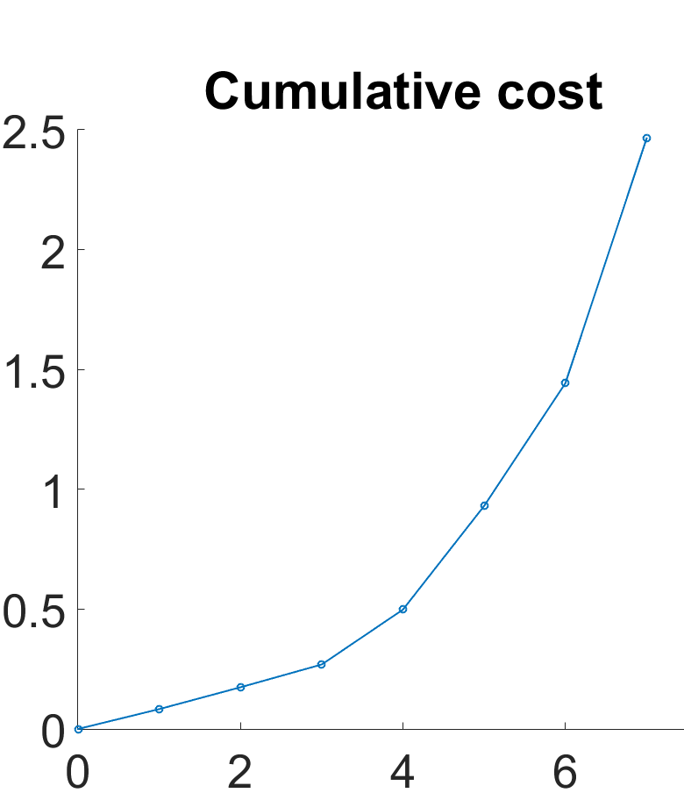
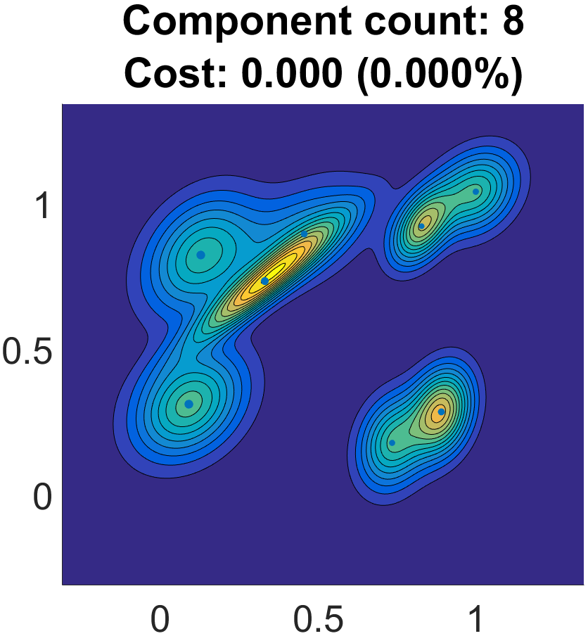
Component Reduction

Slide 56
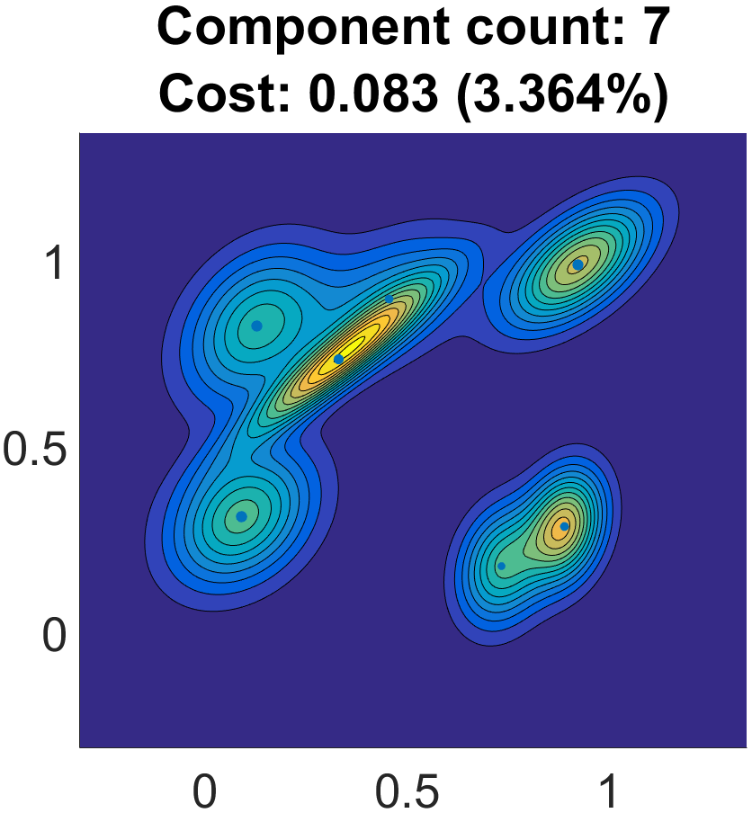
Component Reduction

Slide 57
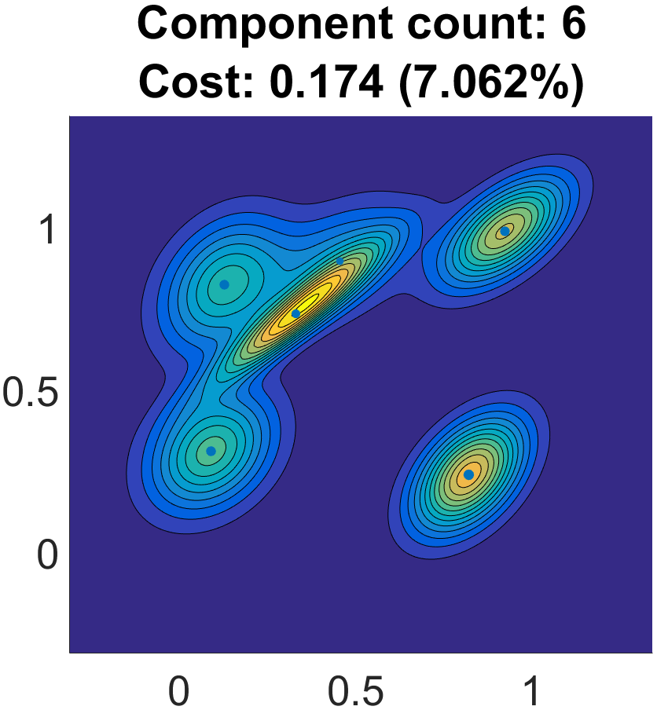
Component Reduction

Slide 58
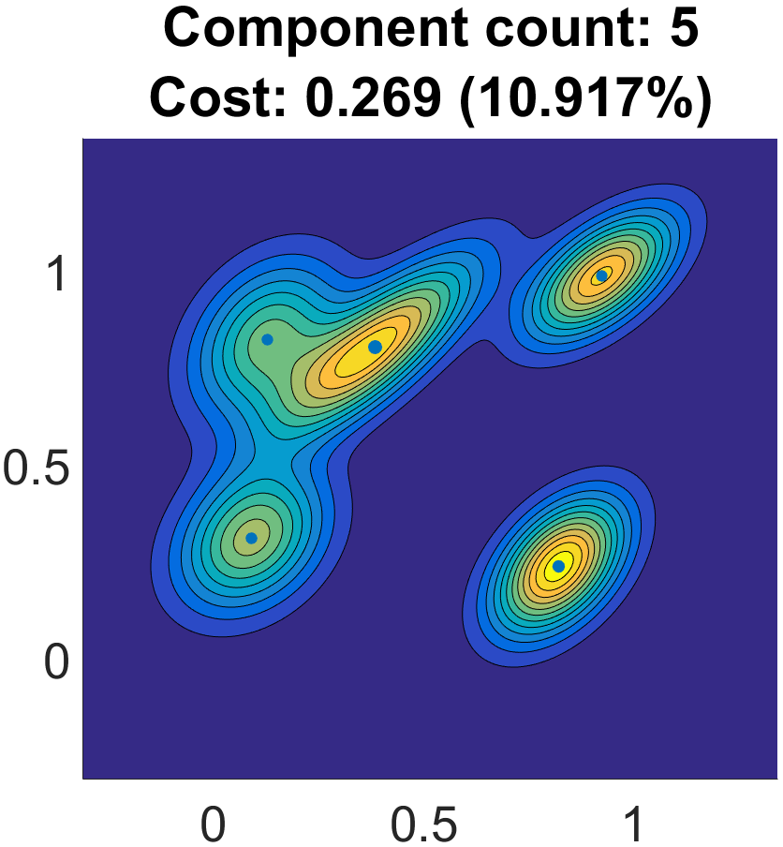
Component Reduction

Slide 59
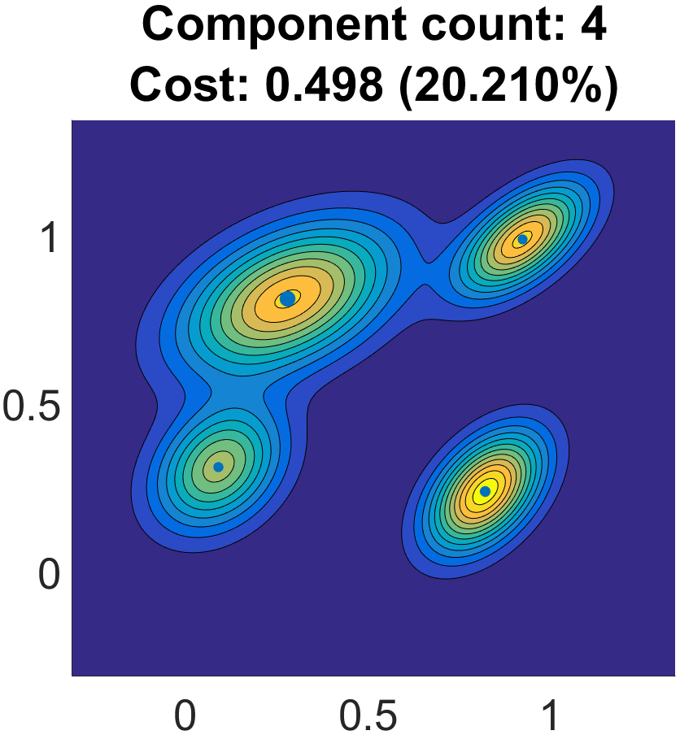
Component Reduction

Slide 60
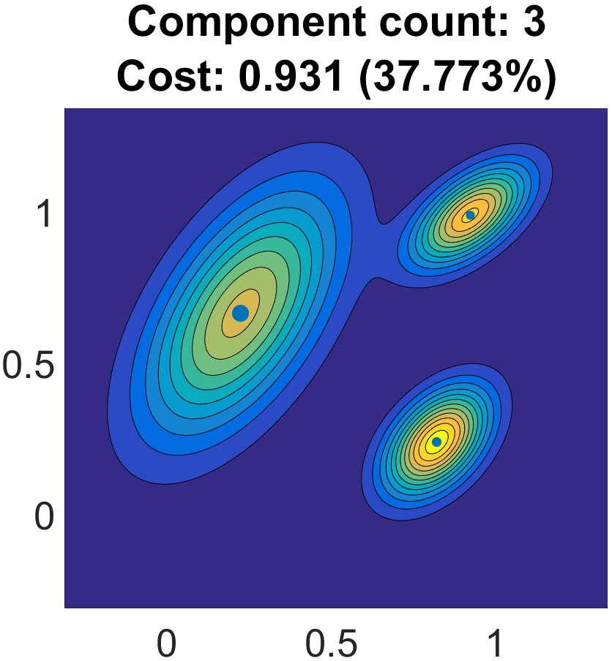
Component Reduction

Slide 61
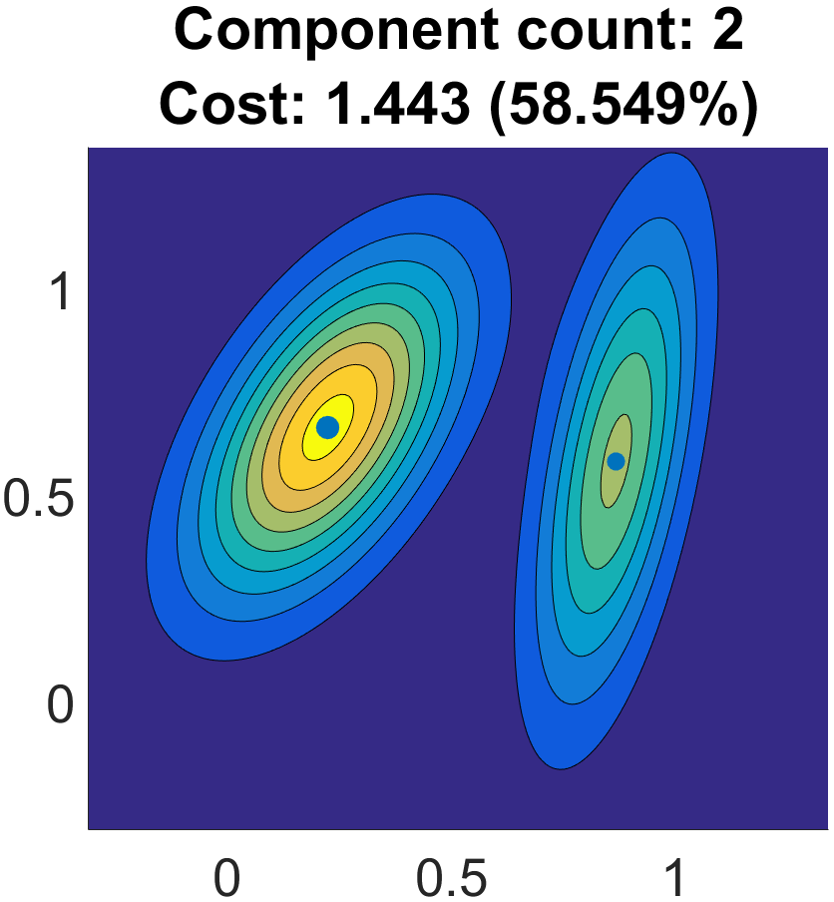
Component Reduction

Slide 62
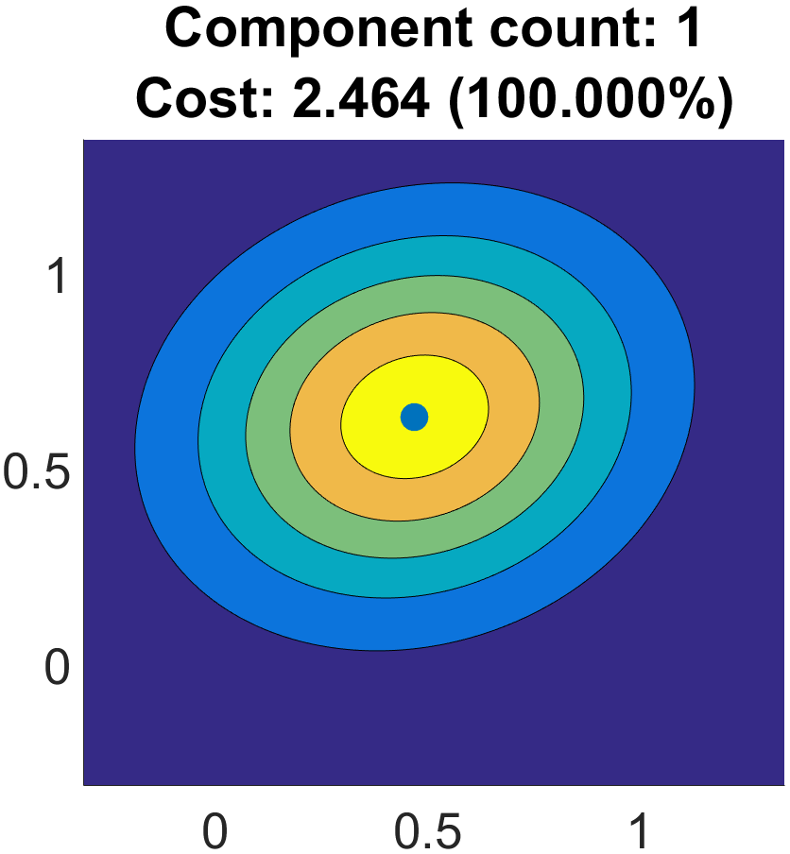
Component Reduction

Slide 63
Component Reduction
0.2

Slide 64
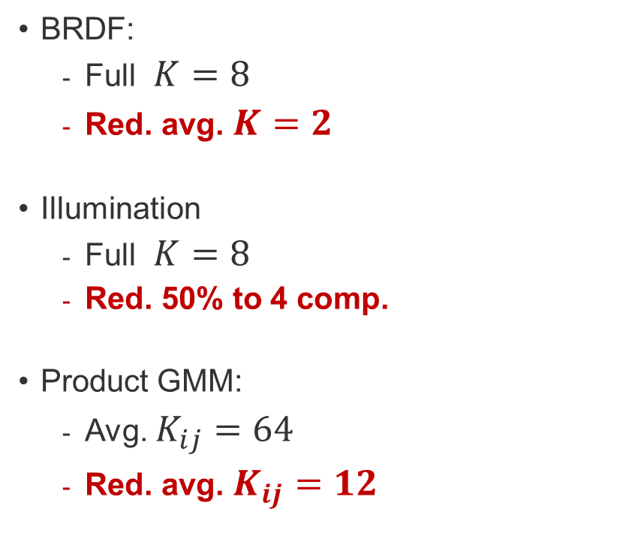
Component Reduction
Reduction
BRDF:
  Full $K=8$
  Red. avg. $K=2$
Illumination
  Full $K=8$
  Red. 50% to 4 comp.
Product GMM:
  Avg. $K_{ij}=64$
  Red. avg. $K_{ij}=12$
0.2

Slide 65
Component Reduction
Reduction
BRDF:
  Full $K=8$
  Red. avg. $K=2$
Illumination
  Full $K=8$
  Red. 50% to 4 comp.
Product GMM:
  Avg. $K_{ij}=64$
  Red. avg. $K_{ij}=12$
0.2

Slide 66
Results
Motivation | Product Importance Sampling | BRDF Fitting | Component Reduction | Results | Future Work

Slide 67
Reference

Slide 68
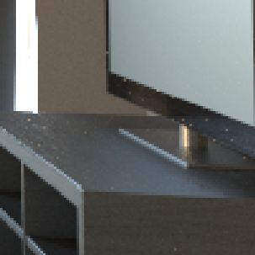
Reference
SPP / MSE
equal time 1hr

Slide 69
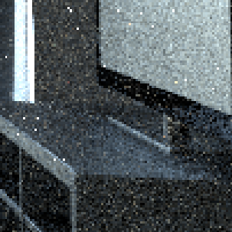
Path Tracer
Reference
4736 / 2.1830
SPP / MSE
equal time 1hr

Slide 70
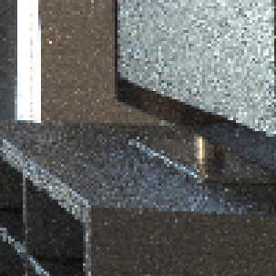
Path Tracer
Vorba2014
Reference
4736 / 2.1830
882 / 0.0331
SPP / MSE
equal time 1hr

Slide 71

Path Tracer
Vorba2014
Our
Reference
4736 / 2.1830
882 / 0.0331
1128 / 0.0211
SPP / MSE
equal time 1hr

Slide 72

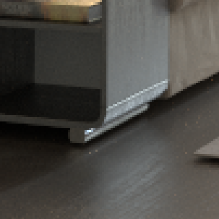
Path Tracer
Vorba2014
Our
Reference
4736 / 2.1830
882 / 0.0331
1128 / 0.0211
SPP / MSE
equal time 1hr

Slide 73
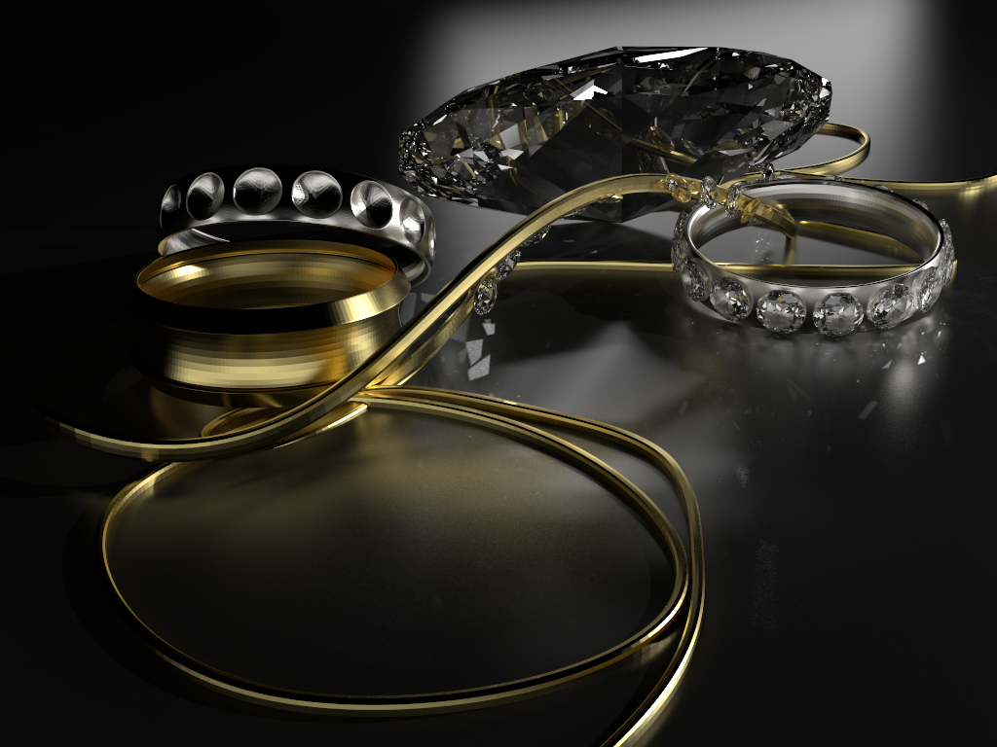
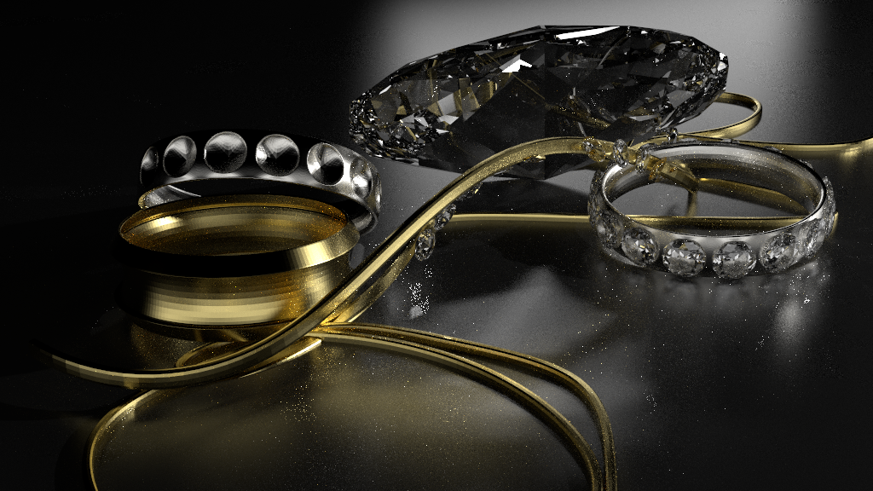
Reference

Slide 74
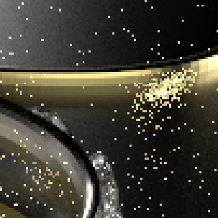
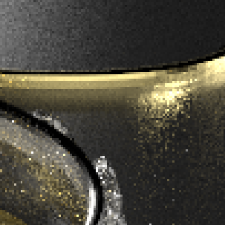


equal time 1hr
Path Tracer
Vorba2014
Our
Reference
4335 / 0.0081
1528 / 0.0025
1322 / 0.0007
SPP / MSE

Slide 75




Path Tracer
Vorba2014
Our
Reference
4335 / 0.0081
1528 / 0.0025
1322 / 0.0007
SPP / MSE
equal time 1hr

Slide 76

Reference

Slide 77





Path Tracer
Vorba2014
Our
Reference
3120 / 0.9715
1616 / 0.006
712 / 0.007
SPP / MSE
equal time 1hr

Slide 78




equal time 1hr
Path Tracer
Vorba2014
Our
Reference
3120 / 0.9715
1616 / 0.006
712 / 0.007
SPP / MSE

Slide 79


Average Path Lenghts
Vorba: 9.8 Ours: 4.9
normalized per-path segment contribution
path depth

Slide 80

Average Path Lenghts
Vorba: 9.8 Ours: 4.9
normalized per-path segment contribution
path depth

Slide 81

Average Path Lenghts
Vorba: 9.8 Ours: 4.9
normalized per-path segment contribution
path depth

Slide 82


Average Path Lenghts
Vorba: 6.5 Ours: 9.0
normalized per-path segment contribution
path depth

Slide 83
Discussion / Future work
Motivation | Product Importance Sampling | BRDF Fitting | Component Reduction | Results | Future Work

Slide 84

Discussion / Future Work
Path Length and Russian Roulette
  Adjoint-driven RR and Splitting [Vorba2016]

Slide 85
Discussion / Future Work
SVBRDFs
  Enlarge BRDF caches
  Direct function transform
  BRDF->GMM

Slide 86

Discussion / Future Work
Extension to other MC-algorithms
  BDPT
  MCMC
  Gradient domain

Slide 87



GD-PT
(full)
Reference
GDPT
(full)
GD-BDPT
(full)

Slide 88


GD-PT
(estimate)
Reference
GDPT
(estimate)
GD-BDPT
(estimate)

Slide 89

Our
Reference

Slide 90

Discussion/Future Work
Optimizing Illumination caches
  Poorly fitted illumination caches
  cause inconsistent convergence rates

Slide 91
Product Importance Sampling for Light Transport Path Guiding
Sebastian Herholz¹ Oskar Elek² Jiří Vorba^{2,3}
Hendrik Lensch¹ Jaroslav Křivánek²
¹University Tübingen ²Charles University Prague ³Weta Digital
Thanks to:
Martin Šik, Ivo Kondapaneni, Ludvík Koutný, Anton Kaplanyan, Johannes Hanika
Anonymous reviewers
You!

Slide 92
Backup

Slide 93

wEM vs CERES

Slide 94

Gradient Domain

Slide 95

Notes:
Example of the discretization correction using a caches for the BRDF*cos. This way we are able to use it in a simple path tracer for sampling the BRDF.
NOTE: to visualize the discretization artifacs we only use 16 elevation angles for the isotropic cache.

Slide 96
Preporcessing times:

Slide 97
Statistics:

Slide 98
END

