Slide 1
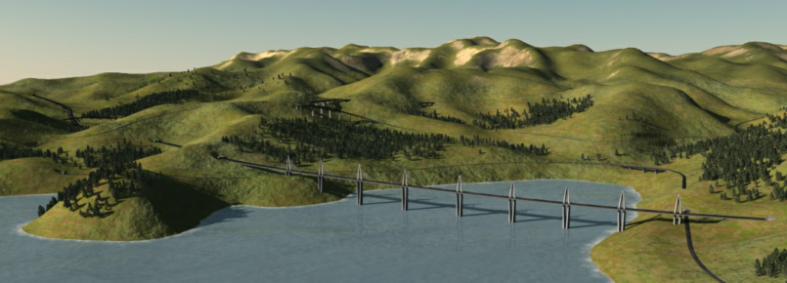
Authoring Hierarchical Road Networks Eric Galin :: Adrien Peytavie :: Eric Guerin :: Bedřich Beneš

Slide 2
Outline
Motivation
Previous work
Algorithm
Overview
Road generation
Removing redundant roads
Mergin roads
Results

Slide 3
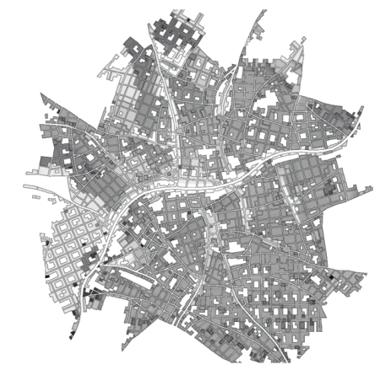
Motivation
Roads in Cities?

Slide 4
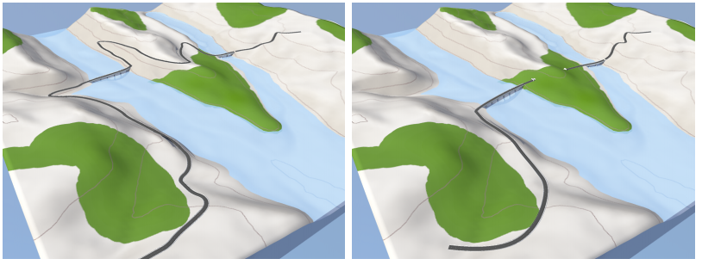
Motivation
Roads in Cities?
ü
Roads over Landscape?

Slide 5
Motivation
Roads in Cities?
ü
Roads over Landscape?
ü

Slide 6
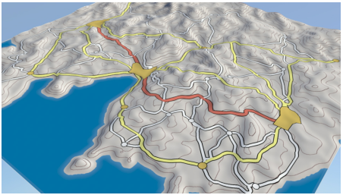
Motivation
Roads in Cities?
Road Hierarchies!
ü
Roads over Landscape?
Cities
Towns
Villages
Highways
Major roads
Minor roads
ü

Slide 7
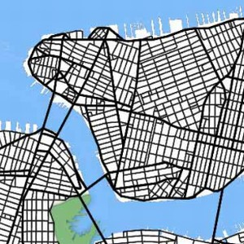
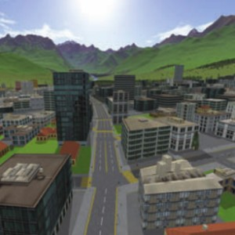
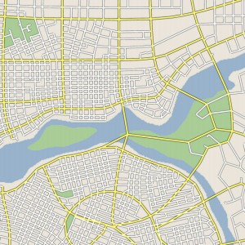
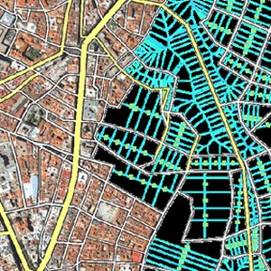
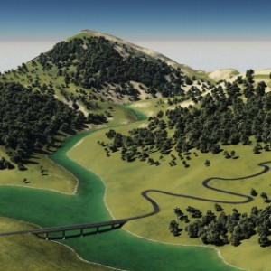
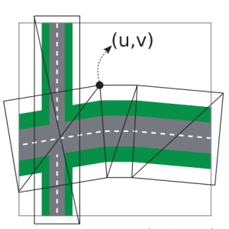
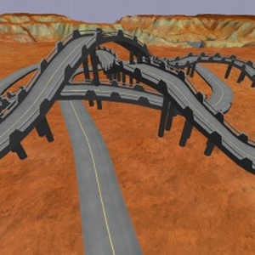
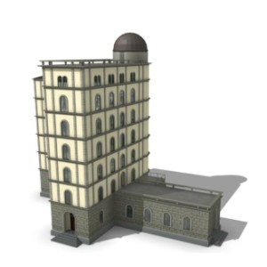
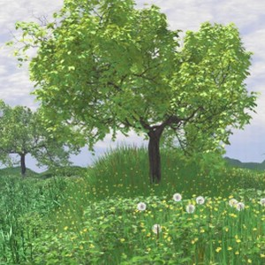
Previous work
Muller01
Wonka09
Chen08
Aliaga08
Galin10
Bruneton08
McCrae09
Muller06
Deussen 98

Slide 8
Algorithm - Overview
For each city pair, find a road over terrain
2) Discard some of the roads as redundant
3) Merge nearby pieces of road
Basically, Galin et al. 2010
Interesting graph theory
Some topology

Slide 9
Algorithm - Overview
For each city pair, find a road over terrain
2) Discard some of the roads as redundant
3) Merge nearby pieces of road
Basically, Galin et al. 2010
Interesting graph theory
Some topology

Slide 10
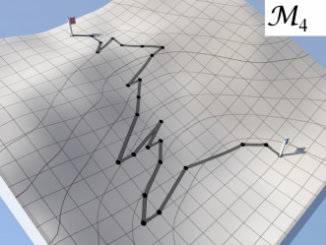
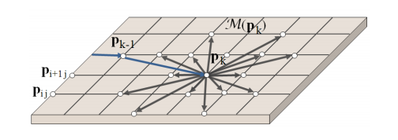
Find a road over terrain…
Isolines
Lattice
Generate graph
Find shortest path
Account for curvature, elevation, environment, “other”

Slide 11
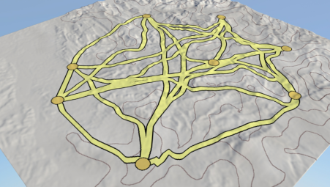
…for each city pair
A
B
E
C
D
F
G
H
i.e. AB, AC, AD, …, FG, FH, GH => Complete Graph over Cities
Road type depends on city size

Slide 12
Algorithm - Overview
For each city pair, find a road over terrain
2) Discard some of the roads as redundant
3) Merge nearby pieces of road
Basically, Galin et al. 2010
Interesting graph theory
Some topology

Slide 13
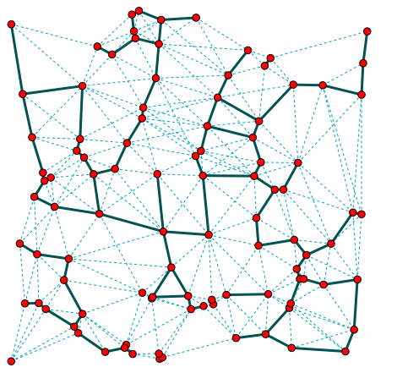
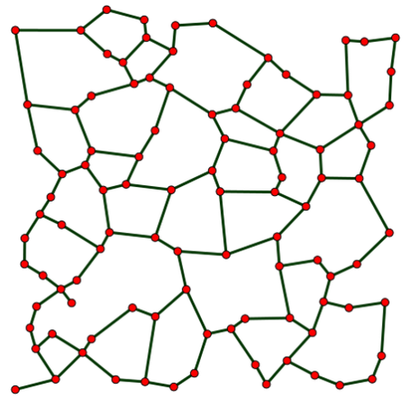
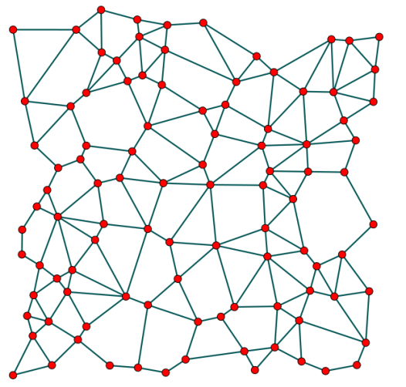
Discard Redundant Roads
Complete Graph – too dense
MST – too sparse
Some candidates:
β-skeleton, 1983
Relative Neighbour
Graph, 1980
Gabriel Graph, 1969
Is a kind of

Slide 14
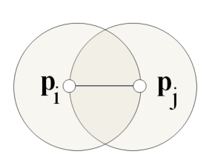
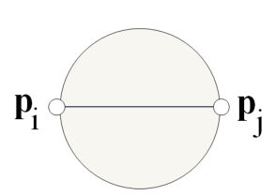
Relative Neighbour and Gabriel Graphs
Relative Neighbour
Gabriel
Contains edge (p_{i},p_{j}) ⬄no other point in Ω
Ω
Ω
Both Contain MST as subgraph; Euclidean Dist.

Slide 15
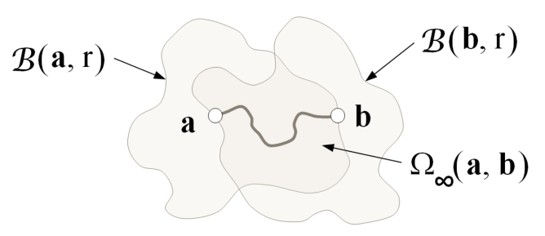
Our Version
Road length ⬄ Euclidean distance
Changes the shape of neighborhood balls
Parameterize graph density by γ

Slide 16
Our Version, cont.
Continuum of densities
γ = 1
γ = 2
γ -> ∞
Gabriel
Relative Neighbour
Ω
Ω

Slide 17
Density Continuum
Rather dense,
γ = 1,2
A little sparse,
γ = 2
Quite sparse,
γ = 8

Slide 18
Algorithm - Overview
For each city pair, find a road over terrain
2) Discard some of the roads as redundant
3) Merge nearby pieces of road
Basically, Galin et al. 2010
Interesting graph theory
Some topology

Slide 19
Merge nearby roads
Distance between curves
Length of leash?
Frechet distance
(over all reparameterizations)

Slide 20
Road Merging, cont.
Roads are close AND road types allow it => MERGE
Merge: e.g. Highways and Highways, Major and Minor
Don’t Merge: e.g. Highways and Major

Slide 21
And more..
Waypoints
User steering
Road interaction

Slide 22
Results
We generate realistic road networks

Slide 23
Results
Real-life Corsica
Our Corsica
We generate realistic road networks

Slide 24
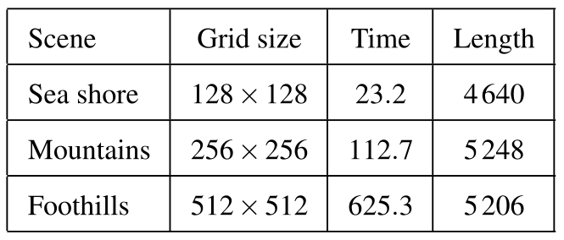
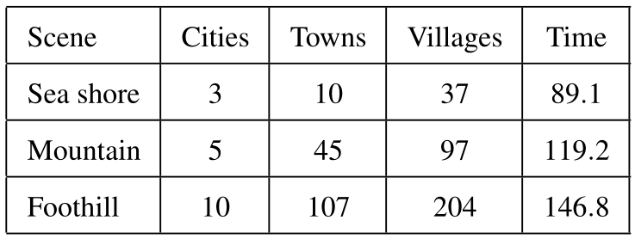
Results
FAST - O(n³) w/o heuristic
512x512 ~ 380 m resolution
Grid size of 256x256

Slide 25
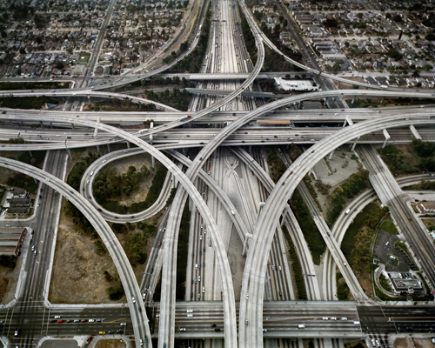
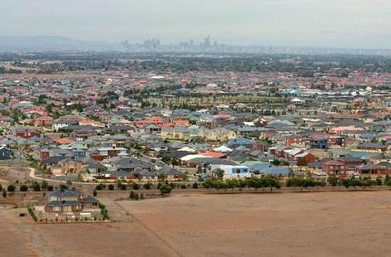
Future Work
Urban fringe
Highway intersections

Slide 26
Thank you!

