Slide 1
Geometry-Aware
Scattering Compensation
for 3D Printing
Denis Sumin¹
Tobias Rittig²
Vahid Babaei¹
Thomas Nindel²
Alexander Wilkie²
Piotr Didyk³
Bernd Bickel⁴
Jaroslav Křivánek²
Karol Myszkowski¹
Tim Weyrich⁵
Notes:
Thank you for the introduction,

Slide 2
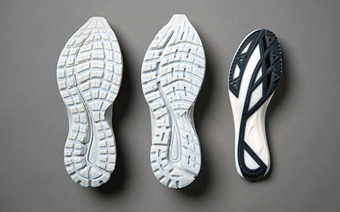
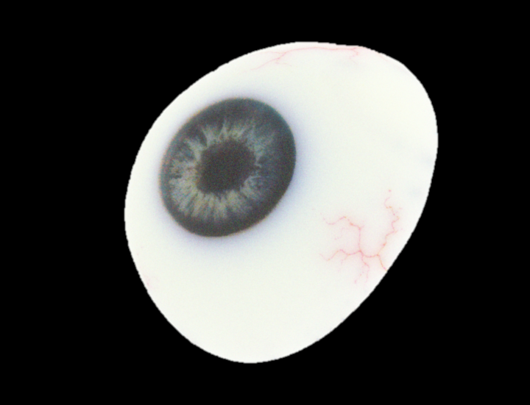
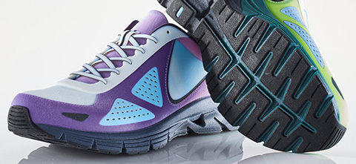
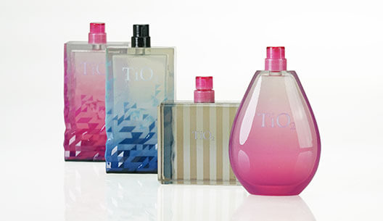
Inkjet 3D Printing – Applications
Appearance matters
[Stratasys 2019]
Notes:
Modern Inkjet printers, for example the Stratasys J750, enable the creation of colorful prints. They are used for functional parts in rapid prototyping as well as for fields where
<click>
the appearance really matters.
You can imagine, that this human eye prostetic has to match the real counterpart perfectly.
And also product designers have really high expectations of their prototype‘s appearance.
==============
As you could see on the title slide, we are working with color 3D printing, which is traditionally based on paper or powder. But we work with Inkjet 3D printing for its superiour quality in appearance reproduction.
For this technique, a printhead deposits liquid photopolymer resins and hardens them immediately with UV light. You can achieve very high resolutions between 300 and 900 dpi depending on the axis of the printer.
Another major advantage is, that the printhead can deposit multiple materials at once. If you use different colored materials you can achieve a wide range of colors through spatial mixing.
This relies on the fact, that the materials are partially tranclucent, so that they can be hardened by UV light and the colors of the materials mix locally through light scattering underneath the surface.
======================================
Color 3D printing is traditionally powder or paper based, but if you aim for a high quality then Inkjet printing is the way to go.
The printhead deposits liquid photopolymer resins in tiny droplets and hardens them immediately with UV light.
The resolution is in the order of 300 to 900 dpi depending on the axis.
With the major advantage being that the head can deposit multiple materials at once. If you are using different base colours you can achieve many shades in between by spatially mixing them.
There is always only one material per voxel, but light locally averages the mixtures into a perceived color.
This is why the technique heavily relies on translucency of the base materials.

Slide 3
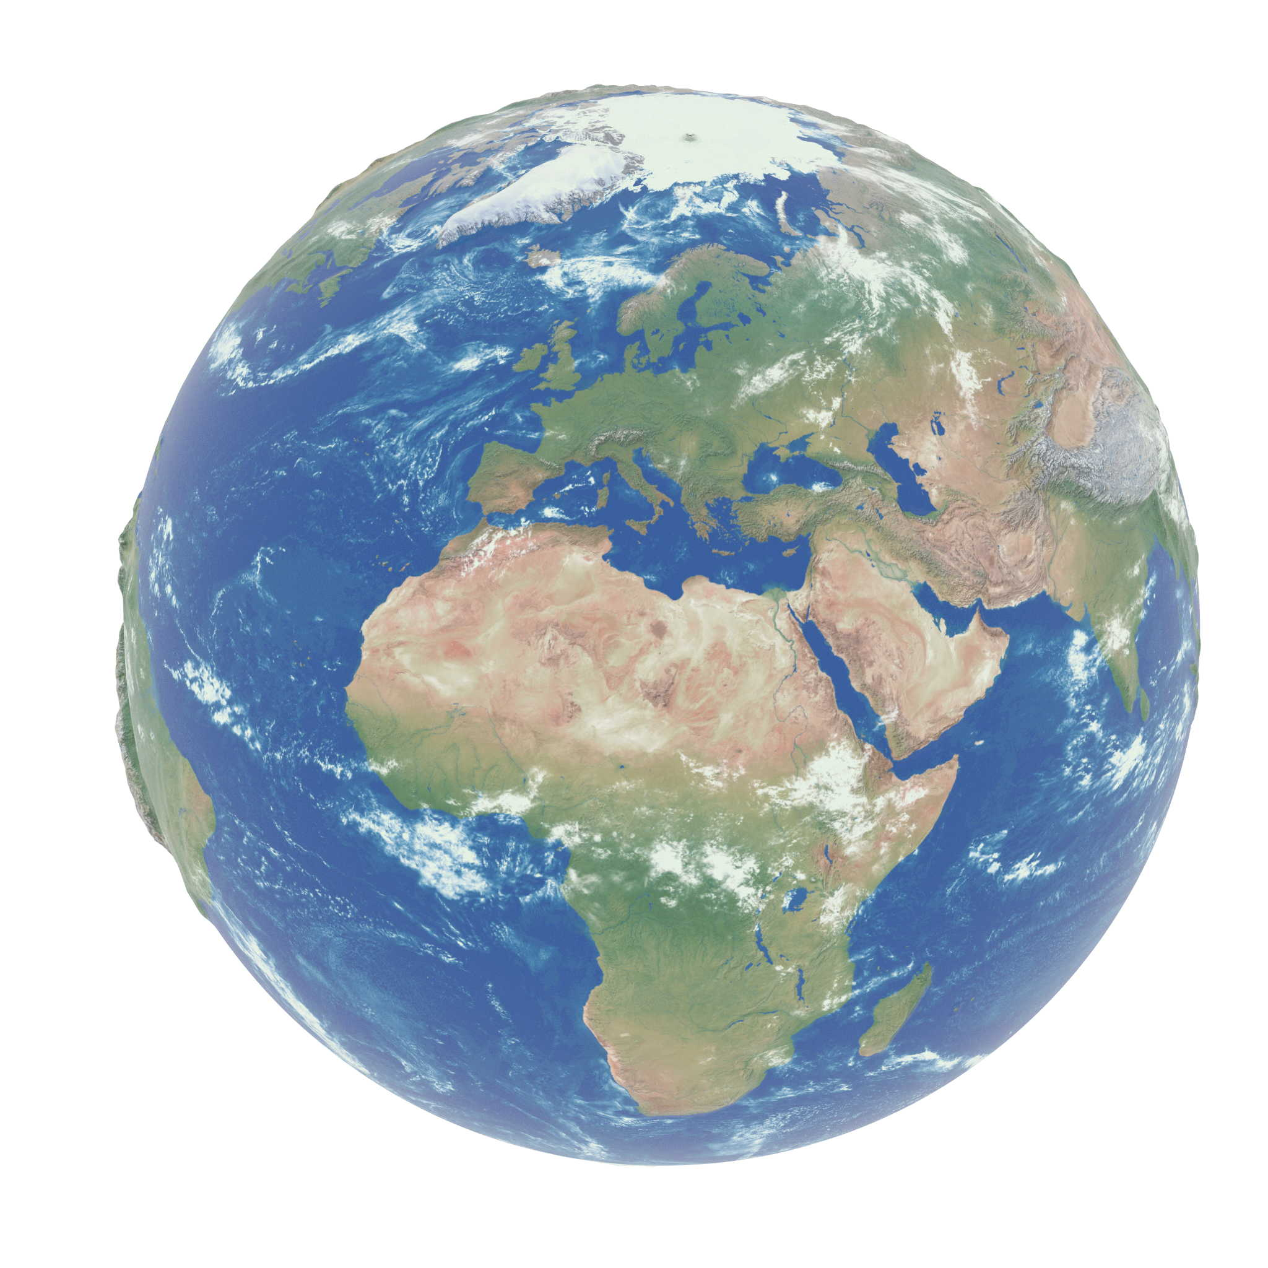
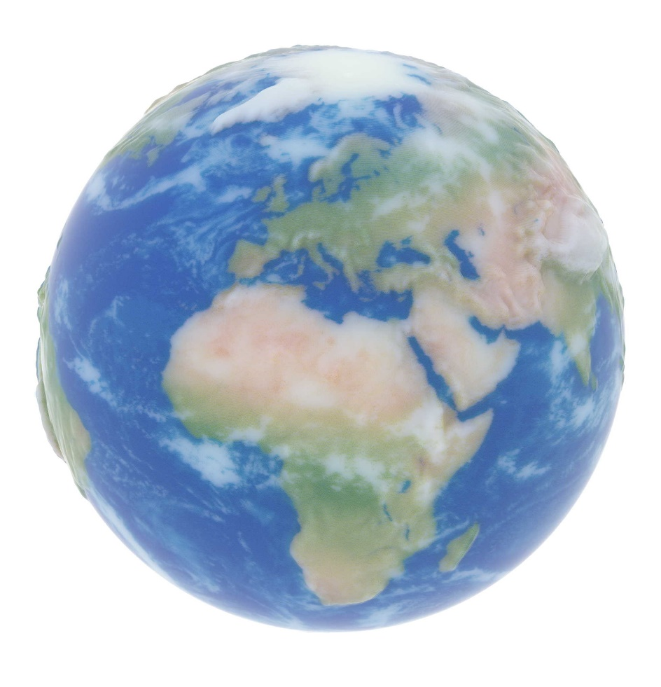
Inkjet 3D Printing – Texture Blurring
Edge Blurring
Contrast Reduction
Target
Printer Default
Notes:
However, when you want to print small objects with a more high-frequency texture, <click>
the results are not so spectacular. <click>
The prints experience edge blurring and <click> contrast reduction.

Slide 4
Issues with Thin Geometry
Target
(0.5 mm thick)
Notes:
More severe problems happen when the objects are thin.
<click>
Consider this thin 0.5mm planar slab

Slide 5
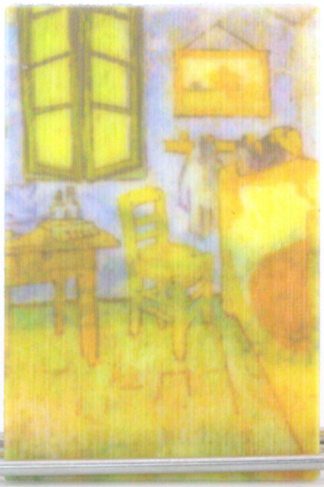
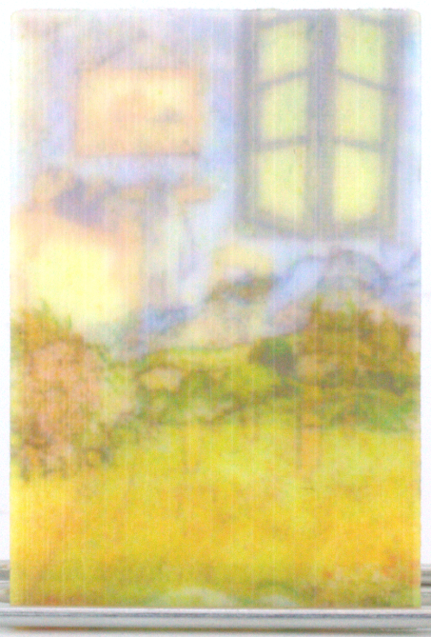
Issues with Thin Geometry
Reduced
contrast
Front
Back
Cross-talk
Printer default
(GrabCAD)
Printer default
(GrabCAD)
Target
(0.5 mm thick)
Notes:
When printed with the default printer software, contrast and color quality on the left side of the slab is very low.
The right side of the slab is completely lost because of the cross talk effect

Slide 6
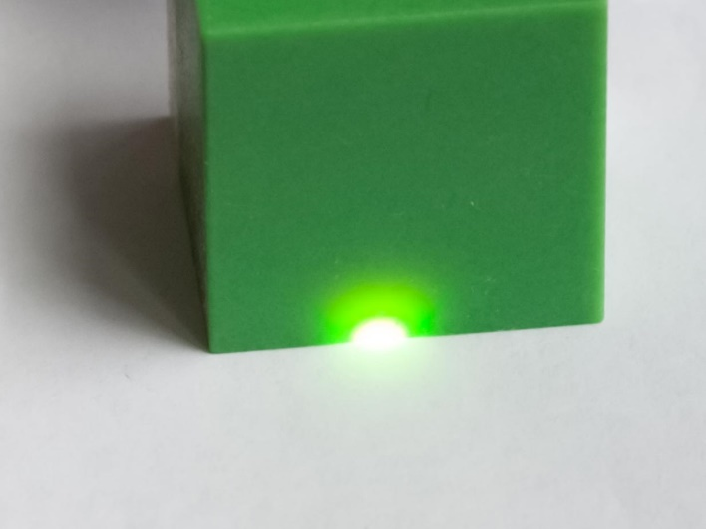
Introduction – Inkjet 3D Printing
Apparent color
Notes:
Let‘s have a look, how the inkjet technology works. A print head disposes small droplets of materials, and the UV lamp cures these droplets, forming slices of the final print.
Materials have to be translucent to make the curing possible.
<click>
The combination of the two voxels in our example won’t look white when viewed from the top. It will look light-magenta as we will see magenta color through the white material.
<click>
We can easily see the extent of materials’ translucency with a flash-light pointed to this 3cm printed object.

Slide 7
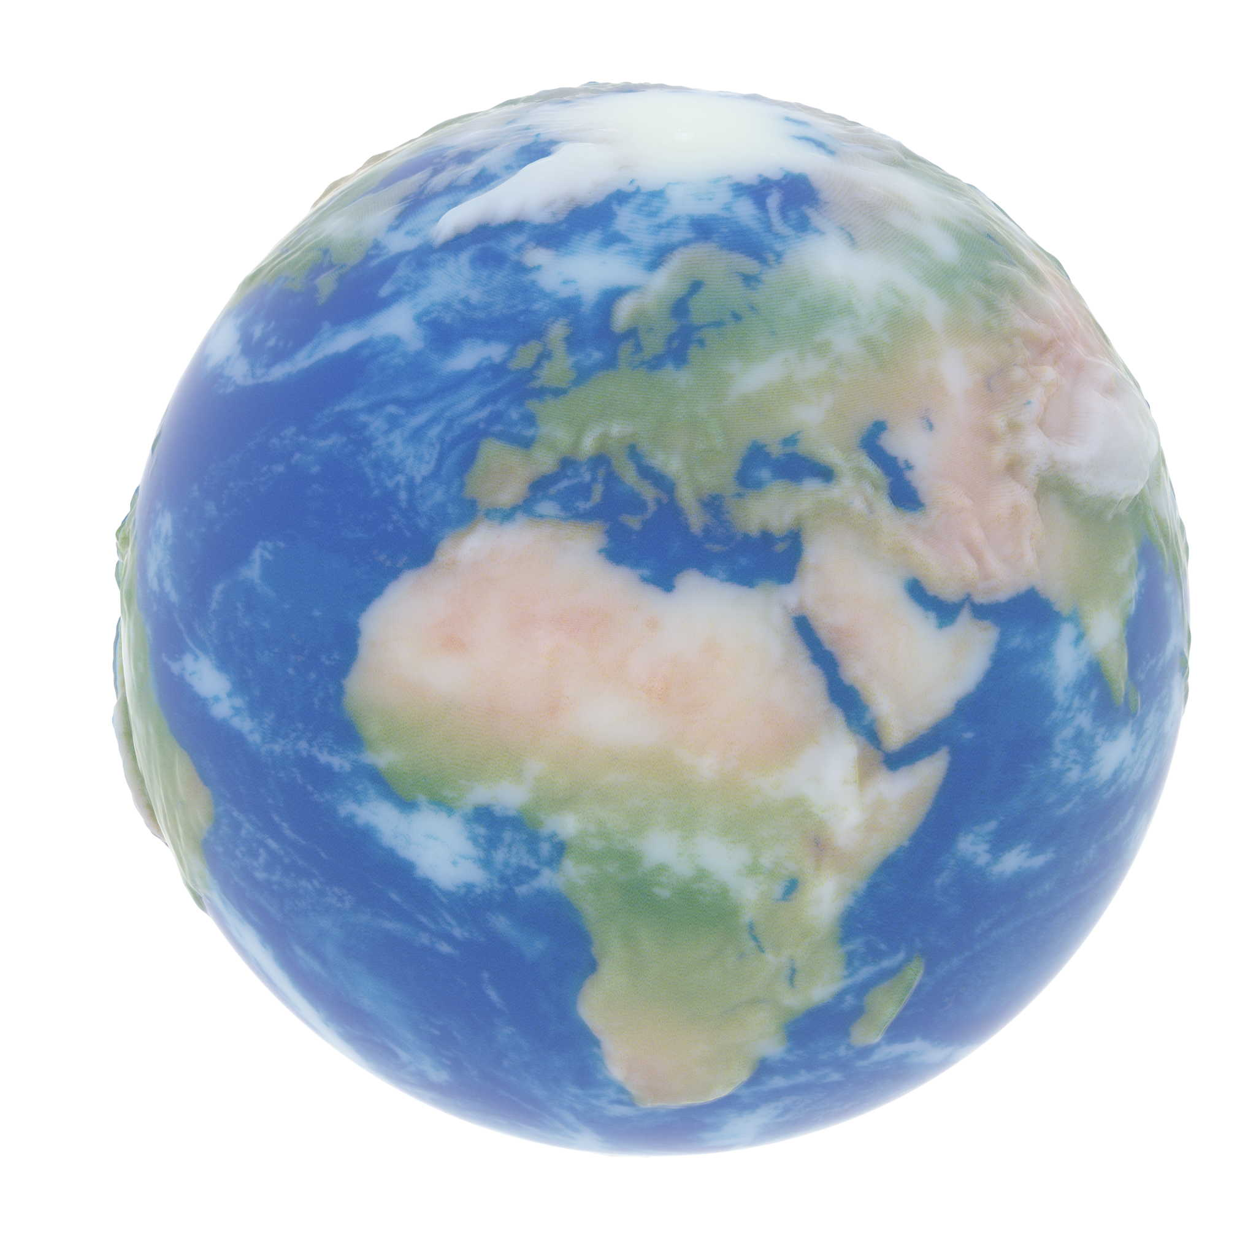
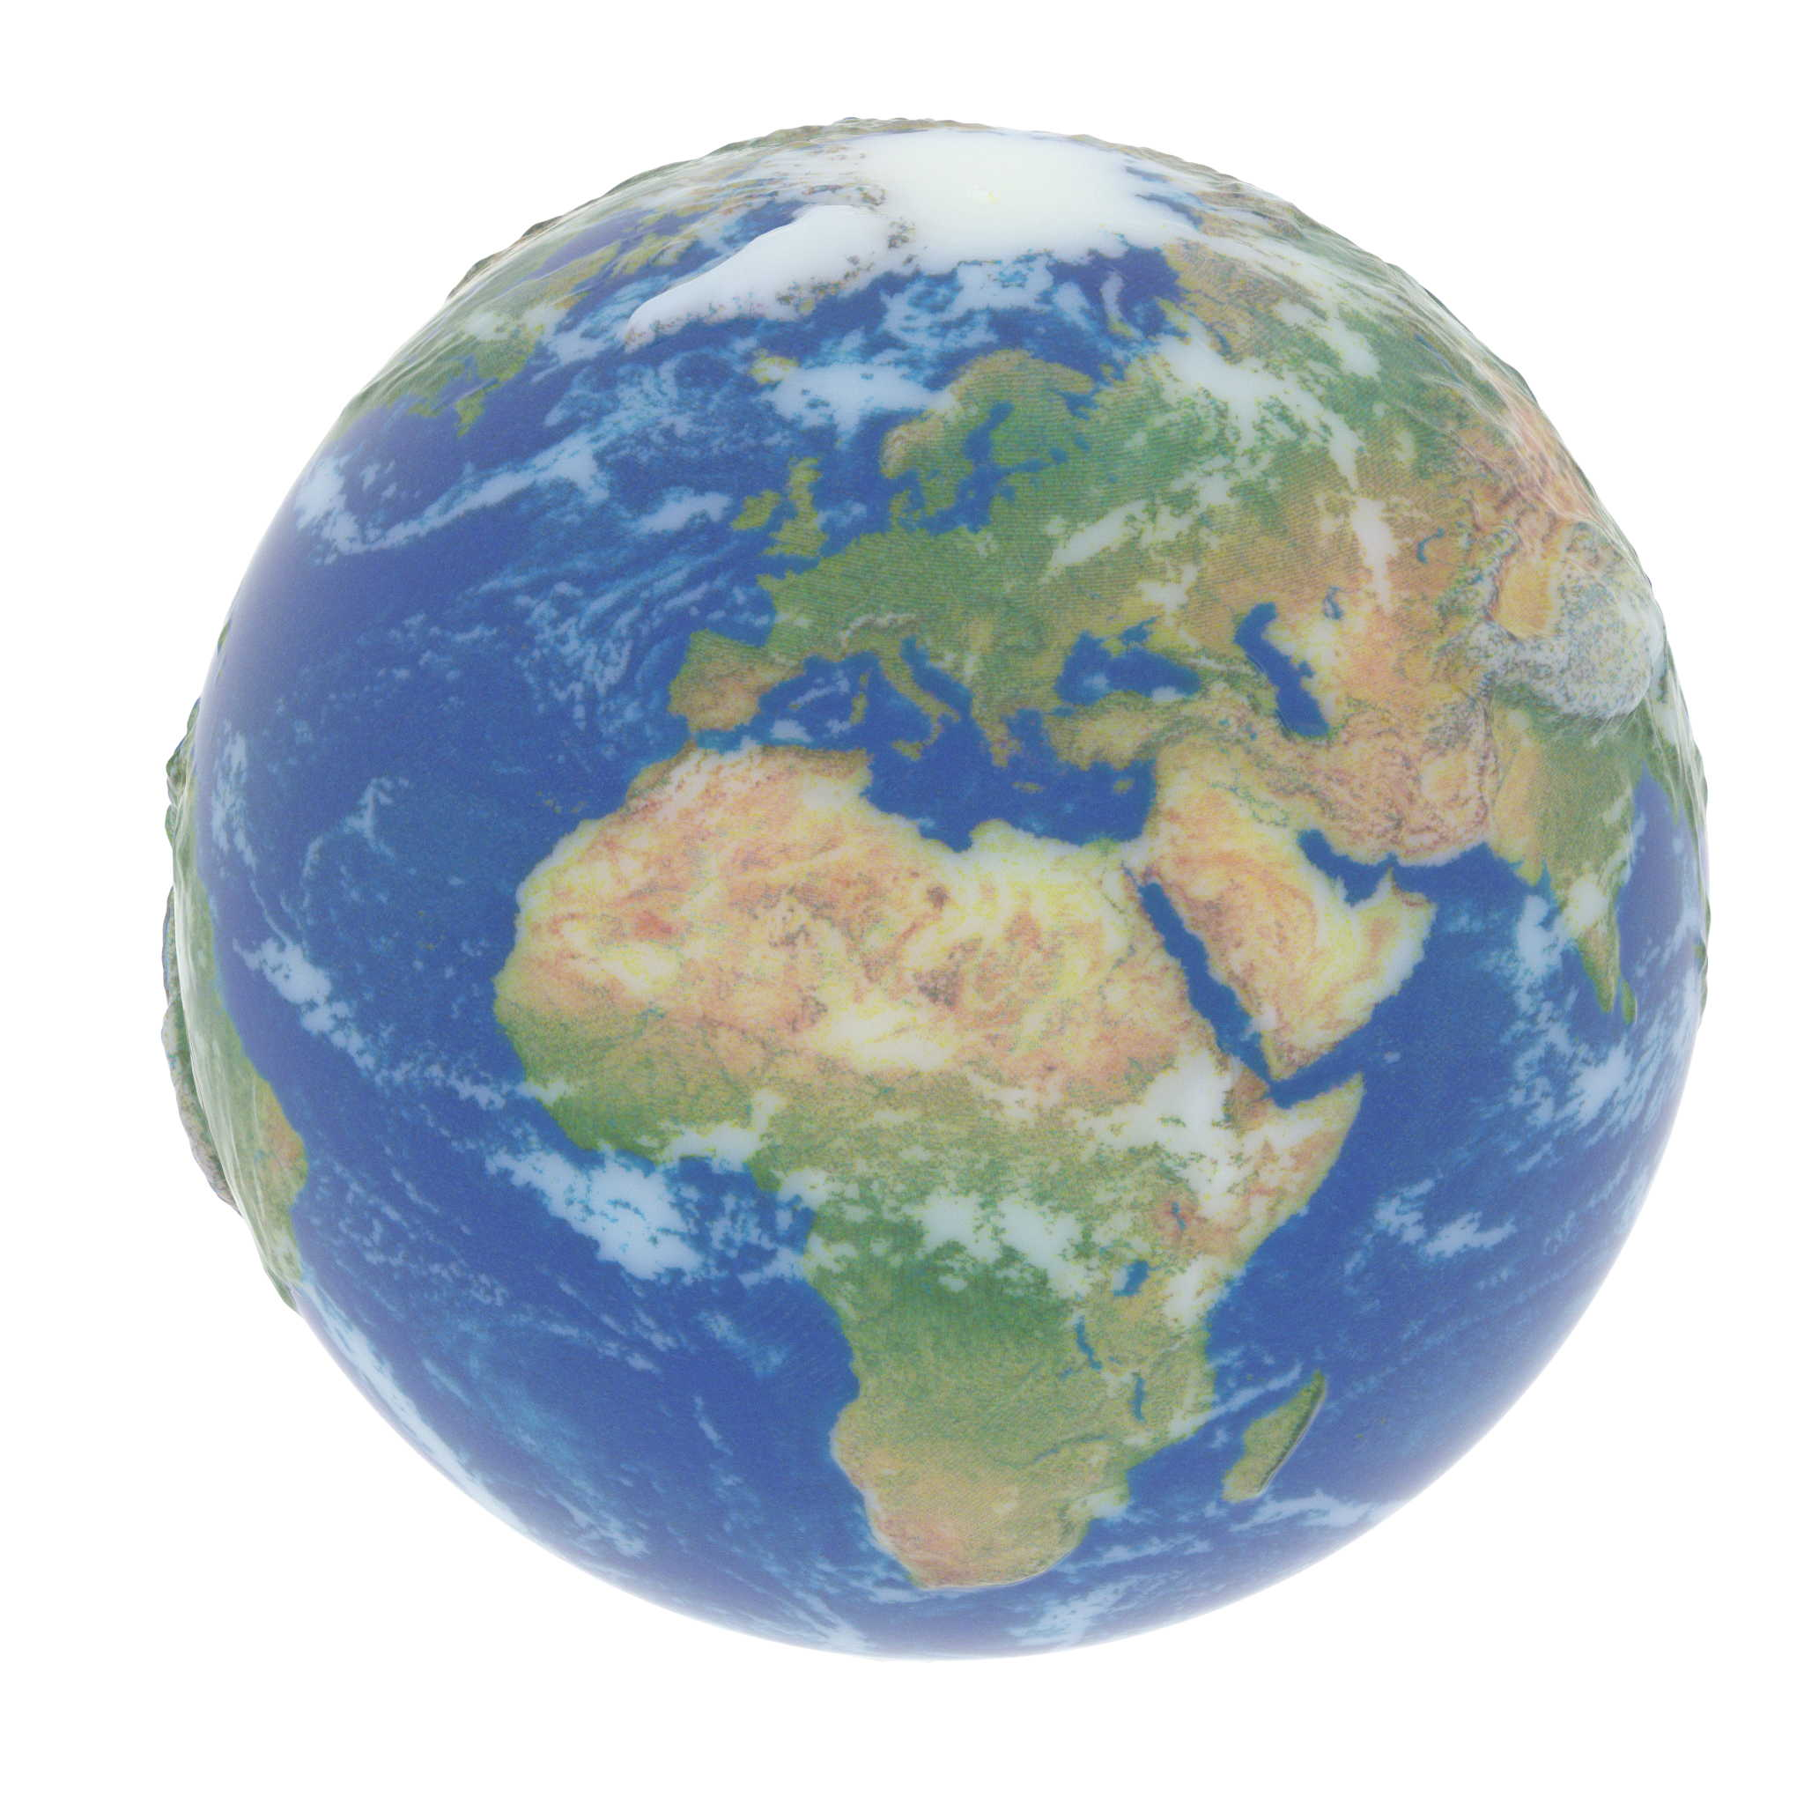
Results’ Fast-Forward
Target
Printer Default
Ours
Notes:
In our talk we show how a particular way of putting voxels of base materials make possible to get a much better resulting match to the target specification.
=========
Physical limits:
Translucency
=> highly interdependent variables in optimization problem
Thin geometry
Absolute absorption is bounded by available volume
On the octostar we introduce Gamut mapping. We say that in thin cases there is no perfect solution as there is

Slide 8
Results’ Fast-Forward
Target
Printer Default
Ours
Notes:
We also discuss the thin geometry cases where the target appearance is not fully reproducible due to a limited gamut of achievable color combinations.
We show that it is possible to control the resulting appearance.
=========
Physical limits:
Translucency
=> highly interdependent variables in optimization problem
Thin geometry
Absolute absorption is bounded by available volume
On the octostar we introduce Gamut mapping. We say that in thin cases there is no perfect solution as there is

Slide 9
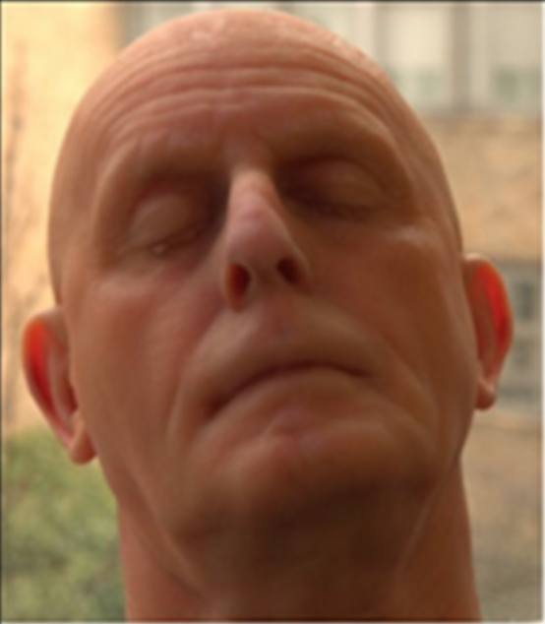
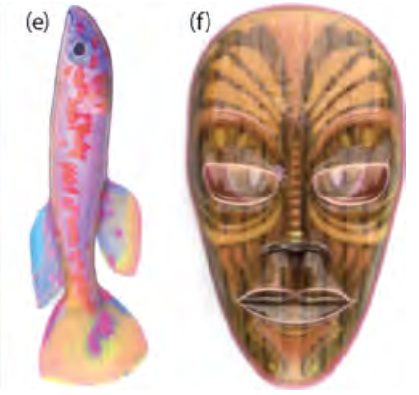
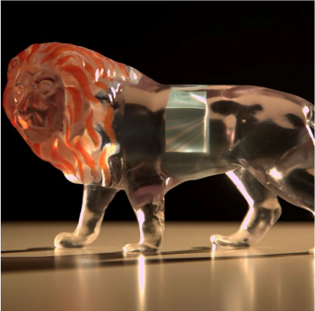
Related Work (1)
Target mesh
Printer specification
Printout
[Brunton et al. 2015]
Halftoning
[Babaei et al. 2017]
Contoning
[Brunton et al. 2018]
Transparency
Notes:
In the past 5 years quite some work has been done in the field of appearance fabrication. Generally, all the works had the same high-level pipeline: target appearance is specified by a mesh and a texture. Then, software has to transform this input into a voxelized models, in which each voxel is set to one of the printer’s base materials. Such model can be immediately fabricated.
<click>
In 2015, Brunton et al. showed the halftoning approach of obtaining the voxelized model.
<click> Two years later, Babaei et al. showed a contoning technique which reduces the amount of lateral noise.
<click>
Last year, Brunton et al. described a method to control the transparency aspect of the models.
All these works used a static model to map the input color to the mixtures of base materials. And neither of these works touched the problem of appearance distortions due to the printing materials’ translucency in the case when the target appearance is meant to be opaque.
=============
Before we get into details of our method lets look at the overall pipeline that is involved when printing with inkjet.
At the beginning stands the input appearance in form of a mesh and a diffuse texture. This information is voxelized into a discrete surface representation before being extruded into the object to form a volumetric solution for the printer.
The third step is to discretize the continous appearance into mixtures of few single base materials that can finally be fabricated by the printer.
In early works by [Hašan 2010] & [Dong 2010] the authors reproduced a specific input bssrdf through layer stacking of only a limited amount of base materials..
Brunton et al. in 2015 replaced the third step by error diffusion halftoning over the surface to achieve full color reproduction.
Babaei et al in 2017 showed how spatially-varying color could also be reproduced by stacking of layers.
Finally, Brunton et al showed at last year‘s SIGGRAPH how the whole pipeline can also be extended to control the perceived translucency over the surface.
All these methods with their forward-only pipeline suffer from the effects of light scattering inside the objects.
Elek et al 2017 thus introduced an iterative feedback loop where they would first simulate the object‘s appearance and then optimize for any unwanted effects. But their method is ultimatively limited to 2.5D objects
We base our approach on this concept and extend it to 3D but tackle the significantly more challenging case of thin geometry.

Slide 10
Related Work (2)
Target mesh
Printer specification
Printout
Prediction
Iterative refinement
[Elek et al. 2017]
Scattering
Limited to
thick planar slabs
Notes:
In 2017, Elek et al were the first to show that a specific arrangement of the base materials makes possible to achieve much sharper and detailed prints.
<click>
They used a refinement loop with high-quality prediction to achieve the final voxelized model.
<click>
However, their work was limited to thick planar slabs. General 3D objects and thin parts of the models were not handled in their work
Key contributions
High level idea

Slide 11
Our Pipeline and Contributions
Target mesh
Printer specification
Printout
Prediction
Iterative refinement
Notes:
A static forward model is not enough to handle the problems we face because of the amount of translucency in the material.
We, therefore, decided to take an iterative approach as introduced by our previous work in Elek et al.
The task of the refinement loop is to find the structure of base materials that realizes the target appearance. Ideally, you want that target specification to be achievable by the 3D printer, and that is especially a problem in thin geometry cases.

Slide 12
Our Pipeline and Contributions
Target mesh
Pre-mapped target
Printer specification
Printout
Thin-geometry color profile
Prediction
Iterative refinement
Contributions:
Thin-geometry color management
Scattering compensation for general 3D objects
Analysis of optimum in the solution space
Notes:
We therefore first handle these cases explicitly with a gamut mapping step and can then optimize the lateral scattering uniformly over the surface.
The main contributions of our work are:
thin-geometry color management, and
<click>
support of complex 3D objects throughout the pipeline.
<click>
While implementing these two, we also did an analysis of optimal solutions for both thin and thick cases.

Slide 13
Our Pipeline and Contributions
Target mesh
Pre-mapped target
Printer specification
Printout
Thin-geometry color profile
Prediction
Iterative refinement
Contributions:
Thin-geometry color management
Scattering compensation for general 3D objects
Analysis of optimum in the solution space
Notes:
We now describe the thin-geometry color management part of our pipeline

Slide 14
Thin-geometry color management

Slide 15
Translucency Effects on Thin Geometry
Limited absorption
Color bleeding (cross-talk)
Target
0.25 mm
0.5 mm
1 mm
2 mm
Target
0.25 mm
0.5 mm
1 mm
2 mm
Notes:
The appearance is constrained on thin geometry in the following two ways.
First, the saturation of colors is limited due to physically limited amount of absorption a volume of a certain size can express. This example shows black base material at different thicknesses. While at 2mm the color is almost black, at the half and quarter mm it is getting lighter
<click>
Second, not all colors are realizable together. In this example we want to achieve these two colors together on different side of thin geometry and the closest achievable colors are shown for different thicknesses on the right..
That motivates us to build a color profile that is dependent on, both, the content in the vicininty and the geometric structure on which it is based.
Our case is different from the known gamut mapping problems in 2D printing or in displays. There, a single set of realizable colors is sufficient to perform the mapping. As we see, in our case the gamut is a function of the other colors in the model and the local model thickness.
======================================
It is influenced by many factors
geometry / volume
surrounding colors
opposite face
same face
We study our color gamut depending on these factors with a gradient decent optimization on volume assignments

Slide 16
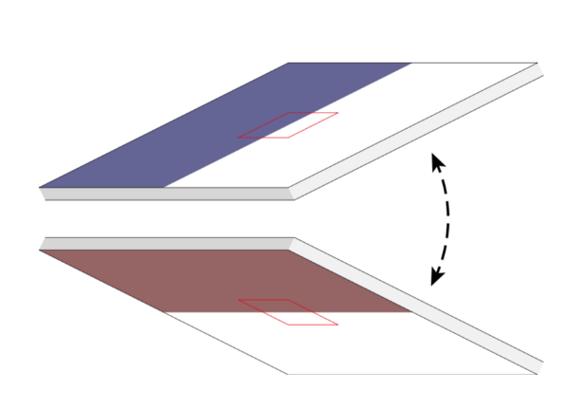
Gradient-Descent Optimization Study
Target:
Result:
0.5 mm
Notes:
Consider this thin planar slub with two different textures on it. How can we determine if the textures are achievable with our printing materials?
<click>
To understand it, we developed a Gradient-Descent Optimization solution which optimizes surface appearance over a set of voxels as the optimization variables.
Now, at 0.5mm, Gradient-Descent Optimization provides us with this solution. These are the renderings of the two sides of the resulting slab.
We see in this example that the uniform blue color of the front face is not as uniform in the resulting solution. The white color is also partially darkened by the back face. Symmetrical distortions are observable on the back face.
Gradient-Descent optimization gives us a balanced solution with a uniform error distribution. We want to reproduce a similar behavior in our gamut mapping solution.
======================================
Show results of GD optimization
Btw, we also validated the heuristics by Elek et al. as a site note
Denis’s narration:
To understand the achievable color pairs, we run gradient-descent optimizations on thin slabs. Having this data, we can understand, if some pair of colors can be reproduced on the two sides of a thin slab of a certain thickness.

Slide 17
Our approach
Build a LUT of achievable color pairs for different thicknesses
Map surface colors to the gamut using the LUT
Front
Gradient-descent 0.5 mm
Back
Notes:
Our solution consists of two steps.
First, <click> we build a LUT of achievable color for many thicknesses using our gradient-descent optimization. This way, we have a knowledge of the physical limitations of our printing materials.
<click>
Then, we change the target specification so that it is realizable in the target volume

Slide 18
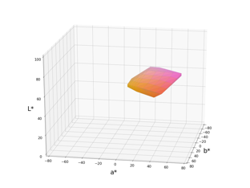
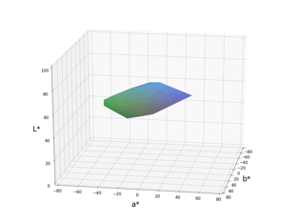
Gamut on Thin Geometry
?
?
0.5 mm
Notes:
The collected color gamuts are parametrized with the local volume thickness and the color of the opposing surface. If the canonical slab is 0.5mm thick, and one face has this rose color, <click> the other face can be colored only with similar warm colors.
<click>
For another face color, the other face can be only colored in the cold colors.
======================================
4 plots of gamuts: 2 colors x 2 thicknesses
Through a coarse sampling of target colors we know what color combinations are possible (show a plot of the boundaries)
Then we sample the interior more densely to construct an actual color pointcloud

Slide 19
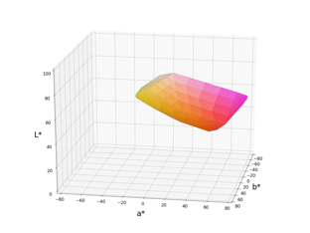
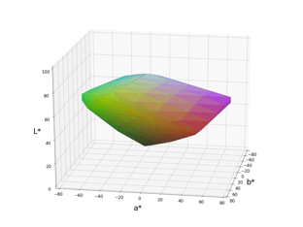
Gamut on Thin Geometry
?
?
1 mm
Notes:
With the increase of the thickness, the gamut of possible color combinations grows.
======================================
4 plots of gamuts: 2 colors x 2 thicknesses
Through a coarse sampling of target colors we know what color combinations are possible (show a plot of the boundaries)
Then we sample the interior more densely to construct an actual color pointcloud

Slide 20
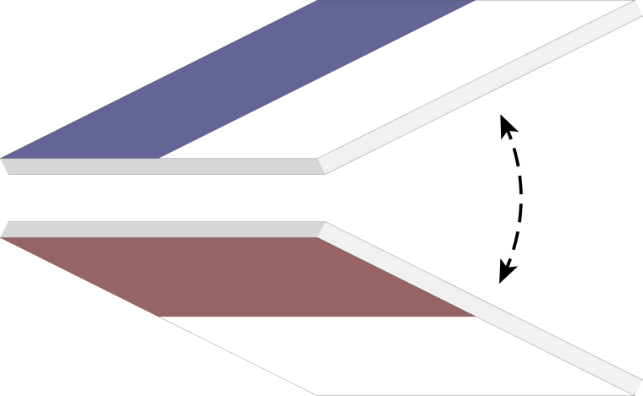
Gamut Mapping on Textures
Target
Gamut-mapped
0.5 mm
Gradient-descent result
Notes:
If we had to gamut-map slabs, where each face has one color, that would be just a lookup for the closest color pair in our collected gamut mapping data.
<click>
However, if the two faces have some textures on them, the point-to-point lookup is no longer valid. To get collective feedback from the opposing surface, we perform gaussian-smoothed lookups of the colors on the other surface. Because of the light scattering, each point is influenced by many points on the opposing surface. Out-of-gamut colors are changed so that they are achievable together with the opposing surface and have the smallest Delta E metric value.
<click>
Our gamut-mapped result is very similar to the gradient-descent optimization result.

Slide 21
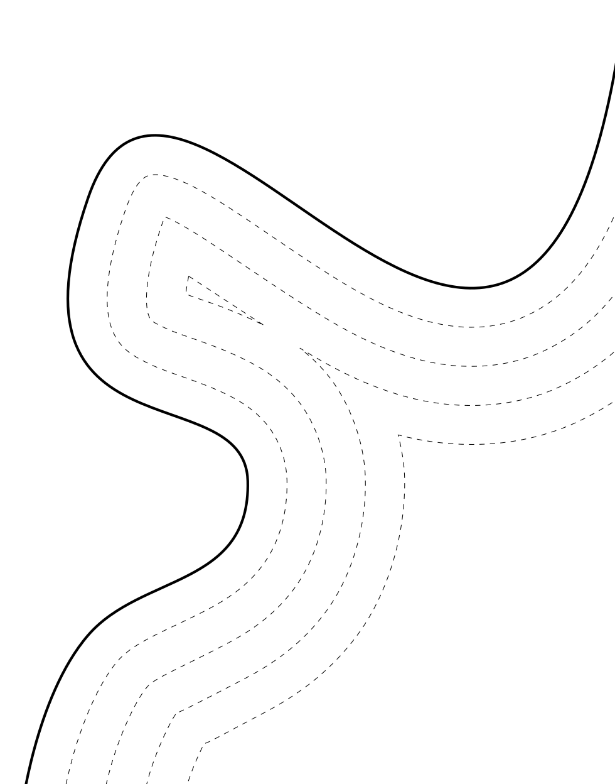
Gamut Mapping on Complex Geometry
Surface
Problem: connect the surface points with influence on each other
We use volume-to-surface mapping
Distance Field
Notes:
To apply a similar approach to complex 3D geometry,
<click>
we need connections between surface points influencing each other.
<click>
We do it through the Volume-to-surface mapping. It is not trivial for complex geometry, and for the implementation details please refer to the paper.

Slide 22
Our Pipeline and Contributions
Target mesh
Pre-mapped target
Printer specification
Printout
Thin-geometry color profile
Prediction
Iterative refinement
Contributions:
Thin-geometry color management
Scattering compensation for general 3D objects
Analysis of optimum in the solution space
Notes:
Now we have realizable target specification, and Tobias will tell you about
<click>

Slide 23
Our Pipeline and Contributions
Target mesh
Pre-mapped target
Printer specification
Printout
Thin-geometry color profile
Prediction
Iterative refinement
Contributions:
Thin-geometry color management
Scattering compensation for general 3D objects
Analysis of optimum in the solution space
Notes:
the refinement procedure which creates the printable material assignment.

Slide 24
Iterative Refinement
Notes:
======================================
Intermediate overview over the pipeline, and where we just inserted the gamut mapping, what is coming next

Slide 25
Iterative Refinement
Target mesh
Printer specification
Printout
Backward Refinement
Forward Prediction
Prediction
Notes:
We have shown that a static forward model to produce a printer specification from an input is not performing well with the amount of translucency we are dealing with in our work.
Instead we are opting for an iterative approach in which we first
<click>
Perform a high quality prediction of object‘s appearance and then
<click>
Update the printer specification to minimize the differences we observe against the target texture.
In the following I will talk about these two steps in detail.
=================
We covered some effects with the input processing, but others greatly depend on the actual arrangement.
We iteratively move closer to the optimum to reduce scattering on the same surface and the linked blurring of edges and local contrast reduction.

Slide 26
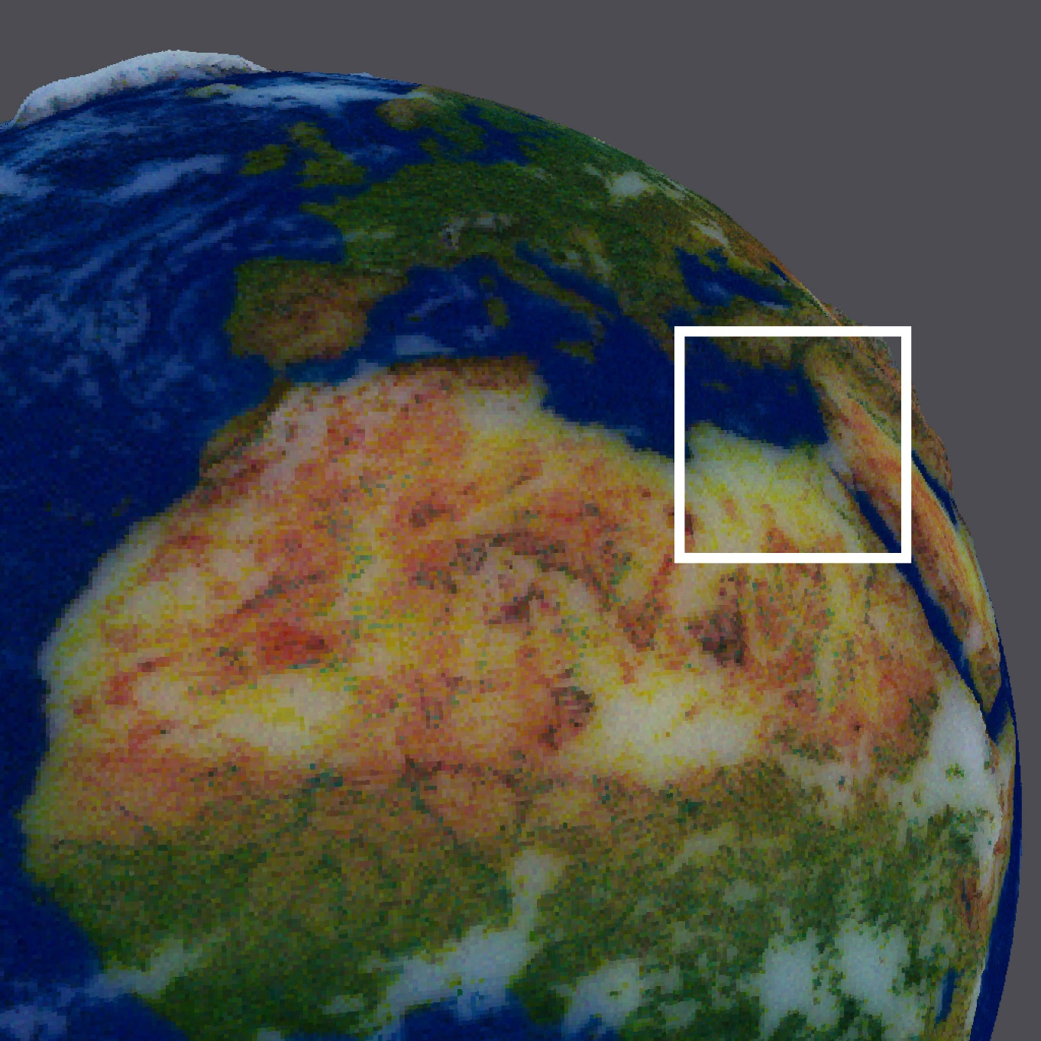
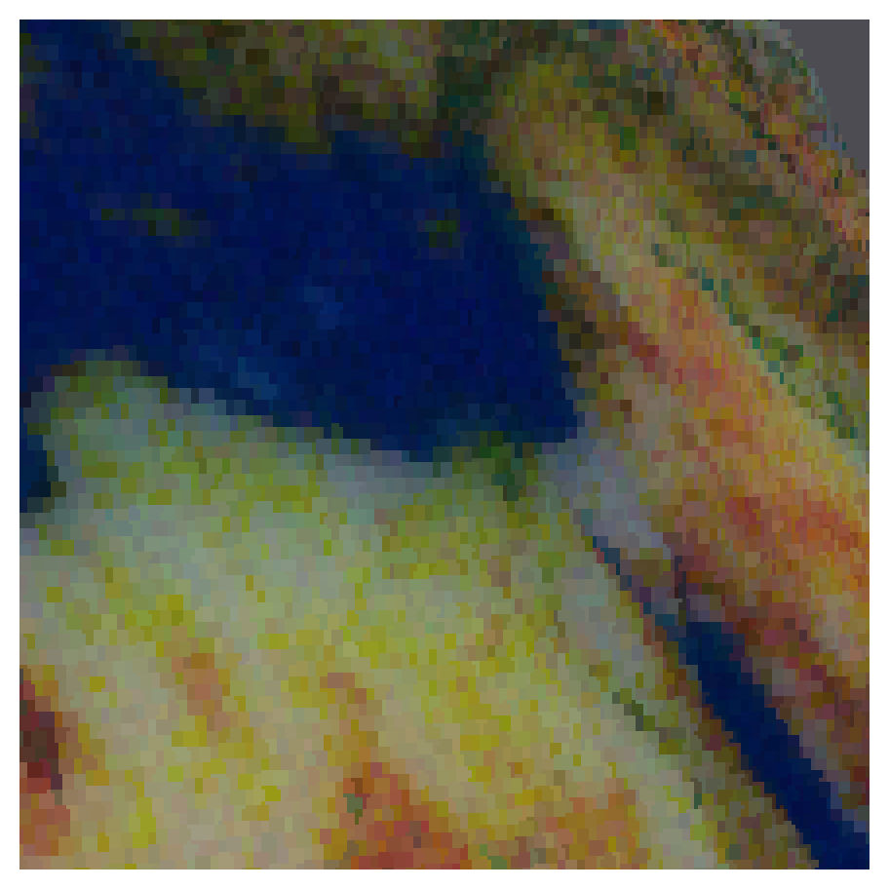
Forward Prediction
Monte Carlo
light transport simulation
Notes:
In the forward prediction pass we use Monte Carlo light transport simulation to render the appearance over the surface.
Using this technique we can accurately capture all the scattering effects, such as blurring of edges, that we observe on the 3D prints.
======================================
We simulate the exact light transport inside the volume using MC path tracing
Detailed assumptions on the light transport [for experts]

Slide 27
Forward Prediction - Assumptions
Illumination
Surface ×
Subsurface ×
Illumination
Notes:
With a normal pathtracer the appearance is a product of the surface attenuation, the subsurface scattering and the incoming illumination.
With our 3D printer we only have control over the subsurface part of the transport - so the part we want to optimize.
And as we don‘t want to bake a certain illumination into the object, we factor out the illumination part
<click>
and assume perfectly white illumination over the surface.
This allows for our 3D prints to be viewed under a wide range of viewing conditions.
Note as well, that surface effects and illumination are later on added by reality when we fabricate the object.

Slide 28
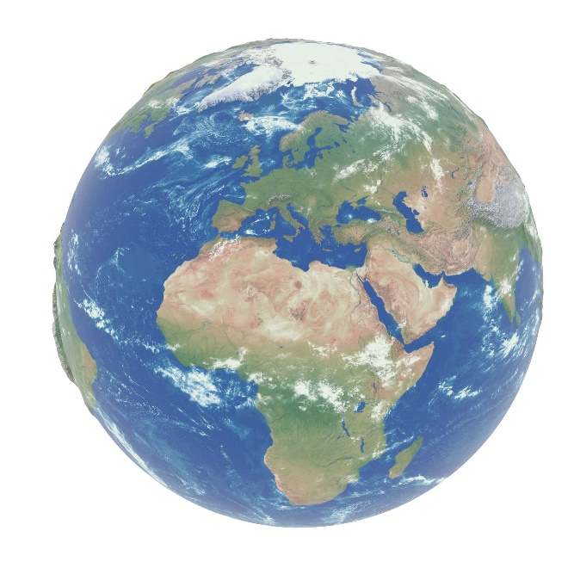
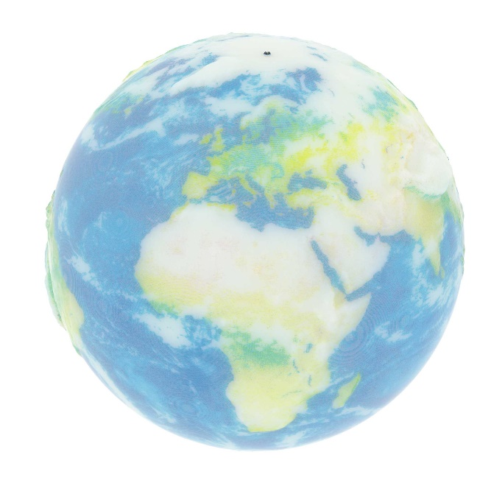
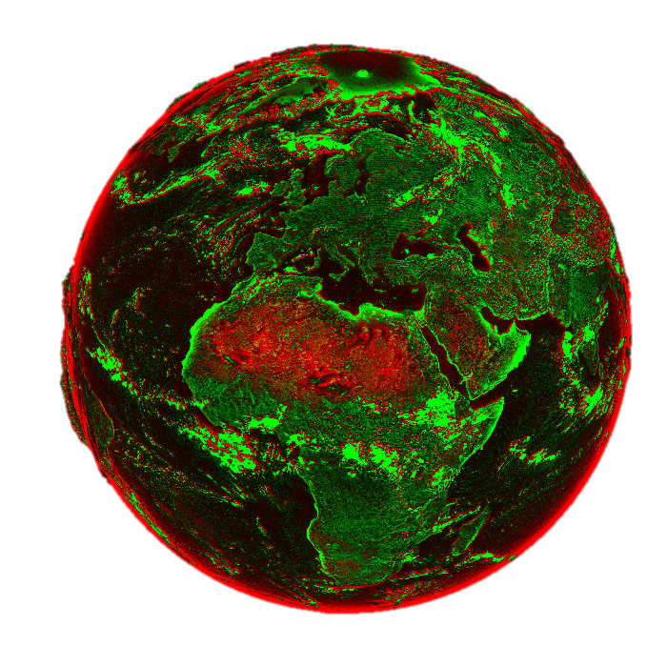
Backward Refinement
+
– $=±Δ$
0
-
Target
Prediction
$±$Difference map
Notes:
Once we have a prediction in the current iteration we can compare it to the target appearance and recieve a positive and negative delta on the surface.
This differencemap tells us, how we would like to change the surface appareance, but the question remains, how do you propagate this error into the volume?

Slide 29
Motivation through Gradient-Descent
Surface
Layers
Target
Gradient-Descent
[Elek 2017]
Limited to
thick planar slabs!
Notes:
To answer this question we asked our gradient descent optimizer that we have shown you earlier, how to optimally arrange a small volume to reproduce a texture on the surface.
<click>
As you can see, it deposits strongly absorbing material closer to the surfaces, whereas deeper layers are more white to allow for the light scattering through.
This is very much in line with the heuristical approach taken by our previous work, which expresses the absorption even more compressed to the surface.
Because we saw that this intuition gives close to optimal results, we base our approach on this.
Remember though, that this previous work was limited to planar slabs <click> which simplifies the traversal of the underlying volume to a layer based approach.

Slide 30
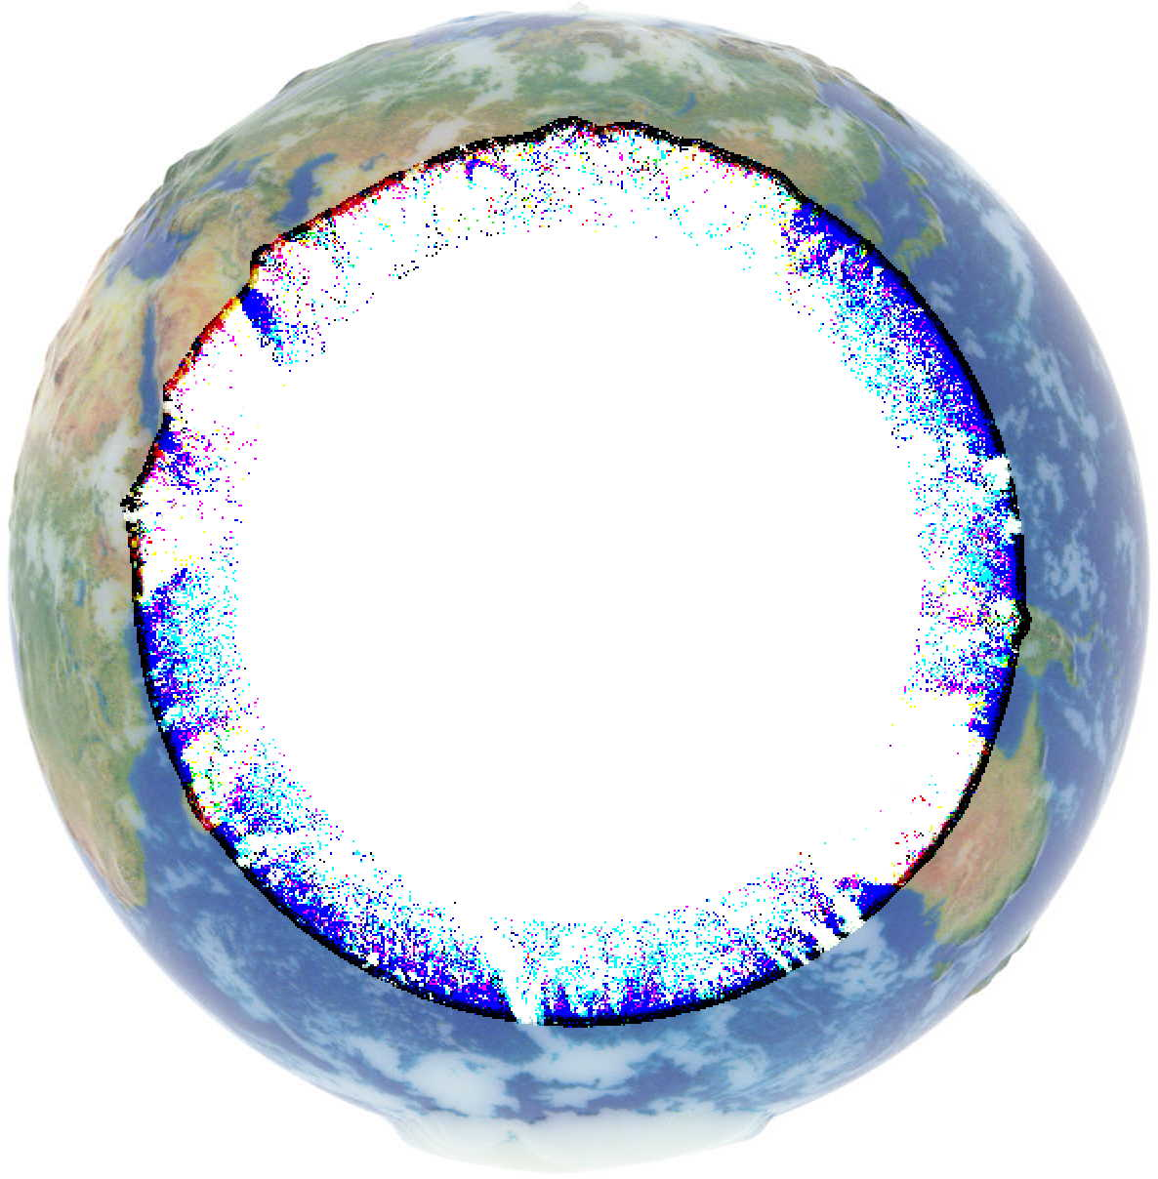
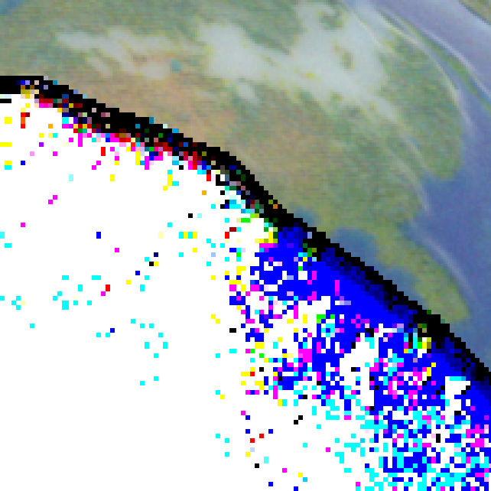
Backward Refinement (2)
+
Darkening
0
-
Lightening
$±$Difference map
Notes:
I will now show how we propogate the difference on the surface for arbitrary 3D geometry.
Negative residual, so darkening, is propagated from the outside to the inside of the objects,
Whereas positive residual, so lightening is propagated from the inside out.
Only once a iso-layer is saturated, remaindings are propagated further.
This way we compress the absorptive materials close to the surface which minimizes any lateral scattering effects, that would cause blurring or cross-talk.
And in case of thin geometry, we propagate the lightening not only to the closest surface, but also to opposing surfaces in order to reduce the crosstalk as well.

Slide 31
Geometry-Aware Scattering Compensation for 3D Printing
Notes:
Here is an animation of the optimization procedure where you see the surface prediction on the left side and on the right side a version that is cut open, in order to visualize the internal structure of the object.
<click>
In the background we plot the error value of the optimization run, where you can see that after 7 iterations we reached the optimum and the optimization can be stopped. I will let it run further to show, that the appearance doesn‘t change majorly.
======================================

Slide 32
Results

Slide 33
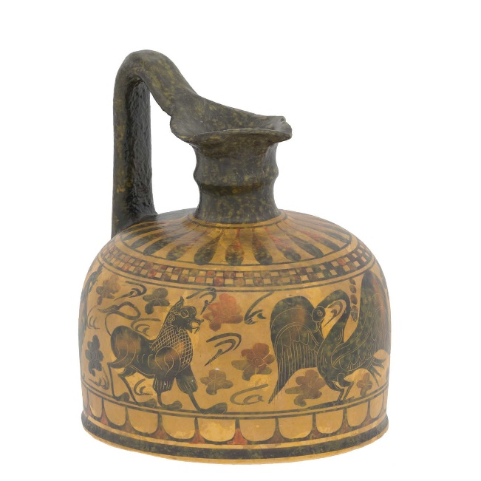
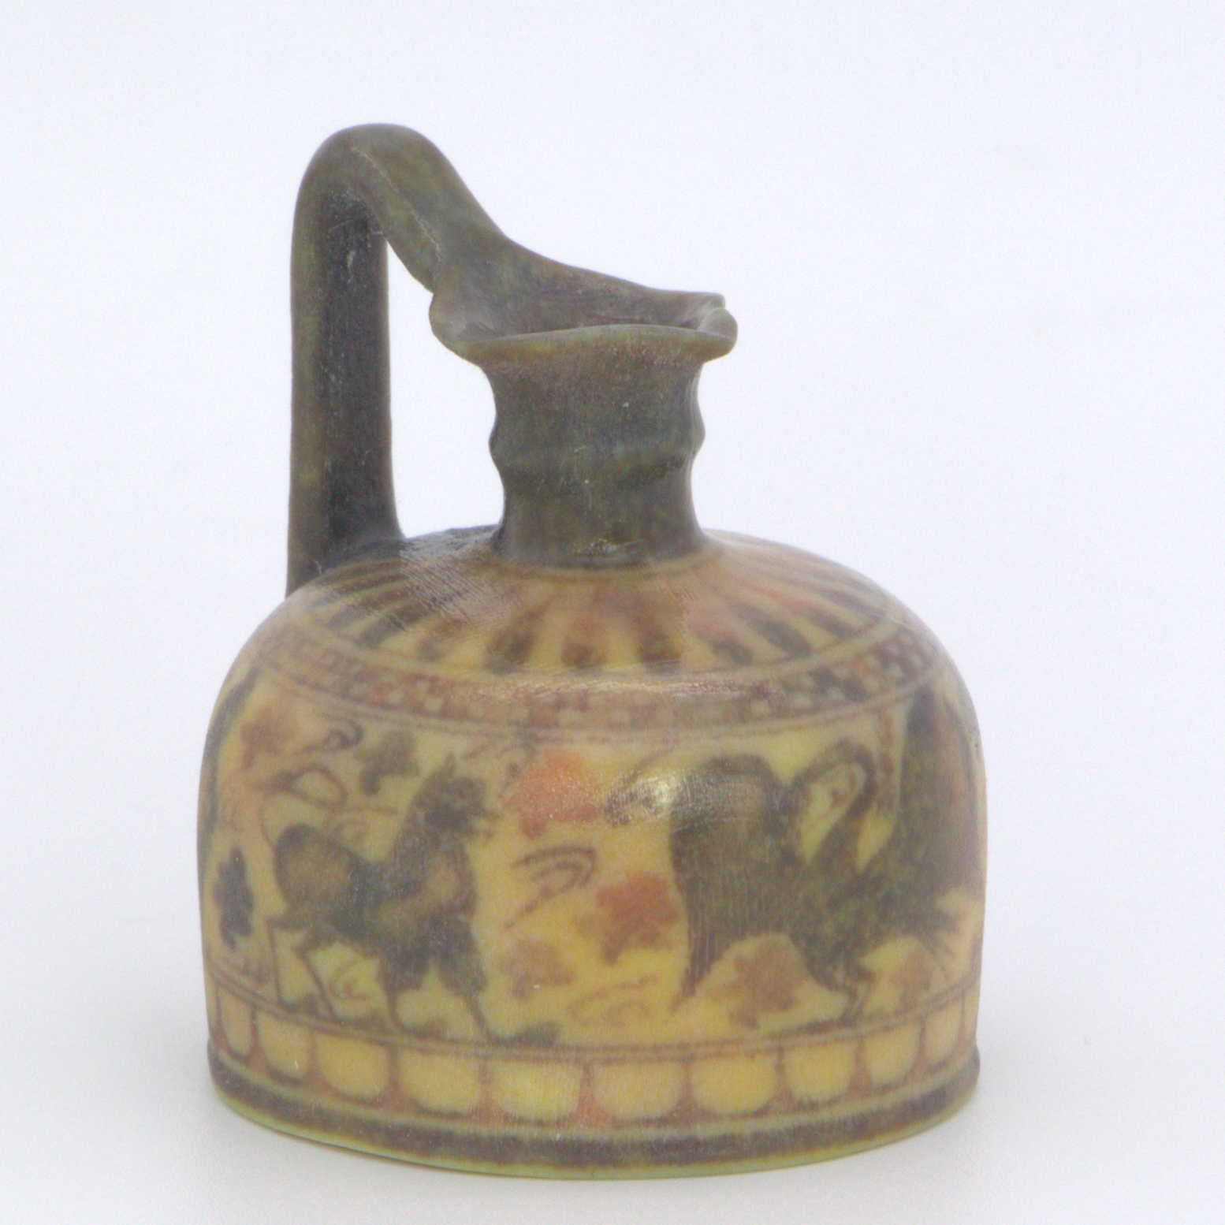
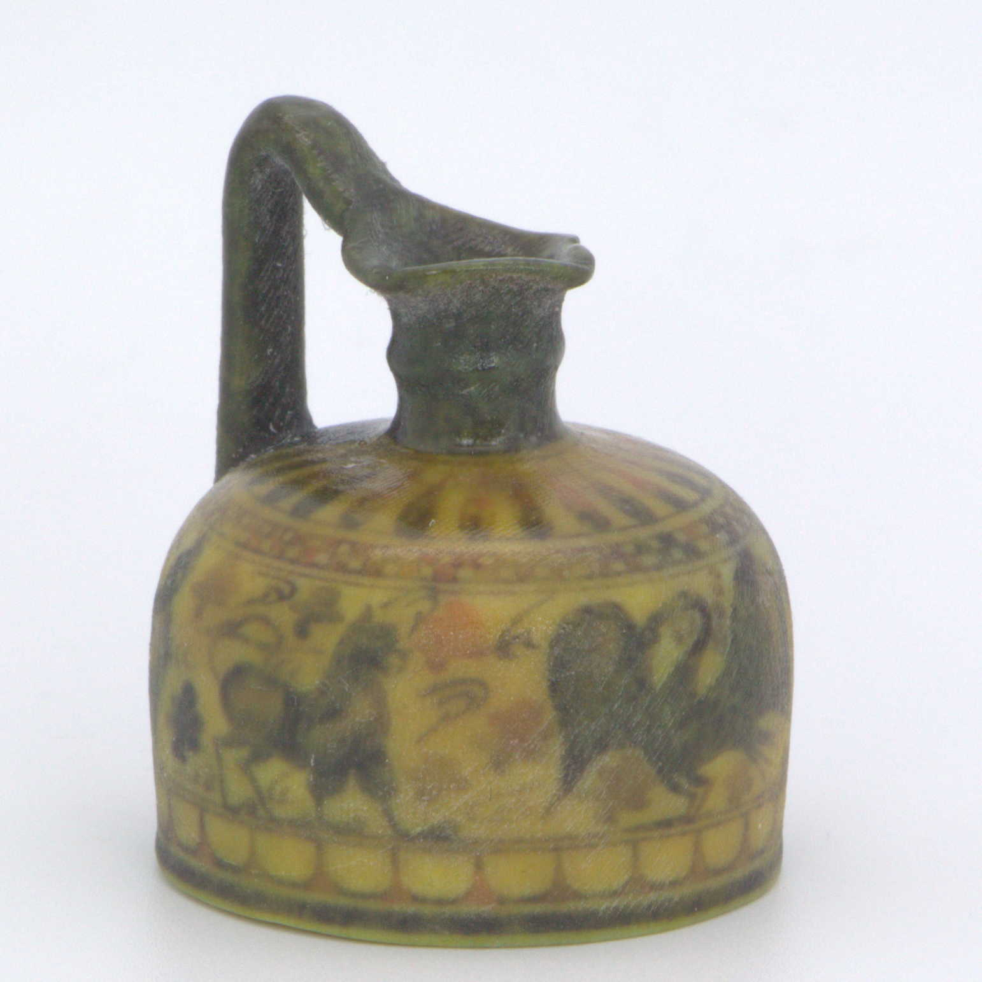
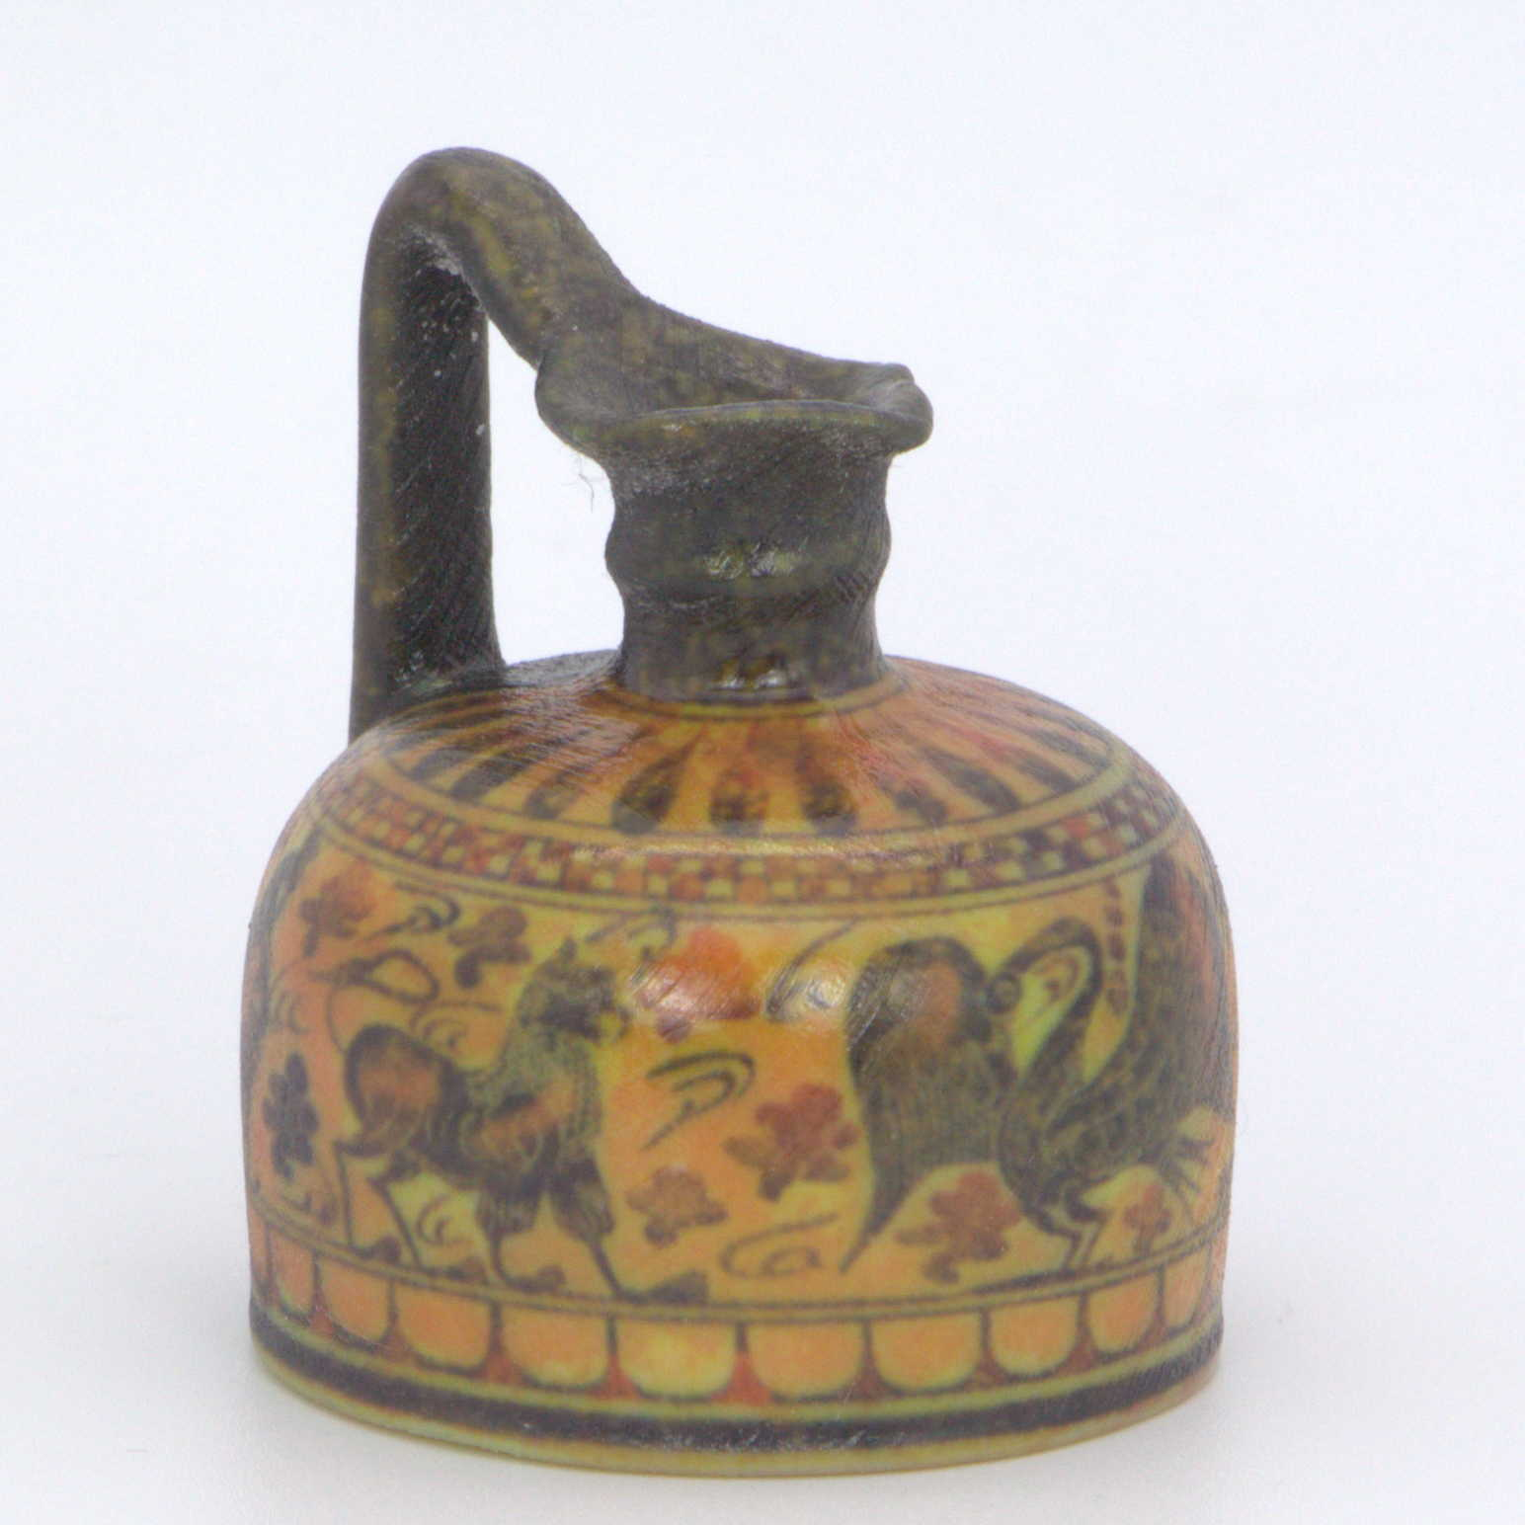
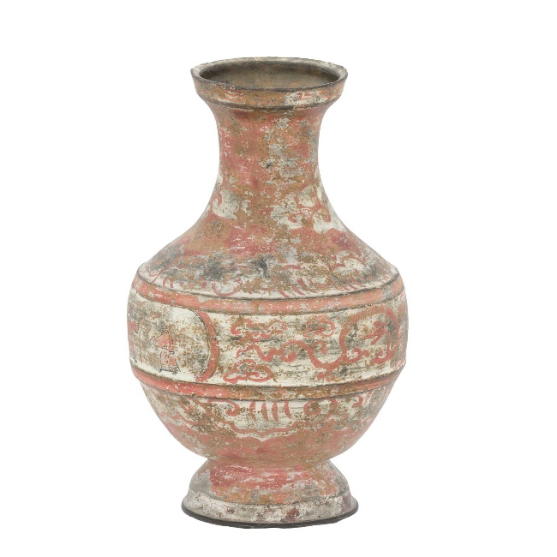
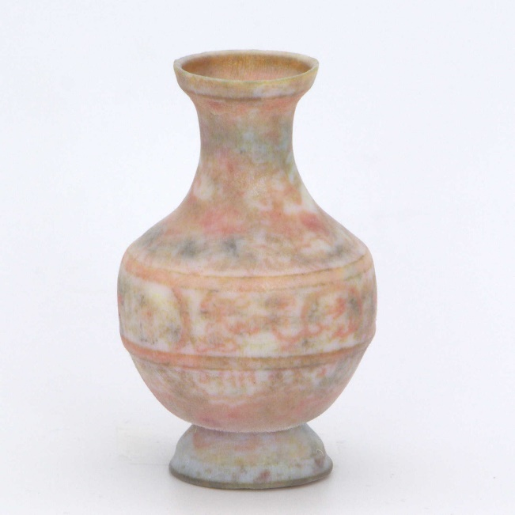
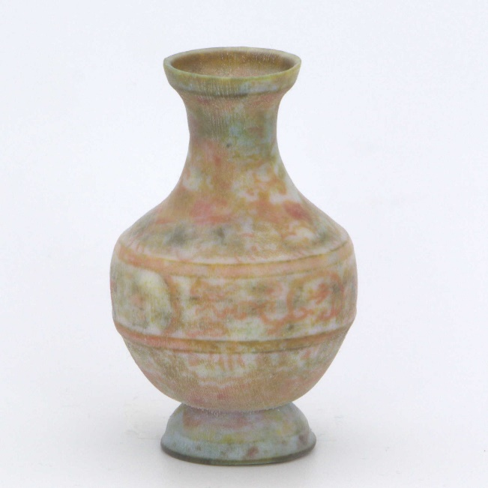
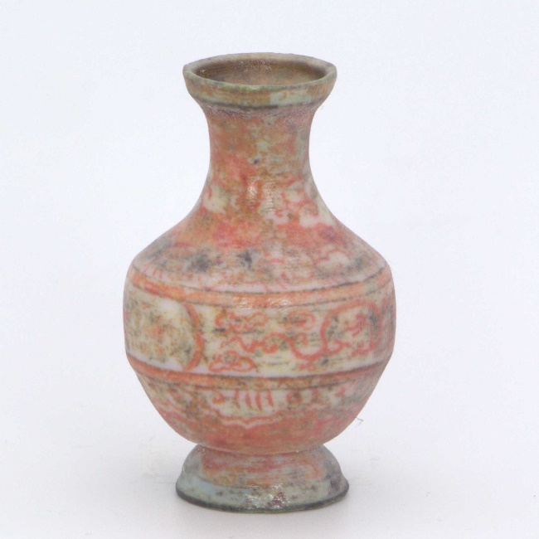
Results on General Geometry
Target
GrabCAD
Cuttlefish
Ours
Notes:
On the left side you the target appearence of the two vases.
<click>
Next to it, we have GrabCAD - the printers default software
<click>
Cuttlefish is an alternative driver software.
<click>
And finally our results on the far right.
You can see how GrabCAD and Cuttlefish clearly suffer from lateral scattering whereas our method improves, both, the sharpness of the texture and the contrast of colors.

Slide 34
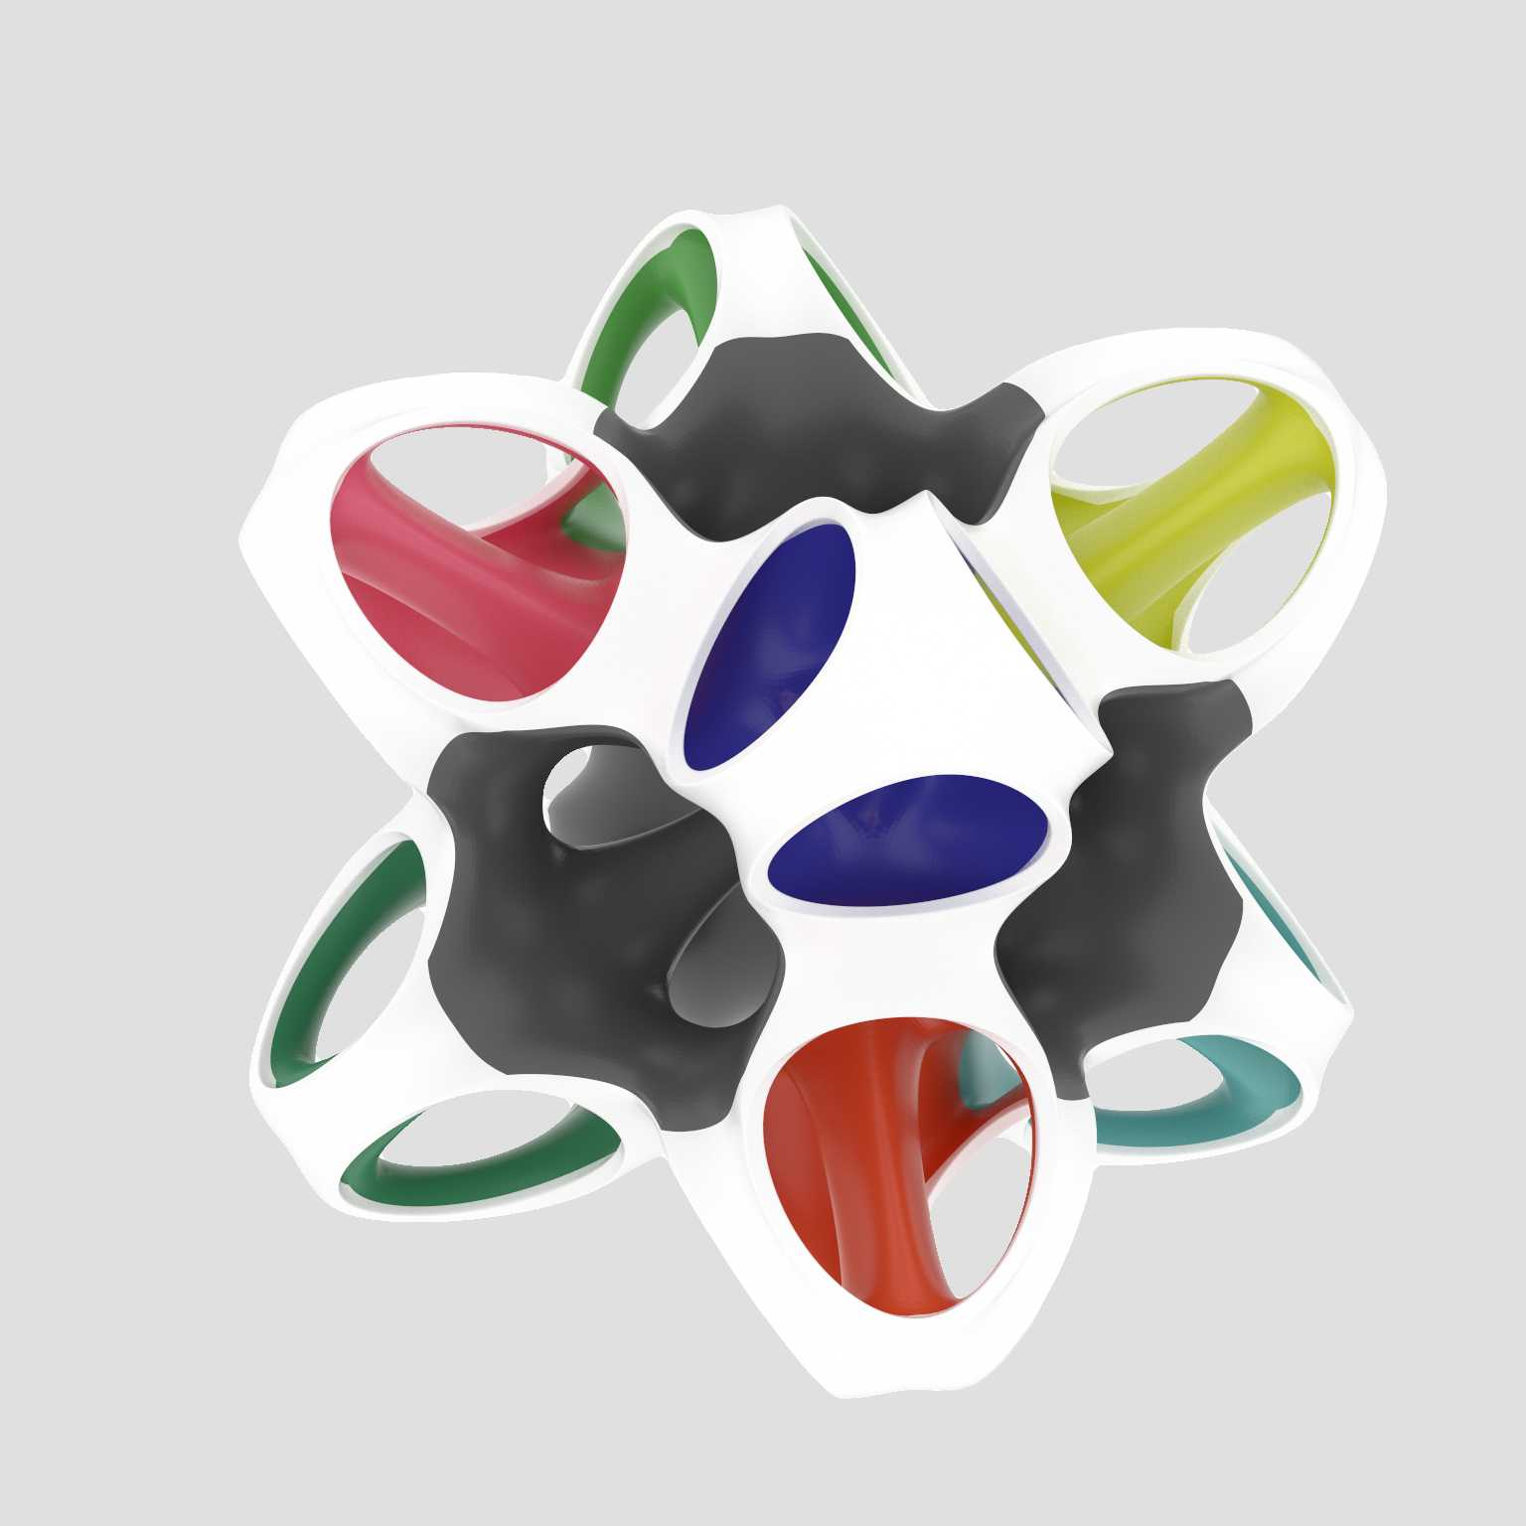
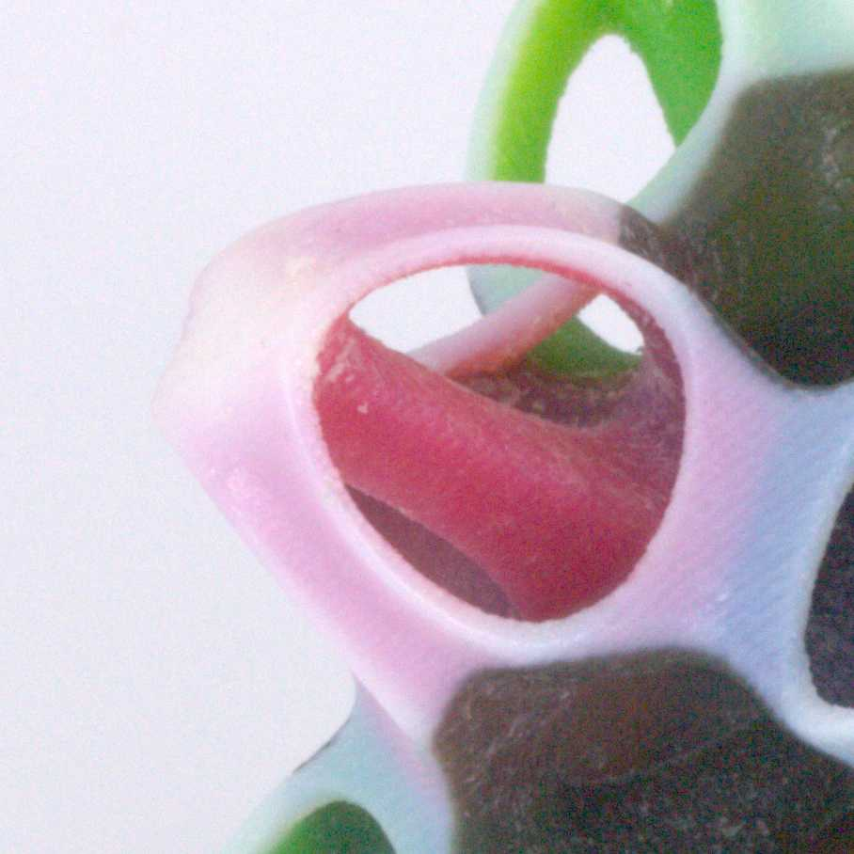
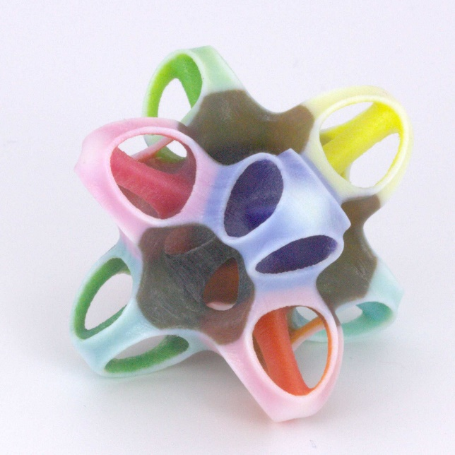
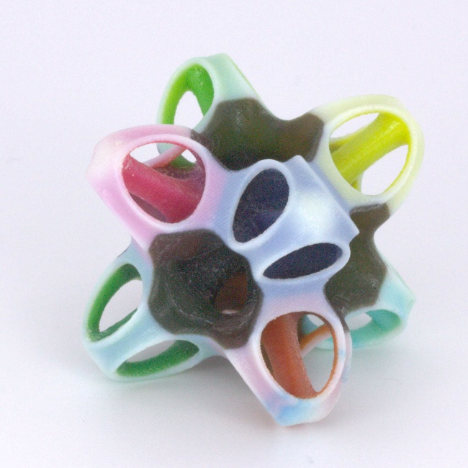
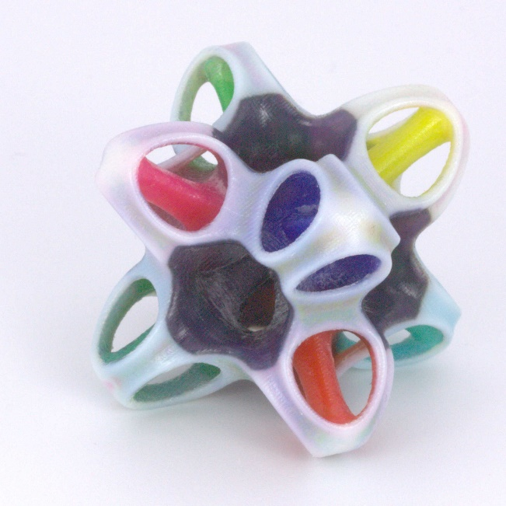
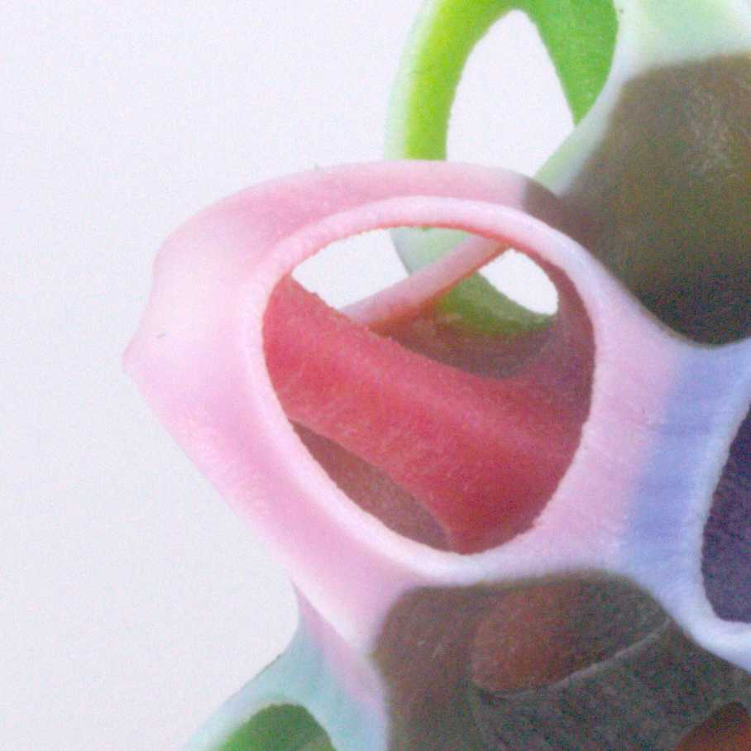
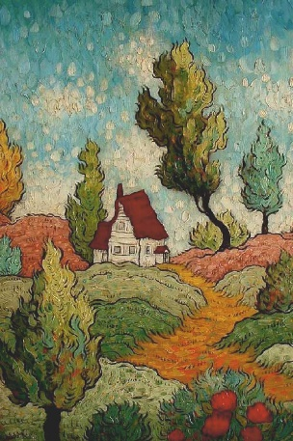
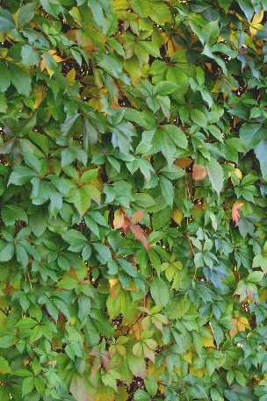
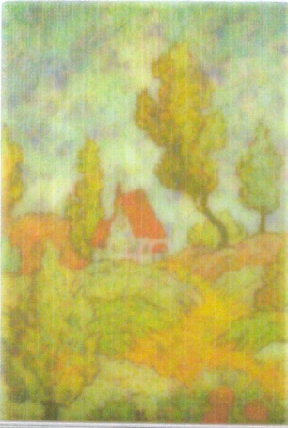
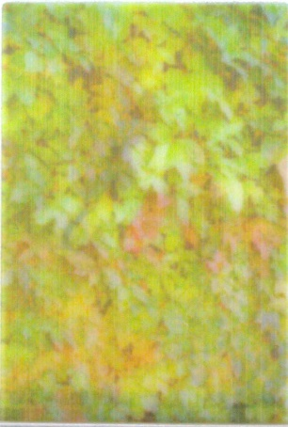
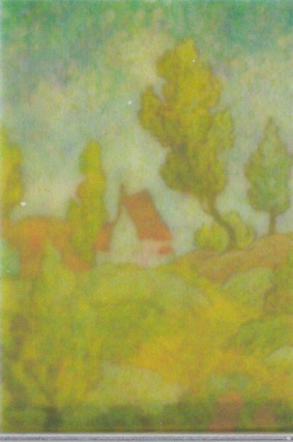
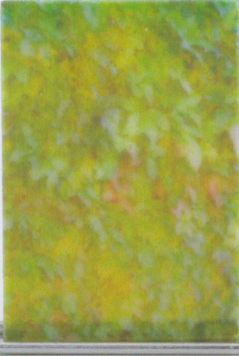
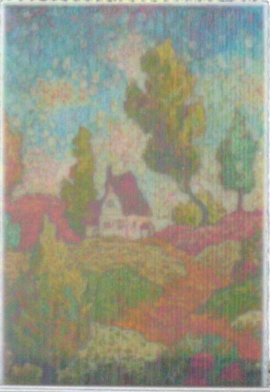
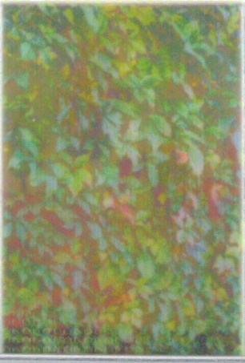
Results on Thin Geometry
Target
GrabCAD
Cuttlefish
Ours
0.5mm Thickness
Notes:
This complex thin object has a wall thickness of around 1mm and is a particularly challenging example, because of the saturated colors on the inside and the purely white outside.
<click>Here the contrast to our method is more subtle, but when we zoom in <click>, we can see how our method desaturates the colors on the inside and turns the outside into grey to cover up the inherent crosstalk visible on the right side in the two other examples.
<click> When we look at textured thin objects our method performs even better and greatly improves over GrabCAD and Cuttlefish. Despite the backlighting, our prints show minimal crosstalk and exhibit the best contrast and color reproduction due to our special handling of thin geometry.

Slide 35
GrabCAD
Front
Back
Printout
Target
Printout
Notes:
In this example from the introduction, GrabCAD performs poorly and a fair amount of cross-talk is visible on the front side. Pay attention to the window visible through on the very left here.

Slide 36
Our (1) – without our Gamut Mapping
Front
Back
Printout
Target
Printout
Notes:
Now only our scattering compensation improves the result already, but still has parts of the window visible.

Slide 37
Our (2) – with our Gamut Mapping
Front
Back
Printout
Target
Printout
Notes:
When we map our target specification using our content-aware gamut mapping, the colors get desaturated with the effect of almost invisible cross-talk.

Slide 38
Limitations and Future Work
Timings of Prediction
Gamut also affected by lateral colors
[Herholz et al. 2019]
Target
Printout
Notes:
As for the limitations of our method, the timings are goverened by the costly Monte-Carlo light transport simulation where we hope to get a good speedup by using the method of Herholz et al presented two days ago.
During our work we discovered that lateral colors also affect the gamut in high-frequency textures and one could think of extending our Content-aware Gamut Mapping along this dimension.

Slide 39
Conclusion
Faithful texture reproduction for complex 3D geometry
Gamut Mapping considering shape and content
Scattering compensation for 3D geometry
Notes:
To conclude our talk, we have shown the first method for faithful texture reproduction for complex 3D geometry which consisted of two major parts.
First a gamut mapping approach considering shape and content.
And second, how to perform scattering compensation for 3D geometry.

Slide 40
Acknowledgments
Individuals:
Donald Degraen, Philipp Urban
Sketchfab users: William Zarek, laurashea, CMPLab
Funding:
European Union: MSCA 642841 & ERC 715767
Czech Science Foundation: 16-18964S, 16-08111S, 19-07626S
This project has received funding from the European Union’s Horizon 2020 research and innovation programme under the Marie Skłodowska-Curie grant agreement No 642841.
Notes:
With that I‘d like to thank the following individuals and institutions for their support

Slide 41
Geometry-Aware
Scattering Compensation
for 3D Printing
Denis Sumin¹
Tobias Rittig²
Vahid Babaei¹
Thomas Nindel²
Alexander Wilkie²
Piotr Didyk³
Bernd Bickel⁴
Jaroslav Křivánek²
Karol Myszkowski¹
Tim Weyrich⁵

Slide 42
Remap [Elek‘17] to 3D
[Elek et al. 2017]
Our

Slide 43
Geometry-Aware
Scattering Compensation
for 3D Printing
Denis Sumin¹
Tobias Rittig²
Vahid Babaei¹
Thomas Nindel²
Alexander Wilkie²
Piotr Didyk³
Bernd Bickel⁴
Jaroslav Křivánek²
Karol Myszkowski¹
Tim Weyrich⁵
This project has received funding from the European Union’s Horizon 2020 research and innovation programme under the Marie Skłodowska-Curie grant agreement No 642841.
Notes:
Feedback:
Interior cutouts nice!+
Process explanation was easy to follow.
Many pictures, descriptive+
Structure+
clean slides + animation
fluent+visual
Capture the introduction/motivation better, cut down to harsh.
previous work explanation was to scarce, maybe unrelatable for novices, but nice separation what was build on top, too quick, not really went into the images.
First slide to busy. split into two slides.
4. slide: gradients no idea what it was.
15. slide: separation of the layers+
pipeline: small fontsize.
GrabCAD only introduced 5 slides after first occurance.
rehearsal, it was missing a bit more pace, energy, confidence+
“3D pipeline for 3D geometry”
Conclusion: essentials of each section in one sentence
Performance aspects
22, ‘complex geometry’ but then only slabs again.
tsszt sounds
Should be more exciting: we are the first to reproduce colors/appearance for 3d printers
deliver more highlevel view, (to technical descriptions),
gamut mapping completely misunderstood, graphs too lowlevel,
more confidence
initial pace only lasted 2 slides
what is essential, new and interesting, get rid of attachments
rehearse rehearse rehearse
slide changing is dropping attention,
running out of time
continuous train of thought missing
“know you are ready”

Slide 44
Results in Numbers
5-6 cm Object sizes
Modeled in 300dpi
X Mvoxel
400 CPU cores
Notes:
Show timings + conversion plots
Leading to future work:
Speed up
Gamut mapping with lateral colors

Slide 45
Color Gamuts
Presented gamuts are for big homogeneous bulks of material.
But: materials’ translucency limits the achievable color combinations.
sRGB in L*a*b* space
Stratasys J750 gamut in L*a*b* space
Notes:
Although the printers are full-color nowadays, it doesn‘t mean they are as expressive as the input we feed it with.
In fact even for thick homogeneous objects, the gamut is limited when comparing to sRGB, which is the default colorspace of most displays and textures.
The field of color science is studying this problem for quite some time and how to compress colors outside of the range into the smaller gamut in a meaningful way.
In our setting we have the additional difficulty of the three dimensional arrangement and the light interactions between the materials.
======================================
Show 2 examples of gamuts (sRGB vs printer)
Denis’s narration:
Although the printers are full-color now, even for the case of homogeneous big objects the gamut of achievable color is limited comparing to sRGB.
As in all color-processing pipelines, it is important to know the gamut limits. It is a well-studied problem.
But because of the translucency of the materials, in our domain there are gamut of achievable color combinations! (next slides)

Slide 46
Content-aware Gamut Mapping
Remapped
Target
d=0.5mm
d=1mm
d=2mm
Surface
a.
a.
d
b.
Target
b.
Notes:
We call it Content-aware Gamut mapping as it takes into account both geometry and color content of the target model.
In a pre-processing step of our pipeline, we iterate over the surface points of our model and check the local thickness d of the model at this point. If It is less than 5mm, we check if the target colors (a. and b.) are achievable together given the amount of volume between them. If they are not achievable together, we search for the pair of colors which are achievable together and are closest to the initial target colors according to CIE dE 94 .
<clicks>
Consider the following example: the target colors are blue and yellow – such a high contrast is not achievable until the thickness is 5 mm. <clicks> The remapping procedure brings the color closer together but strives to preserve the color information.
<click>
Here is an example of the complex-target processing, the geometry in this case is a 0.5mm planar slab. We see that the color become less saturated, the algorithm prevents the window crosstalk by darkening its silhouette in the other image. The changes are symmetrical: the windows itself is lightened, but the clouds in the same spatial location are darkened a bit. All in all it results in less significant cross talk.
=============
Show how we remap colors for 3D geometry
Add it to the pipeline

Slide 47
Content-aware Gamut Mapping
Remapped
Target
d=0.5mm
d=1mm
d=2mm
Surface
a.
a.
d
b.
Remapped, d=0.5mm
b.
Notes:
The slide is just for switching between the target and remapped images

