Slide 1
Advanced 3D graphics for movies and games (NPGR010)
– Monte Carlo integration &
Direct illumination
Jiří Vorba, MFF UK/Weta Digital
jirka@cgg.mff.cuni.cz
Slides of prof. Jaroslav Křivánek, minor edits by Jiří Vorba

Slide 2
Entire the lecture in 5 slides

Slide 3
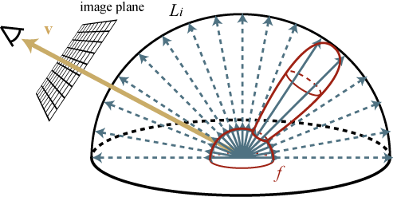
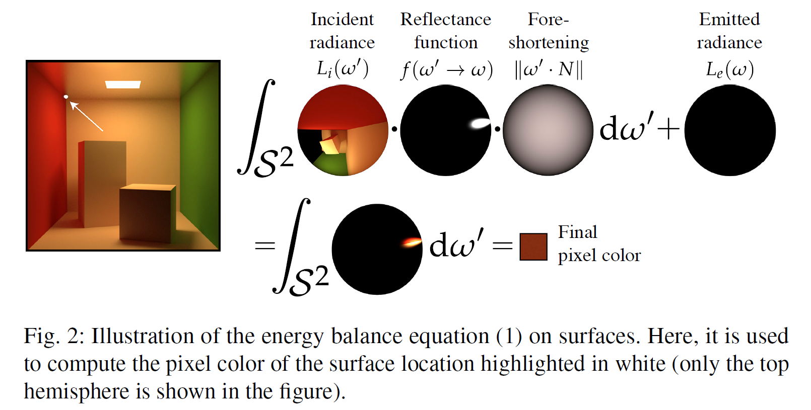

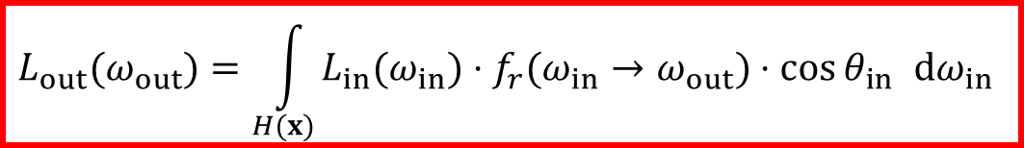


Reflection equation
$$L_{out}$$
$$L_{in}$$
Total reflected radiance: integrate contributions of incident radiance, weighted by the BRDF, over the hemisphere
$$L_{out}(ω_{out})=\int_{H(x)}{L_{in}(ω_{in})⋅f_{r}(ω_{in}→ω_{out})⋅\cos{θ_{in}} dω_{in}}$$
upper hemisphere over x
$$=\int{}$$

Slide 4

Rendering = Integration of functions
$$L_{out}(ω_{out})=\int_{H(x)}{L_{in}(ω_{in})⋅f_{r}(ω_{in}→ω_{out})⋅\cos{θ_{in}} dω_{in}}$$
Problems
  Discontinuous integrand
  (visibility)
  Arbitrarily large integrand values (e.g. light distribution in caustics, BRDFs of glossy surfaces)
  Complex geometry
Incoming radiance L_{in}(x,ω_{in}) for a point on the ceiling.
Images: Greg Ward

Slide 5
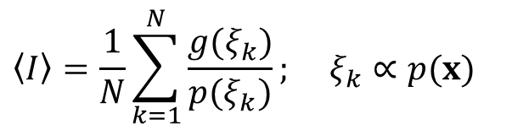


Monte Carlo integration
General tool for estimating definite integrals
Integral:
g(x)
$$I=\int{g(x)dx}$$
Monte Carlo estimate I:
$$\left\langle I\right\rangle =\frac{1}{N}\sum_{k=1}^{N}{\frac{g(ξ_{k})}{p(ξ_{k})}}; ξ_{k}∝p(x)$$
p(x)
0
ξ₅
ξ₃
ξ₁
ξ₄
ξ₂
ξ₆
1
Works “on average”:
$$E[\left\langle I\right\rangle ]=I$$

Slide 6
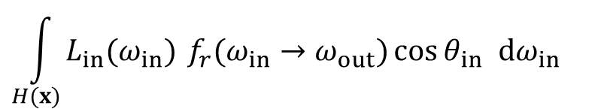

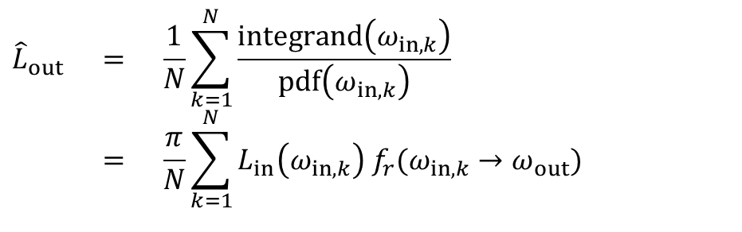
Application of MC to reflection eq: Estimator of reflected radiance
Integral to be estimated:
pdf for cosine-proportional sampling:
MC estimator (formula to use in the renderer):
$$\int_{H(x)}{L_{in}(ω_{in}) f_{r}(ω_{in}→ω_{out})\cos{θ_{in}} dω_{in}}$$
integrand(ω_{in})
$$p(ω_{in})=\frac{\cos{θ_{in}}}{π}$$
$${\hat{L}}_{out} = \frac{1}{N}\sum_{k=1}^{N}{\frac{\text{integrand}\left(ω_{in,k}\right)}{\text{pdf}\left(ω_{in,k}\right)}} \\ = \frac{π}{N}\sum_{k=1}^{N}{L_{in}\left(ω_{in,k}\right) f_{r}(ω_{in,k}→ω_{out}) }$$

Slide 7
Estimator of reflected radiance: Implementation
// input variables
x...shaded point on a surface
normal...surface normal at x
omegaOut...viewing (camera) direction
estimatedRadianceOut := Rgb(0,0,0);
for k = 1...N
[omegaInK, pdf] := generateRndDirection();
// evaluate integrand
radianceInEst := getRadianceIn(x, omegaInK);
brdf := evalBrdf(x, omegaInK, omegaOut);
cosThetaIn := dot(normal, omegaInK);
integrand := radianceInEst * brdf * cosThetaIn;
// evaluate contribution to the outgoing radiance
estimatedRadianceOut += integrand / pdf;
end for
estimatedRadianceOut /= N;

Slide 8
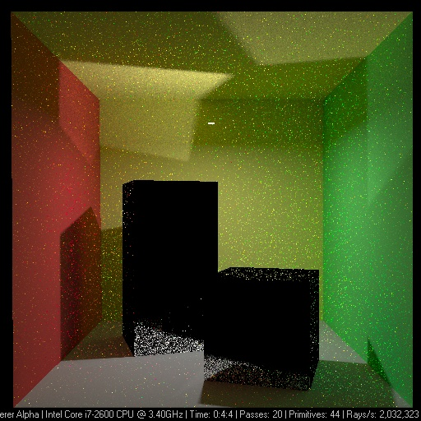
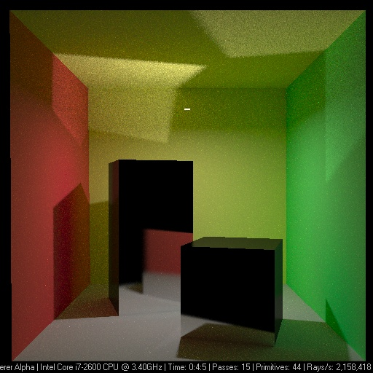
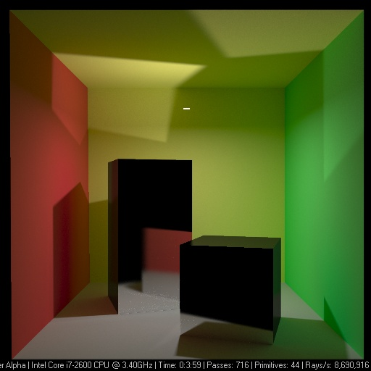
Variance => image noise

Slide 9
… and now the slow way

Slide 10
Digression:
Numerical quadrature

Slide 11

Quadrature formulas for numerical integration
General formula in 1D:
g integrand (i.e. the integrated function)
N quadrature order (i.e. number of integrand samples)
x_{k} node points (i.e. positions of the samples)
g(x_{k}) integrand values at node points
w_{k} quadrature weights
$$\hat{I}=\sum_{k=1}^{N}{w_{k}g(x_{k})}$$

Slide 12
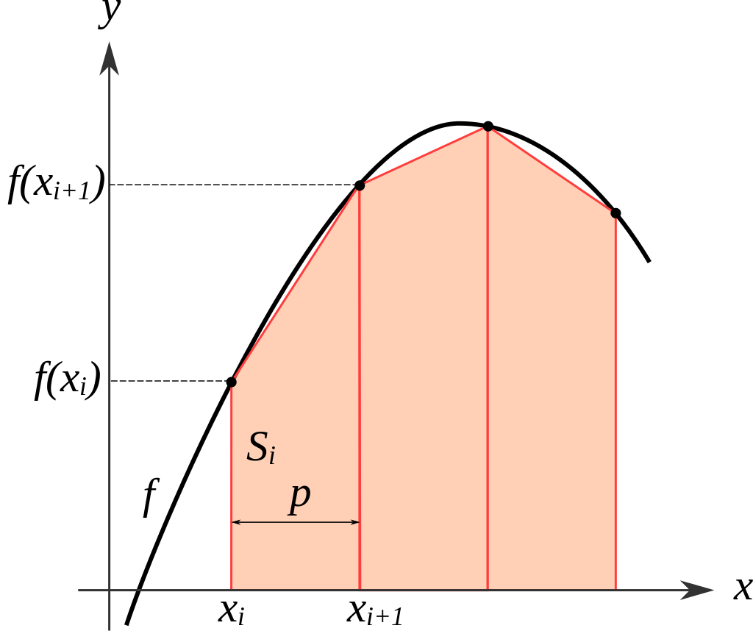
Quadrature formulas for numerical integration
Quadrature rules differ by the choice of node point positions x_{k} and the weights w_{k}
  E.g. rectangle rule, trapezoidal rule, Simpson’s method, Gauss quadrature, …
The samples
(i.e. the node points)
are placed deterministically
Source: Wikimedia Commons

Slide 13
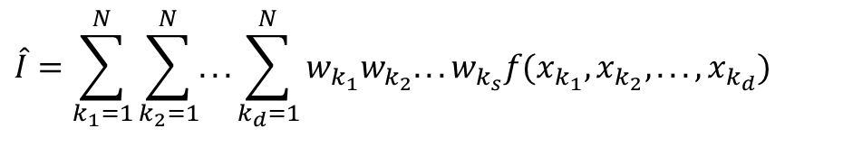
Quadrature formulas in multiple dimensions
General formula for quadrature of a function of multiple variables:
Convergence speed of approximation error E for a d-dimensional integral is E = O(N^{-1/d})
  E.g. in order to cut the error in half for a 3-dimensional integral, we need 2³ = 8 times more samples
Unusable in higher dimensions
  Dimensional explosion
$$\hat{I}=\sum_{k_{1}=1}^{N}{\sum_{k_{2}=1}^{N}{...\sum_{k_{d}=1}^{N}{w_{k_{1}}w_{k_{2}}...w_{k_{s}}f(x_{k_{1}},x_{k_{2}},...,x_{k_{d}})}}}$$

Slide 14
Quadrature formulas in multiple dimensions
Deterministic quadrature vs. Monte Carlo
  In 1D deterministic better than Monte Carlo
  In 2D roughly equivalent
  From 3D, MC will always perform better
Remember, quadrature rules are NOT the Monte Carlo method

Slide 15
Monte Carlo

Slide 16
History of the Monte Carlo method
Atomic bomb development, Los Alamos 1940
John von Neumann, Stanislav Ulam, Nicholas Metropolis
Further development and practical applications from the early 50’s

Slide 17
Monte Carlo method
We simulate many random occurrences of the same type of events, e.g.:
  Neutrons – emission, absorption, collisions with hydrogen nuclei
  Behavior of computer networks, traffic simulation.
  Sociological and economical models – demography, inflation, insurance, etc.

Slide 18
Monte Carlo – applications
Financial market simulations
Traffic flow simulations
Environmental sciences
Particle physics
Quantum field theory
Astrophysics
Molecular modeling
Semiconductor devices
Optimization problems
Light transport calculations
...

Slide 19
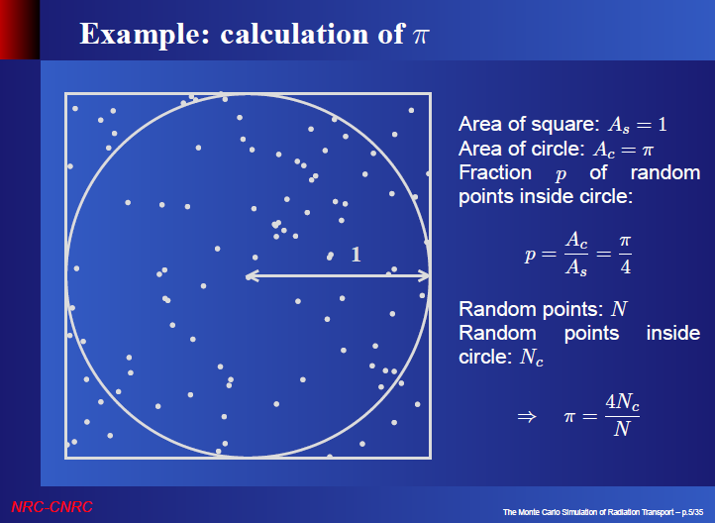
Slide credit: Iwan Kawrakov
4

Slide 20
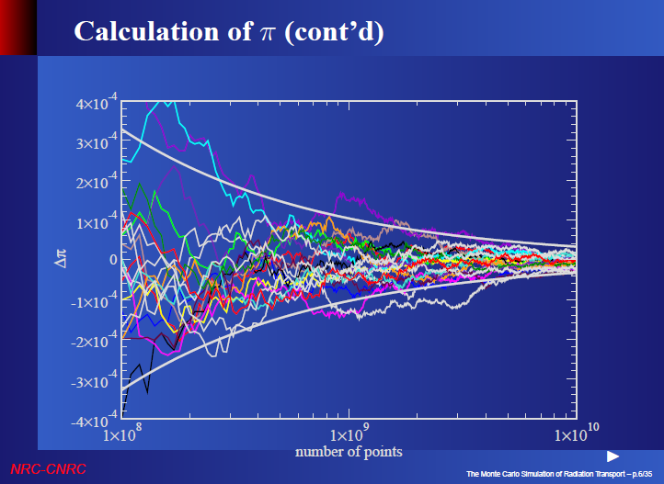
Slide credit: Iwan Kawrakov

Slide 21
Variance => image noise

Slide 22
Monte Carlo integration
Samples are placed randomly (or pseudo-randomly)
Convergence of standard error: std. dev. = O(N^{-1/2})
  Convergence speed independent of dimension
  Faster than classic quadrature rules for 3 and more dimensions
Special methods for placing samples exist
  Quasi-Monte Carlo
  Faster asymptotic convergence than MC for “smooth” functions

Slide 23
Monte Carlo integration
Pros
  Simple implementation
  Robust solution for complex integrands and integration domains
  Effective for high-dimensional integrals
Cons
  Relatively slow convergence – halving the standard error requires four times as many samples
  In rendering: images contain noise that disappears slowly

Slide 24
Review – Random variables

Slide 25
Random variable
X … random variable
X assumes different values with different probability
  Given by the probability distribution D
  X ∼ D

Slide 26
Discrete random variable
Probability mass function
Finite set of values of x_{i}
Each assumed with prob. p_{i}
Cumulative distribution
function
Cumulative distribution func.

Slide 27
Continuous random variable
Probability density function, pdf, p(x)
In 1D:

Slide 28
Continuous random variable
Cumulative distribution function, cdf, P(x)
In 1D:

Slide 29
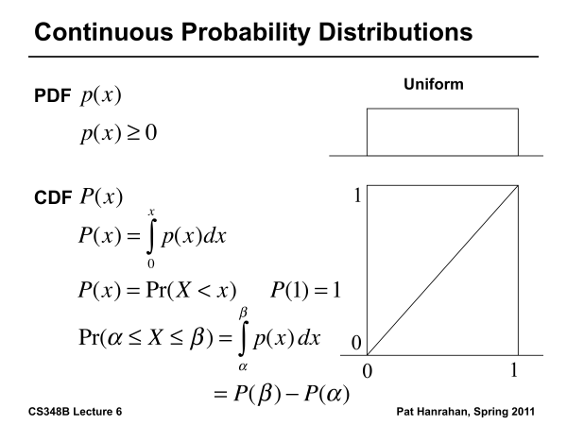
Continuous random variable
Example: Uniform distribution
Probability density function (pdf)
Cumulative distribution function (cdf)

Slide 30
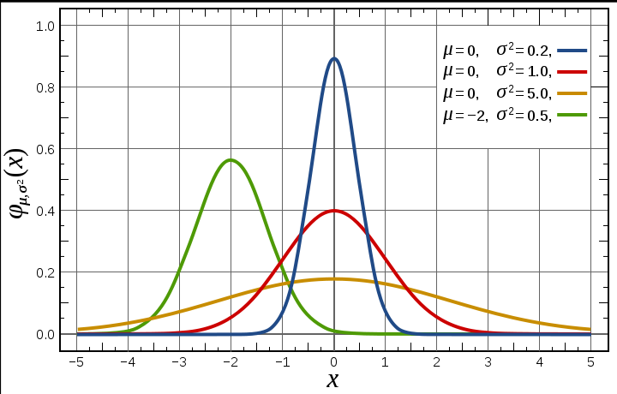
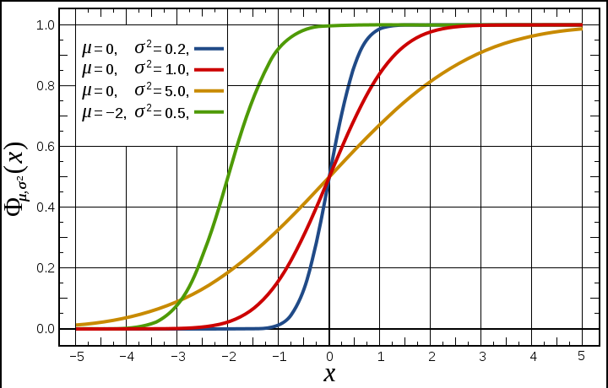
Continuous random variable
Gaussian (normal) distribution
Probability density function (pdf)
Image: wikipedia
Cumulative distribution function (cdf)

Slide 31
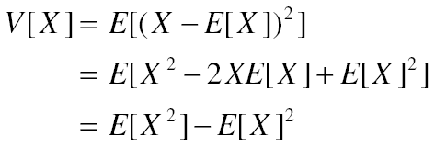
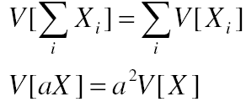
Expected value and variance
Expected value
Variance
  Properties of variance
(if X_{i} are independent)

Slide 32


Transformation of a random variable
Y is a random variable
Expected value of Y
$$Y=g(X)$$
$$E[Y]=\int_{D}{g\left(x\right) p\left(x\right) dx}$$

Slide 33
Monte Carlo integration

Slide 34
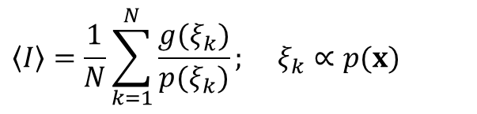
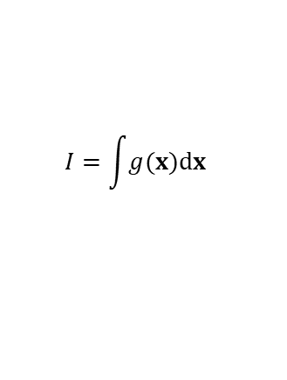

Monte Carlo integration
General tool for estimating definite integrals
Integral:
g(x)
$$I=\int{g(x)dx}$$
Monte Carlo estimate I:
$$\left\langle I\right\rangle =\frac{1}{N}\sum_{k=1}^{N}{\frac{g(ξ_{k})}{p(ξ_{k})}}; ξ_{k}∝p(x)$$
p(x)
0
ξ₅
ξ₃
ξ₁
ξ₄
ξ₂
ξ₆
1
Works “on average”:
$$E[\left\langle I\right\rangle ]=I$$

Slide 35
Primary estimator of an integral
Integral to be estimated:
Let X be a random variable from the distribution with the
pdf p(x), then the random variable F_{prim} given by the transformation f(X)/p(X) is called the primary estimator of the above integral.

Slide 36
Primary estimator of an integral
f(X)
f(x)
0
X
1

Slide 37
Estimator vs. estimate
Estimator is a random variable
  It is defined though a transformation of another random variable
Estimate is a concrete realization (outcome) of the estimator
No need to worry: the above distinction is important for proving theorems but less important in practice

Slide 38
Unbiased estimator
A general statistical estimator is called unbiased if – “on average” – it yields the correct value of an estimated quantity Q (without systematic error).
More precisely:
Estimator of the quantity Q
(random variable)
Estimated quantity
(In our case, it is an integral,
but in general it could be anything. It is a number, not a random variable.)

Slide 39
Unbiased estimator
The primary estimator F_{prim} is an unbiased estimator of the integral I.
Proof:

Slide 40
Variance of the primary estimator
For an unbiased estimator, the error is due to variance:
(for an unbiased estimator)
If we use only a single sample, the variance is usually too high.
Depends on p(x).
We need more samples in practice => secondary estimator.

Slide 41
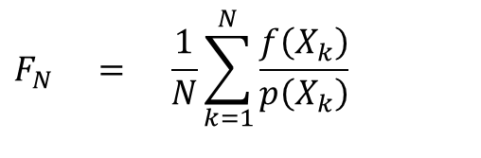
Secondary estimator of an integral
Consider N independent random variables X_{k}
The estimator F_{N} given be the formula below is called the secondary estimator of I.
The secondary estimator is unbiased.
$$F_{N} = \frac{1}{N}\sum_{k=1}^{N}{\frac{f\left(X_{k}\right)}{p\left(X_{k}\right)}}$$

Slide 42
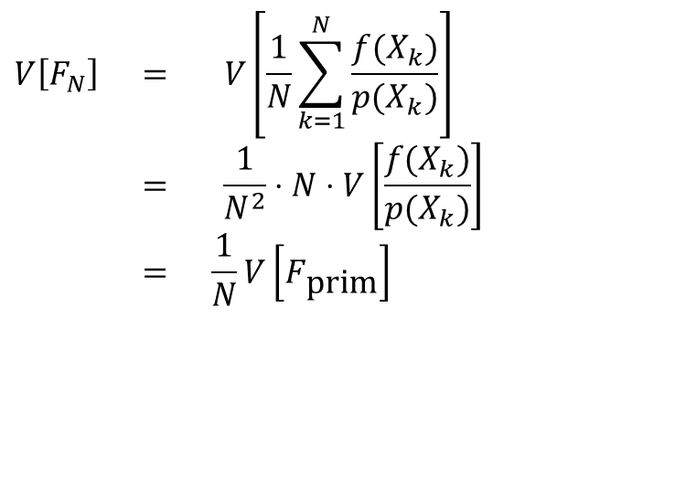
Variance of the secondary estimator
$$V\left[F_{N}\right] = V\left[\frac{1}{N}\sum_{k=1}^{N}{\frac{f(X_{k})}{p(X_{k})}}\right] \\ = \frac{1}{N^{2}}⋅N⋅V\left[\frac{f(X_{k})}{p(X_{k})}\right] \\ = \frac{1}{N}V\left[F_{\text{prim}}\right]$$
... standard deviation is √N-times smaller!
(i.e. error converges with 1/√N)

Slide 43
Properties of estimators

Slide 44
Unbiased estimator
A general statistical estimator is called unbiased if – “on average” – it yields the correct value of an estimated quantity Q (without systematic error).
More precisely:
Estimator of the quantity Q
(random variable)
Estimated quantity
(In our case, it is an integral,
but in general it could be anything. It is a number, not a random variable.)

Slide 45
Bias of a biased estimator
If
then the estimator is “biased” (cz: vychýlený).
Bias is the systematic error of the estimator:

Slide 46
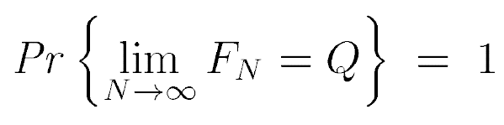
Consistency
Consider a secondary estimator with N samples:
Estimator F_{N} is consistent if
i.e. if the error F_{N} – Q converges to zero with probability 1.

Slide 47
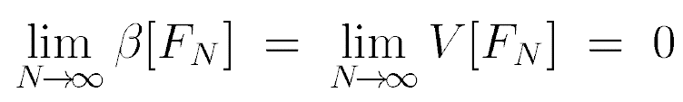
Consistency
Sufficient condition for consistency of an estimator:
Unbiasedness is not sufficient for consistency by itself (if the variance is infinite).
But if the variance of a primary estimator finite, then the corresponding secondary estimator is necessarily consistent.
bias

Slide 48
Rendering algorithms
Unbiased
  Path tracing
  Bidirectional path tracing
  Metropolis light transport
Biased & Consistent
  Progressive photon mapping
Biased & not consistent
  Photon mapping
  Irradiance / radiance caching

Slide 49
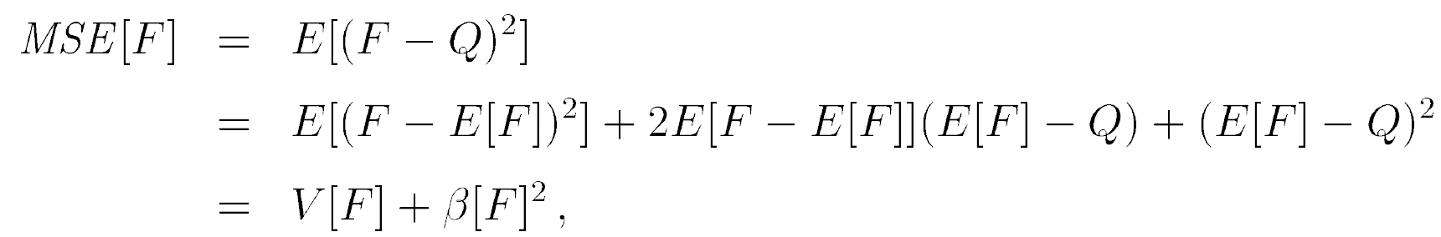
Mean Squared Error – MSE
(cz: Střední kvadratická chyba)
Definition
Proposition
  Proof

Slide 50
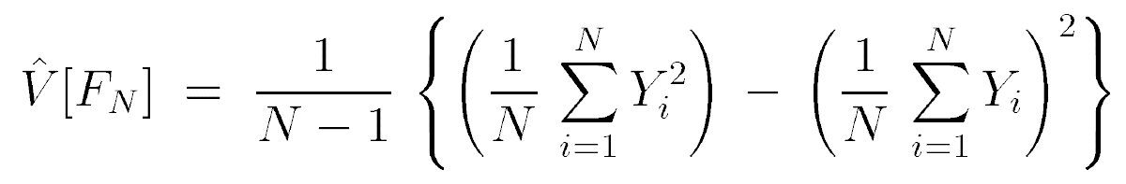




Mean Squared Error – MSE
(cz: Střední kvadratická chyba)
If the estimator F is unbiased, then
i.e. for an unbiased estimator, it is much easier to estimate the error, because it can be estimated directly from the samples Y_{k} = f(X_{k}) / p(X_{k}).
Unbiased estimator of variance
$$k$$
$$k$$
$$k=1$$
$$k=1$$

Slide 51
Why divide by N-1 instead of N?
To get an unbiased estimate
https://en.wikipedia.org/wiki/Bessel%27s_correction

Slide 52

Root Mean Squared Error – RMSE
$$RMSE[F]=\sqrt{MSE[F]}$$

Slide 53
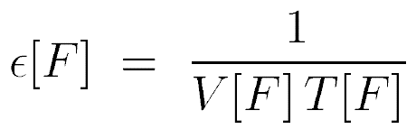
Efficiency of an estimator
Efficiency of an unbiased estimator is given by:
variance
Calculation time
(i.e. operations count, such
as number of cast rays)

Slide 54
MC estimators for illumination calculation

Slide 55

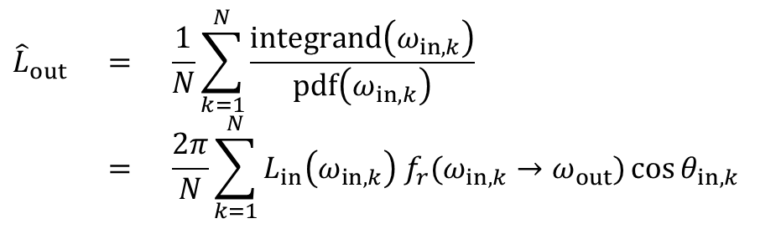
Estimator of reflected radiance (1)
Integral to be estimated:
pdf for uniform hemisphere sampling:
MC estimator (formula to use in the renderer):
$$\int_{H(x)}{L_{in}(ω_{in}) f_{r}(ω_{in}→ω_{out})\cos{θ_{in}} dω_{in}}$$
integrand(ω_{in})
$$p(ω_{in})=\frac{1}{2π}$$
$${\hat{L}}_{out} = \frac{1}{N}\sum_{k=1}^{N}{\frac{\text{integrand}\left(ω_{in,k}\right)}{\text{pdf}\left(ω_{in,k}\right)}} \\ = \frac{2π}{N}\sum_{k=1}^{N}{L_{in}\left(ω_{in,k}\right) f_{r}(ω_{in,k}→ω_{out})\cos{θ_{in,k}}}$$

Slide 56

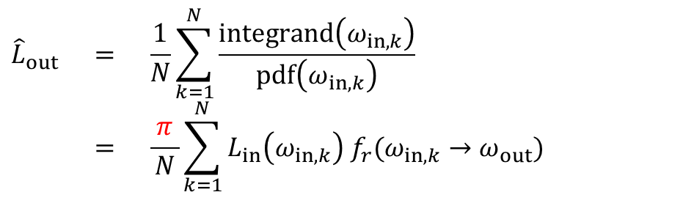
Application of MC to reflection eq: Estimator of reflected radiance
Integral to be estimated:
pdf for cosine-proportional sampling:
MC estimator (formula to use in the renderer):
$$\int_{H(x)}{L_{in}(ω_{in}) f_{r}(ω_{in}→ω_{out})\cos{θ_{in}} dω_{in}}$$
integrand(ω_{in})
$$p(ω_{in})=\frac{\cos{θ_{in}}}{π}$$
$${\hat{L}}_{out} = \frac{1}{N}\sum_{k=1}^{N}{\frac{\text{integrand}\left(ω_{in,k}\right)}{\text{pdf}\left(ω_{in,k}\right)}} \\ = \frac{ π }{N}\sum_{k=1}^{N}{L_{in}\left(ω_{in,k}\right) f_{r}(ω_{in,k}→ω_{out}) }$$

Slide 57
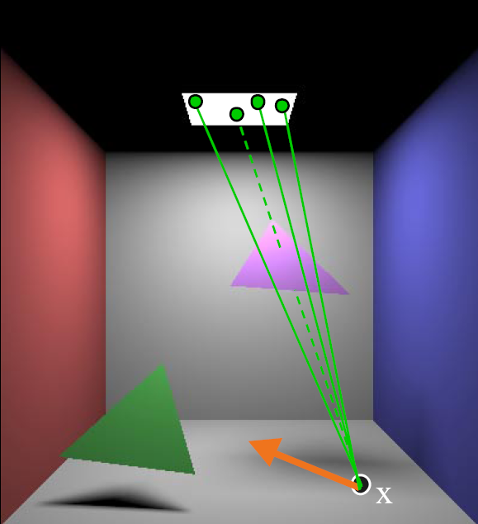
Irradiance estimate – light source sampling

Slide 58
Irradiance estimate – light source sampling
Reformulate the reflection integral (change of variables)
PDF for uniform sampling of the surface area:
Estimator

Slide 59
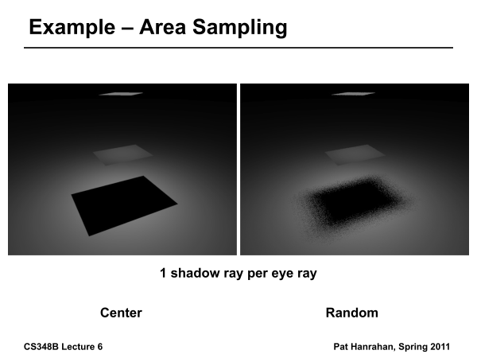
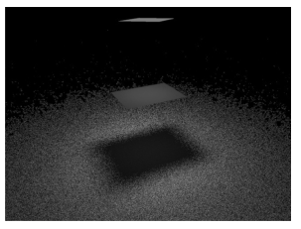
Light source vs. cosine sampling
Light source area sampling
Cosine-proportional sampling
Images: Pat Hanrahan

Slide 61
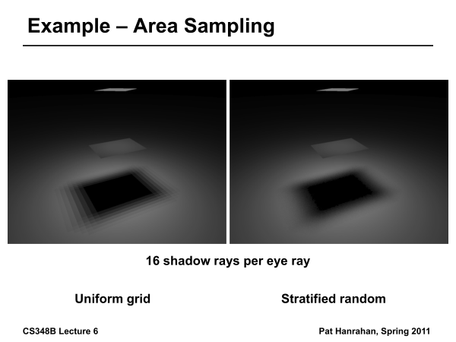

Slide 62
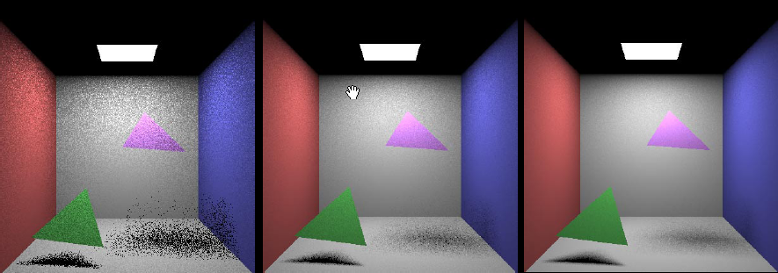
Area light sources
1 sample per pixel 9 samples per pixel 36 samples per pixel

Slide 63
Direct illumination on a surface with an arbitrary BRDF
Integral to be estimated
Estimator based on uniform light source sampling

