Slide 1
Advanced 3D graphics for movies and games (NPGR010) – Path tracing
Jiří Vorba, MFF UK/Weta Digital
jirka@cgg.mff.cuni.cz
Slides by prof. Jaroslav Křivánek, extended by Jiří Vorba

Slide 2
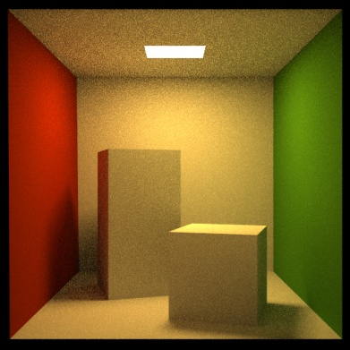
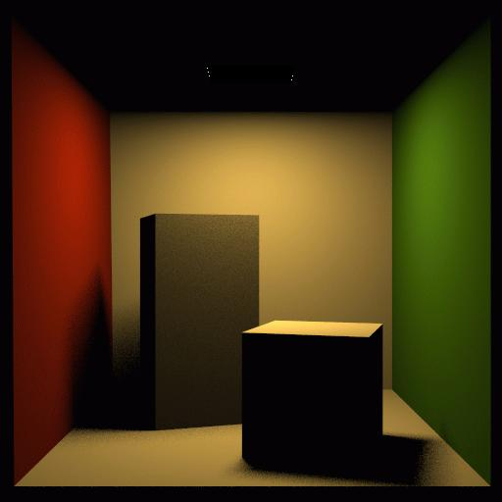
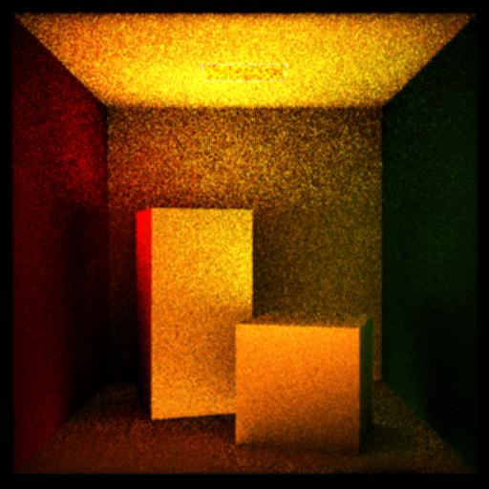
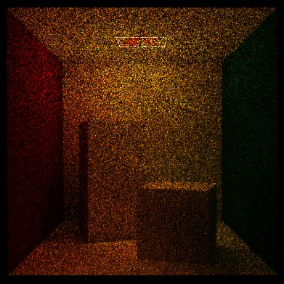
Rendering equation
Solution: Neumann series
$$L = L_{e} + T∘L$$
$$L = L_{e} + T∘L$$
$L = L_{e} + TL_{e} + T^{2}L_{e} + T^{3}L_{e}+$…

Slide 3
Path tracing

Slide 4
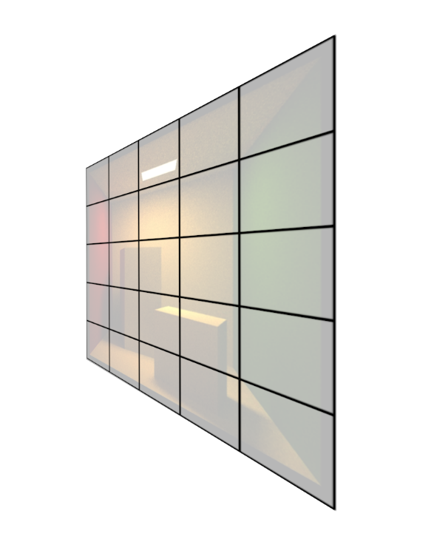
Transport over many paths

Slide 5
Tracing paths from the (pinhole) camera
renderImage()
{
for all pixels
{
Spectrum pixelColor = (0,0,0);
for k = 1 to N_{p}
{
ω_{k} := random direction through the pixel
pixelColor += estimateLin(cameraPosition, ω_{k})
}
pixelColor /= N_{p};
writePixel(k, pixelColor);
}
}

Slide 6
Tracing paths from the (pinhole) camera
For progressive rendering, swap the loop nesting:
renderImage()
{
for k = 1 to N_{p} // rendering “passes”
{
for all pixels
{
Spectrum pixelColor = (0,0,0);
...

Slide 7
Path tracing, v. 0.1
estimateLin (x, ω): // radiance incident at x from direction ω
y = findNearestIntersection(x, ω)
if (no intersection)
return backgroud.getLe (–ω) // emitted radiance from envmap
else
return getLe (y, –ω) + // emitted radiance (if y is on a light)
estimateLrefl (y, –ω)// reflected radiance
estimateLrefl(x, ω_{out}):
[ω_{in} , pdf] = genRandomDir(x, ω_{out}); // e.g. BRDF imp. sampling
return estimateLin(x, ω_{in}) * brdf(x, ω_{in}, ω_{out}) * dot(n_{x}, ω_{in}) / pdf

Slide 8
Path Tracing – Loop version
Path tracing only has tail recursion
Can be unrolled into a loop for better efficiency
New feature: “Russian Roulette” for unbiased path termination
$$L=\sum_{i=0}^{M}{T^{i}L_{e}}$$
$$L=\sum_{i=0}^{∞}{T^{i}L_{e}}$$

Slide 9
estimateLin(x, omegaInAtX) // radiance incident at “x” from the direction “omegaInAtX”
{ // (“omegaInAtX” is pointing *away* from “x”)
Spectrum throughput = (1,1,1)
Spectrum accum = (0,0,0)
for i := 1 to maxLength // solve only first “maxLength” terms of Neumann series
{
hit = findNearestIntersection(x, omegaInAtX)
if noIntersection(hit) // ray leaves the scene – it “hits” the background
return accum + throughput * bkgLight.getLe(x, - omegaInAtX)
omegaOut := -omegaInAtX // omegaOut at hit.pos
if isOnLightSource(hit) // ray happened to directly hit a light source
accum += throughput * getLe(hit.pos, omegaOut) // “pick up” emission
// now estimate the reflected radiance
[omegaIn, pdfIn] := generateRandomDir(hit) // omegaIn at hit.pos
throughput *= 1/pdfIn * brdf(hit.pos, omegaIn, omegaOut) * dot(hit.n, omegaIn)
x := hit.pos // “recursion”
omegaInAtX := omegaIn // “recursion”
}
return accum;
}

Slide 10
estimateLin(x, omegaInAtX) // radiance incident at “x” from the direction “omegaInAtX”
{ // (“omegaInAtX” is pointing *away* from “x”)
Spectrum throughput = (1,1,1)
Spectrum accum = (0,0,0)
while(1) // we don’t cut off the path length now
{
hit = findNearestIntersection(x, omegaInAtX)
if noIntersection(hit) // ray leaves the scene – it “hits” the background
return accum + throughput * bkgLight.getLe(x, - omegaInAtX)
omegaOut := -omegaInAtX // omegaOut at hit.pos
if isOnLightSource(hit) // ray happened to directly hit a light source
accum += throughput * getLe(hit.pos, omegaOut) // “pick up” emission
// now estimate the reflected radiance
[omegaIn, pdfIn] := generateRandomDir(hit) // omegaIn at hit.pos
throughput *= 1/pdfIn * brdf(hit.pos, omegaIn, omegaOut) * dot(hit.n, omegaIn)
x := hit.pos // “recursion”
omegaInAtX := omegaIn // “recursion”
}
return accum;
}

Slide 11
estimateLin(x, omegaInAtX) // radiance incident at “x” from the direction “omegaInAtX”
{ // (“omegaInAtX” is pointing *away* from “x”)
Spectrum throughput = (1,1,1)
Spectrum accum = (0,0,0)
while(1) // we don’t cut off the path length now
{
hit = findNearestIntersection(x, omegaInAtX)
if noIntersection(hit) // ray leaves the scene – it “hits” the background
return accum + throughput * bkgLight.getLe(x, - omegaInAtX)
omegaOut := -omegaInAtX // omegaOut at hit.pos
if isOnLightSource(hit) // ray happened to directly hit a light source
accum += throughput * getLe(hit.pos, omegaOut) // “pick up” emission
// now estimate the reflected radiance
[omegaIn, pdfIn] := generateRandomDir(hit) // omegaIn at hit.pos
throughput *= 1/pdfIn * brdf(hit.pos, omegaIn, omegaOut) * dot(hit.n, omegaIn)
survivalProb = min(1, throughput.maxComponent())
if rand() < survivalProb // Russian Roulette – survive (reflect)
throughput /= survivalProb
x := hit.pos // “recursion”
omegaInAtX := omegaIn // “recursion”
}
return accum;
}

Slide 12
estimateLin(x, omegaInAtX) // radiance incident at “x” from the direction “omegaInAtX”
{ // (“omegaInAtX” is pointing *away* from “x”)
Spectrum throughput = (1,1,1)
Spectrum accum = (0,0,0)
while(1) // we don’t cut off the path length now
{
hit = findNearestIntersection(x, omegaInAtX)
if noIntersection(hit) // ray leaves the scene – it “hits” the background
return accum + throughput * bkgLight.getLe(x, - omegaInAtX)
omegaOut := -omegaInAtX // omegaOut at hit.pos
if isOnLightSource(hit) // ray happened to directly hit a light source
accum += throughput * getLe(hit.pos, omegaOut) // “pick up” emission
// now estimate the reflected radiance
[omegaIn, pdfIn] := generateRandomDir(hit) // omegaIn at hit.pos
throughput *= 1/pdfIn * brdf(hit.pos, omegaIn, omegaOut) * dot(hit.n, omegaIn)
survivalProb = min(1, throughput.maxComponent())
if rand() < survivalProb // Russian Roulette – survive (reflect)
throughput /= survivalProb
x := hit.pos // “recursion”
omegaInAtX := omegaIn // “recursion”
else
break; // terminate path
}
return accum;
}

Slide 13
Loop with Russian roulette
Notes:
Animate the “loop” algorithm with a RR for a single path.

Slide 14
Loop with Russian roulette
Notes:
Let’s trace through the given pixel and intersect the scene

Slide 15
Loop with Russian roulette
Notes:
Now sample a direction based on BRDF, update the throughput and play RR.

Slide 16
Loop with Russian roulette
Notes:
We were lucky and survived so we search for the nearest intersection in the sampled direction.

Slide 17
Loop with Russian roulette
Notes:
We repeat the procedure, sample a direction, update throughput, play RR.
We survive again and the sampled ray leaves the scene so we count in Environment contribution if there is such light.

Slide 18
Finish progression
renderImage()
{
for k = 1 to N_{p} // rendering “passes”
{
for all pixels
{
estimateLin(x,omegaInAtX) …
Notes:
We finish the progression by tracing a sample path for each pixel.

Slide 19
Loop with Russian roulette – path #2
Notes:
Animate the “loop” algorithm with a RR for a single path.

Slide 20
Loop with Russian roulette – path #2
Notes:
We repeat the procedure and trace another path through our bellowed pixel.
We survived at the first intersection and found the second intersection.

Slide 21
Loop with Russian roulette – path #2
Notes:
So we sample a direction and play RR

Slide 22
Loop with Russian roulette – path #2
Notes:
This time we were unlucky so we terminate the path here

Slide 23
Terminating paths – Russian roulette
Continue the path with probability q
Multiply weight (throughput) of surviving paths by 1 / q
RR is unbiased!

Slide 24
Survival probability
It makes sense to use the surface reflectance ρ as the survival probability
If the surface reflects only 30% of light energy, we continue with the probability of 30%. That’s how light behaves in physical reality.
Notes:
Think of RR as simulating absorption. Although it is a mathematical tool and we can choose arbitrary surviving probability.

Slide 25
Survival probability
What if we cannot calculate ρ? Then there’s a convenient alternative, which in fact works even better:
First sample a random direction ω_{in} according to pdf(ω_{in})
Update the path throughput
Use the updated throughput as the survival probability
If direction sampling pdf(ω_{in}) is exactly proportional to BRDF*cos, the above strategy turns out to be exactly equivalent to setting survival probability to the surface reflectance (prove this).

Slide 26
Survival probability
Our work: Adjoint-driven Russian Roulette & Splititng [Vorba & Křivánek 2016]
Weight the survival probability by the expected path contribution
If we enter a bright region, continue path even if throughput might be low
If we enter a dark region, kill the path even if throughput might be high
If the “survival probability” ends up > 1, split the path

Slide 27
Adjoint-driven RR and splitting
Vorba and Křivánek. Adjoint-Driven Russian Roulette and Splitting in Light Transport Simulation. ACM SIGGRAPH 2016

Slide 28
Path tracing, v. 0.1 – with splitting
estimateLin (x, ω): // radiance incident at x from direction ω
y = findNearestIntersection(x, ω)
if (no intersection)
return backgroud.getLe (–ω) // emitted radiance from envmap
else
return getLe (y, –ω) + // emitted radiance (if y is on a light)
estimateLrefl (y, –ω)// reflected radiance
estimateLrefl(x, ω_{out}):
accum := 0
N := computeSplit(x); // number of “new“ split paths
for i = 1 to N
[ω_{in} , pdf] = genRandomDir(x, ω_{out}); // e.g. BRDF imp. sampling
accum += estimateLin(x, ω_{in}) * brdf(x, ω_{in}, ω_{out}) * dot(n_{x}, ω_{in}) / pdf;
return accum / N; // average the split contributions

Slide 29
Beware of exponential branching!
In case of fixed rate N
N^{d} where d is path length

Slide 30
estimateLin(x, omegaInAtX) // radiance incident at “x” from the direction “omegaInAtX”
{ // (“omegaInAtX” is pointing *away* from “x”)
Spectrum throughput = (1,1,1)
Spectrum accum = (0,0,0)
while(1)
{
hit = findNearestIntersection(x, omegaInAtX)
if noIntersection(hit) // ray leaves the scene – it “hits” the background
return accum + throughput * bkgLight.getLe(x, - omegaInAtX)
omegaOut := -omegaInAtX // omegaOut at hit.pos
if isOnLightSource(hit) // ray happened to directly hit a light source
accum += throughput * getLe(hit.pos, omegaOut) // “pick up” emission
// now estimate the reflected radiance
[omegaIn, pdfIn] := generateRandomDir(hit) // omegaIn at hit.pos
throughput *= 1/pdfIn * brdf(hit.pos, omegaIn, omegaOut) * dot(hit.n, omegaIn)
survivalProb = min(1, throughput.maxComponent())
if rand() < survivalProb // Russian Roulette – survive (reflect)
throughput /= survivalProb
x := hit.pos // “recursion”
omegaInAtX := omegaIn // “recursion”
else // terminate the path – break the while loop
break;
}
return accum;
}

Slide 31
Direction sampling – genRandomDir()
We usually sample the direction ω_{in} from a pdf similar to
f_{r}(x, ω_{in} $→$ ω_{out}) cos θ_{in}
Ideally, we would want to sample proportionally to the integrand itself L_{in}(x, ω_{in}) f_{r}(x, ω_{in}$→$ω_{out}) cos θ_{i}, but this is difficult, because we do not know L_{in} upfront. With some precomputation, it is possible to use a rough estimate of L_{in} for sampling [Jensen 95, Vorba et al. 2014]. This is called “path guiding”.

Slide 32
Path guiding
Vorba, Karlík, Šik, Ritschel, and Křivánek. On-line Learning of Parametric Mixture Models for Light Transport Simulation. ACM SIGGRAPH 2014

Slide 33
Path guiding
Vorba, Karlík, Šik, Ritschel, and Křivánek. On-line Learning of Parametric Mixture Models for Light Transport Simulation. ACM SIGGRAPH 2014

Slide 34
Direct illumination calculation in a path tracer

Slide 35
So far: accumulate T^{i}L_{e}

Slide 36
Now: at every vertex

Slide 37
Direct illumination
At each path vertex, we are calculating direct illumination
i.e. radiance reflected from the surface point exclusively due to the light coming directly from the light sources

Slide 38
Direct illumination: Two strategies
At each path vertex, we are calculating direct illumination
i.e. radiance reflected from the surface point exclusively due to the light coming directly from the light sources
Two sampling strategies
Explicit light source sampling (NEE) (“next event estimation”)
BRDF-proportional sampling (already in the above code)

Slide 39
Two strategies at every vertex
x₁
x₂

Slide 40
The use of MIS in a path tracer
At each path vertex do both:
Explicit light source sampling
Generate point on light source & cast shadow ray
BRDF-proportional sampling
One ray can be shared for the calculation of both direct and indirect illumination
But the MIS weight is applied only on the direct term (indirect illumination is added unweighted because there is no alternative technique to calculate it)

Slide 41
Direct illumination: formulas
Look into the previous lecture on MIS.
MIS, two forms of reflection equation and its estimators

Slide 42
NEE - multiple light sources
Option 1:
Loop over all sources and send a shadow ray to each one
Option 2:
Choose one source at random
Sample illumination only on the chosen light, divide the result by the prob of picking that light
(Scales better with many sources but has higher variance per path)
Beware: The probability of choosing a light influences the sampling pds and therefore also the MIS weights.

Slide 43
Option 1 – Sum all contributions
Spectrum accum(0);
// Loop over all “N_{l}” lights
for i := 1 to N_{l}
{
// Estimate reflected radiance at “x” into “omegaOut”
// due to light i
accum += estimateReflLoDirect(x, omegaOut, lights[i]);
}

Slide 44
Option 2 – Stochastic sampling
// Construct probability mass function (aka discrete pdf)
// over all lights with respect to shading position “x” // and outgoing direction “omegaOut”
pmf := constructPmf(x,omegaOut,lights);
// Select light “i” with probability “pmf[i]”
i := pmf.sampleIndex();
// Estimate reflected radiance at “x” into “omegaOut”
// due to light i
Spectrum accum =
estimateReflLoDirect(x, omegaOut, lights[i]) / pmf[i];

Slide 45
Option 2 – Choice of PMF
Naive
Uniform
Proportional to power
Example: Equal area, same orientation, same power
Q: Why are the above not optimal?
$$l_{1}$$
$$l_{2}$$
x

Slide 46
Option 2 – Choice of PMF
Naive
Uniform
Proportional to power
Ideal
Proportional to light contribution with respect to x (and $ω_{o}$)
$$l_{1}$$
$$l_{2}$$
x₁
x₂

Slide 47
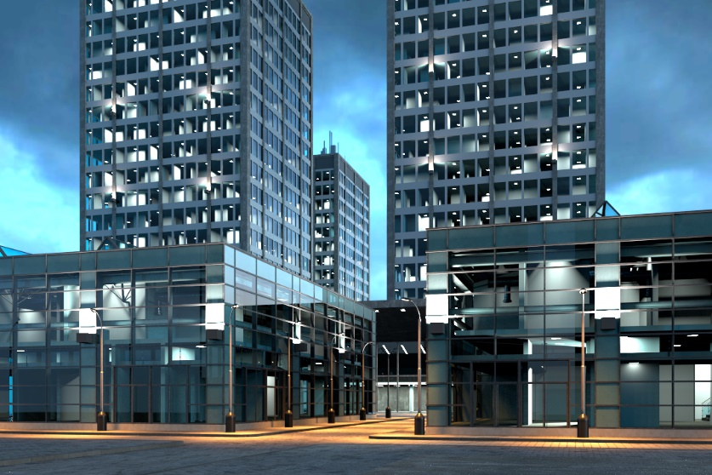
Efficient many-light methods
Problem: thousands of lights
Source: Estevez et Kulla 2018
Source: Vevoda et al. 2018

Slide 48
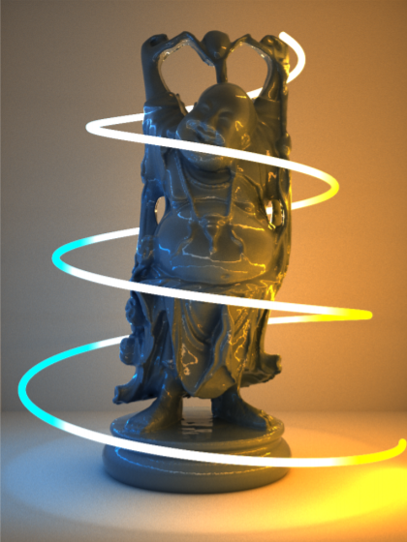
Efficient many-light methods
Problem: thousands of lights
Ideal pmf depends on
Position
Orientation
Distance
Power
Visibility
Source: Estevez et Kulla 2018

Slide 49
Efficient many-light methods
Typical approach
Build a light hierarchy (preprocess)
Construct a tree cut given position x (rendering)

Slide 50
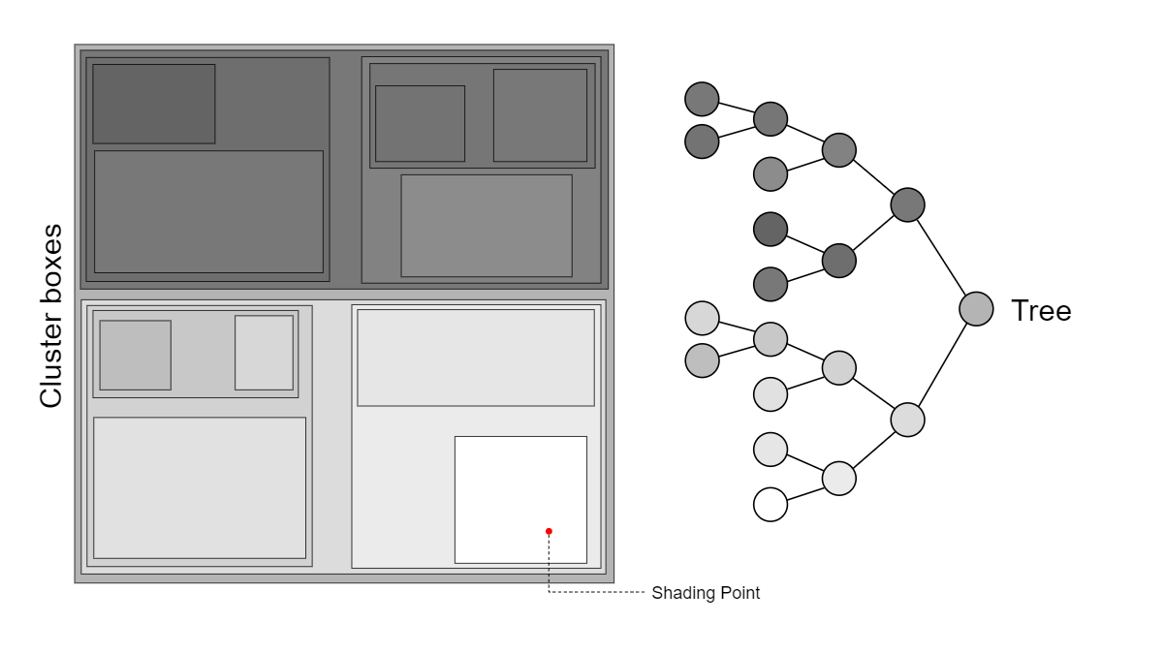
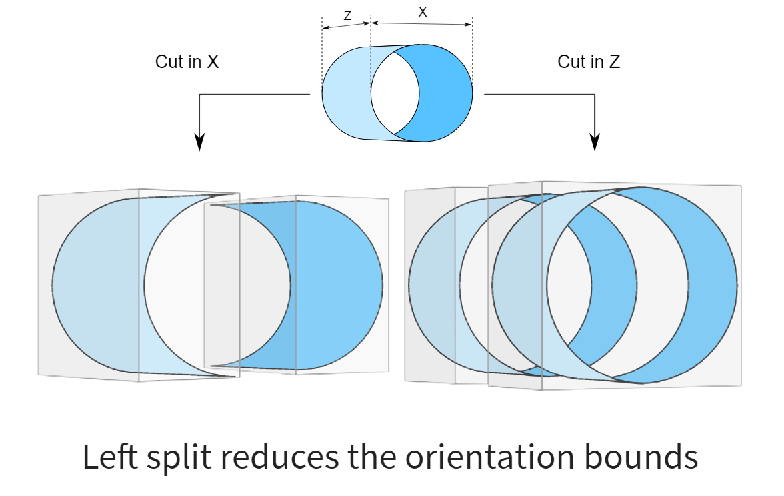
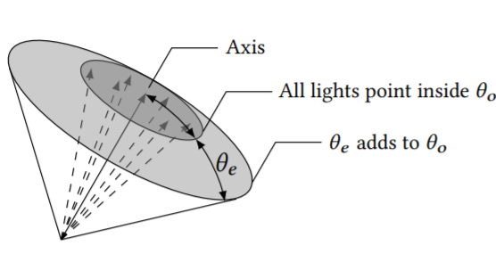
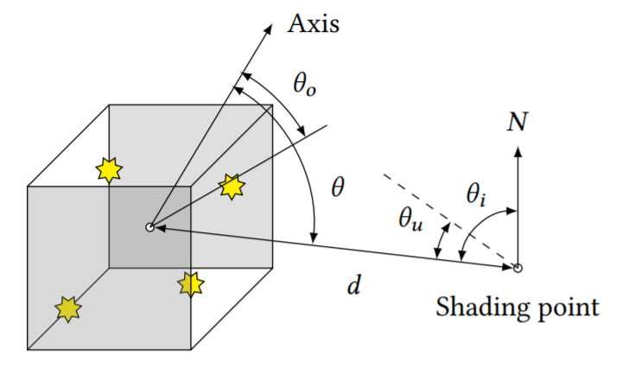
Build a light hierarchy
Cluster based on position, orientation
Compute bounds for each node (spatial, directional)
Source: Estevez et Kulla 2018

Slide 51
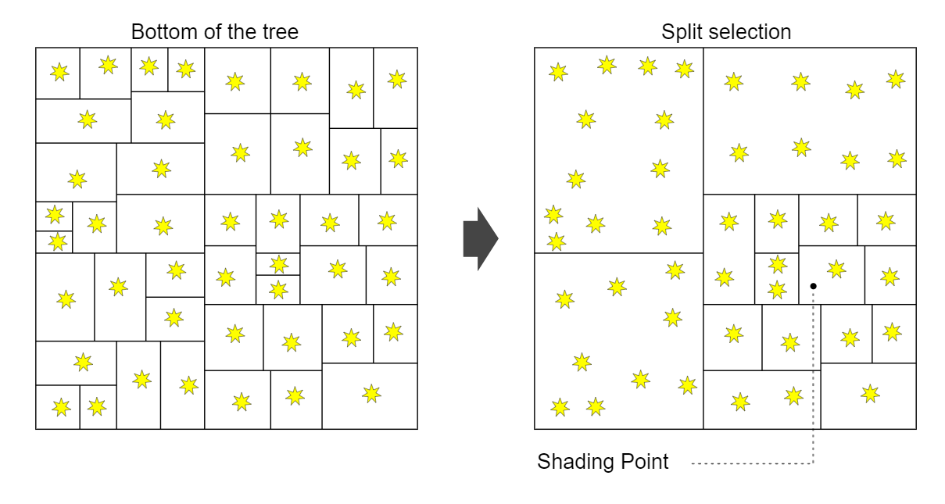
Construct a tree cut given position x
Usually based on un-occluded contributions
Gives us our pmf
Source: Estevez et Kulla 2018

Slide 52
Learning the lights’ contributions
Before (no learning)
Vévoda, Kondapaneni, Křivánek. Bayesian online regression for adaptive direct illumination sampling. ACM SIGGRAPH 2018

Slide 53
Learning the lights’ contributions
After (with learning)
Vévoda, Kondapaneni, Křivánek. Bayesian online regression for adaptive direct illumination sampling. ACM SIGGRAPH 2018

Slide 54
Misc

Slide 55
Typical numbers of rays cast in the scene
Consider 2K image (2M pixels)
Per progression
2M primary rays
(2M shadow rays + 2M) * “average path length”
NEE shadow rays (cheaper - early exit, unless we consider transparent surfaces)
Progressions (aka samples or paths per pixel)
Typically a few hundreds (with good importance sampling)
Highly scene dependent!!
Depends also on the algorithm (Russian roulette, splitting…)

Slide 56
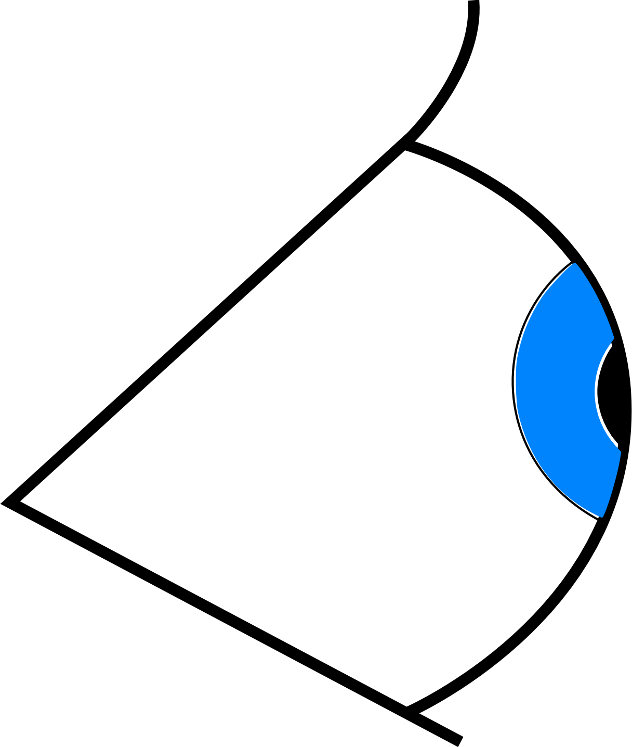
Summary
Pathtracer with next-event estimation
Core of the most production renderers

Slide 57
What we have not covered
Adaptive image plane sampling
Equalizes error over pixels
Essential for movie production (and offline rendering)
Denoising
Essential for both movies and ray-traced games

