Slide 1
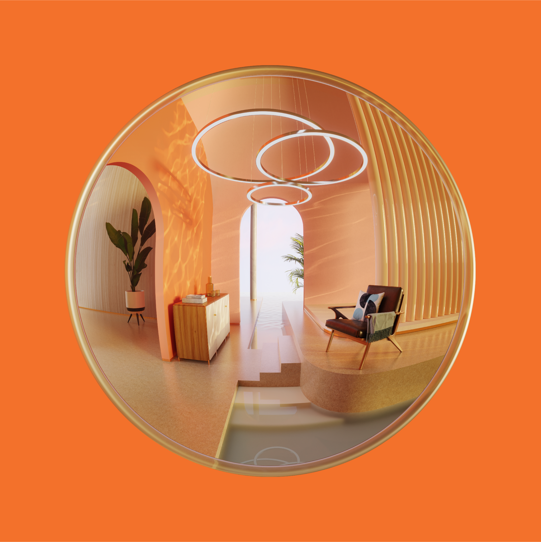

Depth of field solver in Corona
Martin Šik 2024

Slide 2
Depth of field solver in Corona
Martin Šik
Studied PhD in Charles University under the supervision of Jaroslav Křivánek
Focus on (Markov Chain) Monte Carlo Rendering
Internship in Pixar during the studies
Working on Corona for 8 years
Currently leading Corona Rendering Core/Max plugin development

Slide 3
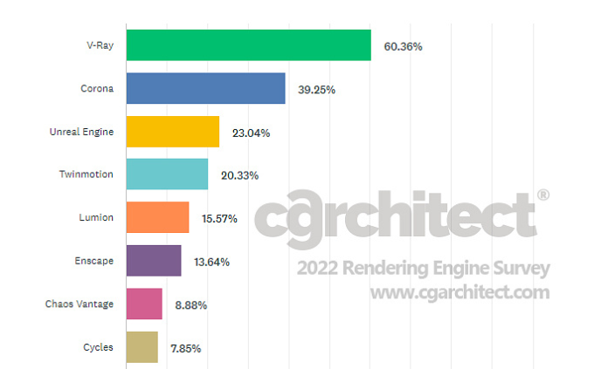
Depth of field solver in Corona
Corona Renderer
Started as student project of Ondřej Karlík in 2009
Since then evolved into one of the top ArchViz renderers
Bought by Chaos in 2017
Plugin for 3ds Max and Cinema 4D

Slide 4
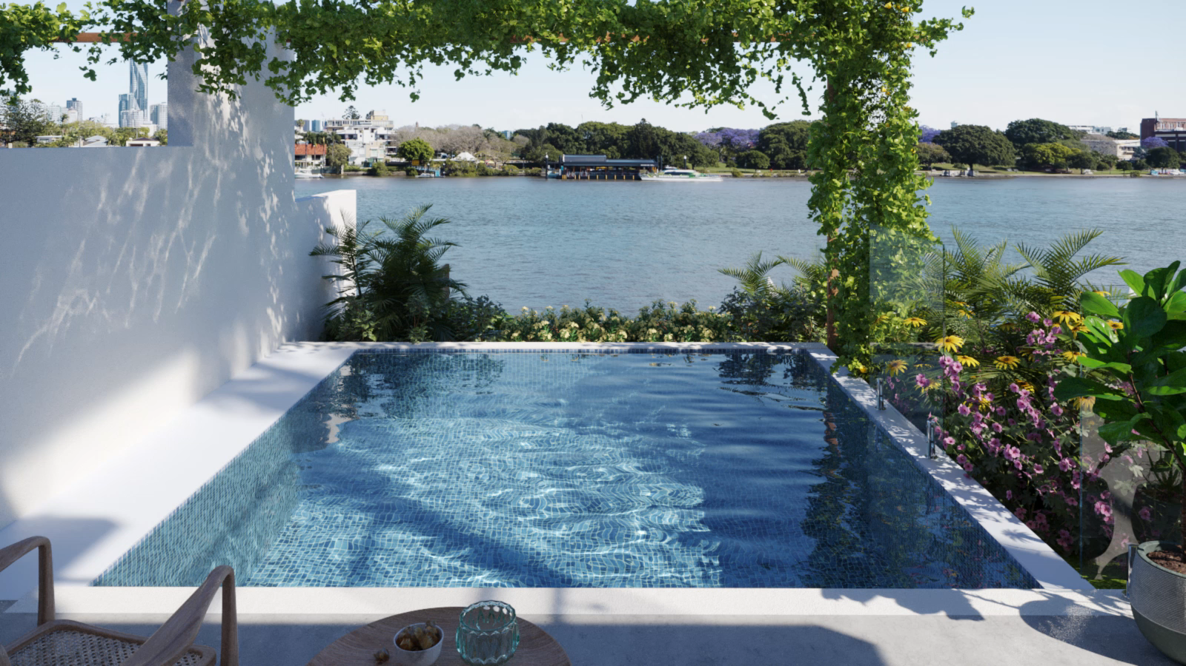
Depth of field solver in Corona
Corona Renderer
Path tracer
On demand Caustics solver (bidirectional Markov Chain photon tracing)
3Darcspace studio

Slide 5
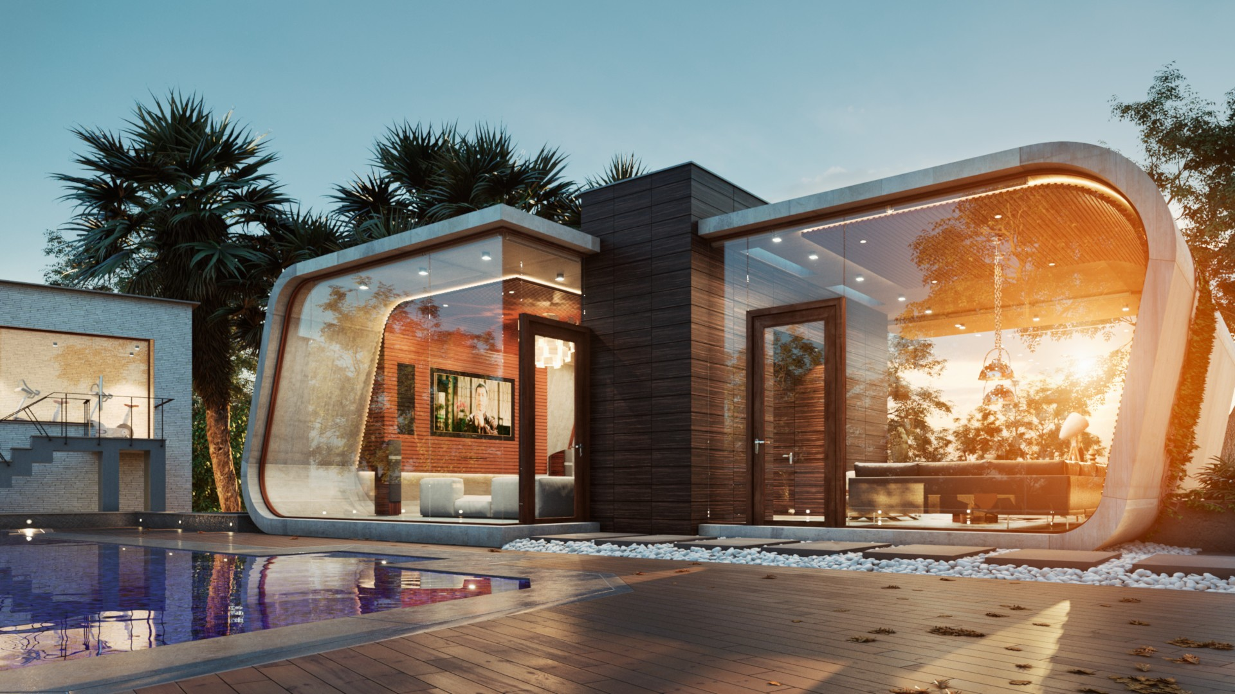
Depth of field solver in Corona
Corona Renderer
Tiago Sillos

Slide 6
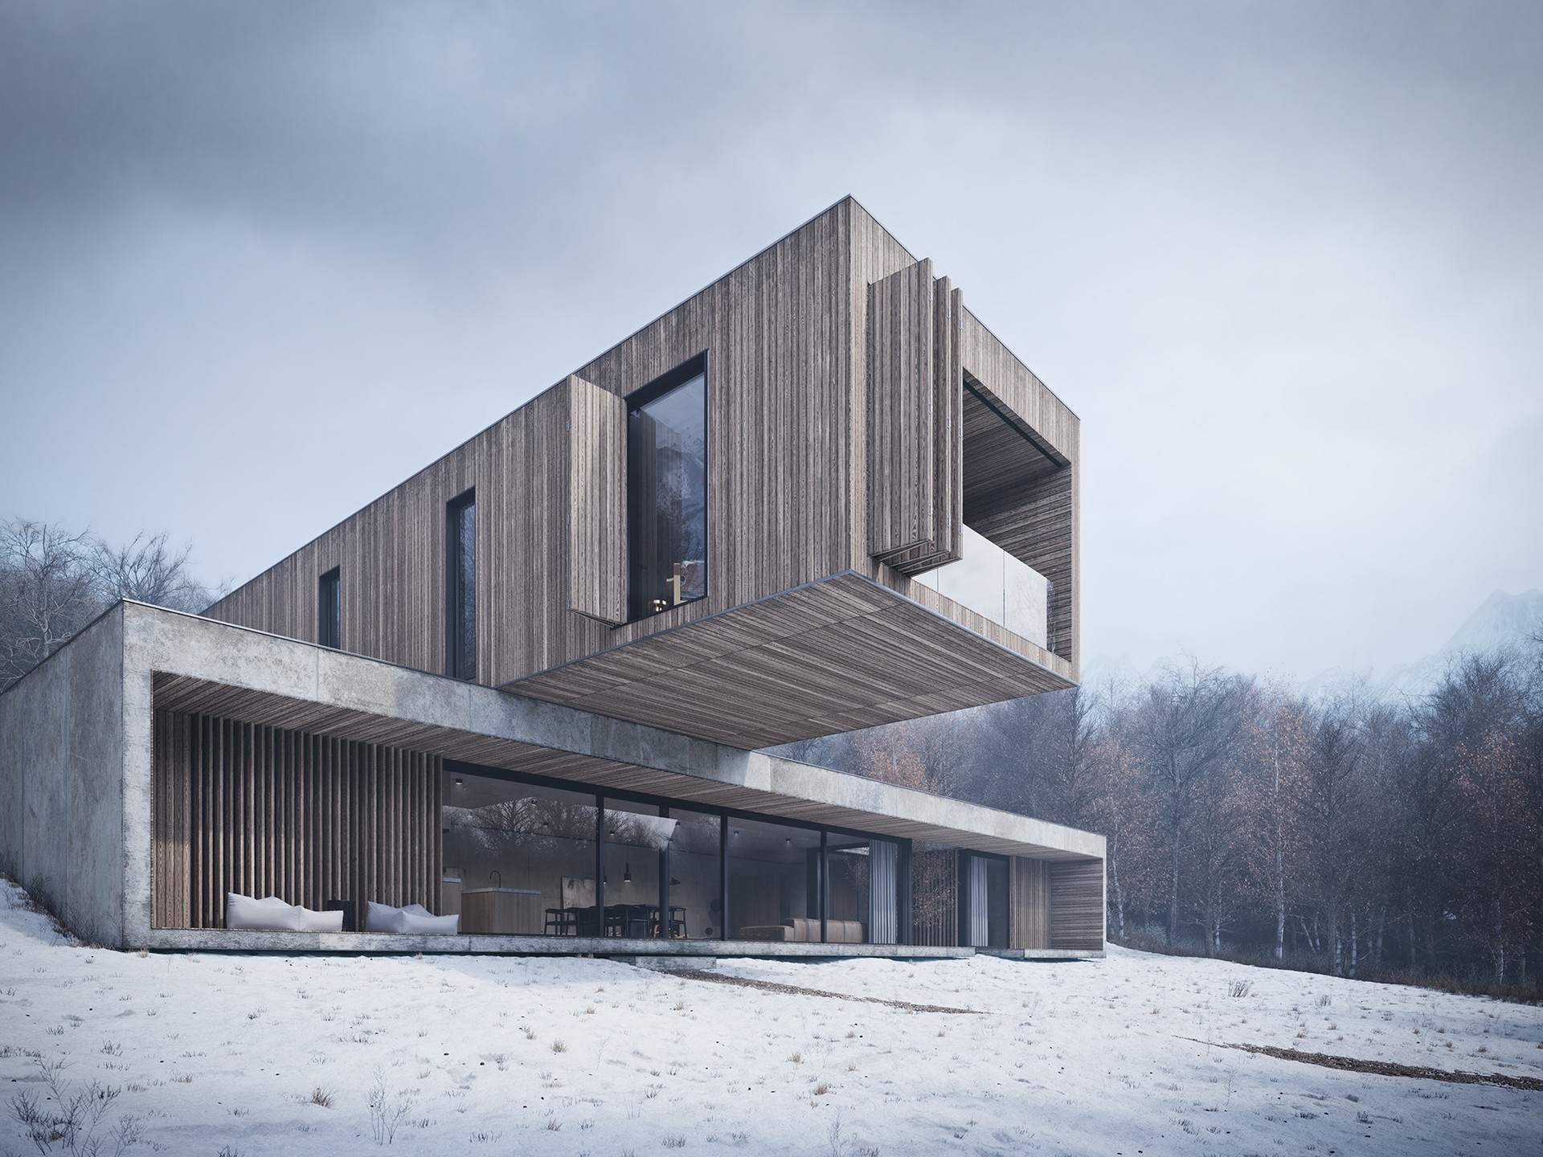
Depth of field solver in Corona
Guilherme Pinheiro (AX2 Studio)

Slide 7

Depth of field solver in Corona
Israa Azzam

Slide 8
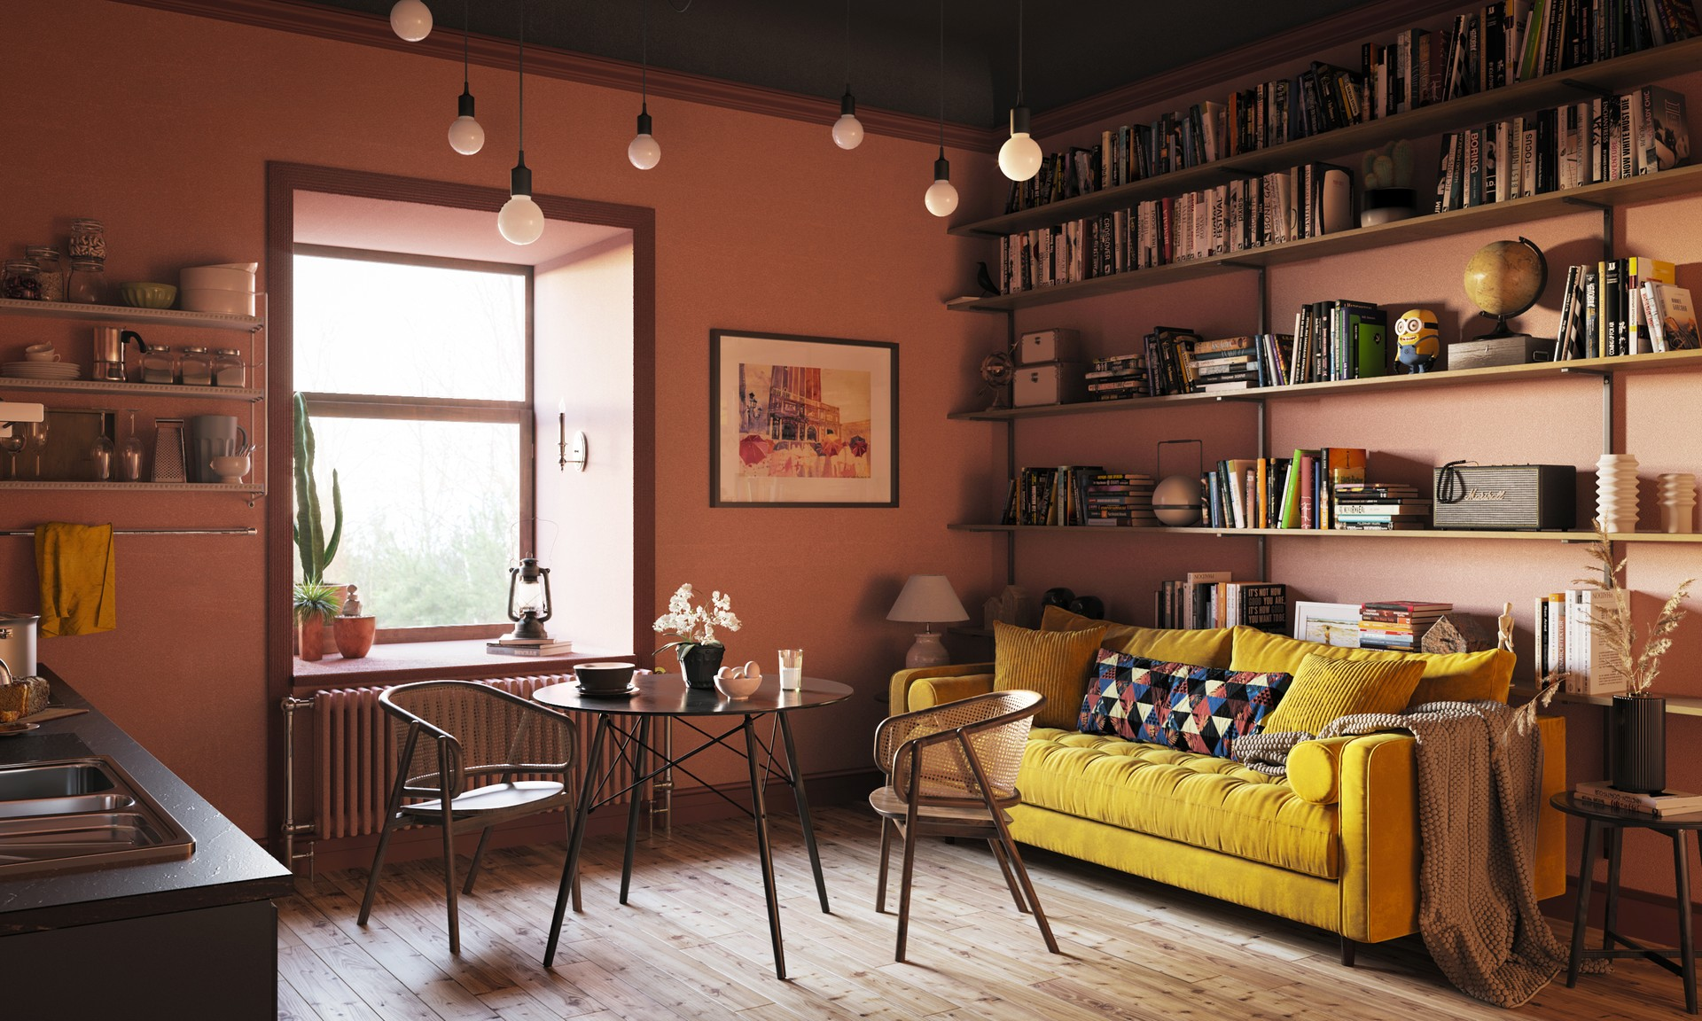
Depth of field solver in Corona
Nikhil Saini

Slide 9
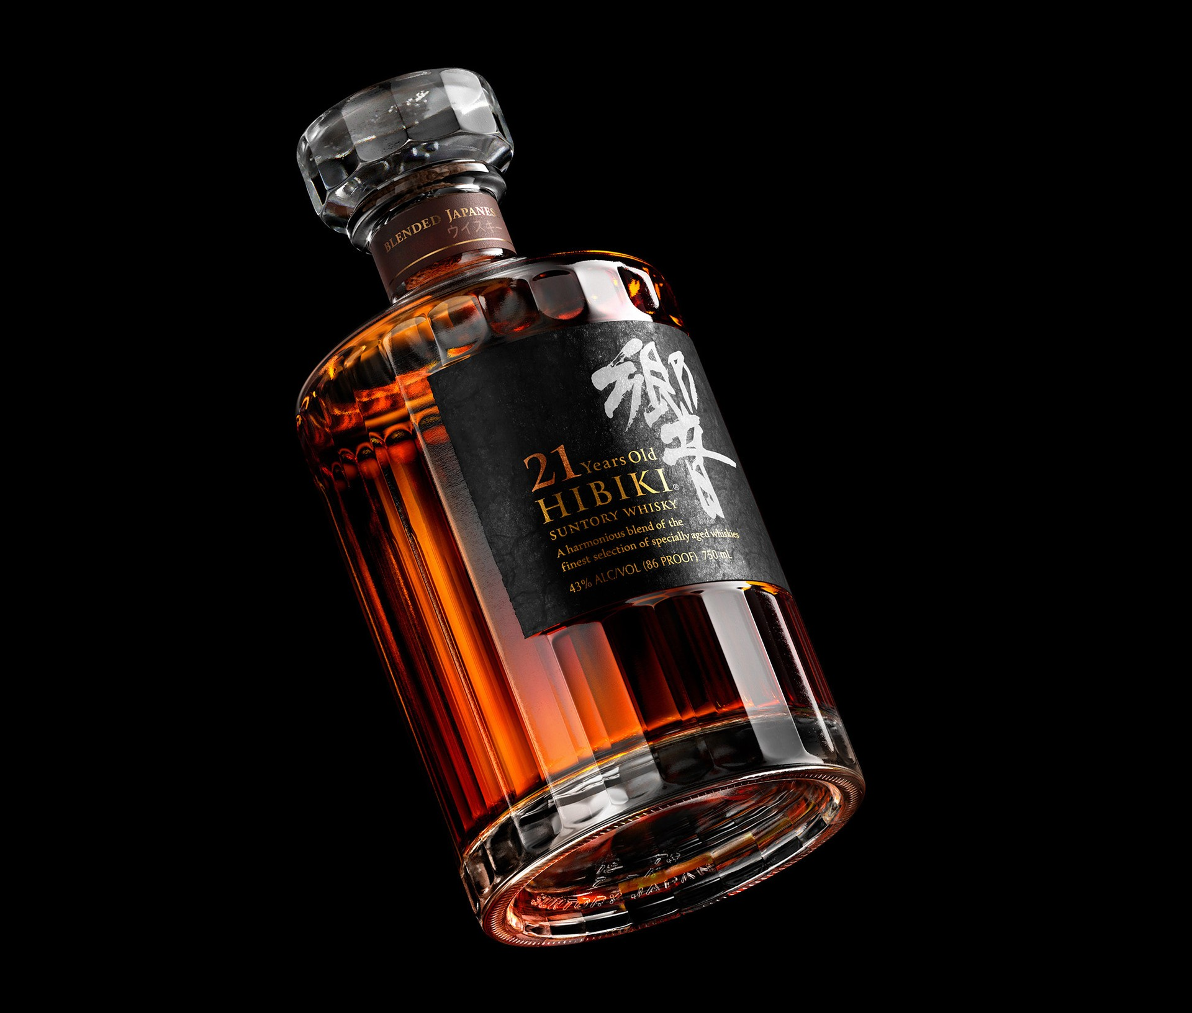
Depth of field solver in Corona
David Turfitt

Slide 10
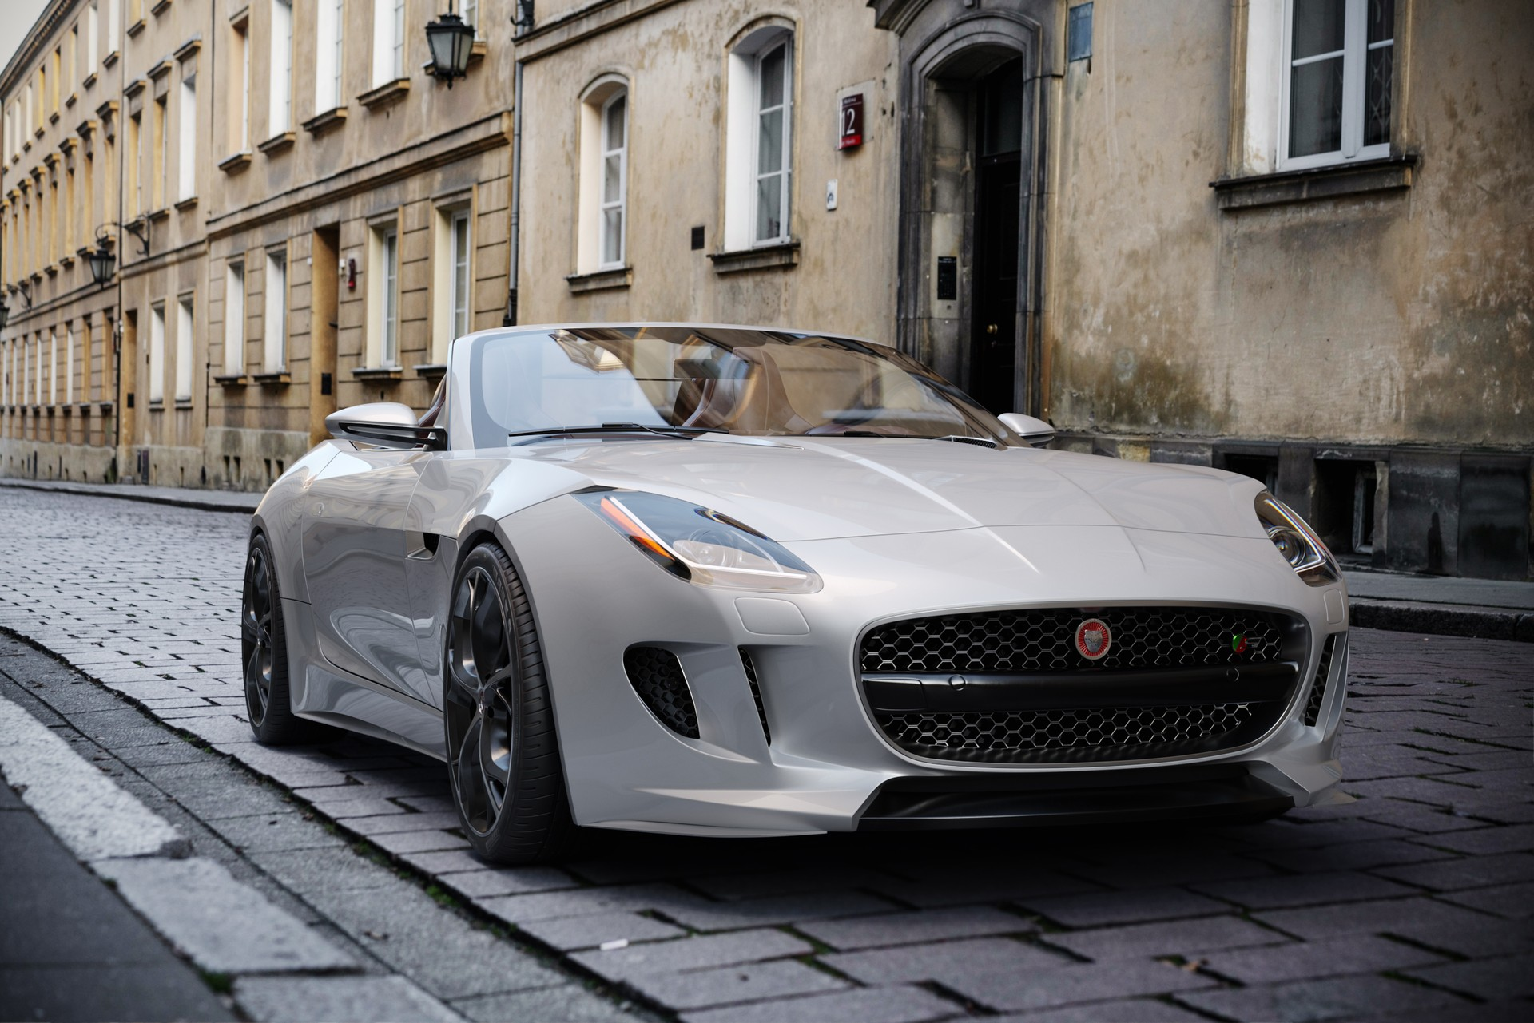
Depth of field solver in Corona
Hongyu Yang

Slide 11

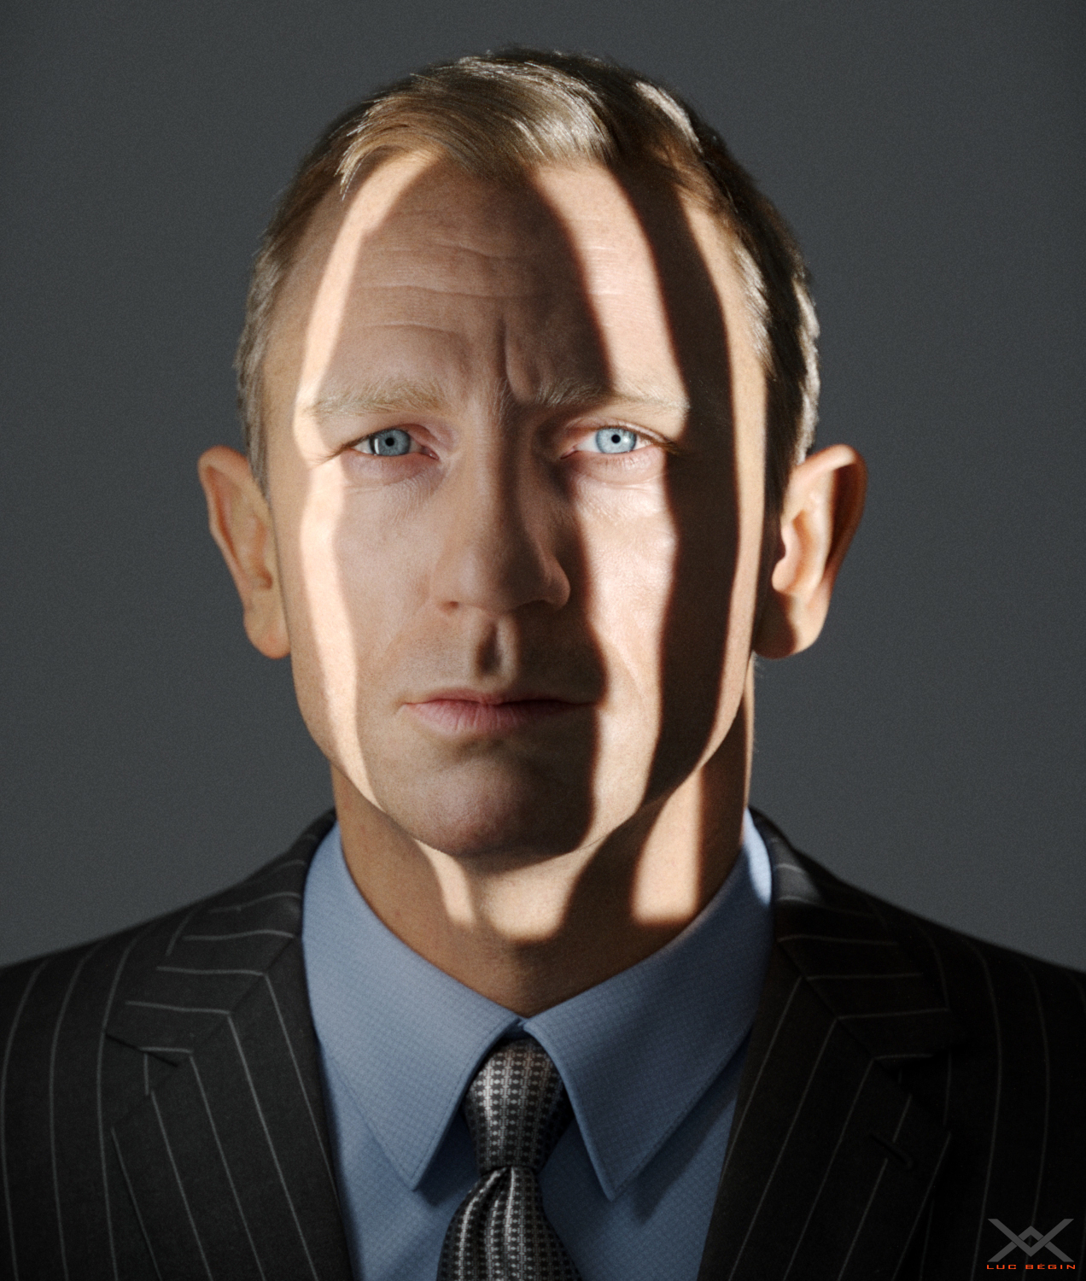
Depth of field solver in Corona
Dmitry Leonovich
Bégin Luc

Slide 12
Depth of field

Slide 13
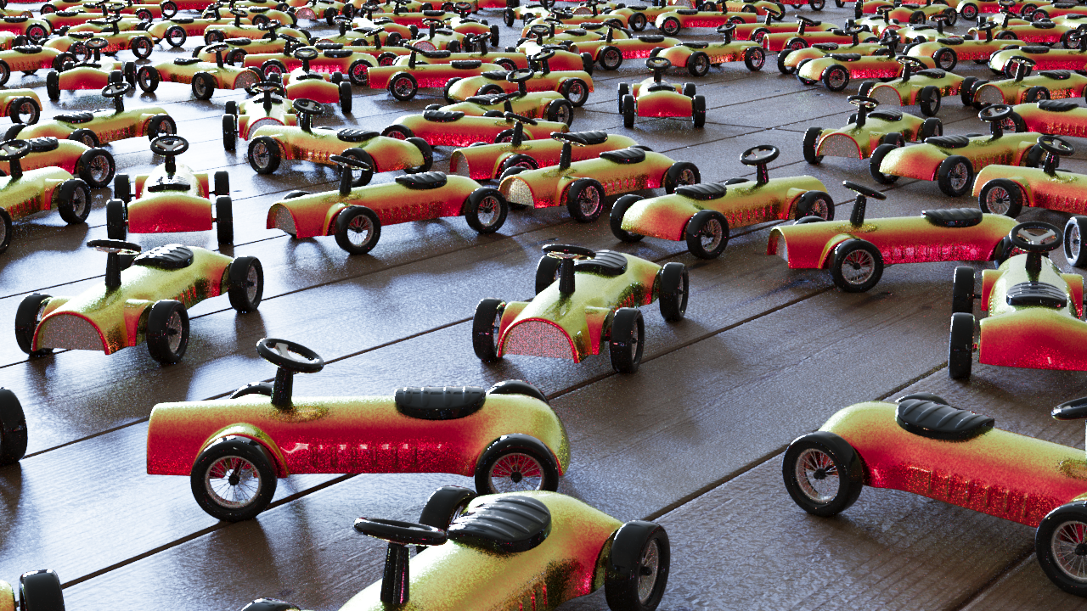
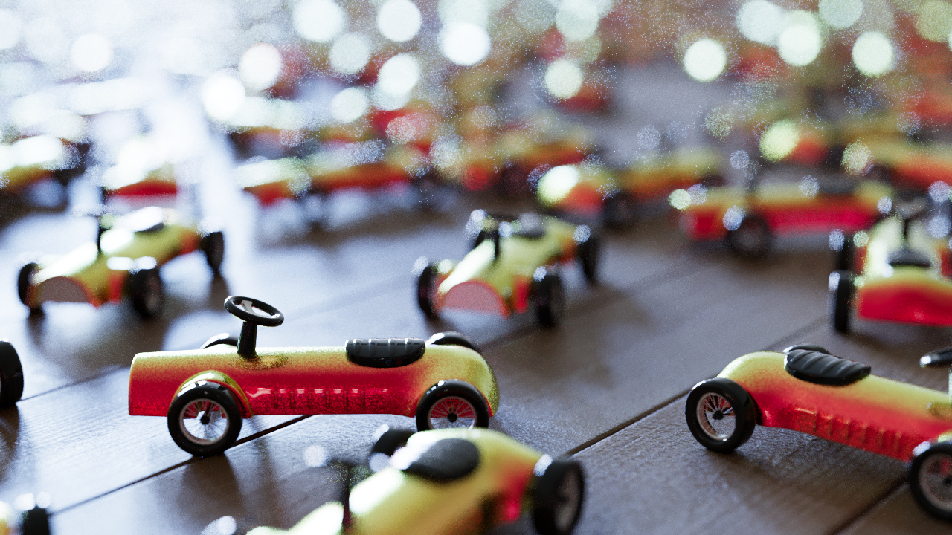
Depth of field solver in Corona
Rendering with limited depth of field
Without DOF
With DOF

Slide 14

Depth of field solver in Corona
Rendering with limited depth of field
Corona DOF Solver
Path tracer
Speedup: 13x !!!

Slide 15
Background & Problem explanation

Slide 16

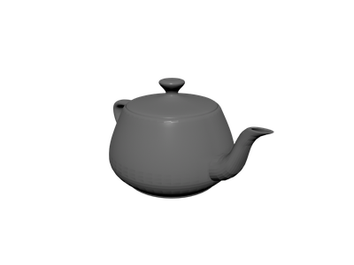

Depth of field solver in Corona
Monte-Carlo pathtracer
Pixel

Slide 17
Depth of field solver in Corona
Pinhole Camera
Pixel
Pinhole

Slide 18
Depth of field solver in Corona
Thin-lens Camera
Focal plane
Lens
Pixel

Slide 19
Depth of field solver in Corona
Thin-lens Camera
Additional 2 dimensions to integrate
Very low probability of hitting important path (light source, highlight)
Results in slow convergence

Slide 20
Our solution

Slide 21
Depth of field solver in Corona
Our solution
Detect important paths (highlights)
Redistribute their energy to neighboring pixels

Slide 22
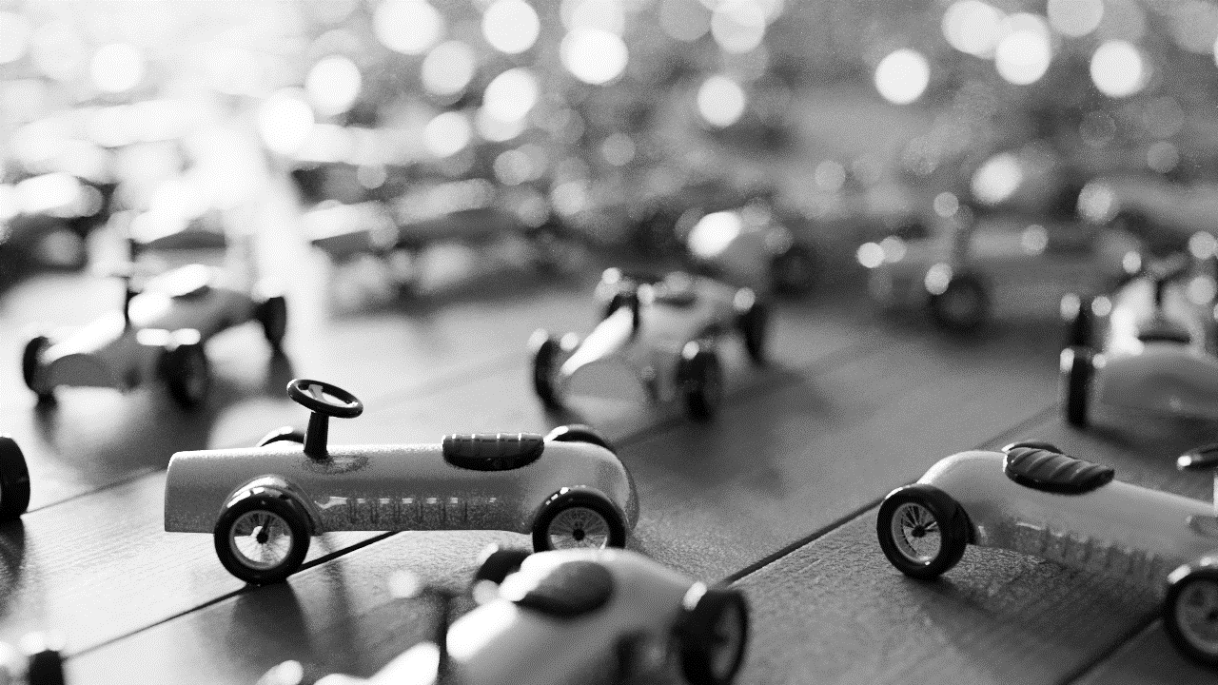
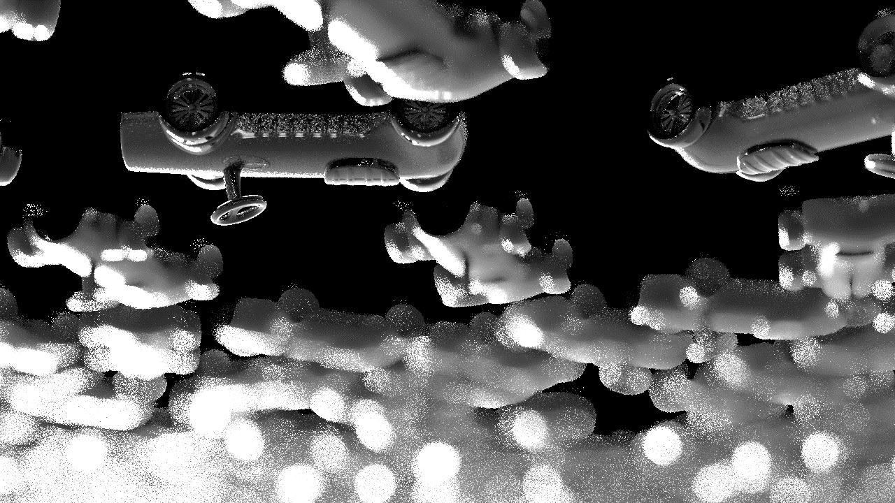
Depth of field solver in Corona
Important paths detection
Cull paths based on BSDF PDF
(not effective for diffuse BSDFs due to poor stratification)
Both for GI/Direct illumination
All direct visible light sources are kept

Slide 23
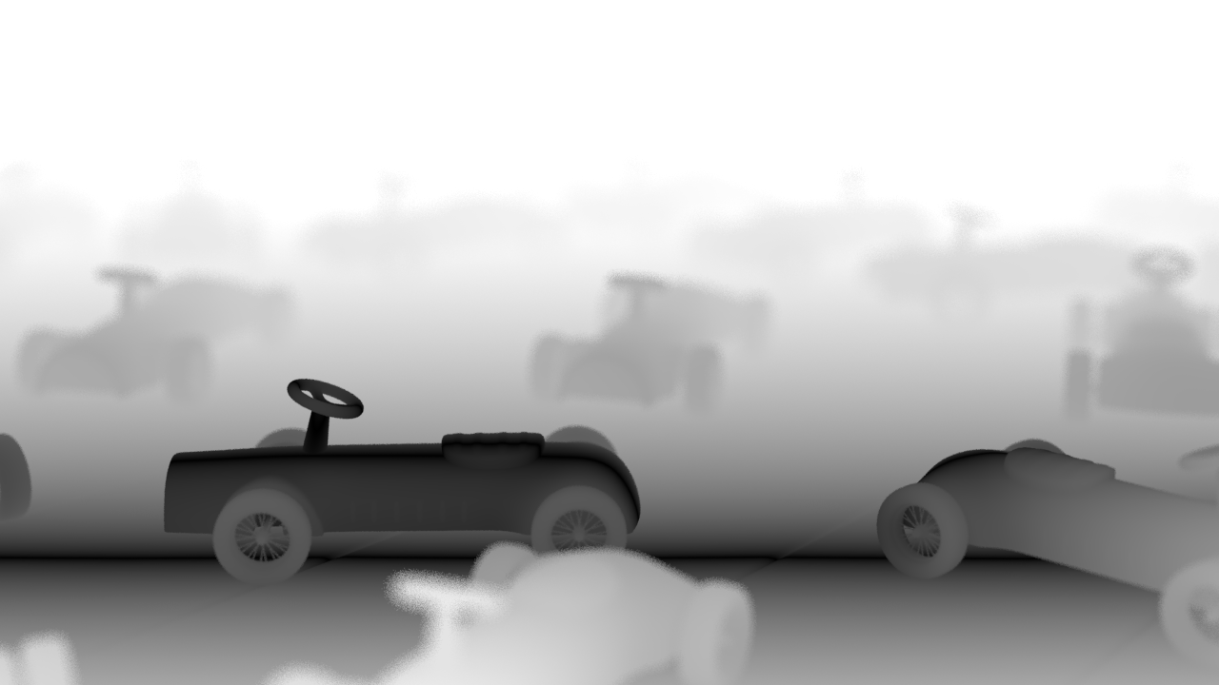
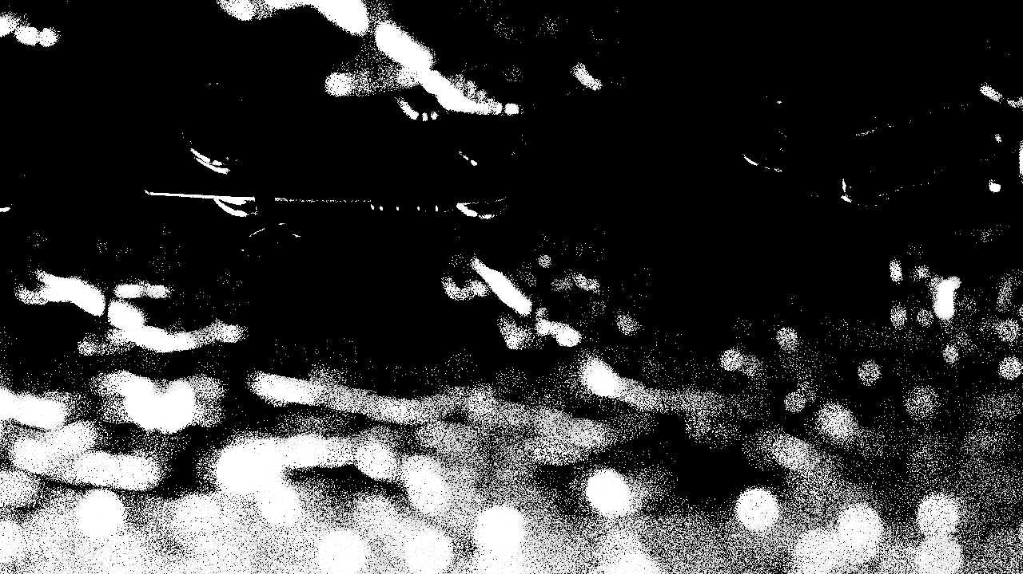

Depth of field solver in Corona
Important paths detection
Path log-scale intensity (contribution)
Log-scale circle of confusion
Their product is the probability of redistribution $P$
Intensity
Circle of confusion
Redistribution probability
LOG
LOG

Slide 24
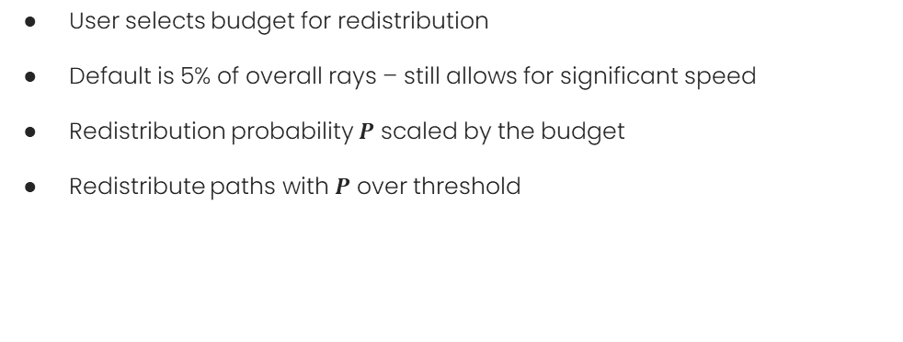
Depth of field solver in Corona
Important paths detection
User selects budget for redistribution
Default is 5% of overall rays – still allows for significant speed
Redistribution probability $P$ scaled by the budget
Redistribute paths with $P$ over threshold

Slide 25
Depth of field solver in Corona
Energy redistribution
Project important path back to the camera
Energy is redistributed among neighboring pixels
Redistribute carefully to render correct image

Slide 26
Depth of field solver in Corona
Path projection
Film
Lens

Slide 27
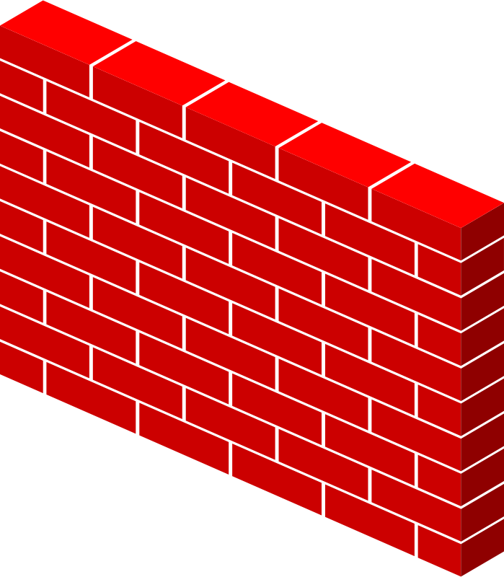
Depth of field solver in Corona
Path projection – energy computation
Film
Lens
BSDF
TRANSMISSION
Vignetting, Distortion,
Film region, etc.

Slide 28
Depth of field solver in Corona
Path projection – energy computation
Film
Lens
EMISSION PROFILE (IES)
TRANSMISSION
Vignetting, Distortion,
Film region, etc.

Slide 29
Depth of field solver in Corona
Path projection
Recomputing path energy is not enough
We use Monte Carlo integration to compute the image
New path probability is required

Slide 30
Depth of field solver in Corona
Path projection – probability
Film
Lens
Marginalize over paths
Estimated pdf => BIASED!
Notes:
PDF must be precise for Monte Carlo integration, estimated pdf would lead to biased rendering.

Slide 31
Depth of field solver in Corona
Energy redistribution path tracing
Markov Chain Monte Carlo algorithm by D. Cline 2005
Initial path is mutated
Mutations are accepted based on energy ratio
Energy of initial path is split
Pixel
Notes:
PDF must be precise for Monte Carlo integration, estimated pdf would lead to biased rendering.

Slide 32
Depth of field solver in Corona
Path projection with MCMC
Film
Lens
2x repetition

Slide 33
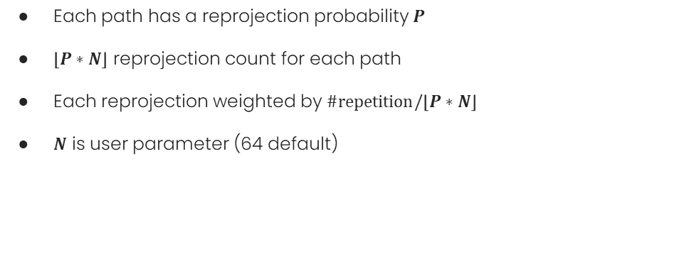
Depth of field solver in Corona
Path projection with MCMC
Each path has a reprojection probability $P$
$\left\lfloor P∗N\right\rfloor$ reprojection count for each path
Each reprojection weighted by $\#repetition/\left\lfloor P∗N\right\rfloor$
$N$ is user parameter (64 default)

Slide 34
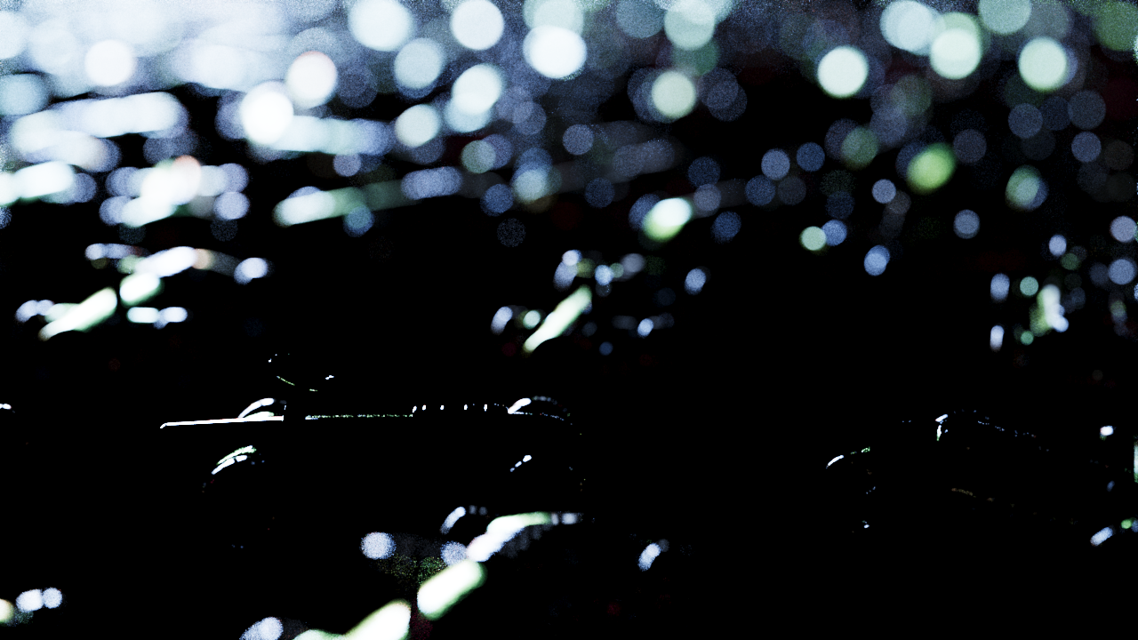
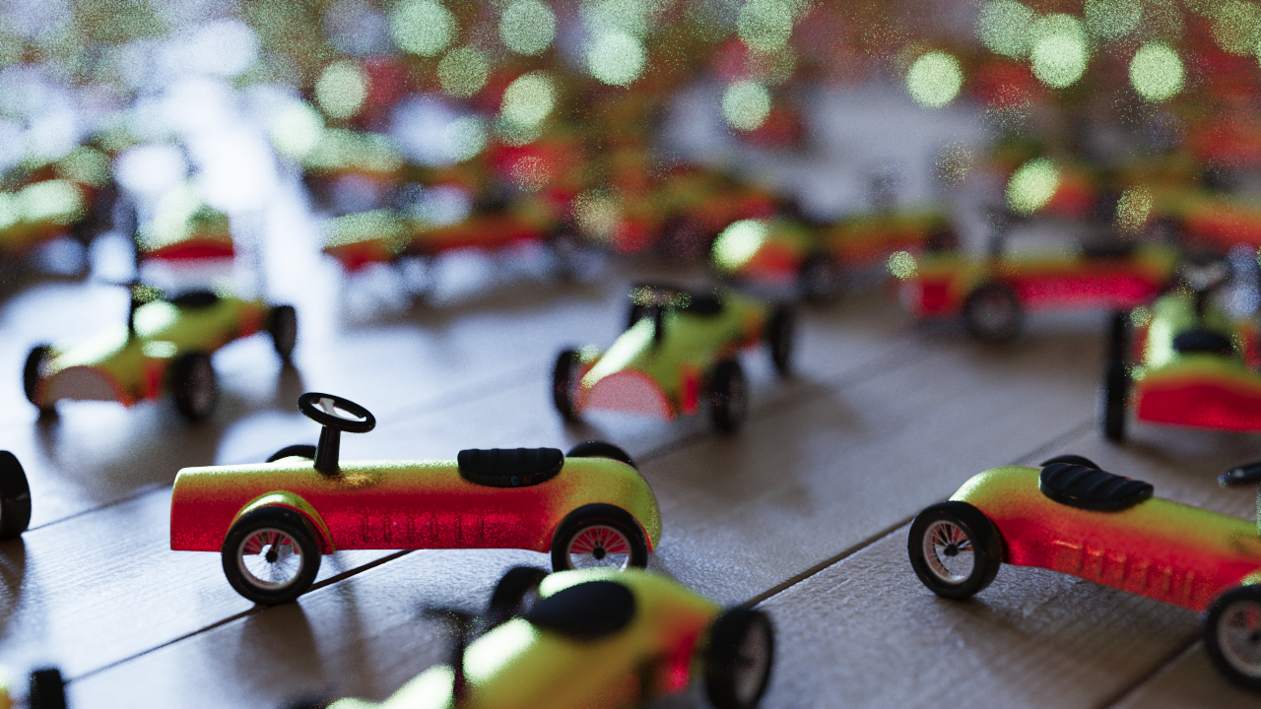

Depth of field solver in Corona
Final image combination
The same buffer for reprojected and normal paths
Per-pixel adaptivity needs more care
Reprojected
Not reprojected
Final image
Low intensity DOF highlights

Slide 35
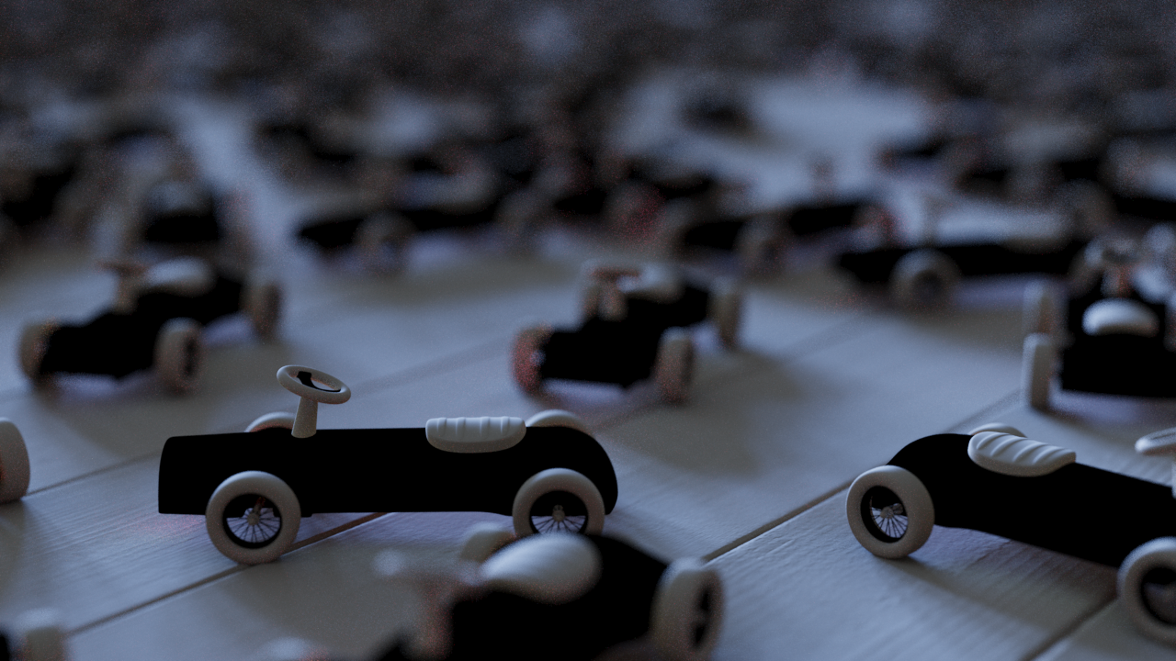
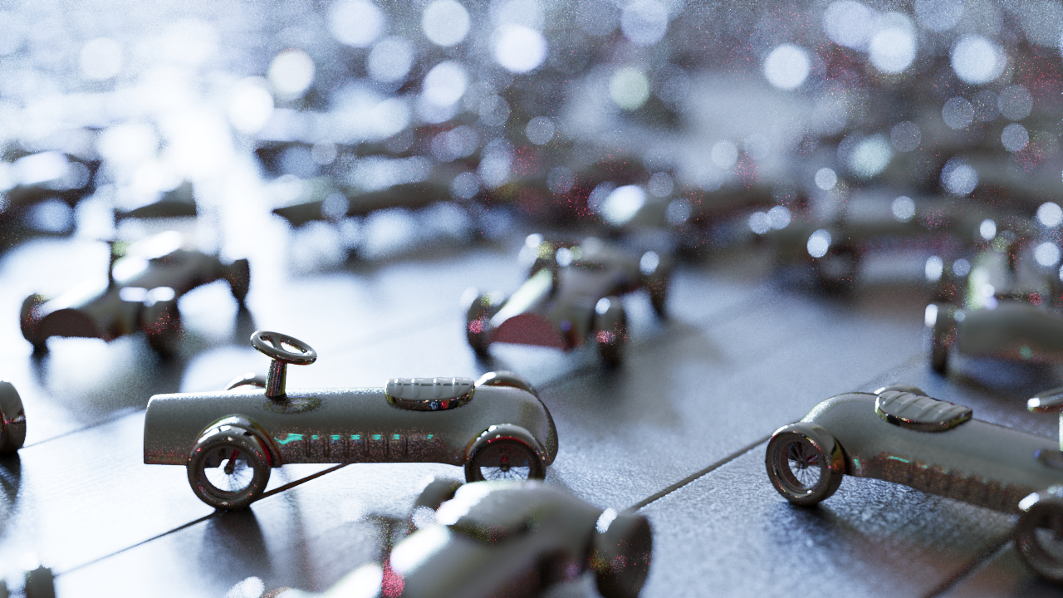
Depth of field solver in Corona
Final image combination
The same buffer for reprojected and normal paths
Per-pixel adaptivity needs more care
We reproject render elements without additional cost
Raw diffuse lighting
Raw specular lighting
Beauty image

Slide 36
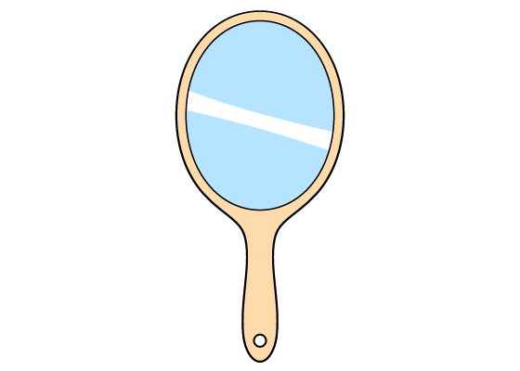
Depth of field solver in Corona
Delta reflection/refraction
Need to retrace the entire path
Pixel

Slide 37
Depth of field solver in Corona
Mollification
Mollifier (kernel) used instead
Reuse the rest of the path
Pixel

Slide 38
Results

Slide 39
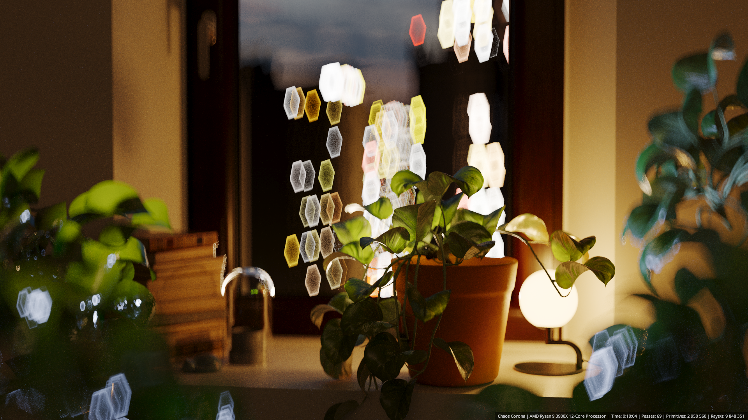
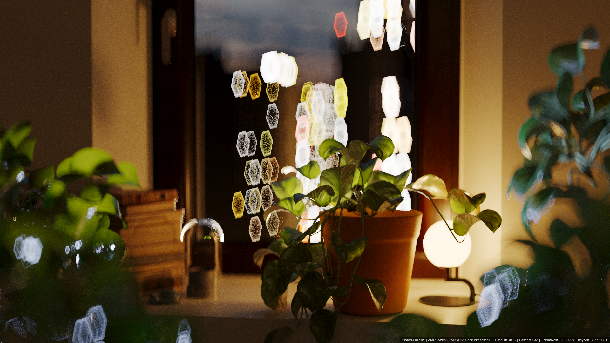
Depth of field solver in Corona
Results – Visible lights
Corona DOF Solver
Path tracer

Slide 40
Depth of field solver in Corona
Results – Visible lights
Corona DOF Solver
Path tracer

Slide 41
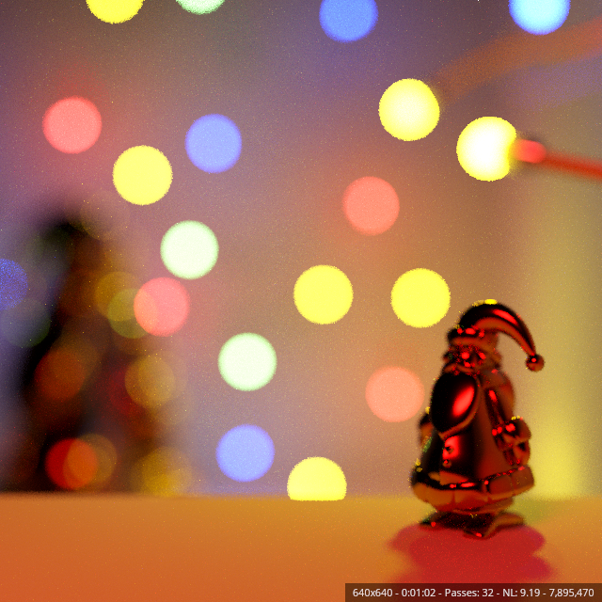

Depth of field solver in Corona
Results – Reflections
Corona DOF Solver
Path tracer
Francesco Legrenzi

Slide 42
Depth of field solver in Corona
Results – Reflections
Corona DOF Solver
Path tracer

Slide 43
Depth of field solver in Corona
Results –GI
Corona DOF Solver
Path tracer
Francesco Legrenzi

Slide 44
Depth of field solver in Corona
Results –GI
Corona DOF Solver
Path tracer

Slide 45
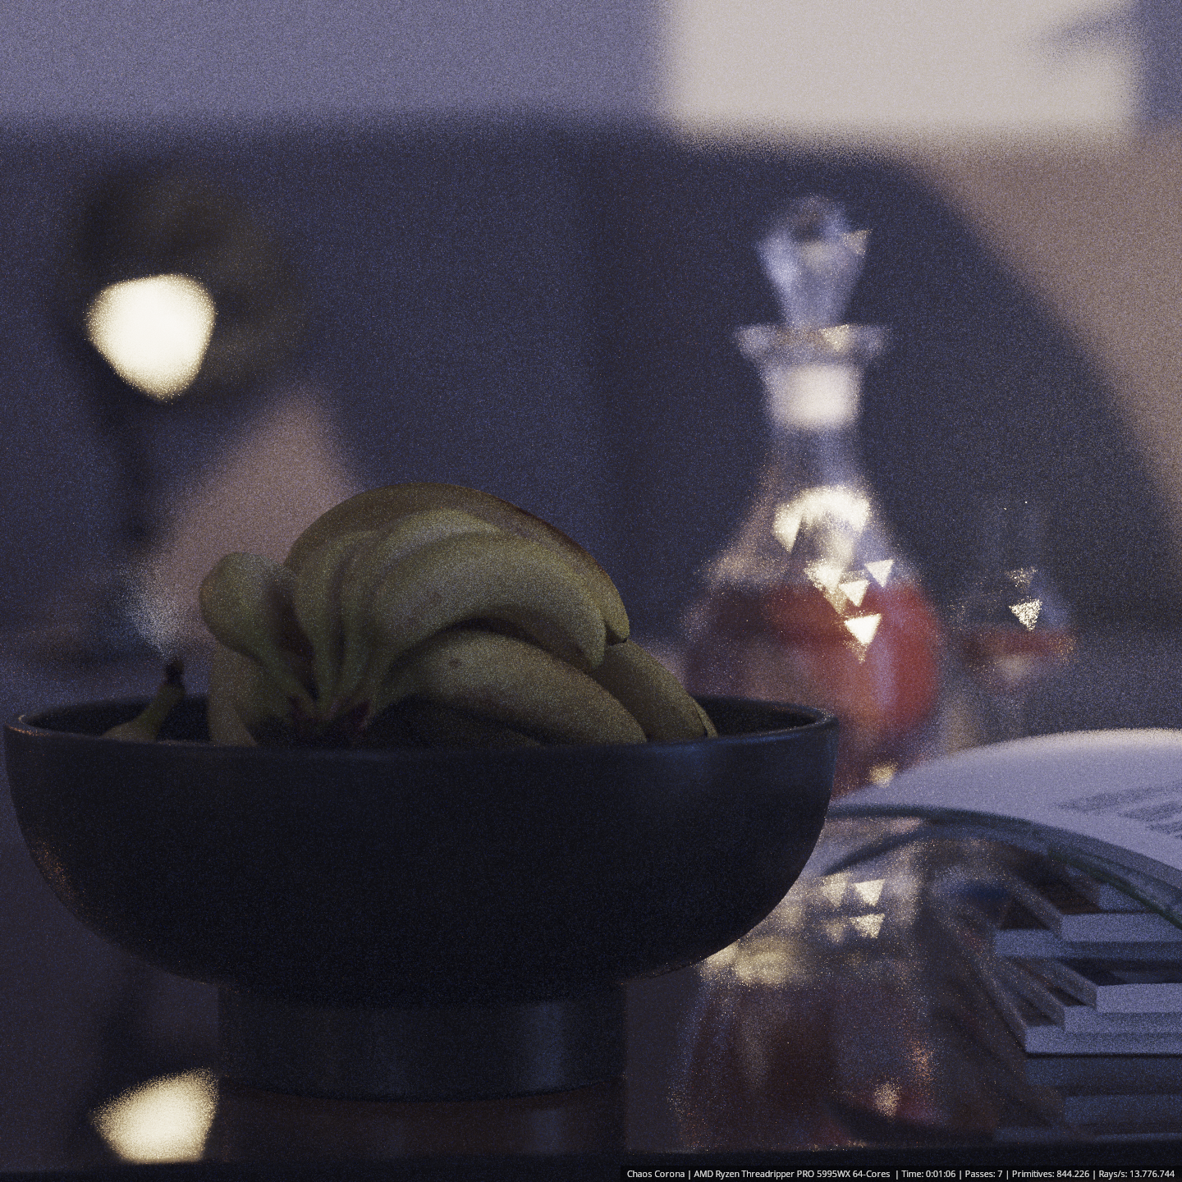
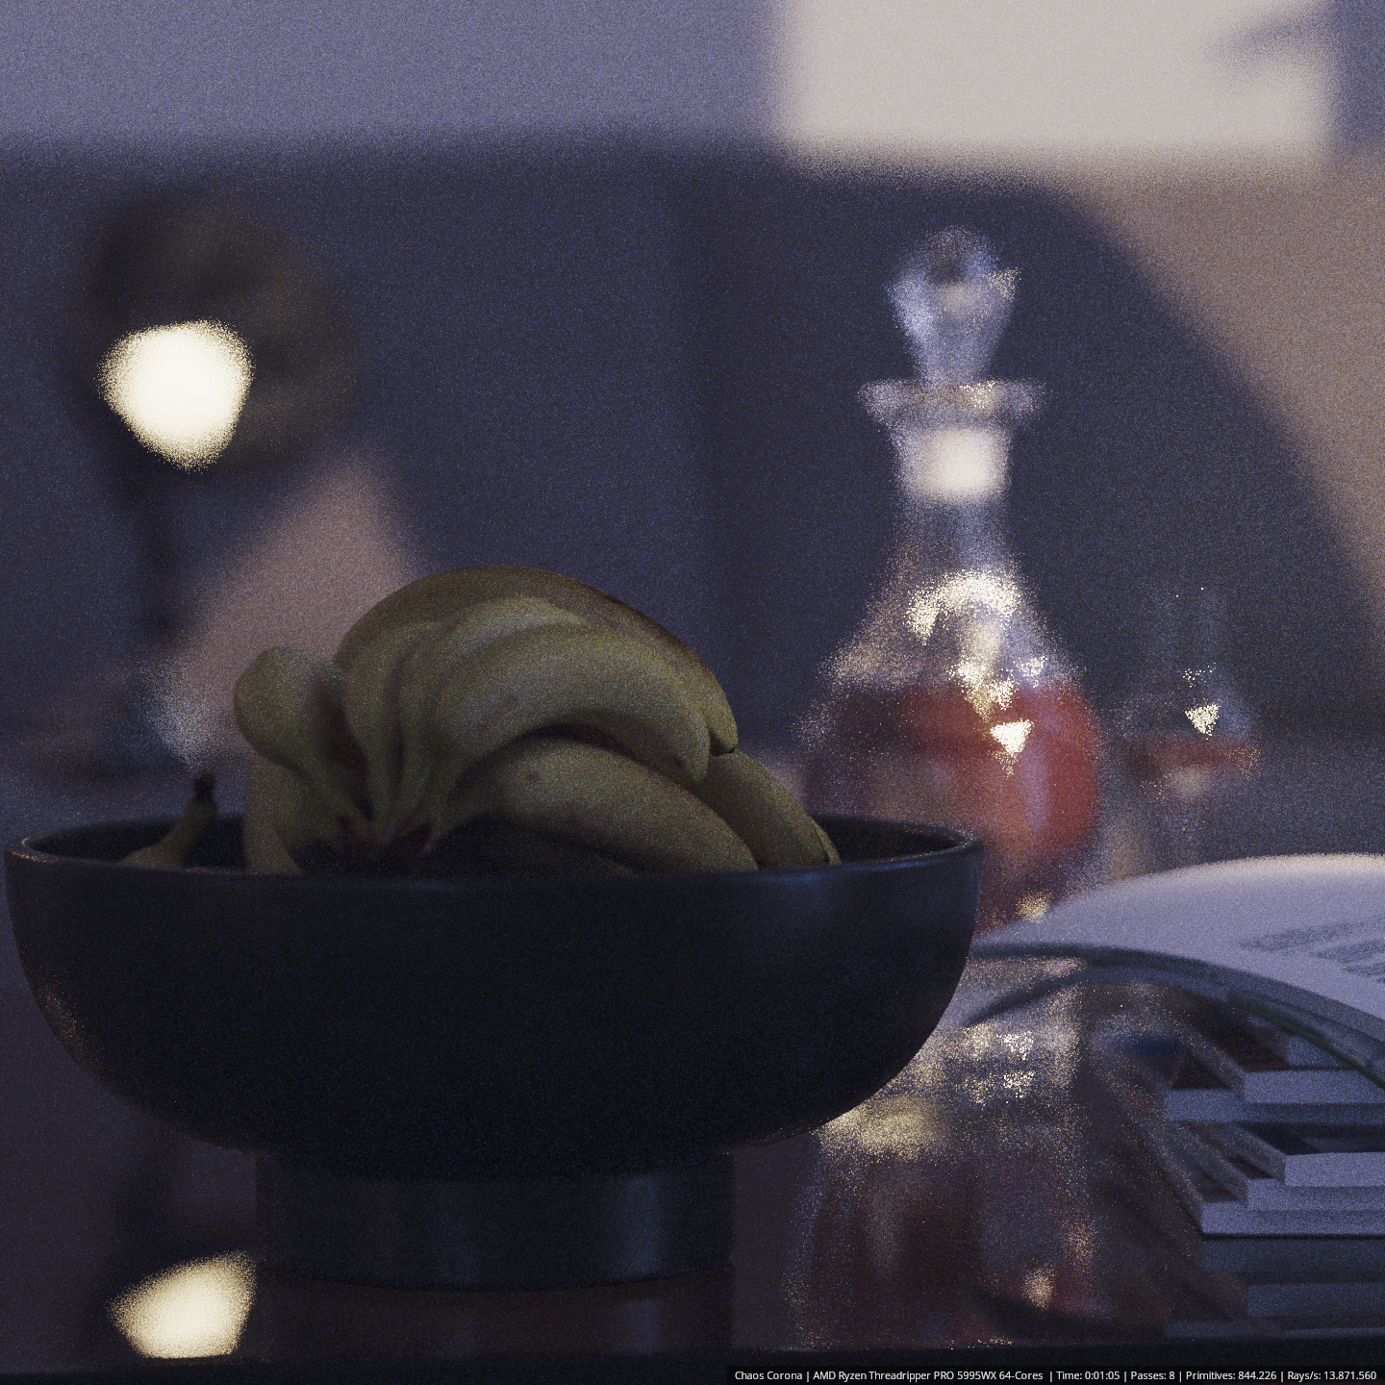
Depth of field solver in Corona
Results – 2 delta reflections
Corona DOF Solver
Path tracer

Slide 46
Depth of field solver in Corona
Results – 2 delta reflections
Corona DOF Solver
Path tracer

Slide 47
Summary and Future work

Slide 48
Depth of field solver in Corona
Conclusion
Solver for faster DOF rendering
Focused on highlights
Unbiased in theory thanks to MCMC
Biased to handle delta reflections/refraction faster

Slide 49
Depth of field solver in Corona
Future work
Replace MCMC with Continuous MIS (West et al. 2020)
Combine lens and BSDF sampling
Use for camera motion blur
Sample time

Slide 50
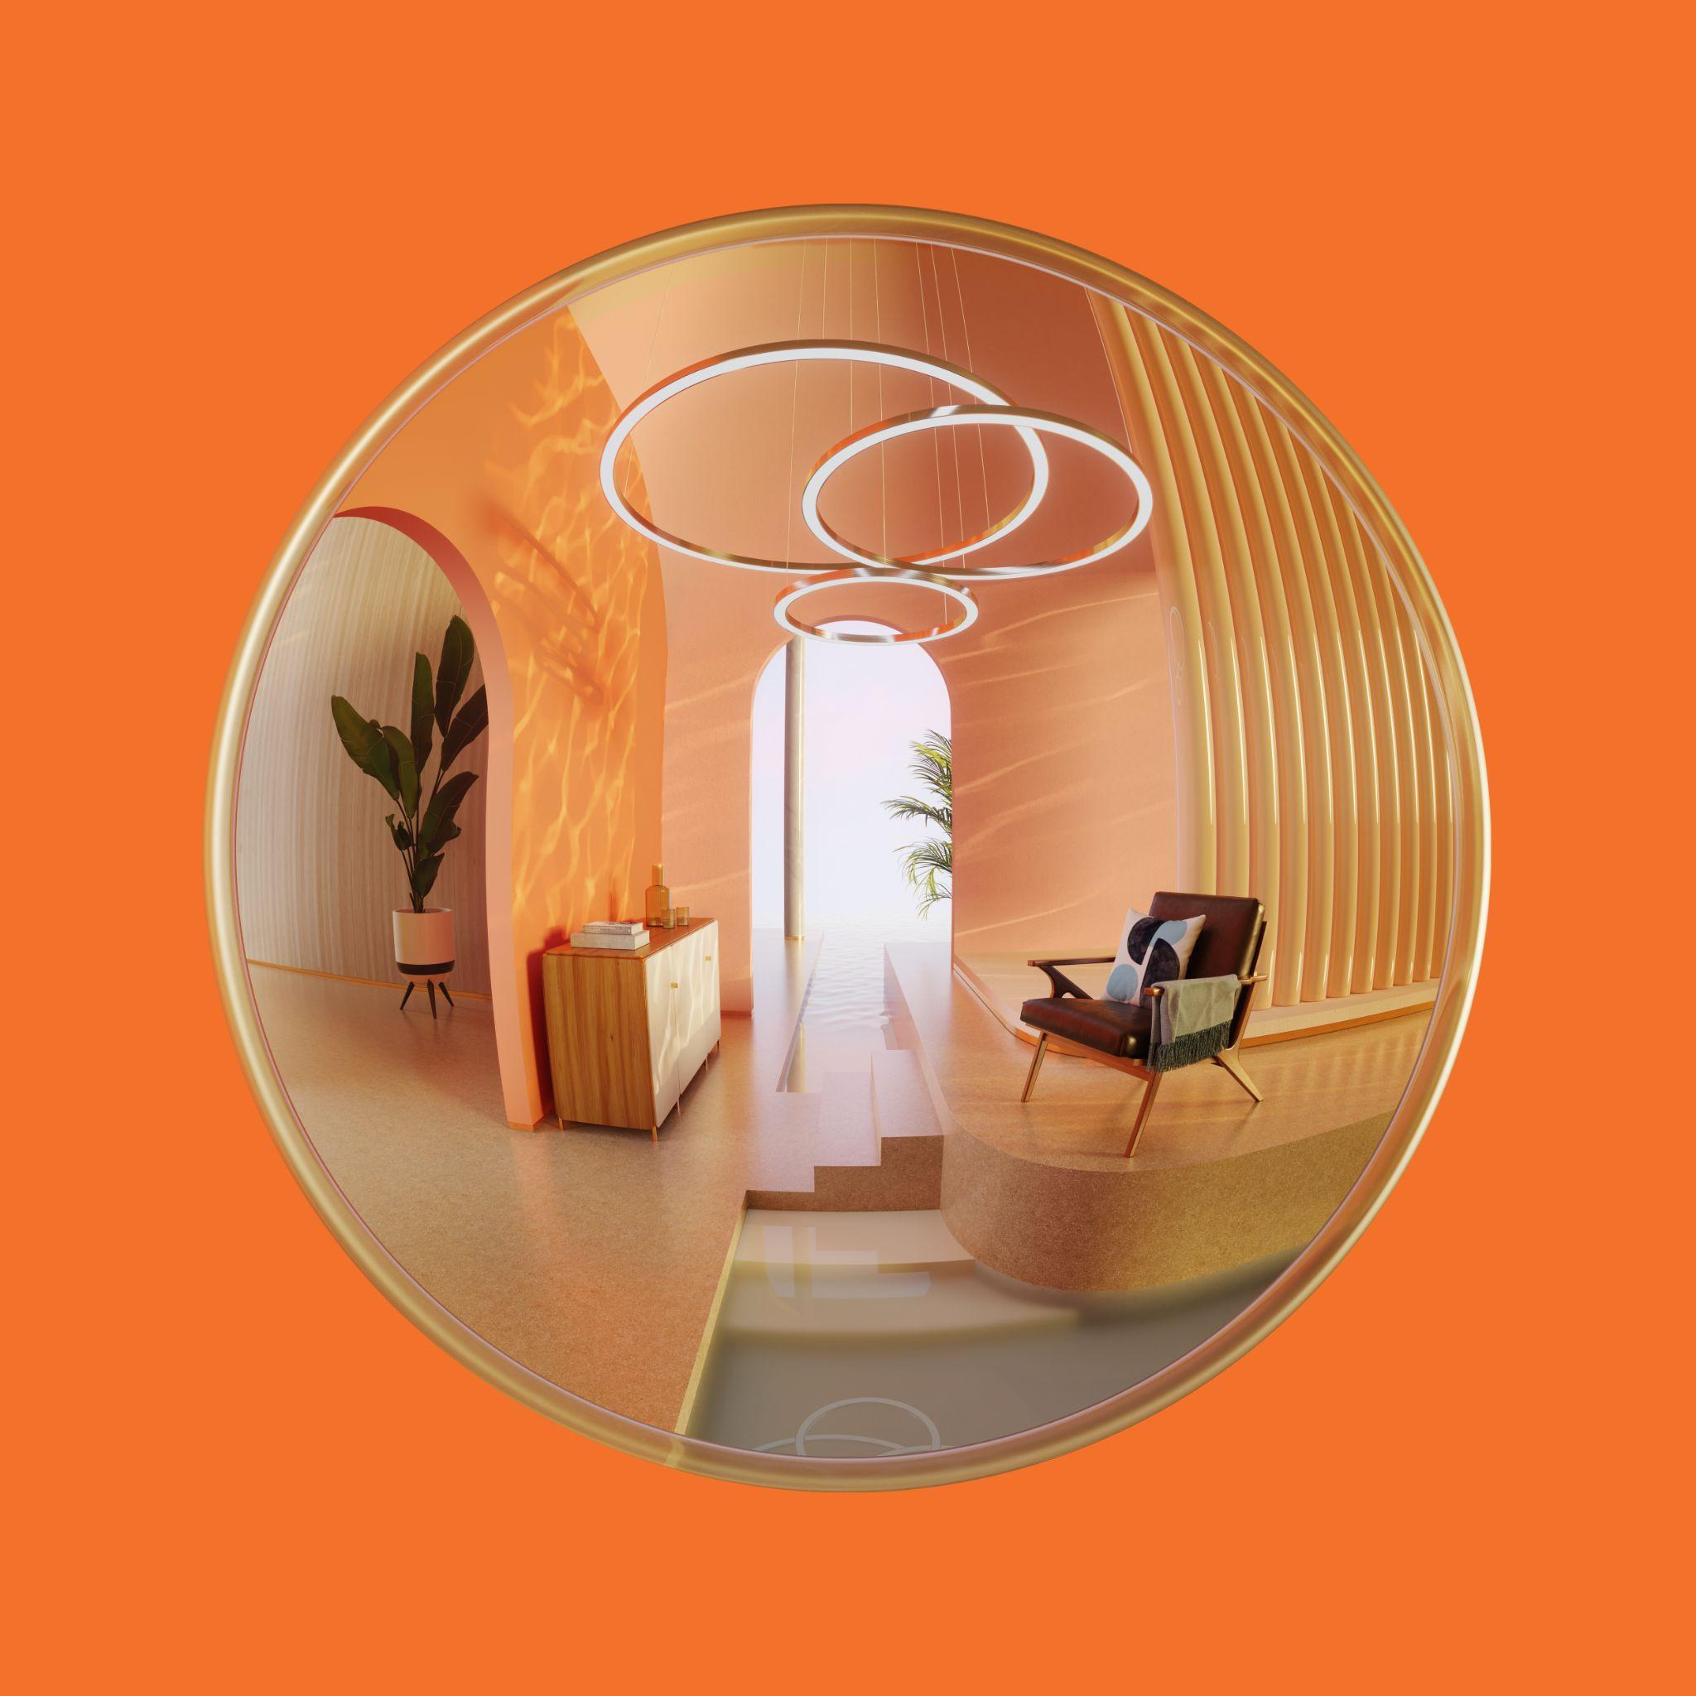
Thank you!

